Slide 1
Variation: the ‘acoustic’ version
Anne Watson
GLOWhub
2017

Slide 2
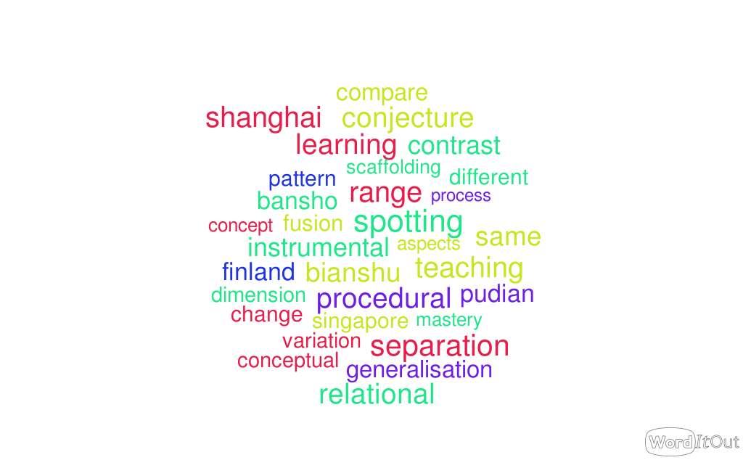

Slide 3
a + b = 20
a – b = 7
Find a and b
… find a and b using a different method
… and another

Slide 4
Compare methods
Swap tables and compare methods
Are the methods fundamentally the same mathematics?

Slide 5
Arithmetical thinking:
What numbers add to give 20?
What numbers have a difference of 7?
Algebraic thinking:
How are a and b related?
Algebraic thinking:
What is the family of number pairs that add to 20?
What is the family of number pairs that have a difference of 7?

Slide 6
a + b = 11
a – b = 1
Variation pattern draws attention to … ?
a + b = 11
a – b = 3
a + b = 11
a – b = 5
a + b = 11
a – b = 7
a + b = 11
a – b = 9
a + b = 11
a – b = 2
a + b = 11
a – b = 4

Slide 7
a + b = 11
a – b = 1
Variation pattern draws attention to …. ?
a + b = 12
a – b = 1
a + b = 13
a – b = 1
a + b = 14
a – b = 1
Variation of representation …

Slide 8
a + b = 11
a – b = 1
Variation pattern draws attention to ….?
a + b = 11
a – b = 11
a + 2b = 11
a – 2b = 1
a + 3b = 11
a – 3b = 5
a + b = 11
a – b = 9
Variation pattern draws attention to …
a + b = 11
a – b = 7

Slide 9
Developing algebraic awareness
Moving from thinking about numbers to thinking about relationships
Using variation to focus on relationships
  What varies & what stays the same?
  What is the same & what is different?
Reasoning and generalising about relationships
Proving

Slide 10
So where is (a + b)?
and where is (a - b)?
a

Slide 11
What questions can you now ask?
that focus on structures/relationships?
that relate to known methods for solving those equations?

Slide 12
What was invariant? What was varied?
Reflection
How were the features varied?
What might you vary next and why?
What features might you want to focus on?

Slide 13
So where is (a + 2b)?
and where is (a - b)?
a

Slide 14
a + 2b = 20
a – b = 8
Variation pattern draws attention to ….?
a + 3b = 20
a – b = 8
a + 4b = 20
a – b = 8
a + 5b = 20
a – b = 8

Slide 15
Draw a square with all its vertices on intersections:
And another one …..
And another one that is different in some way …

Slide 17
(1,2) (3,2) (1,4) (3,4)
Explore the effects of the following changes.
Add 1 to all eight numbers
Choose a number and add it to all eight numbers
Add a whole number to the horizontal coordinates only
Add a whole number to the vertical coordinates only
Going clockwise round your original square, starting in the bottom left corner, make the following changes:
  (add 2, subtract 1), (add 1, add 2), (subtract 2, add 1), (subtract 1, subtract 2)
Add or subtract whatever you like to whatever ordinates you like …..

Slide 18
Exploring questions:
What is the same and what is different about your squares?
What is the same and what is different about the effects of your exploring actions?
What can you change about your square and it still be a square?

Slide 19
What can you now say about this diagram?

Slide 20

Variation
A way to think about maths:
shows scope and structure of mathematical concepts
enables exploration and creativity and conjecture
develops expertise
uses natural powers
is a tool for planning challenging episodes
Not a mysterious import from
Shanghai and Singapore!

Slide 21
pmtheta.com
Anne Watson
Thinkers
Questions and prompts for mathematical thinking
Primary questions and prompts

