Slide 1
Variation cut loose
Consultant’s Day, November 11th 2017

Slide 2
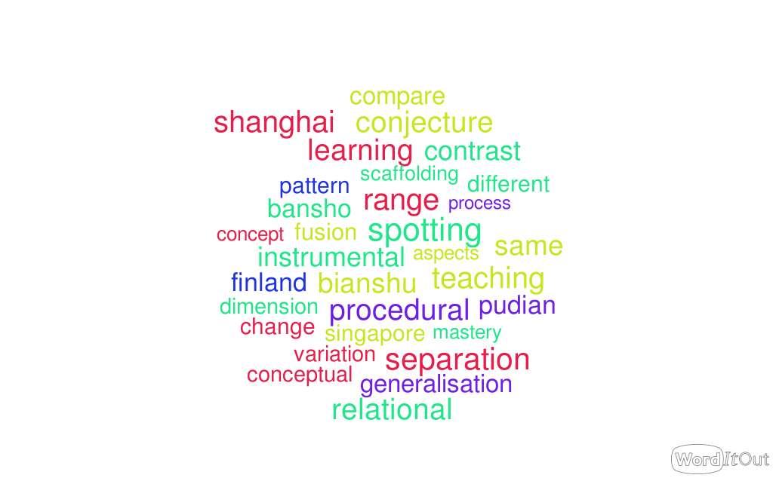
Incoherent
Over- technical
New?

Slide 3
The plan!
Tasks from several sources to get direct experience
Identification and discussion about variation and its role in what we experience
Reflection on the problem-solving that was involved in doing the tasks
Implications for teaching

Slide 4
Find a number half way between:
28 and 34
2.8 and 3.4
38 and 44
-34 and -28
9028 and 9034
.0058 and .0064
How did you do it?
What varied and what stayed the same?

Slide 5
Analysing variation and invariance in the task
Variation
Invariance
What becomes available to be noticed and learnt as a result of the variation and invariance?

Slide 6
What is available to be learnt?
Different ways to find the mid-point (counting from each end; measuring from each end; halving the sum …)
Place value (possible support from calculator, or numberline with zoom, ….)
Relationship of mid-point to end points
Application of prior knowledge (measurement; formulae; scaling; flexibility on numberline)
Opportunities to generalise about finding mid-points
Opportunities to conjecture about mid-point of interval (a,b)
Opportunities to conjecture about properties of linear relationships, e.g. if you multiply the end numbers by k, what happens to the mid-point? if you add c to each point, what happens to the mid-point? etc.
Where does problem-solving kick in?

Slide 7
Analysing variation and invariance in the task
Variation
Invariance
What becomes available to be noticed and learnt as a result of the variation and invariance?
What becomes a problem to be solved using prior knowledge and reasoning? How does it emerge?

Slide 9
Multiplicative reasoning
a = bc bc = a
a = cb cb = a
b = a a = b
c c
c = a a = c
b b
Other ways to write this relationship?

Slide 10
Analysing variation in this situation
Variation
Invariance
What becomes available to be noticed and represented as a result of variation and invariance?

Slide 11
Multiplicative reasoning
What is the same and what is different about
5 and c?
a = 5c 5c = a
a = c x 5 c x 5 = a
5 = a a = 5
c c
c = a a = c
5 5

Slide 12
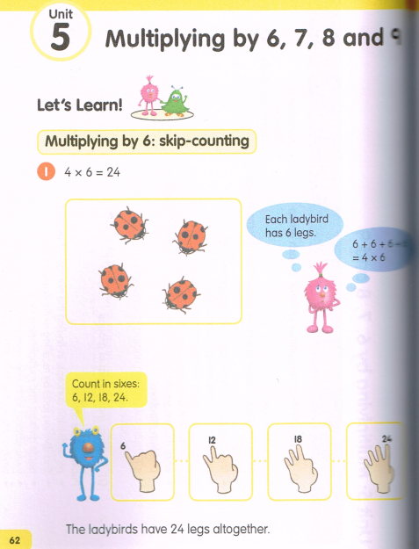
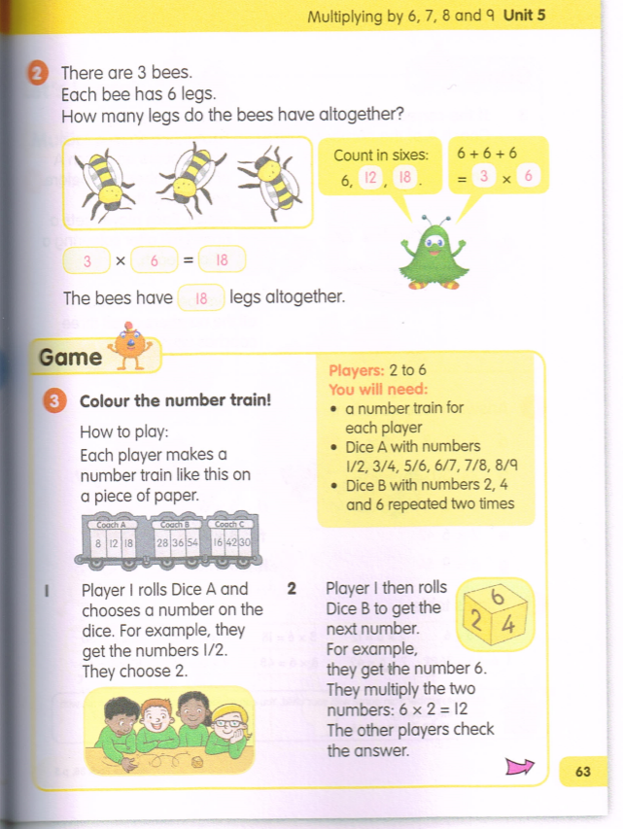
Var/invar?
Var/invar?
Var/invar?

Slide 13
Analysing variation and invariance in the task
Variation
Invariance
What becomes available to be noticed and learnt as a result of the variation and invariance?

Slide 14
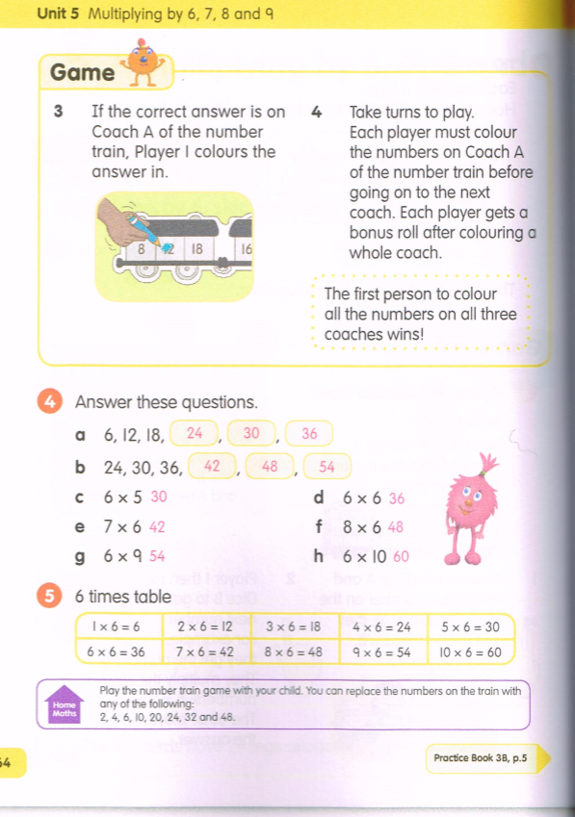
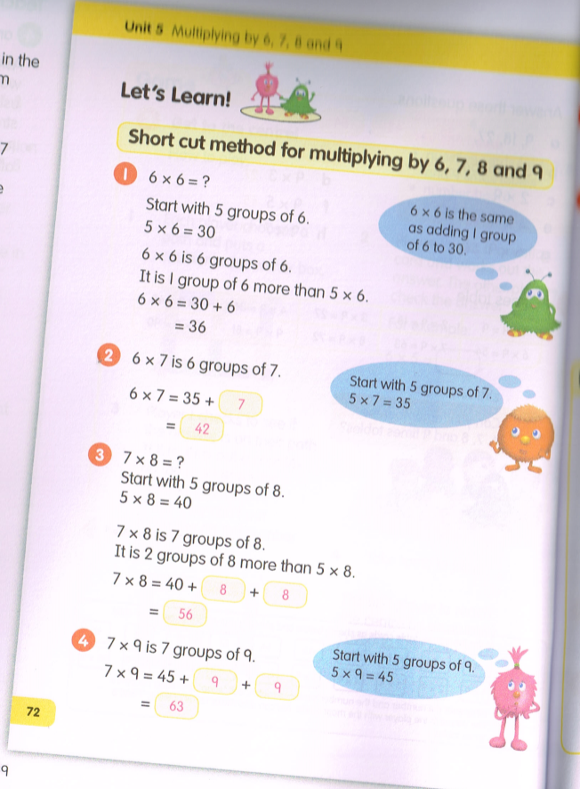
Var/invar?
Var/invar?
Var/invar?
Var/invar?
Var/invar?

Slide 15
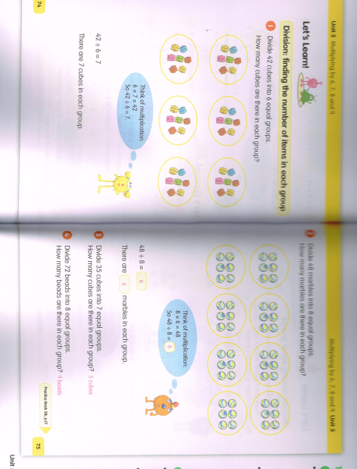
Var/invar?
Var/invar?

Slide 16
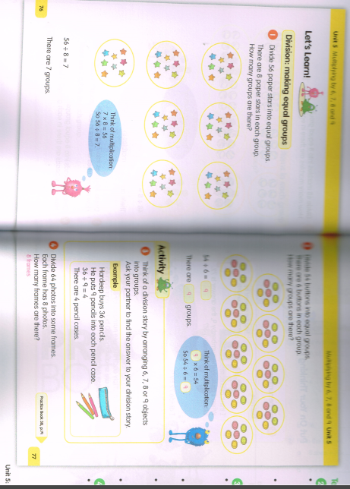
Var/invar?
Var/invar?

Slide 17
Analysing variation and invariance in the task
Variation
Invariance
What becomes available to be noticed and learnt as a result of the variation and invariance?

Slide 18
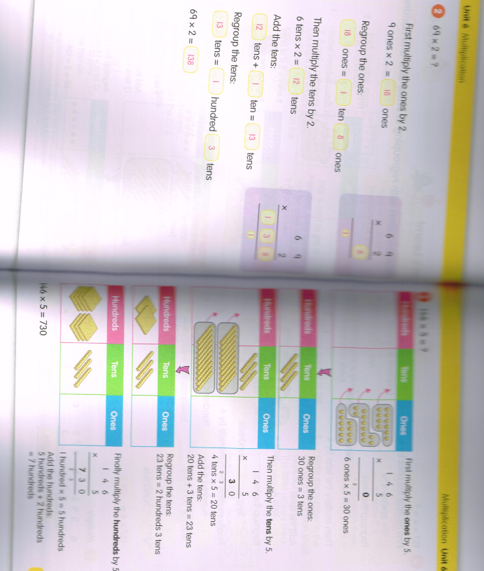
Var/invar?

Slide 19
Analysing variation and invariance in the task
Variation
Invariance
What becomes available to be noticed and learnt as a result of the variation and invariance?

Slide 20

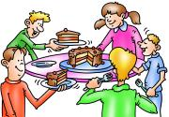
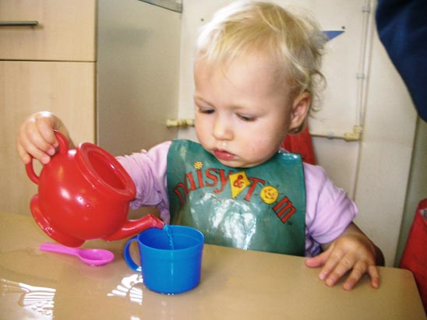

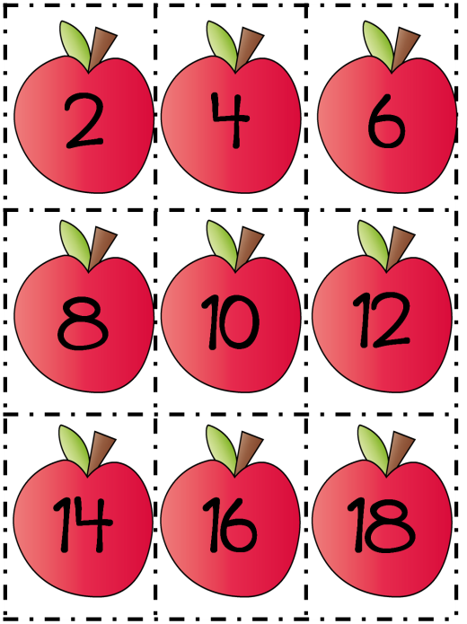
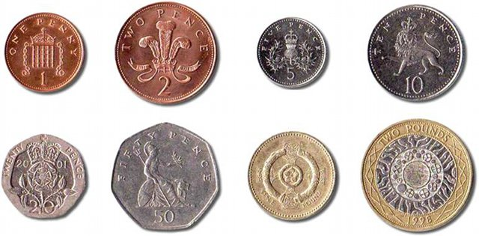

Slide 21
Analysing variation and invariance in the task
Variation
Invariance
What becomes available to be noticed and learnt as a result of the variation and invariance?

Slide 22
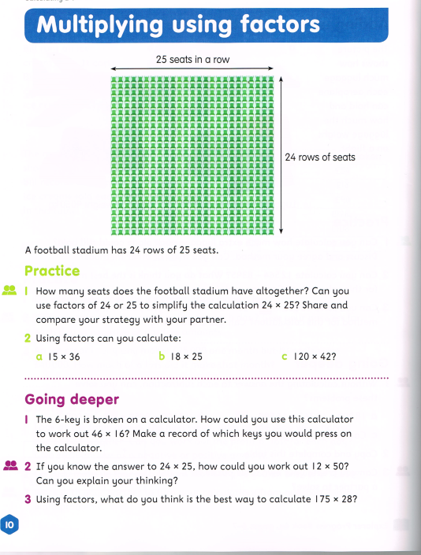
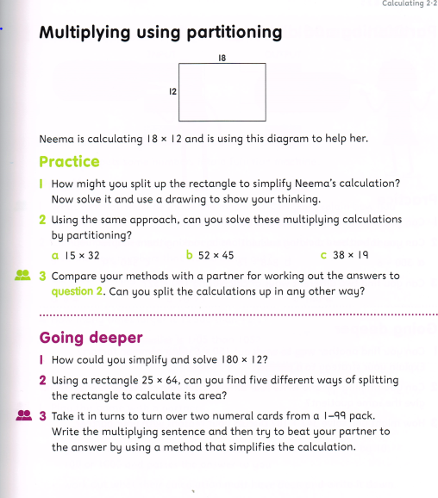

Slide 23
Analysing variation and invariance in the task
Variation
Invariance
What becomes available to be noticed and learnt as a result of the variation and invariance?
What variation do pupils have to experience to become able to do these questions?

Slide 24
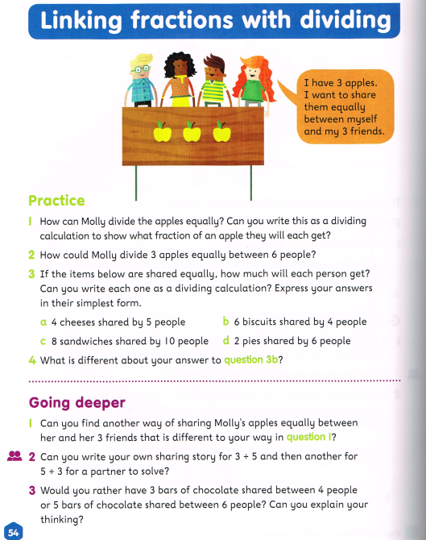
What becomes available to be noticed and learnt as a result of the variation and invariance?
Comparison: what is/isn’t; representations; number relationships; different kinds of outcome

Slide 25
Using comparison explicitly

Slide 26
Contrasts in students’ work
Visual aspects and visual descriptions
Desirable aspects expressed informally
Conventional & desirable aspects expressed formally

Slide 27
Variation used in teaching
be clear about the intended concept to be learned, and work out how it can be varied and what needs to stay the same to make the variation obvious
OR work out what needs to be varied so that the intended concept can be seen as invariant
matching up varied representations of the same example helps learning; or varied examples with the same structure and presentation
the intended object of learning is often an abstract relationship that can only be experienced through examples
draw attention to connections, similarities and differences
variation of appropriate aspects can sometimes be directly visible, such as through geometry or through page layout
when a change in one variable causes a change in another, learners need several well-organised examples and reflection to ‘see’ relation and structure
use deep understanding of the underlying mathematical principles

Slide 28
Does VT bring something to maths that cannot be seen already?
Maths is about variation/invariance
VT gives focus, language, structure
VT commits you to analysing and constructing the relationship between variation/invariance as a professional tool
Experiential –what do YOU see? What do YOU notice? What do YOU do as a result?

Slide 29
Reflection on the effects of variation on you
What struck you during this session?
What for you were the main points to think about (cognition)?
What upset you/ got you going (affect)?
What actions might you want to use in your teaching and talk about with others (awareness) ?
Notes:
Chi et al

Slide 30
Reflection on the mathematical problem-solving in this presentation

Slide 31
Find a number half way between:
When and how did problem-solving kick in?
28 and 34
2.8 and 3.4
38 and 44
-34 and -28
9028 and 9034
.0058 and .0064
What representations and ways of thinking helped?

Slide 32
When and how did problem-solving kick in?
What representations and ways of thinking helped?

Slide 33
When and how did problem-solving kick in?
What representations and ways of thinking helped?

Slide 34
When and how did problem-solving kick in?
What representations and ways of thinking helped?

Slide 35
When and how did problem-solving kick in?
What representations and ways of thinking helped?

Slide 36
Using comparison explicitly
When and how did problem-solving kick in?
What representations and ways of thinking helped?

Slide 37
Reflection on the mathematical problem-solving in this presentation; implications
Dependent on past experience of a range of examples in similar formats, and the same example in different formats
Dependent on past knowledge and seeing or hearing familiarity in the current problem (varied language; varied formats)
Dependent on past knowledge of different meanings (division as fractions; division as grouping; etc. …)
Dependent on simplifying a complex situation and focusing on fewer aspects. Comparison helps; simplification helps; finding a helpful representation helps; trying examples helps; having a conjecture to think about helps – all ways of managing cognitive load of complex problems.

Slide 38
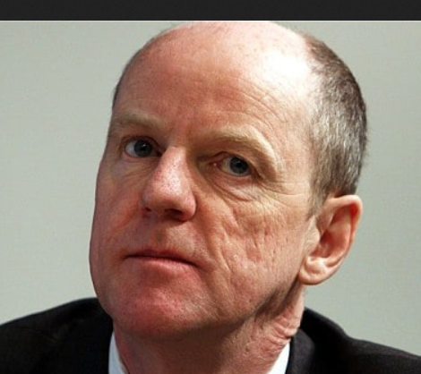

Variation
A way to think about maths:
shows scope and structure of mathematical concepts
enables exploration and creativity and conjecture
develops expertise
uses natural powers
is a tool for planning challenging episodes
Not a mysterious import from
Shanghai and Singapore!

Slide 39
pmtheta.com
Anne Watson
Thinkers
Questions and prompts for mathematical thinking
Primary questions and prompts

