Slide 1
Teaching for Mastery: variation theory
Promoting Mathematical Thinking
Anne Watson and John Mason
NCETM Standard Holders’ Conference
March 2016
The Open University
Maths Dept
University of Oxford
Dept of Education

Slide 2
Ways of Working
We work through lived experience, ours and yours
We offer tasks for you, with colleagues

Slide 3
Task 1: Taxi cab geometry
Taxi-cab distance Dist(P, A) is the shortest distance from P to A on a two-dimensional coordinate grid, using horizontal and vertical movement only. We call it the taxicab distance.
For this exercise A = (-2,-1). Mark A on a coordinate grid.
For each point P in (a) to (h) below calculate Dist(P, A) and mark P on the grid:
P = (1, -1)
(b) P = (-2, -4)
(c) P = (-1, -3)
(d) P = (0, -2)
(e) P =
(f) P =
(g) P = (0, 0)
(h) P= (-2, 2)

Slide 4
Reflection
How was it for you?
How did the variation in the examples influence what happened for you?
Have you made progress towards ‘mastery’ of taxi-cab geometry? What?
Your conjectures about mastery and variation - write them down, ready to modify them later maybe
We are more the same than we are different

Slide 5
Task 2: Adding Fractions
Ready to practise?

Slide 6
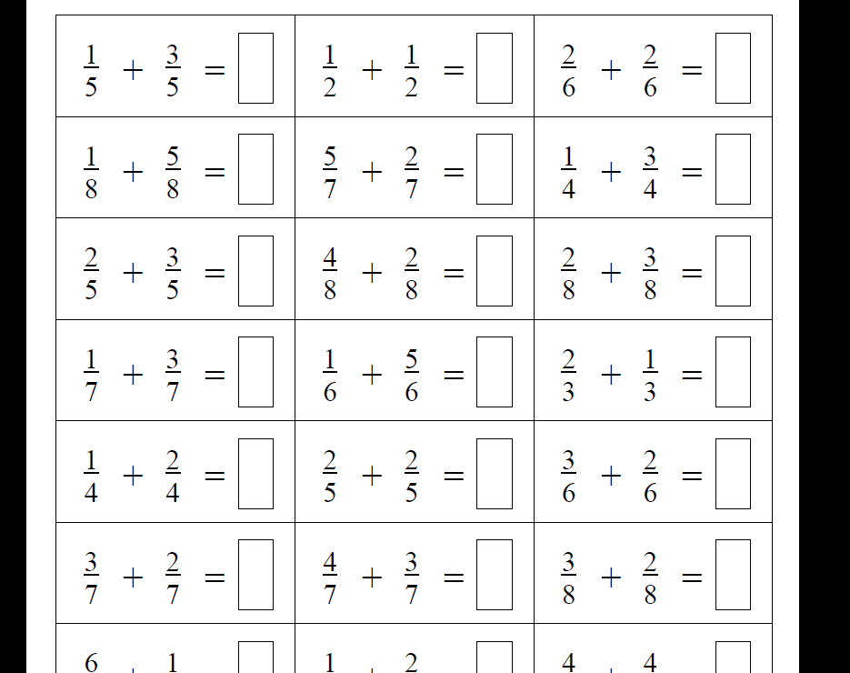
It has been found that once a pattern-action is noticed, it keeps being activated!

Slide 7
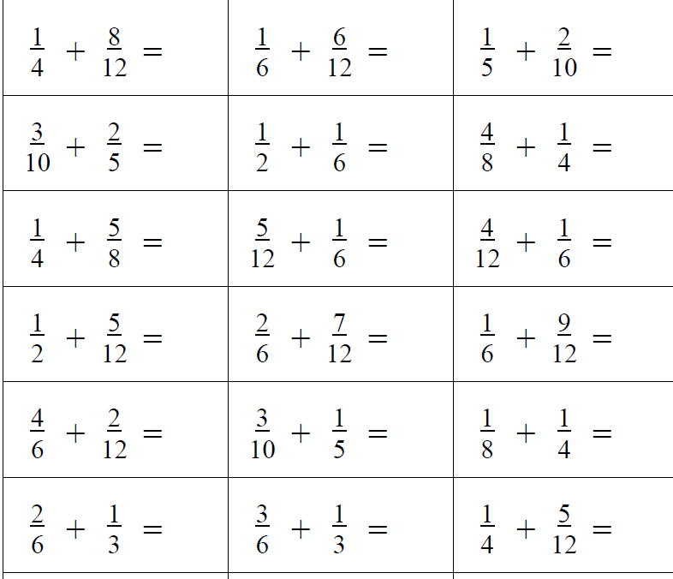

Slide 8
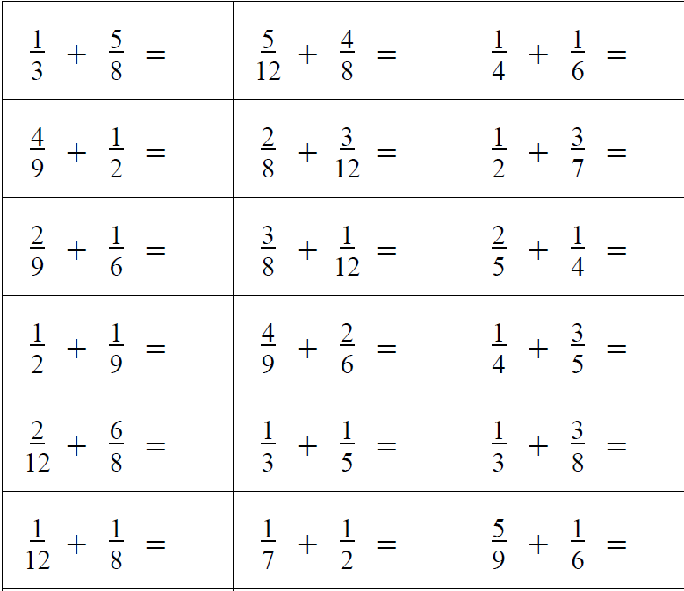

Slide 9
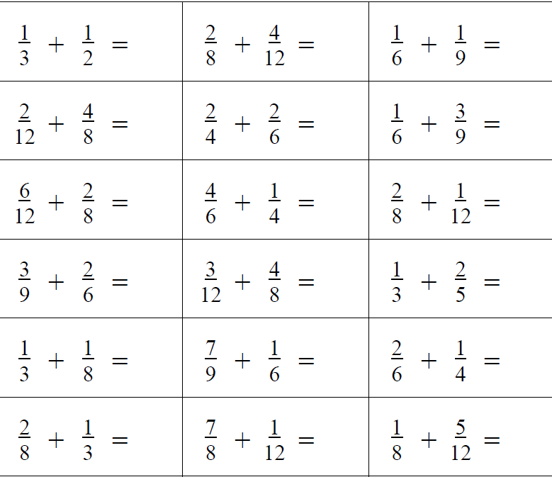

Slide 10
Considerations
Intended / enacted / lived object of learning
Author intentions
Teacher intentions
Learner experience
Didactic Transposition
Task
Author intentions
Teacher intentions
As presented
As interpreted by learners
What learners actually attempt
What learners actually do
What learners experience and internalise
Expert awareness is transformed into Instruction in behaviour

Slide 11
More Considerations
critical aspects
focal points
difficult points
hinges

Slide 12
What are you doing? What are you attending to? What aspect of fractions do you have to think about?

Slide 13
Talk and Plan
What could you do differently to ensure the lived object of learning is some critical aspect of fractions?

Slide 14
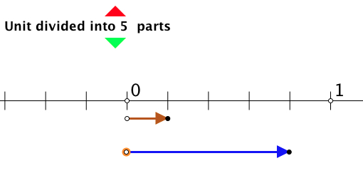
Number Line Fractions
Fractions applet offers model for sums to 1 of fractions with the same denominator, i.e. you can position one fraction and predict where the second will take you.
Vary the denominator, also do sums to < 1, and then do sums to > 1 so as to model the meaning of mixed fractions.
Extend to different denominators where one is a multiple of the other.

Slide 15
Design of the question sequence for numberline fractions applet
Content
Same denominator
Coordinating different denominators
Sums to 1
Going beyond 1
Tenths
Comparing to decimal notation etc.
Pedagogy
Diagram maintaining link with meaning
Teacher choice of examples
Why tenths?
Order (e.g when to do sums to 1 and why)
Learner generated examples

Slide 16
Reflection
Intended enacted lived object of learning
Critical aspects; focal point; difficult point; hinge
Use of variation to bring lived object of learning and intended object of learning together

Slide 17
Words, Meanings and Practice
Mastery is ....
Variation is ....
Avoid the teaching of speculators, whose judgements are not confirmed by experience. (Leonardo Da Vinci)

Slide 18
Mastering
Mastery is a state of mind – an outcome of learning
“Mastery Learning” as a method – all can learn; what differs is the time requirement (1950s Bloom)
Quality of teaching is important: what is available to be learnt?
Lived object of learning
Habits of learning; habits of mind
Mastering a technique
Mastering a concept

Slide 19
Mastery
Mastering a technique
reducing the amount of attention required to carry through the technique accurately (procedures)
Mastering a concept
having a strong personal narrative
awareness of all of the possible dimensions of possible variation
using the concept to express mathematical relationships in a variety of contexts
and access to a rich space of examples and tools for example construction and use

Slide 20
Variation
Variation theory is a theory of learning
What is available to be learnt (not what will be learnt)

Slide 21
Variation
Dimensions of possible variation (scope of the concept)
Dimensions of necessary variation (to bring difficult points and hinge points into focus)
Range of possible (permissible?) change
What conjectures?
What generalisations? (the difficult points)
Conceptual variation
Procedural variation (process; proceed; progress)
Who provides the variation?
Scaffolding (Pu Dian)

Slide 22
Task 3

Slide 23
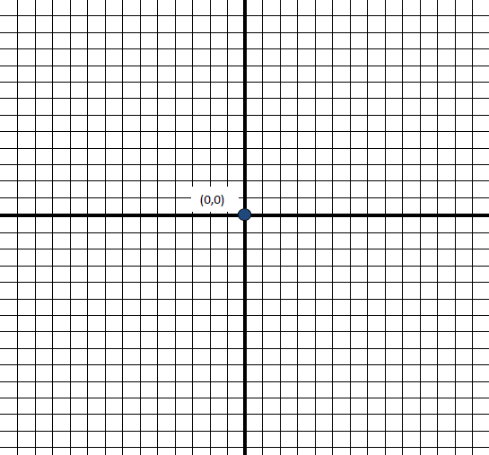

Slide 24
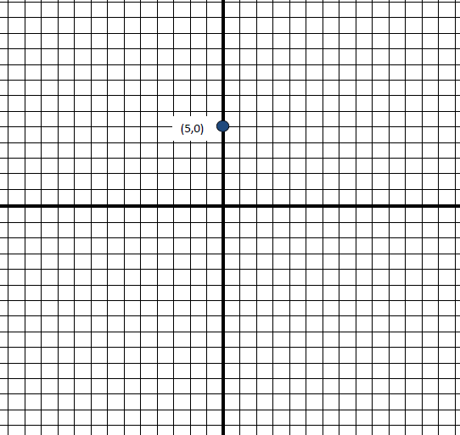

Slide 25
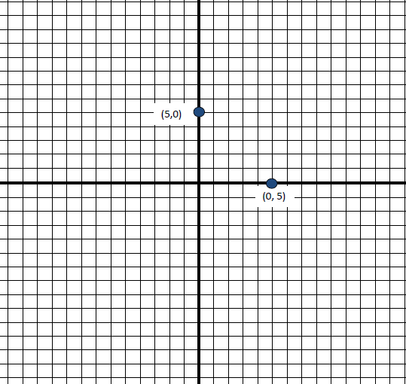

Slide 26
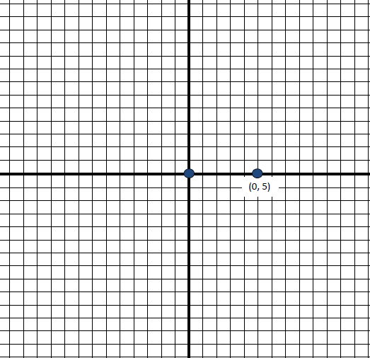

Slide 27
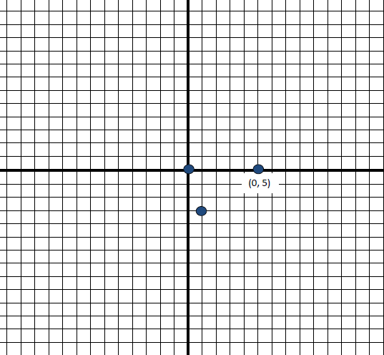

Slide 28
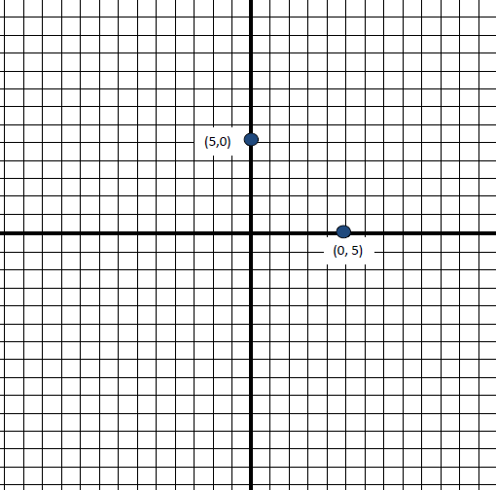

Slide 29
Reflections
What happened for you?
How did the variations influence what happened for you?
Are we more the same than different? (role of prior knowledge; argument for mastery approach to ensure everyone is prepared)
Earlier conjectures about mastery and variation, connections

Slide 30
Task 3: design of question sequence
Construct an object
and another
and another
Variation on the object (and another, and another)
Introduce a new constraint (no others ...)
Ask similar questions of a new object
and another
and another
Variation in method
New kind of question/insight/concept
and another
and another (opportunity to experience)

Slide 31
Types of variation (Chinese analysis)
Conceptual:
presentations; representations; examples/non examples approaches; connections with what we already know; what mathematical problems this new idea is going to help us with; multiple experiences and perspectives; various critical aspects
Procedural:
Multiple problems - one solution method
One problem - multiple solution methods
One situation - multiple presentations

Slide 32
Insert here dynamic graphplotting thingy not sure what you want here
The previous graphing slides – do we want to be able to enter some of their ideas in real time, or illustrate some possibilities? I think we need to be able to click to some graphing software here that will let us enter equations, and also let us sketch plausible graphs

Slide 33
Implications for quality of teaching
Anticipate what variation is necessary to develop procedural mastery (process; proceed; progress), and conceptual mastery
Critical aspects; focus; difficult points; hinges
Dimensions of variation to draw attention to the critical aspects and focus
Ranges of change that will focus attention
Examples and non-examples to delineate the concept
Representations (because the concept is abstract)
Lived object of learning; what they see, hear, do; what generalisations is it possible to make from their experiences?

Slide 34
Reflection on the effects of variation on you
What struck you during this session?
What for you were the main points (cognition)?
What were the dominant emotions evoked (affect)?
What actions might you want to pursue further? (awareness)
Notes:
Chi et al

