Slide 1
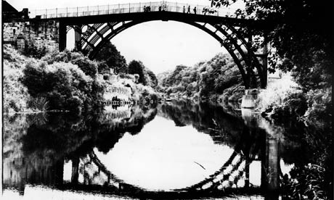
Teaching children to reason mathematically
University of Oxford
Dept of Education
Anne Watson
Ironbridge
2014

Slide 2
Plan
Mathematical reasoning
In the curriculum
The sad case of KS3 geometry
Getting formal
Support

Slide 3
Conjecture
The best way to learn about reasoning mathematically is to do some mathematics
The best way to learn to teach reasoning is to experience mathematical reasoning yourself

Slide 4
How many numbers between 1 and 1000 end in 7 and are not prime?
primes
7
17
37
47
67
.
.
.
not primes
27
57
77
87
.
.
.

Slide 5
Reasoning ...?

Slide 6
Point reflections

Slide 7
Reasoning ...?

Slide 8
Reasoning in the NC: overarching statement
reason mathematically by following a line of enquiry, conjecturing relationships and generalisations, and developing an argument, justification or proof using mathematical language

Slide 9
3 x 16 = 48
48 = 16 x ?
48 ÷ ? = ?
follow a line of enquiry
conjecture relationships
conjecture generalisations
developing an argument
justify
prove using mathematical language

Slide 10
Reasoning @ Upper KS2
use the properties of rectangles to deduce related facts and find missing lengths
3 cm
5 cm
8 cm
7 cm
12 cm

Slide 11
Reasoning @ Upper KS2
distinguish between regular and irregular polygons based on reasoning about equal sides and angles

Slide 12
Reasoning @ Upper KS2
find missing angles (using angle relations)
45ᵒ

Slide 13
Reasoning @ KS 3 & 4
make connections between number relationships, and their algebraic and graphical representations
formalise knowledge of ratio and proportion
identify variables and express relations between variables algebraically and graphically
make and test conjectures, construct proofs or counter-examples
reason deductively in geometry, number and algebra
interpret when a problem requires additive, multiplicative or proportional reasoning
begin to express their arguments formally
assess the validity of an argument

Slide 14
Conjecture
The best way to learn about reasoning mathematically is to do some mathematics
The best way to learn to teach reasoning is to experience mathematical reasoning yourself

Slide 15
Always, sometimes or never true? (Swan)
1 + 1 = 2
π = 3
12 can be written as the sum of two primes
All rectangles are parallelograms
The square of every even integer is even
Multiples of odd numbers are odd
n² - n > 0
π is a special number
The perpendicular bisector of any chord of a circle goes through the centre of the circle
Every even integer greater than 2 can be written as the sum of two primes

Slide 16
 | Justification
1 + 1 = 2 | Definition/demonstration
π = 3 | Definition/ experiment
12 can be written as the sum of two primes | Exemplification
All rectangles are parallelograms | Definition/properties/classification
The square of every even integer is even | Conjecture and proof
Multiples of odd numbers are odd | Counterexample
n² - n > 0 | Counterexample
π is a special number | Meaning of words
The perpendicular bisector of any chord of a circle goes through the centre of the circle | Demonstration, conjecture and proof
Every even integer greater than 2 can be written as the sum of two primes | Counter example/proof

Slide 17
KS 3&4 Geometry
List of vaguely connected things, united by methods of reasoning:
Recognise and name
Draw and measure and calculate
Use conventional notations, labels and precise language
Identify properties
Construct, using facts about properties
Apply facts to make conjectures
Apply facts to reason and prove
Relate algebraic and geometrical representations

Slide 18
Van Hiele
Level 0: Visualization Recognize and name
Level 1: Analysis Students analyze component parts of the figures
Level 2: Informal Deduction Interrelationships of properties within figures and among figures
Level 3: Deduction If … then … because. The interrelationship and role of undefined terms, axioms, definitions, theorems and formal proof is seen.
Level 4: Rigour Axiom systems understood

Slide 19
Level 0: Visualise | Recognise , name | Shapes, angles, types of polygon, etc.
Level 1: Analyse | Analyse parts of figures; compare to definitions | Definitions and properties of shapes, angles, lines etc. Analyse parts of diagrams.
Level 2: Informal Deduction & Induction | It looks as if …. Maybe … Examples show … Interrelationships of properties within figures and among figures | Conjectures from appearance or measuring. Opposite sides of parallelogram are equal; angles at a point add up to 360 degrees; angles in the same segment are equal; corresponding angles are equal etc.
Level 3: Deduction | If … then … because … Use of known facts Understand role of axioms, definitions, theorems and formal proof | Find sides of rectilinear shapes using facts; find angles using facts; towards proofs involving triangles, quadrilaterals, circles, etc.
Level 4: Rigour | Use axiom systems; simple proofs | What can you assume; what has to be proved; constructing and deconstructing proofs involving triangles, quadrilaterals, circles, etc. (and number properties)

Slide 20
Support
From earlier NCs
making and testing predictions, conjectures or hypotheses
searching for patterns and relationships
making and investigating general statements by finding examples that satisfy it
explaining and justifying solutions, results, conjectures, conclusions, generalizations and so on:
by testing
by reasoned argument
disproving by finding counter-examples.

Slide 21
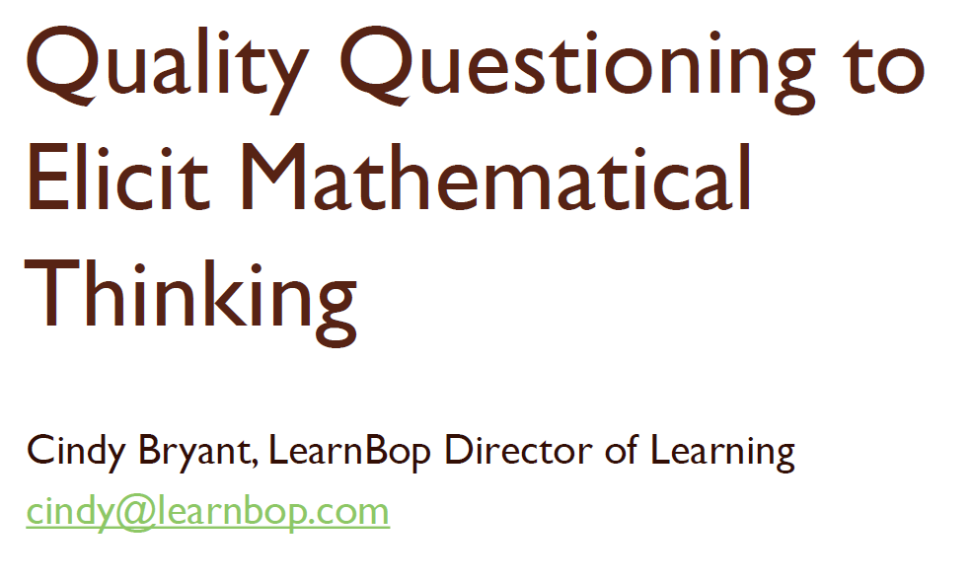
Questions and prompts for mathematical thinking
Watson & Mason 1998, Association of Teachers of Mathematics

Slide 23
Repertoire of questions to probe and frame students’ reasoning
Why do you think that …?
Does it always work?
Can you explain ...?
How do you know?
Why …?
Can you show me …?
Is there another way …?
What is best way to …/explanation of .../proof of ....?
Have you tried all the possible cases?
What do you notice when …?

Slide 24
3 x 16 = 48
48 = 16 x ?
48 ÷ ? = ?

Slide 25
anne.watson@education.ox.ac.uk
University of Oxford
Dept of Education

