Slide 1
Situations Vacant
What mathematical questions might be asked about the following situations?
What mathematical connections or associations do they bring to mind?

Slide 2
Fermi Questions
How many hairdressers would you expect in your town?
How many pharmacies?
… what similar questions might you ask?
Take an item that you purchased recently
How much do the components cost?
Trace the object back to natural resources

Slide 3
Making Change
When the woman sitting opposite me on the train tendered a £20 note to pay for a cup of coffee (about £2.30), the drinks-trolley man couldn’t give her the required change.
I offered to give him £5 in coins “if that would help”.
I duly gave him the coins and he gave me a £5 note.
Then he gave me the coffee which I gave to the woman.
She meanwhile had found a £10 note, which she gave to the drinks-trolley man.
He then gave her £7.70 (all in coins), remarking that “they never give us a big enough float”.

Slide 4
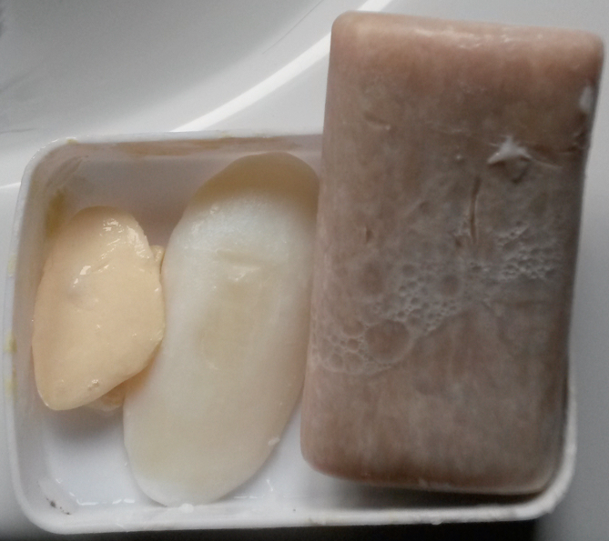
Bars of Soap
My wife adds a fresh bar of soap to the soap dish when the old one has or is just about to break into pieces.
I try to use up the small pieces.
I notice that the new bar is almost at the break-up stage by the time I can no longer satisfactorily use the previous tiny pieces.
What is going on?

Slide 5
Bars of Soap
Assume that the surface area S is disappearing at a constant rate over time
The volume is 0 at time c independent of the initial volume

Slide 6
What questions come to mind?

Slide 7
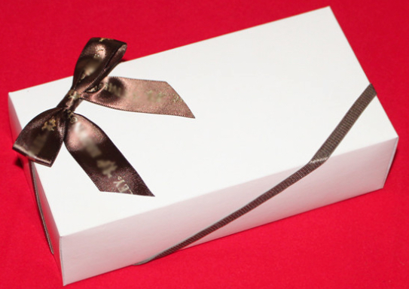
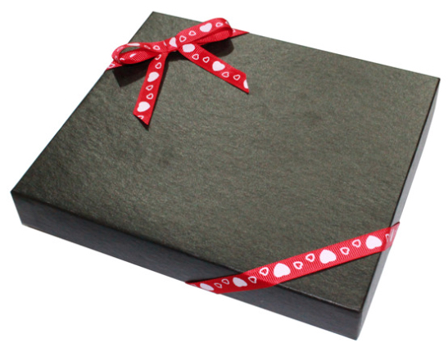
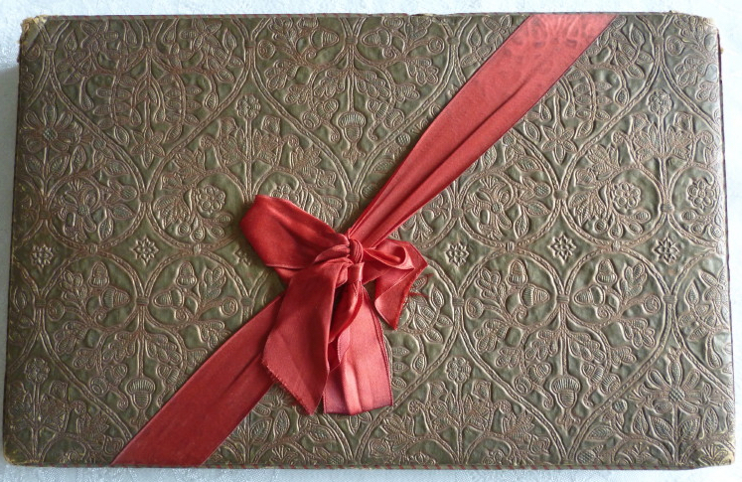
What Questions Come to Mind?

Slide 8
Twisted
Alex Bellos
Notes:
https://twitter.com/OxfordEdMaths?ref_src=twsrc%5Etfw

Slide 9
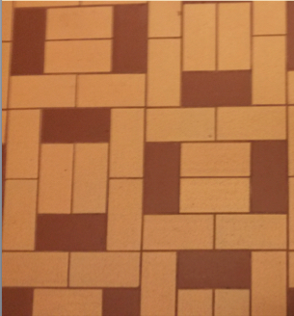
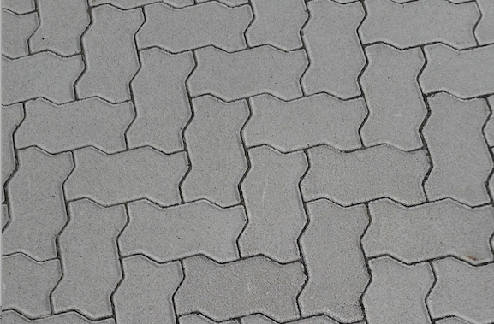
Tiling
Notes:
What is the Same and What is Different?

Slide 10
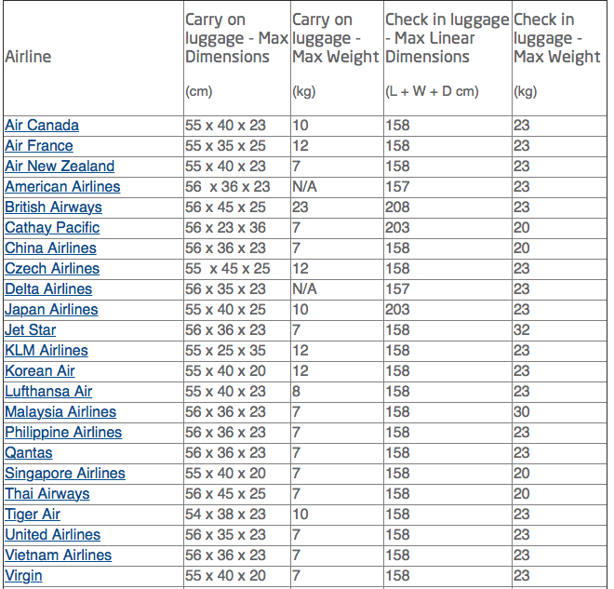
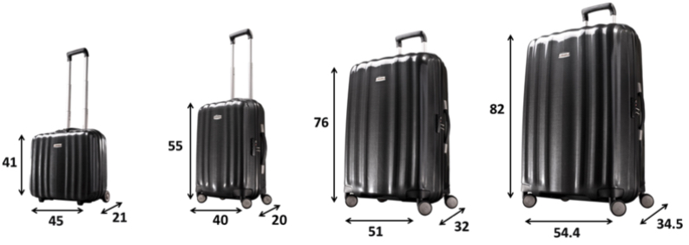
SuitCases

Slide 11
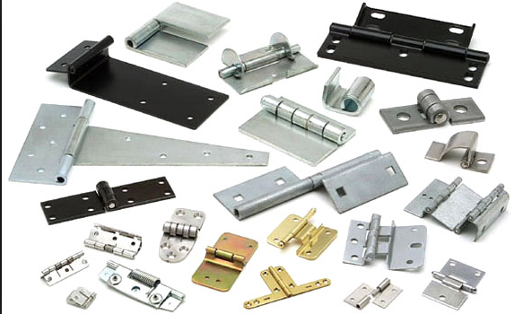
UnHinged?
Notes:
How many different types of hinges can you find in a week?
What are they all for?

Slide 12
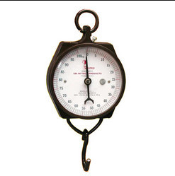
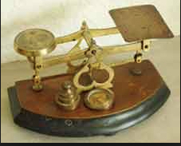
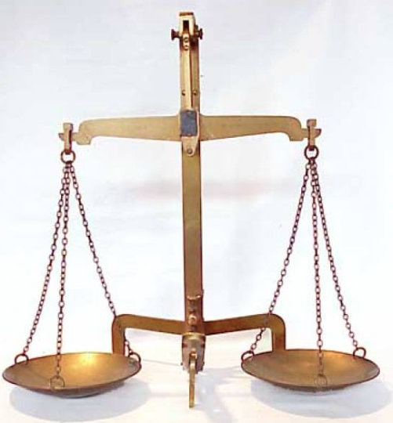
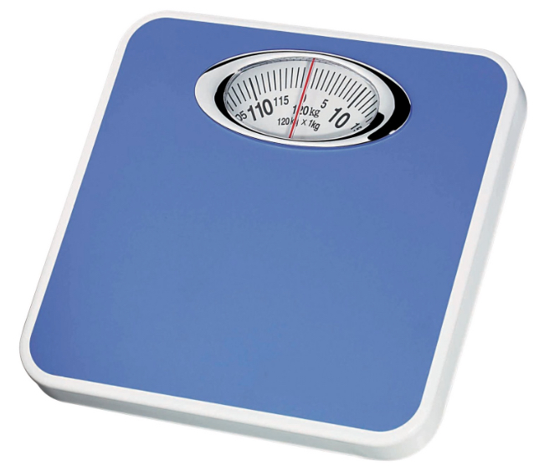
Weighing
What is the same and what is different about these?

Slide 13
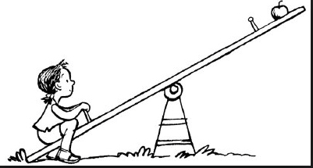
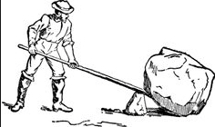
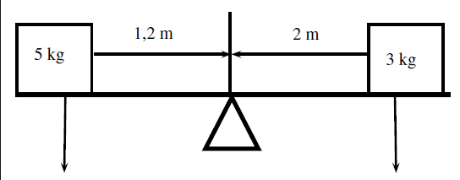
Balancing

Slide 14
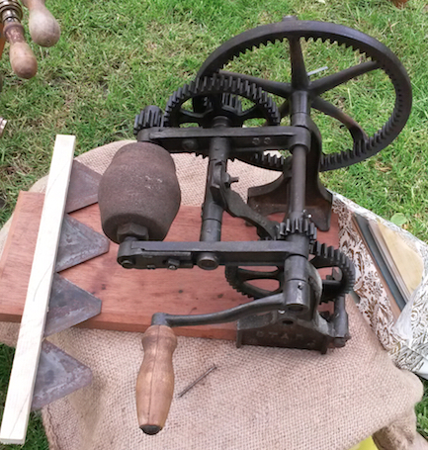
Gearing Up
What is it?
What does it do?
How does it do it?

Slide 15
Piano Pedal

Slide 16
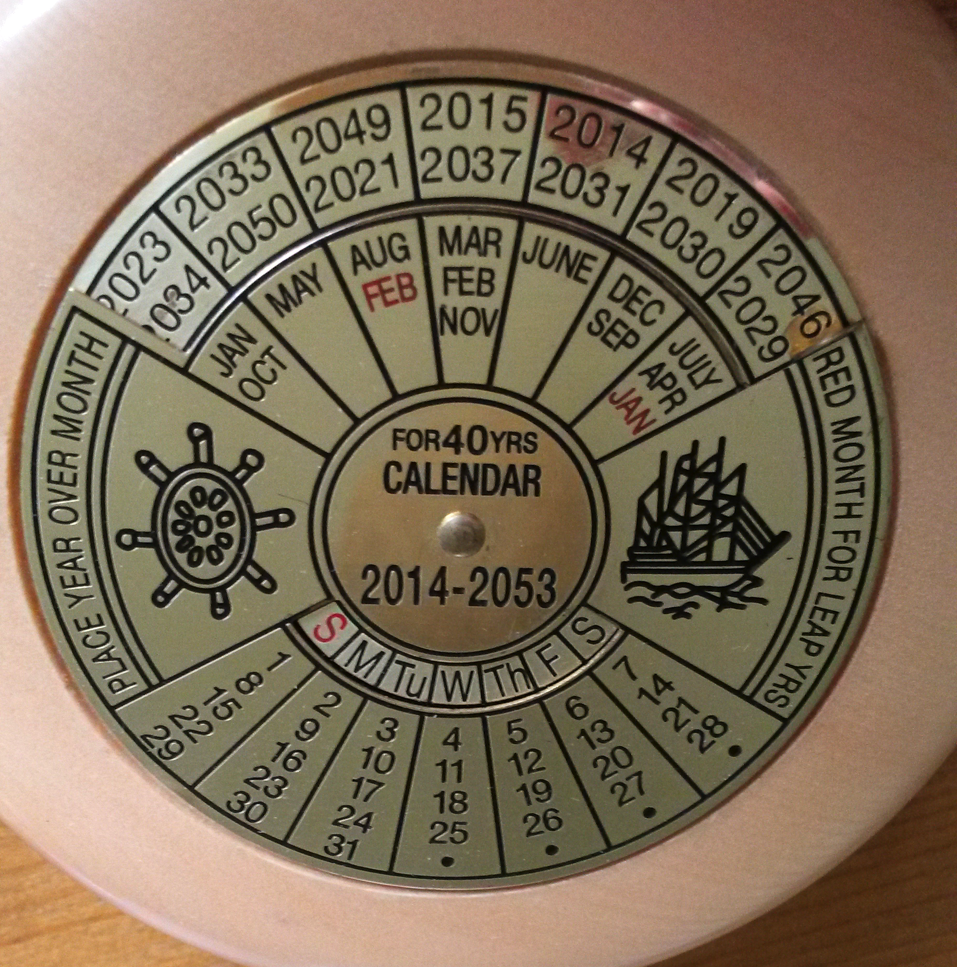
Perpetual Calendar
Fixed
Rotates
Fixed

Slide 17
Vested Interests?
Of 65 scientists who opposed the use of Avandia, some 28% were financially backed by Glaxo.
Of the 31 who supported the use of Avandia, 94% had funding from Glaxo.
Some 47% of study authors had financial conflict of interest, but some 23% did not disclose this.
Of 29 authors recommending a rival drug, 25 had financial links to the rival drug manufacturer.
Avandia Research [Independent March 19 p7]

Slide 18
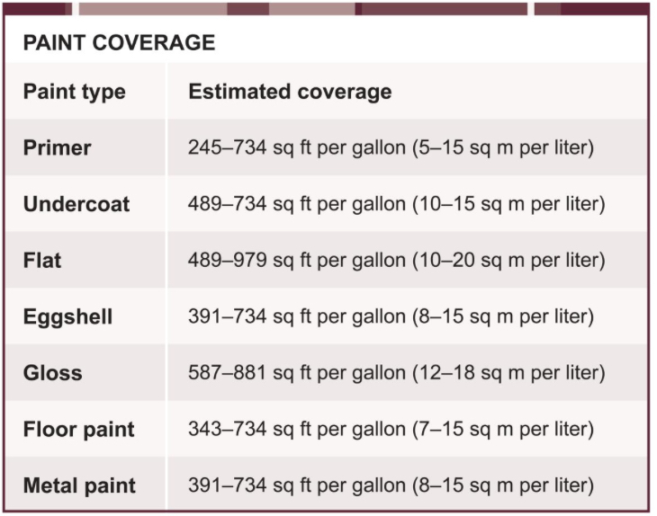

Slide 19
Water
In the UK we use about 150 lt of water perperson per day;
It takes
nearly 200 litres of water to grow the coffee beans for one cup of coffee
15 000 litres to grow 1Kg of beef
35,000 litres for 1 day’s food
100 litres of water to make two slices of bread;
65 litres for the cheese filling
around 250 litres for the milk in a latte
A sheet of paper uses 10 litres
A micro chip uses 32 litres
1 Kg of cotton (eg. a shirt and jeans) takes between 10, 000 and 23,000 litres of water to make
There are some 33 million cubic kilometres of water on the earth
We each drink about 1 m³ of water every year; use about 100 m³ for cleaning and washing and about 1000 m³ for growing food
In 9 countries in Eastern & Southern Africa will have less than 1000 m³ per person per year.
Notes:
Source: Resurgence & Ecologist Nov-Dec 2015 p17-21,

Slide 20
Ice & Water
In 1940, the Chacaltaya glacier in Bolivia covered an area of .22 km^{2;} by 2005 it was less than .01 km²
During that time it lost 90% of its surface area and 97% of its volume

Slide 21
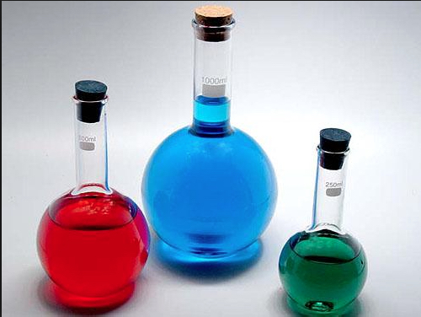
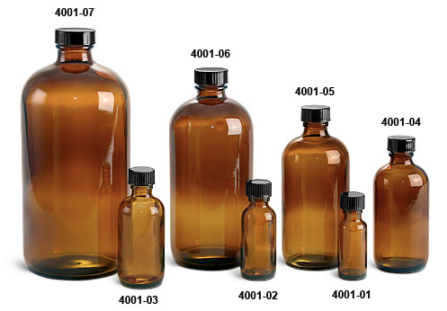
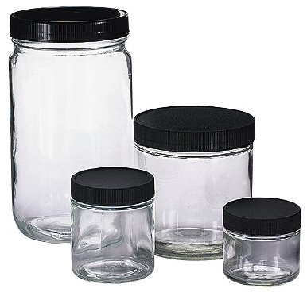
Jars

Slide 22
Coffee Mugs
How many different sized mugs can you find?
What is the largest diameter mug you can find?
What is the tallest mug you can find?

Slide 23
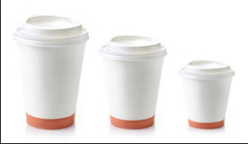
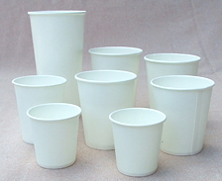
Paper Cups

Slide 24
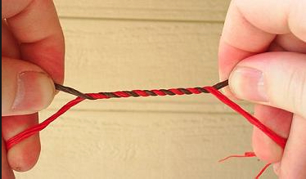
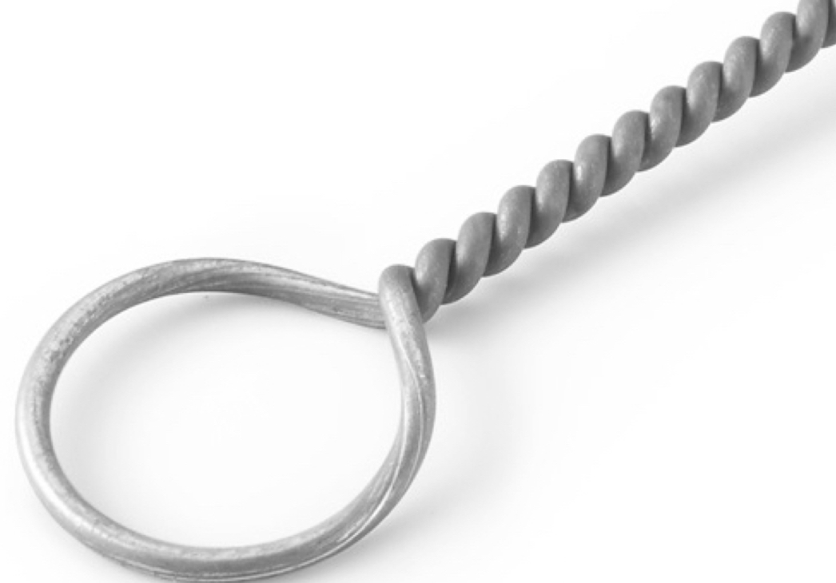
Twisting

Slide 25
Hitched

Slide 26
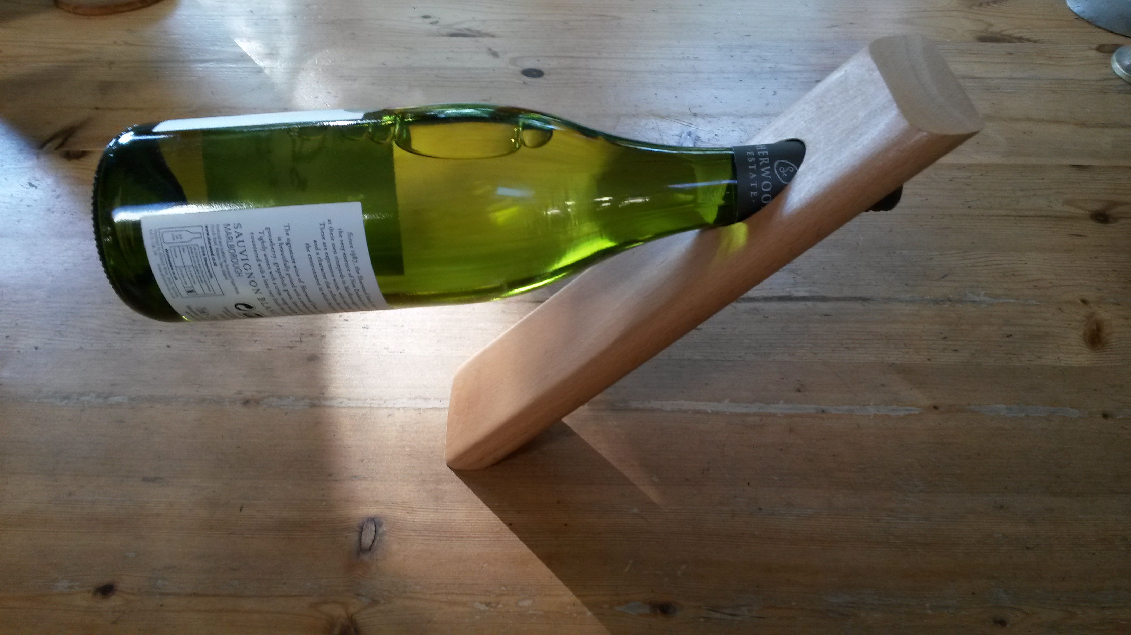
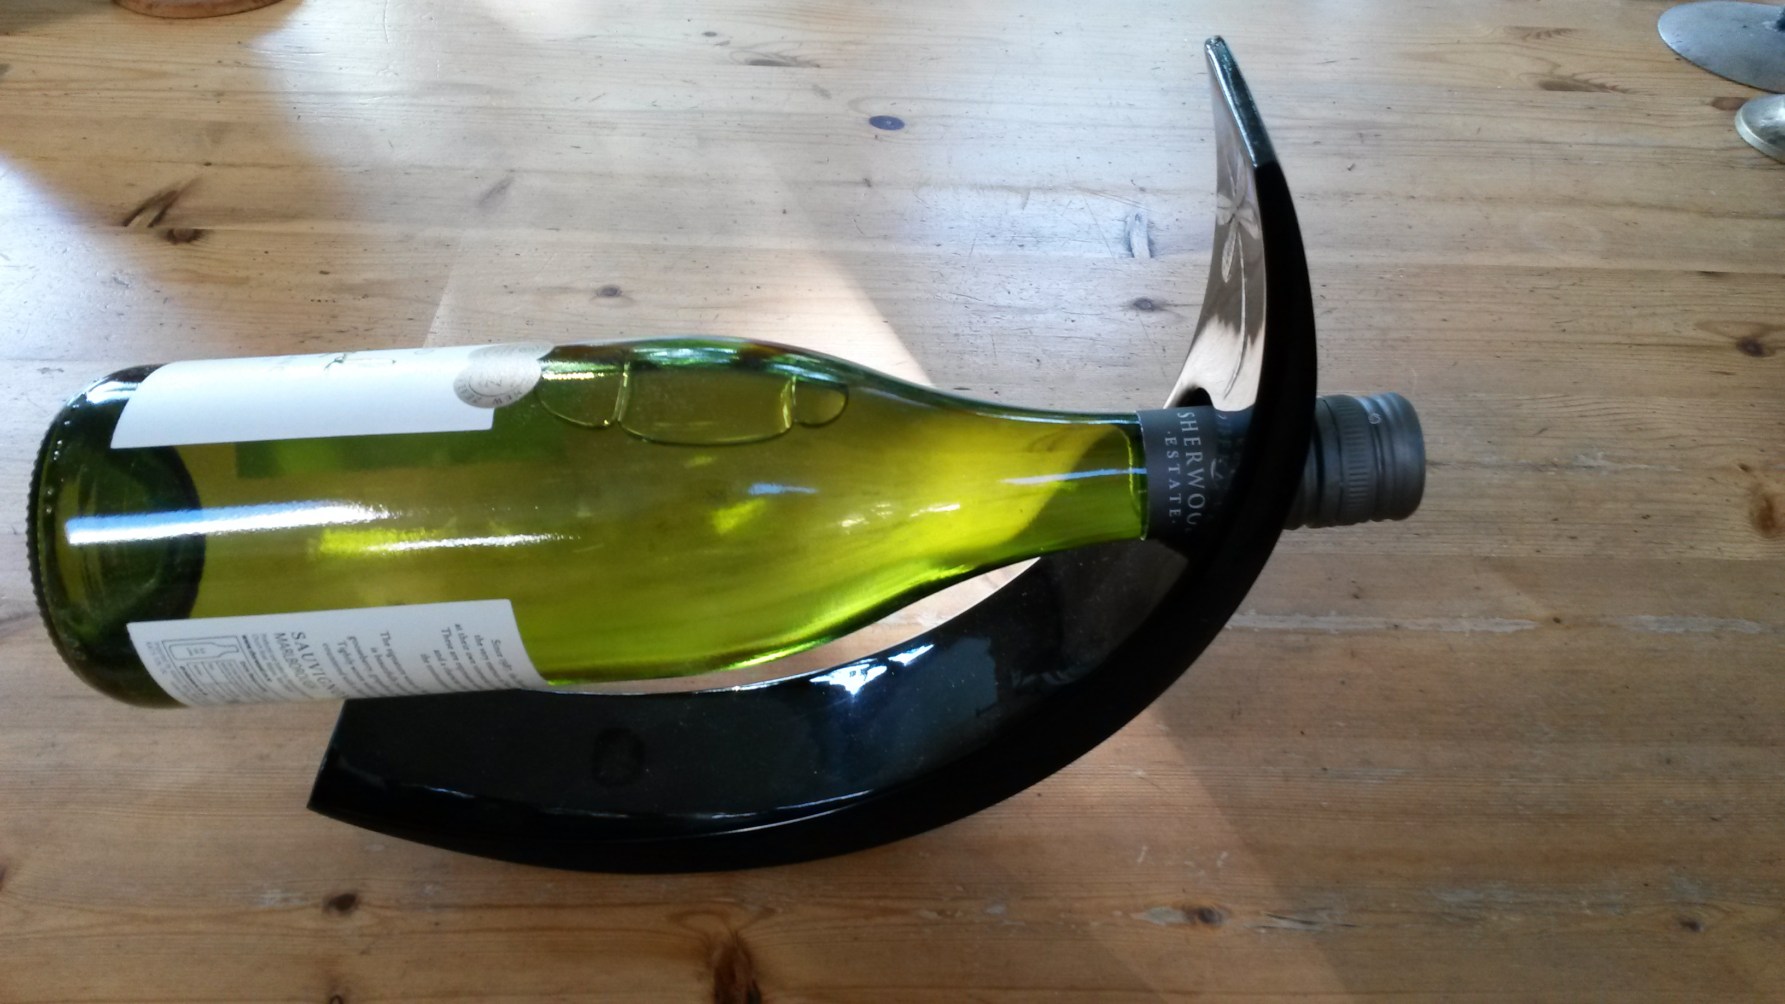
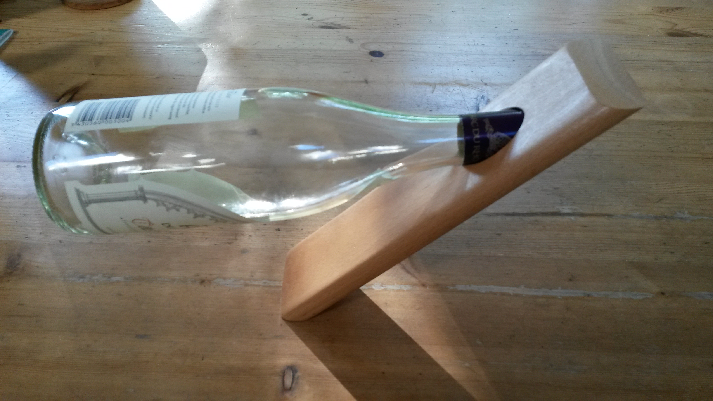
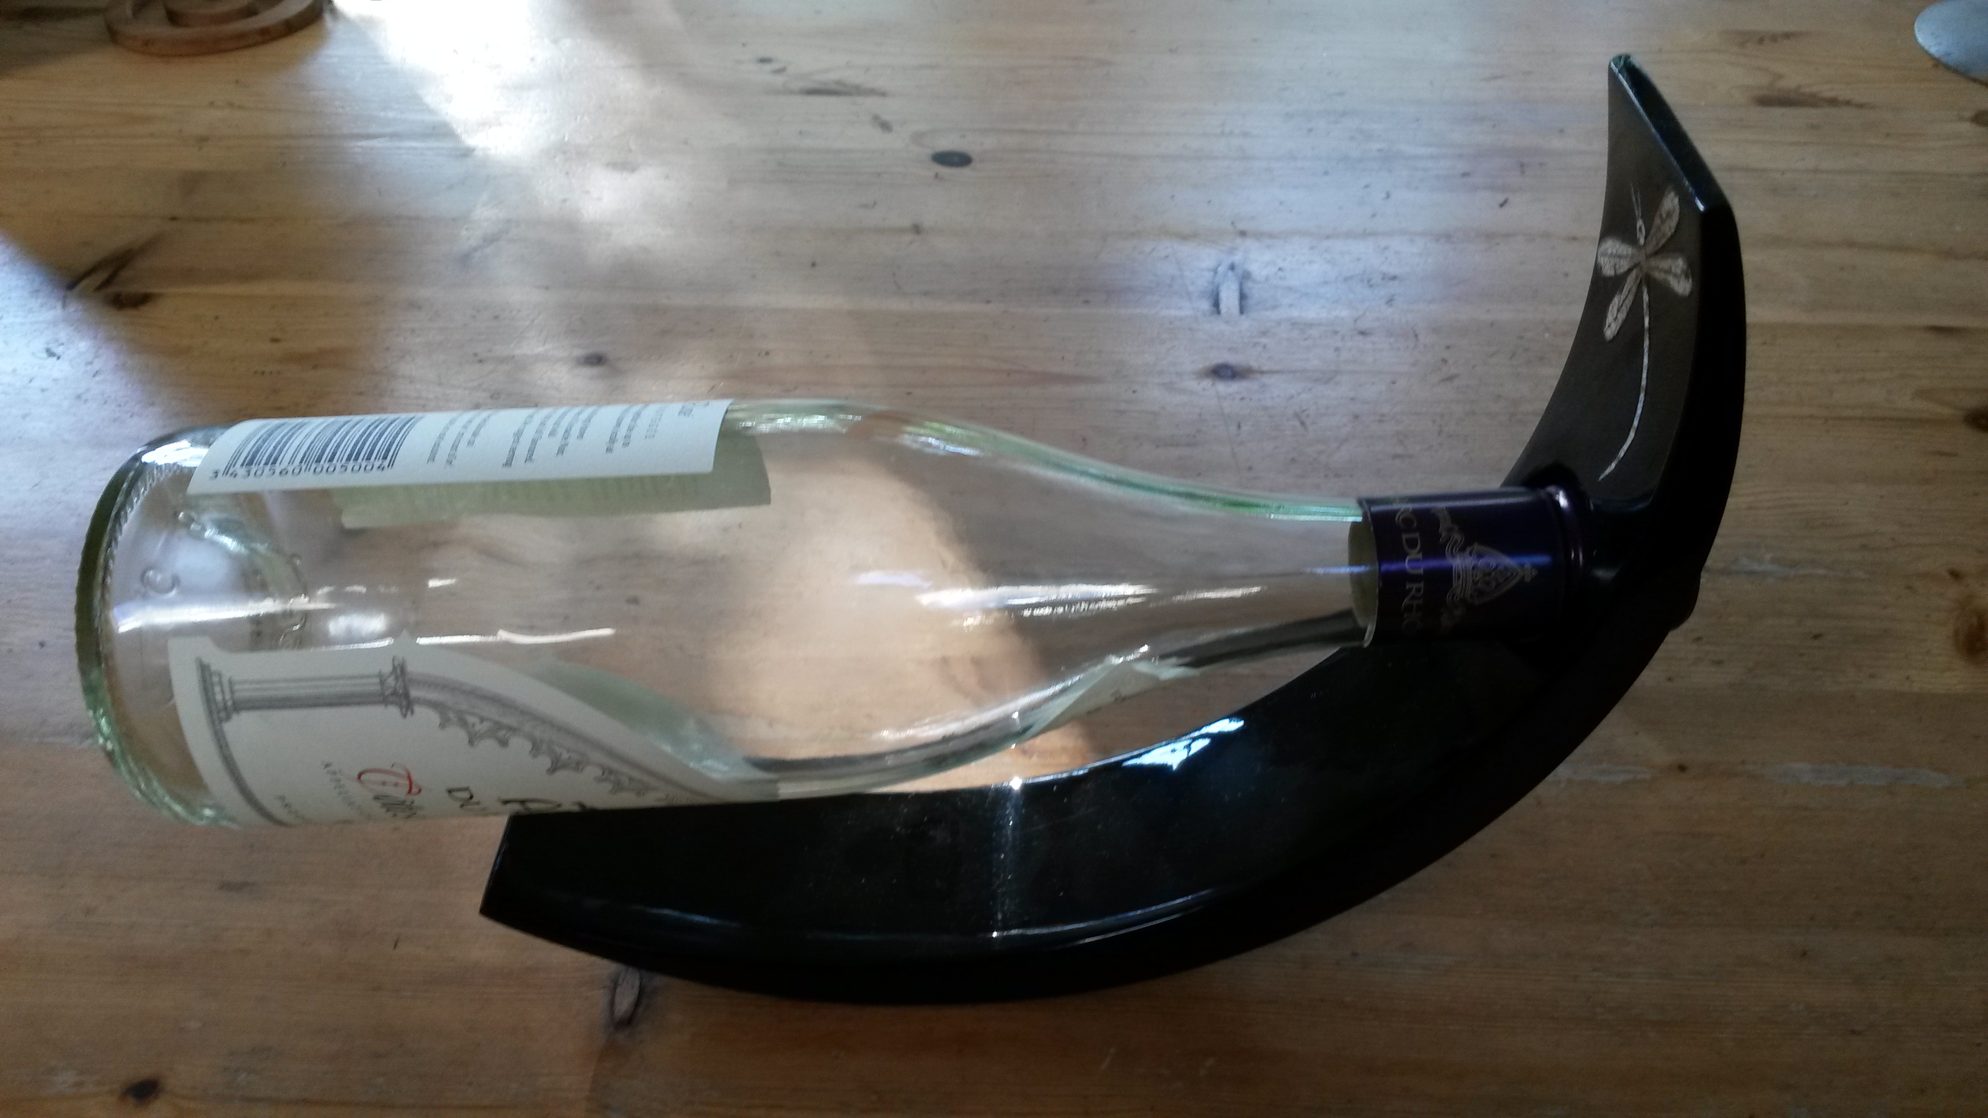
Balanced

Slide 27
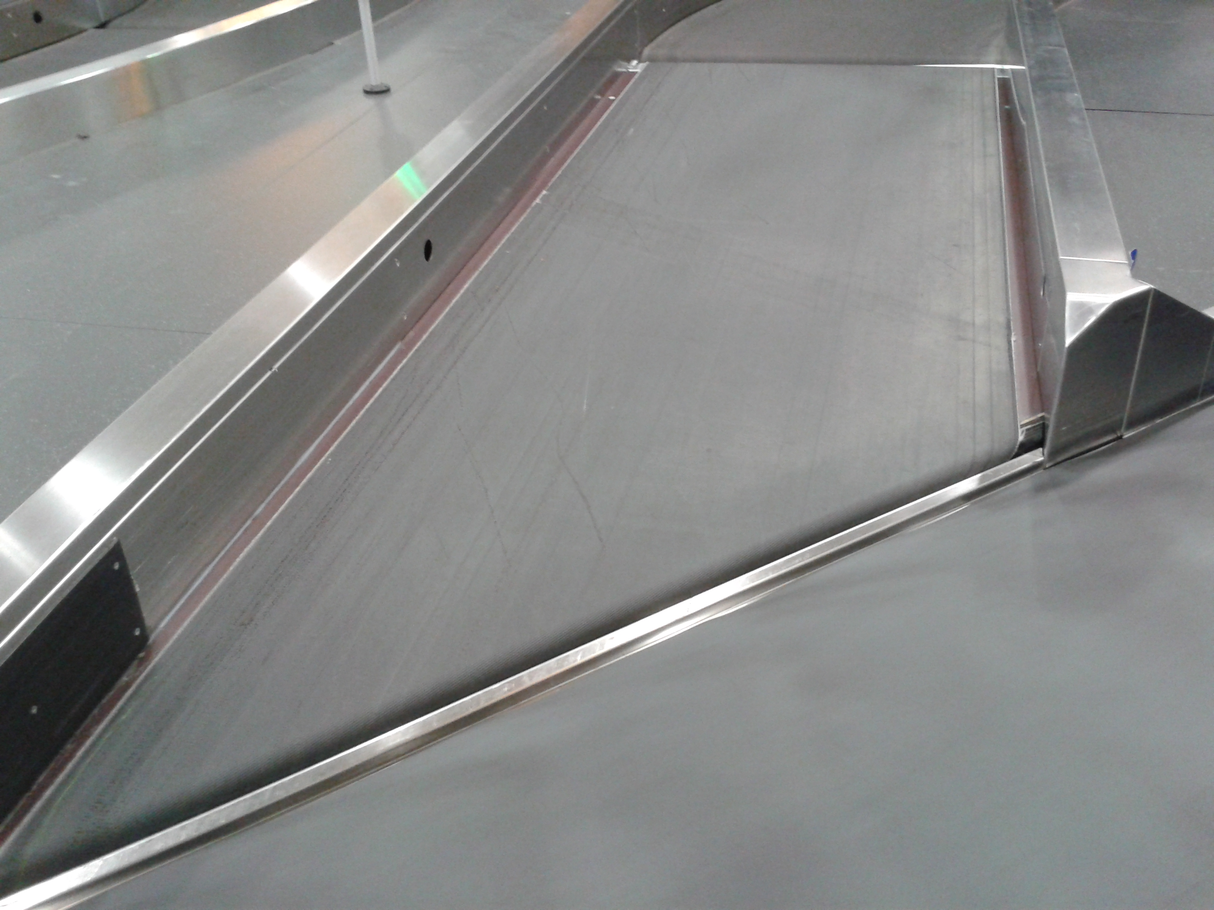
Belted

Slide 28
SWYS
What is changing; What is staying the same?
What shape is the ‘belt’?
Notes:
Cou;d you have a belt that turned through some other angle?

Slide 29
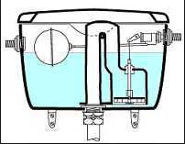
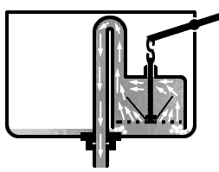
Cisterns

Slide 30
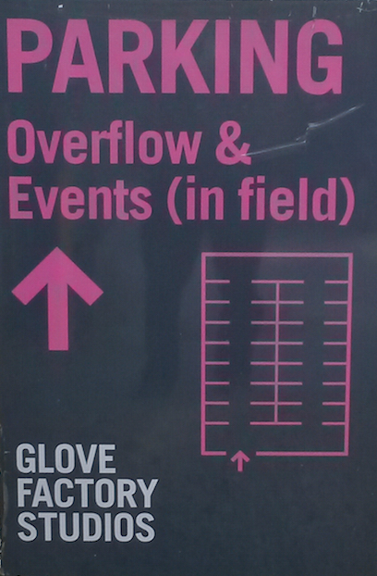
Parking
Notes:
Diagram is obviously schematic.
What should the relative dimensions be?
Possibly an example of “teacher absolute”: not a concern of adolescents!

Slide 31
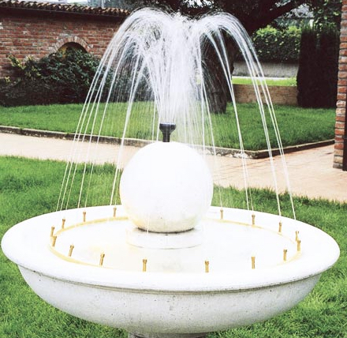
Fountains

Slide 32
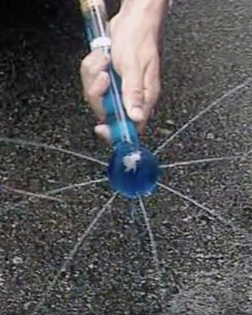
Hydraulics 2

Slide 33
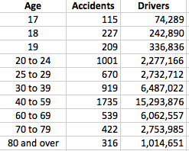
Driving Data

Slide 34
Hiring Room Policy
Commercial Organizations
Main Hall: £16.50 per hour.
Use of Kitchen: £15.00 for first booking, thereafter free.
Upper Room: £7.00 per hour
Non Profit Making Organizations
Main Hall: £13.50 per hour
Use of Kitchen: Free
Upper Room: £5.00 per hour
Pensioners Organizations
Main Hall: £10.50 per hour
Use of Kitchen: Free
Upper Room: £5.00 per hour

Slide 35
Vote Changing
After an election, 29% of those voting for party S said they would now vote for party L because of a change of leader.
But 30% of those who had voted for party L said they would now vote for party S because of the change of leader in party L.
A spokesperson said: “this means no change!”
In fact, twice as many people had voted for party S as had voted for party L.

Slide 36
Journeys
People leave town A for a trip to town B at the same time as other people leave town B for a trip to town A. They meet at noon, lunch and chat together for an hour and then resume their trips. One group arrives at 5pm, the other at 7:15 pm. At what time did they set out? [Arnold]
Two people set out at the same time on a trip from A to B, going at the same speed. One changes to a new speed half way, the other changes to the same new speed at what turns out to be half time. Who arrives first?
If a child sets out from school walking at a pace which will take 20 minutes to get home, and an adult sets out from home at the same time, walking at a pace which will take 10 minutes to get to the school, how long will it take before they meet?
Two cyclists cycle towards each other. At 8am they are 42Km apart. They meet at 11am. One of them averaged 7.5km per hour. What was the average speed of the other?

Slide 37
Half-Life
I realised at one point that I had been away from my home town for one-third of my life. How long was it until I was away for half my life?
What if I move back to my home town?
I am in the midst of a routine task and notice that I am two-thirds finished. How long will it be until I am three-quarters finished, and how long will it take to finish?

Slide 38
Marbles
If John gives one of his marbles to Chris, they will then have the same number of marbles.
If John gives three of his marbles to Anne and Anne gives two of her marbles to Kate, they will all then have the same number of marbles.
If John gives two of his marbles to Quentin, then Quentin will have twice as many marbles as John then has.

Slide 39
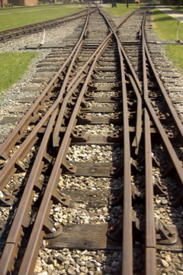
Tracked

Slide 40
The End
Situations Vacant

