Slide 1
Reasoning Reasonably in Mathematics
The Open University
Maths Dept
University of Oxford
Dept of Education
Promoting Mathematical Thinking
John Mason Punta Arenas
Patagonia
Nov 2017

Slide 2
Conjectures
Everything said here today is a conjecture … to be tested in your experience
The best way to sensitise yourself to learners …
is to experience parallel phenomena yourself
So, what you get from this session is what you notice happening inside you!
Principle Conjecture
Every child in school can reason mathematically
What often holds them back is lack of facility with numbers

Slide 3
Outline
We work on some tasks together
We try to catch ourselves reasoning
We consider what pedagogical actions (moves, devices, …) might inform our future actions

Slide 4
Intentions
Participants will be invited to engage in reasoning tasks that can help students make a transition from informal reasoning to reasoning solely on the basis of agreed properties.
Keep track of awarenesses and ways of working
For discussion, contemplation, and pro-spective pre-paration
Background
Successful Reasoning Depends on making use of properties
This in turn depends on Types of Attention
Holding Wholes (gazing)
Discerning Details
Recognising Relationships
Perceiving Properties (as being instantiated)
Reasoning solely on the basis of agreed properties

Slide 5
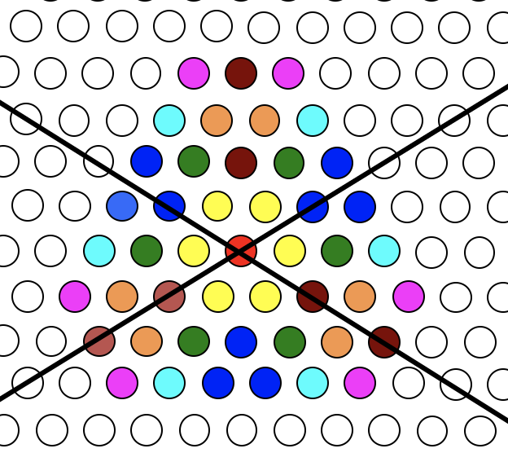
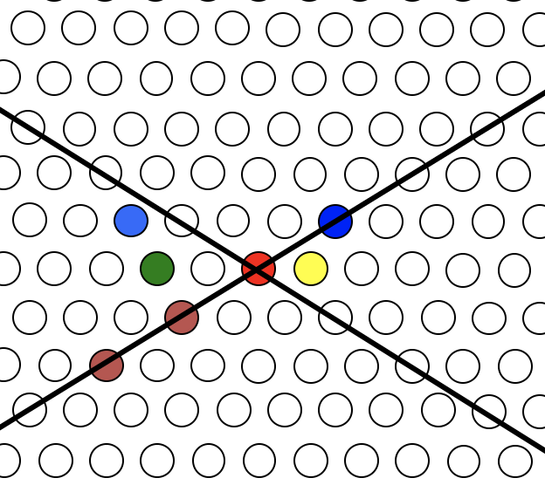
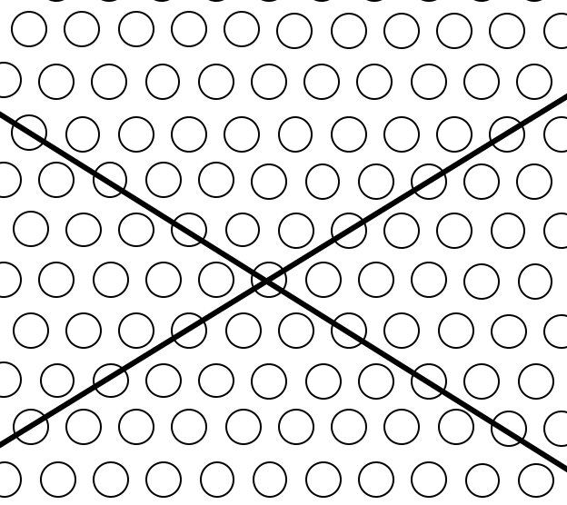
Symmetry-Based Reasoning
The black lines are mirrors
What MUST be the case?
Are there any conflicts?
Is there any redundancy?
How do you know?

Slide 6
Some Stages in Symmetry Reasoning
What mathematical questions might arise?
How few can you specify from which I can work out all the others?
What awarenesses are being made available?

Slide 7
Set Ratios
In how many different ways can you place 17 objects so that there are equal numbers of objects in each of two possibly overlapping sets?
What about requiring that there be twice as many in the left set as in the right set?
What about requiring that the ratio of the numbers in the left set to the right set is 3 : 2?
What is the largest number of objects that CANNOT be placed in the two sets in any way so that the ratio is 5 : 2?
S₁
S₂
What can be varied?

Slide 8
Exchange (Trading)
Select a pile of Blue counters
IMAGINE that you are going to exchange each Blue counter for 3 RED ones, until you can do no more.
How can you lay out the counters so that someone can see easily what you have done?
What mathematical action have you performed?
Imagine now exchanging 2 RED counters for 1 GREEN counter
What mathematical action have you you carried out?

Slide 9
Bags
What could be varied?
I have a bag of counters
I put in 3 more counters, then take out 5
What is the relationship between the number of counters in the bag now and when I started?
Notice that the number in the bag is not stated
I have a bag of counters
I put in 3 more counters, then take out 5
I put in 7 more counters and then take out 11
What question might I now ask you?
What could be varied?
I have a bag of counters
I put in 3 more counters, then take out 5
I put in 7 more counters and then take out 11
There are now half as many counters as I started with
What could be varied?

Slide 10
Buses
IMAGINE that you are driving a bus
At one stop, 5 people get off and 3 people get on
What is the relationship between the number of people now and when I started?
Imagine that you are driving a bus
At one stop, 5 people get off and 3 people get on
At the next stop 11 people get off and 7 people get on
What question might I now ask you?
What could be varied?
Imagine you are driving a bus
At one stop, 5 people get off and 3 people get on
At the next stop 11 people get off and 7 people get on
There are now half as many people on the bus as when I started

Slide 11
Number Line Walk
IMAGINE that you are standing at a point on the number line facing to the right
You walk forward 3 steps then backwards 5 steps
What is the relationship between where you are now and where you started?
IMAGINE that you are standing at a point on the number line facing to the right
You walk forward 3 steps then backwards 5 steps
You walk backwards 11 steps then forwards 7 steps
You are now half as far from 0 as when you started
What question might I ask you?
What could be varied?

Slide 12
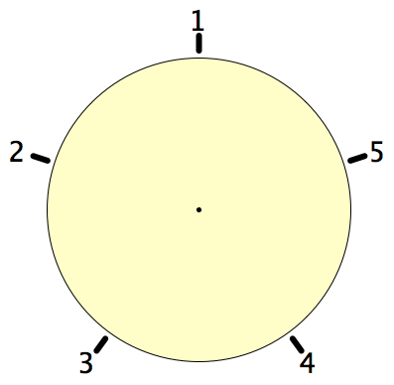
Secret Places
One of these five places has been chosen secretly.
You can get information by clicking on the numbers.
If the place where you click is the secret place, or next to the secret place, it will go red (hot), otherwise it will go blue (cold).
How few clicks can you make and be certain of finding the secret place?
Can you always find it in 2 clicks?
Notes:
Imagine a round table …

Slide 13
Magic Square Reasoning
What other configurations like this give one sum equal to another?
6
7
2
2
1
5
9
Try to describe them in words
2
8
3
4
Any colour-symmetric arrangement?
Sum(
)
=
Sum( )
Notes:
Think of all the patterns obtained like this one but with different choices of the red line and the blue line.
Sketch a few
Here is another reasoning
What about this pattern: is it true?
did you have difficulty recognising the components? This may be why learners find it hard to remember what they were taught recently!

Slide 14
More Magic Square Reasoning
Sum(
)
=
Sum( )

Slide 15
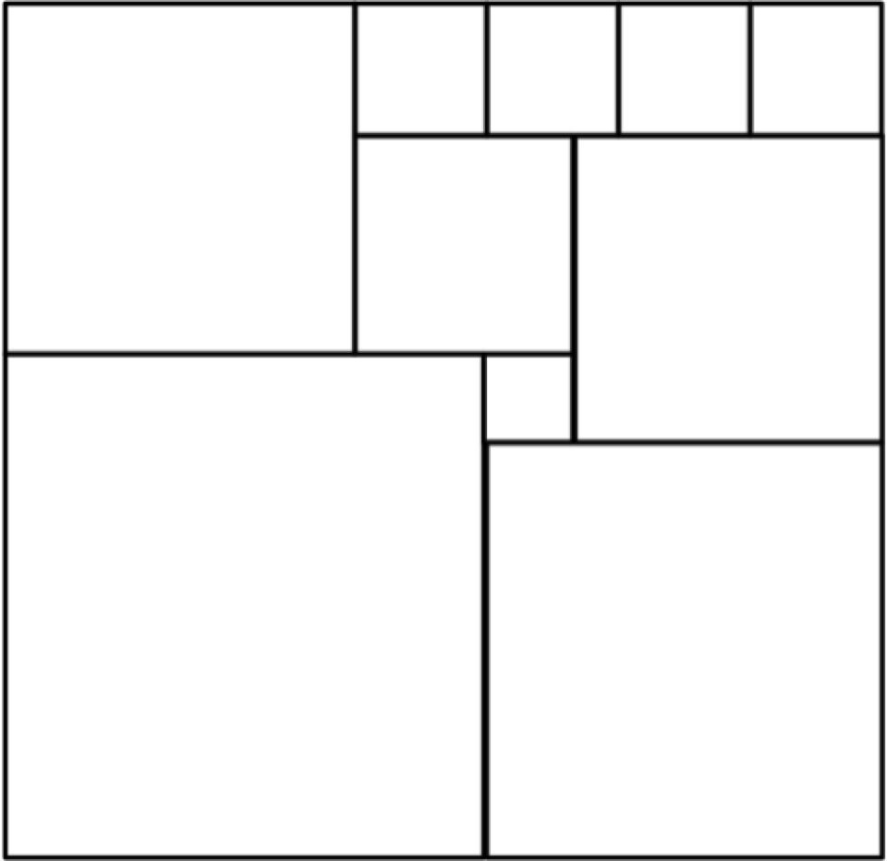
Square Deductions
Each of the inner quadrilaterals is a square.
Can the outer quadrilateral be square?
15a = 6b
4(4a–b) = a+2b
4a–b
Acknowledge ignorance:
denote size of edge of smallest square by a;
4a
b
a+b
Adjacent square edge by b
a
To be a square:
7a+b = 5a+2b
3a+b
So 2a = b
2a+b

Slide 16
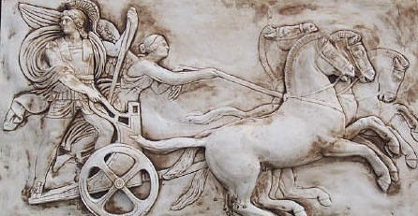
Human Psyche
Awareness (cognition)
Imagery
Will
Emotions (affect)
Body (enaction)
Habits Practices

Slide 17
Three Only’s
Language Patterns & prior Skills
Imagery/Sense-of/Awareness; Connections
Root Questions
predispositions
Different Contexts in which likely to arise; dispositions
Standard Confusions & Obstacles
Techniques & Incantations
Emotion
Awareness
Behaviour
Only Emotion is Harnessable
Only Awareness is Educable
Only Behaviour is Trainable

Slide 18
Reasoning Conjectures
What blocks children from displaying reasoning is often lack of facility with number.
Reasoning mathematically involves seeking and recognising relationships, then justifying why those relationships are actually properties that always hold.
Put another way, you look for invariants (relationships that don’t change) and then express why they must be invariant.

Slide 19
Some Pedagogic Actions
“How do you know?”
“What do you Know” & “What do you Want (to find out)”?
Imagining the Situation before diving in

Slide 20
Scaffolding & Fading Directed – Prompted – Spontaneous
Developing Independence NOT Building Depenednecy
Use of label for some mathematical action
Gradually using less direct, more indirect prompts
Learners spontaneously using it for themselves
This is what Vygotsky actually meant by ZPD
What learners can currently do when cued, and re on the edge of being able to initiate for themselves.

Slide 21
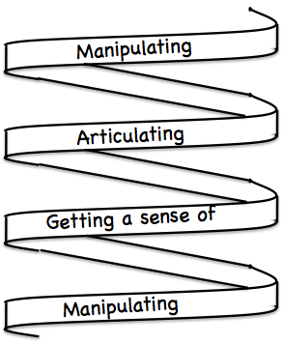
Frameworks
Doing – Talking – Recording (DTR)
(MGA)
See – Experience – Master (SEM)
Enactive – Iconic – Symbolic (EIS)
Specialise … in order to locate structural relationships …
then re-Generalise for yourself
Stuck?
What do I know?
What do I want?

Slide 22
Mathematical Thinking
How might you describe the mathematical thinking you have done so far today?
How could you incorporate that into students’ learning?

Slide 23
Actions
Inviting imagining before displaying
Pausing
Inviting re-construction/narration
Promoting and provoking generalisation
Working with specific properties explicitly

Slide 24
Possibilities for Future Action
Listening to children
(not listening for what you hope to hear)
Getting children to listen to each other
Trying small things and making small progress; telling colleagues
Pedagogic strategies encountered today
Provoking mathematical thinking as happened today
Question & Prompts for Mathematical Thinking (ATM)

Slide 25
Follow Up
john.mason @ open.ac.uk
PMTheta.com → JHM –>Presentations
Questions & Prompts (ATM)
Key ideas in Mathematics (OUP)
Learning & Doing Mathematics (Tarquin)
Thinking Mathematically (Pearson)
Developing Thinking in Algebra (Sage)

