Slide 1
Reasoning in the Mathematics Curriculum
Promoting Mathematical Thinking
Anne Watson & John Mason
Prince’s Trust Maths CPD
London Mar 2 Manchester Mar 9
2013
The Open University
Maths Dept
University of Oxford
Dept of Education

Slide 2
Conjectures
Everything said here today is a conjecture … to be tested in your experience
The best way to sensitise yourself to learners …
is to experience parallel phenomena yourself
So, what you get from this session is what you notice happening inside you!

Slide 3
Differing Sums of Products
Write down four numbers in a 2 by 2 grid
4
7
5
3
Add together the products along the rows
28 + 15 = 43
Add together the products down the columns
20 + 21 = 41
43 – 41 = 2
Calculate the difference
That is the ‘doing’ What is an ‘undoing’?
Now choose positive numbers so that the difference is 11
Notes:
Mathematical context
What probaby matters most is not eh context, but whether students ‘think’ they can solve the problem!

Slide 4
Differing Sums & Products
4
7
Tracking Arithmetic
5
3
4x7 + 5x3
4x5 + 7x3
4x(7–5) + (5–7)x3
= (4-3)x (7–5)
So in how many essentially different ways can 11 be the difference?
So in how many essentially different ways can n be the difference?
Notes:
Revealing Structure by attending to relationships not calculations

Slide 5
Think Of A Number (ThOANs)
Think of a number
Add 2
Multiply by 3
Subtract 4
Multiply by 2
Add 2
Divide by 6
Subtract the number you first thought of
Your answer is 1
7
7
+ 2
3x + 6
7
7
3x + 2
6x + 4
7
6x + 6
7
+ 1
7
1

Slide 6
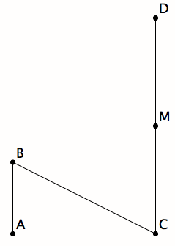
Equilateral Construction
AC is twice AB
M is the mid-point of CD
AB is perpendicular to AC, as is DC
How long should CD be so that BMC is equilateral?

Slide 7
Compound %
At a discount store, I can get a discount of 30%
Should I prefer to calculate the VAT of 20% before or after calculating the discount?
What would Customs and Revenue prefer?
Simpler Question:
If VAT is 20% and there is a local tax of 10%, what is the overall tax?
To whom does it matter in which order they are calculated?

Slide 8
Money Changing
People who convert currencies offer a ‘buy’ rate and a ‘sell’ rate, and sometimes charge a commission in addition!
Suppose they take p% from every transaction, and that they sell $s for 1£ but buy back at the rate of £b for $1. How can you calculate the profit that make on each transaction?

Slide 9
Mathematical Thinking
How describe the mathemtical thinking you have done so far today?
How could you incorporate that into students’ learning?

Slide 10
Possibilities for Action
Trying small things and making small progress; telling colleagues
Pedagogic strategies used today
Provoking mathematical thinks as happened today
Question & Prompts for mathematcal Thinking (ATM)
Group work and Individual work

Slide 11
Reflection
KNOW & WANT
Specialisng & Generalising
Identifying variables; focus on relationships
STUCK? Try another route
Parking “what you can do”
Doing & Reflecting on Doing
Make up own
Cf with neighbour
Explain; Narrate
Recognising familiar structures
Searching past experience
Imagining & Expressing
Generating space of possibilities
How Do You Know?
Choosing egs to get variety (for comparisons, for same & different)
Visual perception –> conjectures; reasoning to achieve certainty
Dynamic images to indicate relationships; scope of generality
“it” –> what is ‘it’?
Cognitive conflict & surprise
Something to discuss
Impossible tasks (How do you know)

Slide 12
Proof by Sorting & Ordering

Slide 13
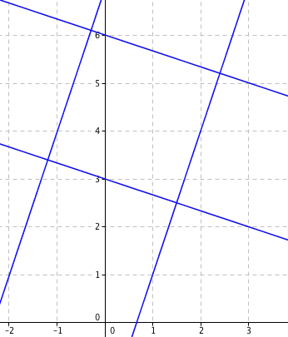
Graphical Reasoning
Lines are
y = 3x - 1
3y = -x + 7
y = 3x + 9
3y = -x+ 17

Slide 14
Reflection
Surprise
Variation
How do you know?
Sorting & ordering
Tracking arithmetic
Multiple representation
Attention, Action & Awareness
Teacher’s
Students’

Slide 15
Tasks
Tasks promote Activity;
Activity involves Actions;
Actions generate Experience;
but one thing we don’t learn from experience is that we don’t often learn from experience alone
It is not the task that is rich …
but whether it is used richly

Slide 16
Follow Up
j.h.mason @ open.ac.uk
mcs.open.ac.uk/jhm3 → Presentations
Thinking Mathematically (Pearson)
Questions & Prompts (ATM)
Learning & Doing Mathematics (Tarquin)
Developing Thinking in Algebra

