Slide 1
Coordinated Perimeters
Based on an idea of Dan Meyer

Slide 2
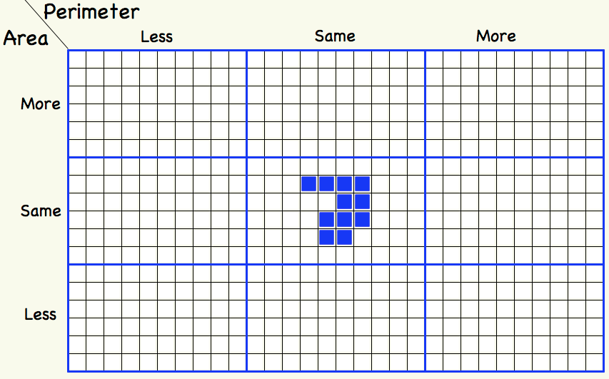
More or Less: Area & Perimeter

Slide 3
Shape Signature
The signature of a 2-D shape is the ratio of the square of the Semi-Perimeter to the Area
What is the signature of a circle?
What is the signature of a square? Of a rectangle?
If a shape is scaled, what happens to the signature?
Can different shapes have the same signature?
What about 3-D?

Slide 4
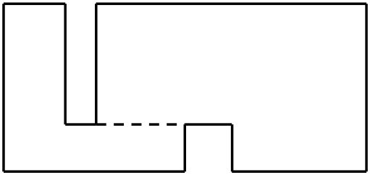
Perimeter Adjustments
Compare the perimeters of the two below (dotted lines show alignments).
Construct other shapes whose perimeters can be worked out using only the lengths of the original rectangle.

Slide 5
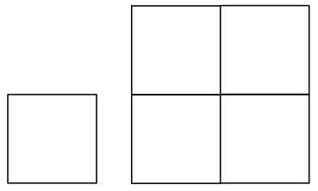
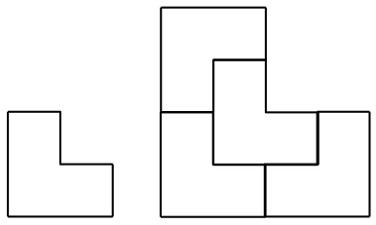
Scaling
Below are two shapes both of which can be scaled by a factor of two using four copies.
What other shapes have this property?
Can you find a shape that can be scaled by a factor of 3 using 9 copies but not by 2 using 4 copies?

Slide 6
Just Enough Information
Draw a rectilinear figure (polygon, all internal angles 90° or 270°).
How few lengths do you need in order to calculate the perimeter?
How few lengths do you need in order to calculate the area?

