Slide 1



Encountering Mathematical Beauty through engaging in
Mathematical Thinking and by recognising
Mathematical Structure
John Mason
June 16 2022

Slide 2
Abstract
Participants will be invited to engage in mathematical tasks which highlight aspects of mathematical thinking, and which offer experience of pleasure arising from beautiful mathematics, all within the scope of the mathematics curriculum.

Slide 3
Observations
Beauty is in the eye of the beholder
Children need to be enculturated into perceiving ‘beauty’ according to the cultures in which they are immersed
Mathematics, rightly viewed, possesses not only truth, but supreme beauty—a beauty cold and austere, like that of sculpture, without appeal to any part of our weaker nature, without the gorgeous trappings of painting or music, yet sublimely pure, and capable of a stern perfection such as only the greatest art can show. The true spirit of delight, the exaltation, the sense of being more than Human, which is the touchstone of the highest excellence, is to be found in mathematics as surely as poetry. [Bertrand Russell]
"the mathematician is only complete in so far as they feel within themself the beauty of the true.” [Goethe]

Slide 4
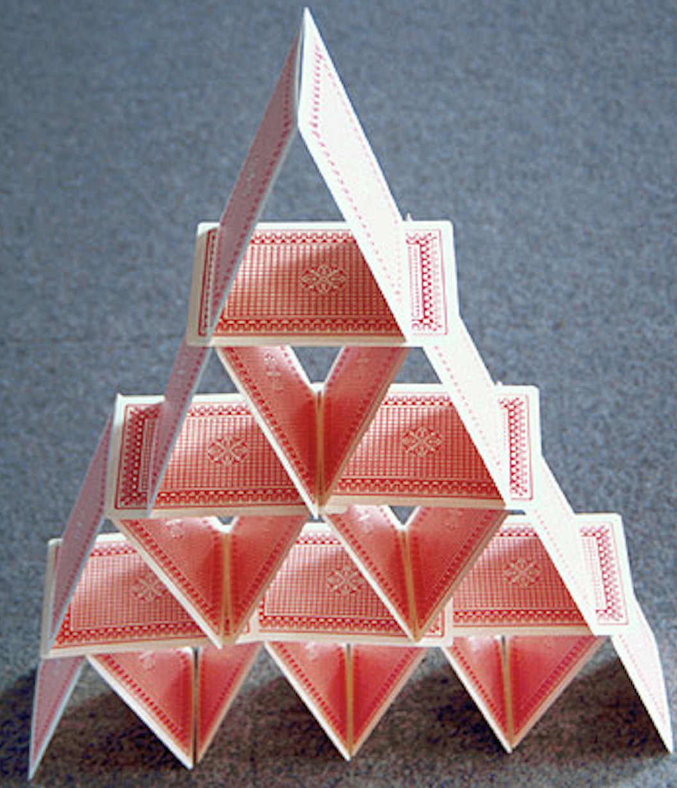
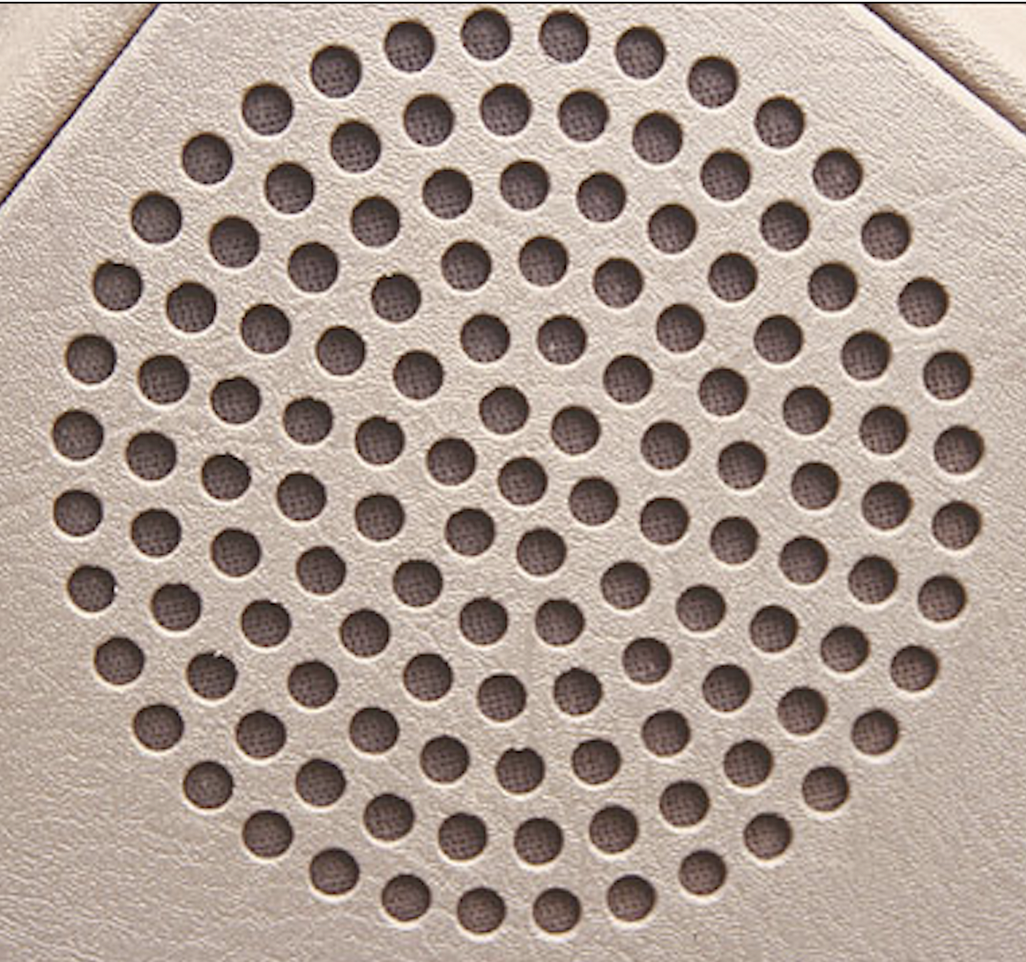
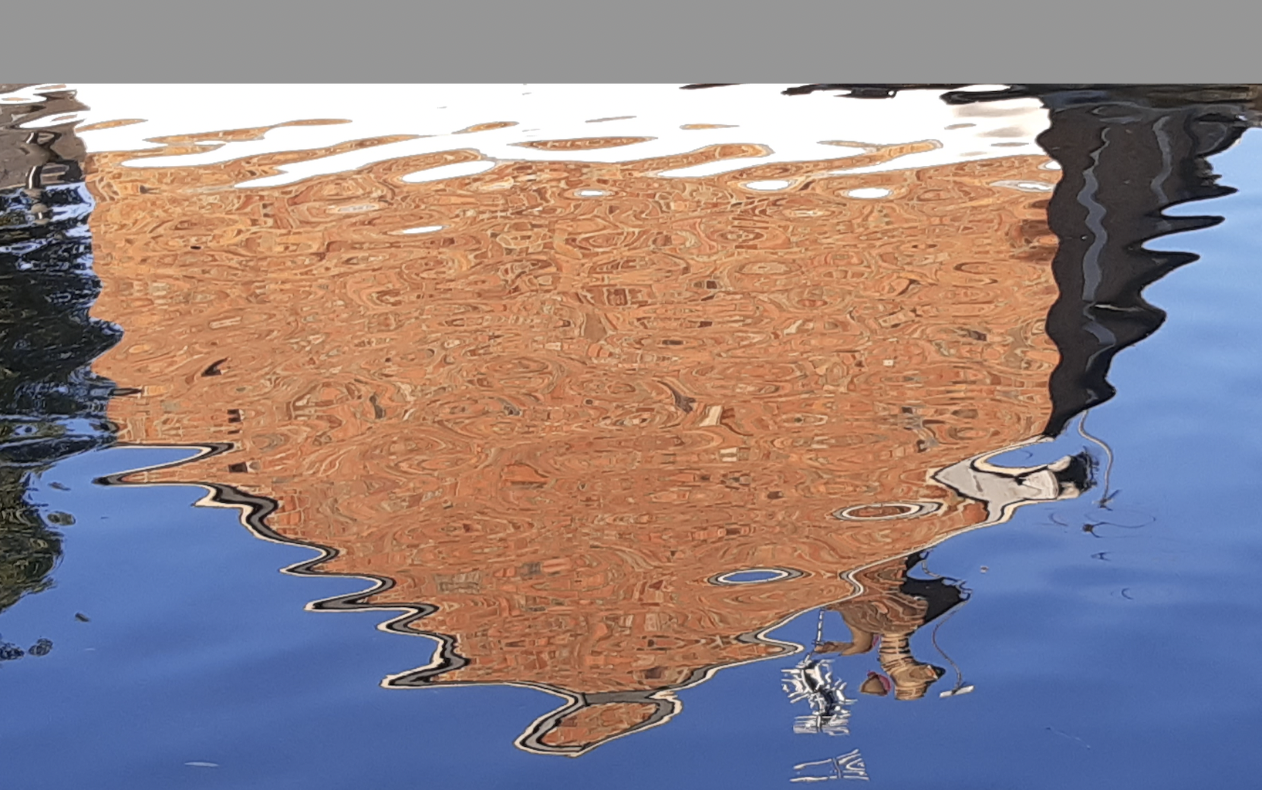
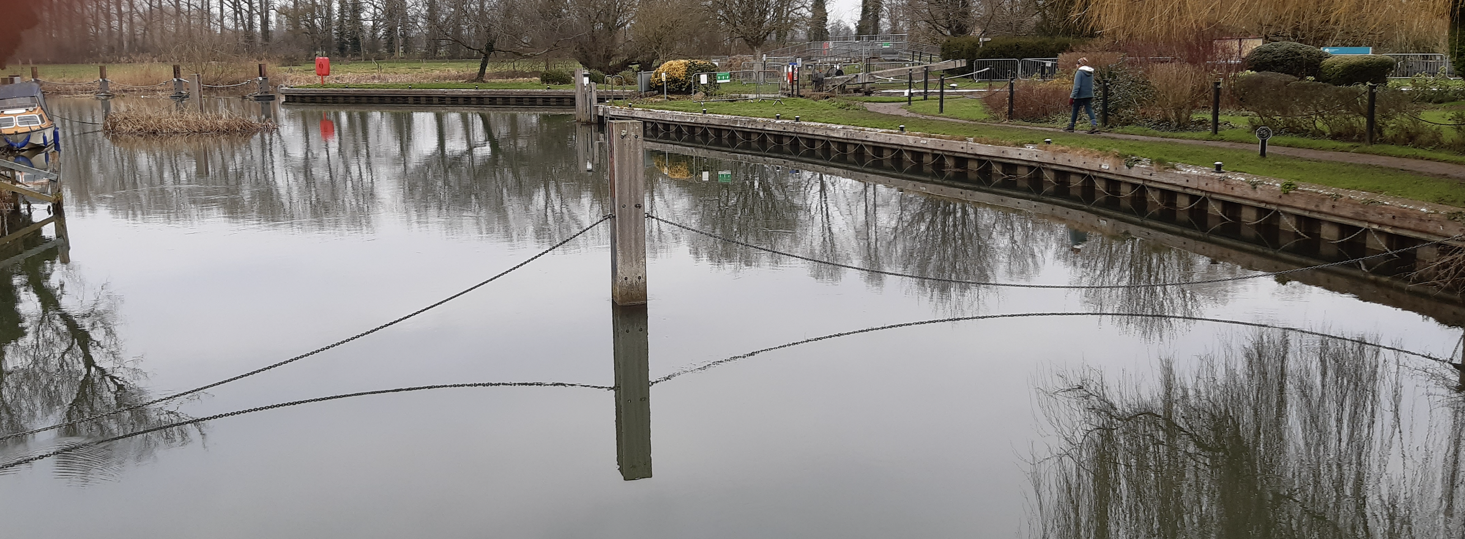

Slide 5
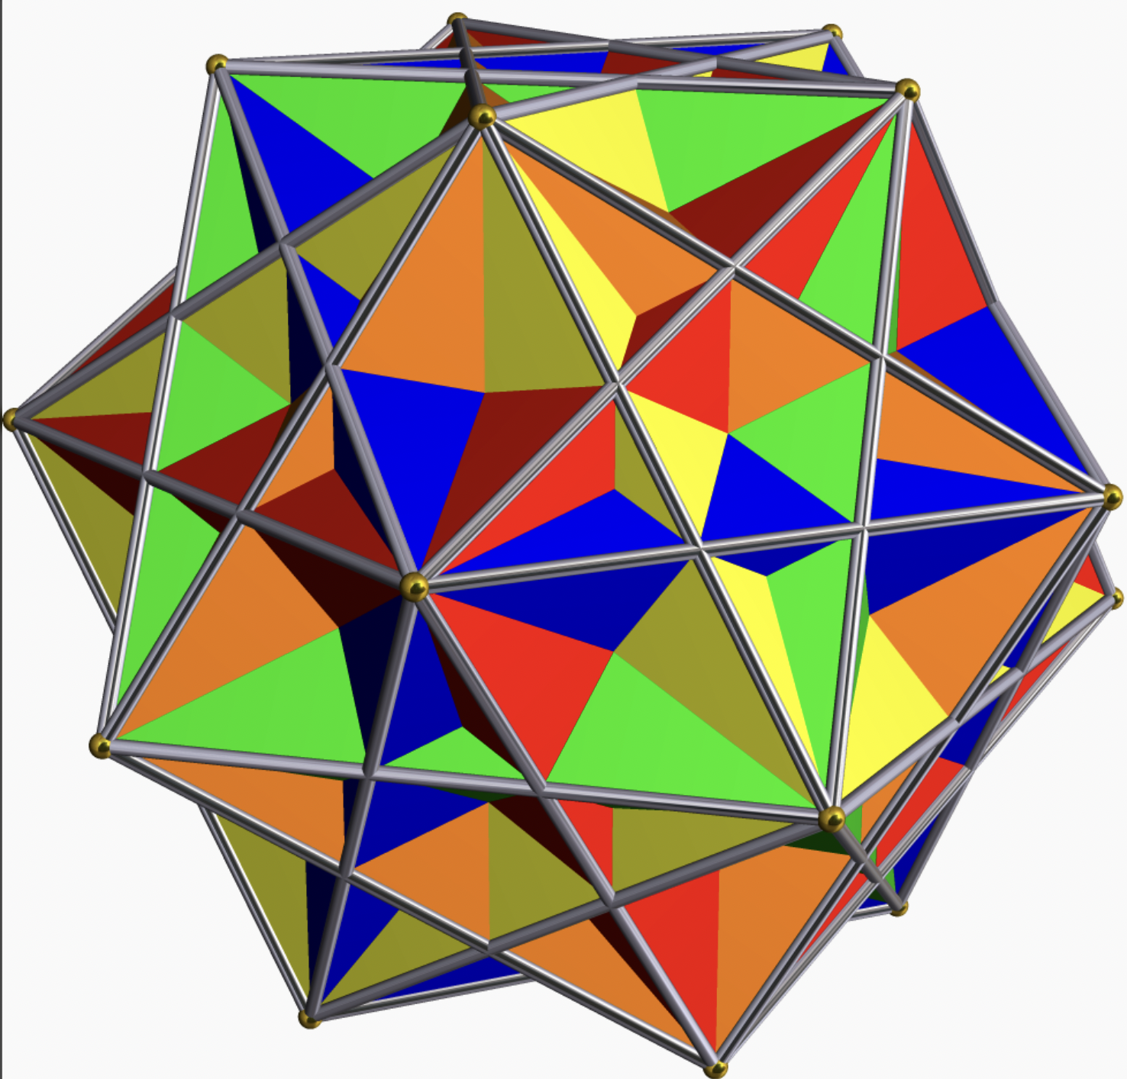

Slide 6
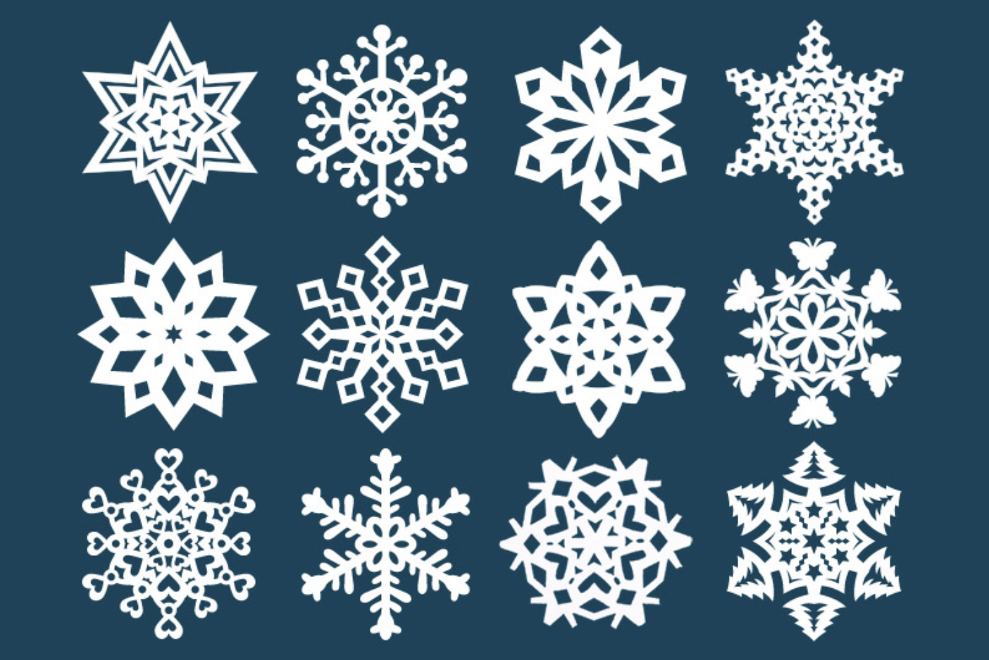

Slide 7
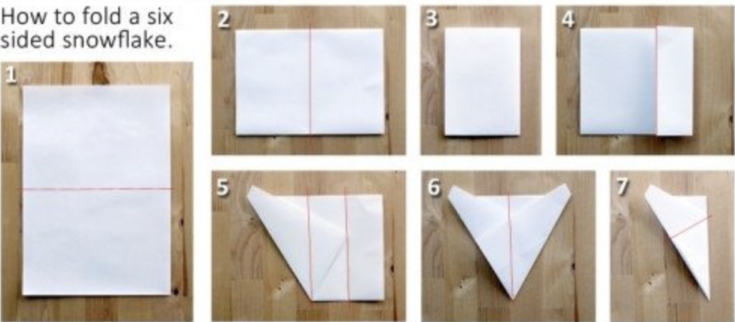
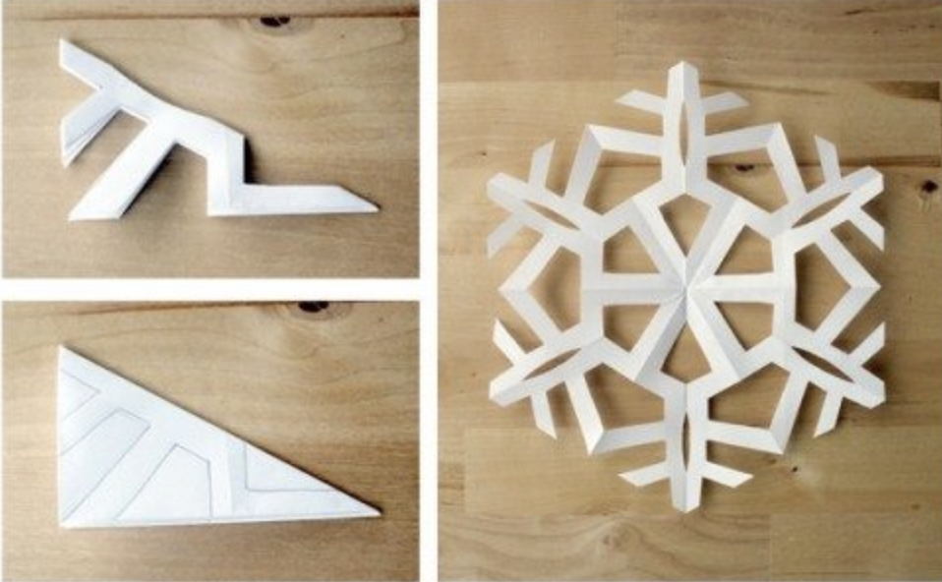
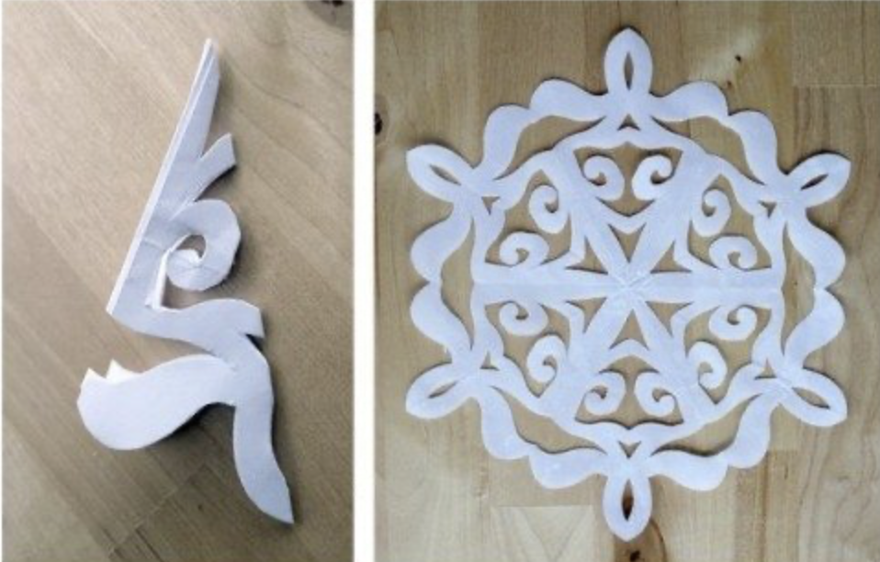

Slide 8
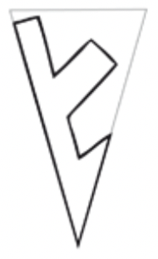
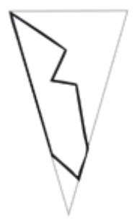
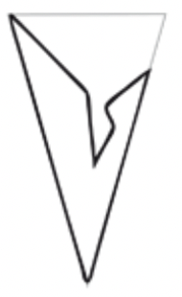
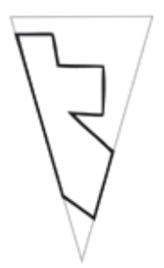
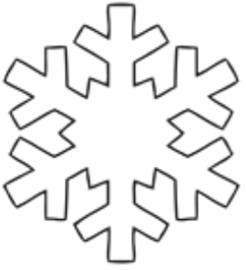
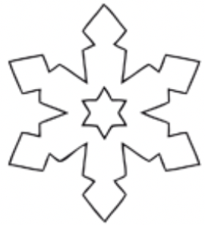

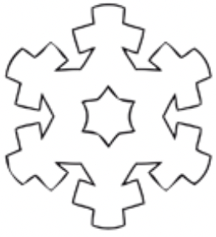
Is it the snowflake which is beautiful?
Or is it the way of making a snowflake?

Slide 9
Productive Relations
Multiply 142857 by 3
Multiply 142857 by 2
Multiply 142857 by 6
Multiply 142857 by 4
Multiply 142857 by 5
Multiply 142857 by 7
428571
It’s not the answers that matter
285714
857142
What matters is their relationships
571428
714285
999999

Slide 10
It’s All in the Notation
1 x 9 + 2 =
12 x 9 + 3 =
123 x 9 + 4 =
1234 x 9 + 5 =
12345 x 9 + 6 =
123456 x 9 + 7 =
1234567 x 9 + 8 =
12345678 x 9 + 9 =
123456789 x 9 + 10 =
11
111
(10+2)x9 + 3 = 10x9 + 2x10 + 3–2 = 10x(1x9+2) + 1
1 111
(120+3)x9 + 4 = 120x9 + 3x10 + 4–3 = 10x(12x9+3)+1
11 111
(1230+4)x9 + 5 = 1230x9 + 4x10 + 5–4 = 10x(123x9+4)+1
111 111
1 111 111
11 111 111
Even more beautiful …
is justifying the conjecture that
‘it always works’
111 111 111
1 111 111 111
123456789(10) x 9 + 11 =
11 111 111 111
???
123456789(10)(11) x 9 + 12 =
111 111 111 111
… ?
1234567890x9
12345678900x9
+10x9+11
+100x9
+11x9+12
1234567900x9+11=11 111 111 111
12345679011x9+12=111 111 111 111

Slide 11
It’s All in the Notation
9 x 9 + 7 = 88
98 x 9 + 6 = 888
987 x 9 + 5 = 8 888
9876 x 9 + 4 = 88 888
98765 x 9 + 3 = 888 888
987654 x 9 + 2 = 8 888 888
9876543 x 9 + 1 = 88 888 888
98765432 x 9 + 0 = 888 888 888
987654321 x 9 + (-1) = 8 888 888 888
9876543210 x 9 + (-2) = 88 888 888 888
9876543210(-1) x 9 + (-3) = 888 888 888 888
…

Slide 12
Arithmetic is …
about Relationships between numbers
NOT about getting answers to calculations
Why are numbers beautiful? It’s like asking why Beethoven’s 9th Symphony is beautiful. If you don’t see why, no-one can tell you. I know numbers are beautiful. If they aren’t, nothing is! [Paul Erdös]

Slide 13
Creativity!
Write down a pair of numbers which sum to 3
  And another pair
  And another pair
Did you catch yourself ‘thinking through’
possibilities?
Write down a positive integer (whole number) which
  No-one else here will write down
  Is the smallest number no-one else here
  will write down
Did you catch yourself ‘thinking through’
small numbers?’
Did you use …
a negative number?
a fraction?
a decimal?
…?
Write down a positive angle which
  No-one else will write down
  No human being has ever previously written down

Slide 14
Pleasure Sources
Use of own powers
  Imagining & Expressing
  Specialising & generalising
  Conjecturing & Convincing
  Making Choices
Making connections
  For oneself!
Surprise

Slide 15
Folding Fractions
Fold the paper in half and make a crease. Unfold
Fold the bottom right corner to make a crease running from the bottom left corner to the top right. Unfold
Fold the bottom left corner to make a crease running from the bottom right corner to the mid-point of the left hand side.
Mark where your last two creases cross and make a horizontal crease through it.
What fraction of the way up the page is the last horizontal crease?
1/3 : without actually doing it,
how could you check this?

Slide 16
Folding FurtherFractions
Fold the bottom up to the middle and make a crease. Unfold
Fold the bottom right corner to make a crease running from the bottom left corner to the right hand one-third mark. Unfold
Fold the bottom left corner to make a crease running from the bottom right corner to the one-quarter-point of the left hand side.
Mark where your last two creases cross and make a horizontal crease through it.
1/3
1/4
What fraction of the way up the page is the last horizontal crease?

Slide 17






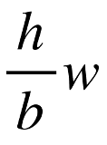
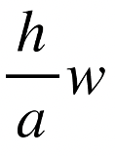

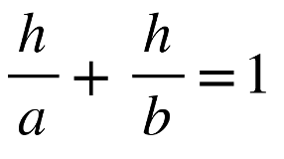


Folding Fractions Resolved
b
a
h
w

Slide 18
Connections
Crossed Ladders
  In an alley-way one ladder with its foot at the base of one wall, reaches 5 metres up the opposite wall, while a second ladder in the opposite direction reaches 6 metres up the opposite wall. How high is the point where the two ladders cross?
V. Arnold
  Some people leave town A headed for town B and at the same time some people leave town B headed for town A. They all meet at noon, eating lunch together for an hour. They continue their journeys. One group reaches their destination at 7:15 pm, while the other group gets to their destination at 5pm. When did they all start? [V. Arnold]
Medieval Couriers
  A feudal lord sends a messenger to another lord some 10 km away, but one hour later he realises the message needs to be altered, so he sends out a second messenger who travels 2 km per hour faster than the first. Will the second messenger stop the first messenger from delivering the message?

Slide 19
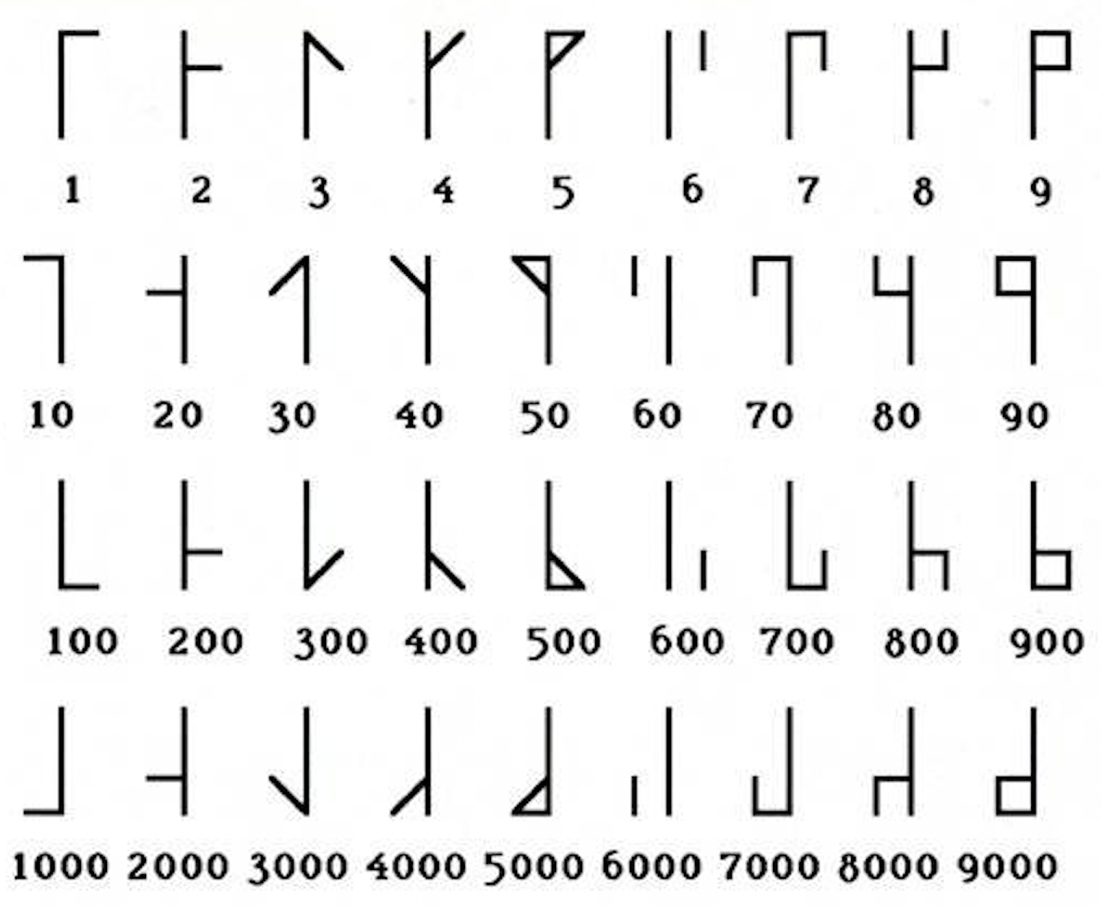
Cistercian Numerals
34
2022
Can you discern a ‘logic’?
What strikes you?
Symmetries?
No need for a 0

Slide 20
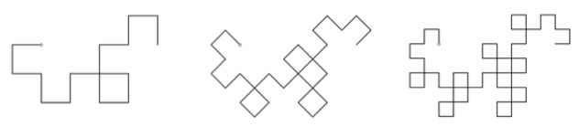
Dragon Curves
In Pairs:
one of you perform the following sequence of actions on one strip
Take a strip of paper
Fold it in half by passing Right-hand end on top of the Left end. Crease it.
Repeat this operation as many times as you can, Right onto Left.
Open the strip up and make each crease a right-angle.
(You may have to re-crease some of the later creases)
Place the strip on a flat surface so you can see the edge.
Smile! You have a (little) Dragon Curve.

Slide 21
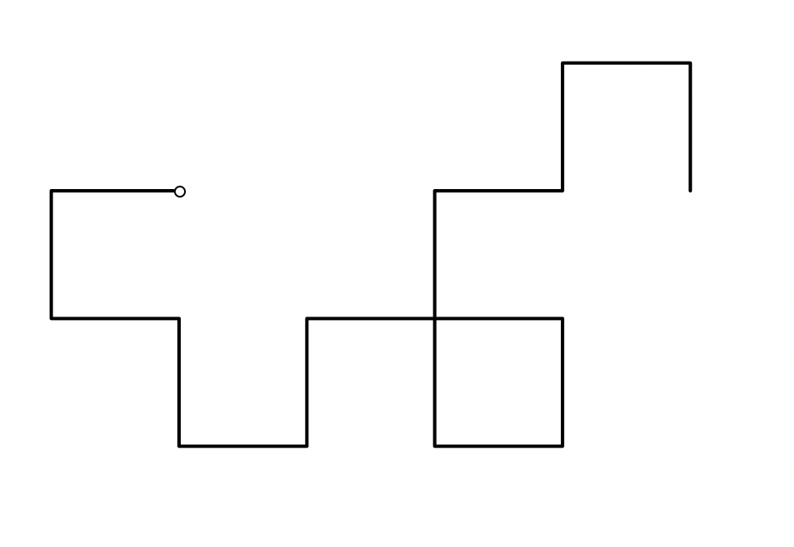
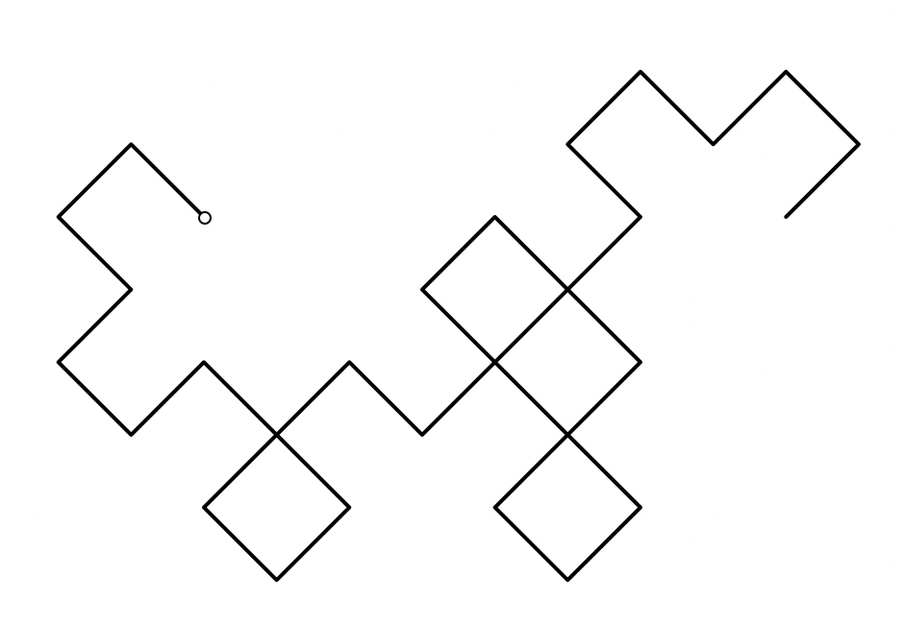
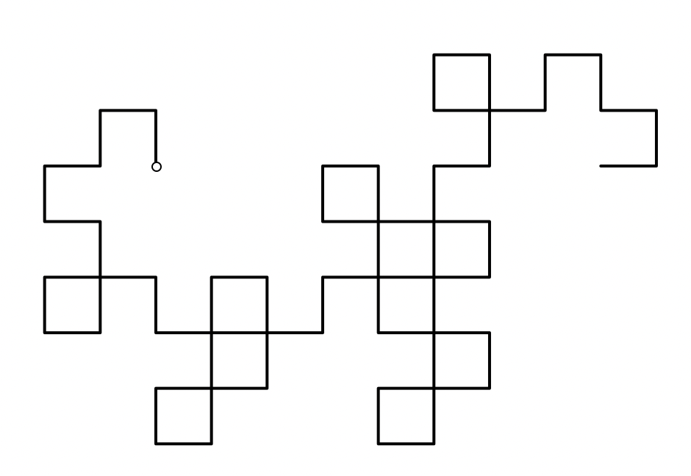
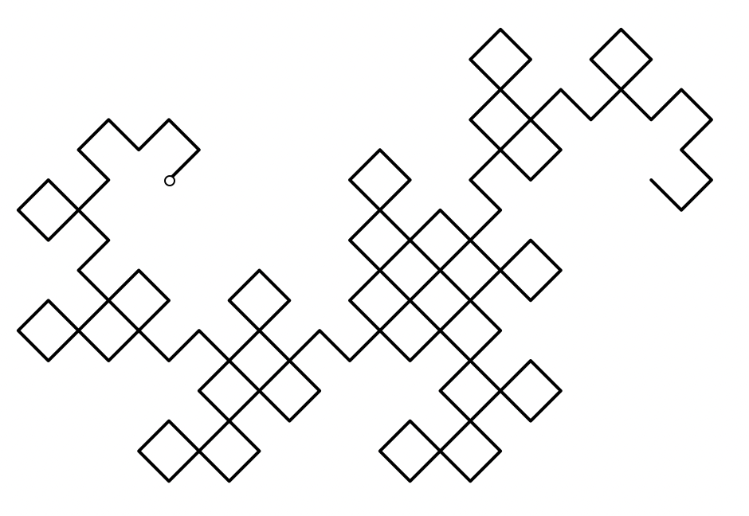
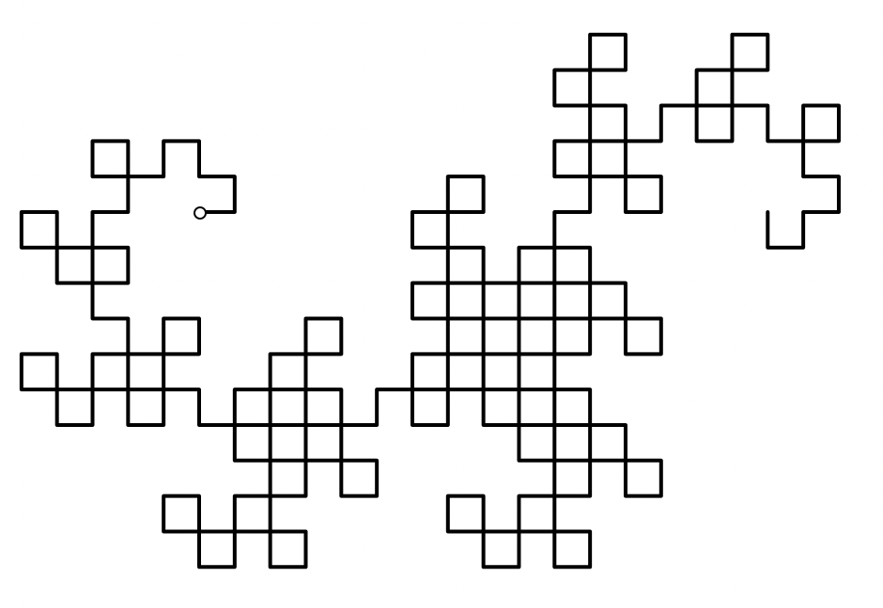



More Dragon Curves

Slide 22
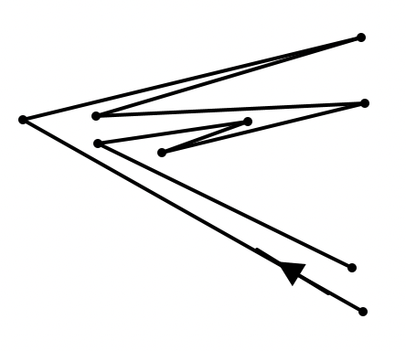
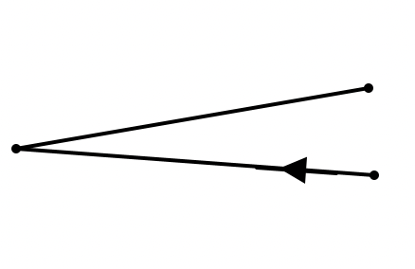
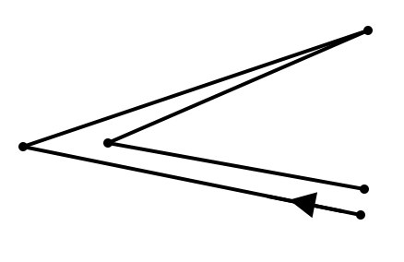
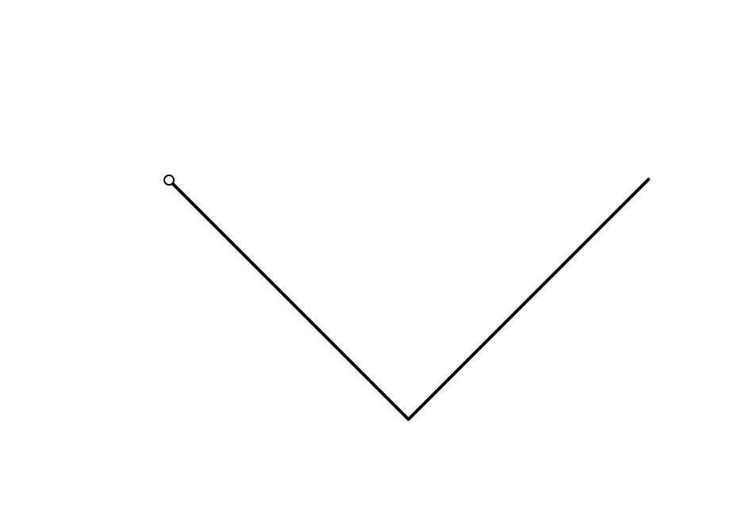
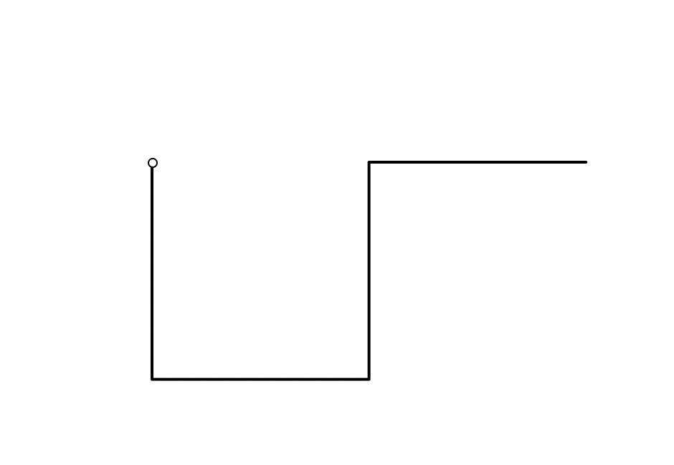
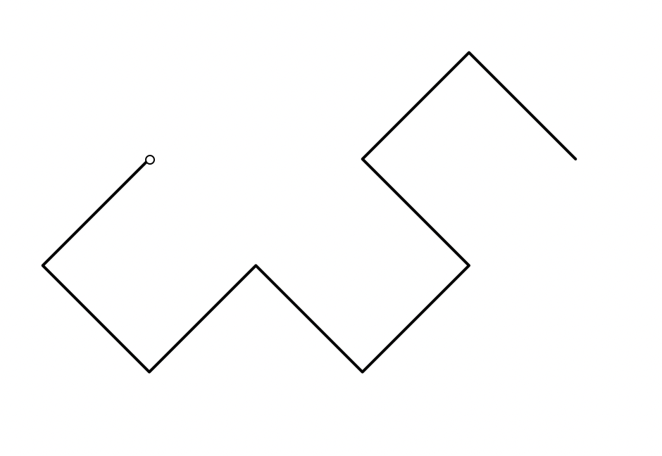
Investigating Dragon Curves
Take it step by step
L
L
L
R
R
L
R
L
L
R
L
L
LLR
LLR L LRR
R
R
R
R
L
L
L
L
L
L
L
What do you need to attend to so that you can ‘see’ the folding process?
Conjecture the next one?
LLR L LRR L LLR R LRR

Slide 23
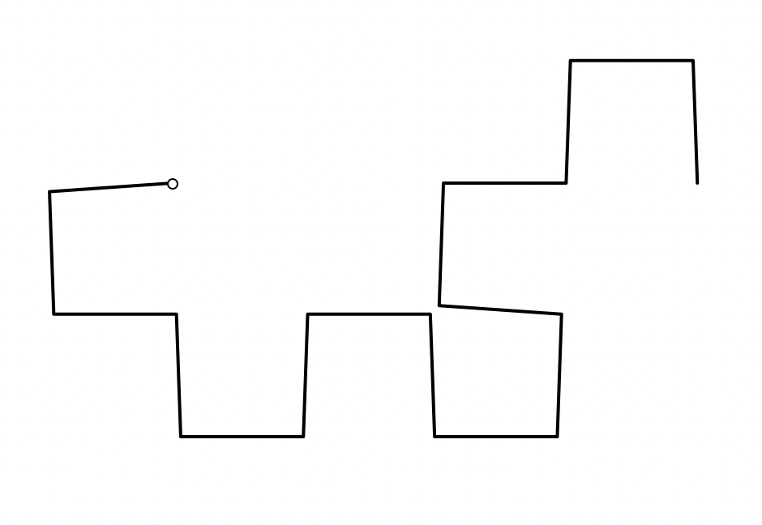
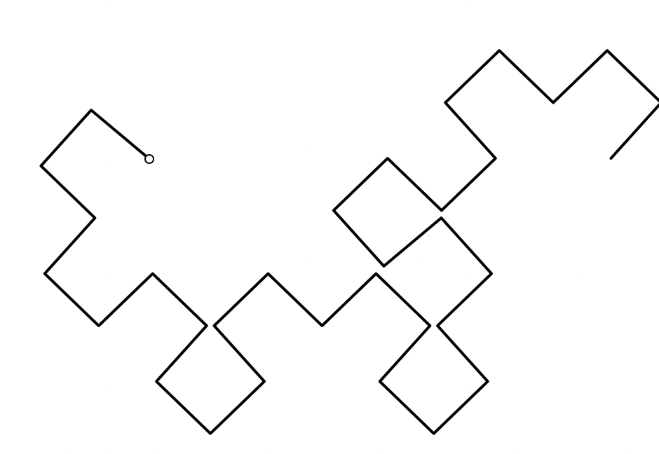
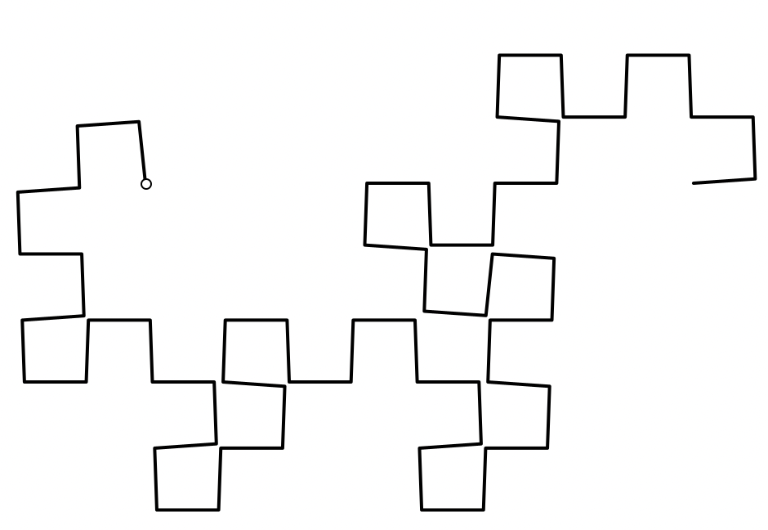
More Dragon Curves
Does the Dragon Curve as specified by L-R sequences
ever cross over itself?
The folding-strip description means it cannot cross itself!

Slide 24
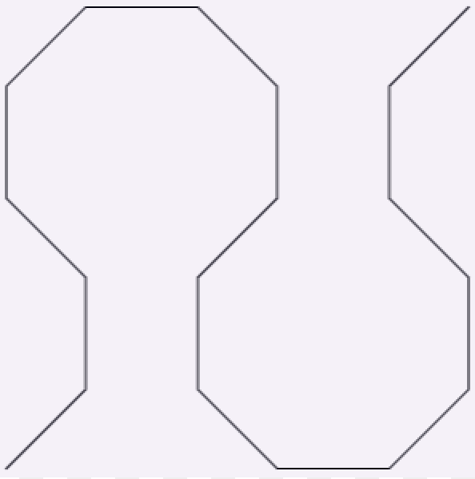
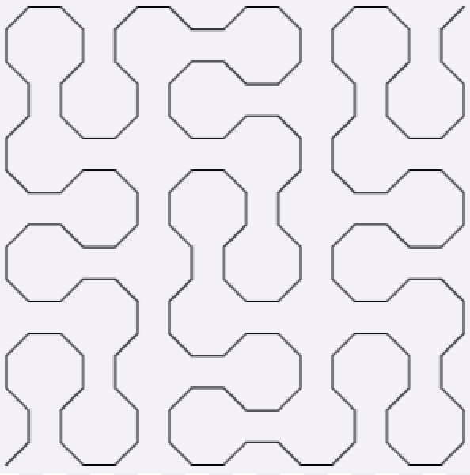
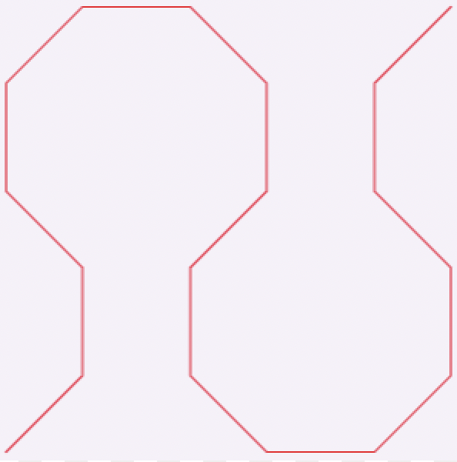
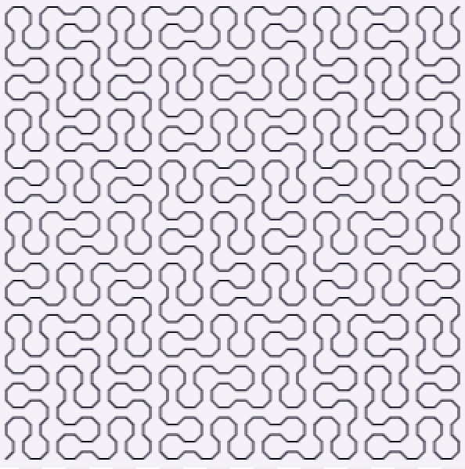
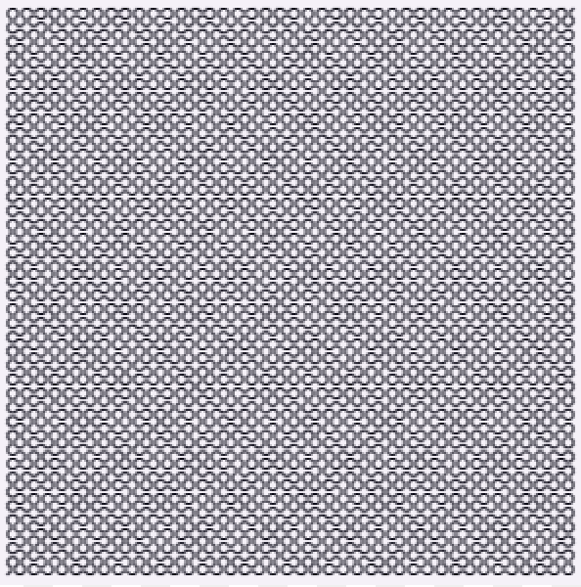
Peano Curves

Slide 25
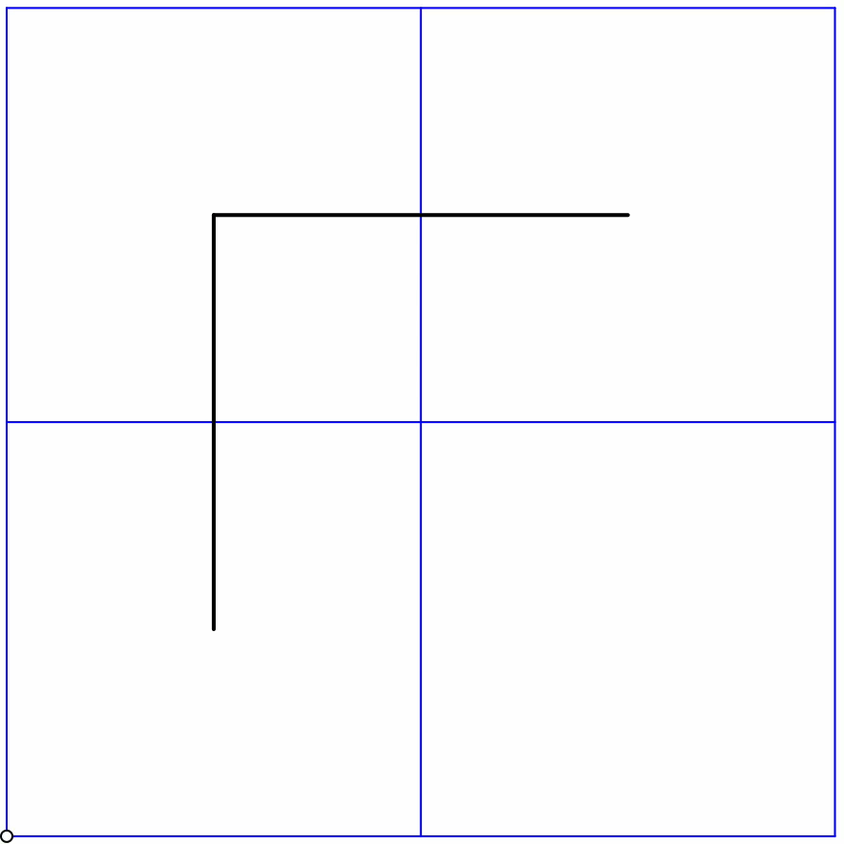
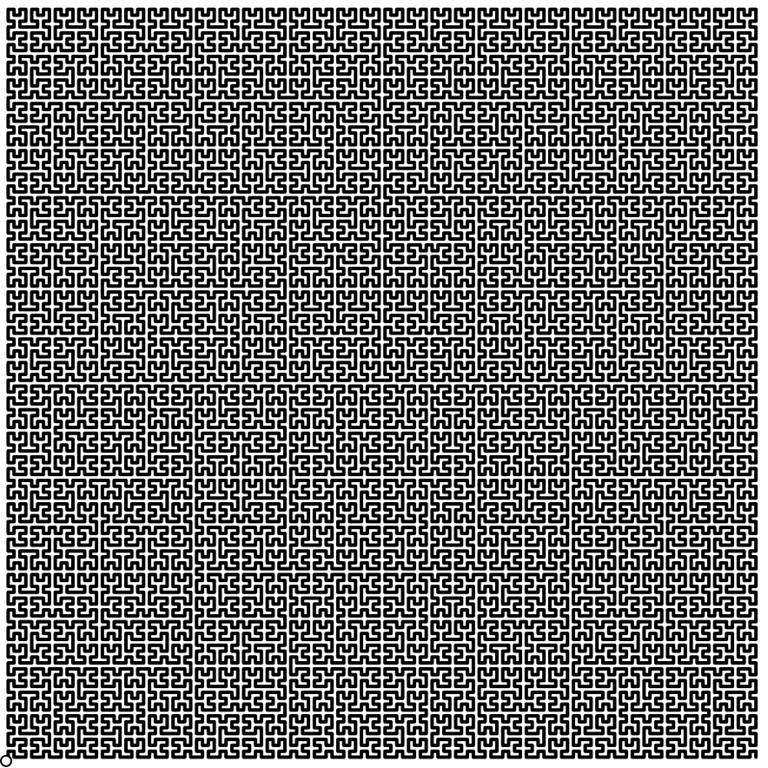
Hilbert Curves

Slide 26
Some Sums
Say What You See
1 + 2 =
3
4 + 5 + 6 =
7 + 8
Watch What You Do
= 13 + 14 + 15
9 + 10 + 11 + 12
16
+
17 + 18 + 19 + 20
= 21 + 22 + 23 + 24
Justify
Generalise
:
²
²
+
²
+ … +
²
+
( +1)
( +2)
( + )
=
²
+
²
+…+
²
( + + 1)
( + + 2)
( + + )

Slide 27
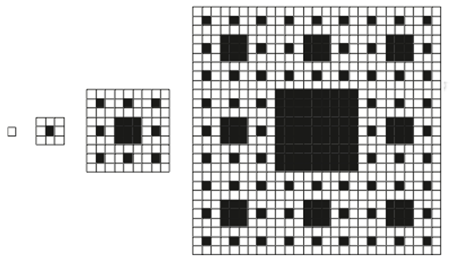
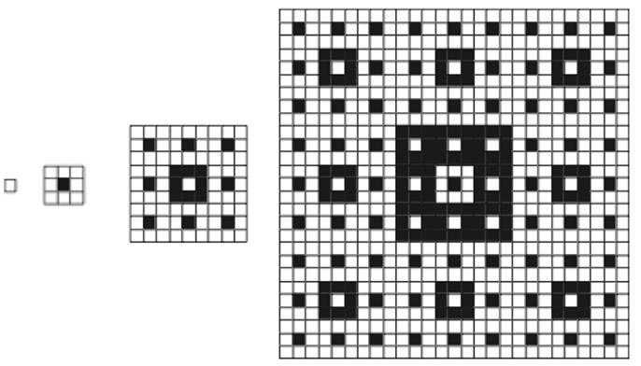
Gasping at Gaskets
Here you see a sequence of ‘gaskets’
Decide on a rule which continue the sequence.
What is the sequence of ratios of black to white cells?
Here is another gasket!

Slide 29
Analytic Frame
Awarenesses
What might be encountered during a task?
  Mathematical concepts; connections; propensity; themes; use of powers
What must be varied so as to enable something to be learned?
  What else could be varied so as to bring something to the surface?
What pedagogical actions might be needed?
What will participants manipulate, get-a-sense-of, and try to articulate? (MGA)
What will participants do, talk-about, and record? (DTR)

Slide 30
the attempt to educate a person by merely focusing on objective content—on inert ideas, scraps of information, bare knowledge—while disregarding the subjective form or emotional pattern of that person’s experience can never be successful. The art of education has to take into account the subjective receptiveness and appreciation of beauty and human greatness, the subjective emotions of interest, joy and adventure, and “the ultimate motive power” (1929a: 62), that is, the sense of importance, values and possibilities (cf.1929a: 45–65). Whitehead 1929
  Whitehead, A. (1911, reprinted 1948). An introduction to Mathematics. Oxford: Oxford University Press.
To tell a child this and to show it the other, is not to teach it how to observe, but to make it the mere recipient of another’s observations: a proceeding which weakens rather than strengthens its powers of self-instruction–which deprives it of the pleasures resulting from successful activity–which presents this all-attractive knowledge under the aspect of formal tuition–and which thus generates that indifference and even disgust not unfrequently felt … . [Spencer 1878 p79]
  Spencer, H. (1878). Education: Intellectual, moral and physical. London: Williams and Norgate.

Slide 31
Beautiful Mathematics involves Relationships
Beauty is in the eye of the beholder
  Indicate to learners what you consider beautiful
  Work on enriching your own sense of the beautiful in mathematics
    By seeking out and articulating instances of mathematical structure (relationships)

Slide 32
Being Mathematical with and in front of your learners
Expressing appreciation
  What ‘Miss’ appreciates
Locating and indicating what is surprising about each concept
  What needs to be attended to, and how?
  Relationships becoming properties
Exploiting every opportunity for learners to make choices
  Another and Another
  Simple–Complicated–Unusual–General
Calling upon learners to use their own powers
  Imagining & Expressing
  Specialising & Generalising
  Conjecturing & Convincing
Attention
  Gazing (Holding Wholes)
  Discerning Details
  Recognising Relationships
  Perceiving Properties (as being instantiated)
  Reasoning on the basis of agreed properties

Slide 33
Follow Up
PMTheta.com
john.mason@open.ac.uk
Questions & prompts for Mathematical Thinking
(Primary & Secondary versions; ATM)
Thinkers (ATM)
Your own encounters with the material world
Your own encounters with the world of mathematical relationships

