Slide 1
making sense of The primary NC
2014
Anne Watson
MaST

Slide 2
Key features
AIMS: fluency, reasoning, problem solving
KS1, lower KS2, upper KS2
Year by year (scheme of work) primary
No levels
PoS list of content – “secondary ready”
Long division; roman numerals; adding fractions; algebra; pie charts!
Guidance (non-statutory; not pedagogy) for primary
Hidden strands

Slide 3
aims
The National Curriculum for mathematics aims to ensure that all pupils:
  become fluent in the fundamentals of mathematics, including through varied and frequent practice with increasingly complex problems over time, so that pupils develop conceptual understanding and are able to recall and apply their knowledge rapidly and accurately to problems

Slide 4
  reason mathematically by following a line of enquiry, conjecturing relationships and generalisations, and developing an argument, justification or proof using mathematical language
  can solve problems by applying their mathematics to a variety of routine and nonroutine problems with increasing sophistication, including breaking down problems into a series of simpler steps and persevering in seeking solutions.

Slide 5
Problem solving – three kinds
Having been subtracting numbers for three lessons, children are then asked: ‘If I have 13 sweets and eat 8 of them, how many do I have left over?’
A question has arisen in a discussion about journeys to and from school: ‘Mel and Molly walk home together but Molly has an extra bit to walk after they get to Mel’s house; it takes Molly 13 minutes to walk home and Mel 8 minutes. For how many minutes is Molly walking on her own?’
If two numbers add to make 13, and one of them is 8, how can we find the other?

Slide 6
Opportunities for Problem-solving hidden in The blurb
... working with numerals, words and the 4 operations, including with practical resources [for example, concrete objects and measuring tools].
... a range of measures to describe and compare different quantities
... solve a range of problems ... make connections between measure and number
... develop the connections ... between multiplication and division with fractions, decimals, percentages and ratio.
... solve a wider range of problems, including increasingly complex properties of numbers and arithmetic, and problems demanding efficient written and mental methods of calculation.

Slide 7
Problem solving explicit in the pos
Many statements saying ‘solve problems’
Year 3: Correspondence problems: “solve problems, including ... correspondence problems in which n objects are connected to m objects”

Slide 8
other news
Same expectations for everyone – better teaching or more teaching
Some arithmetic appears earlier – higher expectations
More emphasis on multiplicative reasoning
All to be ‘secondary ready’ (?)

Slide 9
Sad news
Times tables up to 12 - but in a sensible order
Long division for all in year 6 (testing?)
Addition and subtraction of fractions for all
Roman numerals up to reading dates
‘Knowing and doing’ POS
Aim towards formal column methods
The appendix

Slide 10
better news
Parallel development of number and measure
Procedures & concepts progress together
Mental & written progress together
Less prescription about teaching
Two-year PoS so primary schools can vary order and pace
Room for a ‘thinking’ curriculum
NCETM’s role

Slide 11
A look at arithmetic
  M materials (different images/actions)
  P pupils’ notation (recording)
  S standard notation (symbols; column methods)
  H learning ‘by rote’ (memorised resources)
  C conceptual learning (meaning)
  F fluency (techniques and facts)
  Free to make pedagogic choices about some things, not others (depends on assessment)

Slide 12
Relationships between materials and concepts
What would it mean to add 48 to 27 using: ...

Slide 13
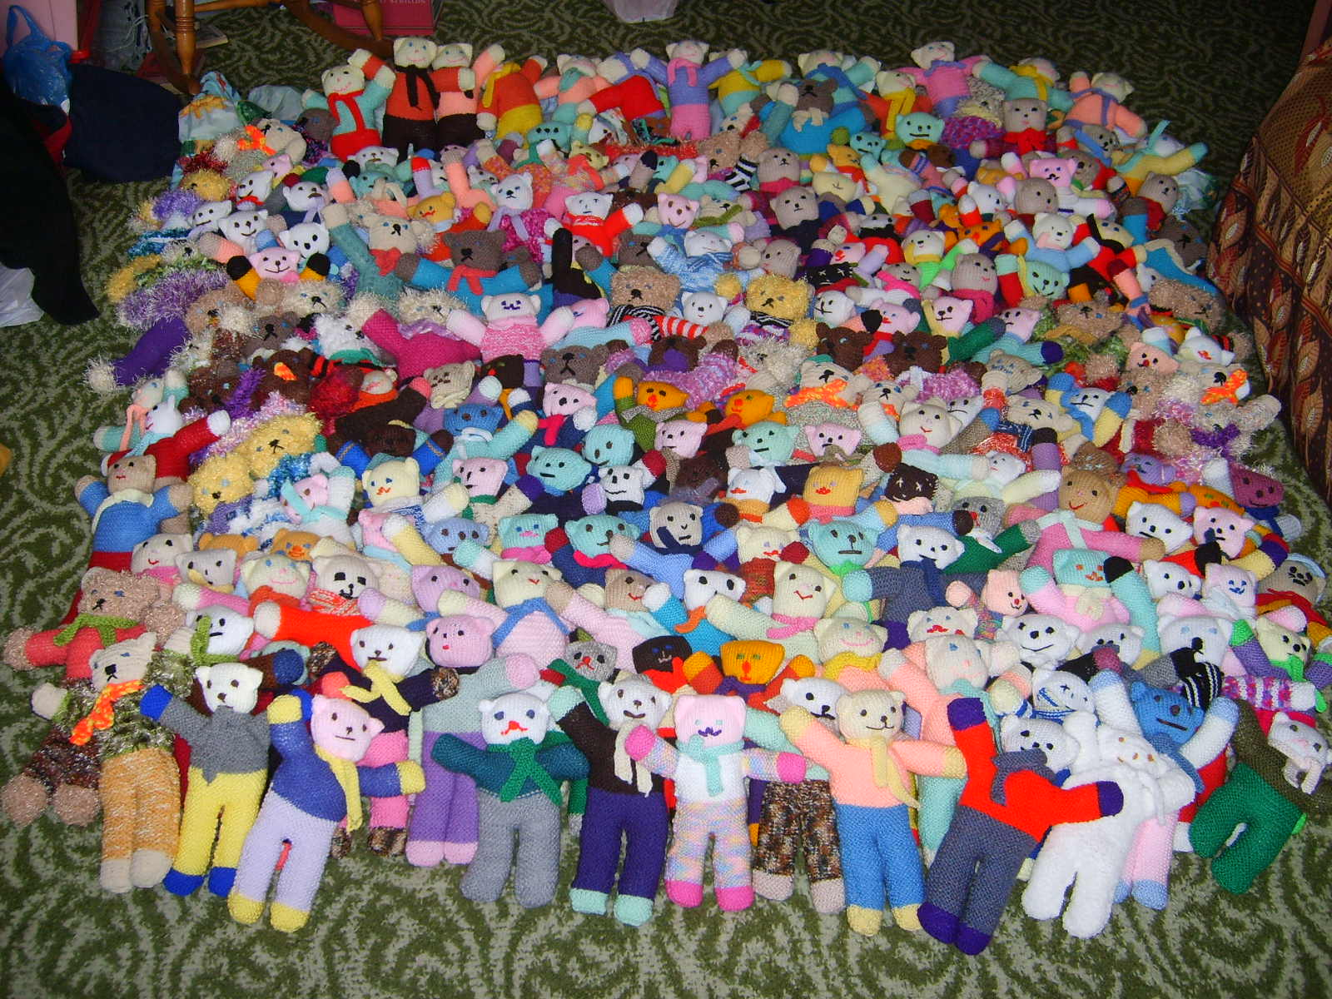

Slide 14



Slide 15
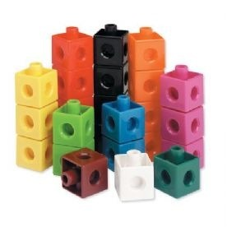
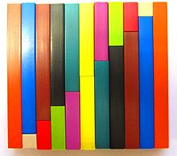

Slide 16
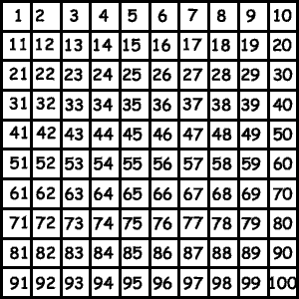

Slide 17


Slide 19


Slide 20


Slide 21
Relationships between materials and concepts: division
  What does ‘divide’ mean?

Slide 22
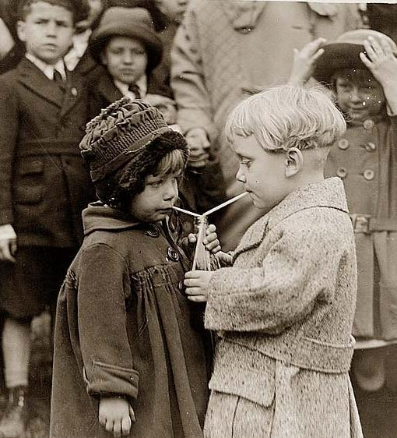

Slide 23


Slide 24
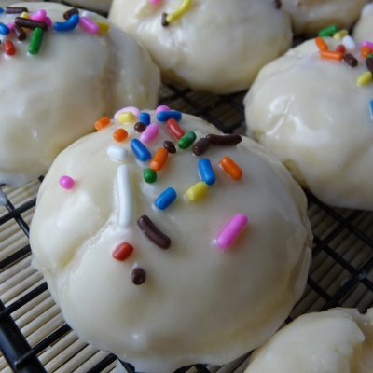

Slide 25


Slide 26
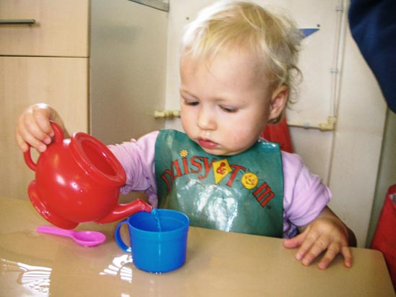

Slide 27



Slide 28
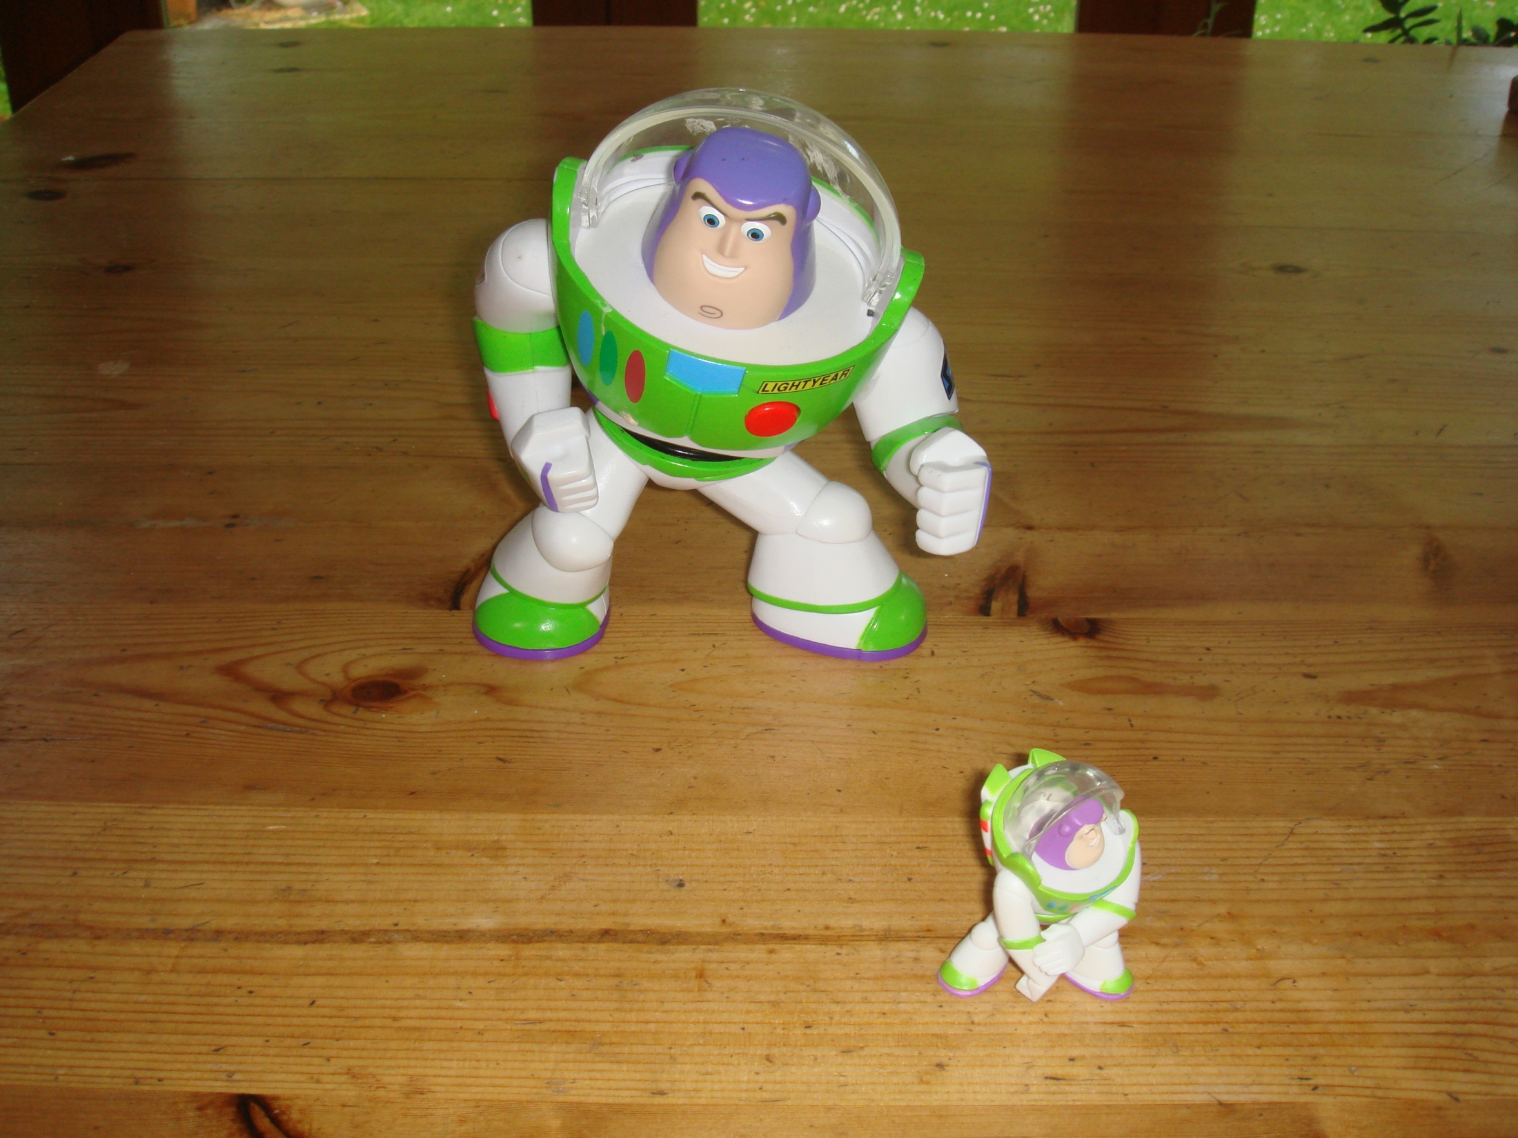

Slide 32
Learning arithmetic
Meaning - quantities, materials, realistic situations (image/action)
Meaning - within mathematics, using the number system (diagram/icon)
Mental methods – number facts, derived facts, memory, image
Notation – symbols, layout
Written method – number facts, layout, shortcuts, inner talk
Do - talk - record
Enactive-iconic-symbolic

Slide 33
Correspondence
What does it mean?
Using intuitive action schema to develop multiple meanings for multiplication and division
Getting away from multiplication seen only, or mainly, as repeated addition and division as only, or mainly, undoing ‘timesing’
Reasoning about the meaning of situations - the relations between quantities
Should run throughout primary maths, including early years

Slide 34


Slide 35
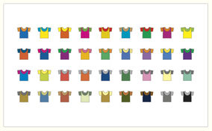

Slide 36
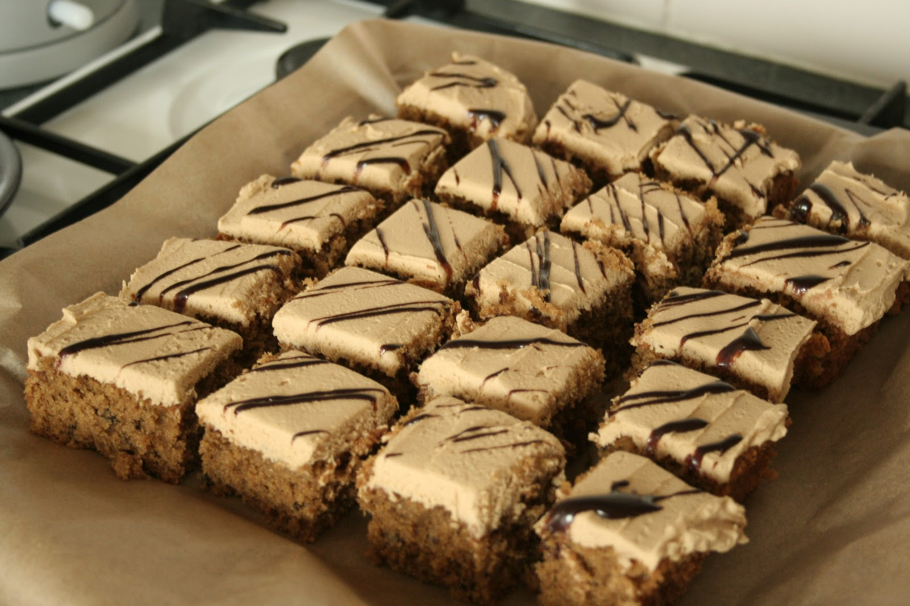
.
Type: | JPG

Slide 37



Slide 38
Fractions: Year 1 pos and ng
... equal parts of an object, shape or quantity
... 1/2 and 1/4 as operators on discrete and continuous quantities by solving problems using shapes, objects and quantities.
... equal sharing and grouping of sets of objects and to parts of an object, shape or quantity. measures,

Slide 39
Year 4 pos & ng
fractions to divide quantities, including non-unit fractions where the answer is a whole number
use of the number line to connect fractions, numbers and measures.
relation between non-unit fractions and multiplication and division of quantities, with particular emphasis on tenths and hundredths.
associate fractions of a length, of a shape and as a representation of one whole or set of quantities.

Slide 40
Year 5 pos & ng
scaling by simple fractions and problems involving simple rates .... supported by materials and diagrams.

Slide 41
Year 3
integer scaling problems
scaled bar charts and pictograms and tables.
measuring and scaling contexts
comparison of measures should also include simple scaling
range of scales in their representations.

Slide 42
Year 5
scaling by simple fractions
scaling by simple fractions, multiplying and dividing by powers of 10 in scale drawings

Slide 43
Creates a need to ...
Work with colleagues to devise a continuous whole-school approach

Slide 44
Algebra: battle of x
Expressing mathematical situations that they already understand

Slide 45
Algebra (year 6) guidance
... symbols and letters to represent variables and unknowns in mathematical situations that they already understand, such as:
  missing numbers, lengths, coordinates and angles
  formulae in mathematics and science
  arithmetical rules (e.g. a+b = b+a)
  generalisations of number patterns
  number puzzles (e.g. what two numbers can add up to).

Slide 46
A quick search for hidden algebra
patterns in the number system; repeating patterns with objects and with shapes..
several forms (e.g. 9 + 7 = 16; 16 – 7 = 9; 7 = 16 - 9)
proper use of equals sign.
addition and subtraction as related operations; the effect of adding or subtracting zero.
commutativity and associativity of addition (e.g. 1+3+5=3+1+5 etc.)
inverse relations (e.g. 4 × 5 = 20 and 20 ÷ 5 = 4).
associative law (2 × 3) × 4 = 2 × (3 × 4)).
distributive law 39 × 7 = 30 × 7 + 9 × 7 can be expressed as a(b + c) = ab + ac
brackets; for example, 2 + 1 x 3 = 5 and (2 + 1) x 3 = 9

Slide 47
Creates a need to ...
Work with colleagues to devise a continuous whole-school approach

Slide 48
planning tasks:
Opportunities for re-professionalisation
Need for working together across years
Development of teacher knowledge:
  multiplicative reasoning throughout primary (including fractions and scaling)
  algebra as expressing relations)
Ensuring the development of problem-solving and reasoning

