Slide 1



What Makes Examples Exemplary for Students of Mathematics?
The Open University
Maths Dept
Promoting Mathematical Thinking
University of Oxford
Dept of Education
John Mason
Jinan Workshop
July 2017

Slide 2
Outline
Familiar Student Behaviour
Mathematical & Pedagogical Theme
  Invariance in the midst of change
Examples, Example Spaces & Variation
Pedagogic Strategies

Slide 3
Conjectures
Everything said here today is to be treated as a conjecture …
... to be tested in your experience
I take a phenomenological stance ...
... I start from and try to connect to, experience

Slide 4
Phenomena
Students often ignore conditions when applying theorems
Students often ask for more examples ...
  But do they know what to do with the examples they have?
  They usually mean ‘worked examples’
Students often have a very limited notion of mathematical concepts ...
  What is it about some examples that makes them useful for students?
  What do students need to do with the examples they are given?

Slide 5
Own Experience
What did you do with examples when studying?
What do you do with examples when reading a paper?
What would you like students to do with examples that you give them or that they find in texts?

Slide 6
What do students say?
“I seek out worked examples and model answers”
“I practice and copy in order to memorise”
“I skip examples when short of time”
“I compare my own attempts with model answers”
NO mention of mathematical objects other than worked examples!
Notes:
These are Oxford ugs starting their 2nd year in mathematics

Slide 7
On Worked Examples or Case Studies
Did you ever use worked examples or case studies?
  How?
Templating: changing numbers to match
What is important about worked examples?
  knowing the criteria by which each step is chosen
  knowing things that can go wrong, conditions that need to be checked
  having an overall sense of direction
  having recourse to conceptual underpinning if something goes wrong
  Being able to re-construct when necessary
Notes:
Extensive research by Renkl et al shows that what matters is not only what to do next, but how you know to do that

Slide 8
Capital Investment & Labour
A Cobb-Douglas function is defined for x and y > 0 by the formula P(x, y) = Ax^{s}y^{t} (s, t > 0).
…
In a particular case A = 100; s = 1/2; t = 1/5 where x is the capital investment and y the total labour time.
If currently, capital investment is 30 and labour time is 24, in what ratio should capital and labour be increased to maximise output?
Notes:
Binmore & Davies Calculus p106

Slide 9
Re-Stocking
At regular intervals a firm orders a quantity x of raw materials which is placed in stock. This is depleted at constant rate until none remains, at which point it is immediately re-stocked. With quantity x.
The firm requires X units of each year and on average the firm re-stocks y times a year. Thus xy = X.
The cost of holding one unit for a year is d. Since the average time an item is in stock is x/2, it costs xd/2.
The cost of reordering is e. The yearly reordering cost is ey.
The firm wants to minimise xd/2 + ey.
…
Notes:
Binmore & Davies Calculus p 224-226.

Slide 10
Designing a Worked Example or Case Study
Careful choice of parameters to avoid confusion
Care not to imply misleading relationships
What will you encourage students to do WITH the example?
What key ideas are being used or illustrated?
What could go wrong for students trying to use it as a template?

Slide 11
Examples of Mathematical Objects
Unfortunately, students sometimes over-generalise, mis-generalise or fail to appreciate what is being exemplified
What is involved in experiencing some thing as an example of something?
Notes:
Fischbein: Figural Concpets

Slide 12
Misled by an Examples
To find 10% you divide by 10
so, to find 20% you divide by …
To differentiate x^{n} you write nx^{n-1}
so, to differentiate x^{x} you write ...
(x-1)² + (y+1)² = 2² is a circle which
has centre at (1, -1) and radius 2
if f(3) = 5 then f(6) = 10
  Specific appearances:
  sin(2x) = 2sin(x);
  ln(3x) = 3ln(x)
  sin(A + B) = sin(A) + sin(B)
  (a + b)² = a² + b² etc.
Notes:
In each case, students have used an example as the basis for generalisation!
Sometimes linearity is only used when the ‘scale factor’ is large
(accounting for: minimise effort; find something to do; carry out first action that becomes available)
Fischbein “figural Concepts”

Slide 13
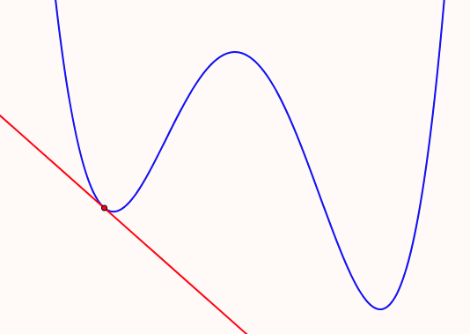
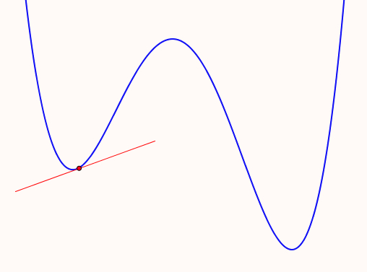
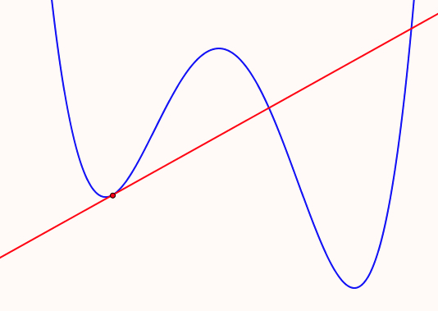
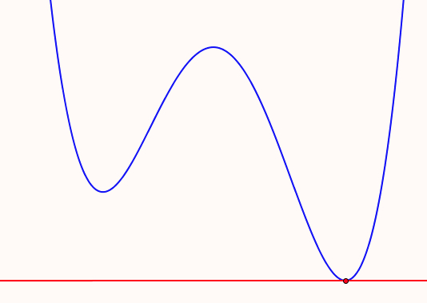
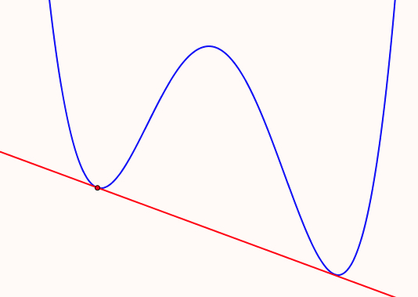
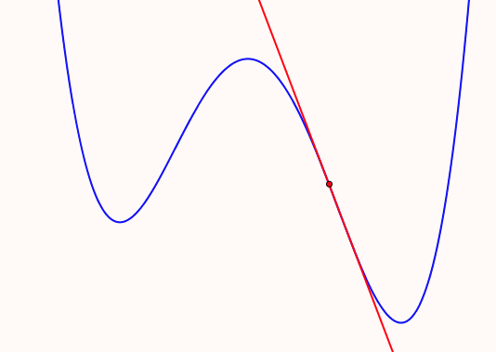
Tangents
Sketch some examples of tangents to a quartic for students learning about tangents
What misapprehensions might be induced?
(figural concepts)
Notes:
Based on knowing that students mis-interpret the definition of tangency;
And some textbooks even use a misleading definition!

Slide 14
Example Construction
What features need to be salient?
  contrasting several examples
  What can be changed
  (dimensions of possible variation)
  and over what range
  (range of permissible change)
  What unintended assumptions might learners make?
Stressing what aspects can be changed
and what relationships remain invariant
  dimensions of possible variation
  range of permissible change
What pedagogical strategies might be used to make these features salient?
Notes:
Essence of the concept

Slide 15
Distributions & Demand-Supply Curves
What would be useful examples of
  probability distributions?
  demand and supply curves?
What specifics do you want to draw attention to?

Slide 16
Course Concepts and Objects
Who produces examples?
  Lecturer?
  Students?
What do they do with them?

Slide 17
Domain & Image
Construct continuous functions
for which the (maximal) domain and range are:
Image
y in R
y in R
y ≥ 0
y in R
y > 0
y in R
y > 1
y in R
|y| ≤ 1
Domain
x in R
x in R & x ≥0
Choose a class of objects your students need to be familiar with, and build a similar chart
x in R & x > 0
x in R & |x| ≤ 1
x in R & |x| < 1

Slide 18
Domain & Image
Construct continuous functions
for which the (maximal) domain and range are:
Image
y in R
y in R
y ≥ 0
y in R
y > 0
y in R
y > 1
y in R
|y| ≤ 1
Domain
x in R
x in R & x ≥0
√xsin(x)
?
x in R & x > 0
x in R & |x| ≤ 1
?
?
x in R & |x| < 1
Choose a class of objects your students need to be familiar with, and build a similar chart
Notes:
Based on knowing that students struggle with tangency when the curves ‘cross’ or meet the curve elsewhere

Slide 19
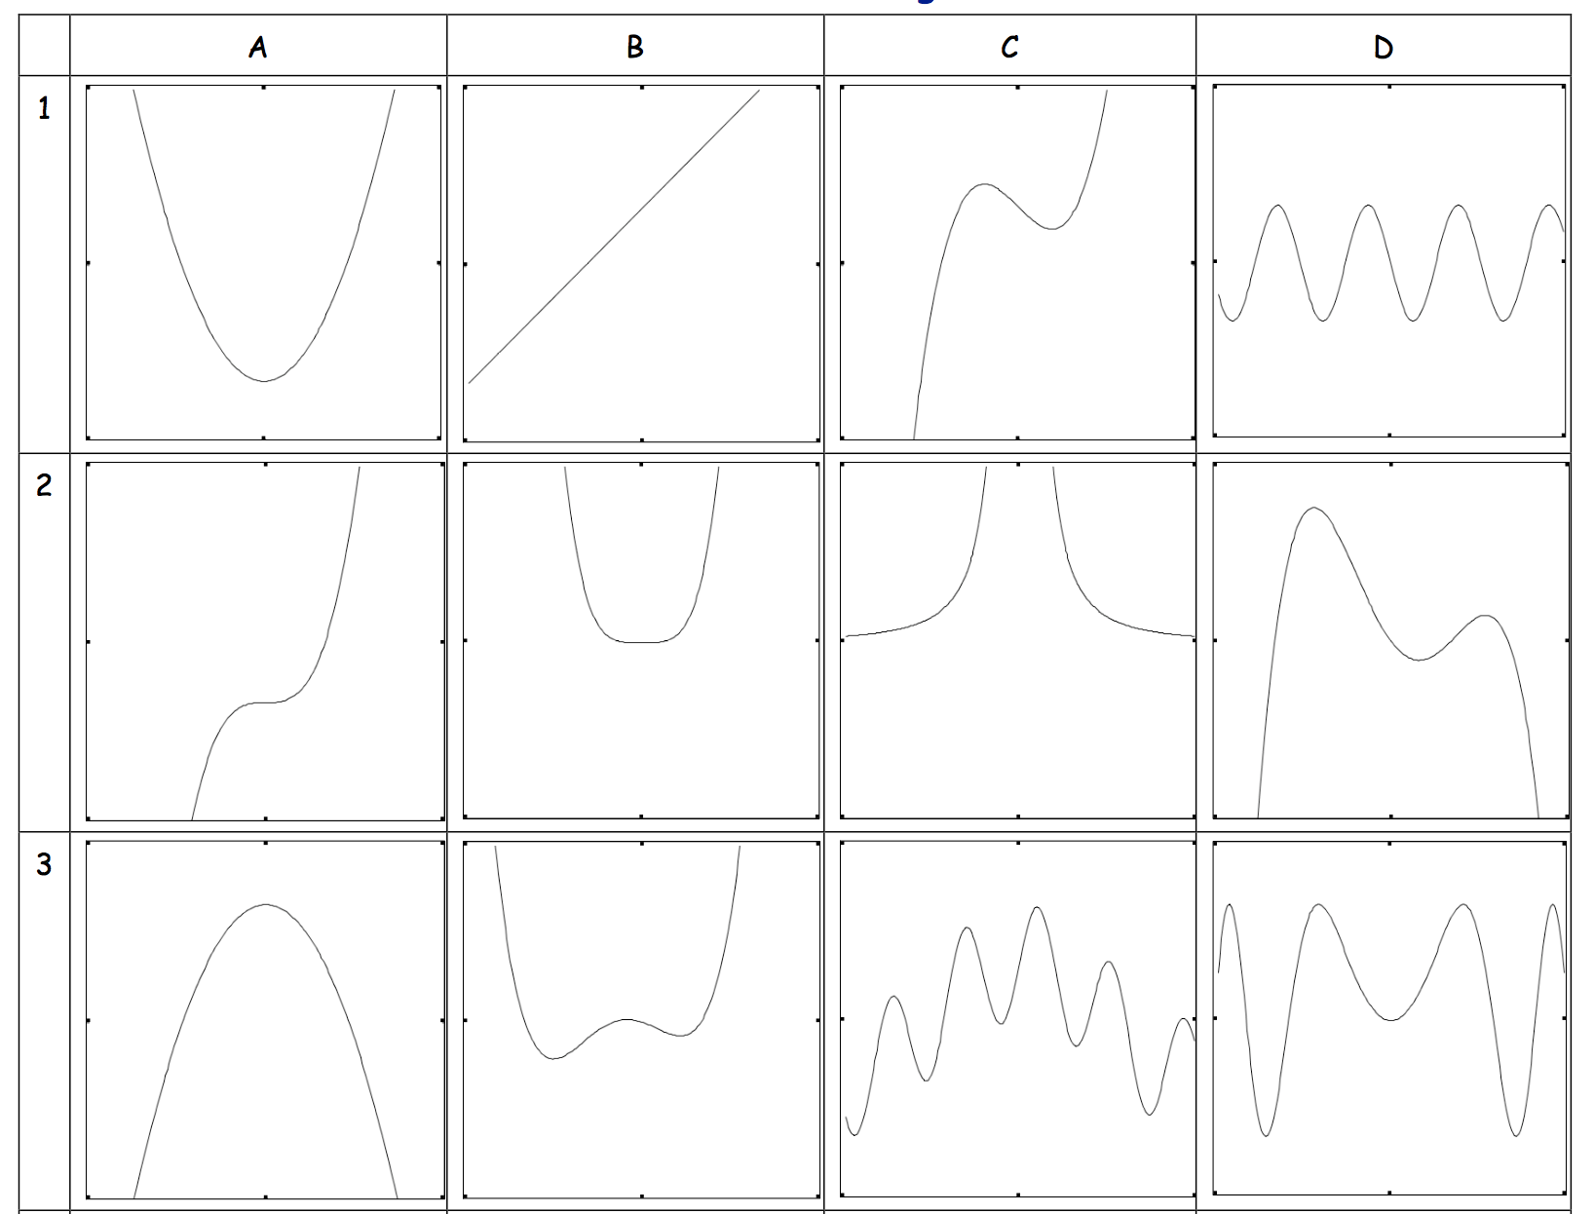
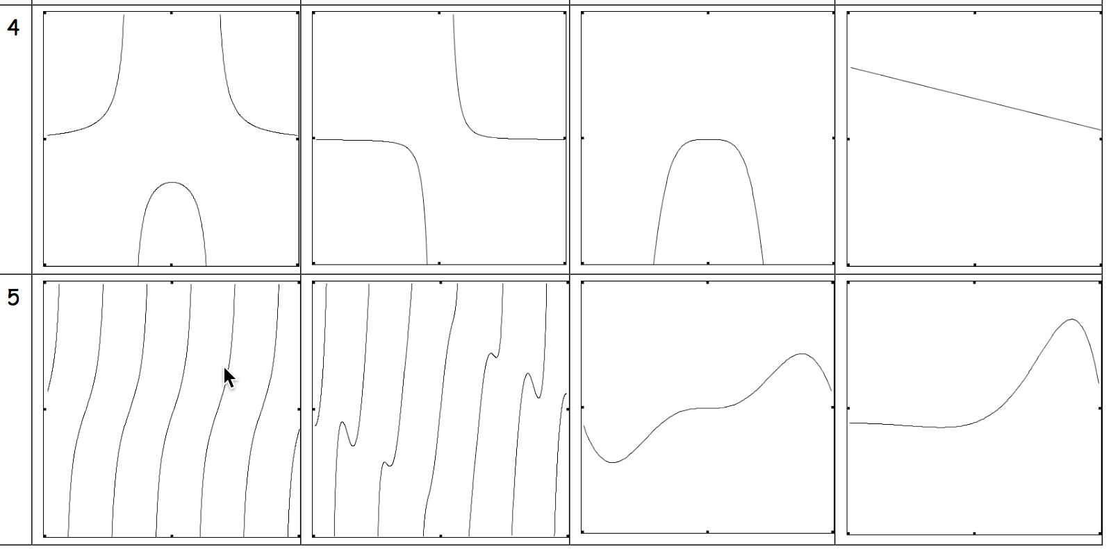
Same & Different

Slide 20
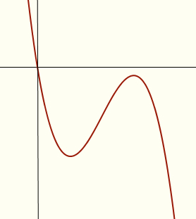
Constrained Construction
Sketch the graph of a cubic polynomial which goes through the origin
and which also has a local maximum
and which has only one real root
and which also has a positive inflection slope
Note the task structure:
use of constraints to challenge
usual/familiar examples
What combinations of
Local maximum or not;
Numbers of real roots;
Sign of inflection slope;
are possible?
Notes:
Extending and enriching accessible example spaces

Slide 21
Construction Tasks
Write down a quadratic function whose root slopes are perpendicular
Write down a cubic function whose root slopes are alternately perpendicular
iff
The sum of the reciprocals of the non-zero root slopes must be 0!
What about a quartic?

Slide 22
s1 s2 = -1
s2 s3= -1
s3 s4 = -1
s1 = s3 and s2 = s4
forces

Slide 23
Groups with Non-Obvious Identities
The set {2, 4, 6, 8} under multiplication modulo 10 forms a group.
What is the identity element?
Construct another example.

Slide 24
Power Groups
Consider the Dihedral group D₆ presented as the elements G = {e, a, a², b, ab, a²b}
where a³ = e, b² = e and ba = a²b.
Let P(G) be the set of non-empty subsets of G considered as a group under the operation
ST = {st: s in S and t in T}.
Show that {{e}, {a}, {a²}, {e, a}, {e, a²}, {a, a²}, {e, a a²}} is a subgroup of P(G).
For a general group G which subsets of P(G) themselves for a subgroup?

Slide 25
Write down another integral like this one which is also zero
  and another
  and another
  and another which is different in some way
What is the same and what is different about your examples and the original?
What features can you change and still it has integral zero?
Write down the most general integral you can, like this, which has answer zero.
Notes:
Perhaps require stick to polynomials, with degree as small as possible
Example of reversing or undoing something which is familiar as a doing
Some learners tried preserving the difference between the limits(!) despite associating integral with area
Some immediately multiplied by a constant, but others did not
Some altered the linear function; some went to sin(x)
some revealed uncertainty between integral and area and negative area.
Have you ever found that students don’t recognise when a theorem can be applied (or else apply it when it is not applicable)?

Slide 26
Variation
What can be changed and still it is an example?

Slide 27
Construction Task
Write down a pair of distinct functions for which the integral of the difference over a specified interval is zero.
  and another
  and another
How did your attention shift so that you could come up with those examples?
Construct an example of a pair of distinct functions for which the integral of the difference is 0 over finitely many finite intervals; over infinitely many.
Notes:
When technical terms are used, we are triggered into accessing a space of examples. We want students to have as rich an accessible example space as possible. This means providing them with construction techniques.

Slide 28
|x|
Of what is |x| an example?
What is the same and what different about
graphs of functions of the form
or
Characterise these graphs in some way

Slide 29
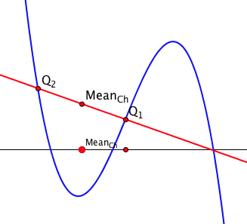
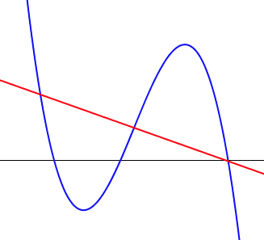
Cubic Phenomenon
Imagine the graph of a cubic polynomial with 3 real roots
Imagine a straight line through one of the roots
Imagine the mid-point of the other two points of intersection with the cubic
What is the locus of these mid-points as your line rotates about the root?
What has ‘being a root’ have to do with the phenomenon?

Slide 30
Cubic Phenomenon
Imagine the graph of a cubic polynomial with 3 real roots
Imagine a straight line through one of the roots
Imagine the mid-point M of the other two points of intersection with the cubic
Imagine a chord of the cubic whose mid-point is vertically aligned with M.
When extended, where will it meet the cubic again?

Slide 31
Applying a Theorem as a Technique
To show that the function has a maximal value.
Note that f(x) ≥ 0, and that as x –> ±∞, f(x) –> 0
Since f is continuous on [-N, N] it attains its extrema
Since f(0) = 1, choosing forces f to achieve a maximum value by the theorem that a continuous function on a bounded interval attains its extremal values
Now show that the polynomial
has a maximal value
p(x) = -x¹⁰² + ax¹⁰¹ + bx⁹⁹ + cx + d

Slide 32
Preparing to Apply a Theorem as a Technique
Sketch a continuous function on the open interval (-1, 1) which is unbounded below as x approaches ±1 and which takes the value 0 at x = 0.
Sketch another one that is different in some way.
and another; and another
What is common to all of them?
Can you sketch one which does not have an upper bound on the interval?
Notes:
Students had failed to use the theorem about achieving extrema on a closed interval, to apply to this case of an open interval. So tutor asked them to construct examples.

Slide 33
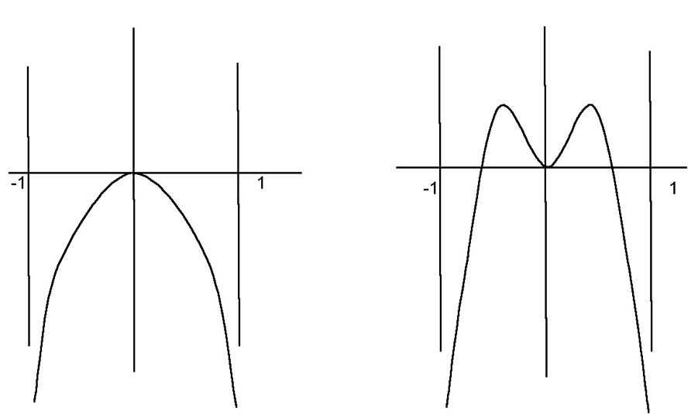
Student Constructions
Notes:
Because it is continuous was all that students offered.
Only when the tutor mentioned that because the function goes to negative infinity at both ends, there cannot be a maximum ‘close’ to an end, so you can locate a subinterval which is closed, did ‘closed & bounded’ cue appropriate steps.

Slide 34
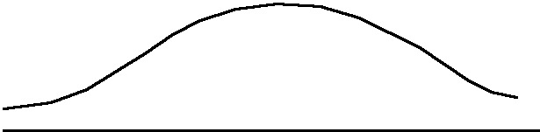
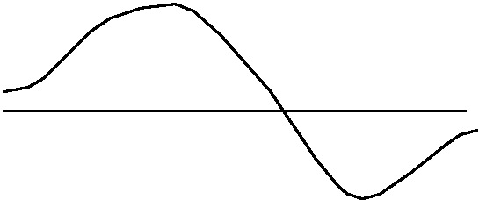
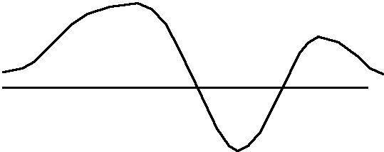
More Student Constructions
What can we change in the conditions of the task and still have the same (or similar) phenomenon,
i.e. make use of the same reasoning?
Notes:
Here we want to force the function to have a relative maximum, or a relative extremum.
The tutor then asked what other conditions, for functions defined on other types of domain, would similarly guarantee a maximum, or a minimum.

Slide 35
Preparing the Ground
Construct a function F : [a, b] --> R
  which is continuous and differentiable on (a, b)
  for which f(a) = f(b)
  but nowhere on (a, b) is f’(x) = 0
Having attempted this, students are likely to appreciate the proof that it is impossible
Notes:
Setting an impossible task in order to prompt possibility and significance of a theorem

Slide 36
Choosing Examples to Exemplify
Suppose you were about to introduce the notion of relative extrema for functions from R to R.
  what examples might you choose, and why?
  would you use non-examples? why or why not?
How might you present them?

Slide 37
Undoing a Familiar Doing
familiar doing:
Given f(x), find
unfamiliar undoing:
What can you say about f if
What if f is known to be continuous?
Notes:
Limit f(x) as x-3 is 5;
Egs: f(x) = 2x–1 + h(x)(x-3)^2 for any h(x) with a limit at 3.
If f is continuous, f(3)=5 and f’(3) = 2

Slide 38
Bury The Bone
Construct an integral which requires two integrations by parts in order to complete it
Construct a limit which requires three uses of L’Hôpital’s rule to calculate it.
Construct an object whose symmetry group is the direct product of four groups
Notes:
Alternatives:
construct an object which makes it difficult to see that it is ...
an integration by parts; a use of L’Hopital; that its symmetry group is a direct product; ...

Slide 39
Marking Student Scripts
Looking for what is correct
Distinguishing between
  Babbling: trying to express something but not quite mastering the discourse
  Gargling: throwing words and symbols at the page in the hope that something will get some marks
Notes:
Babbling introduced by Nicolina Malara, used by Scataglini-Belghitar and by Berger at Tertiary level

Slide 40
Conjecture
When learners construct their own examples of mathematical objects they:
  extend and enrich their accessible example spaces
  become more engaged with and confident about their studies
  make use of their own mathematical powers
  experience mathematics as a constructive and creative enterprise

Slide 41
The Exemplification Paradox
In order to appreciate a generality, it helps to have examples;
In order to appreciate something as an example, it is necessary to know the generality being exemplified;
so,
I need to know what is exemplary about something in order to see it as an example of something!
What can change and
what must stay the same in order to preserve examplehood?
Dimensions of possible variation
Ranges of permissible change
Notes:
Need to break into this ‘shell’
Using the previous ‘examples’, we can explore some pedagogic tactics

Slide 42
Probing Awareness
Asking learners what aspects of an example can be changed, and in what way.
  learners may have only some possibilities come to mind
  especially if they are unfamiliar with such a probe
Asking learners to construct examples
  another & another; adding constraints
Asking learners what concepts/theorems an object exemplifies

Slide 43
What Makes an Example ‘Exemplary’?
Awareness of
‘invariance in the midst of change’
What can change and still the technique can be used or the theorem applied?
Particular seen as a representative of a space of examples.

Slide 44
Useful Constructs
Accessible Example Space
(objects + constructions)
Dimensions of Possible Variation
  Aspects that can change
Range of Permissible Change
  The range over which they can change
Conjecture:
  If lecturer’s perceived DofPV ≠
  student’s perceived DofPV
  then there is likely to be confusion
  If the perceived RofPCh are different, the students’ experience is at best impoverished
Notes:
Link to Chris Sangwin’s Question Space

Slide 45
Pedagogic Strategies
  Another & Another
  Bury the Bone
  Sequential constraints designed to contradict simple examples
  Doing & Undoing
  Request the impossible as prelim to proof
These are useful as study techniques as well!
Notes:
I have offered you one or two examples of each tactic ... is that sufficient to be exemplary? Is your example-space corresponding to each richer than one example in one mathematical domain?

Slide 46
Proposal
The first time you give an example of a mathematical object (not a worked example)
  ask students to write down on a slip of paper what they expect to do with the example
Near the end of the course, when you give (or get them to construct) an example
  ask students to write down on a slip of paper what they expect to do with the example
get them to put their initials or some other identifying mark on the papers, so that you can identify development
Notes:
Is there any development over time?

Slide 47
To Investigate Further
Ask your students what they do with examples (and worked examples or case studies)
Compare responses between first and later years
When displaying an example, pay attention to how you indicate the Dimensions of Possible Variation & the Ranges of Permissible Change.
Consider what you could do to support them in making use of examples in their studying

Slide 48
For MANY more tactics:
Mathematics Teaching Practice: a guide for university and college lecturers, (Horwood Publishing, Chichester, 2002).
Mathematics as a Constructive Activity: learners constructing examples. (Erlbaum 2005).
Using Counter-Examples in Calculus (College Press 2009)
Thinking Mathematically. (Pearson 1982/2010)
J.H.Mason @ open.ac.uk
PMTheta.com/jhm-Presentations.html

