Slide 1


Using Our Natural Powers:
Expressing Generality
IMM
Sept 2021

Slide 2
Throat Clearing
Conjecturing Atmosphere
  Everything that is said and during our time together is to be treated as a conjecture …
  … it is said in order to reconsider and modify as required
  … it must be tested in your experience
  You must not believe anything I say!!
It is through working on tasks that we gain experience, encounter mathematical themes, and make use of our natural powers
What matters in these sessions is
NOT what conjectures you come up with,
NOT what justifications you are able to make
BUT what you notice yourself doing and encountering

Slide 3
Advice
Getting stuck on a problem is an honourable state,
from which one can learn.
When (not ‘if’) you get stuck, ask yourself
  What do I know?
  What do I want?
  Can I find a simple(r) example?

Slide 4
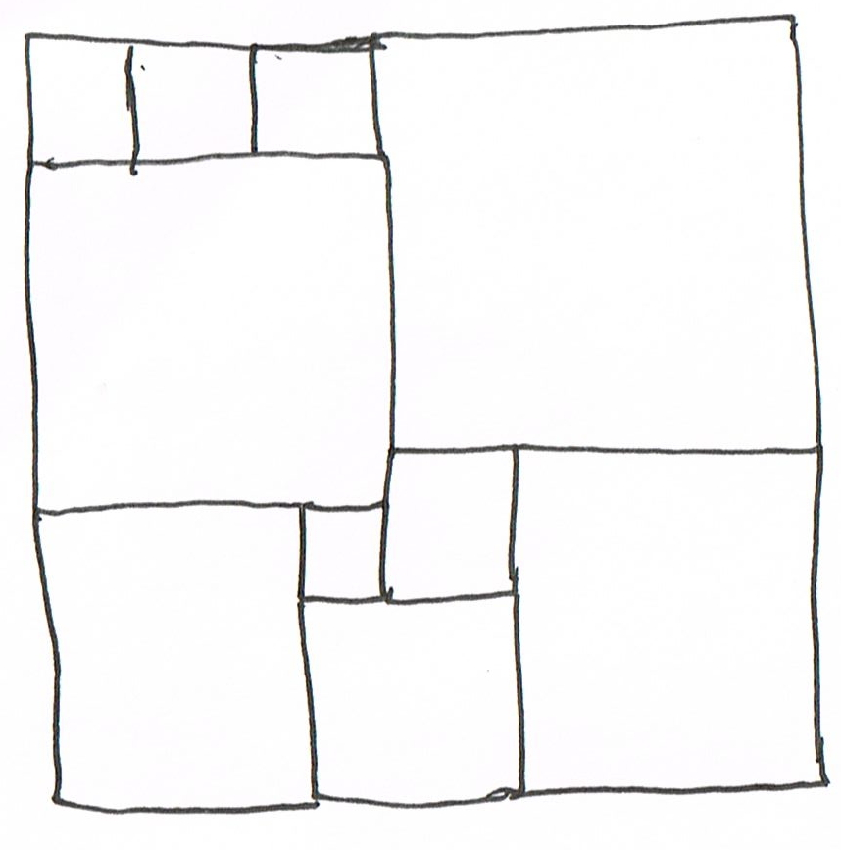
Task 1: Square Deduction
Could these all be squares?
How might you get started?
Anyone willing to admit being stuck?
Acknowledge your ignorance (Mary Boole)
Take some quantity that
you don’t know but want to know
and assign it a variable
Now express relationships
using that (those) variables

Slide 5
Square Deduction: acknowledging ignorance
(3a+b)/3
3a+b = 3(3b-3a)
12a = 8b
So 3a = 2b
(2a+5b) – (5a+2b)
= 3b-3a
a+3b
3a+b
a
b
For an overall square
4a + 4b = 2a + 5b
So 2a = b
2a+b
a+b
a+2b
3
11
For n squares upper left
n(3b - 3a) = 3a + b
So 3a(n + 1) = b(3n - 1)
But not also 2a = b
9
3
2
8
7
5

Slide 6
Reflection
Present what you do not know as a symbol
(Mary Boole)
Acknowledging and expressing ‘ignorance’
What did you notice?
Where you aware of
  Imagining & Expressing
  Specialising & Generalising
  Conjecturing & Convincing
  Organising & Characterising
Did you encounter
  Doing & Undoing
  Invariance in the midst of change
  Freedom & Constraint
  Extending & Restricting
Seeking a place to ‘start’
Discerning Details
Imagining and then expressing relationships
Using expressed relationships to reason with
(justifying conjectures)

Slide 7
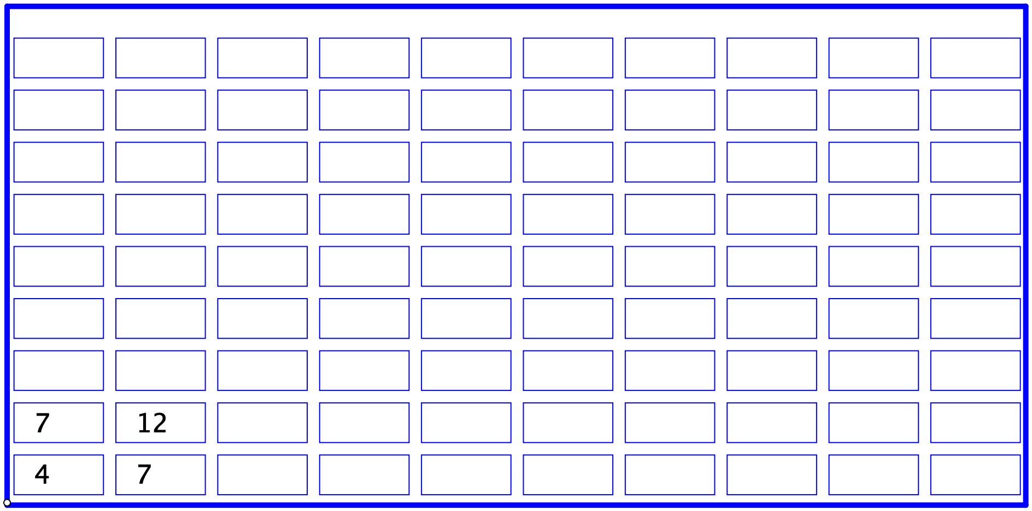
Task 2: Sundaram’s Grid
On the grid provided, each row and each column are in arithmetic progression
What will the entry in row 5 column 6 be?
Sundaram’s Claim: If you double any entry in the grid and add 1, however far extended to the right and up, the result will be a composite number.

Slide 8
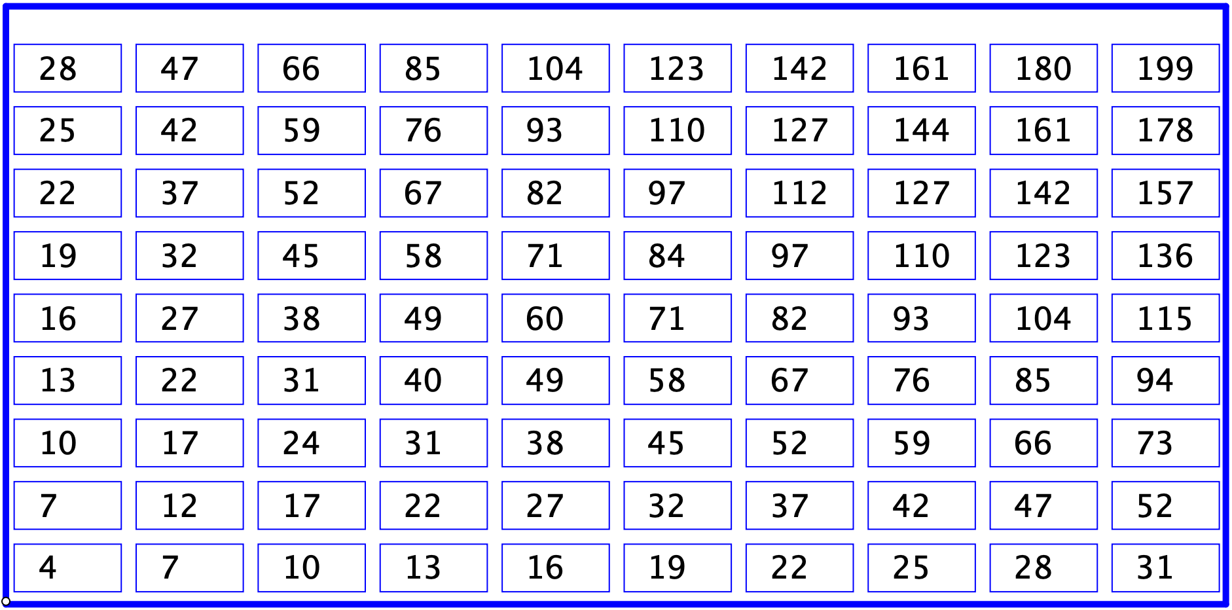
Sundaram’s Claim
If you take any entry in the grid, no matter how far extended to the right and up, double it and add 1, then the result will be a composite number.

Slide 9
Sundaram’s Claim
If you double any entry in the grid and add 1, however far extended to the right and up, the result will be a composite number.
Some initial specialising in order to ‘check’
Strategy
  Need to express the entry in row R and column C
  Show that adding one to its double makes it factor non-trivially
Step 1
  The entry in row 1 column C is 1+3C
  The entry in row 2 column C is 2+5C
  The entry in row 3 column C is 3+7C
Conjecture
  The entry E in row R column C is E = R+(2R+1)C
The R-C entry is E = 2RC+R+C
  2E + 1 = 4RC+2R+2C+1 = (2R+1)(2C+1)
2E+1 is composite as long as R > 0 and C > 0
Expressing generality
Using what is known to re-express what is given
Recognising what is found as what is wanted!

Slide 10
Reflection
Imagining and then expressing the relationships you know
Where you aware of
  Imagining & Expressing
  Specialising & Generalising
  Conjecturing & Convincing
Role of particular (special) cases in order to imagine and express a generality, from which to then reason

Slide 11
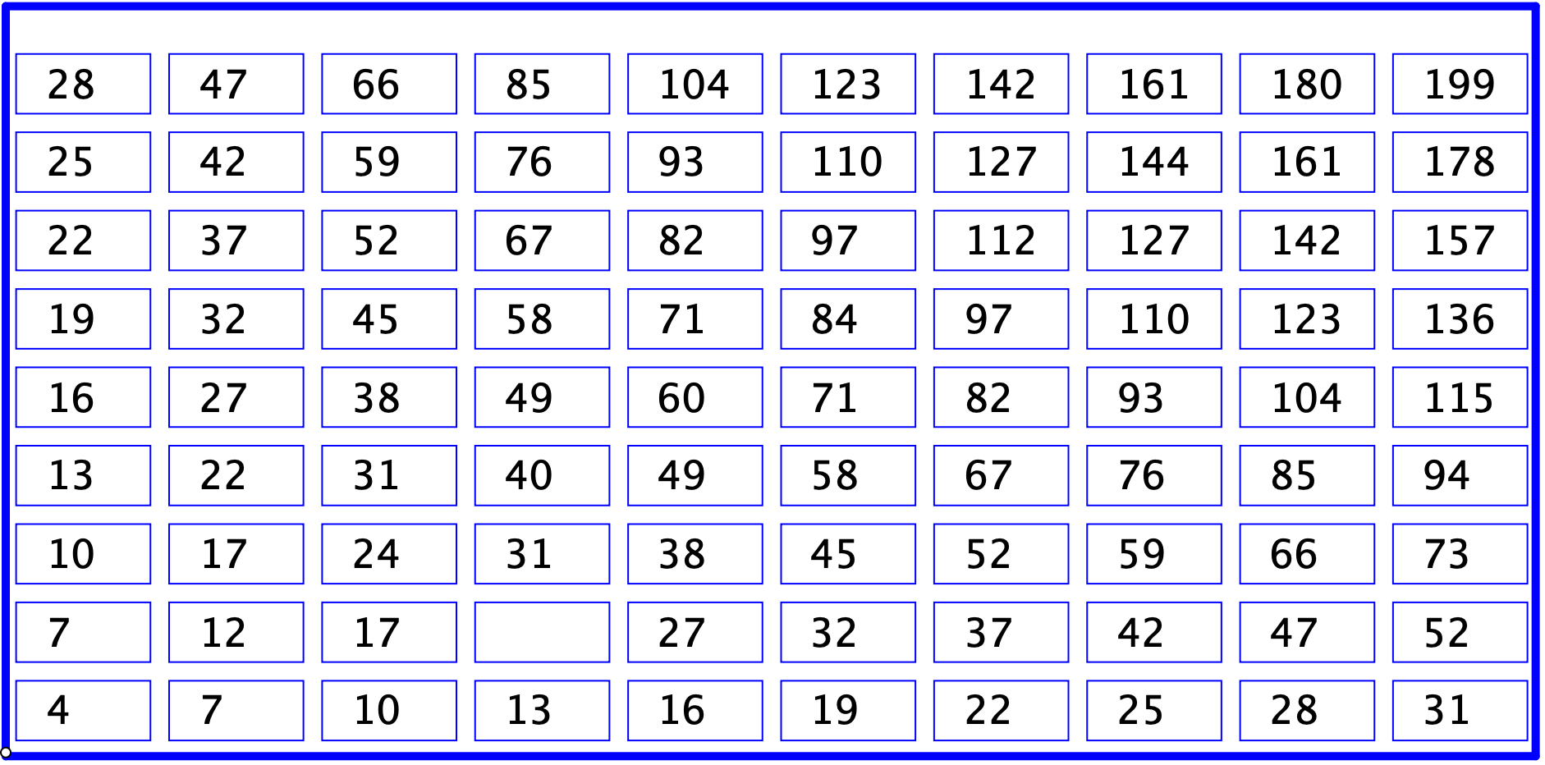
Sundaram’s Second Claim
The difference in the sums of the diagonally opposite corners of any unit square on the grid, is 2. Generalise!
Strategy
  express the entry in row R and column C
  Show that making a rectangle has the required property
(58 + 82) – (67 + 71)
= 2
The R-C entry is E(R, C) = 2RC+R+C
To make a rectangle, add [r, c]
to make the opposite vertex
The other vertices are [R+r, 0] and [0, C+c]
Calculate
  Diff = E(R, C) + E(R+r,C+c) – ( E(R+r, C) + E(R, C+c) )
  Diff = rc
Difference is independent of R and C!
What about parallelograms?
Some initial specialising in order to ‘check’
Expressing generality
Performing Calculation
Recognising implications

Slide 12
Reflection
Where you aware of
  Imagining & Expressing
  Specialising & Generalising
  Conjecturing & Convincing
  Using what you found recently

Slide 13
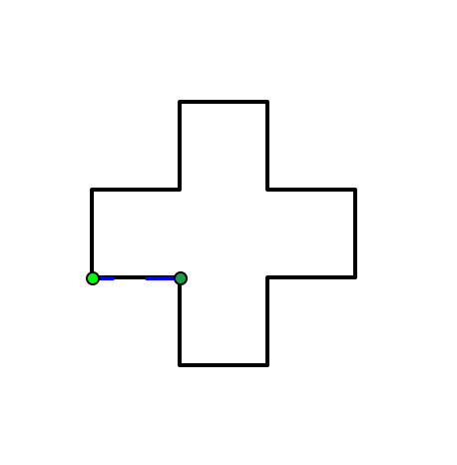
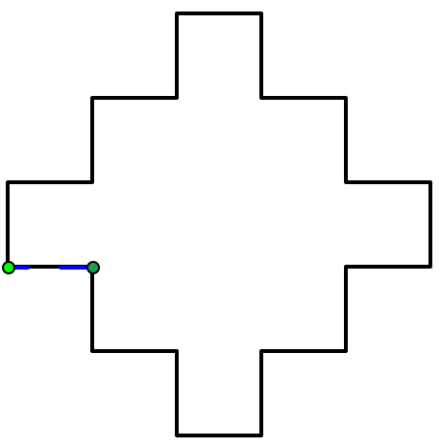
Word Play
A ‘Word’ consists of a sequence made up of L and R
An ‘Angle set’ consist of a sequence of angles
A ‘Scale Set’ consist of a sequence of scale factors.
Repetitions is the number of times the actions indicated by the word are repeated, taking into account the scaling
Word = RLL
Angles = [90°]
Scaling = [1]
Repetitions = 4
Word = RLRLL
Angles = [90°]
Scaling = [1]
Repetitions = 4
Keeping the Scaling and Angles fixed as here, what words will result in a closed figure?
What if Words also include F (straight forward)?

Slide 14
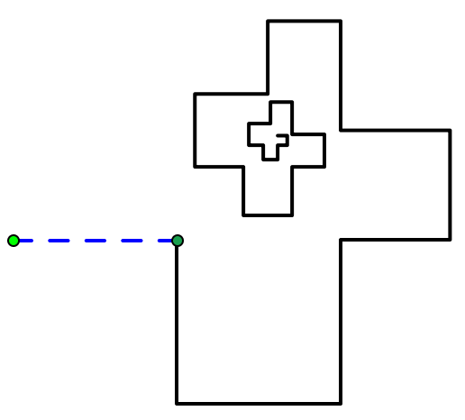
Word Play
What is the limit point for the following, taking the green points as [0,0] and [1,0]?
Word = RLL
Angles = [90°]
Scaling = [1,1,1,2/3, 2/3, 2/3]
Repetitions = 10
What other input data would have the same limit point?

Slide 15
Reflection
Learner choices
Reading instructions and interpreting them on a diagram
Constructing own examples for a purpose
  Providing practice in predicting, expressing generality
Immersed in a larger domain of tasks

Slide 16
Reflection on Session
What struck you particularly?
What natural powers did you use?
  Imagining & Expressing
  Specialising & Generalising
  Conjecturing & Convincing
  Organising & Characterising
  Others?
What Mathematical Themes did you encounter?
  Doing & Undoing
  Invariance in the midst of change
  Freedom & Constraint
  Making the implicit explicit
  Others?

Slide 17
The Next Session …
… will focus on Functions
Slides from this session are available at
www.PMTheta.com/jhm-presentations.html

