Slide 1


A Mathematician’s work is never done: there is (almost) always a way to generalise
John Mason
Hungary
April 2 2022

Slide 2
Outline
Some tasks that might appear ‘finished’ but can be extended
Extending & Enriching the space of examples to which you have access usually releases endorphins (pleasure) because of the extra scope and hence sense of power
Paying attention to the focus and form of your attention
Conjecture
  If teacher and learners are not attending to the same things and in the same ways, then communication between them is likely to be impoverished

Slide 3
Digits
1 x 8 + 1 = 9
12 x 8 + 2 = 98
123 x 8 + 3 = 987
1234 x 8 + 4 = 9876
…
123456789 x 8 + 9 = 987654321
123456789(10) x 8 + 10 = 9876543210
Being playful!
123456789(10)(11) x 8 + 11 = 9876543210(-1)
123456789(10)(11)(12) x 8 + 12 = 9876543210(-1)(-2)
What struck you?
What does ‘this ‘enable?

Slide 4
More Digits
8 x 1 + 1 = 9
What are you attending to?
How are you attending to it?
8 x 121 + 21 = 989
Gazing (Holding a whole)
Discerning Details
Recognising Relationships
Perceiving Properties
Reasoning using Properties
8 x 12321 + 221 = 98789
8 x 1234321 + 2221 = 9876789
…
8 x 12345678987654321 + 222222221 = 98765432123456789
8 x 123456789(10)987654321 + 2222222221 = 9876543210123456789
8 x 123456789(10)(11)(10)987654321 + 22222222221
= 9876543210(-1)0123456789
A world of possibilities opens up!

Slide 5
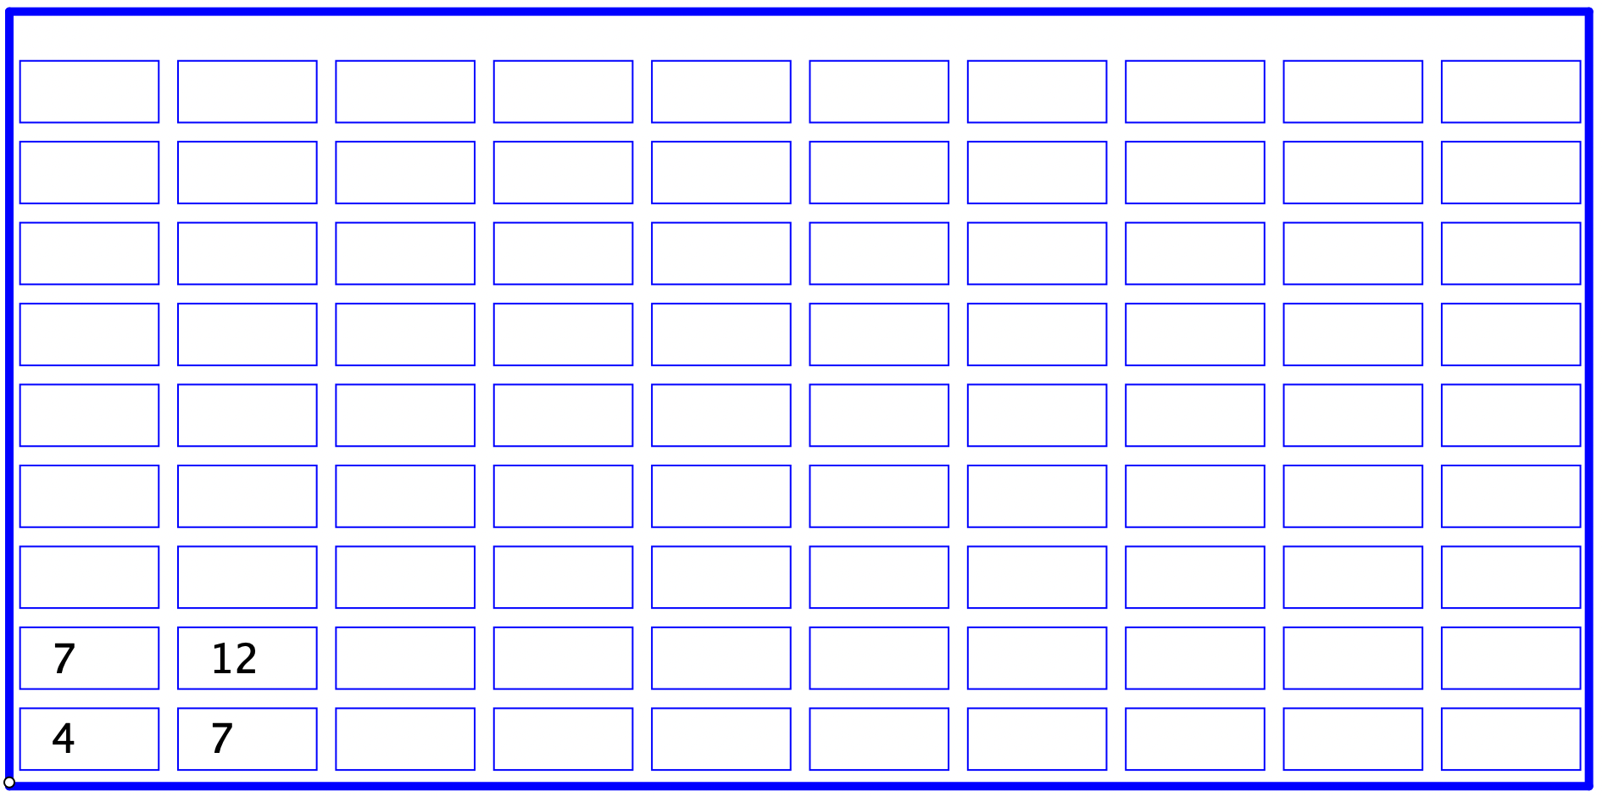
Sundaram Grids
The rows and columns of this grid are arithmetic progressions
What is the entry in the highlighted cell?

Slide 6
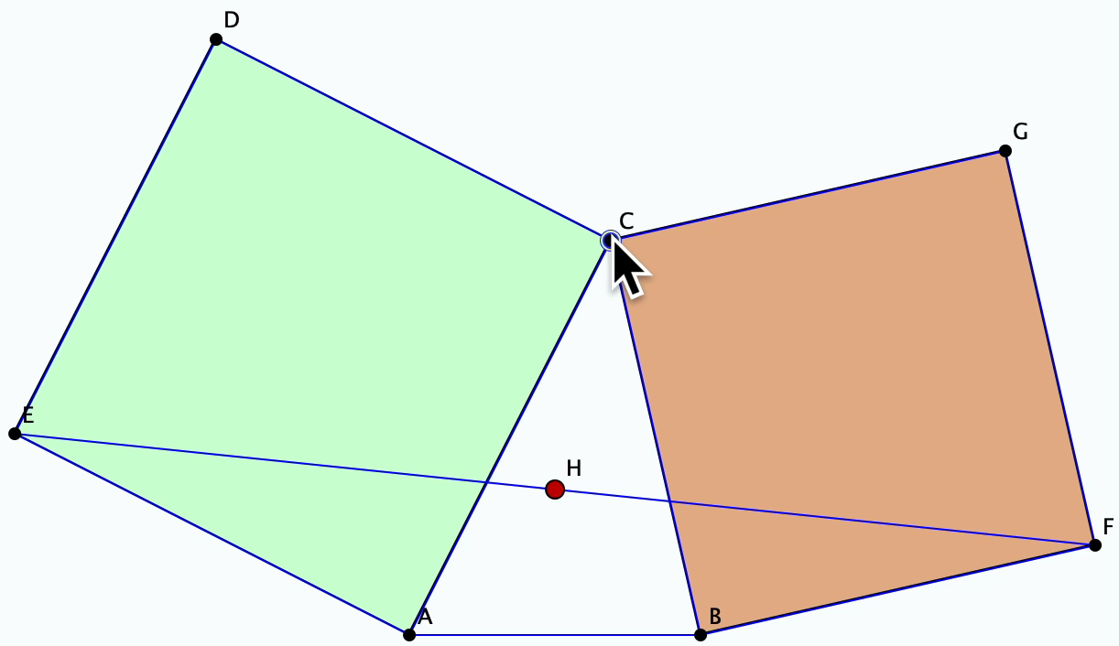
Bottema’s Theorem
On a line segment AB, draw a triangle ABC. Put squares outwards on sides AC and BC.
Join the vertex of the square on AB adjacent to A to the vertex of the square on BC adjacent to B. Let H be the midpoint of that segment.
Vary the position of C.
Explain/justify the invariance.

Slide 7
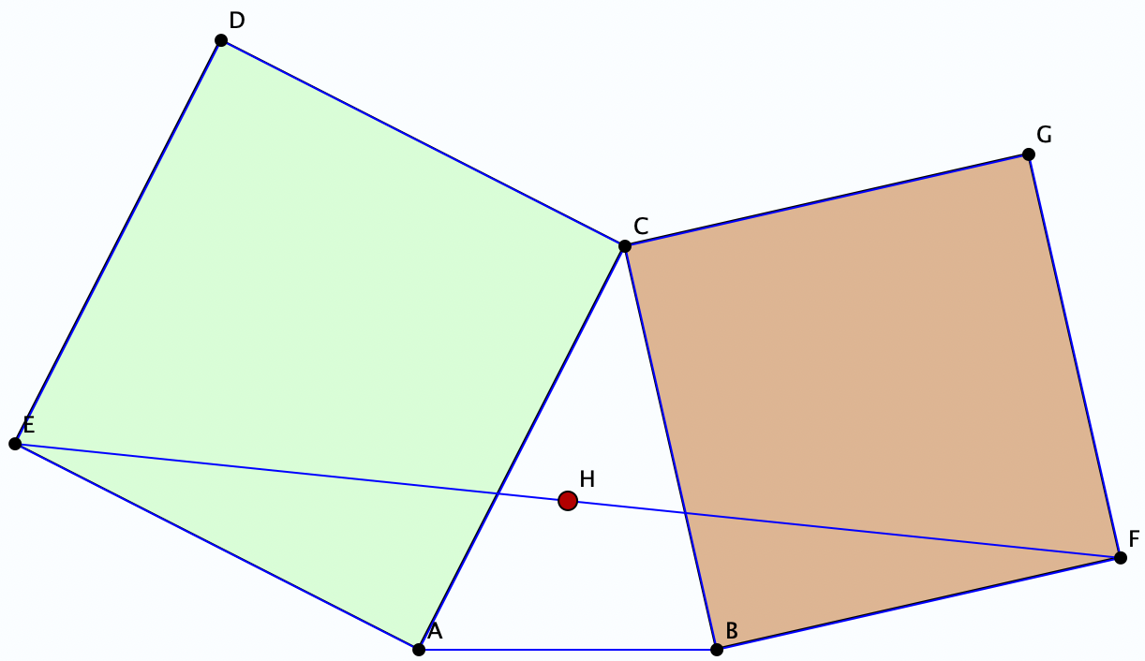
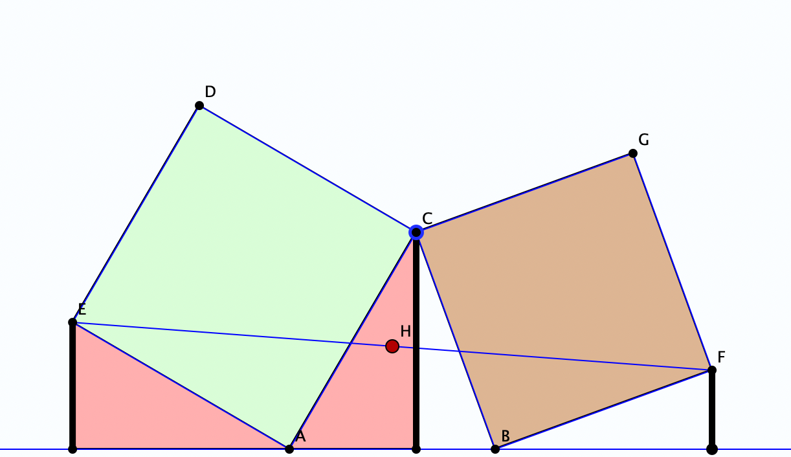
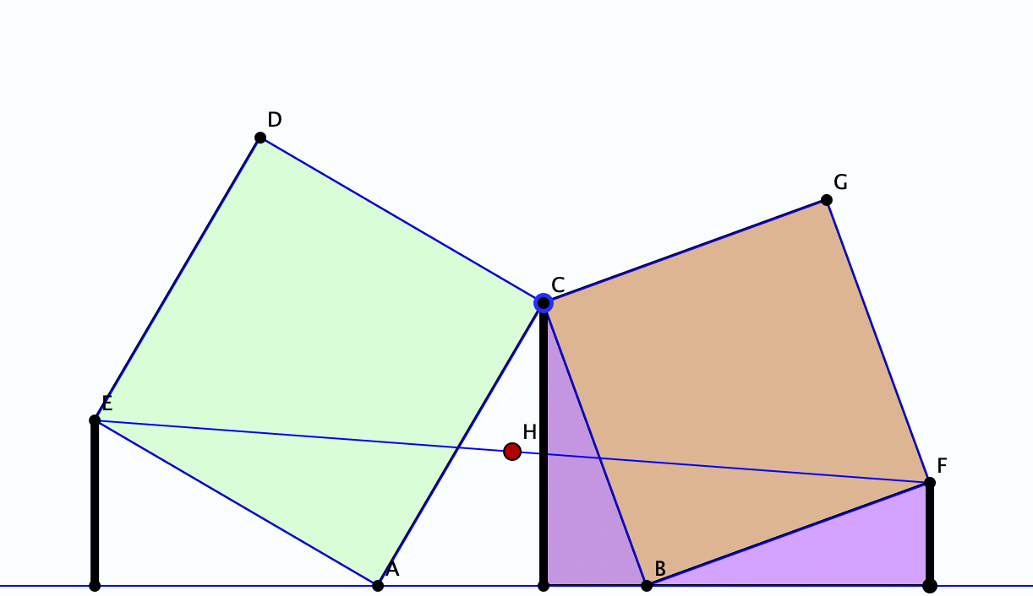
Bottema’s Theorem Justified
An action is required!
What are you attending to?
How are you attending to it?
Gazing (Holding a whole)
Discerning Details
Recognising Relationships
Perceiving Properties
Reasoning using Properties

Slide 8
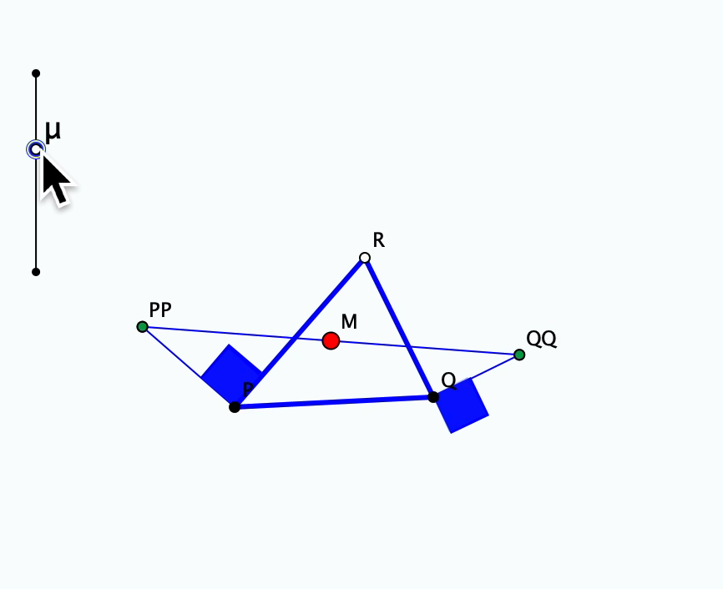
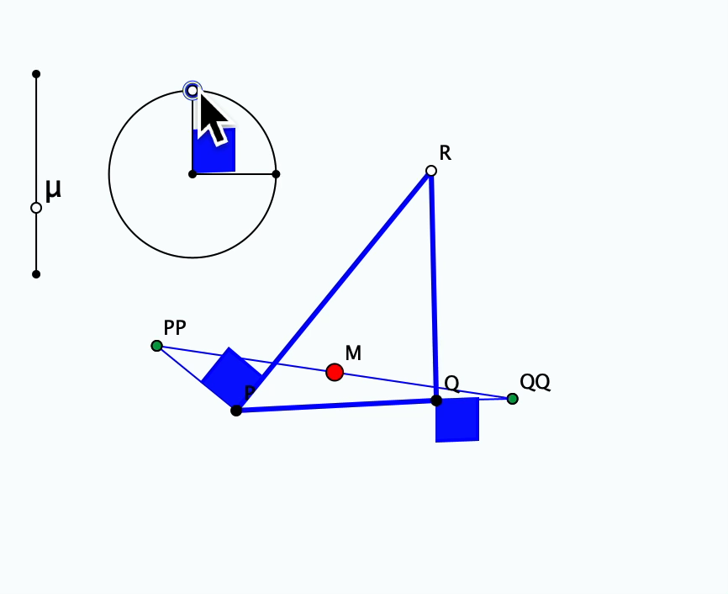
What Makes the Theorem Work?
What have the squares
to do with it?
If not the scale,
what about ‘the’ angle?

Slide 9
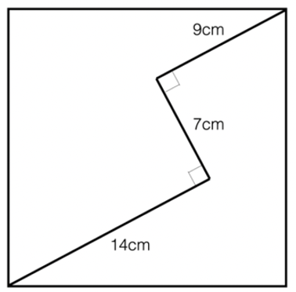

Sizing it Up
What is the size of the square?
Diving in with …
Trig (insert angle labels)?
Diagonal?
Extend lines?
(14 + 9)² + 7² = 2 x 17²
What tasks can you now resolve?
How could you make a similar task using ‘nice numbers’?
x² + y² = 2z²
What about the 2?
Parametrise
Ola Helenius

Slide 10
Being Rational about Irrationals
Articulate how the following decimal numbers would be continued indefinitely
  0.101001000100001…
  0.102003000400005…80000000090000000010…
  0.1234567891011121314…
Why must these be irrational?
Make up your own irrational using these ideas
  Justify your claim that it is irrational
Pleasure of creativity
Enriched example space
Method not objects

Slide 11
Being Rational about Irrationals
Write down a decimal ‘point’ followed by the numbers from 1 to 9 in sequence.
Now follow those by the ‘digits’ (10), (11), … and imagine continuing forever.
0.123456789(10)(11)(12)…
0.123456789
10
11
12
…
0.12345679012…
Now re-write as an ordinary decimal.
Is the result rational or irrational?
What questions does this open up for you?

Slide 12
Marbles
If Anne gives one of her marbles to John, they will have the same number of marbles.
  What can you say about the
  number of marbles they each started with?
If Anne gives John one of her marbles, she will then have one more than twice as many marbles as John then has.
  How are Anne’s and John’s starting marbles related?
  If John started with 12 marbles, how many did Anne start with?
  What can you say about the number of marbles they each started with?
If Anne gives John one of her marbles, she will then have one more than twice as many marbles as John then has.
However, if instead, John gives Anne one of his marbles, he will have one more than a third as many marbles as Anne then has.
  How many marbles have they each currently?
What variations are available to you?
What variations are available to you?
Generalise!
Recast these as :
people getting on and off buses
People’s ages
What further variations can you come up with?

Slide 13
Proizvolov
Write down the numbers from 1 to 8. Choose four numbers from your set and put them in a column, in descending order as you read down.
Put the remaining four numbers in a parallel column, but in ascending order as you read down.
For each pair on the same row, form the positive (absolute) difference.
Add up all the differences.
Try using a different selection for your first column.
Why is the answer always the same?
6
4
3
1
2
5
7
8
4
1
4
7
16
What are you attending to?
How are you attending to it?
Response to surprise …
Exploration of variations!
Specialising
Generalising

Slide 14
Proizvlov
Why does it work?
What is the ‘it’ that is happening?
What variations might be considered?

Slide 15
Proizvlov 2
Choose four numbers each greater than 20 and summing to 121. Write them on slips of paper
Choose four numbers each smaller than 20 and summing to 41. Write them on slips of paper.
Choose any four of your 8 numbers and put them in a column in descending order reading down.
Put the remaining four in a parallel column beside the first, but in ascending order as you read down.
Now form the positive differences in each row.
Add up all the differences.
No matter how you arrange your columns subject to the specified constraints, the answer will be the same. WHY?
30, 21, 36, 34
6, 16, 11, 8
34
30
21
16
6
8
11
36
28
22
10
20
80

Slide 16
Reflection
Bring to mind a task that you have set for someone else recently
What were learners expected to encounter?
What examples of the task are learners currently familiar with?
What examples of a relevant concept can learners construct?
What opportunities for variation and generalisation can you discern?

Slide 17
When a Task is ‘Completed’
What else can I now do that I couldn’t before?
What could be varied?
  How does this alter the approach?
  What constraints are there restricting what can be varied?
Are there any boundary examples?

Slide 18
When a Topic is Near Completion
What examples do I have access to?
How can more examples be constructed?

Slide 19
Follow-Up
PMTheta.com
John.Mason@open.ac.uk
Questions & Prompts for Mathematical Thinking (ATM UK)
Thinkers (ATM UK)
Thinking Mathematically (Pearson)
Learning & Doing Mathematics (Tarquin)

