Slide 1
Functions
BSRLM discussion
March 12th 2011
Institute of Education

Slide 2
Why equations, graphs and functions

Slide 3
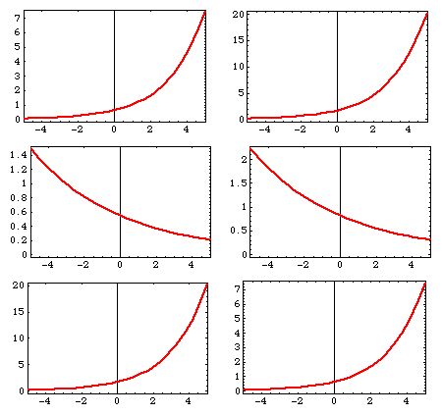
What’s the same and what’s different?

Slide 4
Equations
A=1/2bh
v²- u² = 2as
y = 2x+5
3x - 5=9 - 2x

Slide 5
Nature of graphs
One variable
Two variables
More variables
Interval data

Slide 6
Nature of functions
One-to-one or one-to-many mappings between sets
Input/output machines with algebraic workings
Input/output ‘black boxes’ such as trigonometric or exponential functions
Expressions to calculate y-values from given x-values
Relations between particular x-values and y-values
Relations between a domain of x-values and a range of y-values
Representations of relations between variables in ‘realistic’ situations
Graphical objects which depict particular values
Graphical objects which have particular characteristics
Graphical objects which can be transformed by scaling, translating and so on
Structures of variables defined by parameters and relations

Slide 7
What is met in primary school?

Slide 8
Equations (in primary)
unknown numbers in number sentences
situations like x + y = 6, or x – y = 4
use of formulae: areas of simple shapes; conversions of units.

Slide 9
Graphs (in primary)
pictorial representations
bar charts
trend lines
experimental data against time
discussed in terms of steepness, higher/lower distinctions, and zeroes
scaling the vertical axis
scaling the horizontal axis.

Slide 10
Functions (in primary)
term-to-term rules for simple sequences
one-to-one, many-to-one, and one-to-many mappings
qualitative relations between variables in realistic phenomena

Slide 11
Problems in learning about functions
Discuss ...

Slide 12
Sidetracked by notation
f as a label
f(y) and f(b) as different functions
f(x) as the formula for a function
f(3) means the function has value 3
f(x+y) = f(x) + f(y)
f(y) is the ordinate
f(x) = g(x) is an instruction to find an unknown
f(x) is a graph
f(x) means ‘f times x’

Slide 13
Yerushalmy’s work (JRME year 8) students using graphing software
Car hire with a $100 cost per day and $5 cost per mile
f(n)= n. 100 + x * 5
f(n) +f(x) = n * 100 + x. 5
f(n, b) = (n . 100) + (b. 5)
(n .100) + (k.5) =f(n, k)
f(d, k) = n(d) . 100 + n(k) * 5

Slide 14
Research findings re: equations (in relation to graphs and functions)
Methods which retain the notion of equality of expressions seem particularly powerful, and relate well to understanding the properties of functions.

Slide 15
Research re: graphing in relation to equations and graphs
Graphs and graphing both realistic and algebraic data: problems of conceptual understanding rather than technical problems.
Swan and colleagues: cognitive conflict
Ainley, Pratt and colleagues: purpose, utility, meaning.

Slide 16
Research re: functions in relation to equations and graphs
Understanding, both in pure mathematics and as tools for modelling, takes many years to develop.
continuous and discrete;
with and without time in the x-axis;
smooth and non-smooth
calculable and non-calculable
do/do not depict the underlying relations in obvious ways

Slide 17
Consistent use of multiple representation software over time can, with appropriate tasks and pedagogy, enable students to understand the concepts and properties associated with functions, and be able to use functions to model real and algebraic data.

Slide 18
anne.watson@education.ox.ac.uk

