Slide 1


Flipping ICT:
Being of One Accord
John Mason
Swansea
July
2023

Slide 2
Abstract
Participants will be invited to engage in some mathematical tasks to do with chords of (graphs of) functions, leading to a discussion of different modes of interaction between learner, mathematics, and teacher. This in turn will raise questions about different ways to use mathematical software to ‘flip’ a classroom. The core role of attention, both mathematical and social, will anchor the discussion.

Slide 3
Getting Started: Fixed End Chords
Imagine the graph of a function
Fix a point P on the graph.
Now imagine various chords passing through P.
As the other end of the chord gets closer to P,
the length of the chord goes to 0, as does the rise of the chord.
To study the original function, and following Cauchy and Weierstrasse, you concentrate on what happens near one point P.
Then you see what happens as P changes … but it is hard to get a sense of what to expect at different positions of P.

Slide 4
Getting Started: Fixed Width Chords
Now re-imagine the graph of your function
Choose an interval of width w on the x-axis,
Pick a point X on that interval, dividing the interval into the ratio μ : 1 – μ.
Imagine the chord of the graph corresponding to your interval.
Now imagine using X to drive your interval along the x-axis, with its corresponding chord constantly width w .
You could plot above X the length of the chord, the rise of the chord, or some other attribute.
To study the original function, it makes pedagogical sense to graph the attribute value. As the chord width changes, so does the graph, but you get a sense of a shape corresponding to the attribute.
As the interval width goes to 0, the attribute graph also goes to 0, but how fast? What power of w do you have to divide by to get a non-zero limit?

Slide 5
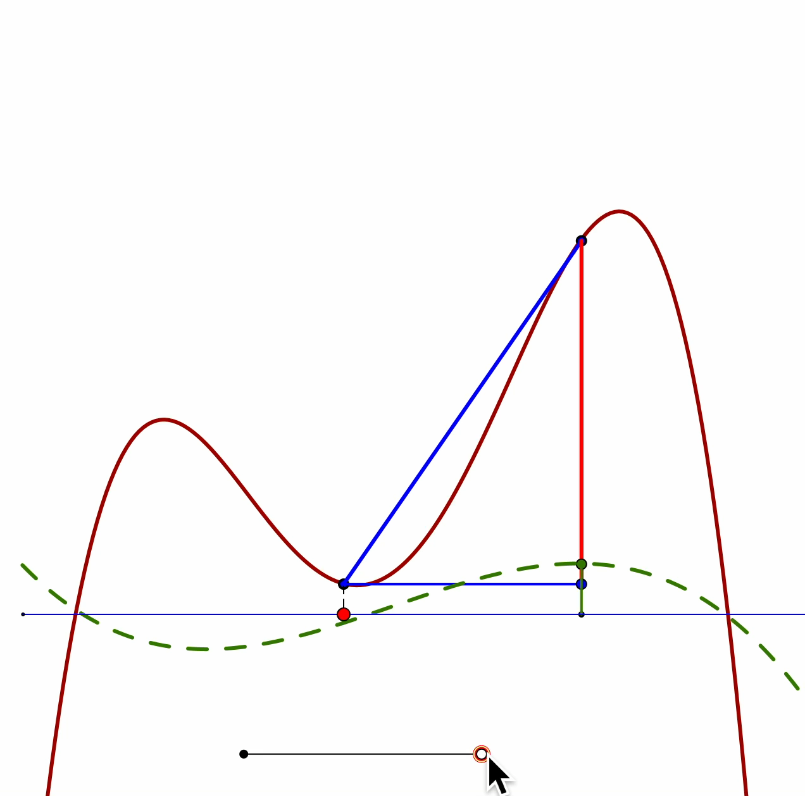
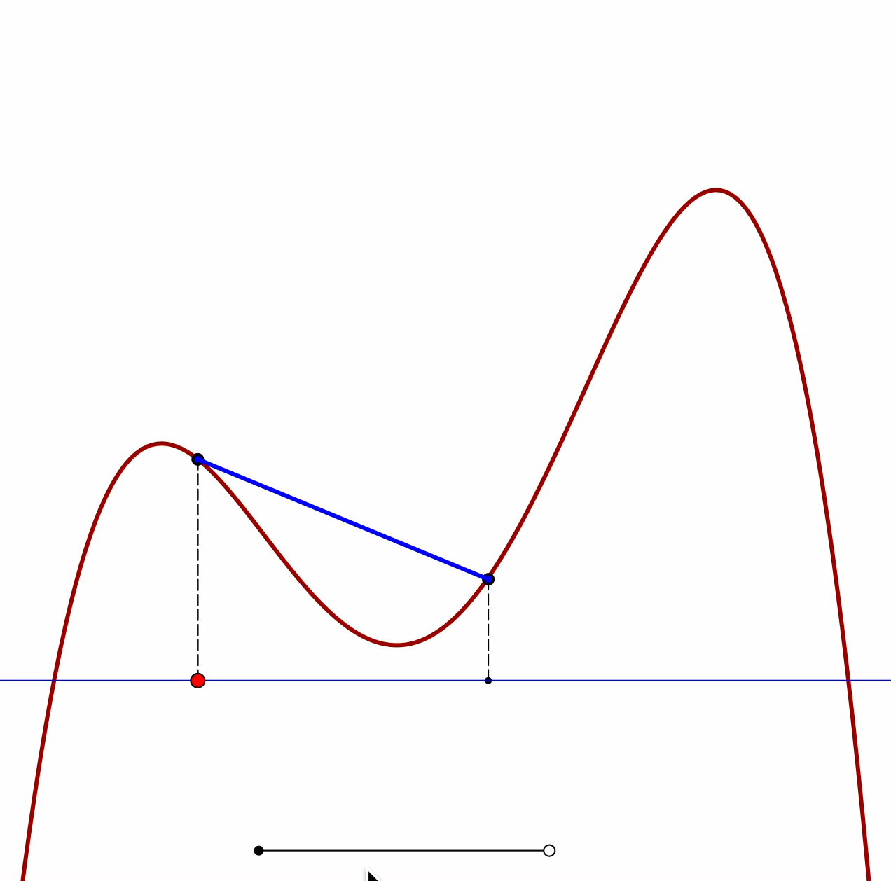
Fixed End Chord Animations
Interest is in behaviour at a point P (above Red point).
Rise of chords as other end of chord approaches P … goes to 0.
Graph of rise adds little to fact of 0 at limit.
Graphing ratio of
rise to interval width
depicts gradient when interval width is 0
Learner expected to imagine this happening at each point P.

Slide 6
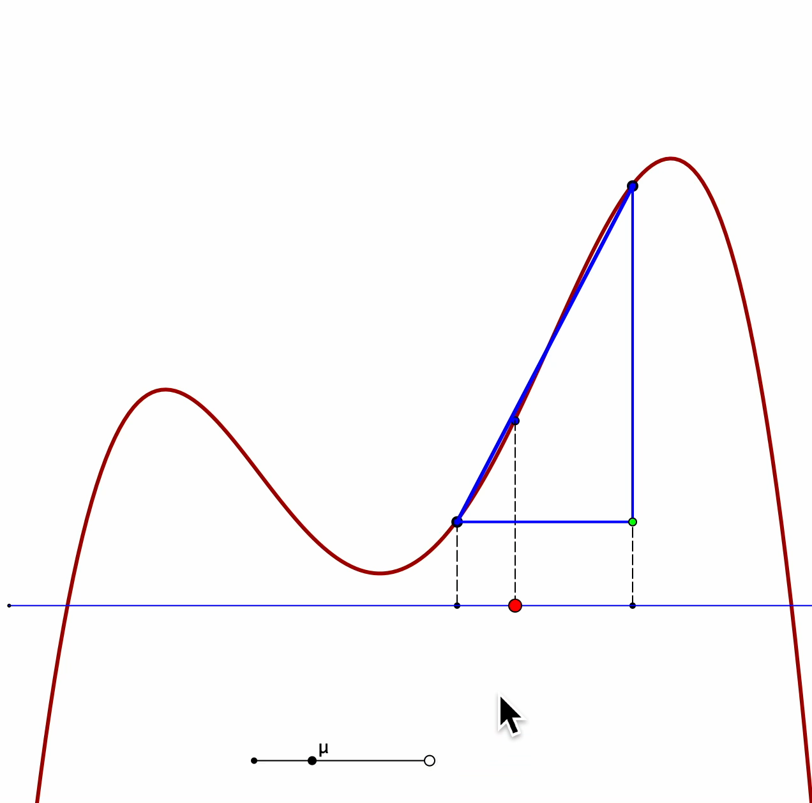
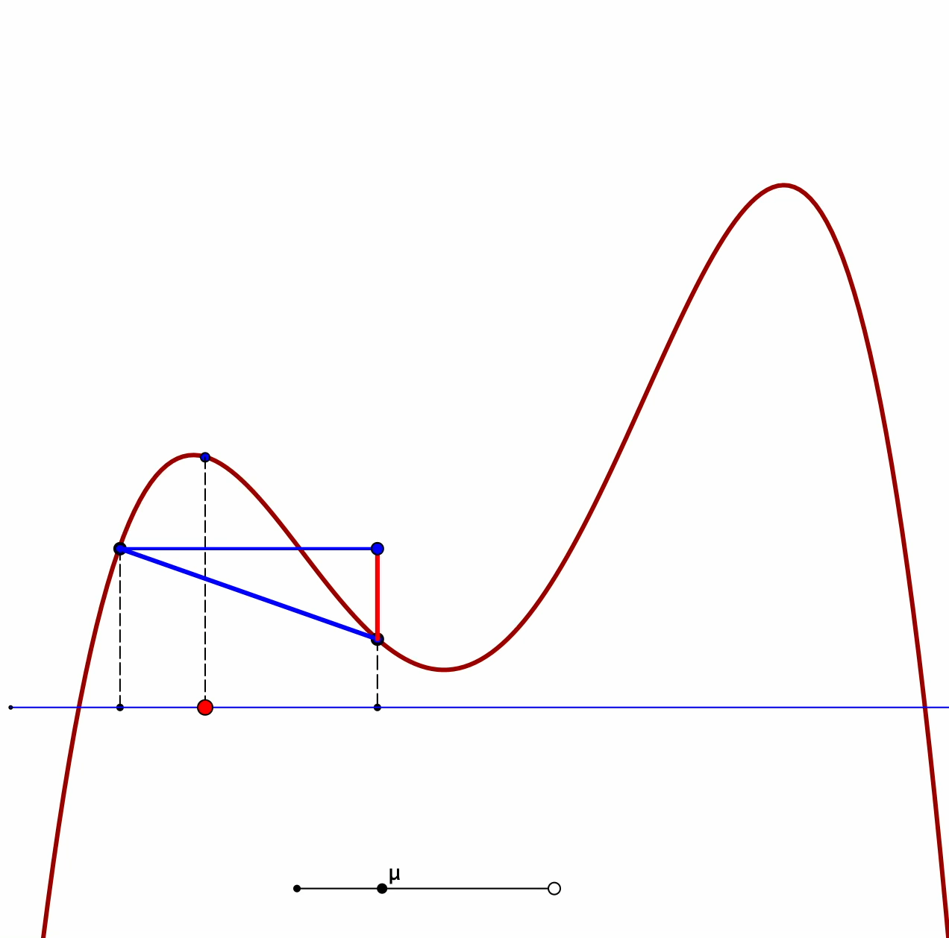
Fixed Width Animations
Driving point (red) at a fixed ratio of interval width.
Gradient of chords graphed for each (red) point.
Gradient tends to a limit as interval width goes to 0
Graphs contribute to a sense of the limit curve (the derivative)

Slide 7
Seeing Images
Affirming
Challenging
leading to altering
Developing
Concept Image
What could students actually do with images?
Notes:
Chordal Triangle
Mu-Chords Triangle

Slide 8
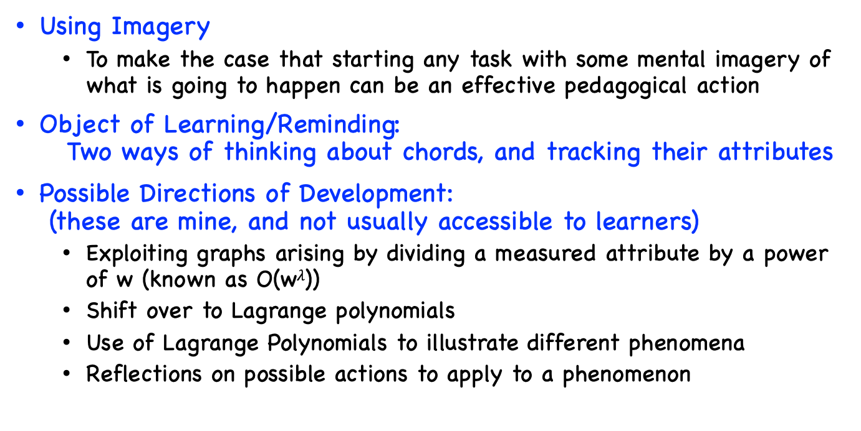
Pedagogic Comments
Using Imagery
  To make the case that starting any task with some mental imagery of what is going to happen can be an effective pedagogical action
Object of Learning/Reminding:
Two ways of thinking about chords, and tracking their attributes
Possible Directions of Development:
(these are mine, and not usually accessible to learners)
  Exploiting graphs arising by dividing a measured attribute by a power of w (known as O(w$λ$))
  Shift over to Lagrange polynomials
  Use of Lagrange Polynomials to illustrate different phenomena
  Reflections on possible actions to apply to a phenomenon

Slide 9
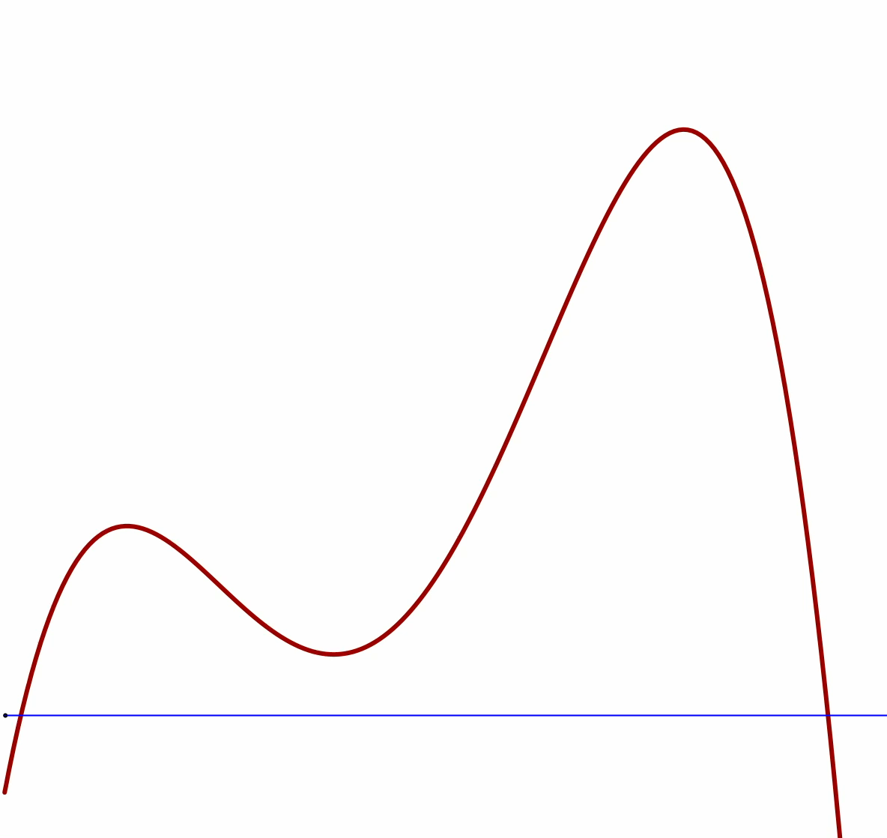
Lagrange Polynomials introduction
Imagine the graph of a quartic (4th degree polynomial) with negative values when x is very large in absolute value
Imagine 5 points on that quartic
Imagine changing the positions of those points,
but requiring the quartic to pass through them
So we can be of one accord at the start, here is an example
Note use of variation
to draw attention to the aspect
‘to be learned’ ie comprehended
By adjusting five points, the quartic can be varied

Slide 10
Pedagogic Comments
Object of Learning/Reminding
: variation in polynomials through a given number of points
which produces a variety of shapes;
Possible Directions of Development:
  Lagrange polynomials
  Use of Lagrange Polynomials to illustrate different phenomena
  Reflections on possible actions to apply to a phenomenon

Slide 11
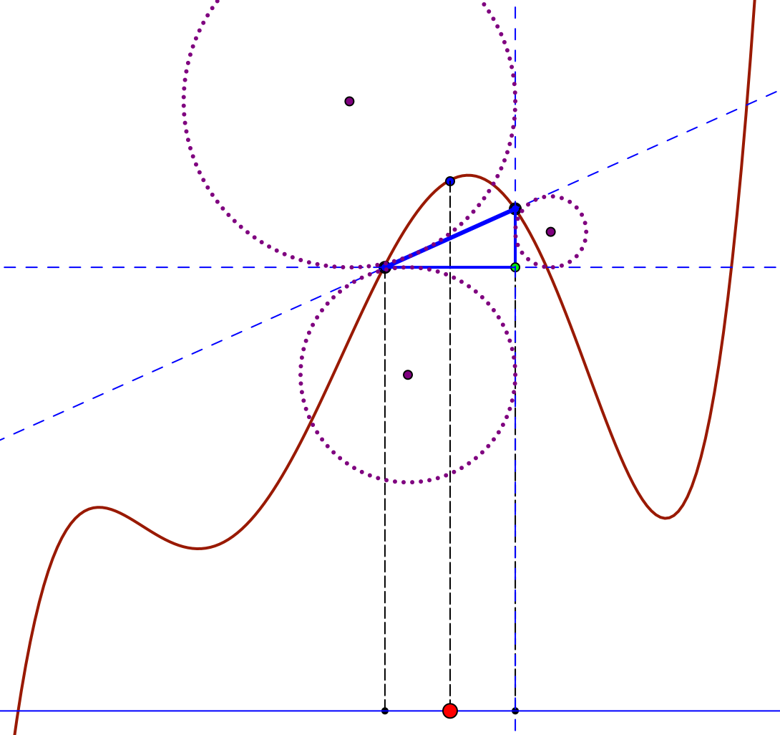
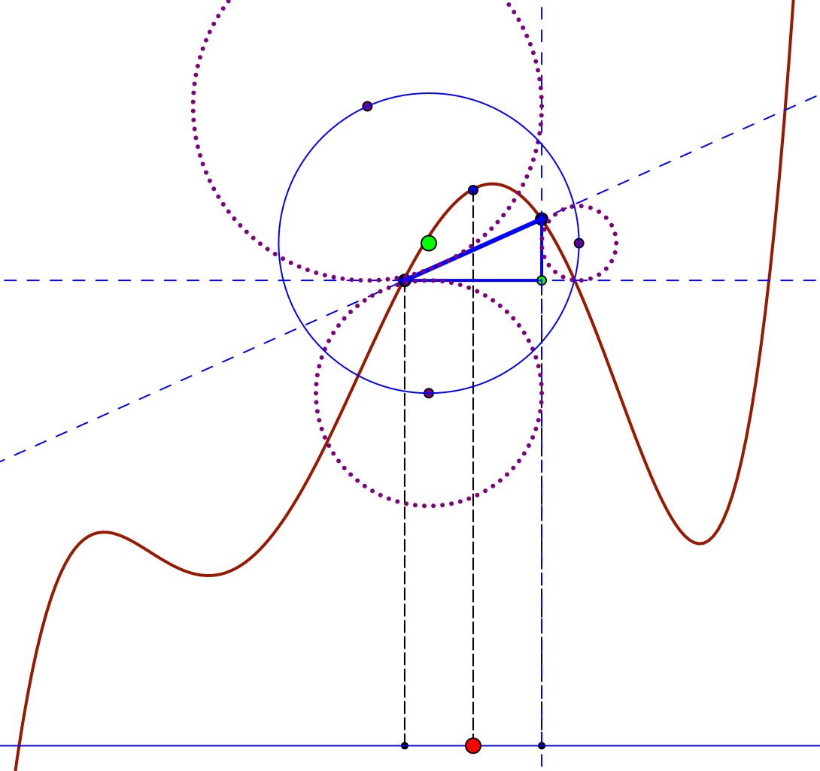
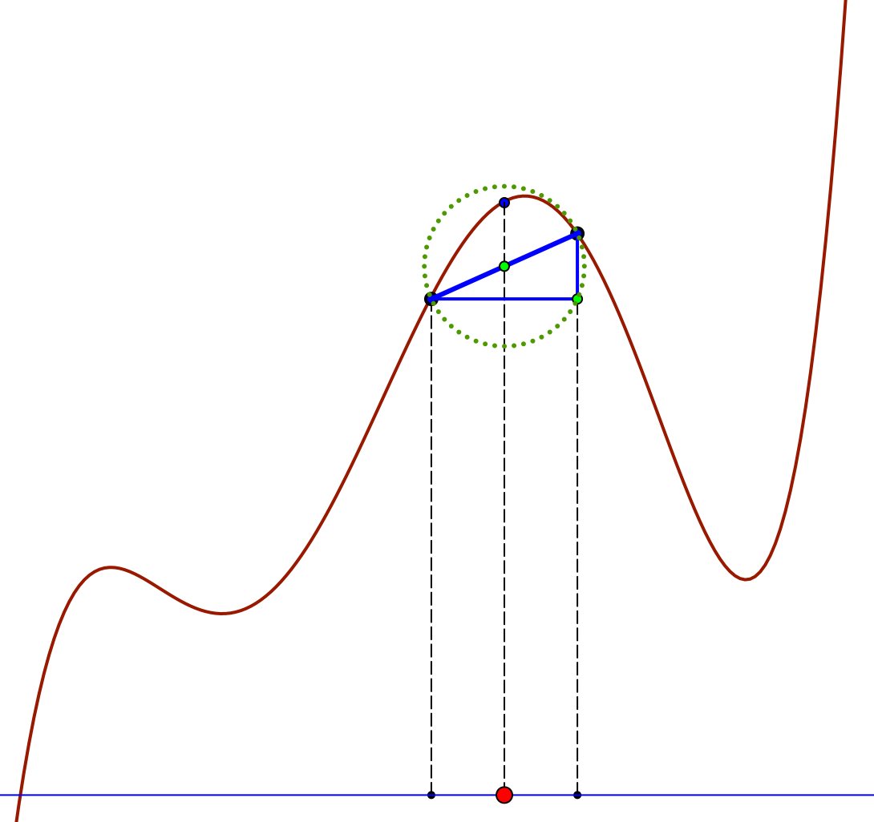
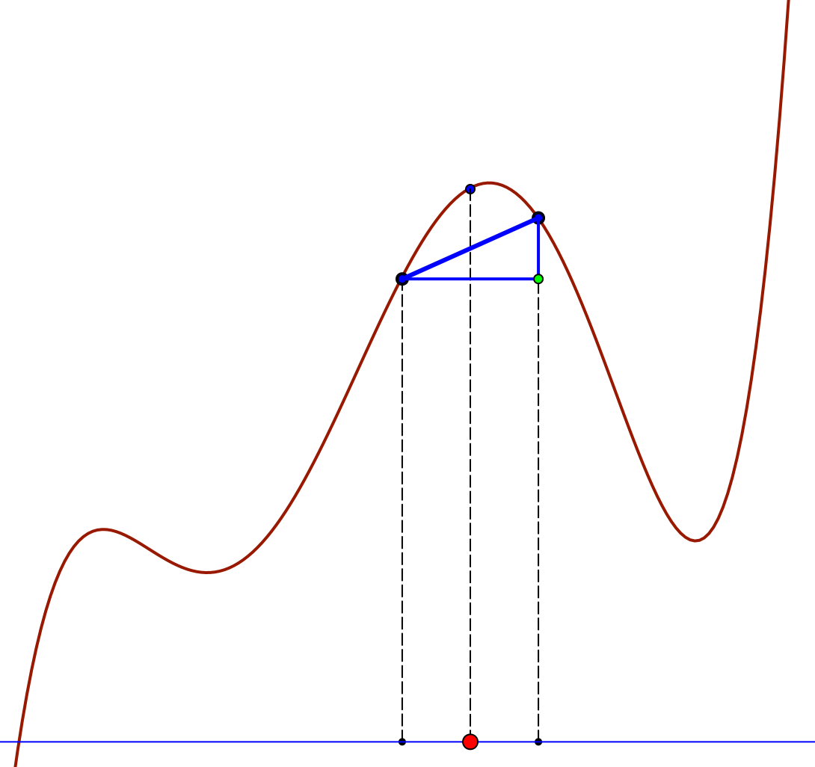
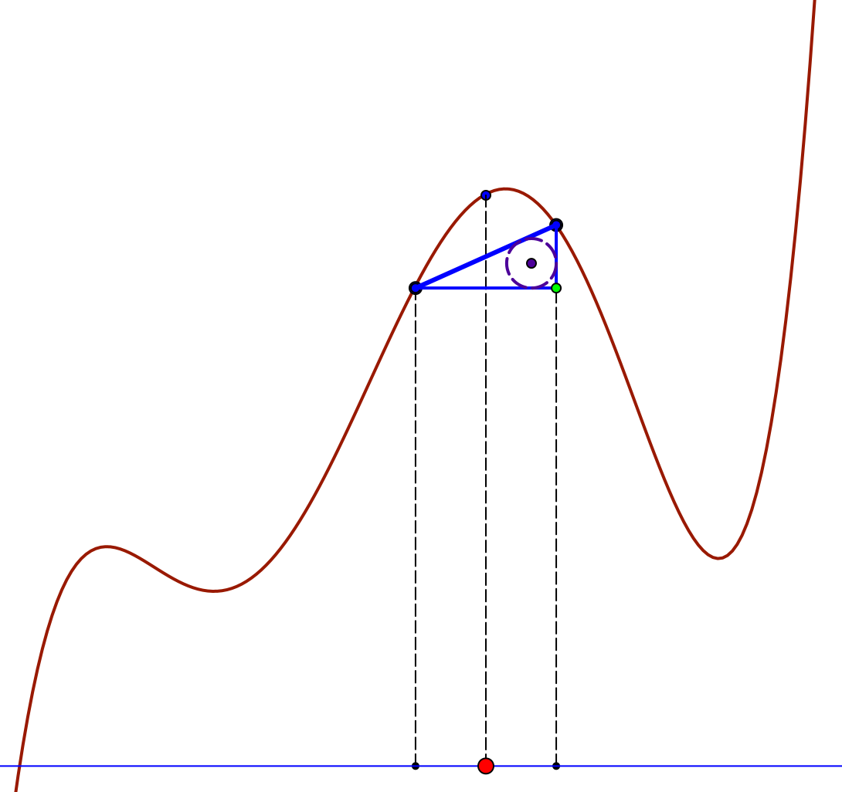
Some Attributes of a Centrally Driven Chordal Triangle
Say What You See

Slide 12
Working on What You Saw
Say (to yourself) What You Saw
Say (to a neighbour) What You Saw
Sense of variability
  Accessible example space
  Domain of generality

Slide 13
Conjectures
There are several types of learner activity which contribute to learning mathematics
They are based around encountering mathematical phenomena:
  Imagining; pictures, animations,
  Following Exposition & Worked Examples;
  Sets of exercises; Situations to explore
  Experiencing ways of working on these
  Constructing their own variations and extensions
  Being examined: appreciation & comprehension
There are a range of modes of interaction between teacher, learner and mathematics
  expounding, explaining, exploring, examining, exercising, expressing,
Some of these traditionally take place in classrooms,
but they could take place elsewhere
(backed up by my 40 years experience
at the Open University)
In each case, what is at stake is what
learners are attending to,
and how they are attending to it
Effective ‘Flipping’
means deploying these modes efficiently
Migration of
Ways of Working
to increase effectiveness

Slide 14
Attention Conjectures
If people are not attending to the same thing(s),
then communication is likely to be disrupted and at best partial
If people are attending to the same things, but in different ways,
then again, communication is likely to be disrupted and at best partial
Each act of teaching is an intervention in the attention of learners
Hence the importance of
Being of one Accord
My intention is to
illustrate some of these conjectures
through inviting you to engage
with some mathematical thinking
(Chords of Graphs of Functions)
in some of these different modes
Everything said today, especially by me,
is to be taken as
a CONJECTURE to be tested
in your past, present
and future experience

Slide 15
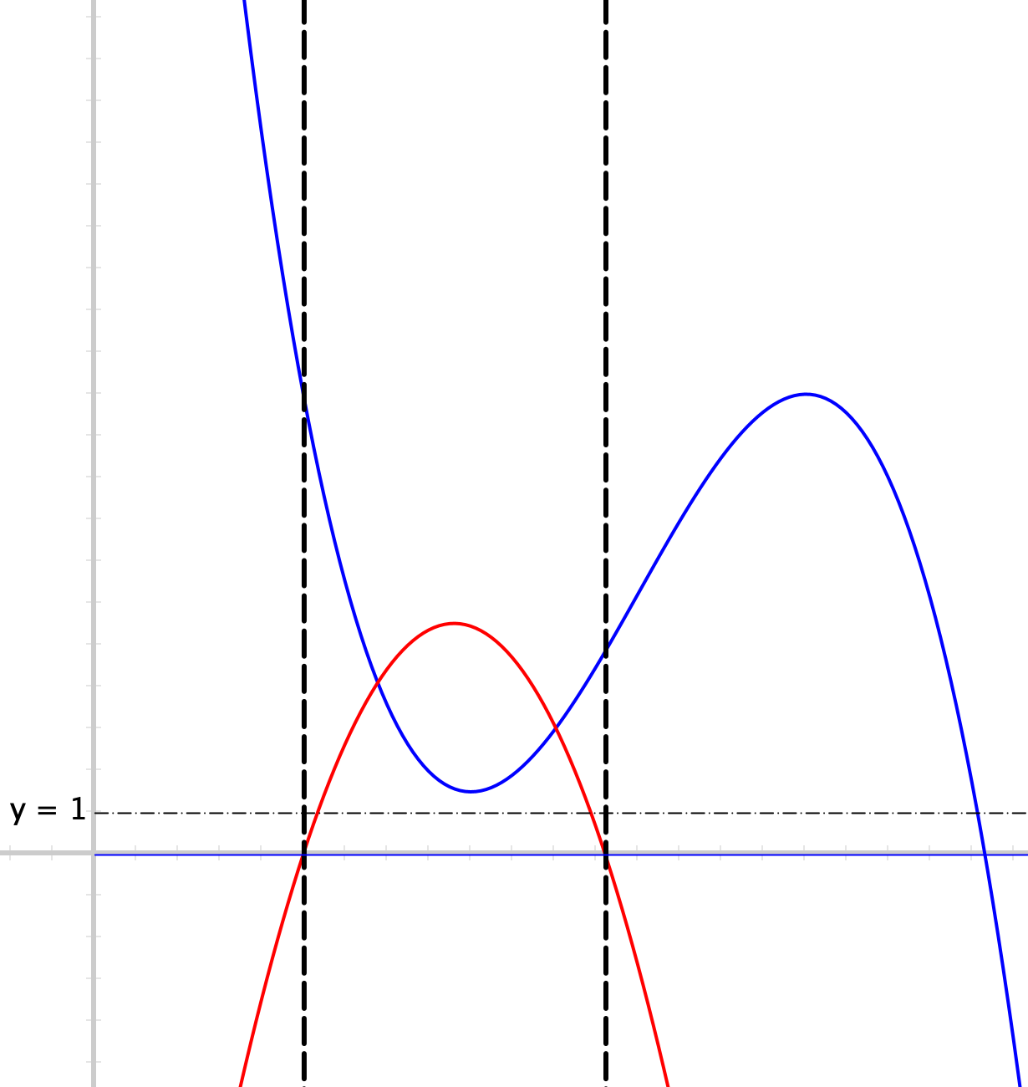
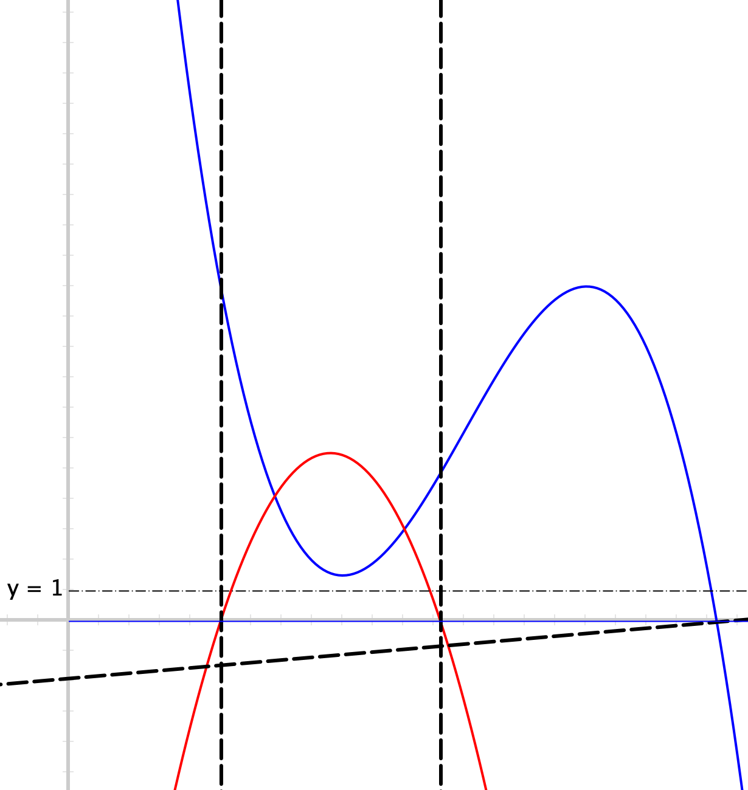
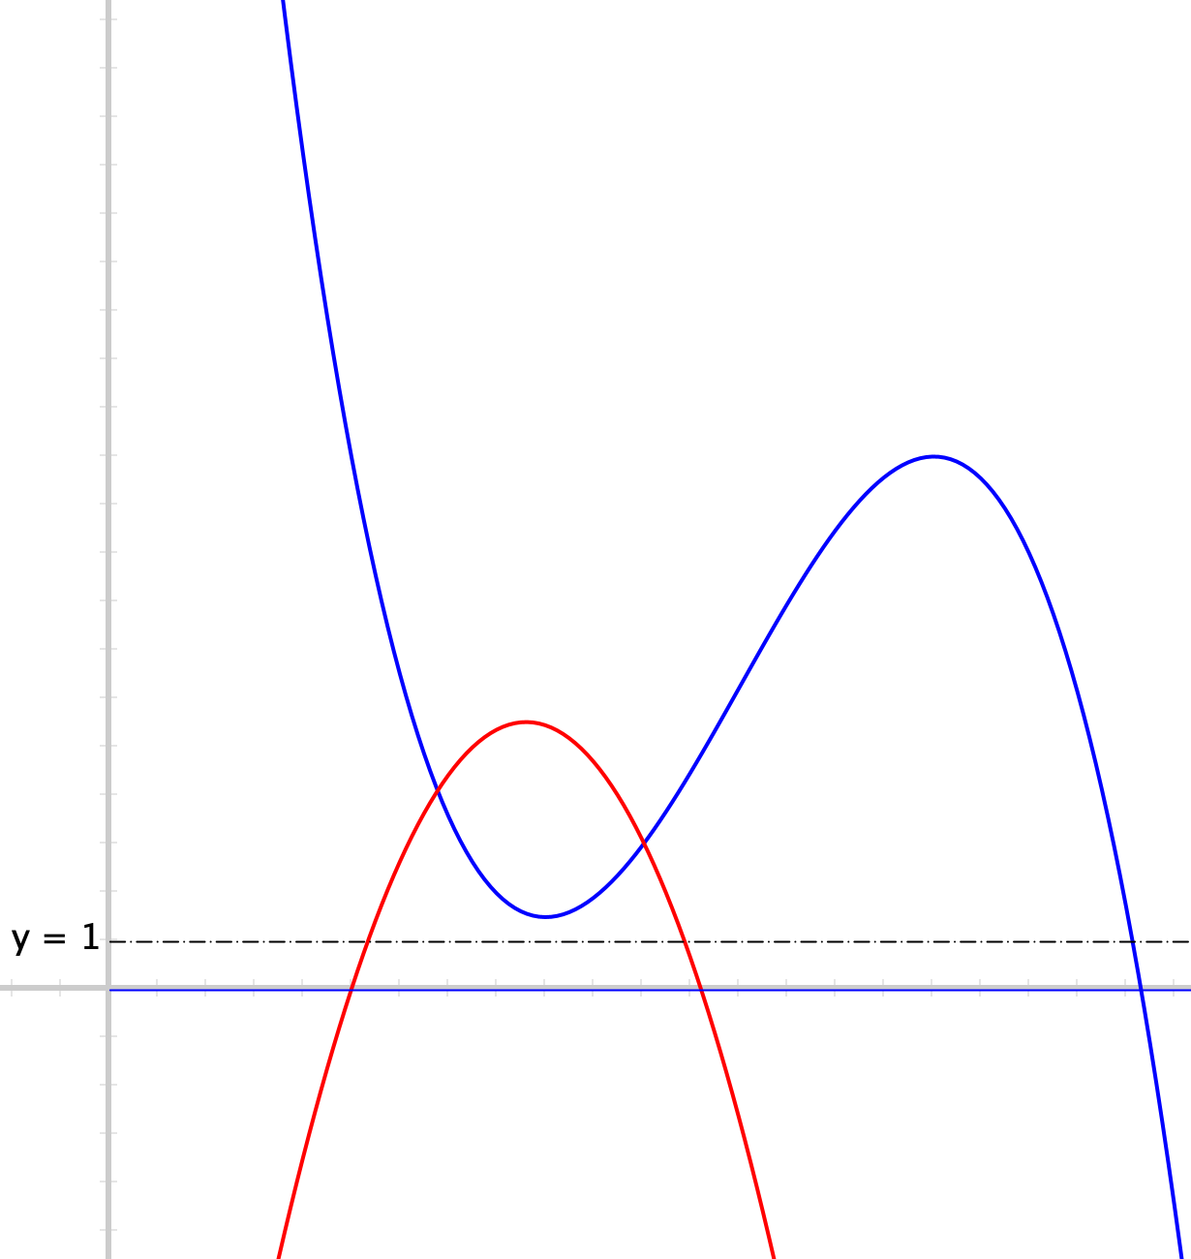
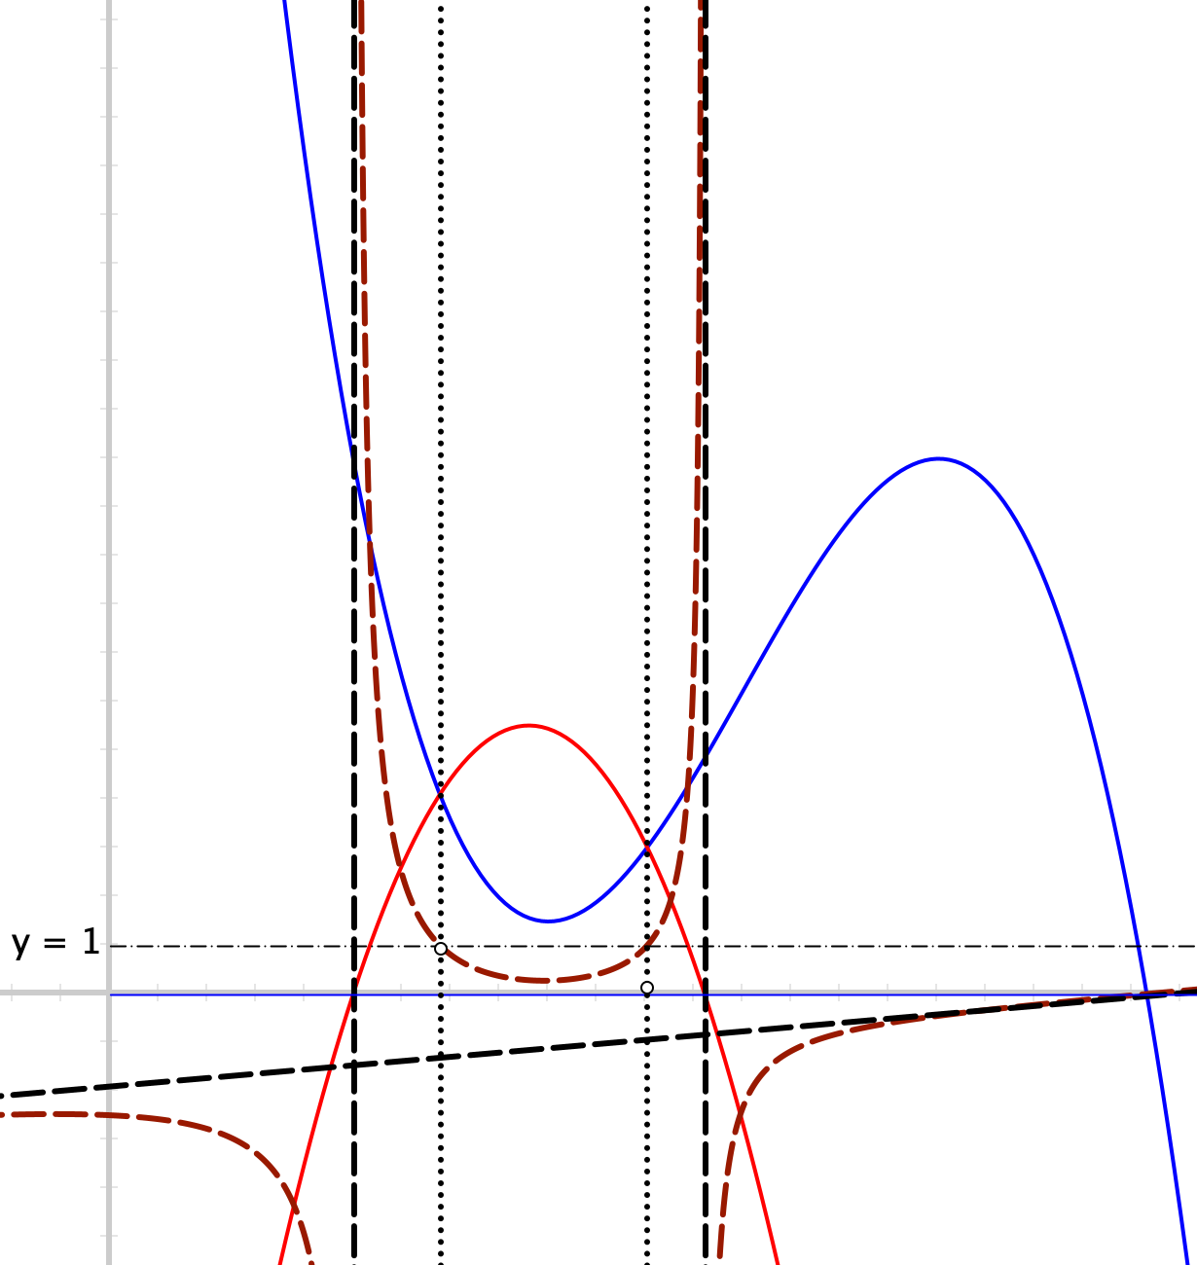

Rational Polynomials
Predict everything
you can of the
rational polynomial arising from the
blue numerator and red denominator
Pedagogic Modes
Individual work
Collective work
Tutor led work
Single diagram
Sequence of diagrams
Applet

Slide 16
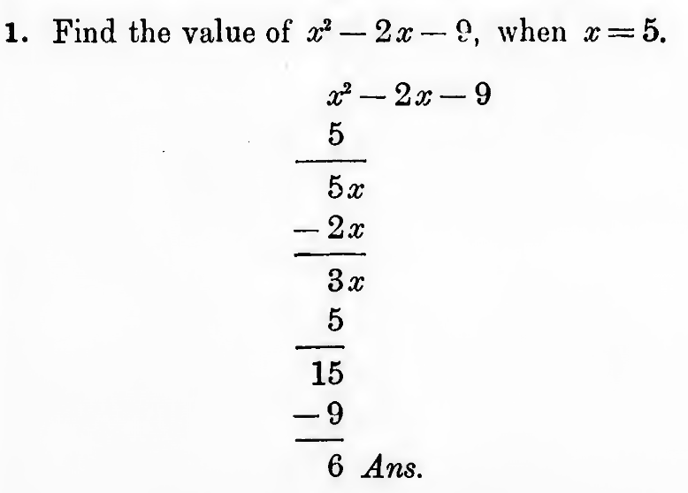
Exercise
What is happening?
What is achieved?
What generality is being illustrated?
Working on
an exercise

Slide 17
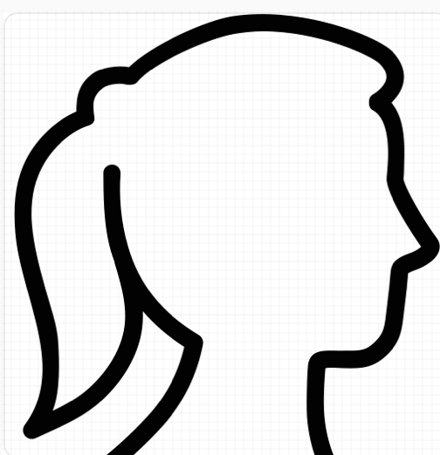
Student Actions
Watching
Listening
Reading
Imagining
Following
Where exposed to mathematical language?
Construing
Pondering
Considering
Where exposed to mathematical reasoning?
Exercising
Reconstructing
Exploring
Who creates
questions or examples?
Which actions require
teacher/tutor presence?
Developing into a practice?

Slide 18
Attention Conjectures
If people are not attending to the same thing(s),
then communication is likely to be disrupted and at best partial
If people are attending to the same things, but in different ways,
then again, communication is likely to be disrupted and at best partial
Holding Wholes (gazing)
Discerning Details
Recognising Relationships
Perceiving Properties
Reasoning on the basis of agreed properties
Being object of attention:
Positive
Negative
Neutral
Paying attention to others:
Listening
Appreciating
Valuing

Slide 19
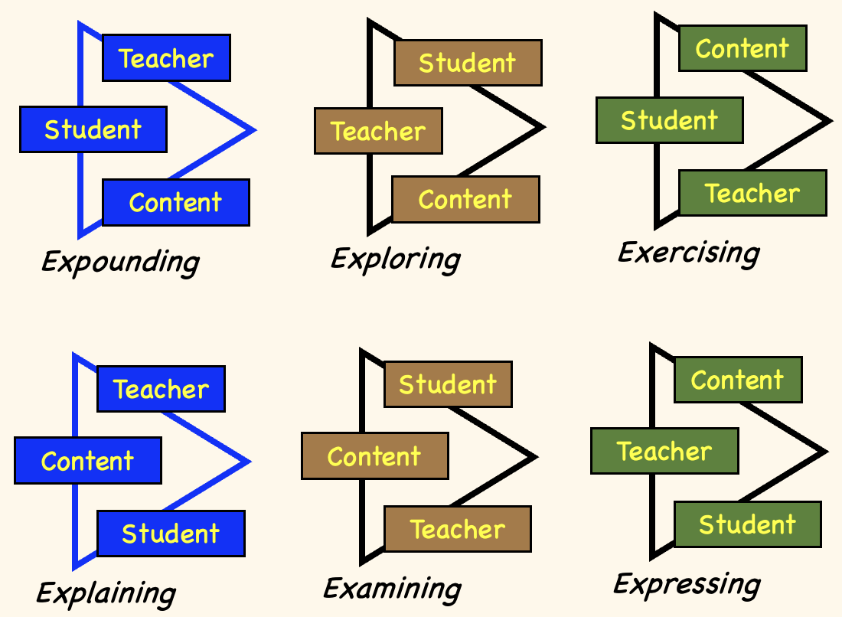
Six Modes of Teaching-Learning-Maths
Proposal: six different ways in which teacher, student and content can inter-act
Conjecture: all six are needed to fully enrich learners’ experience
‘Being of one accord’
Attending to the same things, in the same way
Engaging in the same mode of interaction
For example, not simply
‘putting in time doing tasks’
when you could be
‘exploring’
Where and when do these modes normally take place in classrooms?
Which might be usefully flipped or the ways of working migrated?

Slide 20
Actions
Teacher
Student
Content
Initiator
Mediator
Student
Teacher
Student
Content
Content
Teacher
Responder
Expounding
Exploring
Exercising
Teacher
Student
Content
Content
Content
Teacher
Student
Teacher
Student
Explaining
Examining
Expressing

Slide 21
Milieu
Interactions between Learner, Teacher and Mathematics
take place within an ethos, which has aspects of
  Espoused and manifested values
  Classroom rubric (pedagogical and social practices)
These all amount to the direction and form of attention
  Who or what gets what sort of attention

Slide 22
Resources
Learners need access to requisite resources corresponding to the mode of interaction envisaged
Tasks need to be formulated so as to contribute to and direct attention appropriately in, the mode of interaction envisaged
Mind the
overheads!
Mind the
Gap!
Software
Appropriate
Tasks
Opportunities to locate
and fill in gaps in
comprehension,
appreciation,
performance
WTTT: Worthwhile
Things Take Time
Time
Set impossible task so that in discussion learners appreciate the conditions necessary to make a theorem possible or procedure useable
Ethos of affective
Engagement:
Curiosity,
Puzzlement
Interest
Engagement
Commitment
Show-and-tell using software followed by exercises and exposition followed by tutorial
Immersion
contrasted with
watching

Slide 23
Flipping Classrooms or Migrating Ways of Working
Learners doing for themselves what was once done for them:
  Using classroom interactions mostly for expressing, explaining, and even examining, but also developing ways of exploring and exercising;
  Providing audience (peers, tutor) as
  immediate support;
  infrequently used for expounding.
  Using out-of-class time for expounding,
  but also some exploring, some exercising,
  practice in expressing to oneself
Importance of
self-explanations
and
personal narratives

Slide 24
‘Slowly (Sensitively) Migrating Ways of Working
Engage learners in working on a diagram, a set of exercises, an animation
  Say What You See
  Can you See …
  How are … and … related?
  What is the phenomenon? (what is happening?)
Exposing a phenomenon; Making Conjectures
Exploring the phenomenon, the conjecture(s)
Reasoning to justify the conjecture, to explain the phenomenon
Refining that reasoning to be convincing but succinct
Theorem
comes from the Greek for
“to look at”
“a way of seeing”
Importance of working on
discerning details
recognising relationships
perceiving (general) properties
To prove a theorem
is
to get others to see what I am seeing
so that learners can do this for themselves

Slide 25
Pedagogical Actions become Learning Actions
Activity
Ways of working
Imagine …
Picture/Poster
Animation
Stated phenomenon
Set of exercises
(structured)
Say What You See
Watch What You Do
Discerning Details
Recognising Relationships
Perceiving Properties
as being instantiated
Reasoning using
agreed properties

Slide 26
Stimuli and their Uses
Phenomena to be explained
  Exploration: teacher-guided or learner self-directed
  Followed by exposition
Concepts to be identified & exemplified (by tutor, by learner)
Procedures to be integrated and interiorised
  Exercises (or exercise-exploration); variation principle

Slide 27
Follow Up
PMTheta.com
John.mason@open.ac.uk
Mathematics Teaching Practice: a guidebook for university and college lecturers, Horwood Publishing, Chichester. 2002 (100 tactics)
Questions and Prompts for Mathematical Thinking, ATM, Derby.
What Do we Really Want Students to Learn? Teaching At A Distance 25, p4-11. (1984)
Which Medium, Which Message, Visual Education Feb 1979, p29-33.

Slide 28
Task Sequence
Ways of Working
Transition from
Teacher-led to Student-driven
Polynomials varied
Rotating the graph of a function
Fixed-Width Chords
Chordal rise
Chordal slope
  Contrast with FE chords
Mid-Chord Gap
Chordal Triangle
Chordal Triangle constructs
Chordal Mid points
Working on & with
Imaginings
Pictures
Animations
Applets
Worked Examples
Expositions
Exercises
Teacher provided
Student constructed
Exercises for gaining facility and familiarity
Opportunity to ask questions
Opportunity to express to others
Explorations to gain richness of concept images
Opportunity to immerse oneself in fresh ways of thinking and acting
Opportunity to display comptence

Slide 29
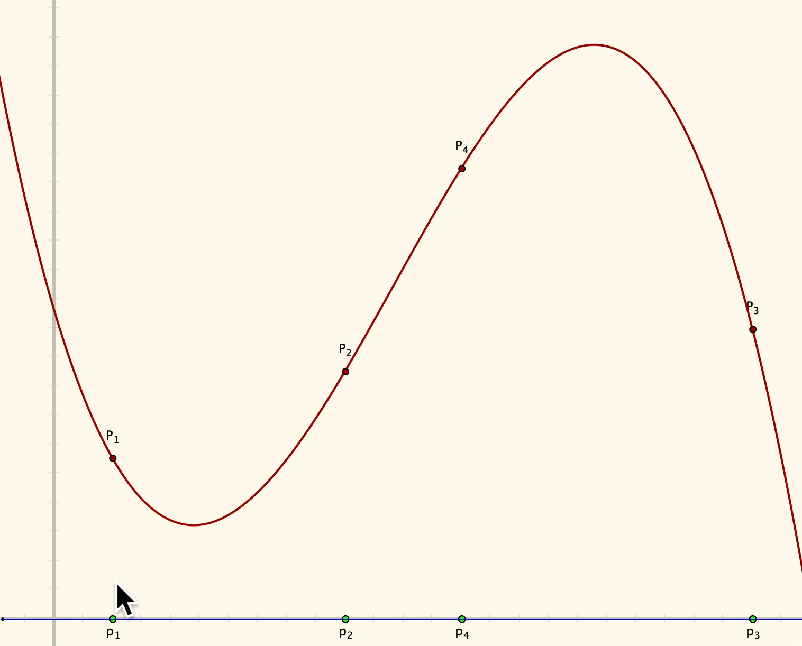
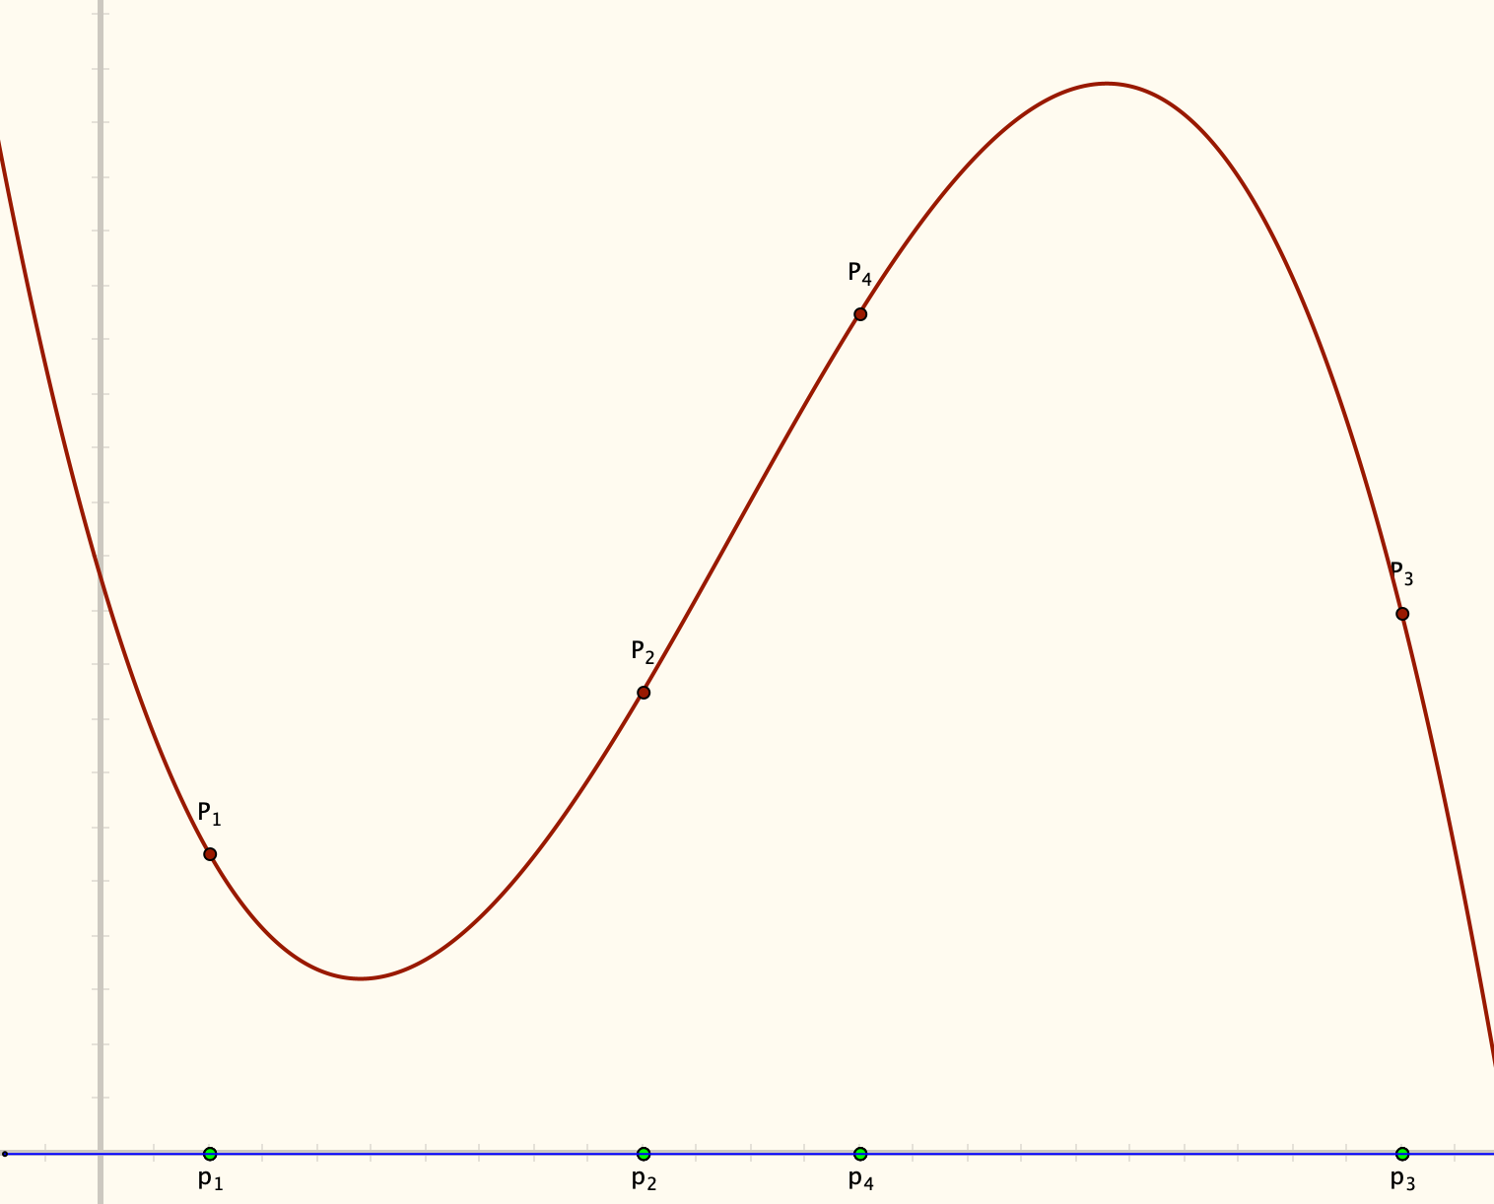
Getting Started
Probably not a familiar task
Imagining
As preparation
Imagine the graph of a cubic polynomial
Imagine four points on that cubic
Imagine one of those points moving up and down, dragging the cubic with it
Building power to imagine
Seeing
Say What You See
(or Saw)
Anticipating
Conjecturing
Sense of
possible variation
Concept Image

Slide 30
Chords
Imagine the graph of a Quintic (degree 5) polynomial
Imagine a chord drawn between two points on the curve
I invite you to be interested in what happens as the interval specifying the chord gets smaller and smaller
There are two ways to control the chord
  Fixing the width, driving the chord along the curve by its midpoint, and graphing the chord-property of interest
  Fixing a point on the curve, driving the chord length to 0, plotting the chord-property of interest,
  THEN doing this for another (all other) points on the curve.

Slide 31
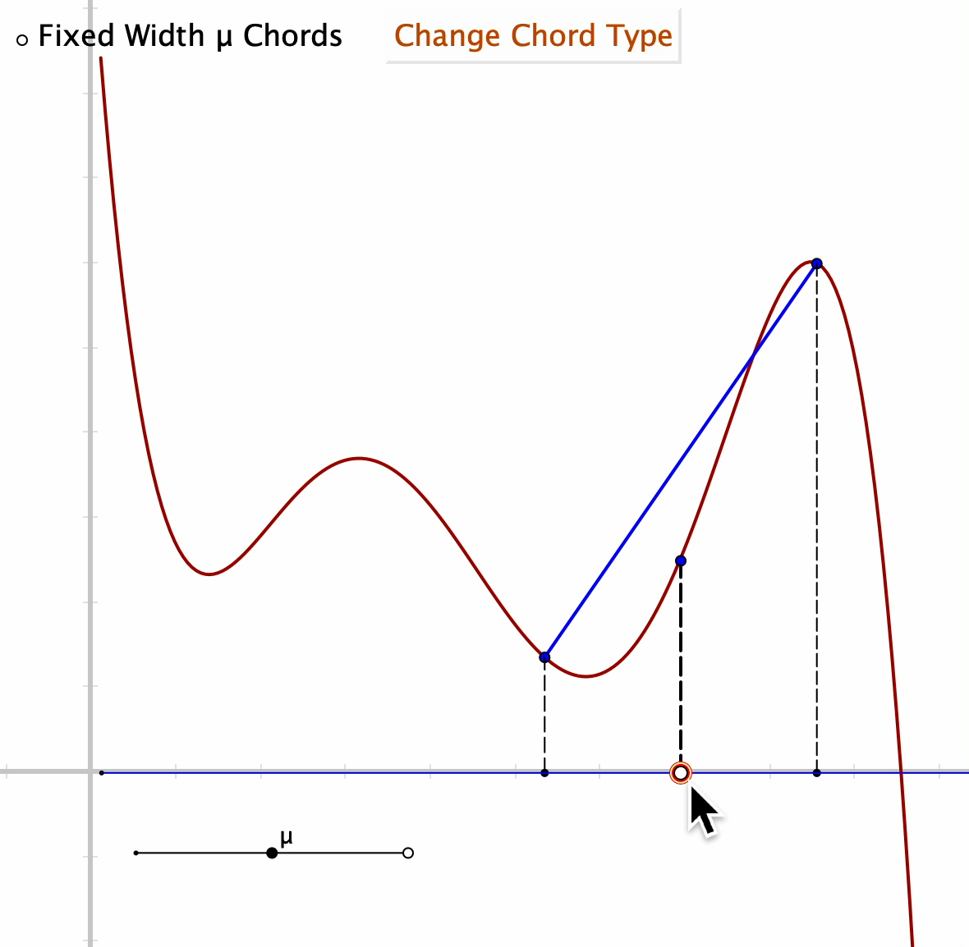
Two Kinds of Chords

Slide 32
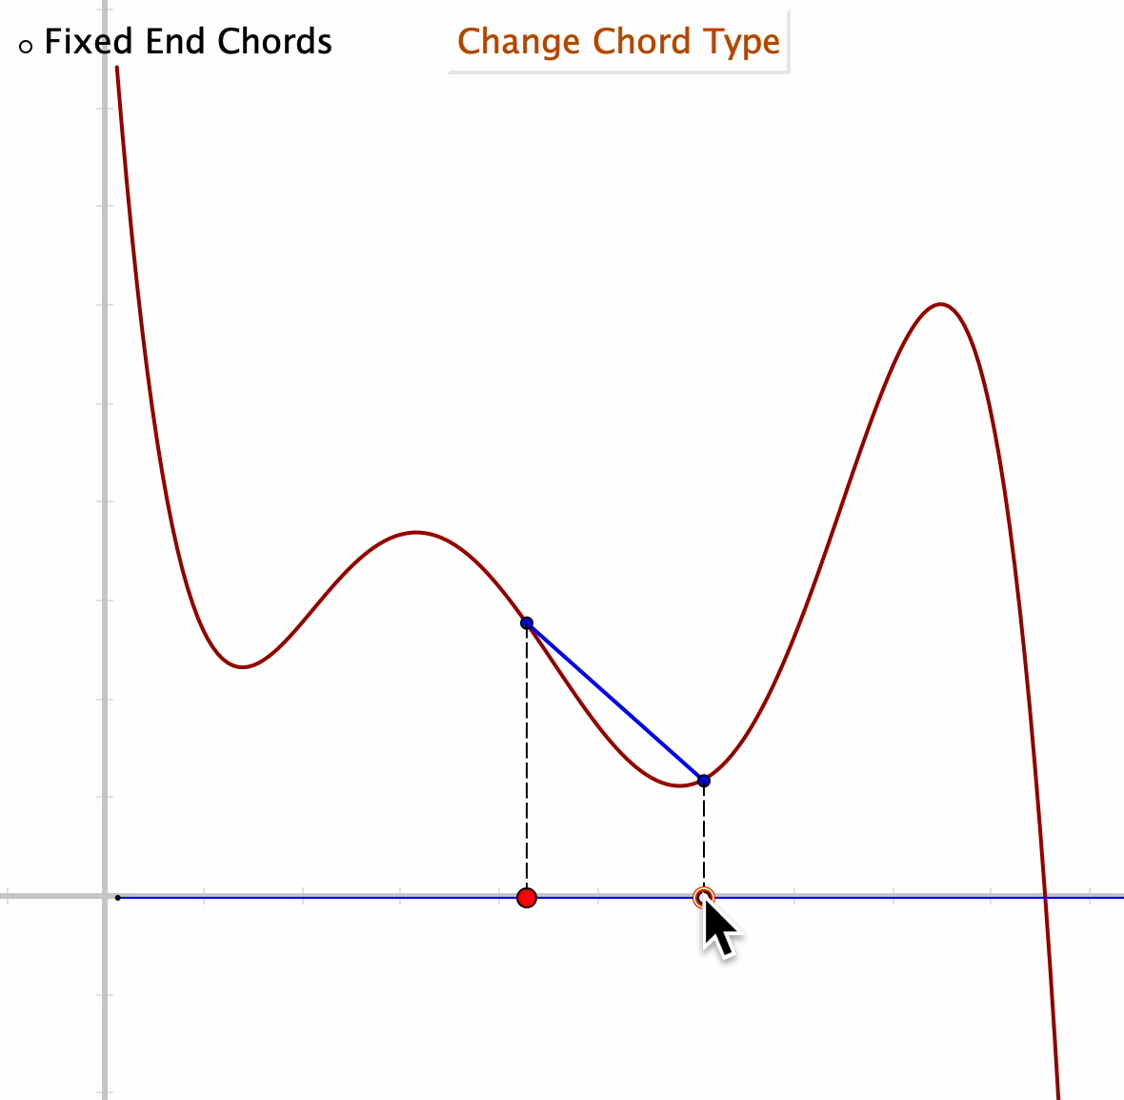

Slide 33
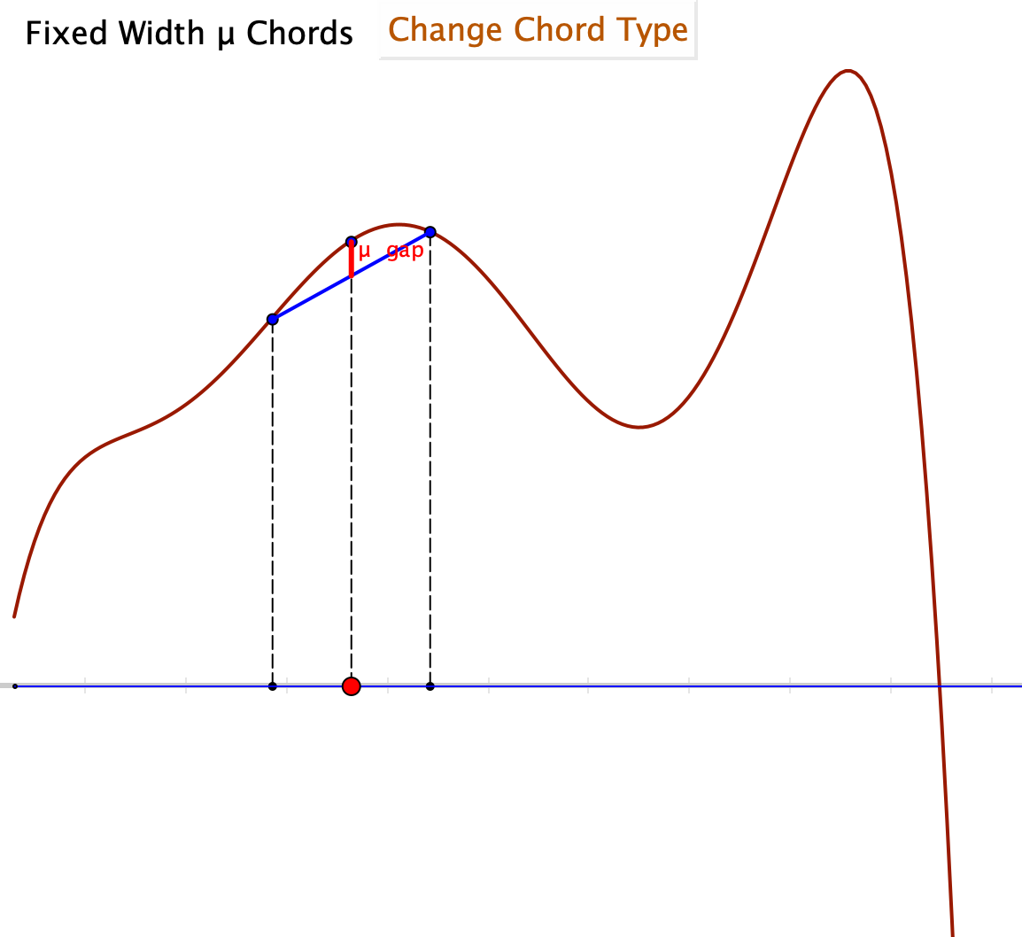
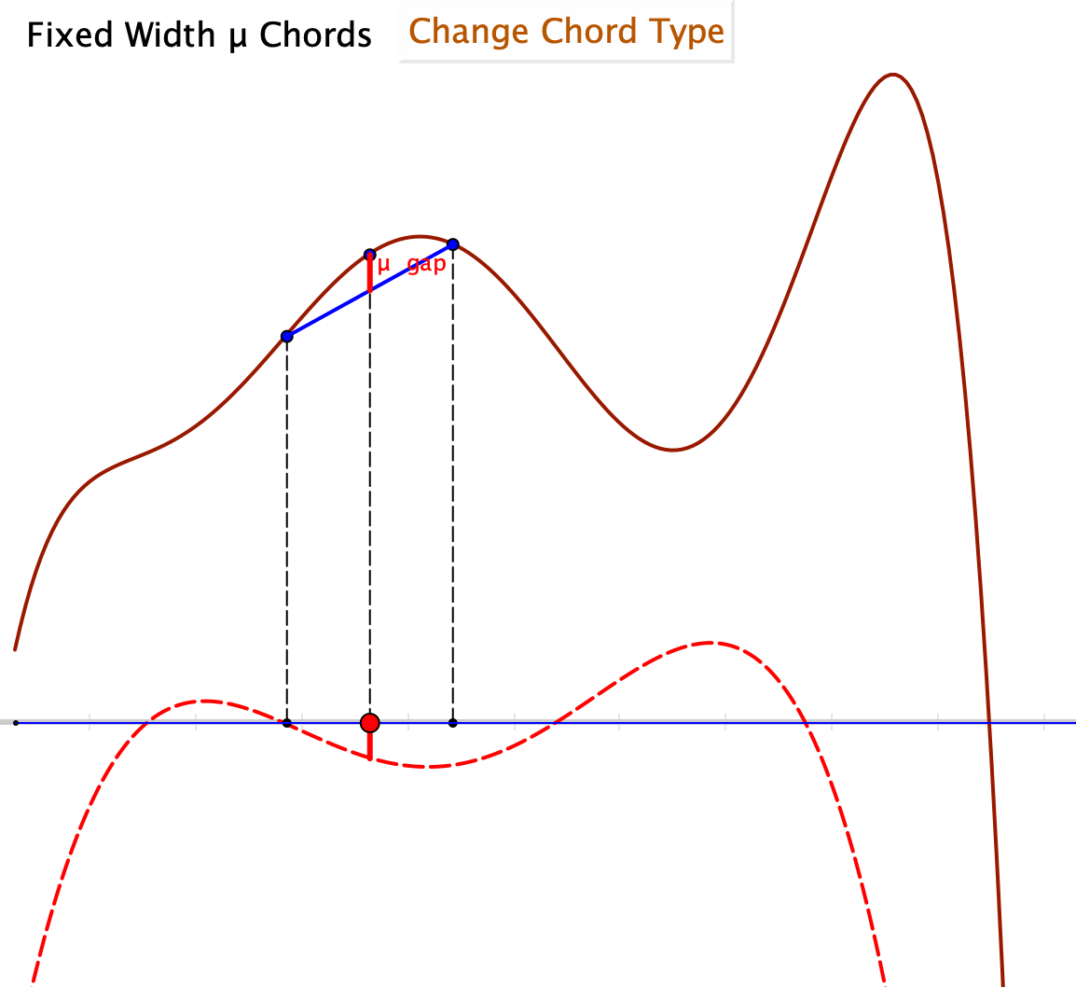
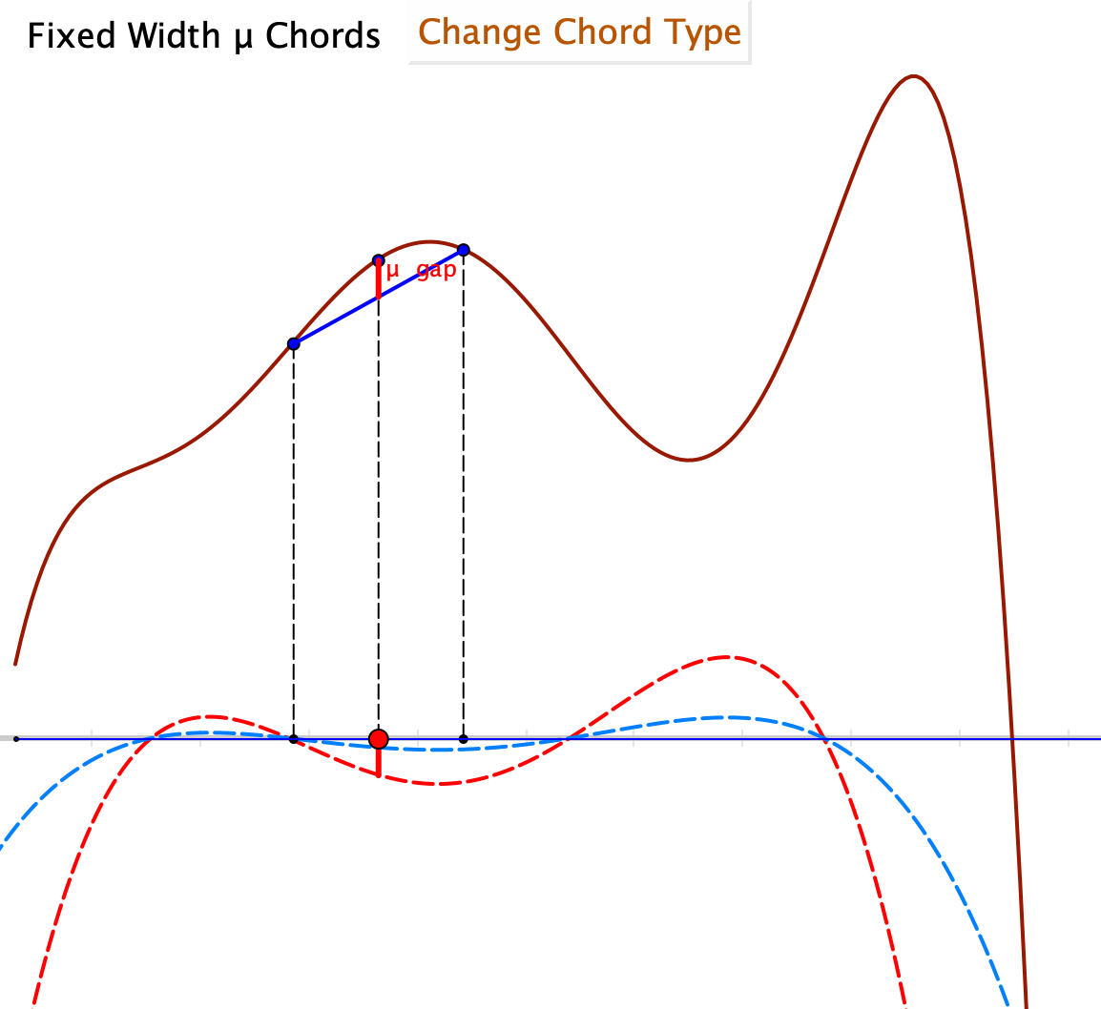
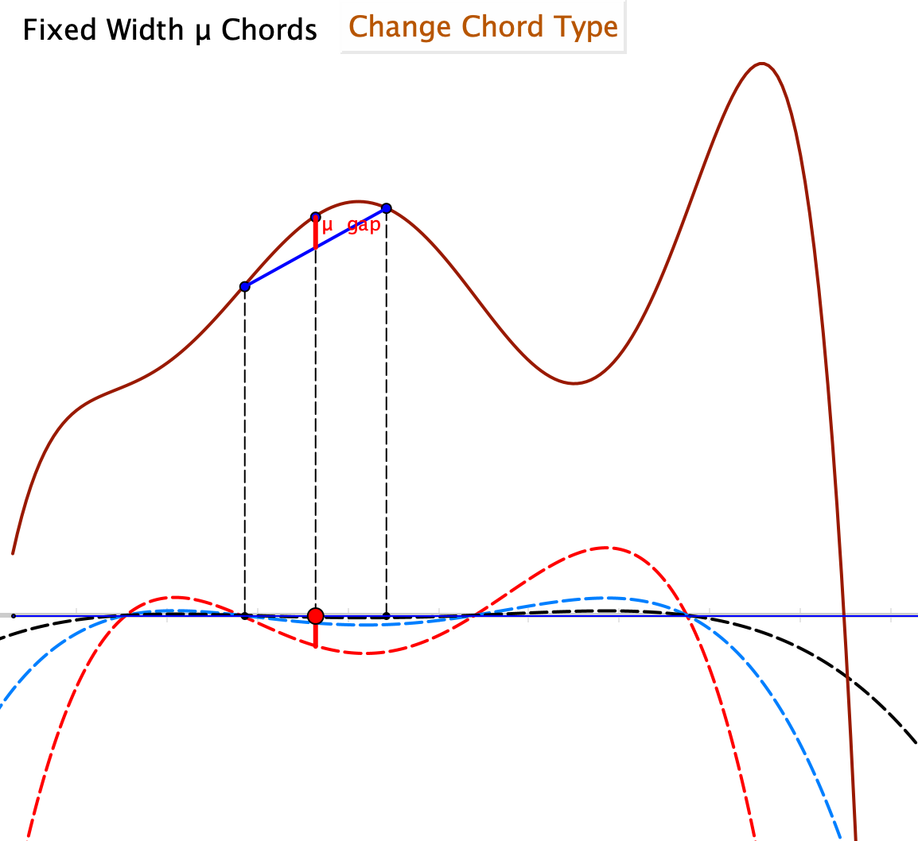
Graphical Chords and Chordal Graphs: Mid-point gap

