Slide 1
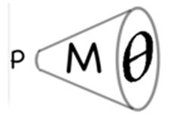

Enacting variation theory in the design of task sequences in mathematics education
University of Oxford
Dept of Education
Anne Watson
VT SIG
Oxford 2014

Slide 2
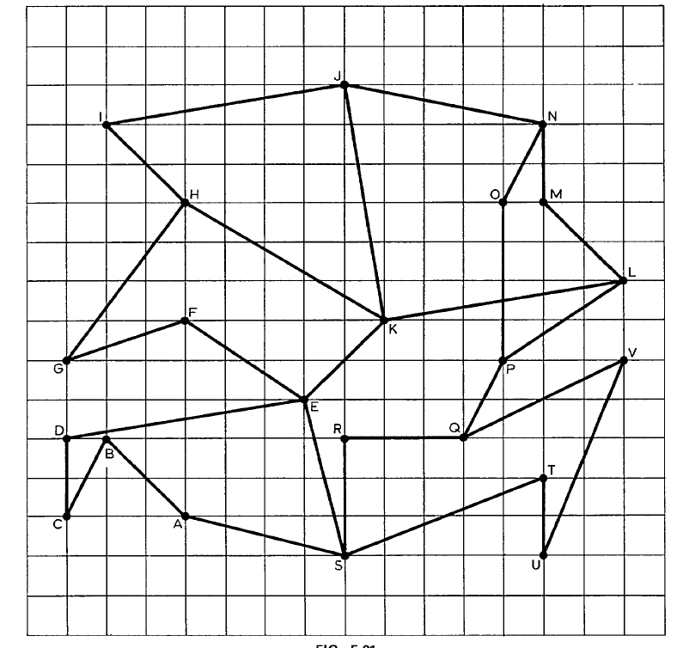

Slide 3
Variation
Slope and position are varying
The question draws attention to slope
Seek similarity among line segments (compare)
Similarity is called ‘vector’ (generalisation)
Define vector
How do they learn that position does not matter? (need vector AND position; fusion)
Limited range of change

Slide 4
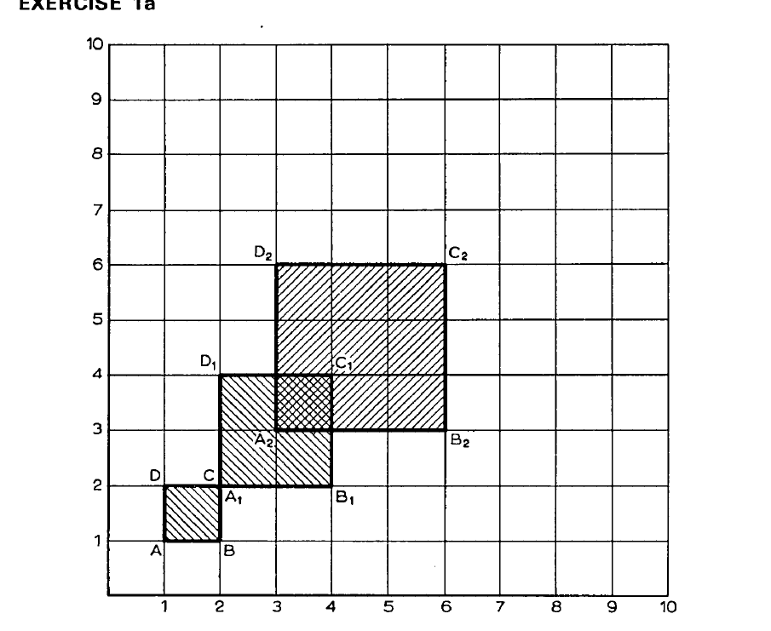

Slide 5
Variation
Size and position vary; shape invariant
Can discuss size or position (intended variation is the same)
Relation is called ‘enlargement’ (generalisation)
Identify properties
Size and position vary together (not fusion; dependency relation)
Limited range of change

Slide 6
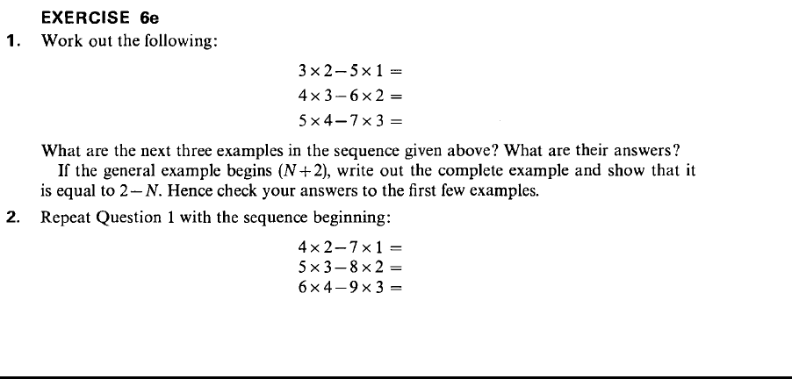
Midlands Mathematics Experiment

Slide 7
3 x 2 – 5 x 1 =
4 x 3 – 6 x 2 =
5 x 4 – 7 x 3 =
x ( - 1) – ( + 2) x ( - 2) =

Slide 8
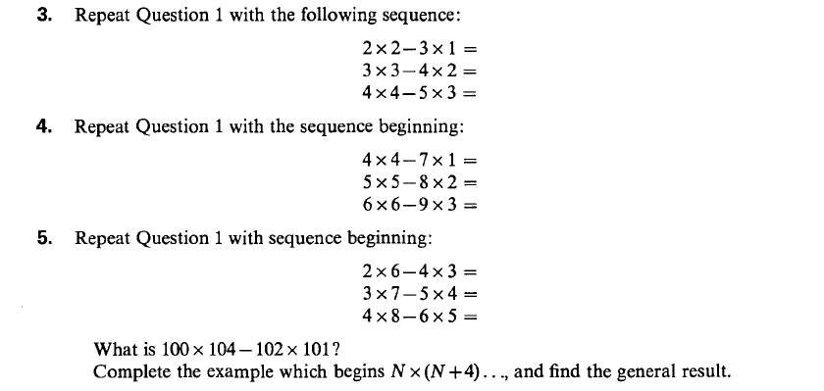

Slide 9
Variation
In each subset, numbers vary but structure does not (induction from pattern)
Generalise structure of subset
Structure varies
Structure of structures (generalisation)
Intended object of learning – structure – is not visible but limits the choice of DofV - DofPV

Slide 10
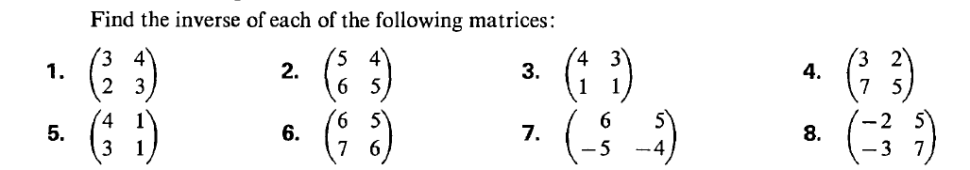
Visual variation; all answers are the same

Slide 11
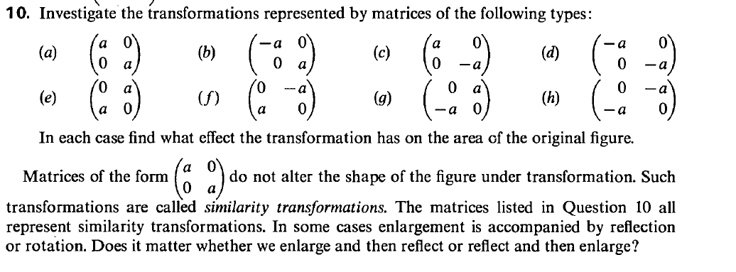
all possible variations of a subclass of matrices; compare outcomes;
relate matrix to outcome;
relate outcomes to characteristics of matrices;
dependency relationship
DofV position and sign of a and 0, range of change limited to 2x2 matrix

Slide 12
Availability of variation/invariant relation
Visual, available without teacher direction
Visual, available with teacher direction
Visual or non-visual and independent of prior knowledge
V or non-V but dependent on prior knowledge
Dependent on prior knowledge and teacher direction

Slide 13
Priorities
Mathematics
Variation theory
How VT is being used in mathematics education field more generally (building on ICMI Study and yesterday’s symposium)
Work in progress
...burning the midnight oil

Slide 14
Issues
What varies; what is invariant?
How do they relate?
Mixture of variation and invariance varies:
  Learning about things
  Learning about actions
  Learning about mathematical relations

Slide 15
What do you look at?

Slide 16
Kullberg, Runesson and Måtensson
Division with denominator <1
Counterintuitive
Varying
  object of learning (numbers in division) against a background of invariant relations
  outcomes
  presentation in lessons

Slide 18
Issues
Mixture of variation and invariance; visual variation offers several DofV and RofC
Role of attention to focus on variation in relation
Relation is about dependency (not fusion)
Talk about ‘division’ as an abstract idea, not as a calculation

Slide 19
What do you look at?

Slide 20
Sun
OPMS: one problem - multiple methods of solution
OPMC; one problem - multiple changes (transformations)
Varying
  actions (enactive –iconic-symbolic)
  representations
IOOL
  deriving facts, i.e. method of variation
  invariant relationship between addition and subtraction

Slide 21
Big problem for variation theory
You cannot vary an invariant mathematical dependency relation when that is the intended object of learning
  Can you vary its critical features?
  Can you offer varied examples? (induction)

Slide 22
Dynamic geometry

Slide 23
What do you look at?

Slide 24
Leung
Variation used to explore possibilities and generate examples
Direct perception is used in this task in two ways:
  enact idea of 'parallel' by sight
  researcher sees range understandings

Slide 25
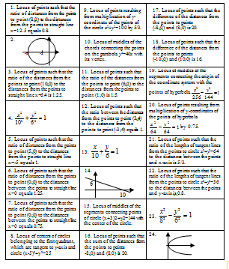
What do you see?

Slide 26
Koichu
IOOL: " mathematics teachers' awareness of structural similarities and differences" among some geometry concepts
achieve this through sorting and matching task
  Verbal; algebraic; graphical
  Algebra: first distraction (hindrance)
  Visual graphics: second distraction (familiarity)
Final version verbal only – no visual or symbolic impact; vary objects and generators only
Relate objects and their properties

Slide 27
The problem of abstraction

Slide 28
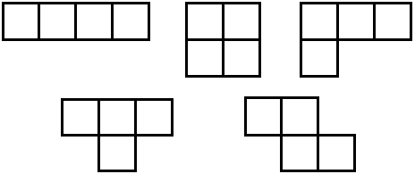

Slide 30
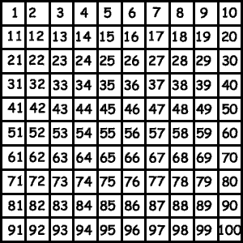

Slide 31
1 | 2 | 3 | 4 | 5 | 6 | 7
8 | 9 | 10 | 11 | 12 | 13 | 14
15 | 16 | 17 | 18 | 19 | 20 | 21
22 | 23 | 24 | 25 | 26 | 27 | 28
29 | 30 | 31 | 32 | 33 | 34 | 35
36 | 37 | 38 | 39 | 40 | 41 | 42
43 | 44 | 45 | 46 | 47 | 48 | 49

Slide 32
1 | 2 | 3 | 4 | 5 | 6 | 7 | 8
9 | 10 | 11 | 12 | 13 | 14 | 15 | 16
17 | 18 | 19 | 20 | 21 | 22 | 23 | 24
25 | 26 | 27 | 28 | 29 | 30 | 31 | 32
33 | 34 | 35 | 36 | 37 | 38 | 39 | 40
41 | 42 | 43 | 44 | 45 | 46 | 47 | 48
49 | 50 | 51 | 52 | 53 | 54 | 55 | 56
57 | 58 | 59 | 60 | 61 | 62 | 63 | 64

Slide 33
New question-types
On an 9-by-9 grid my tetramino covers 8 and 18. Guess my tetramino.
What tetramino, on what grid, would cover the numbers 25 and 32?
What tetramino, on what grid, could cover cells (m-1) and (m+7)?
New object: grid-shape relation

Slide 34
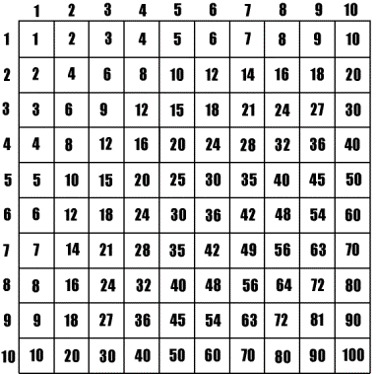
Generalise for a times table grid

Slide 35
New question-types
What is the smallest ‘omino’ that will cover cells (n + 1, m – 11) and (n -3, m + 1)?
New object: cell-shape relationship

Slide 36
8 | 13 | 20 | 29 | 40 | 53 | 68 | 85 | 104
13 | 18 | 25 | 34 | 45 | 58 | 73 | 90 | 109
20 | 25 | 32 | 41 | 52 | 65 | 80 | 97 | 116
29 | 34 | 41 | 50 | 61 | 74 | 89 | 106 | 125
40 | 45 | 52 | 61 | 72 | 85 | 100 | 117 | 136
53 | 58 | 65 | 74 | 85 | 98 | 113 | 130 | 149
68 | 73 | 80 | 89 | 100 | 113 | 128 | 145 | 164
85 | 90 | 97 | 106 | 117 | 130 | 145 | 162 | 181
104 | 109 | 116 | 125 | 136 | 149 | 164 | 181 | 200

Slide 37
Variations and their affordances
Shape and orientation (comparable examples)
Position on grid (generalisations on one grid)
  Size of number grid (generalisations with grid size as parameter)
  New abstract object
Nature of number grid (focus on variables to generalise a familiar relation)
Unfamiliar number grid (focus on relations between variables)
New abstract object

Slide 38
The problem of relation

Slide 39
Giant

Slide 40
Role of formatting to draw attention to variation and invariance
object | g | ÷ | h | = | r |  | g | ÷ | r | = | h |  | h | x | r | = | g
shoelace
bus pass width
footprint

Slide 41
Use of variation in mathematical tasks
(cf. Ingerman)
IOOLs are often an invariant abstract relationship that can only be experienced (mediated) through varied examples
relating varied input and dependent output (Kullberg, Sun)
the intended object of learning might be awareness of an invariant relation (Koichu)
attention drawn to intended relationship (Kullberg, Sun, Watson)
  Role of teacher
  Role of layout
variation can sometimes be directly visible, such as through geometry or through page layout, but often requires interpretation of symbolic forms that are not visualisable (Kullberg, Leung, Koichu, Watson)
the learners' action as a result of perceiving variation can be intuitive and superficial (Koichu)
role of limited range of change

Slide 42
Does VT bring something to maths that cannot be seen already?
Maths is about variation/invariance
VT gives focus, language, structure
VT gives commitment to analysing and constructing variation
Experiential, no need for ‘black box’ e.g neuroscience; laboratory studies

Slide 43
VT focuses on ...
What is available to be learnt?
Where and how can attention be focused?
What alternative generalisations are available for learners?

Slide 44
Questions arising ...
How to focus on dependent relations which do not vary?
How to focus on structures that are abstract, invisible?
  when relevance is outside students’ experience, being in their future abstract mathematical world.

Slide 45
Role in English policy and practice
Reason requires knowledge
Shanghai
Textbook design
Professional training and development
..... ☹

Slide 46

anne.watson@education.ox.ac.uk
University of Oxford
Dept of Education

