Slide 1
Doing, Learning & Teaching Mathematics: developing the inner explorer
The Open University
Maths Dept
Promoting Mathematical Thinking
University of Oxford
Dept of Education
Anne Watson & John Mason Norway Sept 2016
Notes:
Worthwhileness requires Curriculm Validity-transparency

Slide 2
Our abstract
Exploration is a key component of mathematical behaviour. It is important that learners of all ages develop habits of exploration throughout their mathematics learning. The propensity to explore feeds an “I can and I will” disposition towards mathematics. As teacher educators we are two steps removed from classroom learning, and unless we maintain and develop our own ‘inner explorer’ we may lose our validity when working with prospective teachers. In this session, participants will be invited to work on several situations which offer opportunity to develop their ‘inner explorer’.
These will provide the basis for further discussion on developing the inner explorer.

Slide 3
Practices
(action)
Zones for Potential Development
Dissonant Zone
For teachers and
for us as educators
Disposition-lacking Zone
Knowledge-lacking Zone
Congruent Zone
Can you imagine yourself ‘doing’ something in your situation, soon?
Knowledge separate from disposition and practice
Disposed to, but disconnected from knowledge and practice
Practice-lacking Zone
Knowledge
(maths, pedagogy)
Dispositions (sensitivities to notice)
Andy Ragatz Dphil thesis

Slide 4
Self & Others
Develop my own inner explorer, otherwise I will not know what to promote & support in the development of others.
To be sensitive to learners, I need to have recent immediate parallel experience of my own.

Slide 5
Lived Experience
Our way of working: do mathematics together and reflect on what we did, and how and why we did it - what prompted us?
Simply talking about …
problem-solving heuristics does not change practices, knowledge or dispositions
pedagogical strategies does not enable those practices

Slide 6
Authentic Mathematical Activity
Us (inner explorer)
Teacher educators (inner explorer)
Teachers (I can and will develop myself and others)
Students (I can, I will and I do explore as a habit)

Slide 7
Billiard Tables

Slide 11
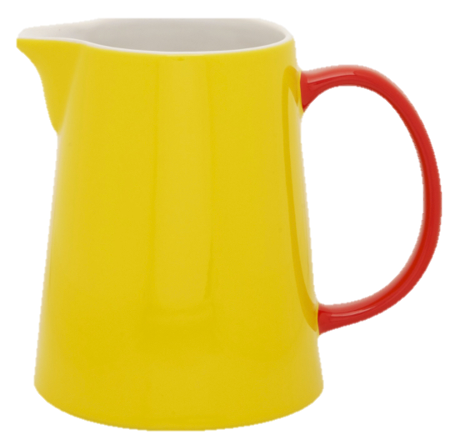
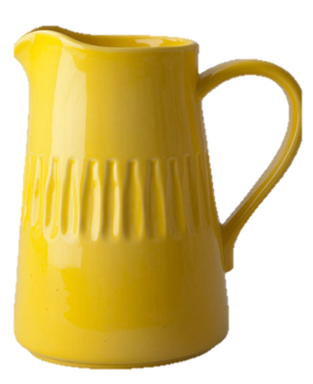
Jugs
Aim: to obtain 1 Litre
Actions:
pouring from one jug to another; refilling from or or emptying into the bucket.
Jug sizes:
2 Litres
3 Litres
3 Litres
5 Litres
2 Litres
4 Litres
3 Litres
6 Litres
make up your own

Slide 12
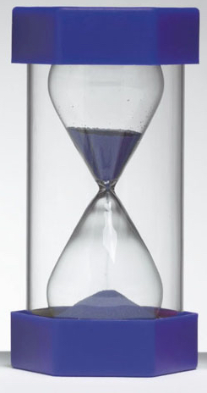
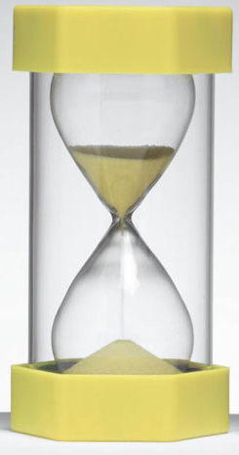
Sand-Timers
Aim: to Measure 1 minute
Actions:
Flip one or other or both timers
Timer times:
2 mins
3 mins
3 mins
5 mins
2 mins
4 mins
3 mins
6 mins
make up your own

Slide 13
Task Reflections
Can you
cross every square?
make any volume?
measure any time?
What is the same, and what different about these three?
What did you do?
What could you have done? What variations are possible?
What mathematics has been encountered?
What curriculum validity is there?
Notes:
Explore how? Conjecture? test? What is the experience like?
Whole number arithmetic;
Factors, common factors, highest common factors
Linear combinations of co-prime numbers
Linear combinations of numbers that have common factors
Standard notations

Slide 14
Marbles 1
If Anne gives one of her marbles to John, they will then have the same number of marbles.
What can you say about the number of marbles they each started with?
Recast this task in terms of people on Anne’s boat and people on John’s boat

Slide 15
Marbles 1A
Anne and John are standing on a number line. If Anne moves to the left one position and John to the right one position, they will be standing on the same position.
What can be said about their relative positions originally?
Anne & John are standing on a number line. If Anne moves one step towards the origin, and John moves one step away from the origin, they will end up standing on the same place.
What can be said about their relative positions originally?
What can be varied?

Slide 16
Marbles 2
If Anne gives one of her marbles to John, they will then have the same number of marbles; if John now gives two of his marbles to Sikunder, they will then have the same number.
What can you say about the relation between Anne’s and Sikunder’s marbles to start with?

Slide 17
Marbles 2A
If Anne gives one of her marbles to John, and John gives two of his marbles to Sikunder, then they will all have the same number.
What can you say about the relation between Anne’s, John’s and Sikunder’s marbles to start with?

Slide 18
Marbles 3
If Anne gives John one of her marbles, she will then have one more than twice as many marbles as John then has.
If John started with 12 marbles, how many did Anne start with?

Slide 19
Marbles 4
If Anne gives John one of her marbles, she will then have one more than twice as many marbles as John then has.
However, if instead, John gives Anne one of his marbles, he will then have one more than a third as many marbles as Anne then has.
How many marbles did they each have at the beginning? At the end?
Recast this as people on boats
Recast this as movements on the numberline

Slide 20
Marbles 5
John has some green marbles and some red marbles;
Anne has some blue marbles and some red marbles;
If Anne gives John one of her blue marbles for each red marble that John has, and if John gives Anne two of his green marbles for each red marble that Anne has, what can be said about the relationship between the number of marbles Anne started with and the number that John started with?

Slide 21
Mean Calculations
Amongst 8 people the mean number of CDs they each own is 140.
One person leaves the group and the mean decreases by 20.
How many Cds did that person have?
Instead, one person joins the group and the mean decreases by 20.
How many CDs does that person have?

Slide 22
Task Reflections
What did you do?
What could you have done? What could be varied?
What mathematics has been encountered?
What is the curriculum validity?
Notes:
Explore how? Conjecture? test? What is the experience like?
Whole number arithmetic;
Factors, common factors, highest common factors
Linear combinations of co-prime numbers
Linear combinations of numbers that have common factors
Standard notations

Slide 23
Pressures & Tensions
Developing dispositions over time
Developing behaviour
because it says so in the curriculum
Developing curiosity
Developing behaviour
for being tested
?
Dispositions develop because of successes in something worthwhile, felt as worthwhile:
knowledge, skill, solving real problems, seeing something intrinsically mathematical, the mental ‘high’
An extra ingredient for teachers is recognising curriculum validity
Notes:
Dispositions develop because of successes in something worthwhile, felt as worthwhile: knowledge, skill, solving real problems, seeing something intrinsically mathematical, the mental high. The extra ingredient for teachers is recognising curriculum validity
Dispositions develop because of successes in something worthwhile, felt as worthwhile: knowledge, skill, solving real problems, seeing something intrinsically mathematical, the mental high. The extra ingredient for teachers is recognising curriculum validity
Changing teaching: Working in all zones of change: beliefs, practices and knowledge
Working on maths; recognising certain aspects of doing mathematics, naming them, constructing narratives/stories of how they act out in the whole project of doing mathematics. Experiencing success (beliefs); through authentic work (practices); and being explicit about naming practices (knowledge)

Slide 24
Task Design: … to experience
Enactive - Iconic – Symbolic
Worlds of experience;
Modes of (re)presentation
Enactive - exploration phase leading to a need for signs and/or diagrams of some kind that can be manipulated - not real jugs and real sand-timers etc.
Iconic - making manipulable marks or diagrams to continue exploration / own questions/ generating cases to think about (make conjectures; test conjectures; verbal generalisations)
Symbolic - relating to conventional mathematics, reporting results in traditional formats, expressing generality

Slide 25
People’s Powers
Imagining & Expressing
Specialising & Generalising
Conjecturing & Convincing
Organising, Classifying & Characterising

Slide 26
Task Design and Ways of Working
Curriculum validity
Experience
Notice experience
How did it come about?

Slide 27
MSc in Teacher Education (Mathematics and Science)
Distance Learning
Practice Based
University of Oxford
www.education.ox.ac.uk

Slide 28
Further Reading
Mathematics as a Constructive Activity: learner generated examples (Watson & Mason: Erlbaum)
Questions & Prompts for Mathematical Thinking (Watson & Mason: ATM Derby)
Thinkers (Bills, Bills, Watson & Mason:ATM Derby)
Thinking Mathematically (Mason: Pearson)

