Slide 1
Pre-parative and Post-parative Play as Key Components of Mathematical Problem Solving
John Mason
Punta Arenas
Dec 2017

Slide 2
Outline
Introduction
Background to Mathematical Play (Quotations)
Leading to basic tension
Example Task
Paration and other manifestations
Paration Conjectures
Example Tasks

Slide 3
Slogans
Teaching takes place IN time; Learning takes place OVER time
Low threshold; High ceiling
It is not the task that is rich, but the whether the task is used richly
Outer Task; Inner Task; Meta Task
I am interested in specific mathematical and pedagogical actions: acts of teaching
Stimulus for this thinking:
New examination at 16+ featuring word problems and teachers (and publishers) asking for help on how to ‘teach problem solving’
Stance:
You cannot teach problem solving
You can involve people in actions by means of which they may become better at solving problems

Slide 4
Human Emotions (according to psychologists)
Distinguish 7 different emotions
Include Play & Exploration
Play is self chosen and self-directed
Play is activity in which means are more valued than ends
Play has structure, or rules, which are not dictated by physical necessity but emanate from the minds of the players
Play is imaginative, non-literal, mentally removed in some way from ‘real’ or ‘serious’ life
Play involves an active, alert, but non-stressed frame of mind
Panksepp 1998

Slide 5
Apparatus & Free Play
Caleb Gattegno (1957) chapter 1 is Free Play
Followed by a blank page or two
Then Chapter 2!
Zoltan Dienes (1963 p21)
Many people have suggested before the natural way in which children acquire knowledge is through play in some form or other. It is not at all clear, however, what the processes are that lead from play to purer forms of cognition such as construction of classifications, logical classifications and deductions
Jenny Cane (2017)
This journey of free play, initially with [Cuisenaire] rods and later with free writing, is one journey that continues across all paths on the curriculum graph. It is essential and an activity that the children never tire of, no matter how old they are.

Slide 6
Zoltan Dienes (1963 p22-23)
Manipulative play may quite imperceptibly move over to a search for regularities. When a rule or rules are found, play may occur which uses these rules. Children delight in regularities, and the formulation of a rule-structure is a kind of closure which ties up all the loose ends of past experience. Children feel safe within such a rule-structure. Once it's been thoroughly mastered, and has become part of the currency of play, the closure is often reopened by asking questions. In this case the rules themselves will be the object of manipulation and situation is open again and higher level
Dearden (1967 p145-146)
When a teacher presents a child with some apparatus or materials ... he [or she] typically has in mind someone particular conception of what he [or she] presents in this way. But then the incredible assumption seems to be made that the teacher’s conception of the situation somehow confers a special uniqueness on it such that the children must also quite inevitably conceive of it in this way too

Slide 7
Grayson Wheatley (1992 p534)
Often when manipulatives are used in teaching mathematics, the teacher demonstrates the way they are to be used and students are left little freedom to give meaning to the experience in ways that make sense to them; the way the materials are to be used is prescribed.
There is the mistaken belief on the part of the teacher that the mathematics is apparent in the materials …. This is based on the belief that mathematics is ‘still up there’ and that models ‘show’ the concepts.
The demonstration with concrete materials is quite appealing because the concepts are so vivid for those who have already made the construction. Thus there is the mistaken belief that since we, as adults, can see the mathematics in the blocks, the students will too. But the ‘seeing ‘ requires the very construction the activity is intended to teach.

Slide 8
Luis Meira (1998 p185)
… Manipulatives are not, of themselves, carriers of meaning for insight. ‘Although kinaesthetic experience can enhance perception and thinking, understanding does not travel through the finger tips and up the arm’ (Ball 1992 p47). It is through their use as tools that students have the opportunity to gain insight into their experience with them. Research has shown that for children to use concrete representation effectively without increased demands on their processing capacity, they must know the materials well enough to use them automatically (Boulton-Lewis 1998). If the user is constantly aware of the artifact it is not a tool, for it is not serving the purpose of enabling some desired activity to move toward the desired goal state (Winograd & Flores 1986). …
Students sometimes learn to use manipulatives in a rote manner, with little or no learning of the mathematical concepts behind the procedures (Hiebert & Wearne 1992) and the inability to link their actions with manipulatives to abstract symbols (Thompson & Thompson 1990). This is because the manipulative is simply the manufacturer's representation of a mathematical concept that may be used for different purposes in different contexts with varying degrees of ‘transparency’.

Slide 9
Anna Sfard (1994 0192)
Algebraic symbols do not speak for themselves. What one actually sees in them depends on the requirements of a specific problem to which they are applied. Not less important, it depends on what one is prepared to notice and able to perceive.

Slide 10
Francisco Varela (1992 p14)
The key point, then, is that the organism brings forth and specifies its own domain of problems and actions to be ‘solved;’ this cognitive domain does not exist out ‘there’ in an environment that acts as a landing pad for an organism that somehow drops or is parachuted into the world. Instead, living beings and their worlds of meaning stand in relation to each other through mutual specification or co-determination.
Francisco Varela (1996 p91)
The most important ability of all living cognition is precisely, to a large extent, to pose the relevant questions that emerge at each moment of our life. These are not predetermined but enacted, we bring them forth against a background, and the relevance criteria are oriented by our common sense, always in a contextualized fashion.

Slide 11
Tension
Setting up situations in which, through play, learners will pose pertinent, productive mathematical questions for themselves
Ensuring that learners encounter ‘scientific knowledge” which they might otherwise not encounter
Enculturating learners into posing mathematically productive problems
Winnicot (1971) sees mother-and-child as a biological unity, which after physical separation (birth) become cognitively and emotionally distinct when psychologically healthy. So too the learner in the classroom is part of an environment, constructed by adults so as to bring children into contact with scientific knowledge while becoming independent

Slide 12
Set Counts
You have some counters to place in these two sets
In how many different ways can they be placed so that S₁ and S₂ have the same number of counters
In how many different ways can they be placed so that the ratio of the number in S₁ to the number in S₂ is 3 : 2?
What is the largest number of counters that cannot be placed so that the ratio of the number in S₁ to the number in S₂ is 3 : 2?
There are closed formula for these, but not, so far as l know, for 3 set analogues
Notes:
Free Play; John Holt representative attention; fruitful mathematical question

Slide 13
Parations
Pre-paration
Imagining the situation in as much detail as possible;
Getting to know the territory; affordances; relationships
Paration
Engaging in the situation, having actions, emotions and thoughts becoming available
Post-paration
Appreciating scope of possible variation; example-space;
Turns into pre-paration for the future

Slide 14
Other Manifestations
Three-Act-Math
Dan Meyer videos or enactments
Situation without data which begs a question;
What data needed to resolve question;
Check prediction against actual
Walking-Talking through a Mock Exam
Making hidden curriculum explicit
Realistic Mathematics Education (Freudenthal)
Imagining a situation so that it becomes real
Learner Generated Examples

Slide 15
Conjecture: in order to facilitate and improve problem solving
Prompting (enculturating) learners to
Act playfully with situations
Imagine a situation context (fully, intimately)
Raise questions
Seek out relationships
All before attending to any data, doing calculations or expressing relationships (Parking first actions)
Varying conditions and data so as to become aware of a space of similar problems
NOT only before a mock exam, but as part of the rubric of the classroom.
Hidden Curriculum (Snyder
Notes:
Hidden Curriculum

Slide 16
Overflow Problem Presentation
A student has two open-topped cylindrical containers.
The larger container has a height of 20 cm, a radius of 6 cm and contains water to a depth of 17 cm.
The smaller container has a height of 18 cm, a radius of 5 cm and is empty.
The student slowly lowers the smaller container into the larger container. As the smaller container is lowered, the water first overflows out of the larger container and then eventually pours into the smaller container.
Determine the depth of the water in the smaller container when the smaller container is resting on the bottom of the larger container.

Slide 17
Overflow Presentation
Imagine a cylindrical bucket of water, the water level being near to but not at the top of the bucket.
Imagine a smaller empty cylindrical can descending slowly into the bucket, its open top always upwards.
The can stops when its bottom is on the bottom of the bucket.
What happens during the submersion process?
What questions might arise?

Slide 18
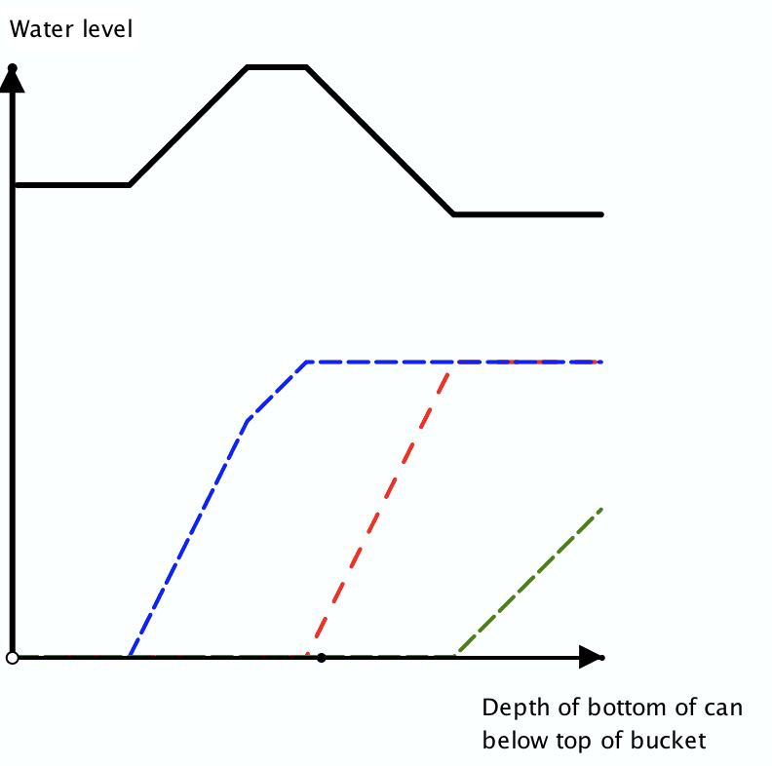
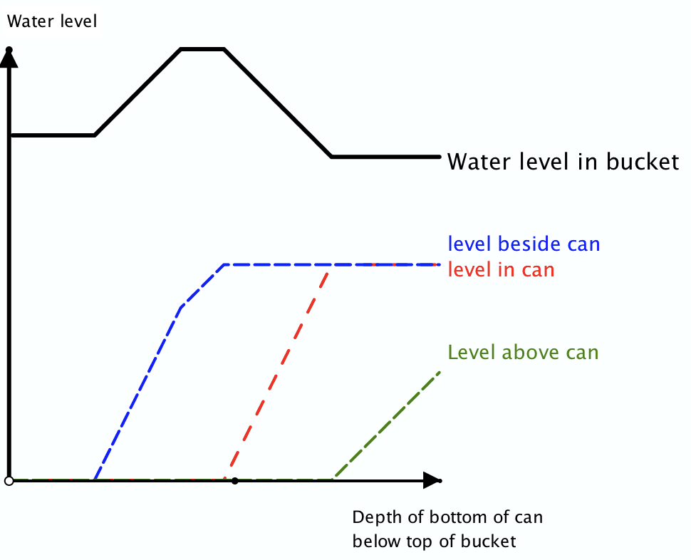
Overflow Re-Presentation
Notes:
My playfulness leads to alternative task

Slide 19
Overflow Problem
A student has two open-topped cylindrical containers.
The larger container has a height of 20 cm, a radius of 6 cm and contains water to a depth of 17 cm.
The smaller container has a height of 18 cm, a radius of 5 cm and is empty.
The student slowly lowers the smaller container into the larger container. As the smaller container is lowered, the water first overflows out of the larger container and then eventually pours into the smaller container.
Determine the depth of the water in the smaller container when the smaller container is resting on the bottom of the larger container.

Slide 20
Two Candles
Imagine you have two candles of different diameters so that they burn at different rates
What happens if the candles are lit at the same time?
What sorts of questions might be asked?
Focused free play
Suppose you are told the time taken to burn each completely.
What else do you know?
Example:
If one takes 4 hours and the other 5 hours to burn down, when will one candle be 3 times the length of the other?

Slide 21
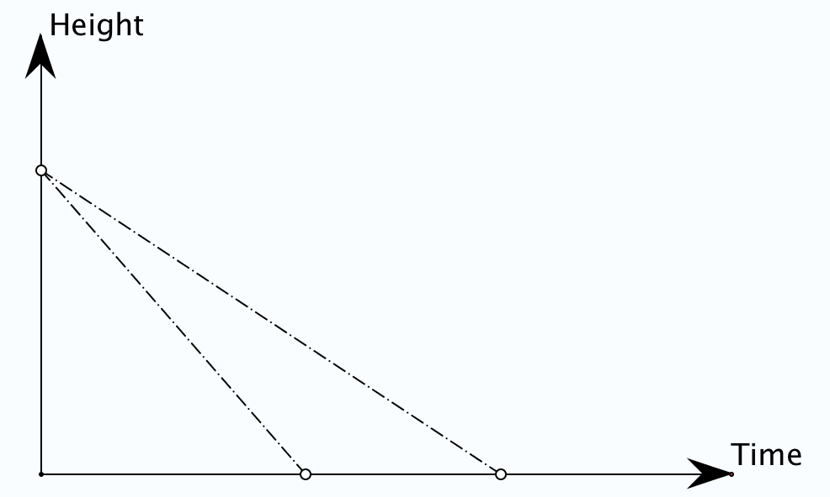
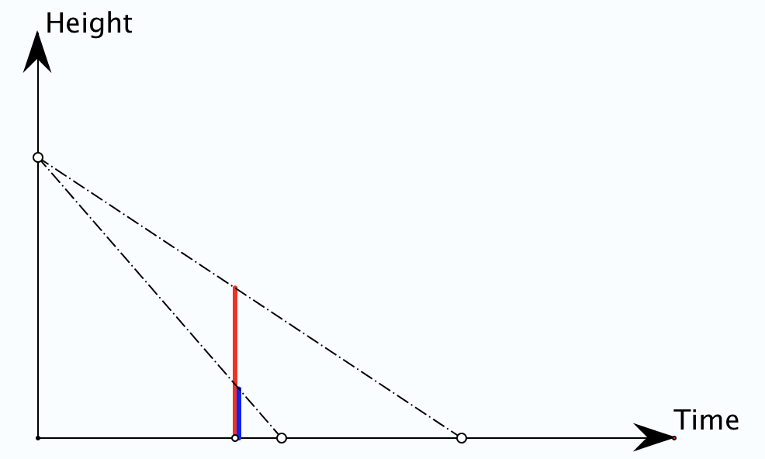
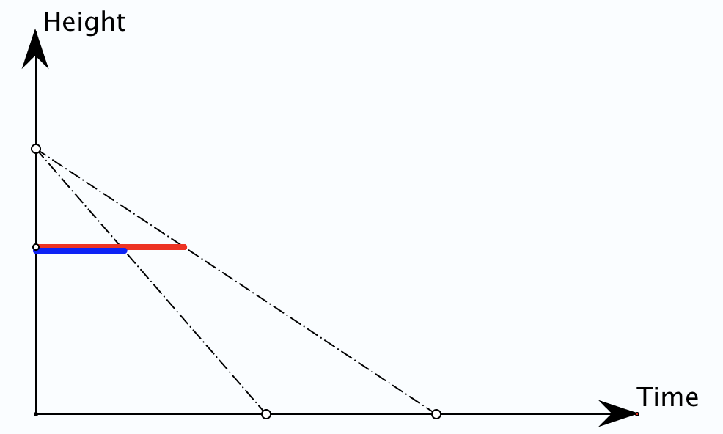
What might the question be?
If one takes 4 hours and the other 5 hours to burn down, when will one candle be 3 times the length of the other?
Notes:
Manuel Santos

Slide 22
Candle Algebra
Let the candles burn for t hours from a height of 1 unit.
The heights at time t are
Oops!
Ok!
Notes:
Tracking Arithmetic

Slide 23
General Candles
Two candles take a and b hours respectively to burn down.
Is there a time at which one candle is h times as high as the other?
Particular Calculation
Tracking Arithmetic for quick generalisation
So must have either
or
Is there a height which will take one candle t times as long to burn down from as the other?
Notes:
Use partocular to experess general (Tracking Arithmetic)

Slide 24
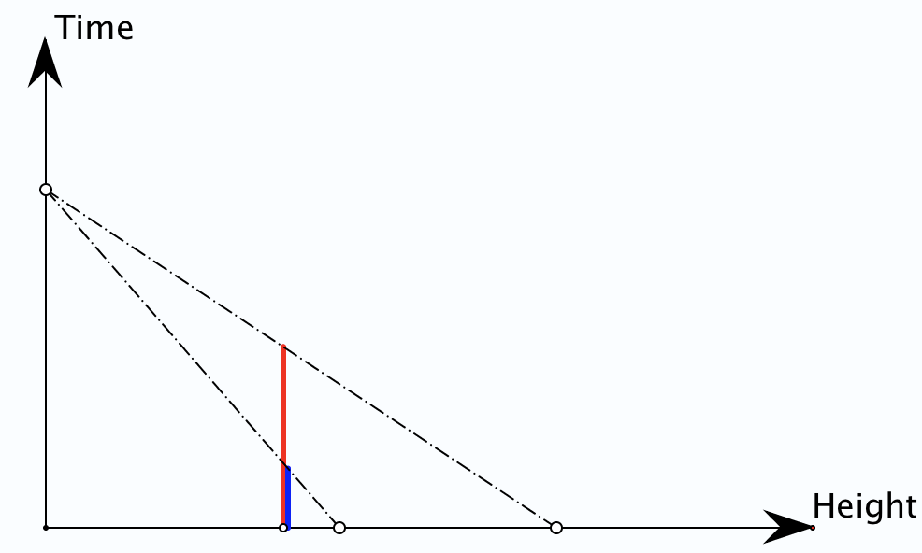
Same and Different Candles
Two candles of different sizes take the same time to burn down.
If they are 4 units and 5 units in height respectively, is there a height from which it will take one candle 3 times as long to burn down as the other?

Slide 25
Rational Functions
Topic-based variation of standard topic arising from play and suggesting opportunity for play … a playground!

Slide 26
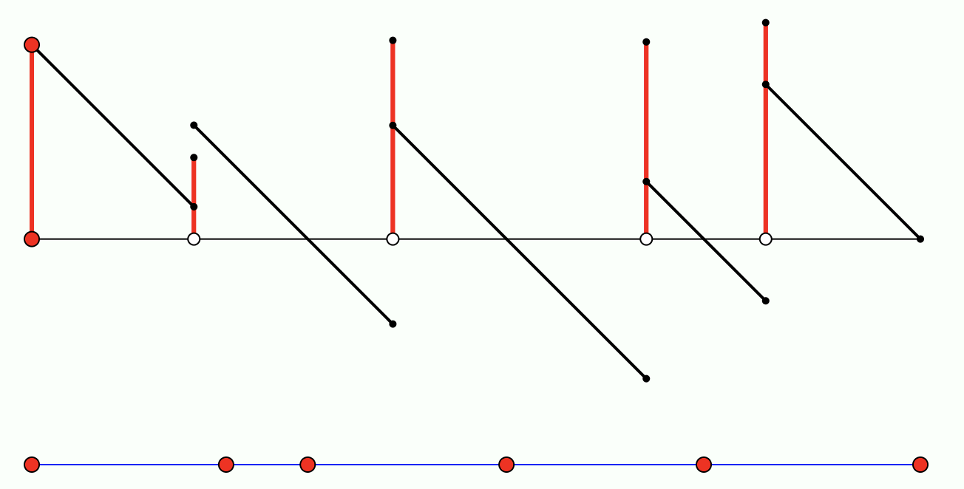
Krutetskii’s Petrol Pumps
Twenty identical motor vehicles are parked along a circular road.
The total amount of gas in all of the machines is enough for only one of them to travel the whole circular road.
Prove that at least one of these vehicles could travel the entire road, taking gas along the way from the other 19 vehicles. (Krutetskii 1976 No. 10 p150).

Slide 27
Extended Petrol Pumps
Suppose that there is a collection of petrol pumps, perhaps dotted around a forest, and suppose there are tracks between various pairs of pumps.
Suppose also that a number of trails have been devised, each trail consisting of a consecutive sequence of tracks forming a circuit which visits all of the pumps at least once.
Each trail has an associated consumption for each car between each successive pair of pumps making up that trail.
Suppose also that the total amount of petrol in all the pumps is equal to the total over all the cars of the total consumption for each car over its trail.
Must there be a pump which can serve as the common starting point for all of the cars to make a complete circuit on their respective trails?

Slide 28
Variations
Name-tags:
Suppose an equal number of men and women arrive for dinner at a circular dining table with just the correct number of chairs. They sit down at random only to discover that the host had actually put name-tags at each place. By simply rotating the table without disturbing the guests, it can be arranged to have at least one person sitting at their correct place. Can you do better?
Outnumbered:
Is it always possible to find one of the women so that if you start with her and count clockwise, the number of women counted so far is never smaller than the number of men so far? If twice as many women as men arrived for the dinner, is it possible to find somewhere to start counting so that there are never less than twice as many women as men?
Well-Formed-Formulae (Parsing brackets)
Suppose you are given a sequence of brackets, or a sequence made up of operators and objects. Place them in sequence round a circle. Then it is always possible to find some starting point on the circle so that the sequence gives a well formed and hence mathematically meaningful expression.

Slide 29
Conjectures Summary
Play before calculating (Pre-paration)
To comprehend relationships
Play while calculating (Paration)
Specialising in order to express structural relationships
Noting possible variations or extensions (for generalisiang)
Play after resolving (Post-Paration)
Learner expanding and enriching example-space
Teacher appreciating possibilities, perhaps even changing data so as to arrange a specific encounter with a mathematical theme, power or heuristic

Slide 30
Contact
John.Mason@open.ac.uk
PMTheta.com/jhm-presentations.html

