Slide 1


Roles of Phenomena & Examples in
Motivating Meaning-Making in
Mathematics
John Mason
Bergen MatRIC Conference
Making & Communicating Meaning
Oct 2019

Slide 2
OutLine
Raising some questions
Some personal stories from my experience
  I can’t make meaning for you, that is something you have to do
  I can invoke meaning-making actions, display them and invoke them
  The meaning you make of my story will involve your own stories of past experience, and so will not be my meaning
What might be learned from reflecting on my stories?
In the workshop, I will focus on pedagogical actions that can promote meaning-making or sense-making.
Here I invite you to try to trap what it is that you have to do in order to make sense of phenomena and example-construction.
  Then we will know what we are trying to promote!

Slide 3
Some Questions
What can be said about the experience of something ‘becoming meaningful’ or
‘becoming more meaningful’?
What triggers meaning-making?
What aspects of the educational milieu contribute to meaning-making?

Slide 4
What is ‘Meaning’
What does it feel like when something becomes ‘meaningful’?
Is there a difference between
  Something being meaningful or having meaning
  Making meaning out of something?
Having rich concept images: associations, connections
  Cognitive, affective, enactive
Having personal narratives (cognitive with affective components usually linked to action)

Slide 5
Ways of Working
I am interested in the lived experience of thinking mathematically
I am going to invite you to make sense of (make meaning from) some mathematical phenomena
What you can hope to get from this session is what you notice yourself doing
This can provide the basis for ongoing dialogue

Slide 6
Rotatable Graphs
Many learners seem unclear about the graphs of polynomials as |x| ->
Imagine the graph of a quadratic
  Imagine rotating it through a small angle
  Why can this not be the graph of a function?
Construct the graph of a differentiable function which remains a function when the graph is rotated by a small angle.
  And another, which is not linear
  And another, which uses a different idea and is not linear
How do you know it remains a function?
Rotating through 180° of course preserves
‘being a function’ …

Slide 7
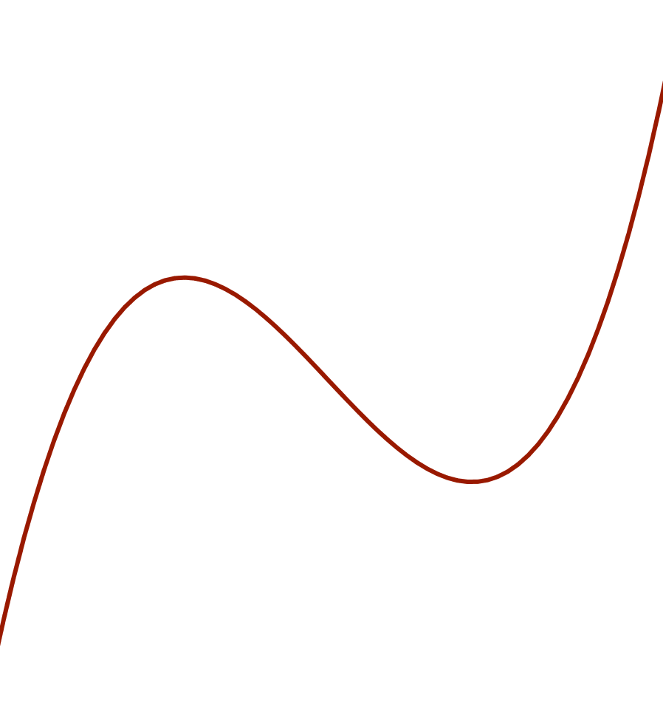
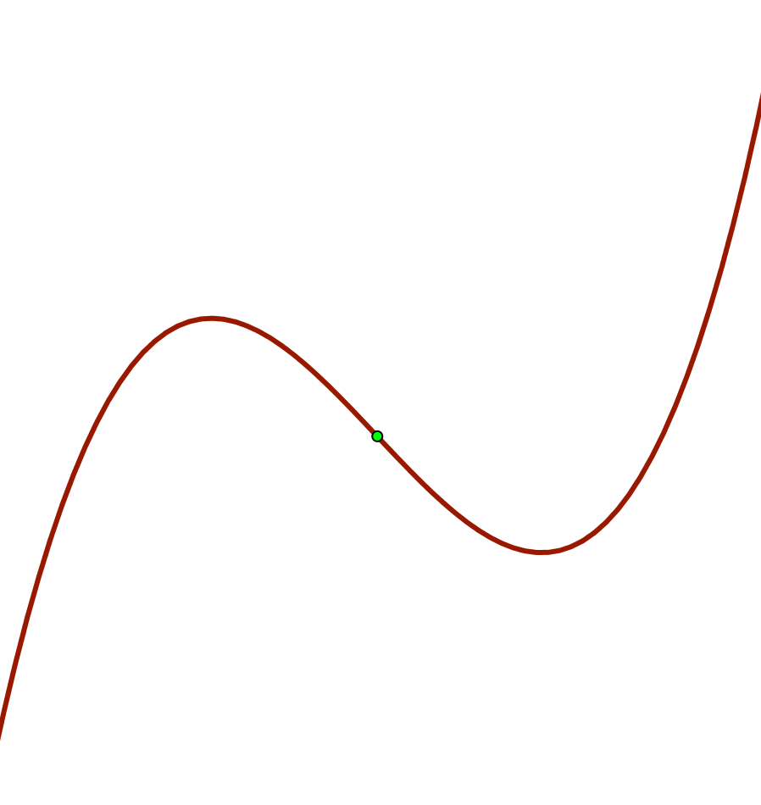
Rotating through 180°
Cubics:
  almost completely uninteresting

Slide 8
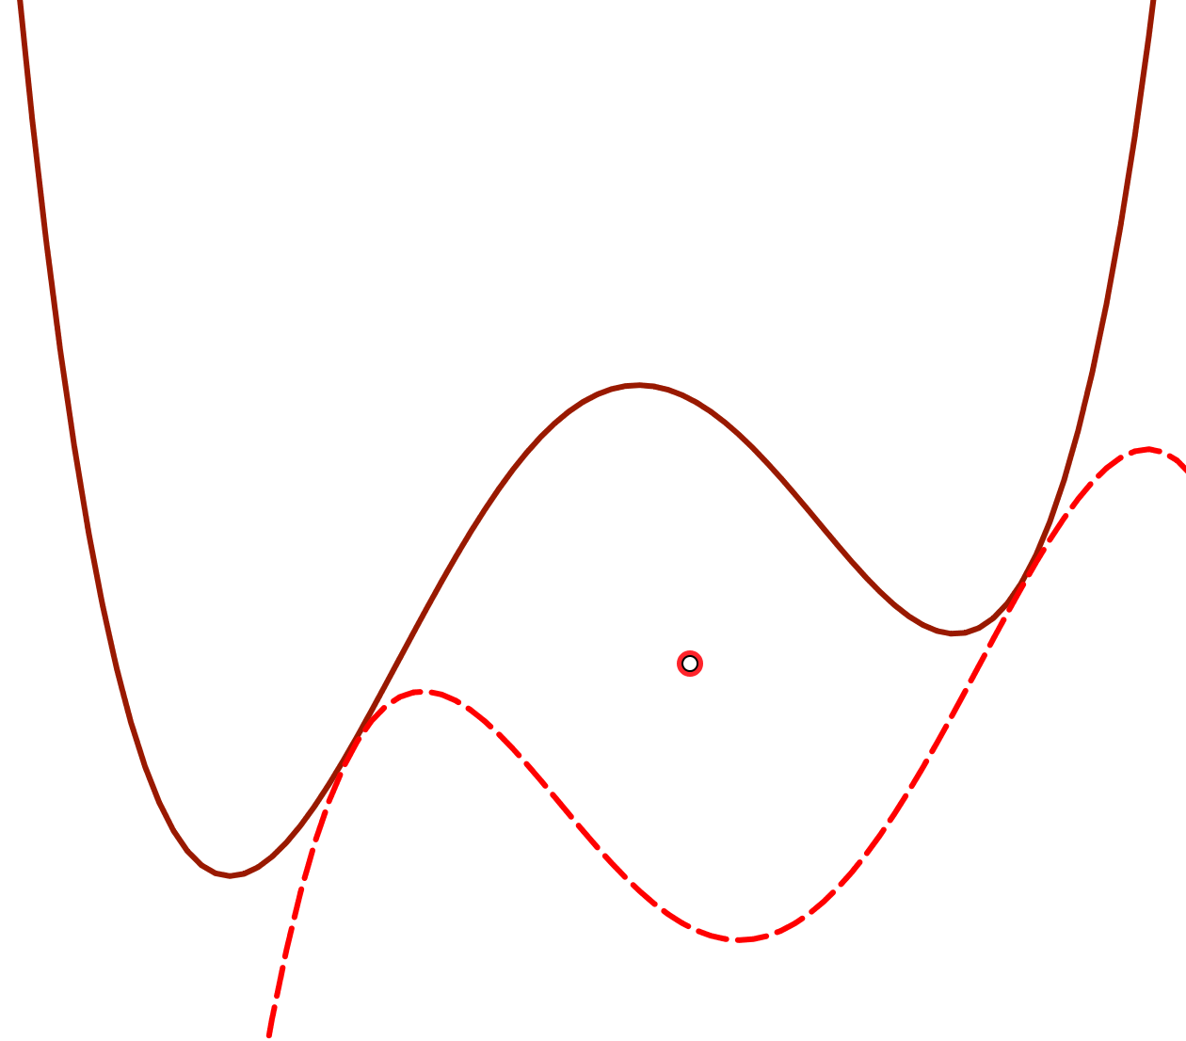
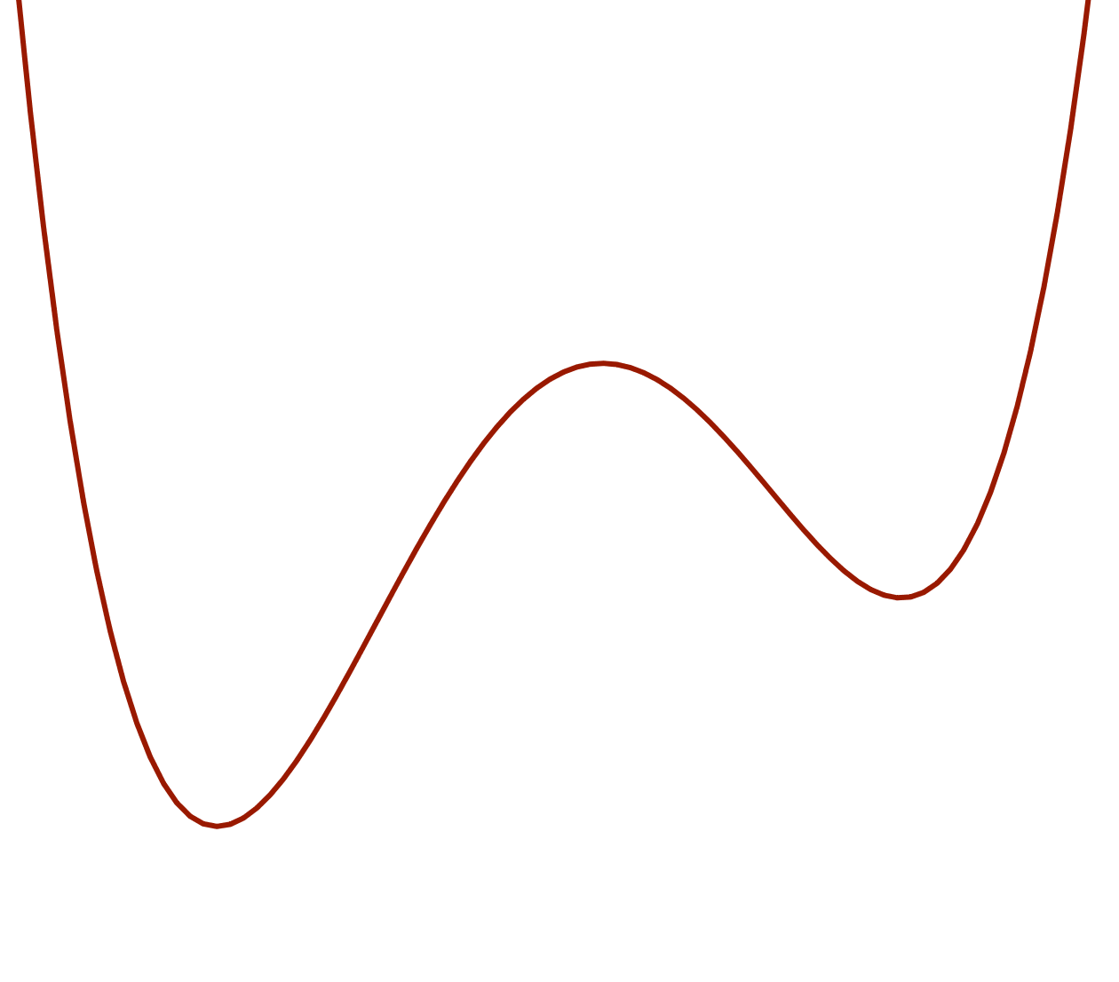
Rotating through 180°
Quartic has more going for it
Points of tangency when translated …
  Same slope

Slide 9
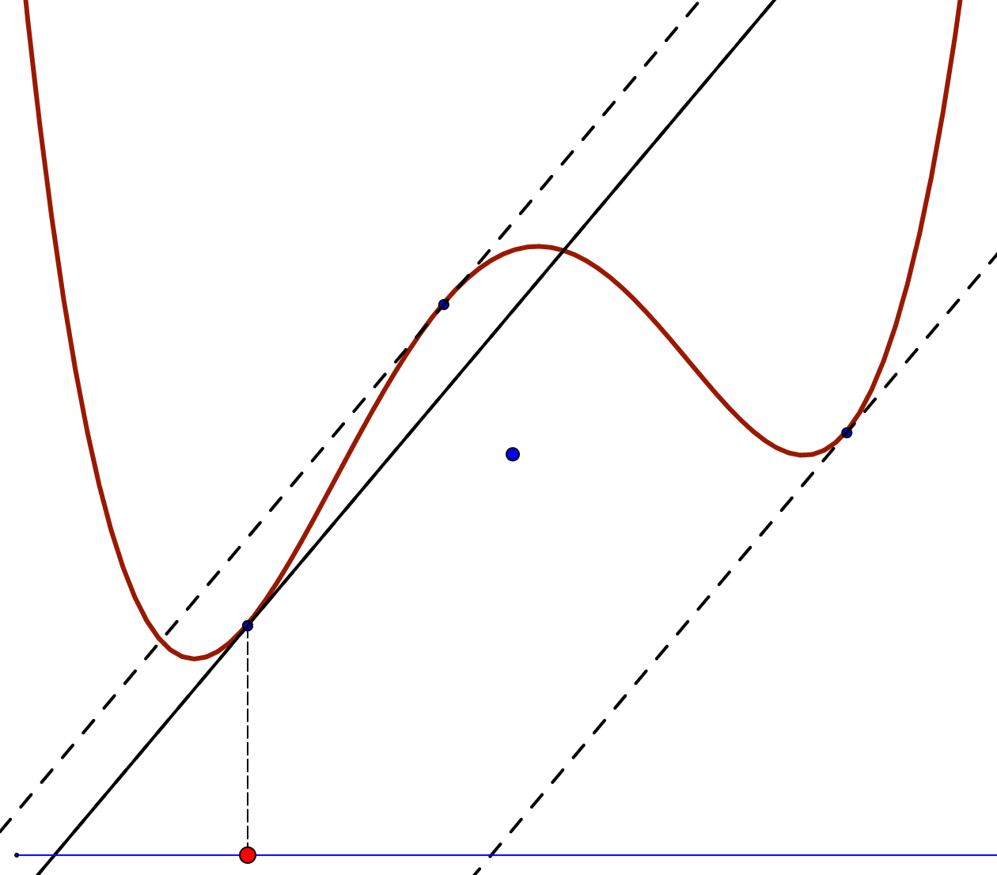
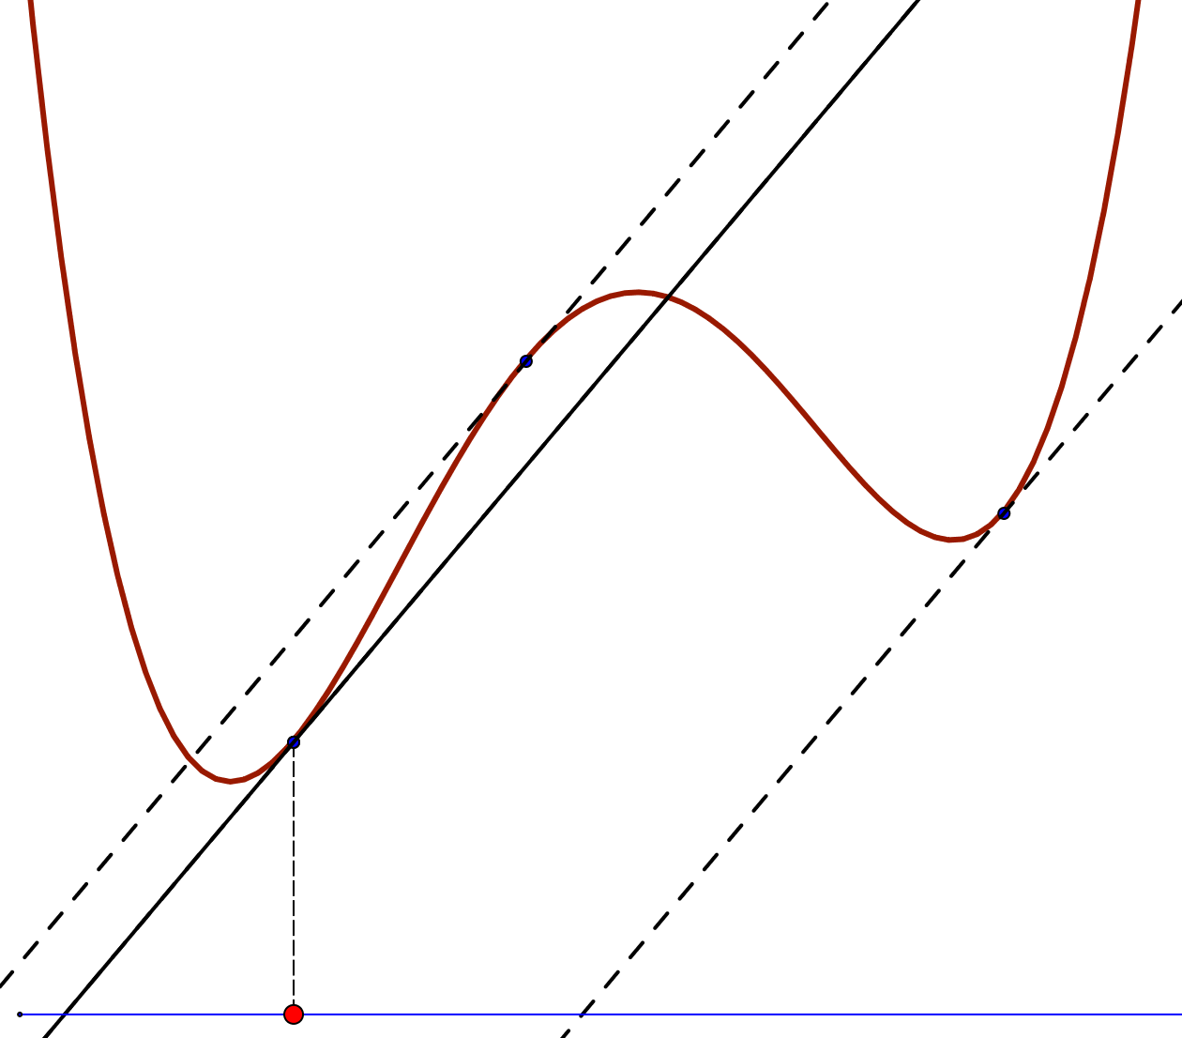
Mutual Tangents

Slide 10
Reflection
What did you have to do to make sense of
  The animations ?
  Underlying mathematical ideas ?

Slide 11
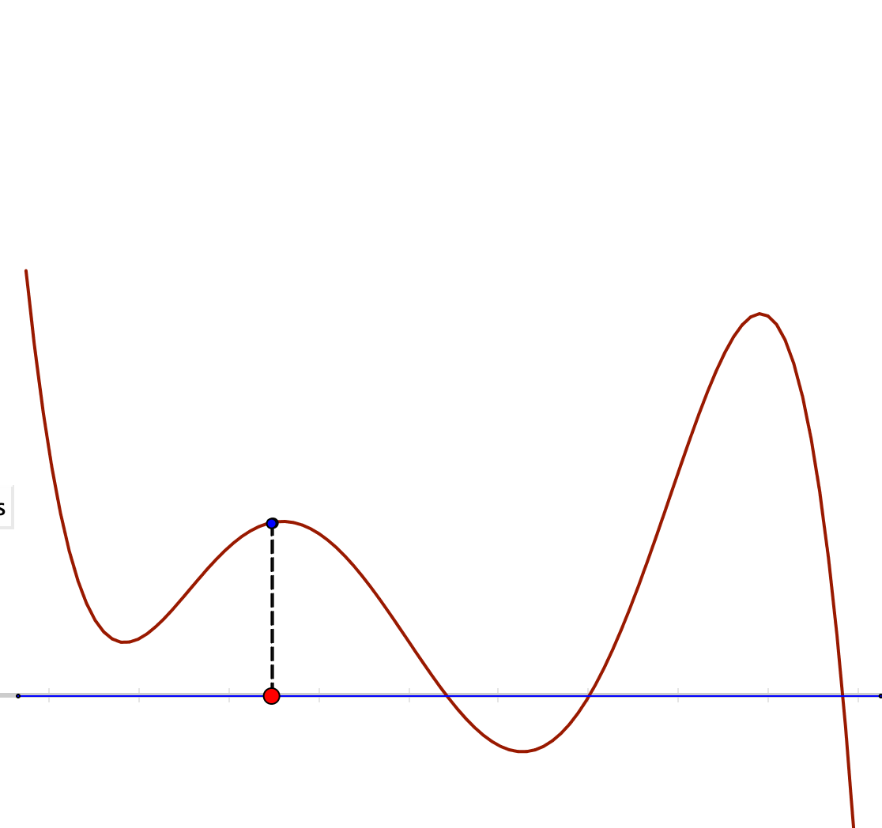
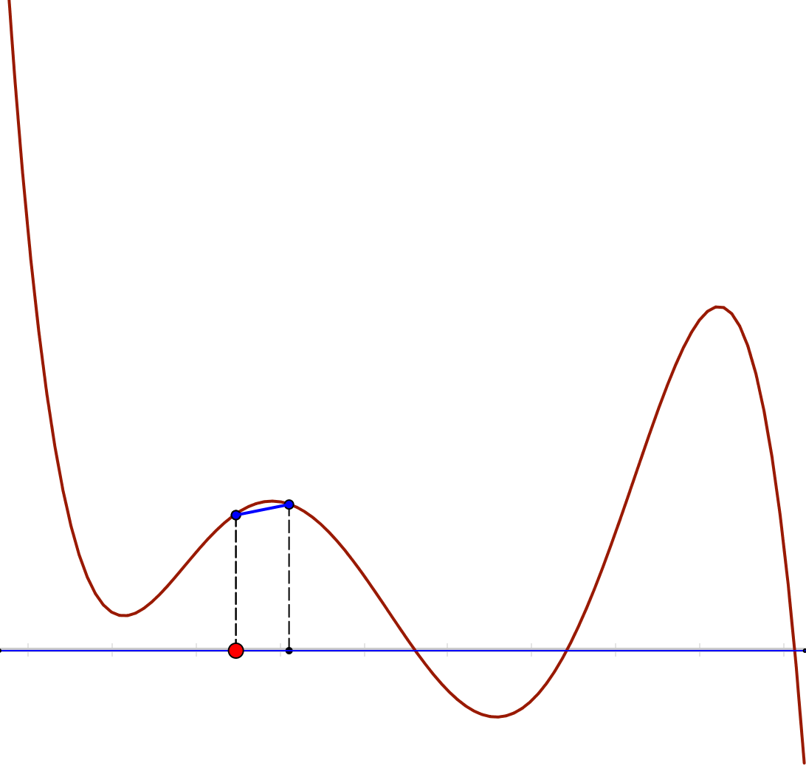
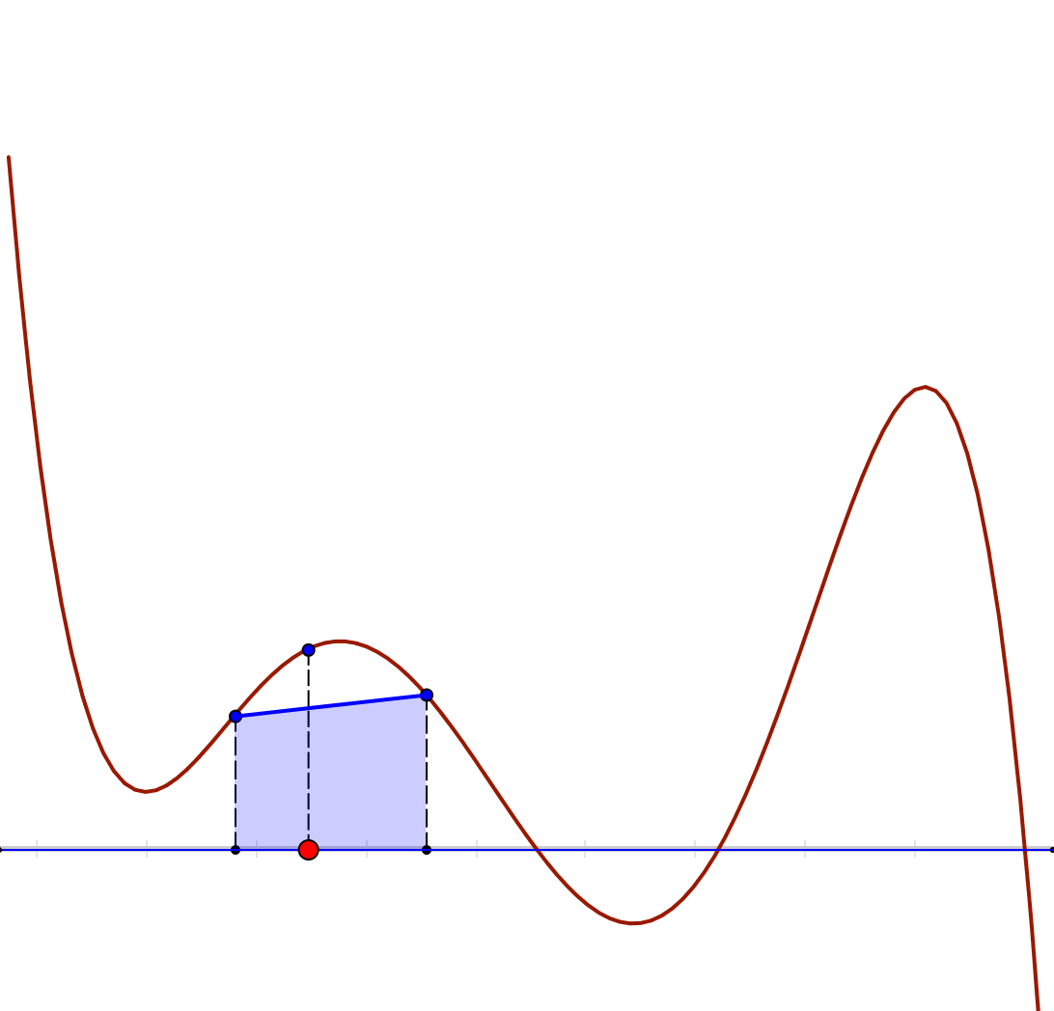
Fundamental Theorem
Imagine the graph of a smooth (differentiable) function:
  I shall use polynomials
Imagine a point on the x-axis, as the left hand end of an interval of width w.
Imagine the chord of the function formed by that interval
Imagine shading in the area between the chord and the
x-axis on that interval.
What happens to the shaded area as the interval width w goes to 0?

Slide 12
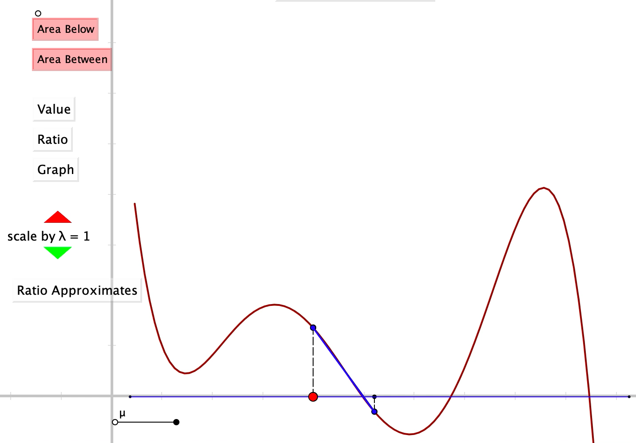

Slide 13
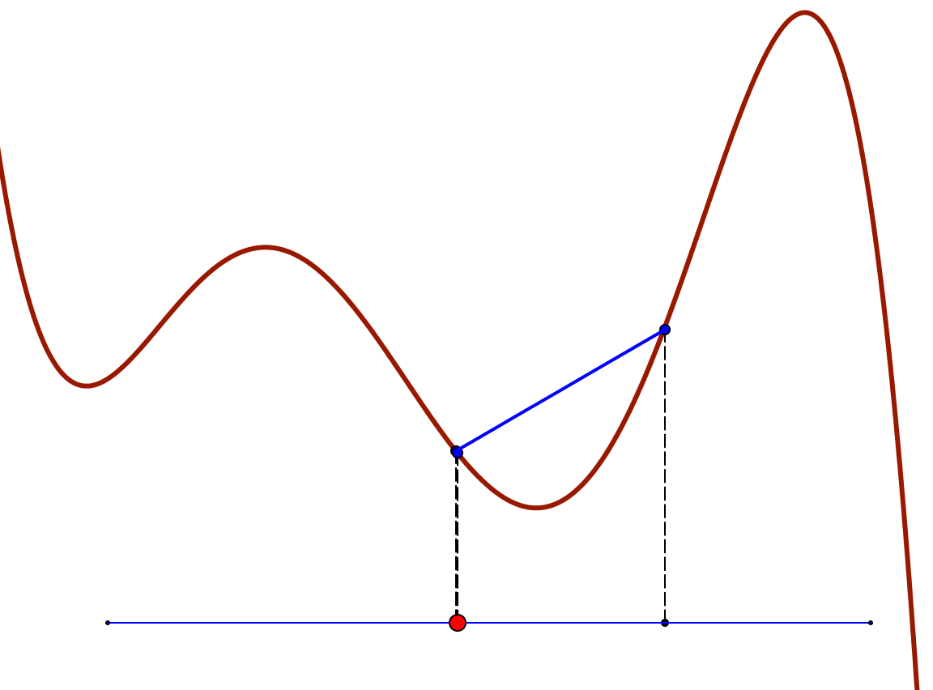
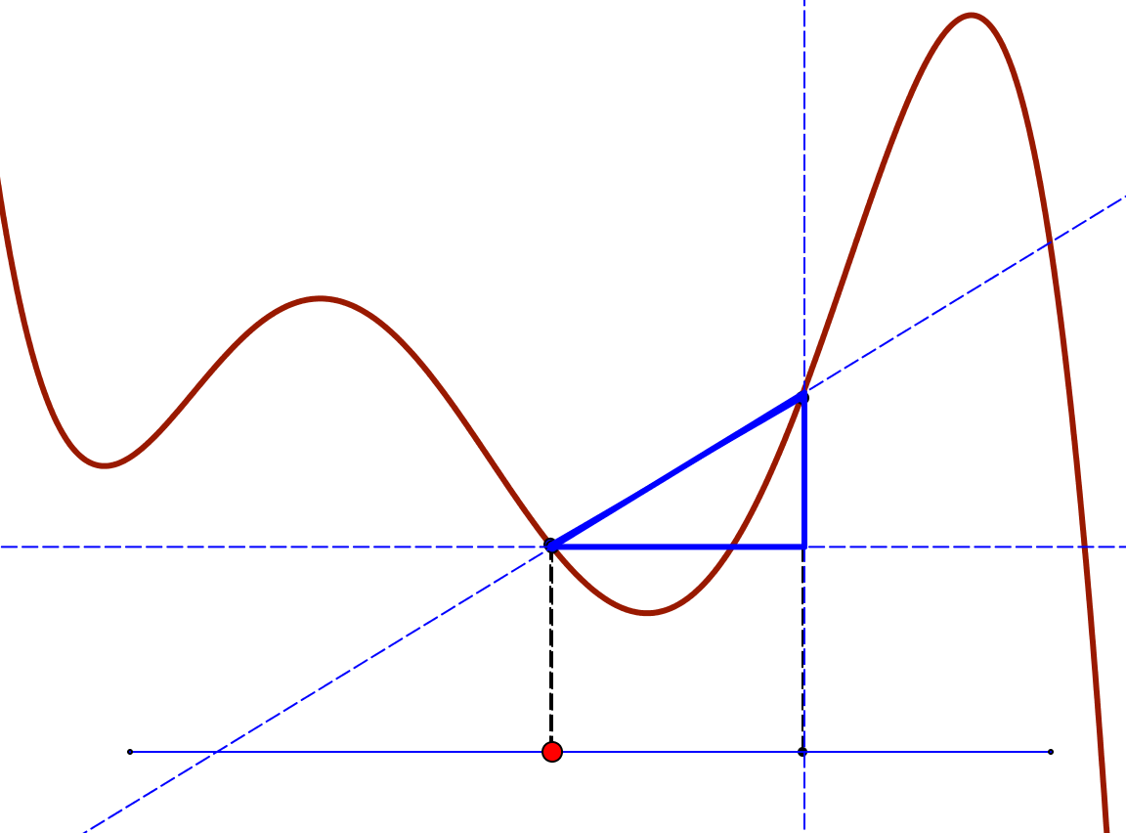
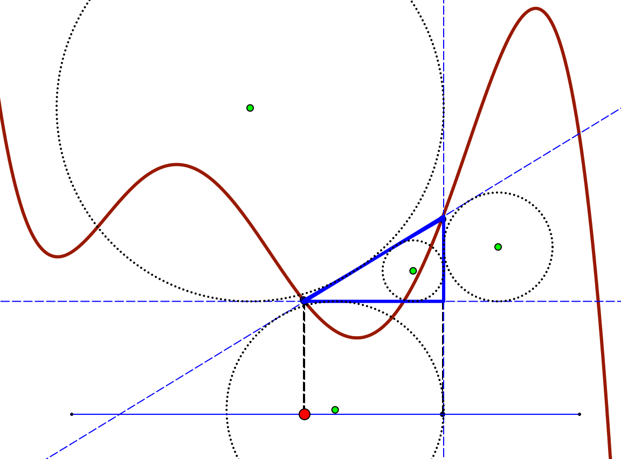
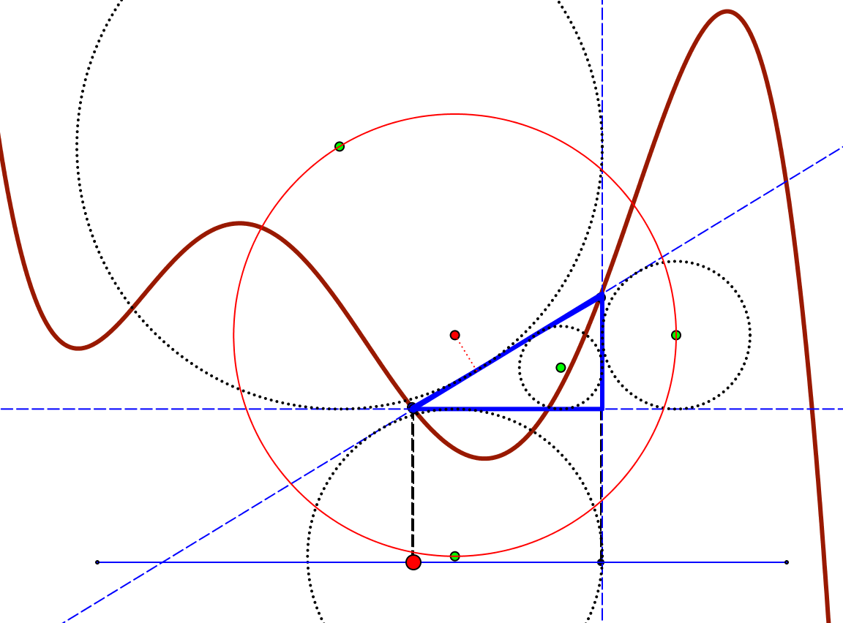

Chordal Constructions

Slide 14
Reflection
What did you have to do to make sense of
  A static image ?
  A dynamic image
  Underlying mathematical ideas ?
Did you notice any change in your energy/interest/motivation?

Slide 15

Construction in a Square
Tim Brzezinski

Slide 16
Reflection
What did you have to do to make sense of
  the animation?
Did rehearsing the narrative assist in any way?
Did you notice any change in your energy/interest/motivation?
“Conjecture without words”

Slide 17
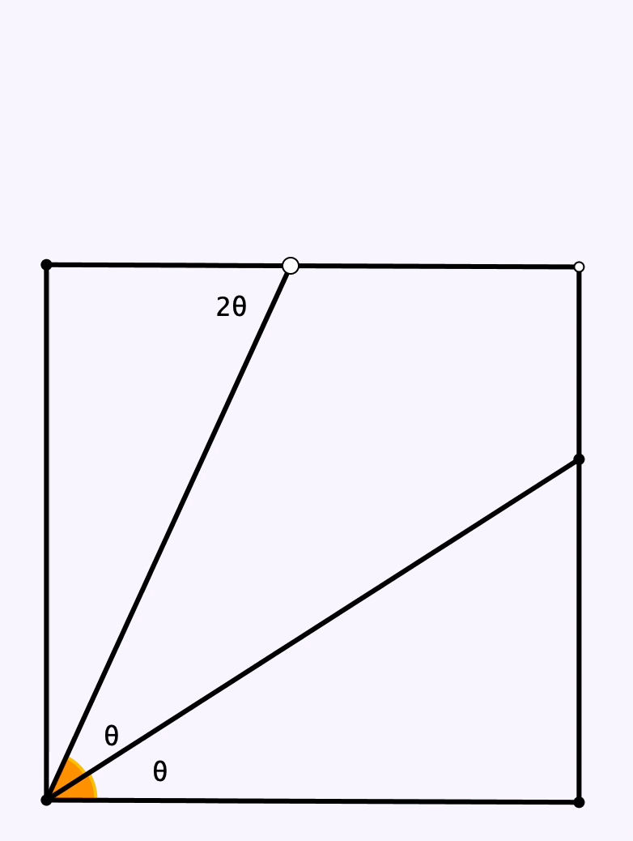

Slide 18
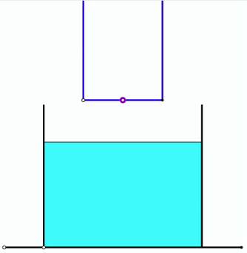
Overflow
Imagine a bucket not quite full of water
Imagine a heavy open-topped empty can being slowly submerged in the bucket.
What is likely to happen?

Slide 19
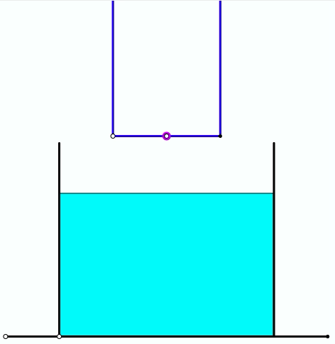
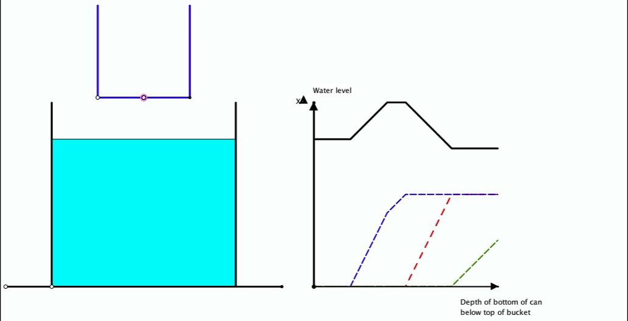
Overflow

Slide 20
Galilean Sums
Say What You See
Say What You See to someone beside you
Write down the next term
And the next after that
Have you simplified them?
Construct another sequence ‘like this one’
Generalise
Watch What You Do
Notes:
Consecutive terms of an AP. Constant as long as difference is twice first term
Ratio of two Aps; constant as long as ratio of first term to ratio the same

Slide 21
Another & Another
Construct another integral like this
  Say to someone else what is the same and what different about your integral and this one
Construct another like it
And another
Construct one that is different in some way
Tends to reveal what learners are attending to
Releases creativity
Activates & Enriches Example Space

Slide 22
Reflection
What did you choose to vary?
What else could be varied?
What ideas might it help to animate as support for this task?

Slide 23
A Timely Story
1967/8 Wielandt studying subnormal subgroups of groups
  A construction device (semi-direct products);
  with wreath products as a special case
  For me, joyfulness at being able to construct examples
  Led me to embark on trying to classify finite groups which are the derived group of some finite group …
    forced to abandon(too hard!)
Around 2001
  Started work on PolyDials; displaced by other projects
Recently
  Balloon Diagrams for multiplicative structure of number
  Symmetry triggered interest in group of actions on balloon diagrams
  Developing an Applet to manifest these actions

Slide 24
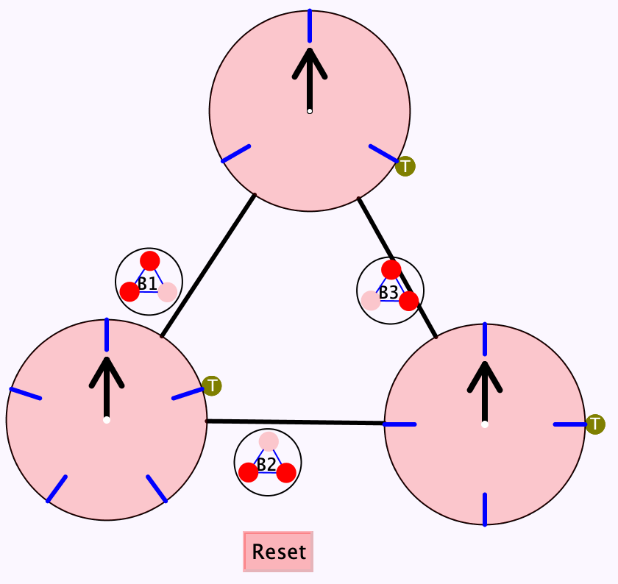
PolyDials
Imagine a configuration of lines
At each intersection there is a dial
Clicking on a line advances the hand of each dial on the line

Slide 25
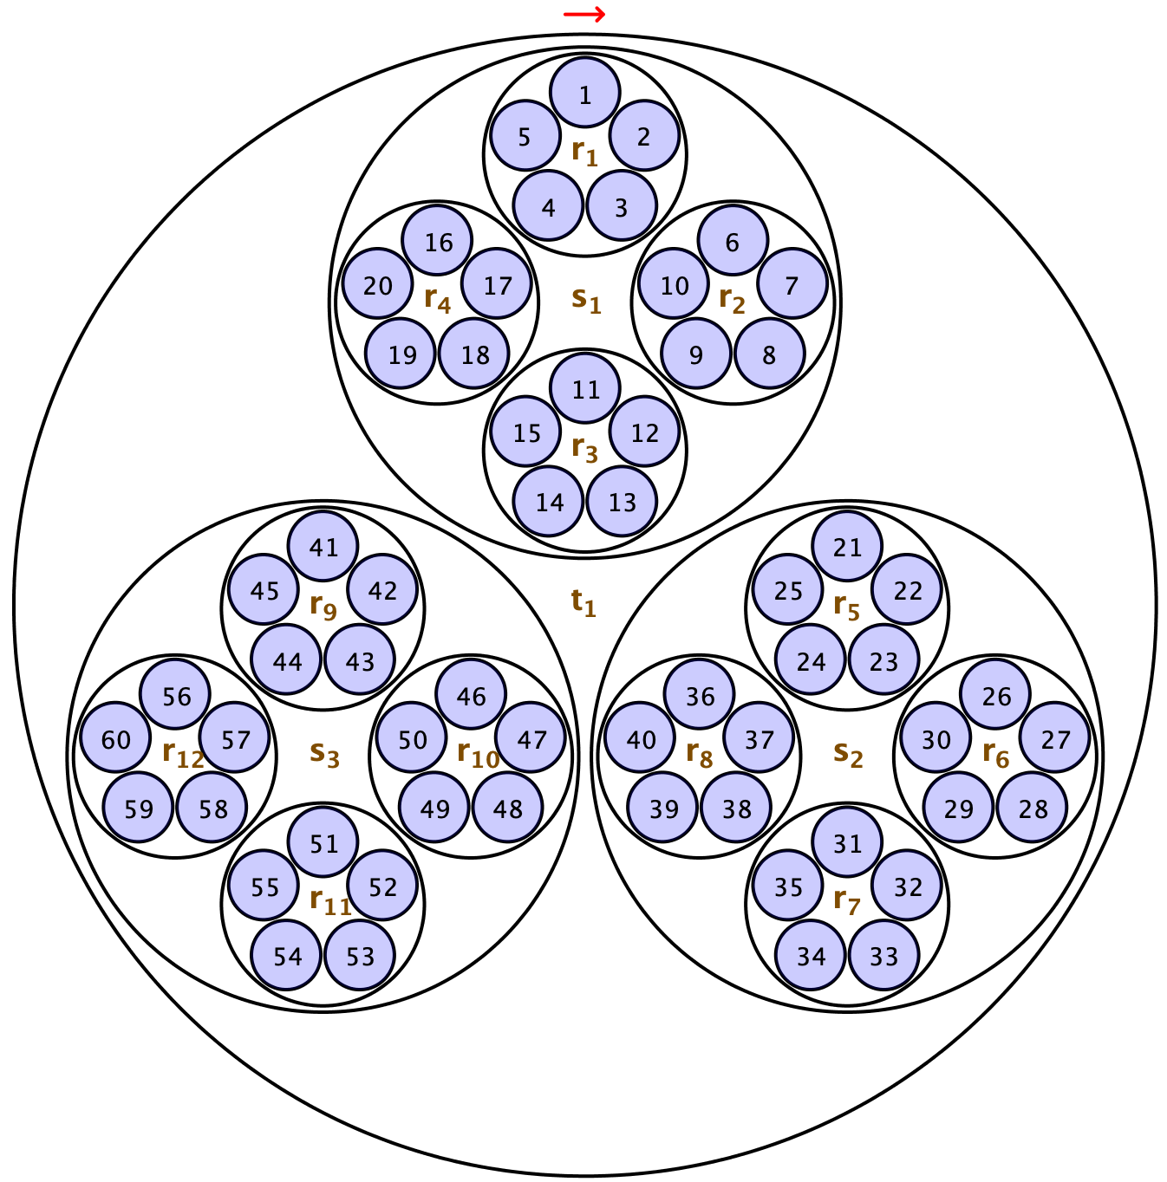
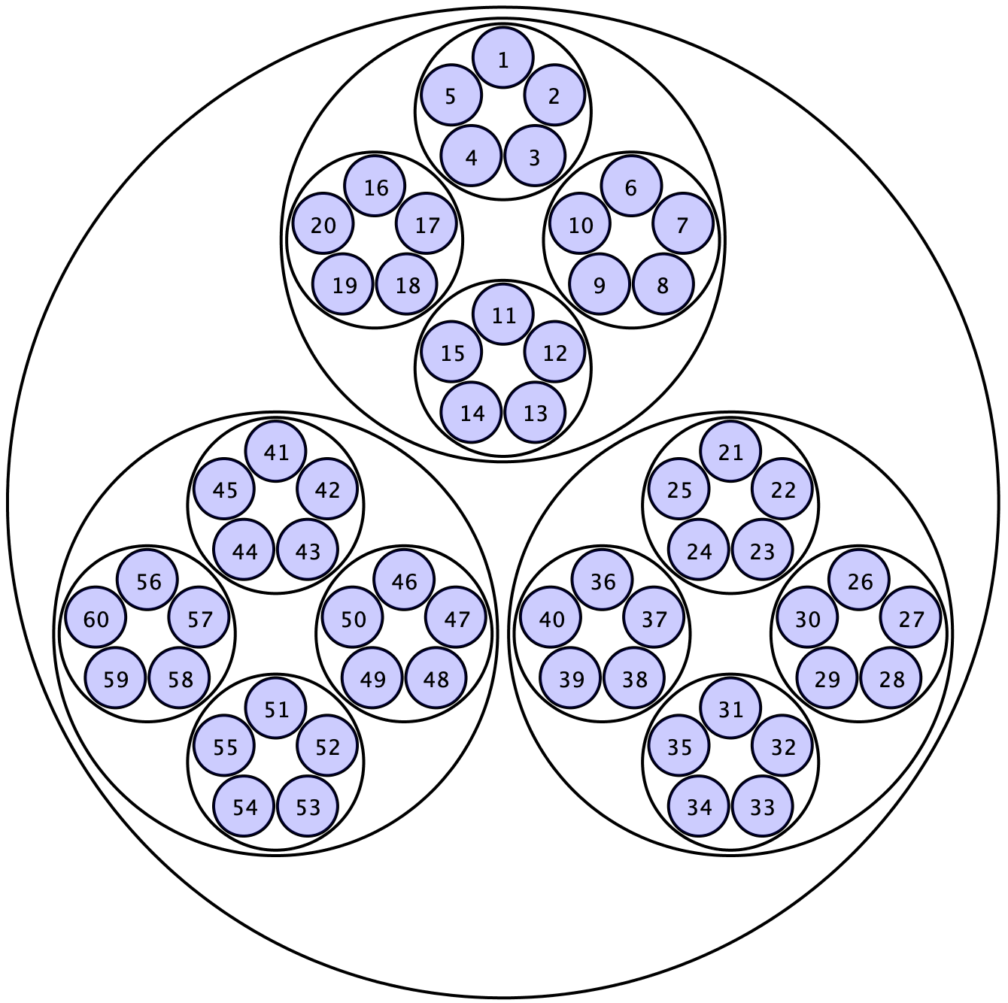
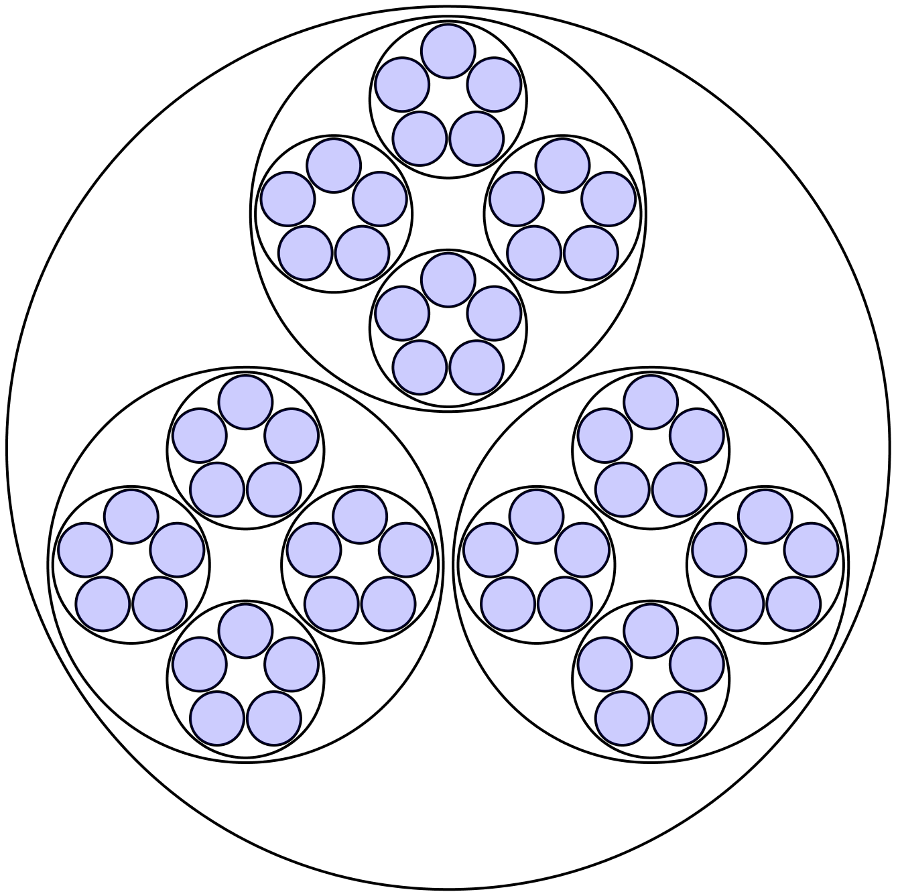
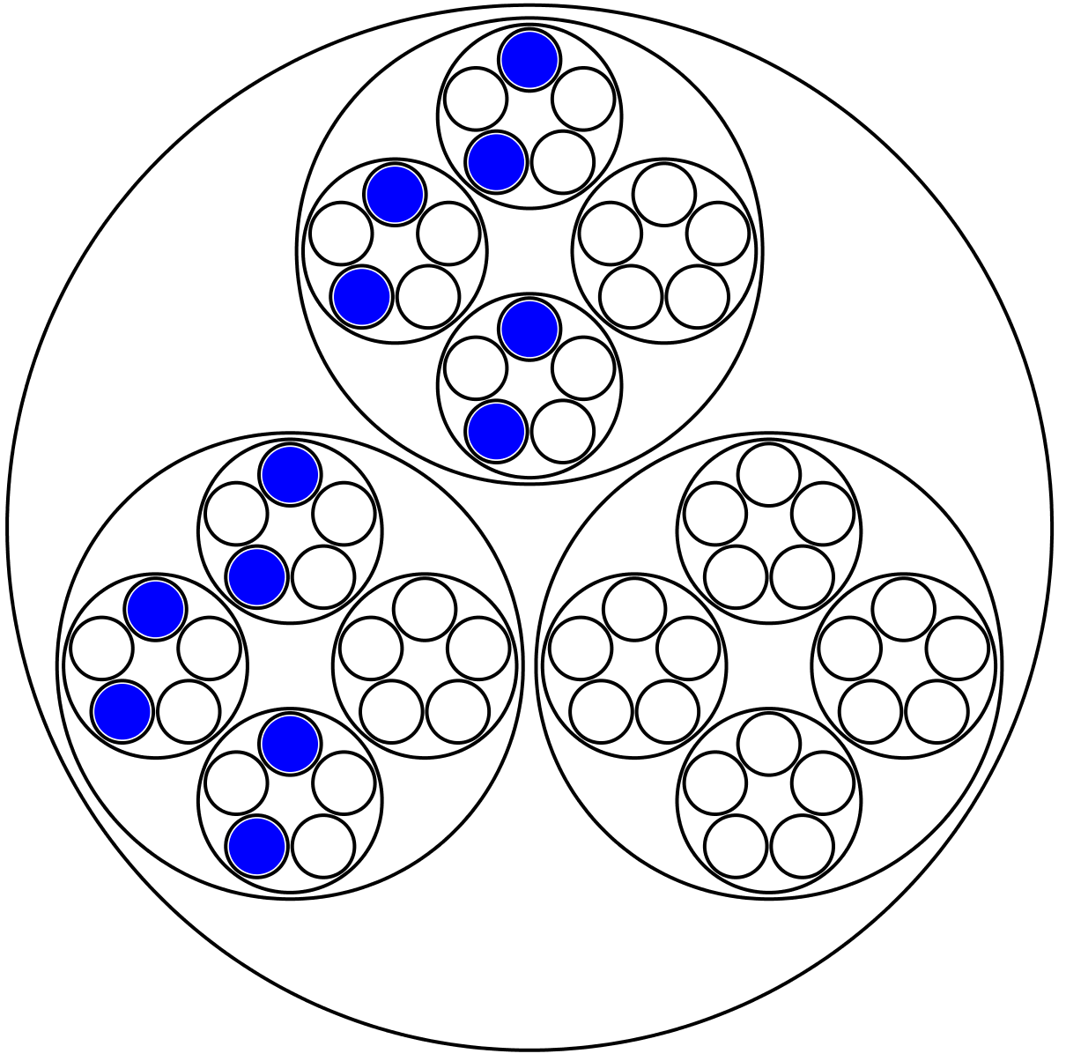
Balloon Diagrams for Multiplicative Structure of Number
3 lots of
Making structure manifest
4 lots of
Two thirds of
5 lots of
Three quarters of
Two fifths of
5 lots in
3x4x5
4 lots in
3 lots in all
Two fifths of
Three quarters of
Two thirds of
3x4x5
Notes:
Stephen von Worley at http://www.datapointed.net/2012/10/animated-factorization-diagrams/
Idea from Yorgey

Slide 26
Connections
Of what is |x| an example?
  Metric
  Continuous not everywhere differentiable function
  Absolute value
  Useful for graphing shapes (|x+y| + |x-y| = 1

Slide 27
How is Meaning Made?
By Linking
  Rich concept images
  Richly connected example spaces (including construction devices
  Personal incantations/narratives
Through developing personal narratives
There is evidence that those whose concept-webs
do not develop in complexity over time
are more likely to drop out
[Mercedes McGowen 1998]
Notes:
McGowen, M. 1998, Cognitive Units, Concept Images, and Cognitive Collages, Unpublished PhD thesis, Warwick University, Coventry.

Slide 28
What Encourages Meaning Making?
Being in the presence of others making meaning
Experiencing meaning-making actions initiated by others
Sufficient time and disposition to use these actions oneself

Slide 29
Factors Acting to Block Meaning-Making
Monster Barring (Des MacHale 1980)
Pressure of time
Not having access to useful meaning-making actions
Effort required
Notes:
MacHale, D. (1980). The Predictability of Counterexamples, American Mathematical Monthly, 87, p752.

Slide 30
Monster Barring
Term used by Lakatos;
see Des MacHale
|x| is a counter-example to
“Continuous means differentiable”
Construct a function which is continuous everywhere but discontinuous somewhere
for a different reason.
Construct a function which is continuous everywhere but discontinuous at several points, for as many different reasons as you can
Dismissed as ‘pathological’
Construct a function which is continuous everywhere but not differentiable at several points, for as many different reasons as you can
Exploiting Examples
Use the idea to make your own examples
The construction techniques are more important than the actual example

Slide 31
Monster Barring
Construct a function differentiable at a point, but with arbitrarily large slope arbitrarily close to that point.
Construct a function which satisfies the intermediate value theorem on every interval, but which is not continuous.
A set is a limit-set if there exists a set S for which L is the set of limit points of S.
  What sorts of sets are limit-sets?

Slide 32
Reflections
What space of examples (including construction techniques) is accessible to learners?
What associations and connections do learners have with a particular concept or technique?
What mathematical actions are learners disposed to, and confident to enact for themselves?
  Does this grow and develop during the course?
Approach these questions through becoming aware of them in yourself. Then generating tasks in which learners can display their own appreciation and comprehension.
Placing something in a more general context is part of linking and enriching

Slide 33
Follow-Up
John.Mason@open.ac.uk
PMTheta.com
Mason, J. & Klymchuk, S. (2009). Counter Examples in Calculus. London: Imperial College Press.
Mason, J. 2002, Mathematics Teaching Practice: a guidebook for university and college lecturers, Horwood Publishing, Chichester.

