Slide 1
Alignment in mathematics education
Anne Watson & John Mason
Friday 7th Dec 2012

Slide 2
Alignment
curriculum
pedagogy
assessment

Slide 3
What to see in mathematics lessons – practitioner comments
Conceptual understanding
Procedural fluency
Solving problems:
Extending mathematical repertoire
Developing identification and application
Developing reasoning

Slide 4
Alignment in mathematics lessons
New ideas can be seen to build on prior knowledge when ....
New ideas might confuse students when ....
Teachers ask ‘why?’ when ...
A range of representations might be used when .....
Lesson will be ‘stop-start’ rather than flow smoothly when ....
Written work may be rough when ...
Students may appear to be ‘off task’ when ...
Teachers may have to deviate from the lesson plan when ....
A lesson might contain no direct instruction when ....
Silent work might be used at the start when ....
A short test might be used when ...

Slide 5
Example task

Slide 6
In that task .......
curriculum
pedagogy
assessment

Slide 7
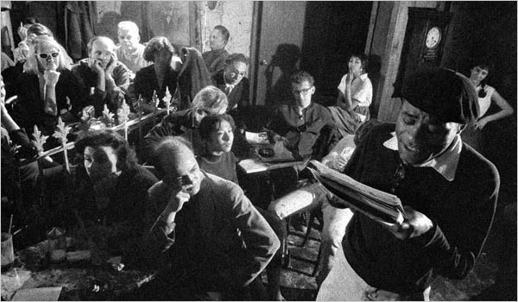
Thinkers who inform mathematics education
Sociologists
Anthropologists
Psychologists
Cultural and gender studies
Philosophers
Mathematicians
..... Politicians

Slide 8
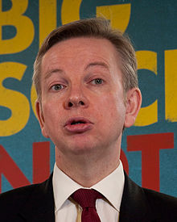
Policy
International comparisons (assessment/pedagogy)
EBacc –EBC (assessment/curriculum)
Curriculum nature and content (curriculum/pedagogy)
Teacher recruitment and retention (pedagogy)
Expenditure

Slide 9
Aaarrrggghhh! Help
I cannot take the problems of the country onto my shoulders
It is easier to appear to make maths teachers act in certain ways than to appear to make Amazon act in certain ways

Slide 10
Teachers’ research-informed change
Small changes in practice
Collaboration
Task design
Development of personal
enquiry
Ownership of short and
medium term planning
(pedagogy/professionalism)

