Slide 1
Linearity is only a special case: a curriculum rethink
Anne Watson & John Mason
Ark Curriculum Plus
Feb 2023
We gather some functions together
in a perspective on some key curriculum ideas
that deserve more attention
than the labels ‘linear’ and 'non-linear' suggest
Notes:
Key Stage 3 and prevalence of linear functions, linear expressions
How these relate to children’s prior experience of number relations
How linear functions sit in the world of functions in general

Slide 2
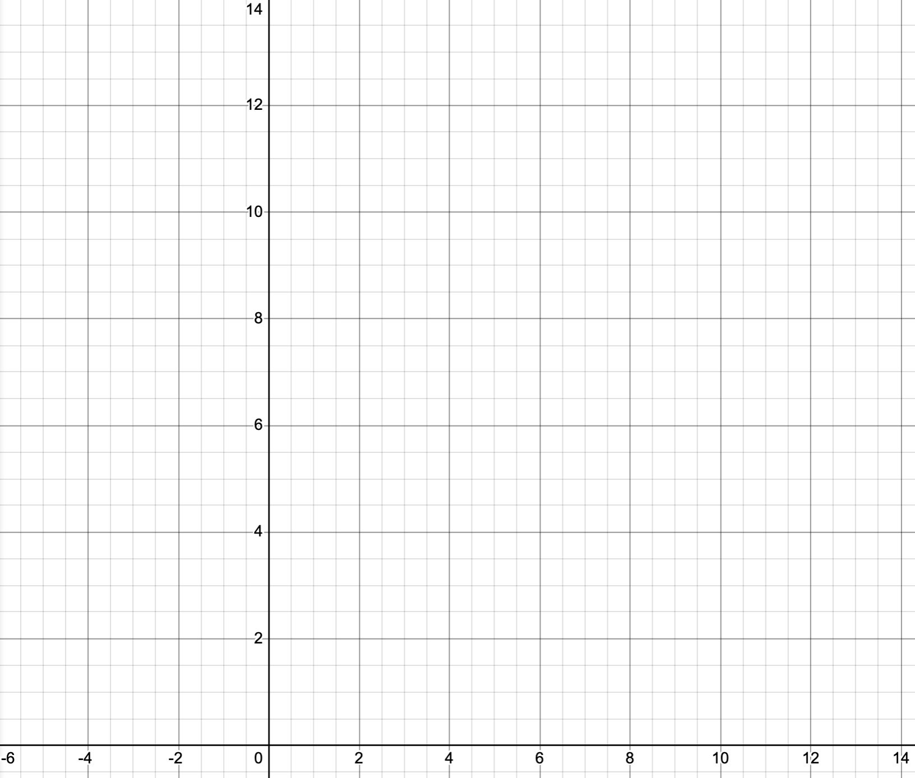
Say What You See,
to a neighbour
What is the Same and what Different about the coloured lines?
What relationships are represented by the coloured lines?
What do you need to attend to
in order to recognise Number Bonds to 10?
Notes:
Issue of Discrete vs Continuous … when is it ok to join the dots?
Number bonds from KS1 so worth building on that experience
Extend the concept of number bonds to 3.7, 6.3, etc. and complements in general

Slide 3
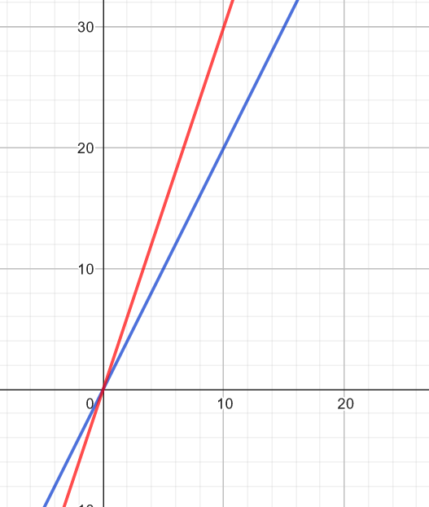
x 3
What is the Same and what Different about the coloured lines?
x 2
x 1
What relationships are represented?
What do you need to attend to in order to discern
Multiplication facts?
Proportionality?
Notes:
Any surprises?
Visual component of concept inage can be powerful and informtive

Slide 4
A straight line goes through (0,5) and (3,0) on the usual axes
Write an equation to represent this line
… and another
… and another
Compare equations with somebody near you.
How do their and your equations express visual aspects of the graph?
Notes:
Use your sense of the graph to isolate details from which an equation can be formed.

Slide 5
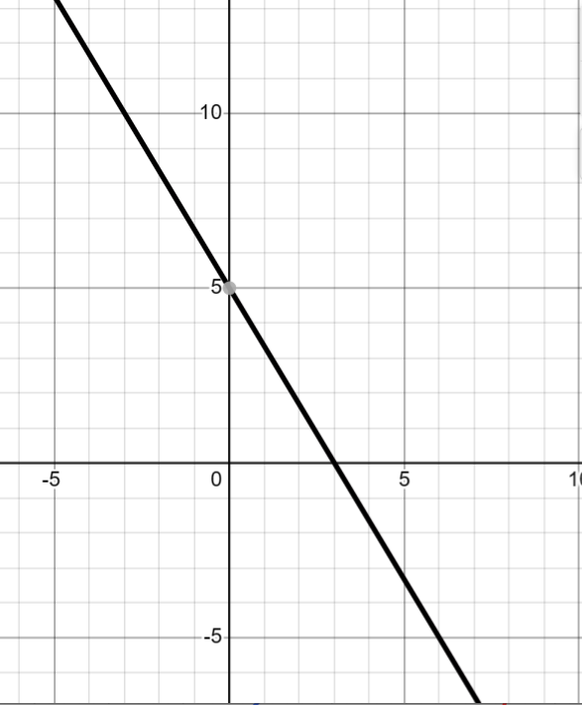


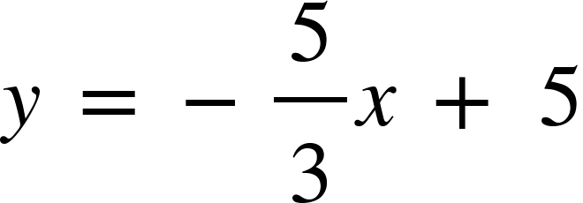
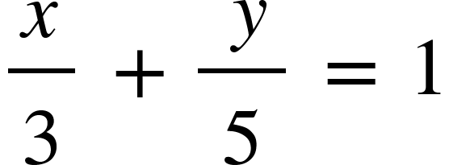
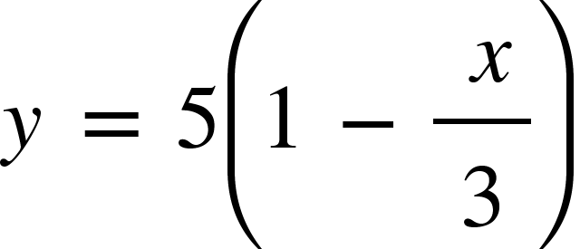
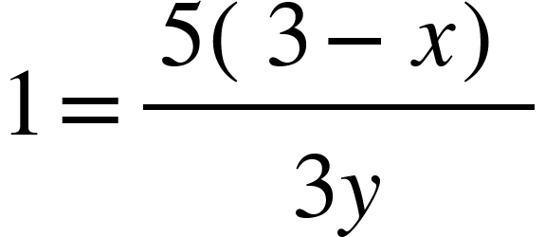
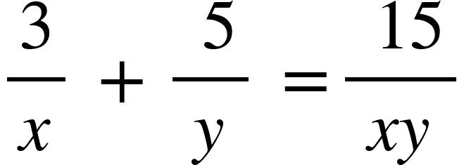
Examples
Use of Fact Families
Notes:
Each of these equations will give the graph using Desmos or Geogebra graphing apps
BUT some of these are not specified at certain points!!!

Slide 6
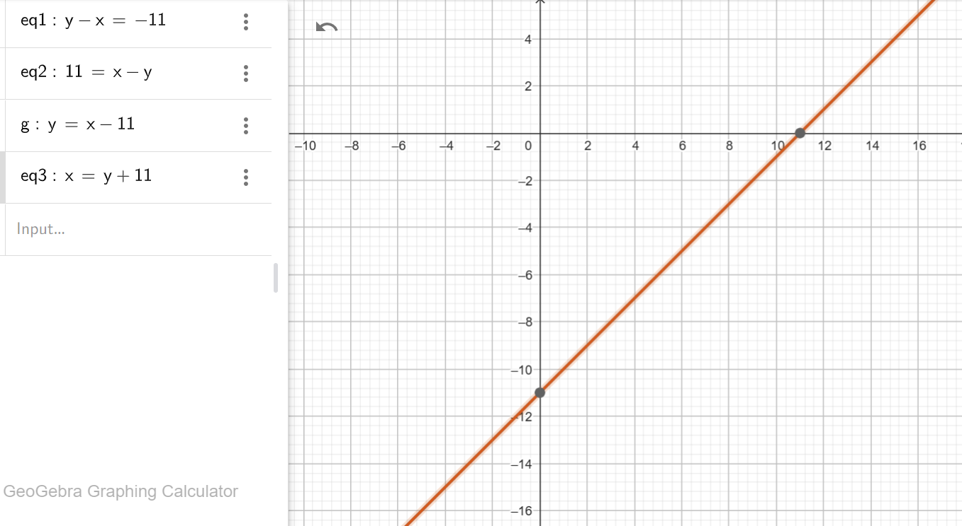
What do you need to attend to in order to see this line as a reflection of a ‘number bond’ line?
6
Notes:
Graphs of functions as objects in their own right, subject to playfulness!
Various versions all superimposed
“g” was a name inserted by Geogebra by itself.

Slide 7
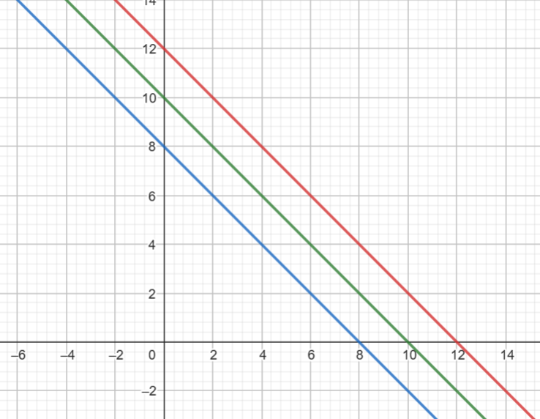
Pick a point on the Blue line
x + y = 8
(x + 2) + y = 8 + 2
x + (y + 2) = 8 + 2
Add 2 to one of the dashed lengths
What effect does that have on the graph?
[a, b]
on x+y=8
[a+2, b]
on x+y=10
[a, b+2]
on x+y=10
Ambiguity
Notes:
Playing with functions using a graphing app
Ambiguity with linear graphs: does adding 2 shift it up or to the left or at some other angle?

Slide 8
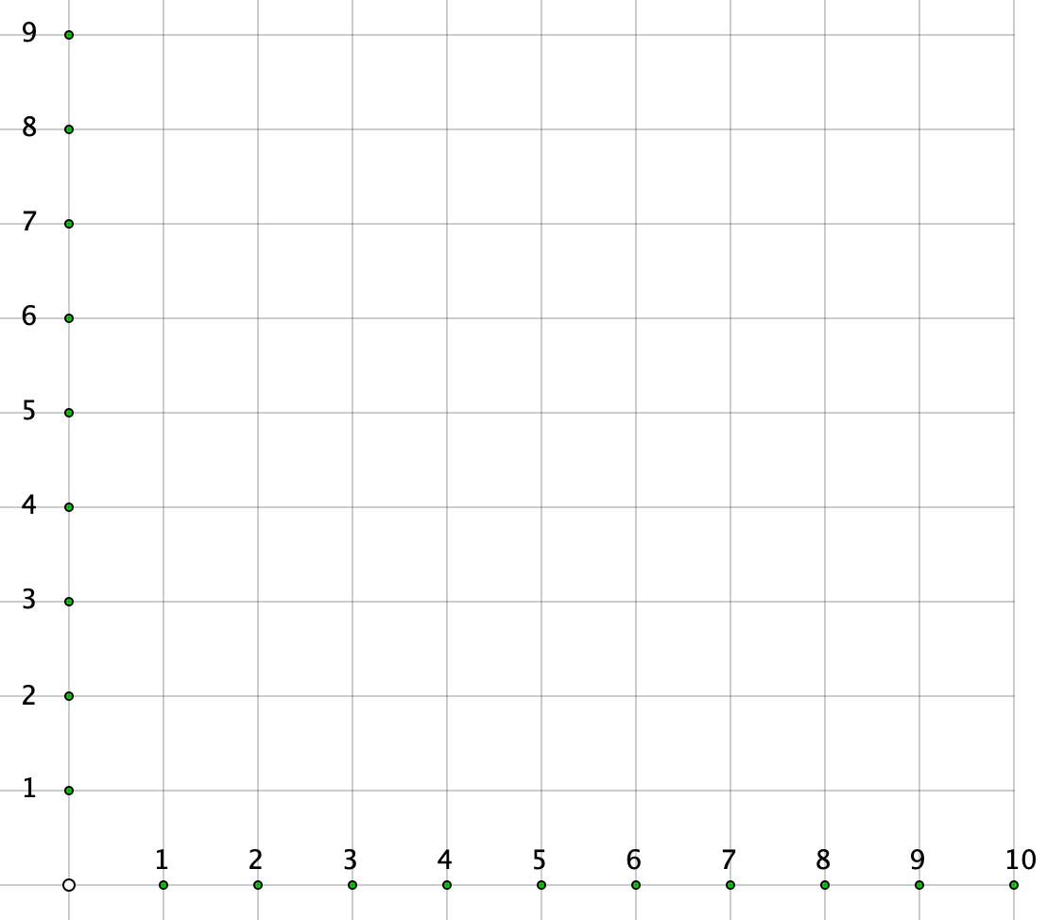
Sequences
Notes:
Children’s prior experience of sequences can be expressed graphically
Is it ok to join the dots? y= –2x+10 as a function specified on the positive integers, but extendable

Slide 9

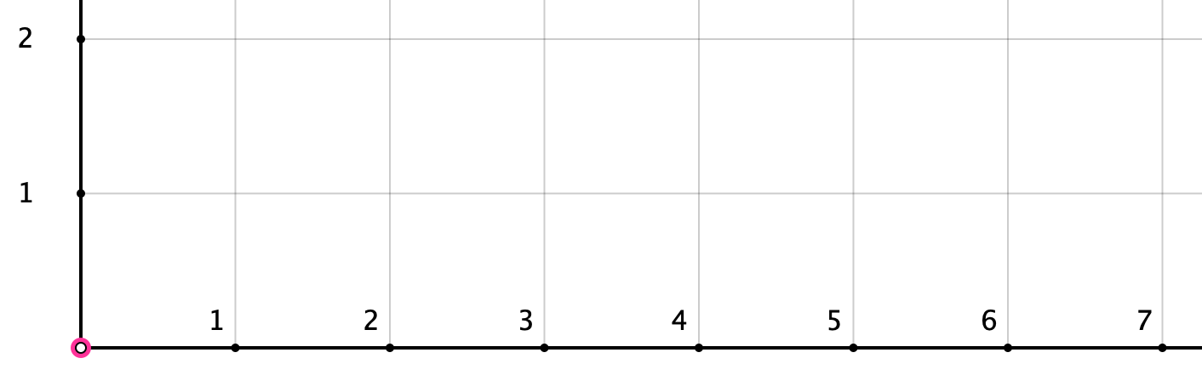
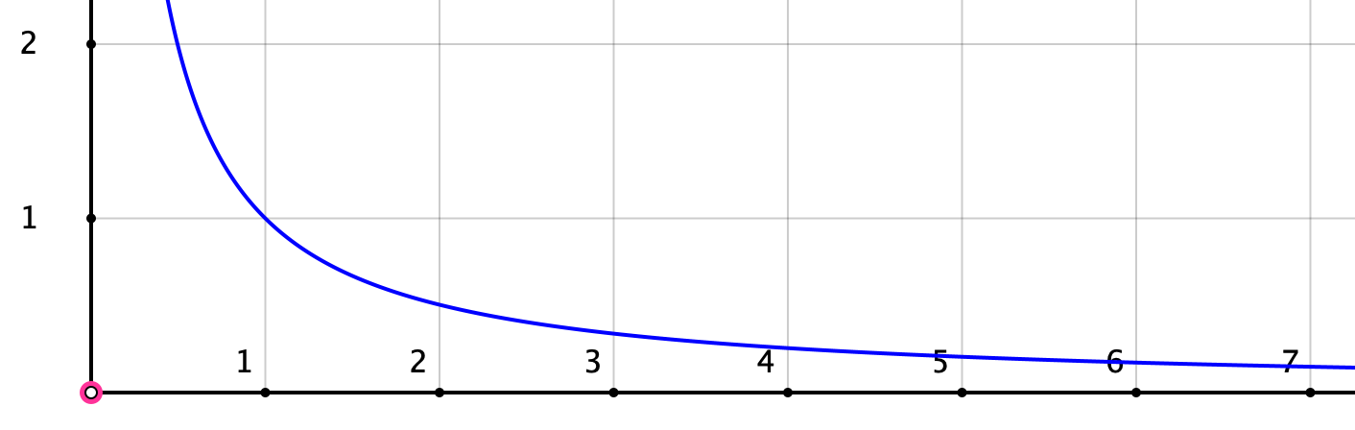
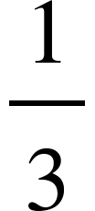


Making fractions (Griffiths, Back & Gifford 2023)
If one cake is shared between 5 people, each person gets one fifth.
If one cake is shared between 6 people, each person gets one sixth
etc.
2 people
each
Size of portion
3 people
each
4 people
each
5 people
each
Number of people
1 person gets all
Notes:
Children’s prior experience of sharing
Is it ok to join the dots? Expresses a general relationship which encompasses the discrete.
Another context … dimensions of rectangles that have a fixed area .,.. How are these contexts alike?

Slide 10
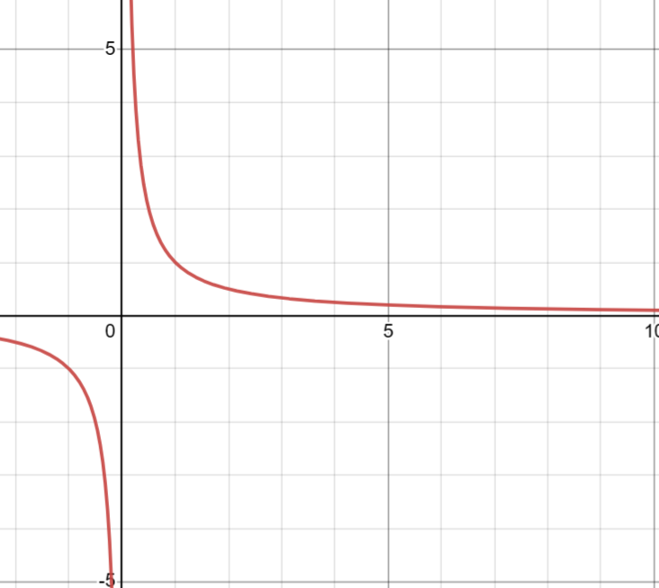
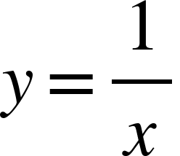

Notes:
Graphs of some familiar relationships to be added to children’s example spaces.
Why not … possibility of excitement at the very big and very small.

Slide 11
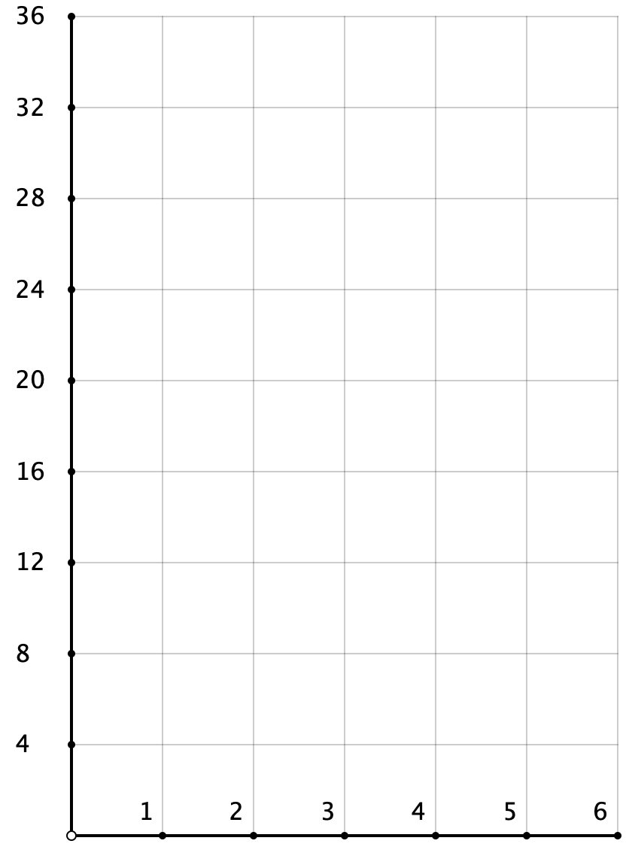
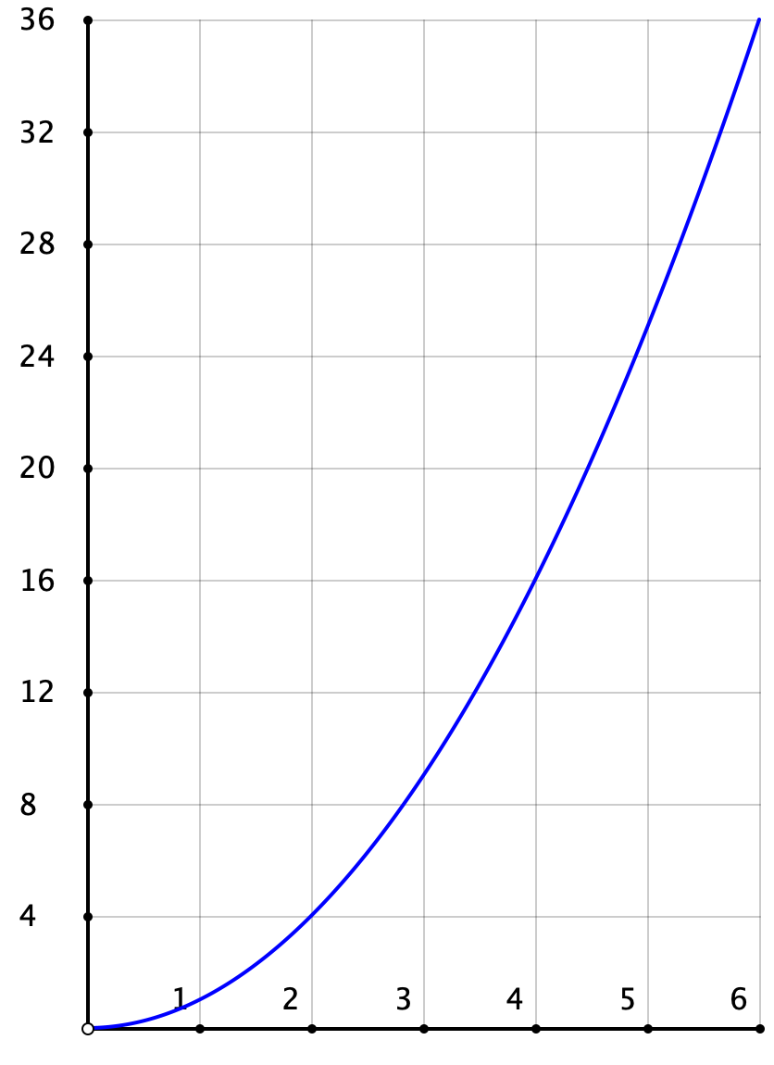
Area of Square
Area of a Square
Side of Square

Slide 12
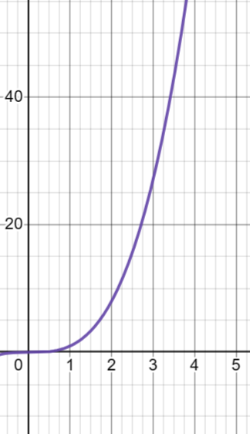
Volume of Cube
Side of cube

Slide 13
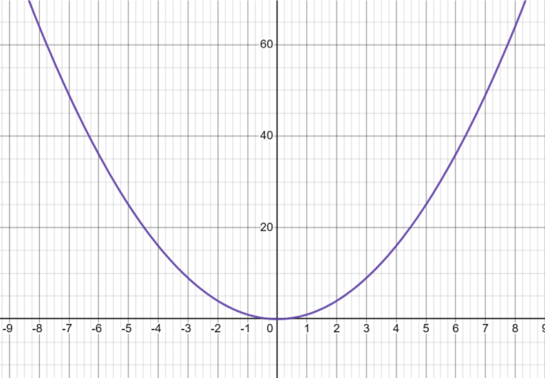
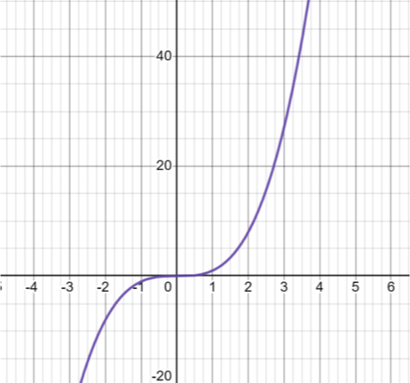
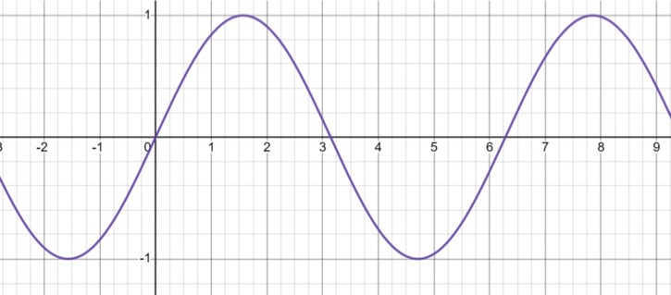
Notes:
Wave function (physics session) sometimes referred to as the Casualty (TVProgramme) Graph

Slide 14
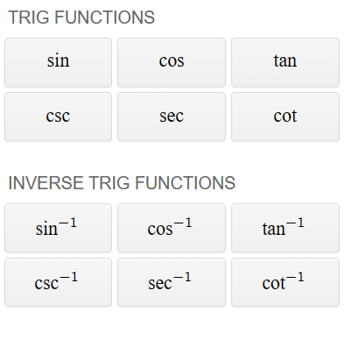
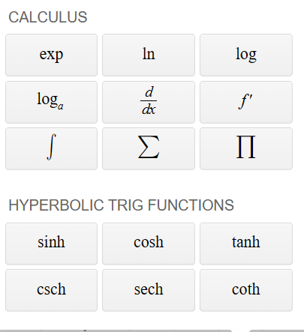
Notes:
Child’s encyclopaedia of funny functions available on graphing apps
Playing withb them … by simply adding and subtracting for example

Slide 15
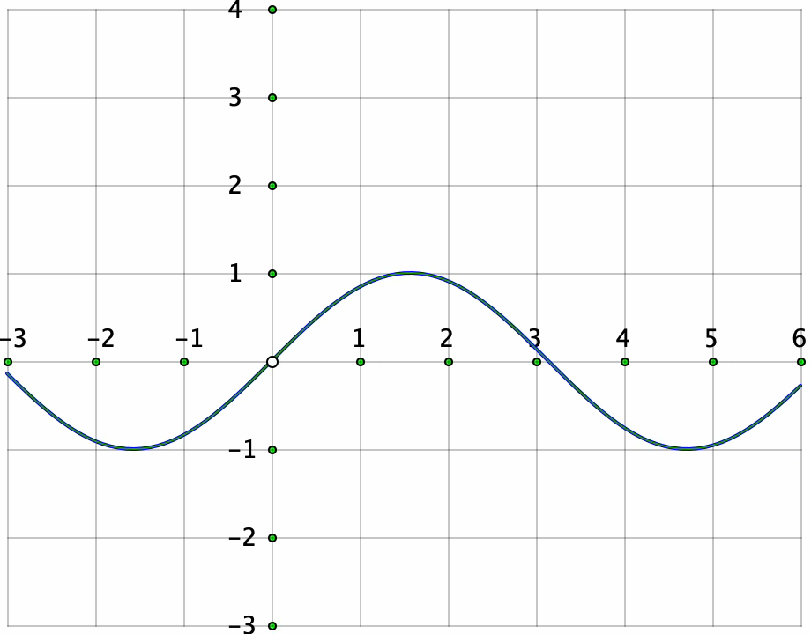
Playing with functions
using
graphing calculator apps
Notes:
What is being done at each stage (animation)

Slide 16
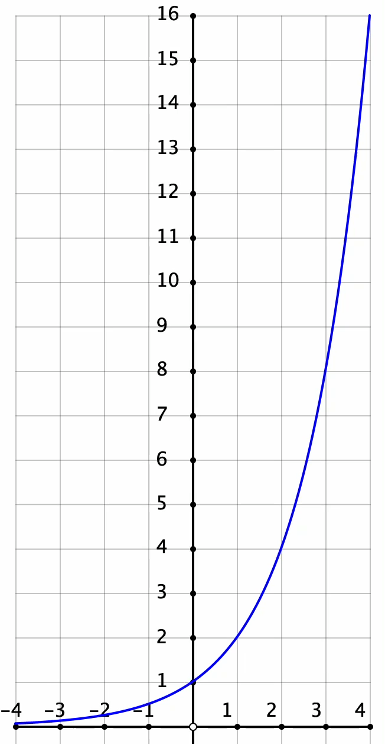
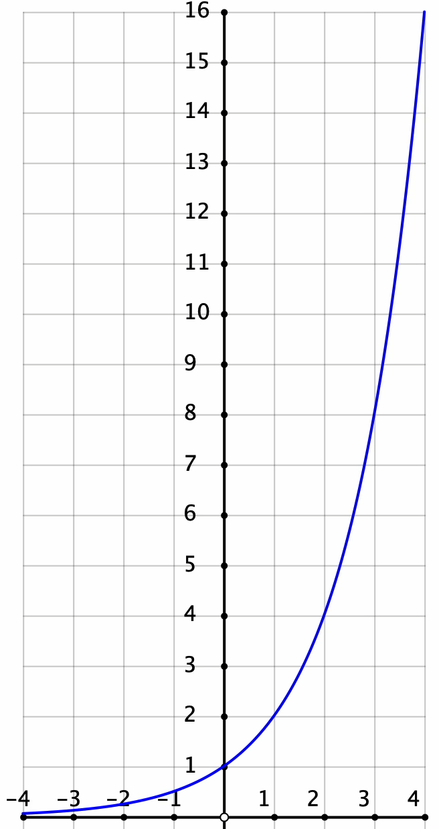
y = 2^{x}
Shift up by 2
y = 2^{x} + 2
Shift Right by 2
y = 2^{(x-2)}
Notes:
Similarly with 2^x (doubling very familiar to children)
Linearity doesn’t illustrate what happens in general
to (the graph of) a function
when additive transformations are applied.

Slide 17
Functions in mathematics and in real contexts
Varying rates of change
How gradient changes is important
Turning points
Inverses and no inverses
Continuous or not continuous
Not usually/always proportional
Not always increasing
Rarely constructed by joining dots
Zeroes on x-axis important
Translations unambiguous
Function machines/mapping diagrams rarely give useful information about the function
Notes:
Important things to become aware of about functions

Slide 18
What learners know
Varying rates or change – speeding up and slowing down
How gradient changes is important – climbing hills, up and down
Turning points – area and perimeter puzzles
Inverses and no unique inverses – square roots, undoing binary operations
Continuous or not continuous – staircases
Not usually/always proportional – sharing cake
Not always increasing – sequences, division
Rarely constructed by joining dots – very small changes
Zeroes on x-axis important – repeated subtraction sequences
Translations unambiguous
Function machines/mapping diagrams rarely give useful information about the function – functions found on calculators
Notes:
Prior experiences of children
So why not encourage playing with functions visually

Slide 19
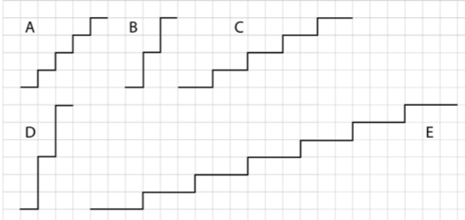
Concept Image of Positive Gradient
Why might I have been shocked to find this in a section about constant gradient?
Notes:
Appears in many materielas … misleading if not interpreted as intended.

Slide 20
Why bother about constant gradients
(apart from in proportional contexts)?

Slide 21
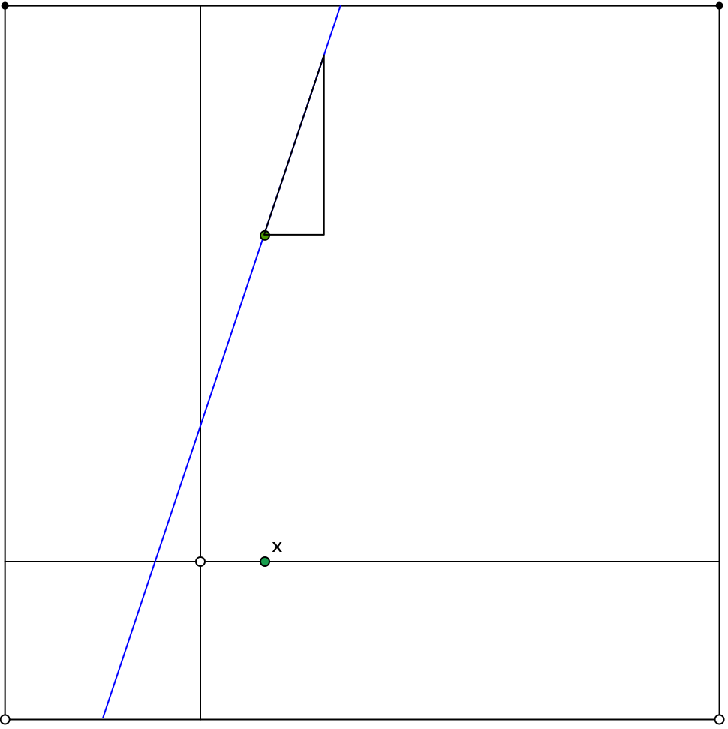
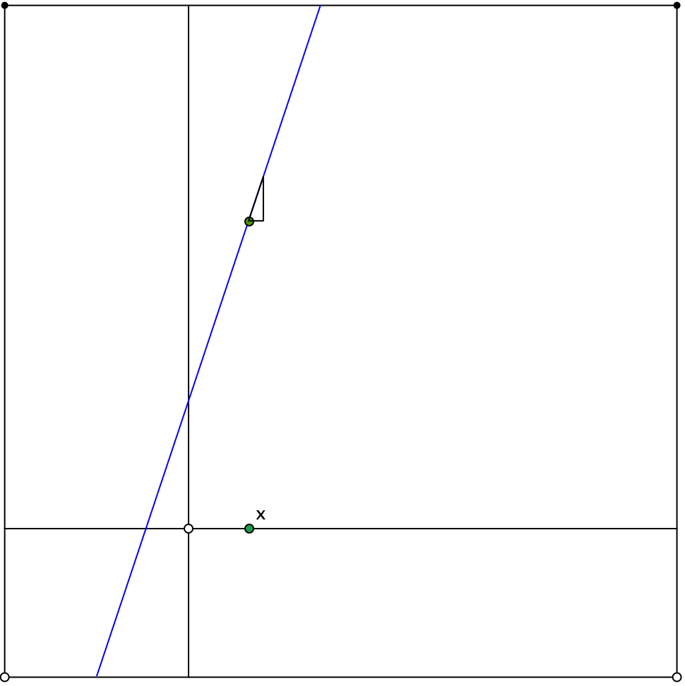
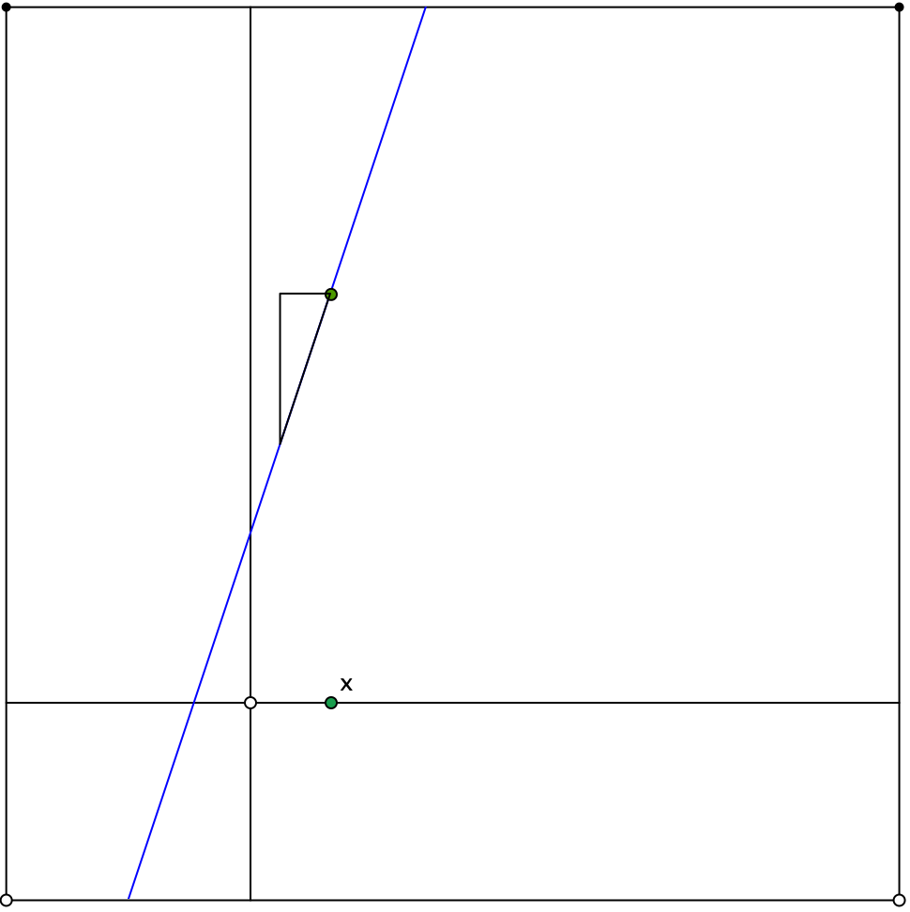
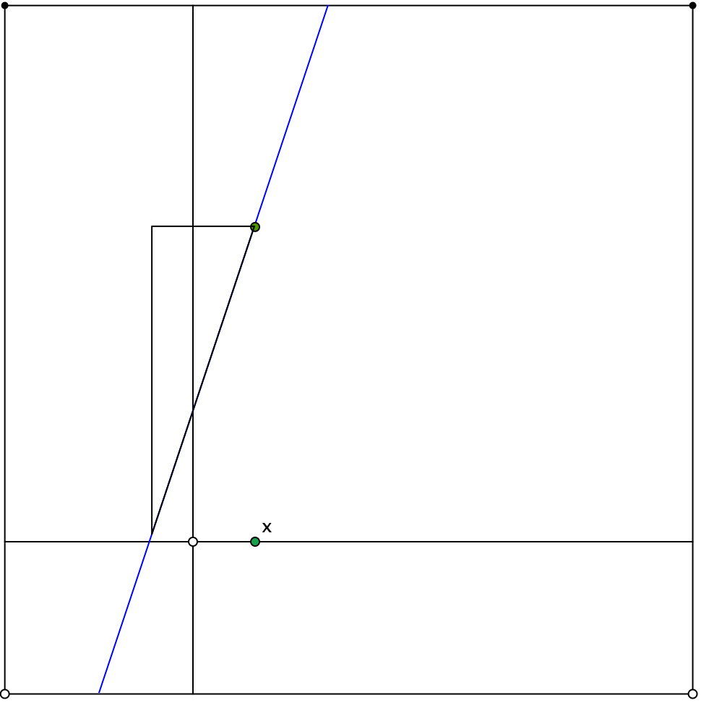
Zooming in on a straight line
Notes:
Straight lines have constant gradient … the gradient triangle
Which turns out to be he basis for studying the rate of change in many different situations

Slide 22
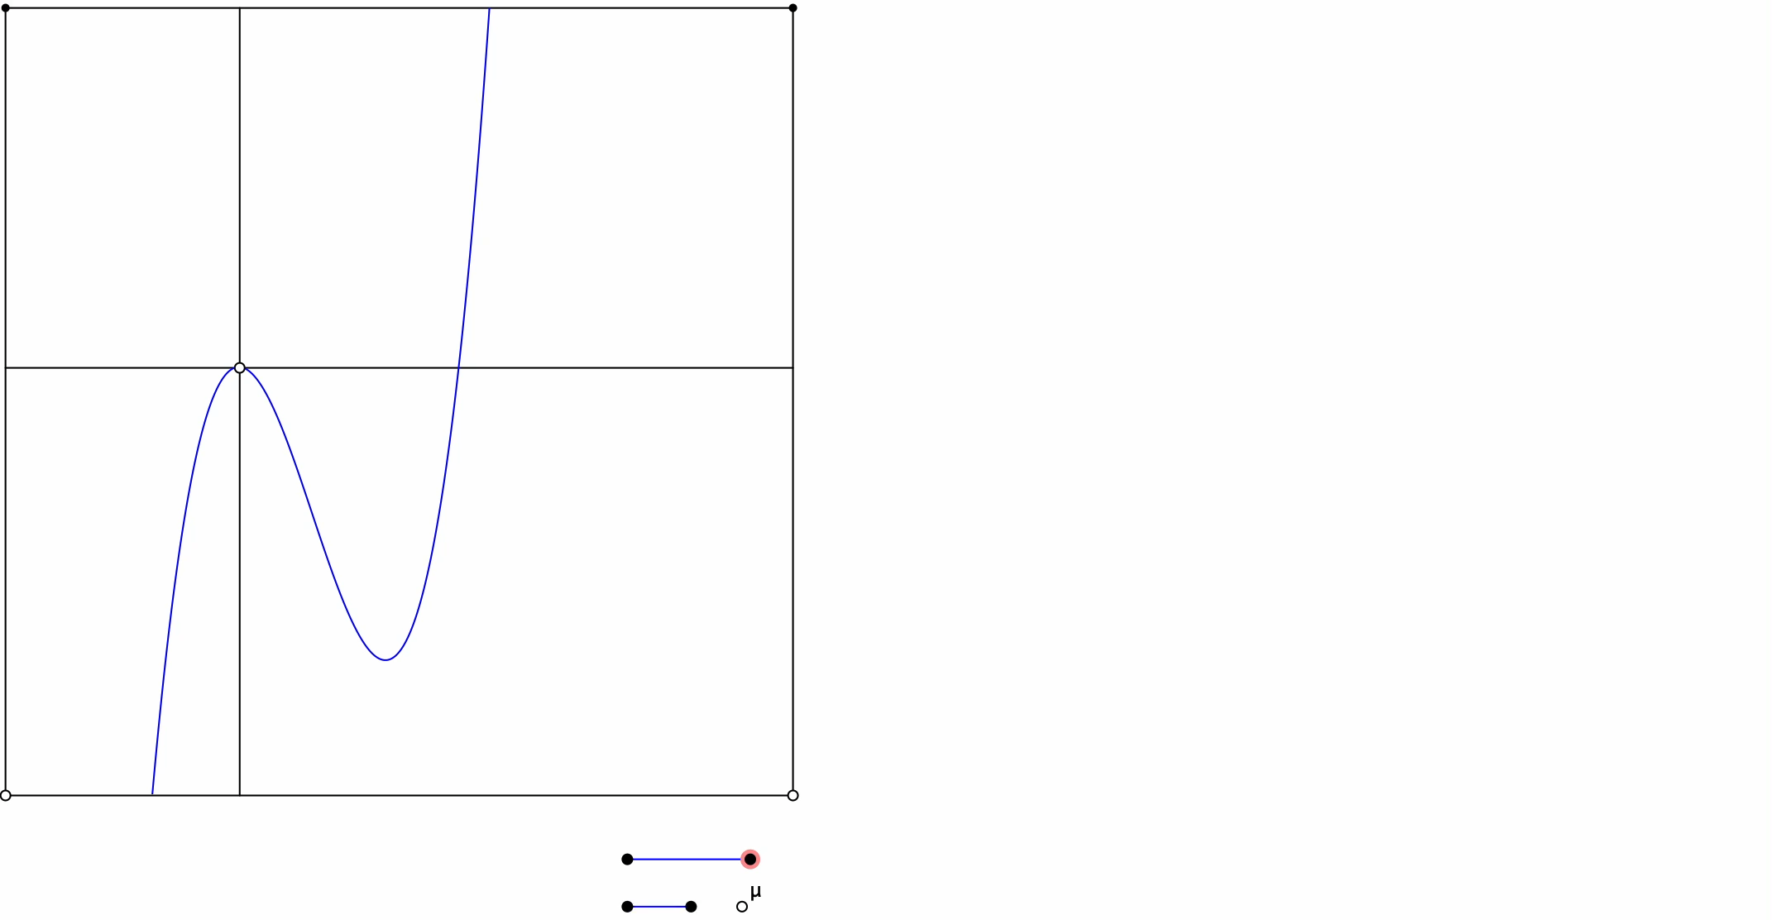
Gradient Triangle for Cubic
Zooming In
Notes:
Gradient triangle gives a very good approximation when it gets very small, and you zoom in on the graph …
What is studied later is functions which have this zoom-in property.

Slide 23
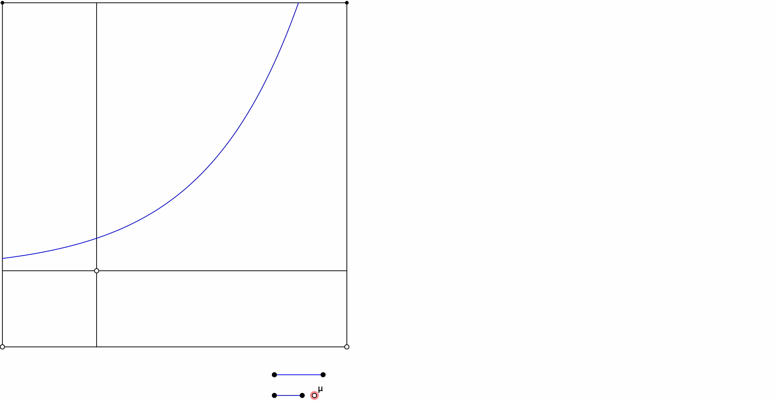
Notes:
Perfectly accessible at KS3 based on prior experience

Slide 24
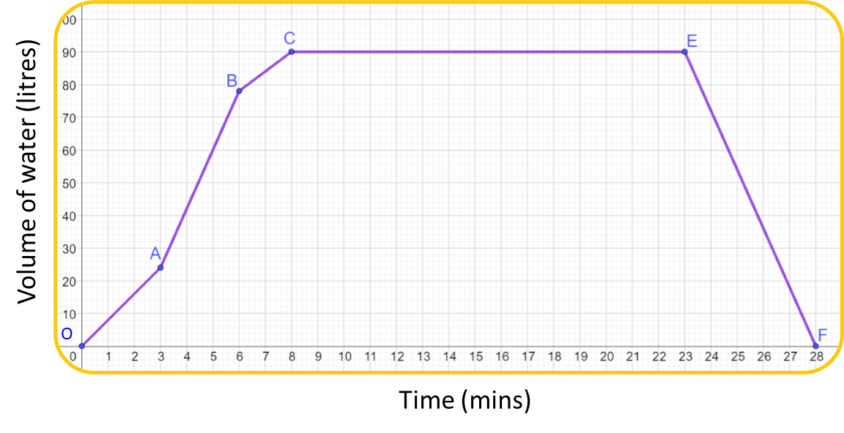
What best describes the highlighted section of the graph?
Filling fastest
Filling slowest
Not filling or emptying
Emptying
Notes:
Maths Mastery

Slide 25
What best describes the highlighted section of the graph?
Filling fastest
Filling slowest
Not filling or emptying
Emptying

Slide 26
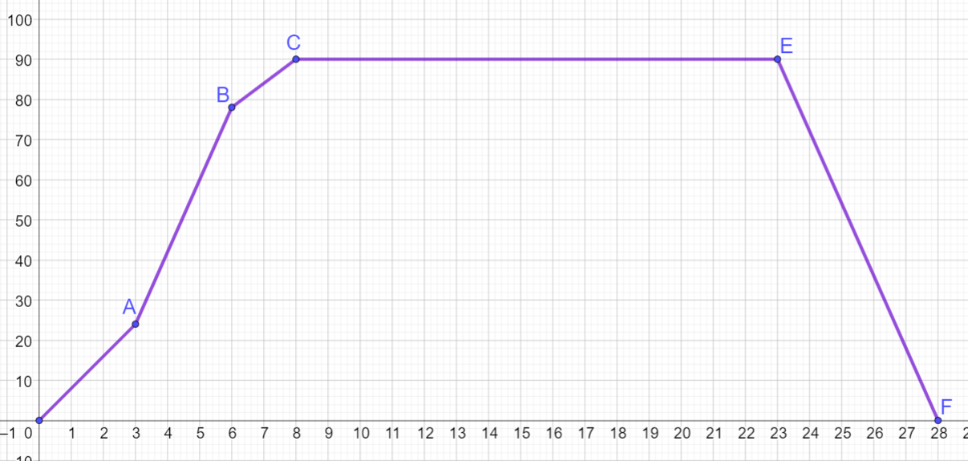







Piecewise relationships can describe values increasing and decreasing.
Work out the gradient for each of the sections marked.
What does this tell you about the rate and direction of water flow?
$$?$$
$$?$$
Volume of water (litres)
$$54$$
$$?$$
$$?$$
$$24$$
$$3$$
$$?$$
Time (mins)

Slide 27
The sketch graph shows the depth of water in a container over time.
Which option best describes how the depth is changing?
Depth
Time
Depth decreasing at a constant rate
Depth increasing more and more slowly
Depth increasing more and more quickly
Depth increasing at a constant rate

Slide 28
The sketch graph shows the depth of water in a container over time.
Which option best describes how the depth is changing?
Depth
Time
Depth decreasing at a constant rate
Depth increasing more and more slowly
Depth increasing more and more quickly
Depth increasing at a constant rate

Slide 29
The sketch graph shows the depth of water in a container over time.
Which option best describes how the depth is changing?
Depth
Time
Depth decreasing at a constant rate
Depth increasing more and more slowly
Depth increasing more and more quickly
Depth increasing at a constant rate

Slide 30

The containers below are filled with water at the same rate.
Sketch a depth-time graph for each.
Hint: Think about how fast the depth of water is changing at the beginning, middle and end.

Slide 31
When is linearity ever helpful mathematically?
Proportionality (always go through origin)
Approximating rate of change
Building polynomials from linear factors
(another story for another time)

Slide 32
Problems with KS3 focus on linear relations
Usually increasing (what about decreasing?)
Usually introduced by joining points (when is this justified?)
Gives wrong impression about inverse functions
(most functions do not have inverses)
Gives wrong impression about continuity of functions
(many useful functions have discontinuities)
Constant rate of change (most situations have varying rate of change)
Ambiguous about direction of translations
(usually different translations have different effects)
Confuses relative importance of x and y intercepts
Ignores early experiences with number relations and equations

Slide 33
Follow-Up
PMTheta.com
annewatson1089@gmail.com
John.mason@open.ac.uk

