Slide 1



Nurturing Mathematical Minds: getting learners to make use of their natural powers
The Open University
Maths Dept
University of Oxford
Dept of Education
Promoting Mathematical Thinking
John Mason
Jurassic Maths Hub
Taunton
June 2017

Slide 2
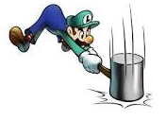
Throat Clearing
Everything said here is a conjecture …
  … to be tested in your experience
My approach is fundamentally phenomenological …
I am interested in lived experience.
Radical version: my task is to evoke awareness (noticing)
So, what you get from this session will be mostly …
  … what you notice happening inside you!
Avoid the teaching of
speculators,
whose judgements are
not confirmed
by experience.
(Leonardo Da Vinci)
Who takes initiative?
Who makes choices?
What is being attended to?

Slide 3
My Current Interests
The role and nature of attention in teaching and learning mathematics
Drawing on the full human psyche:
  Cognition, Affect, Enaction; Attention, Will, Witness; Conscience
Extending Dual Systems Theory to the whole psyche
  S1: automaticity
  S1.5: emotivity
  S2: consideration (particularly cognitively)
  S3: openness to creative energy
How tools and tasks mediate between student, teacher and mathematics

Slide 4
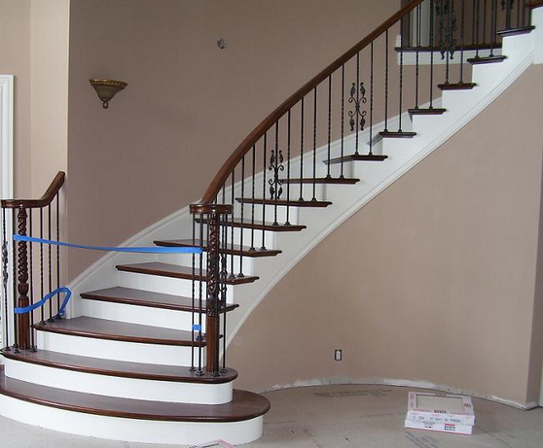
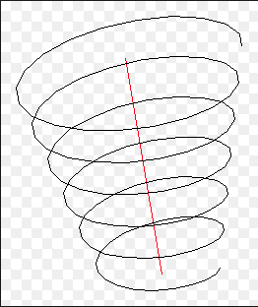
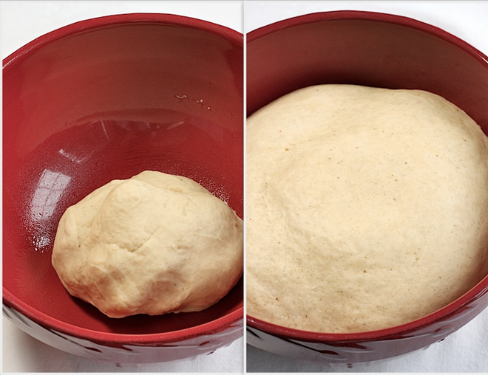
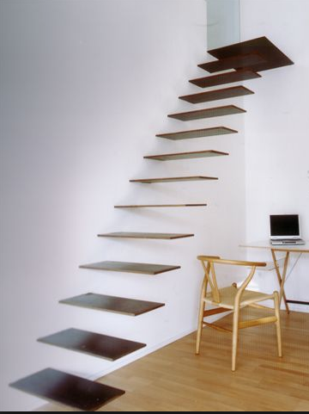

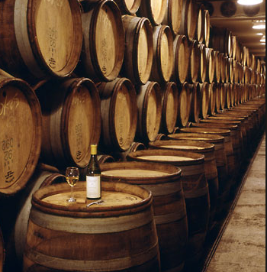
Conceptions of Learning
Consequences for Teaching
Staircase
Spiral
Maturation

Slide 5
Imagining & Expressing
Imagine a Quadrilateral, then draw it
  Now draw a quadrilateral which has its diagonals perpendicular
  Now draw a quadrilateral with perpendicular diagonals of unequal length
Draw a pentagon
  With exactly one right angle
  With exactly two right angles
  With exactly three right angles
  How many right angles can a polygon have?

Slide 6
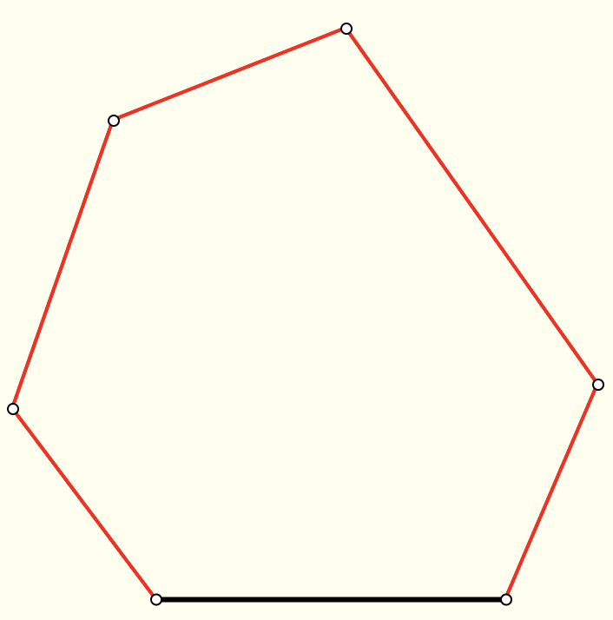
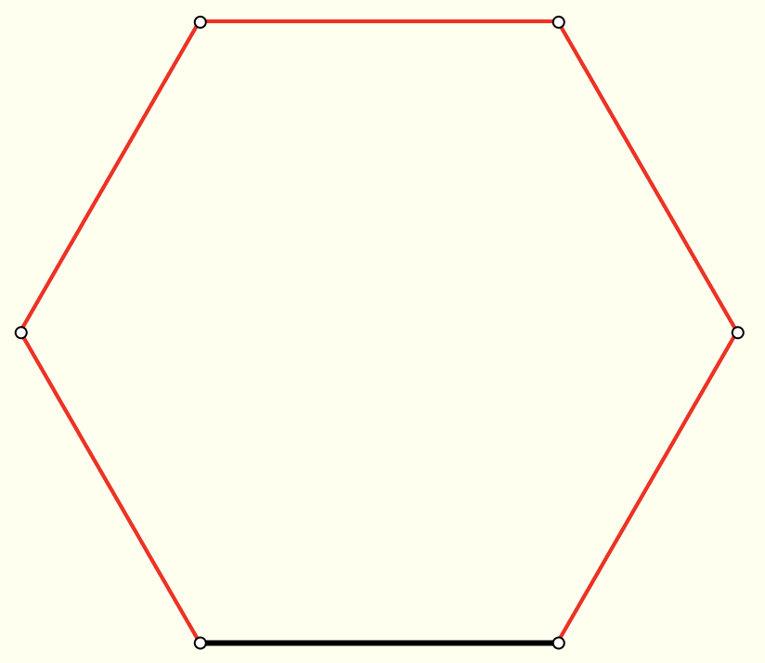
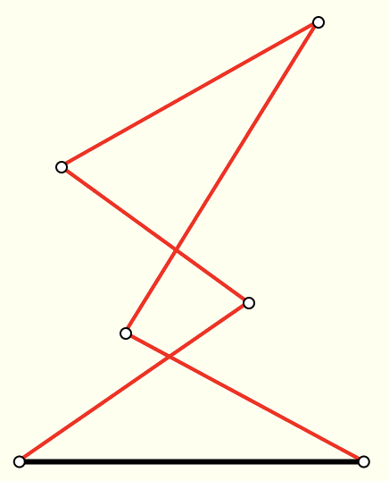
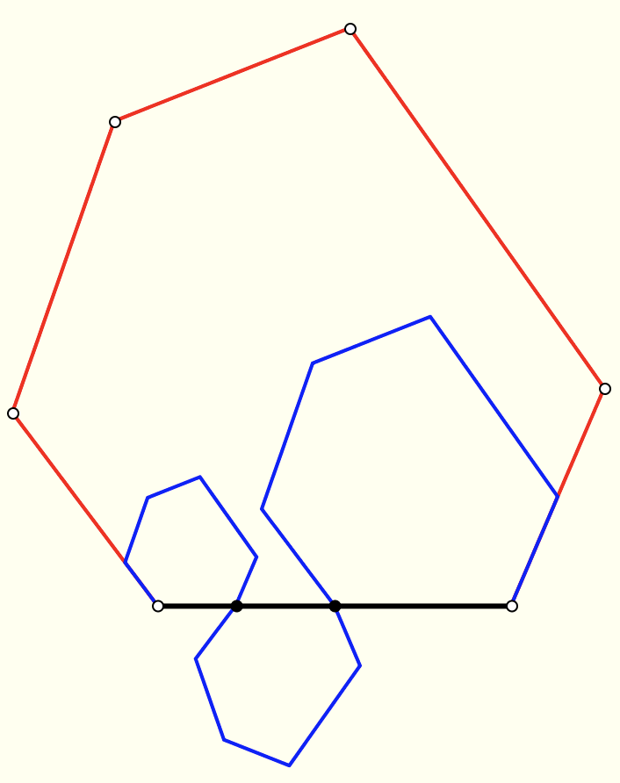
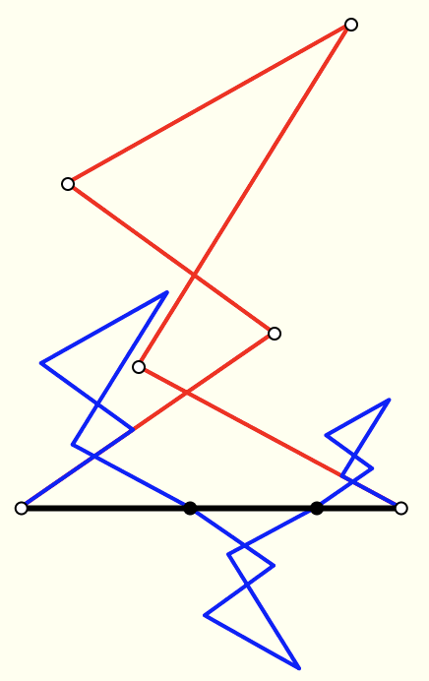
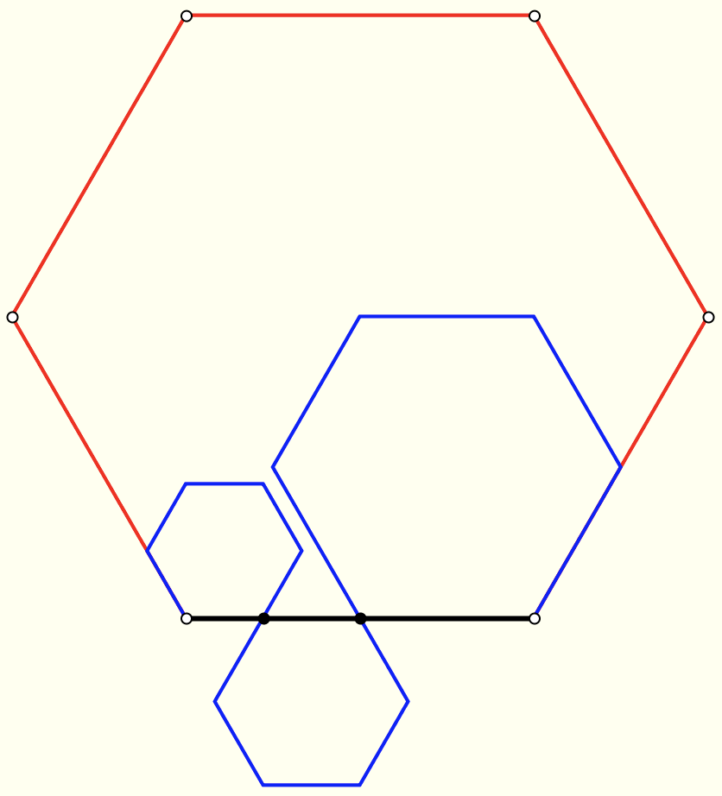
Path Lengths
Imagine a black line segment.
On that segment, construct a hexagon
What is the length of the blue path in relation to the red path?

Slide 7
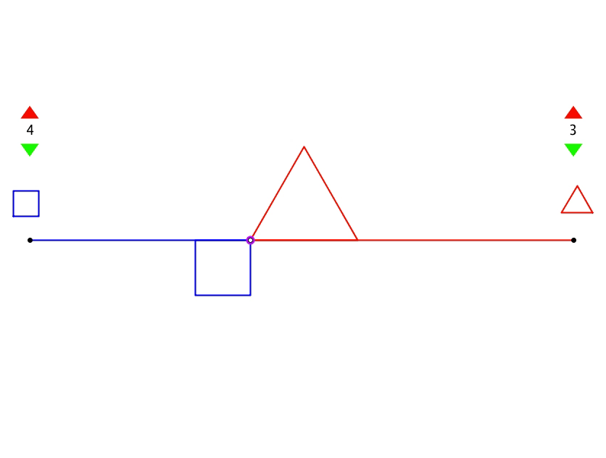
Coordinated Perimeters

Slide 8
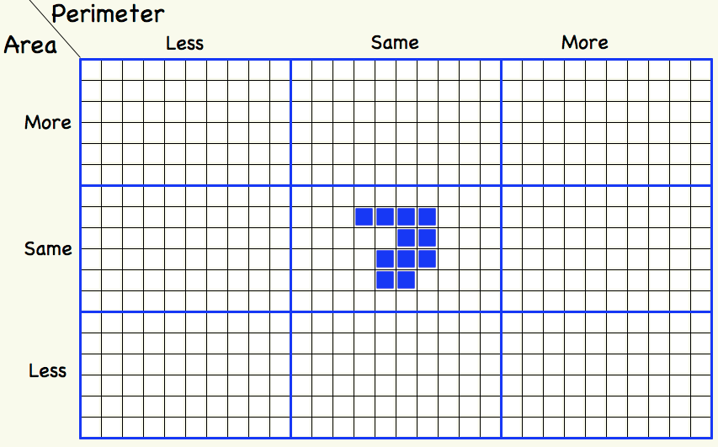
More or Less: Area and Perimeter

Slide 9

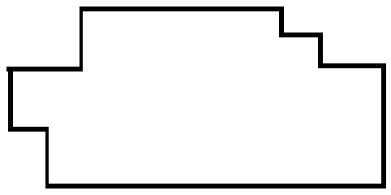
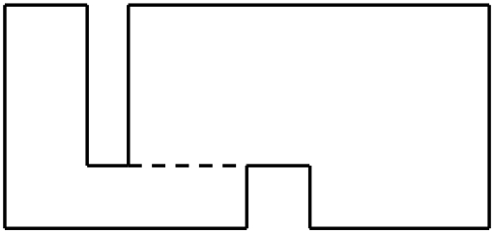
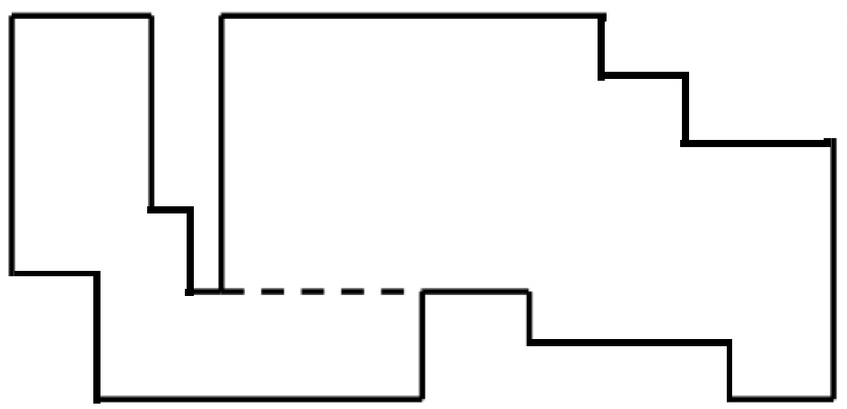
Perimeter Adjustments
Compare the perimeters of the shapes below
(dotted lines show alignments).
Construct other shapes whose perimeters can be worked out using only the lengths of the original rectangle.
What more information is needed to calculate the areas?

Slide 10
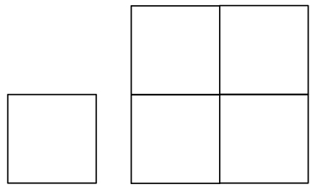
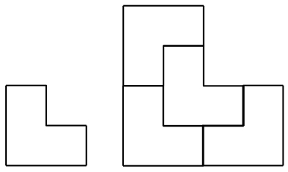
Scaling
Below are two shapes both of which can be scaled by a factor of two using four copies.
What other shapes have this property?
Can you find a shape that can be scaled by a factor of 3 using 9 copies but not by 2 using 4 copies?

Slide 11
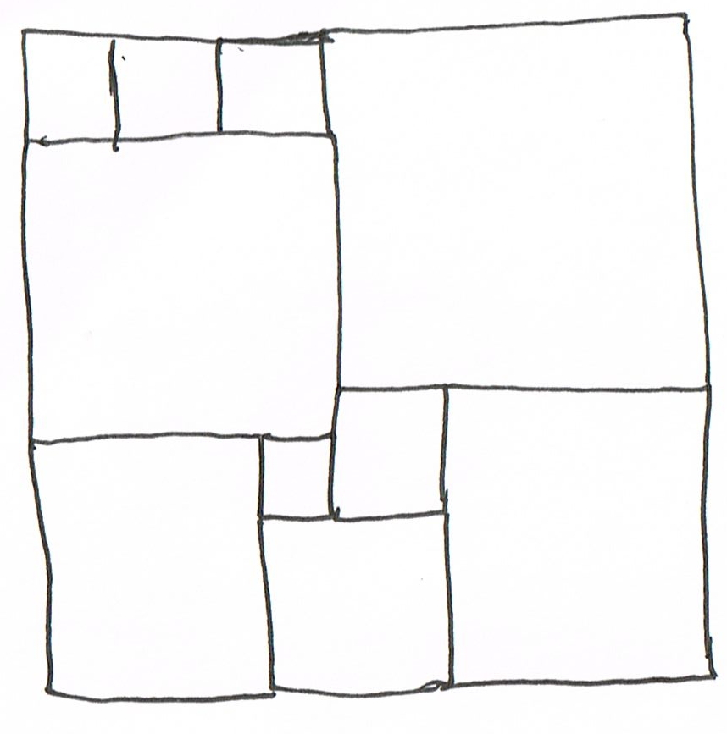
Square Deduction
Could these all be squares?

Slide 12
Square Deduction: acknowledging ignorance
(3a + b)/3
(3a + b)/3 = 3(b – a)
12a = 8 b
So 3a = 2b
put a = 2 & b = 3
3(b – a)
a + 3b
3a + b
a
b
a + 2b
For an overall square
4a + 4b = 2a + 5b
So 2a = b incompatible!
2a + b
a + b
3
11
For n squares upper left
3(b – a) = (3a + b)/n
So 3a(n+1) = b(3n -1)
But not also 2a = b
9
2
3
7
8
5

Slide 13
Being Playful (Extending)
2(2a+3b)
2a+b+
3
3:2
2(a+3b)
2(2a+3b)
2(
2a+b+
)
3
3
+b–a
a
3
a+b
b
2a+3b
a+3b
a+2b
2:3
2:3
2(a+3b)
2(2a+3b)
3
3
2(2a+3b)
a
9
2(a+3b)
2(
2a+b+
)
+ (b–a) + (a+ 3b)
3
=
3
=
+ (2a+3b)
b
32
3

Slide 14
How Complicated?

Slide 15
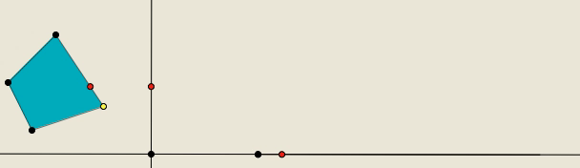
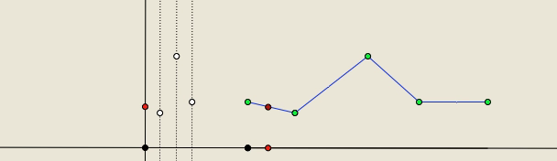
Perimeter Projections

Slide 16
Skip Counting
Starting at 3, counting in 5s
  What will the 100th number be?
Starting at 4 counting in 7s
    What will the 100th number be?
Starting at 23, counting down in 5s
Starting at 101 counting down in ths

Slide 17
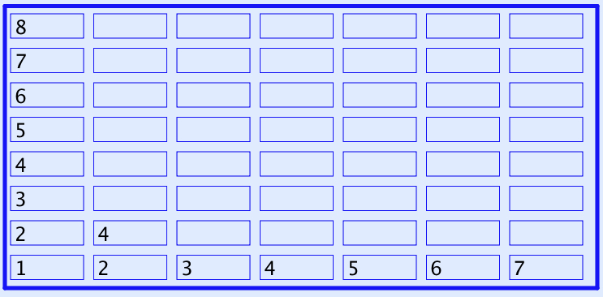
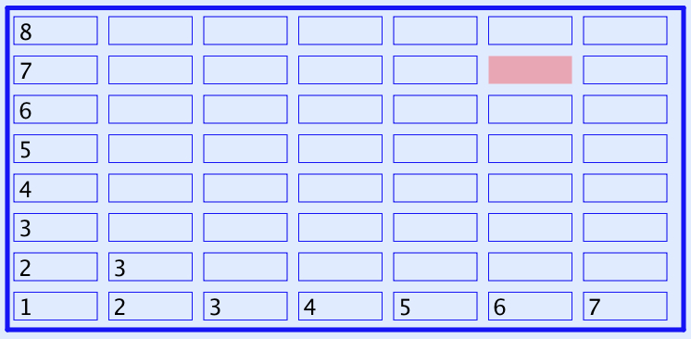
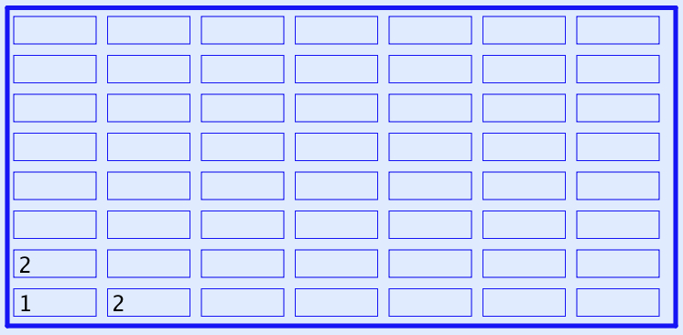
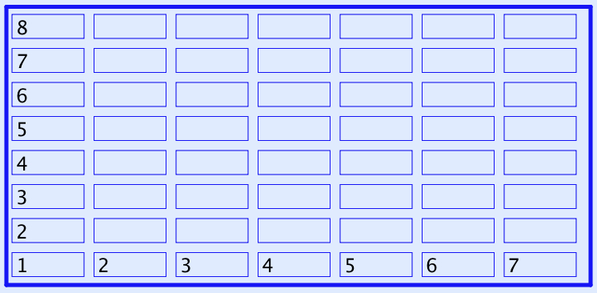
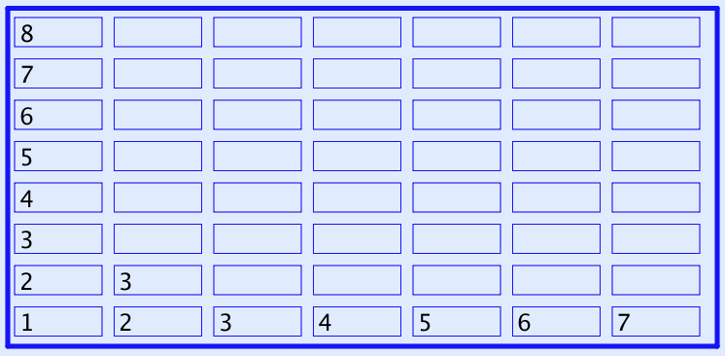
What Next?
Every row and column is an arithmetic progression
(constant difference)

Slide 18
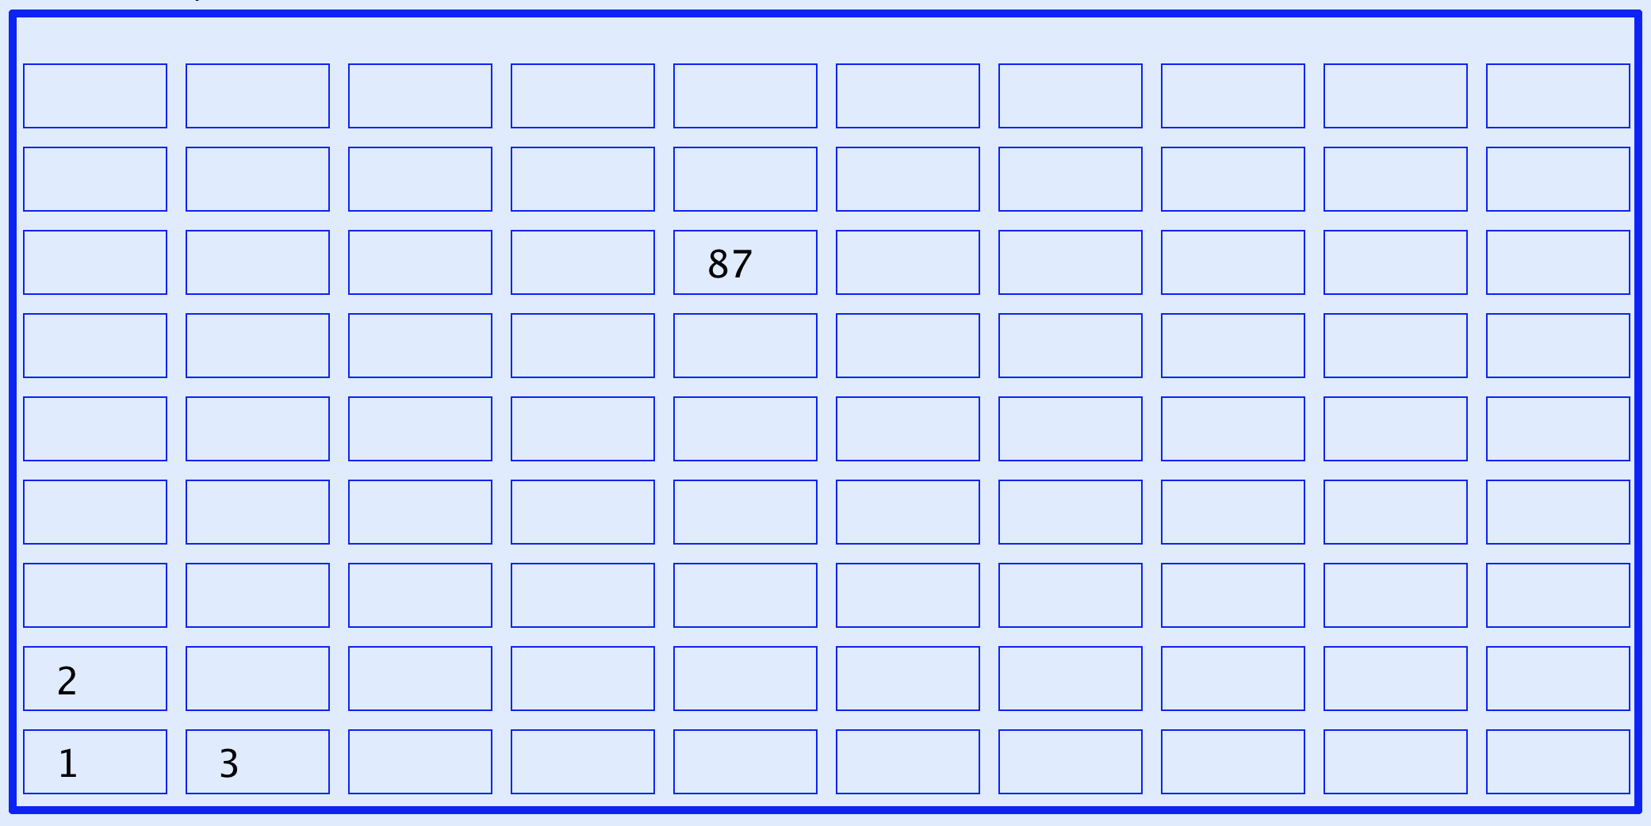

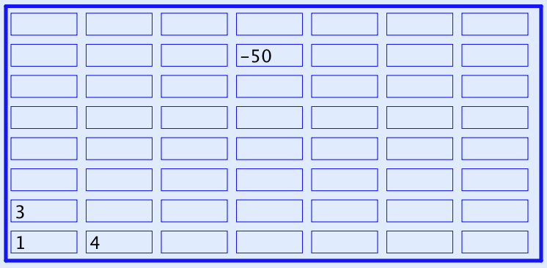
Now What Next?
A lesson without the opportunity to express generality
is not a mathematics lesson
Notes:
Expressing Generality

Slide 19
Appreciating & Comprehending Division
I tell you that 10101 is divisible by 37.
What is the remainder upon dividing
1010137 by 37?
What is the remainder upon dividing
1010123 by 37?
What is the remainder upon dividing
10124 by 37?
What is the remainder upon dividing
232323 by 37?
Make up your own similar question
  What is the same and what different about your task and mine?
How do you know?
0
Did you write it down for yourself?
How do you know?
1010100+37
23
How do you know?
23
0
How do you know?
It’s all about what you are attending to,
and how you are attending to it
Attention is directed
by what is being varied
Notes:
Student initiative

Slide 20
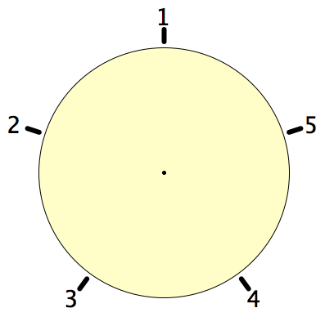
Secret Places
One of these five places has been chosen secretly.
You can get information by clicking on the numbers.
If the place where you click is the secret place, or next to the secret place, it will go red (hot), otherwise it will go blue (cold).
How few clicks can you make and be certain of finding the secret place?
Can you always find it in 2 clicks?
Notes:
Imagine a round table …

Slide 21
Progression & Development
DTR (do, talk, record)
MGA (manipulating, getting-a-sense-of, articulting)
EIS (enactive, iconic, symbolic: Bruner)
  (weaning off material objects)
PES (enriching Personal Example Space)
LGE (Learner Generated Examples)
Re-construction when needed
Communicate effectively with others

Slide 22
Reasoning Conjectures
What blocks children from displaying reasoning is often lack of facility with number.
Reasoning mathematically involves
seeking and recognising relationships,
then justifying why those relationships are actually properties that always hold.
Put another way, you look for invariants
(relationships that don’t change)
and then express why they must be invariant.

Slide 23
Inner, Outer & Mediating Aspects of Tasks
Outer
  What task actually initiates explicitly
Inner
  What mathematical concepts underpinned
  What mathematical themes encountered
  What mathematical powers invoked
  What personal propensities brought to awareness
Mediating
  Between Teacher and Student
  Between Student and Mathematics (concepts; inner aspects)
Activity
  Enacted & lived objects of learning
Object of Learning
Resources
Tasks
Current State
Notes:
Tahta
Bennett

Slide 24
Concrete-Pictorial-Abstract
(re)-presentations
Enactive – Iconic – Symbolic
Manipulating – Getting-a-sense-of – Articulating
Doing – Talking – Recording

Slide 25
Powers & Themes
Are students being encouraged
to use their own powers?
Powers
or
are their powers being usurped by textbook, worksheets and … ?
Imagining & Expressing
Specialising & Generalising
Conjecturing & Convincing
(Re)-Presenting in different modes
Organising & Characterising
Themes
Doing & Undoing
Invariance in the midst of change
Freedom & Constraint
Restricting & Extending
Exchanging

Slide 26
Reflection and the Human Psyche
What struck you during this session?
What for you were the main points (cognition)?
What were the dominant emotions evoked? (affect)?
What actions might you want to pursue further? (enaction)
What initiative might you take (will)?
What might you try to look out for in the near future (witness)
What might you pay special attention to in the near future (attention)?
What aspects of teaching need specific care (conscience)?
Notes:
Chi et al

Slide 27
Reflection
Withdrawing from action
Becoming aware of an action, or a relationship
NOT ‘telling them so they remember’
but rather
immersing them in a culture of mathematical practices

Slide 28
Stances
Deficiency
  What learners cannot (do not) do at different ages and stages
  What teachers do not know, do, or appreciate about different topics and pedagogical strategies
Proficiency
  What learners & teachers & policy makers do already
  Not doing for learners & teachers what they can already do for themselves
Efficiency & Effectiveness
  Seeking efficient and effective ways of enhancing, extending, and enriching
    Peoples’ sensitivities to notice what matters
    Peoples’ powers,
    Peoples’ appreciation of mathematical themes,
    Peoples’ experience of mathematical thinking
    Peoples’ internalisation of effective actions

Slide 29
To Follow Up
PMTheta.com
john.mason@open.ac.uk
Designing & Using Mathematical Tasks (Tarquin)
Mathematics as a Constructive Enterprise (Erlbaum)
Thinking Mathematically (Pearson)
Key Ideas in Mathematics (OUP)
Researching Your Own Practice Using The Discipline of Noticing (RoutledgeFalmer)
Questions and Prompts: (primary) (ATM)
Annual Institute for Mathematical Pedagogy
(early August: see PMTheta.com)

