Slide 1


Attention when
Doing, Learning or Teaching Mathematics
John Mason
M500 WW
Jan
2024

Slide 2
Opening Calculation
(20 + 24) + (20 + 24) + (20 + 24)(20 + 24) = ?
= (20 + 24)(2 + 20 + 24)
= (44)(46)
= (4)(506)
= 2024

Slide 3
Throat Clearing
I am interested in the lived experience of
thinking, teaching and learning Mathematically
I invite you to try to sensitise yourself to
  What you are attending to
and
  How you are attending to it,
while engaged in mathematical thinking
Everything said today, especially by me, is
A CONJECTURE
to be tested in and against your experience.
What you get from this session will be mostly what you NOTICE about your attention

Slide 4
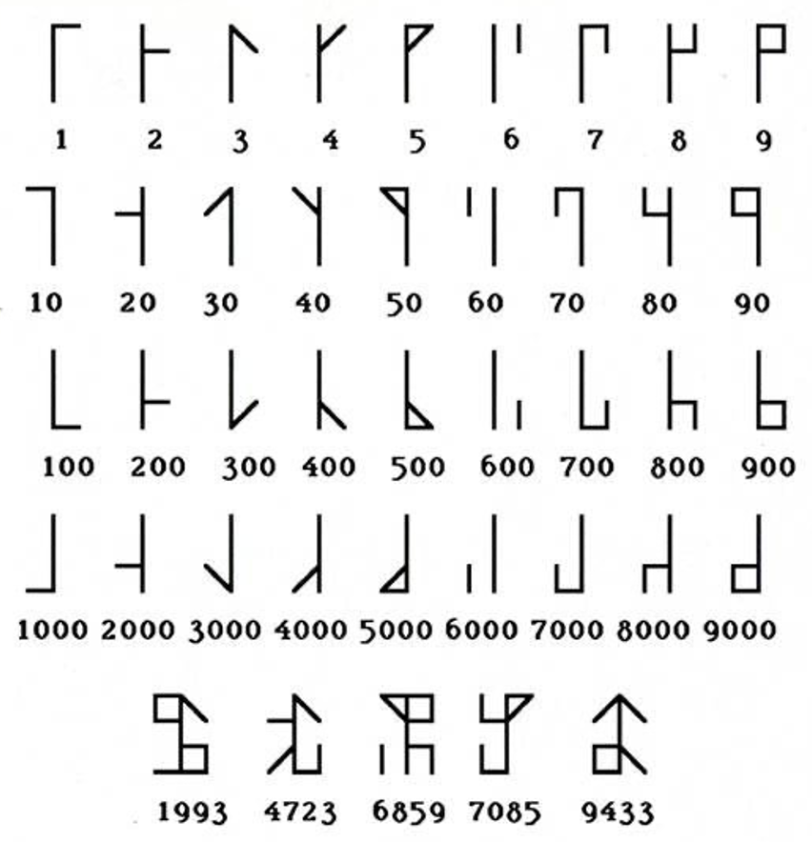
Cistercian Numerals
Depict 2024
Shifts of Attention
Holding Whole(s) (Gazing)
Discerning Details
Recognising Relationships
Perceiving Properties
Reasoning on the basis of agreed Properties

Slide 5
Shifts of Attention
Holding Whole(s) (Gazing)
Discerning Details
Reasoning on the basis of agreed Properties
Recognising Relationships
Perceiving Properties

Slide 6
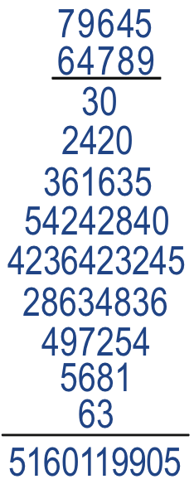
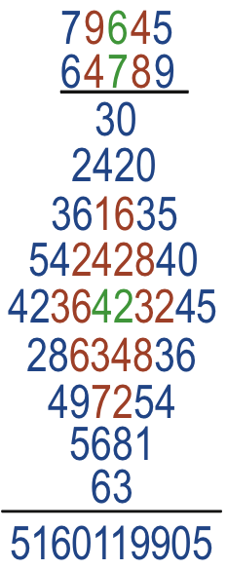
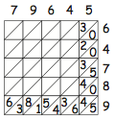
Diamond Multiplication
Is it correct?
How is it done?
Attention Focus
Pairs to be multiplied
Systematically?
Pairs in answer

Slide 7
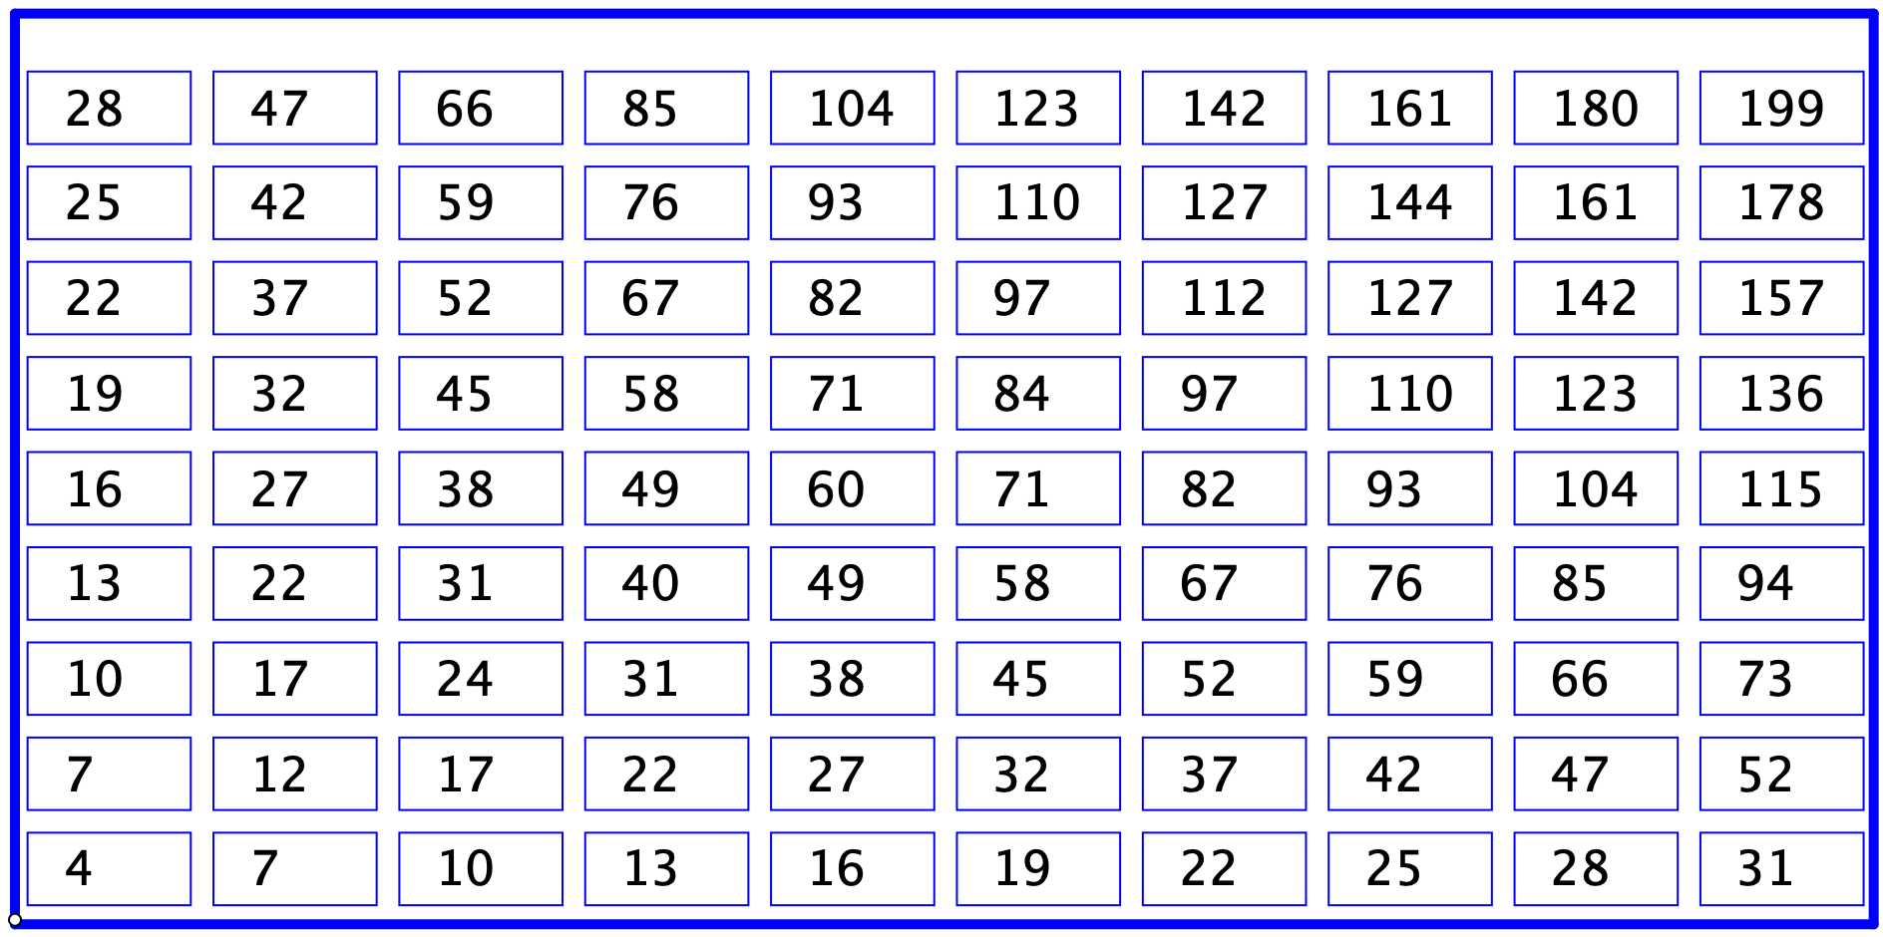
Sundaram Grids
Conjecture: One more than double any entry is composite
Numbers!
Doubling and adding 1
Differences

Slide 8
Forms of Attention
Macro
  Locus, Focus, Multiplicity
Meso
  Principal concern(s); absolute; centre of gravity
    Macro-Social; Meso-social; Micro-social
    Personal
Micro
  Holding Wholes
  Discerning Details
  Recognising Relationships (in a particular situation)
  Perceiving Properties (as being instantiated)
  Reasoning on the basis of agreed properties (abstraction)

Slide 9
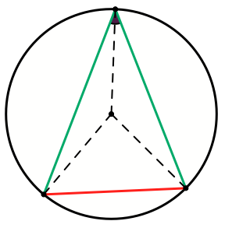
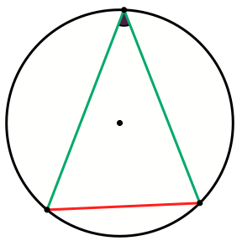
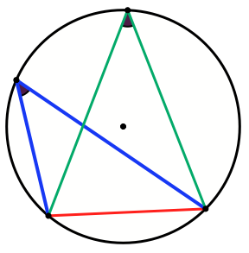
Invisible Embedded Figures

Slide 10
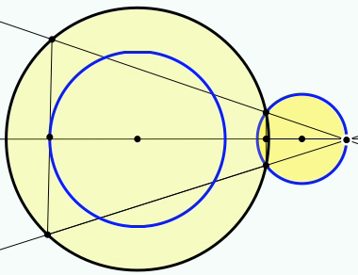
Phenomenon
What is the phenomenon?
How does your attention shift?

Slide 11
Understanding Division
234234 is divisible by 13 and 7 and 11;
  What is the remainder on dividing 23423426 by 13?
  By 7? By 11?
Make up your own!

Slide 12
Some Arithmetic
34 + 83 – 34 = ?
278 + 341 – 248 – 371 = ?
Which is larger, 47 x 29 or 49 x 27?
Is 38 helpful?
Calculate
What were you attending to?
Reaction-Response
Direct Calculation
How did your attention shift?
Balk (affective block)
Structural-Relation informed calculation
Relational Thinking
Notes:
Marta Mollina; Castra; Max Stephens; …

Slide 13
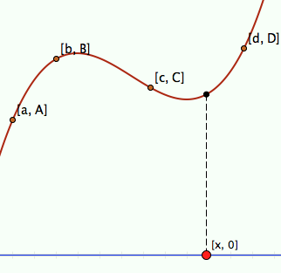
Algebraic Reasoning
(x – b)(x – c)(x – d)
(x – c)(x – d)(x – a)
y =
A
+
B
(a – b)(a – c)(a – d)
(b – c)(b – d)(b – a)
(x – d)(x – a)(x – b)
(x – a)(x – b)(x – c)
+
C
+
D
(c – d)(c – a)(c – b)
(d – a)(d – b)(d – c)

Slide 14
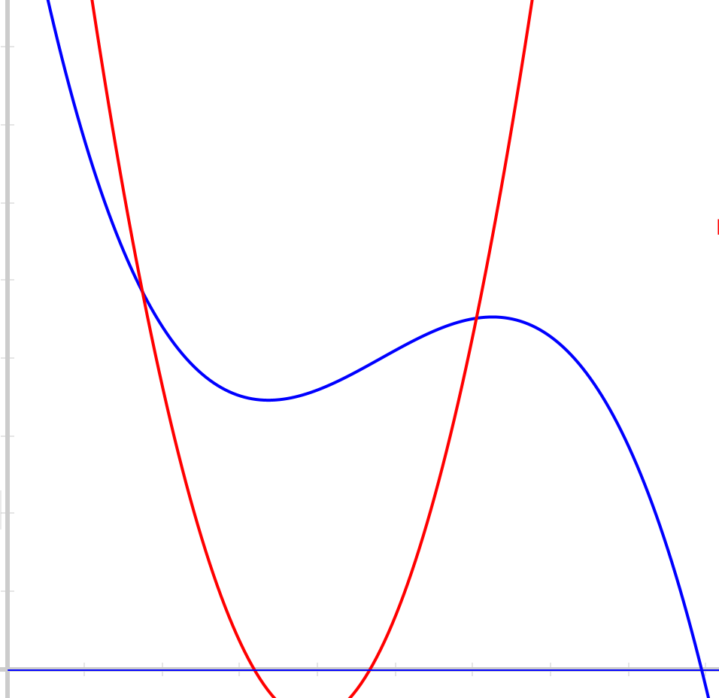
Rational Polynomials
What can be said about the rational polynomial formed by taking the Blue graph as numerator and the red graph as denominator?

Slide 15
Reflection on Tasks

Slide 16

Sundaram’s Grid
a+c
a+b+c+d
a
a+b
Foci of Attention
Gazing (Holding Wholes)
Discerning Details
Expressing generality
Recognising Relationships
Relationships
Perceiving Properties

Slide 17
Proizvlov Task 1
Write down the numbers from 1 to 8. Choose four numbers from your set and put them in a column, in descending order as you read down.
Put the remaining four numbers in a parallel column, but in ascending order as you read down.
For each pair on the same row, form the positive difference.
Add up all the differences.
Try using a different selection for your first column.
Why is the answer always the same?
6
4
3
1
2
5
7
8
4
1
4
7
7
4
3
1
2
5
6
8
5
1
3
7
16
16
Attention Foci
Columns
Change over
Differences
Same & Different
Invariance in the midst of change
Freedom & Constraint

Slide 18
Proizvlov Task 2
Choose four numbers each greater than 20 and summing to 121. Write them on slips of paper
Choose four numbers each smaller than 20 and summing to 41. Write them on slips of paper.
Choose any four of your 8 numbers and put them in a column in descending order reading down.
Put the remaining four in a parallel column beside the first, but in ascending order as you read down.
Now form the positive differences in each row.
Add up all the differences.
No matter how you arrange your columns subject to the specified constraints, the answer will be the same. WHY?
Predict the answer!
30, 21, 36, 34
6, 16, 11, 8
34
30
21
16
6
8
11
36
28
22
10
20
80

Slide 19
Acting on Graphs

Slide 20
Alternating Squares

Slide 21
Balancing Act

Slide 22
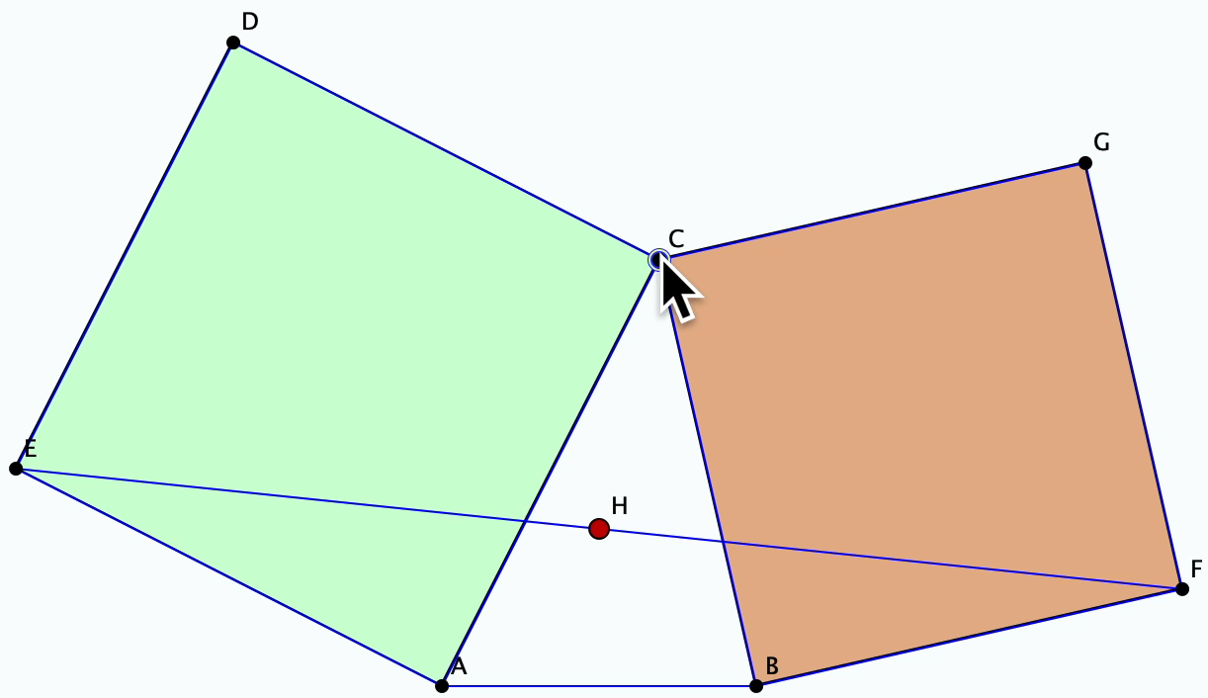
Bottema’s Theorem
Attention Foci
Gazing (holding wholes)
Invariance in the midst of change
Squares
Discerning Details
Invariant midpoint
Recognising relationships
How midpoint formed
Perceiving Properties

Slide 23
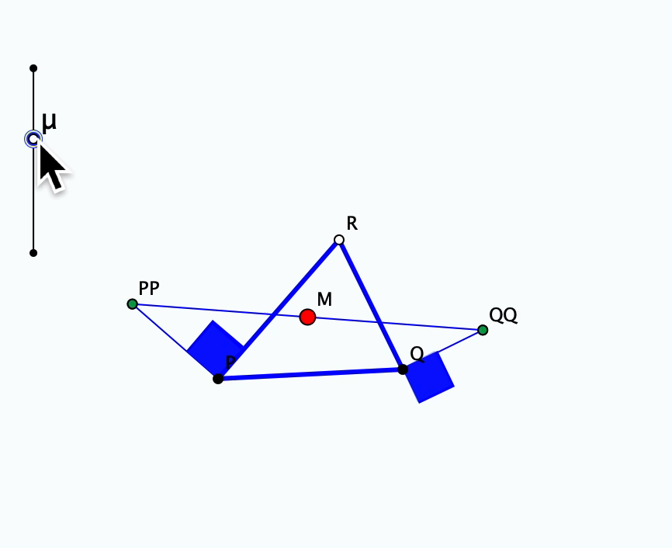
Bottema Extended

Slide 24
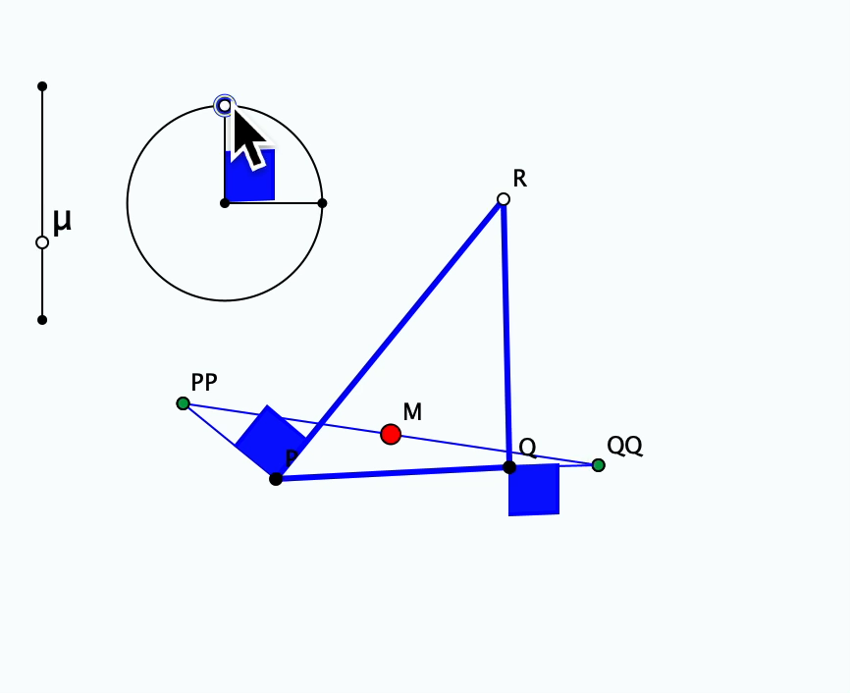
Bottema Extended further

Slide 25
Square Count
How many squares can you discern?
What question am I going to ask you?
In how many different ways can you count them?
What were you doing with your attention?
Notes:
16?

Slide 26
Powers & Themes
Powers
Imagining & Expressing
Specialising & Generalising
Stressing & Ignoring
Organising & Characterising
Themes
Invariance in the midst of change
Doing & Undoing
Freedom & Constraint
Extending & Restricting

Slide 27
Reflection as Self-Explanation
What struck you during this session?
What for you were the main points (cognition)?
What were the dominant emotions evoked? (affect)?
What actions might you want to pursue further? (Awareness)
Notes:
Chi et al

Slide 28
The world is a mirror for the people
(Hyemeyhosts Storm)
The universe is a mirror in which we can contemplate
only what we have learned to know about ourselves
(Italo Calvino)
It is only after you come to know
the surface of things
that you venture to see what is underneath;
But the surface of things is inexhaustible
(Italo Calvino)

Slide 29
Follow-Up
PMTheta.com
john.mason@open.ac.uk
Many articles

