Slide 1
YERME Workshop
A Role for Attention in Data Analysis
John Mason
Dublin 2017

Slide 2
Outline
Introductions
Two immediate experiences
Commentary about attention
Selected extracts from different people’s data
Reflection & Summaries

Slide 3
Say What You See
Notes:
What you notice depends on what you are attuned or sensitised to notice

Slide 4


Expressing What is Seen
Sketch what you saw
What is the same and what different about the two diagrams?
Notes:
Expectations based on partial information

Slide 5
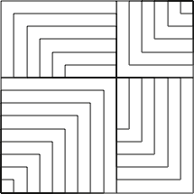
Present or Absent?

Slide 6
Is 51 + 51 = 50 + 52?
How do you know?
What is Fran attending to?
Fran: Like fifty-one plus fifty-one are one hundred and two, but fifty-one, if you subtract fifty, you can add to fifty-one, one from the other, one more, and you get fifty-two.
Teacher-Researcher: Ah, that is interesting. You said that you can take one from here [pointing to the first fifty-one] and add it to this one [pointing to the second fifty-one]. Isn’t it? Is that what you said?
Fran: And you get there, one hundred… fifty plus fifty-two.
How is her attention shifting?
Babbling or Gargling?
What is being attended to?
Listening-to or
listening-for?
Teaching Action:
selecting/editing
What is Fran attending to?
Notes:
Mason, J. (2012). You Can Lead a Horse to Water…: Issues in Deepening Learning Through Deepening Teaching. In S. Hegedus & J. Roschelle (Eds.) Democratizing Access to Important Mathematics through Dynamic Representations: Contributions and Visions from the SimCalc Research Program. Berlin: Springer-Verlag.
Nicolina Malara; Brent Davis

Slide 7
Conjecture
A sensible place to begin analysis of qualitative data is to ask yourself:
  What would I have to be attending to in order to say or do what I hear being said or see being done?
  What would I be overlooking?
  How would I be attending to it?
  What might I be overlooking when I look at this data?

Slide 8

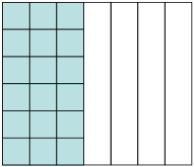
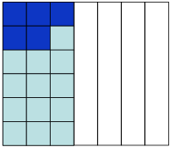
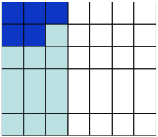
Semantic & Syntactic-babble
(1073) Syria: Nikol divided her square into seven equal parts and took the three. Then she coloured with a dark blue marker the five sixths of the area she coloured first. She divided into six parts and took the five.
(1074) T: But which five did Nikol take?
(1075) Syria: She took the five.
(1076) Xenios: Please sir now I got it…
(1077) Jim: This is what I wanted to tell you sir.
(1078) Syria: Ah, she did wrong. She should have taken five pieces.
(1079) T: What do you mean by five pieces?
(1080) Syria: Five rows.
What is being attended to?
Notes:
Students are working on finding 5/6 of 3/7.
(1072) T: Let’s see what Nikol did. Nikol would you like to explain us what you did? But no, let’s hear Syria explain to us what Nikol did.

Slide 9
(1081) T: So class do you all see here [He points to Figure]? Nikol took five small squares. And what is her answer?
(1082) Syria: 5/42.
(1083) T: Correct, it is 5/42 because she took five small squares from a total of 42. Do you agree?
(1084) Class: No.
The case of Syria is a representative example of a pupil whose awareness of the meaning underlying multiplication is both “in action” and “in articulation”

Slide 10
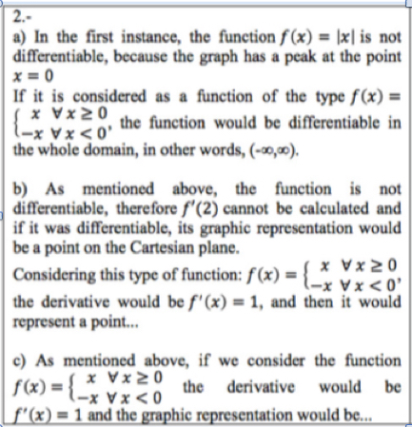
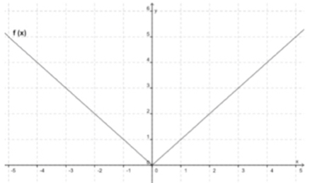
Luis Pino-Fan et al (2017) PNA (2).
Examine the function
f(x)=|x| and its graph
For what values of x is f(x) differentiable?
If possible, calculate f’(2) and draw a graph representation of your solution. If not possible explain why
If possible, calculate f’(0) and draw graph representation of your solution. If not possible explain why

Slide 11
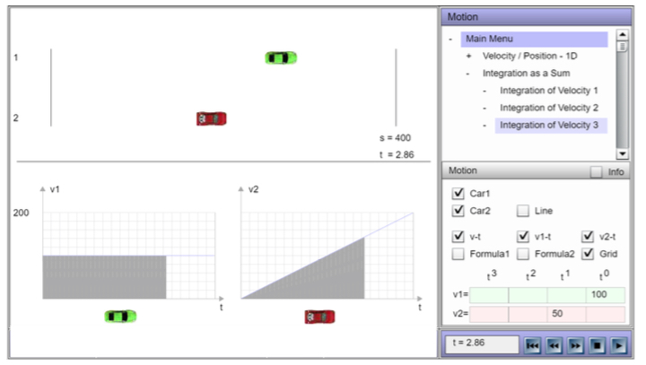
Ninni Hogstad

Slide 12
Jinf Cai (ICME 13)
Go To
Jinfa Cai

Slide 13
Questions
Do you assume that people’s choices reflect what is the case for them?
Do you assume that people’s choices are well considered?

Slide 14
Say What You See
Notes:
Can you see boy reading?, boy copying or checking? Girl thinking?

Slide 15
Attention
What is being attended to (focused on)?
How is it being attended to?
  Holding Wholes
  Discerning Details
  Recognising Relationships
  Perceiving Properties as being instantiated
  Reasoning on the basis of agreed properties
Focus on particular
Focus on generality
being instantiated

Slide 16
Reporting Data
Accounting For
Account of
“They couldn’t …”
“They can’t”
“They didn’t display
evidence of …”
“They don’t display
evidence of …”
“I didn’t detect
evidence of …”
“I don’t detect
evidence of …”

Slide 17
Precision Conjecture
The more precisely the data is specified,
the more we learn about
the researcher’s sensitivities to notice
The universe is a mirror
in which we can contemplate
only
what we have learned
to know about ourselves
(Italo Calvino)

Slide 18
Accounts-of & Accounting-for
I cannot evaluate your analysis
if I cannot distinguish it
from the data itself
Accounts-of: brief-but-vivid accounts
Reduce-remove theorising, judgement,
excuses, evaluations, justifications

Slide 19
Essence of Discipline of Noticing
Systematic Reflection
  Past (accounts-of not accounting-for)
Preparing & Noticing
  Actions and situations (educating awareness)
  For Future & Present
Recognising Choices
  Could-have & Could-be
  (not should-have or shoul- be)
Validating
  for Self & with Others

Slide 20
Systematic Reflection
Keeping
Accounts
Seeking
Threads
Recognising Choices
Distinguishing
Choices
Accumulating
Alternatives
Preparing & Noticing
Identifying & labelling
Imagining
Possibilities
Noticing
Possibilities
Validating with Others
Describing
Moments
Refining
Exercises

Slide 21
Specting
Intraspective
Extraspective
Introspective
Interspective

Slide 22
What are the significant products of research?
Transformations of the ‘being’ of the researchers
Increased sensitivity to notice what was previously not noticed
Refined vocabulary for discussing, discerning and analysing
Awareness which informs future choices of action
  Self
  Others

Slide 23
Interwoven Worlds
Own
world of experience
Colleague's
world of experience
Trying
Seeking
resonance
Reflecting
Recognising
Possibilities
with others
Preparing
Expressing
World of observations
& theories

Slide 24
Protases
I cannot change others;
I can work at changing myself
To express is to over stress
One thing we do not seem to learn from experience,
is that we do not often learn from experience alone

Slide 25
Stances
Deficiency
  What learners cannot (do not) do at different ages and stages
  What teachers do not know, do, or appreciate about different topics and pedagogical strategies
Proficiency
  What learners & teachers & policy makers do already
  Not doing for learners & teachers what they can already do for themselves
Efficiency & Effectiveness
  Seeking efficient and effective ways of enhancing, extending, and enriching
    Peoples’ sensitivities to notice what matters
    Peoples’ powers,
    Peoples’ appreciation of mathematical themes,
    Peoples’ experience of mathematical thinking
    Peoples’ internalisation of effective actions

