Slide 1
What school mathematics can be … really
Anne Watson
Mathematical Association
Annual Conference 2022

Slide 2
Calculate:
20 – 19 + 18 – 17 + 16 – 15 + 14 – 13 + 12 – 11
Calculate:
3.1416 x 2.7831 + 3.1416 x 12.27 – 5.0531 x 3.1416
from Éva Fülöp (2021)

Slide 3
Calculate:
20 – 19 + 18 – 17 + 16 – 15 + 14 – 13 + 12 – 11
Calculate:
3.1416 x 2.7831 + 3.1416 x 12.27 – 5.0531 x 3.1416
Wonder before acting
Suspect there are simple ways
Seek & recognise patterns & relationships
Relate wholes & parts
Contemplate similarities
Use conceptual knowledge of differences, operations & distribution
Conjecture about possible effects of actions
Maybe want to make up some questions that are like these

Slide 4
Find a number, expressed as a fraction, between $\frac{5}{7}$ and $\frac{3}{4}$
that has 11 as numerator
(from Dave Hewitt’s ATM video)

Slide 5
What else …….? Then what …..?

Slide 6
Find a number, expressed as a fraction, between $\frac{5}{7}$ and $\frac{3}{4}$
Find a number, expressed as a fraction, between $\frac{5}{7}$ and $\frac{3}{4}$, that has 11 as numerator
Find a sequence of numbers, expressed as fractions, between $\frac{5}{7}$ and $\frac{3}{4}$, that have consecutive numbers as their numerators
Find an infinite sequence of numbers, expressed as fractions, between $\frac{5}{7}$ and $\frac{3}{4}$, that have consecutive numbers as their numerators

Slide 7
Wonder before acting
Suspect there are simple ways
Seek & recognise patterns & relationships
Relate wholes & parts (FRACTIONS!)
Use conceptual knowledge of fractions, equivalence, the meaning of the numerator, infinite sequences
Conjecture about possible effects of actions
Maybe want to make up some questions that are like these (and wonder how Dave made these up)

Slide 8
What else …?
A field for exploration?
Always, sometimes, or never true?
If you add the same number to the numerator and the denominator of a fraction, the fraction value increases
from PISA

Slide 9
What else …….? Then what ……?
Calculate:
20 – 19 + 18 – 17 + 16 – 15 + 14 – 13 + 12 – 11
Can differences be a field for exploration?

Slide 10
What else …?
Choose any five numbers from 1 to 10 inclusive and list them vertically.
This leaves you with 5 remaining numbers. List those vertically in reverse order of magnitude next to the first list.
Example:
2 | 9
3 | 6
7 | 5
8 | 4
10 | 1
Find the absolute (positive) differences of the horizontal pairs and add them all together. Put your answer in the chat.
(Proizvolov's identity)

Slide 11
The solution of unfamiliar, not-yet-routine, problems can create a reason for learning some new mathematics
… can generate curiosity and fields for exploration

Slide 12
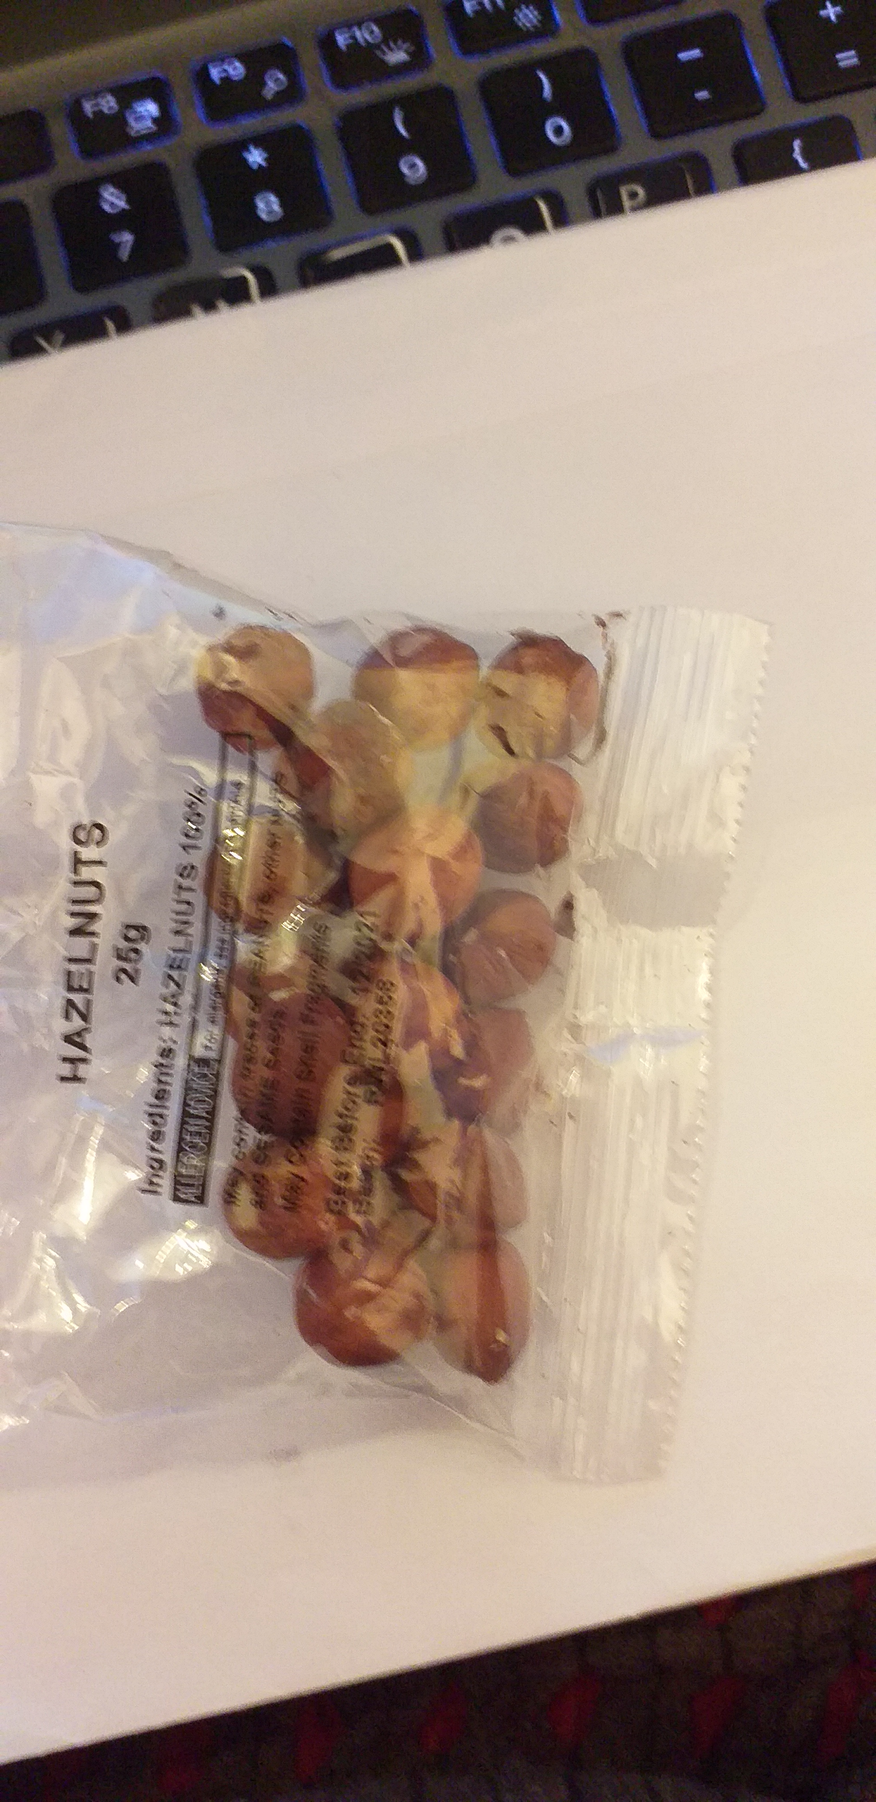
BO
MO

Slide 13
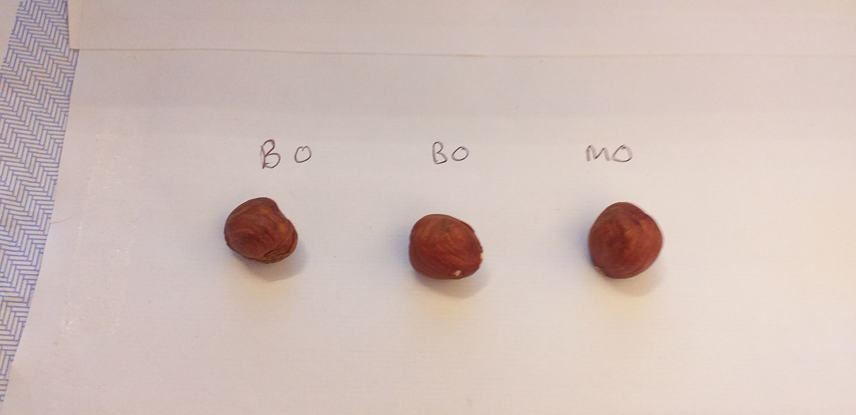

Slide 14
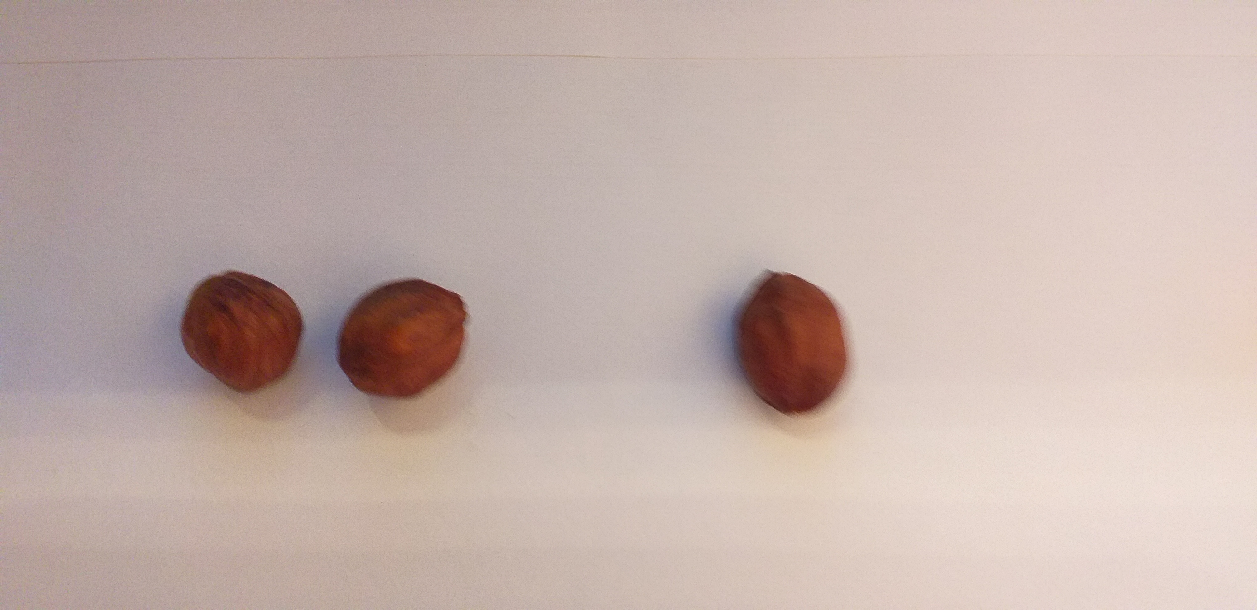

Slide 15
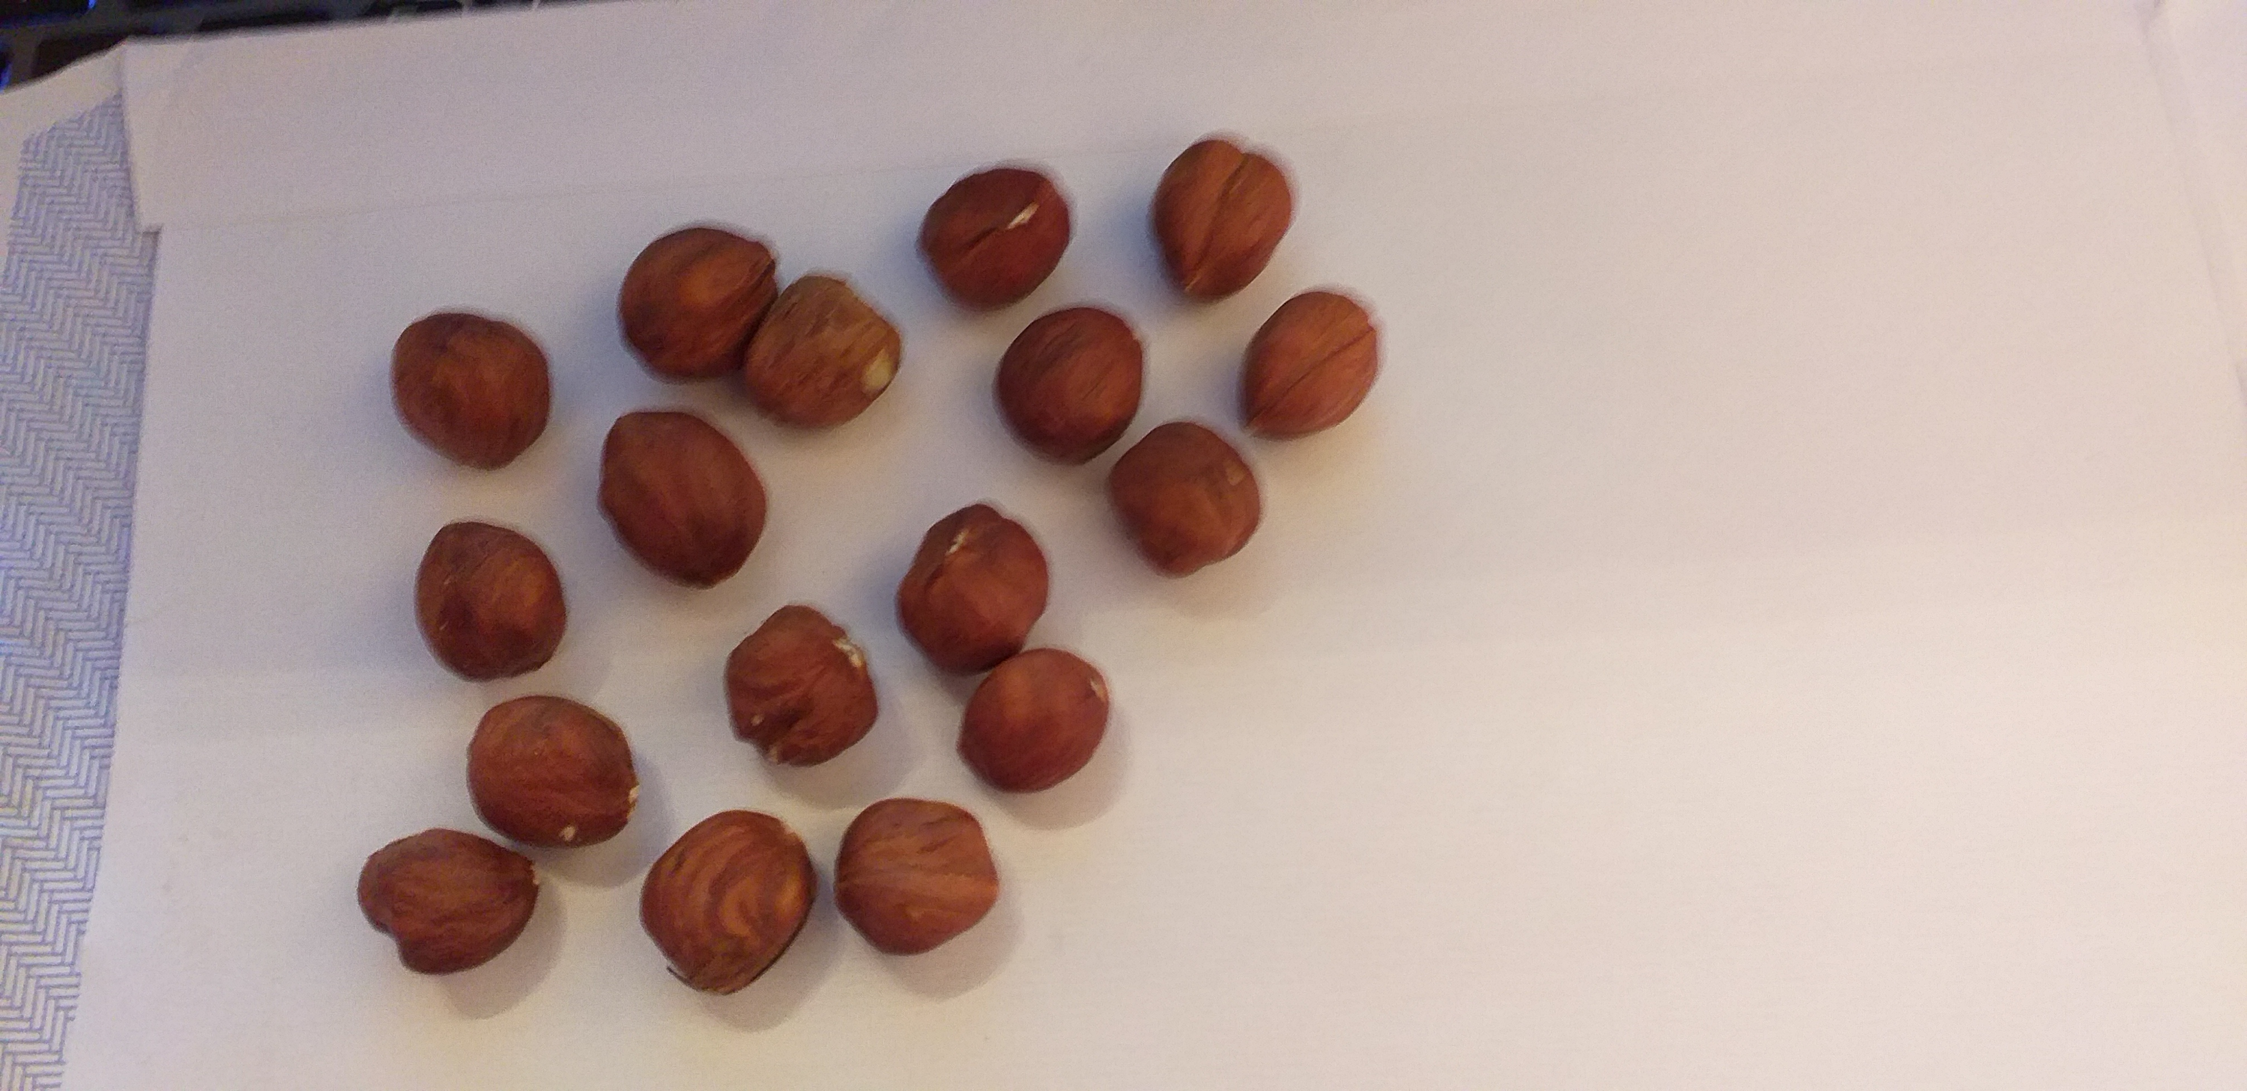
17

Slide 16
What’s the problem with 17?
odd
prime
not a multiple of 3

Slide 17
What else …….? Then what …..?
Fields for exploration
How can we share 17?
Adventures in numbers (partitioning whole numbers)
Adventures in multiplicative structure (17 happens to be prime)
Adventures in algebra (formulating the problem)
2p + p = 17
q + ½ q = 17

Slide 18
Are these unfamiliar problems?
Are they accessible using school mathematics?
Are they worth doing?

Slide 19
Calculate:
20 – 19 + 18 – 17 + 16 – 15 + 14 – 13 + 12 – 11
Calculate:
3.1416 x 2.7831 + 3.1416 x 12.27 – 5.0531 x 3.1416
from Éva Fülöp (2021)

Slide 20
Find a number, expressed as a fraction, between $\frac{5}{7}$ and $\frac{3}{4}$
that has 11 as numerator
(from Dave Hewitt’s ATM video)

Slide 22
17

Slide 23
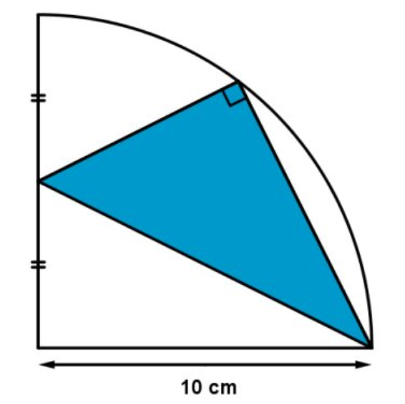
What is the blue area?
What concept would you reach for first?
How would you choose how to start, if you have more than one idea?

Slide 24
Features of mathematical problems
Unfamiliarity
Unusual combination of interacting elements
Significant cognitive load
Recognise underlying structures
Devise suitable representation
Think about meanings and connections
Decide what is necessary
Conceptual
knowledge
Simpler questions
Learn to read
a maths problem
Remember necessary facts and methods
Memory
Deal with awkward numbers
Textual comprehension
Learn to adapt
Derive, devise or
transform known methods

Slide 25
What forms of knowledge are needed?
Machine knowledge
Human knowledge
Knowing what (factual)
Knowing how (to perform)
Knowing when (to act)
Knowing why
Knowing implications
Knowing how to seek and use relationships and properties
Concept image
Example space

Slide 26
 | Conceptual | Procedural
Deep | Knowing why a mathematical idea works… Implications & connections | Understanding how it works … Choosing what to do
Superficial | Spotting and naming | Performing
Star & Stylianides (2017)

Slide 27
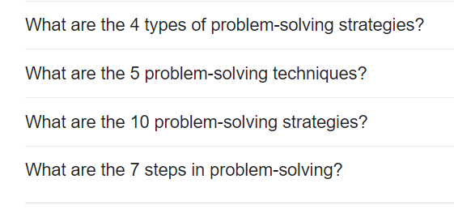
How many problem solving strategies have been implied so far in this talk?
Google ‘mathematical problem solving strategies’

Slide 28
Sources of problem-solving advice:
Blum & Niss, 1991; Cai & Lester, 2005; Carlson & Bloom, 2005; Garofalo, 1993; Halmos, 1980; Kilpatrick, 2016; Lester & Kehle, 2003; Mason, Burton, Stacey, 1982; Nunokawa, 2005; Pólya, 1966; Schoenfeld, 1985

Slide 29
Solving unfamiliar, non-routine, problems is a normal human activity
Combining past experience in new ways to solve unfamiliar problems is a normal human activity

Slide 30
The solution of unfamiliar, non-routine, problems is the aim of learning mathematics
Who thinks so?

Slide 31
Our NC thinks so
… increasingly complex problems
… nonroutine problems with increasing sophistication

Slide 32
Our non-statutory guidelines think so
regular opportunities for … non-routine questions
should not direct students towards a methodology for solution
develop their repertoire of strategies

Slide 33
Other countries think so
Europe: Niss (e.g. 2019)
Mathematical thinking
Reasoning
Using mathematical facts and methods
Using appropriate aids and tools
Modelling
Representing
Understanding and using symbols and formalism
Communicating
English speaking world: Kilpatrick et al. (2001)
Conceptual understanding
Adaptive reasoning
Procedural fluency
Strategic competence
Productive disposition

Slide 34
Educational Endowment Foundation thinks so
include problems for which learners do not have well-rehearsed, ready-made methods

Slide 35
What Works Clearing House thinks so
Problem solving … the development of innovative strategies … these skills have a direct impact on students’ achievement scores …

Slide 36
PISA thinks so (framework for 2022):
https://pisa2022-maths.oecd.org/

Slide 37
Radius = 100 cm.
Three sectors of equal size
What element would you start with when formulating this problem?

Slide 39
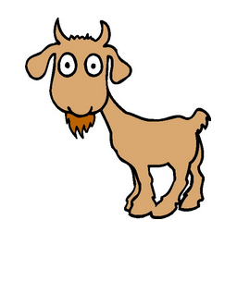
What is the area that the goat can graze?
What do you know that might be helpful? (knowing what)
What can you do that might be helpful? (knowing when)

Slide 40
Dimensions of variation?
Label variables?
Relationships?
Diagram(s)?
Useful knowledge?
What procedures?

Slide 42
What forms of knowledge are needed?
Machine knowledge
Human knowledge
Knowing what (factual)
Knowing how (to perform)
Knowing when (to act)
Knowing why
Knowing implications
Knowing how to seek and use relationships and properties
Concept image
Example space

Slide 43
Teaching problem solving
Developing problem solving habits and attitudes over time
Learners cannot learn to solve problems only by ‘type-spotting’ and then using prepared methods
Analogical reasoning and memory for past methods can hinder the development of new insights (Szabo, 2017)
Learners cannot learn to solve problems by following generic heuristics

Slide 44
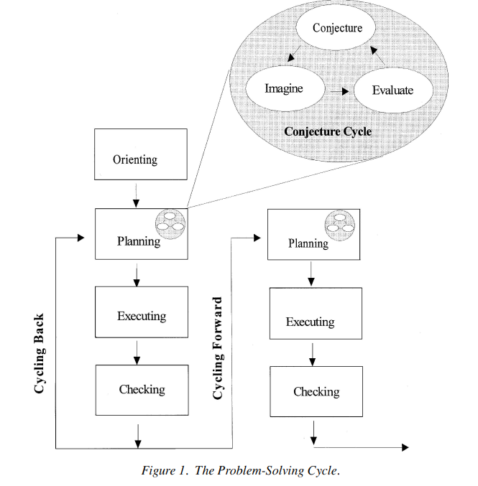
Carlson & Bloom, 2005

Slide 45
Developing problem solving habits and attitudes over time
Learners cannot learn to solve problems only by ‘type-spotting’ and then using prepared methods
Analogical reasoning and memory for past methods can hinder the development of new insights (Szabo, 2017)
Learners cannot learn to solve problems by following generic heuristics
Develop a ‘mathematical memory’ (Krutetskii, 1967)
Memory for generalised, curtailed and flexible systems and structures (Krutetskii, 1976)
“mathematical memory is formed during mathematical activities, based on the ability to generalize mathematical relationships” (Szabo 2017)

Slide 46
… getting from where you are to where you want to be through successive reformulations of the problem until it becomes something you can manage (Kilpatrick, 2016, p. 69).

Slide 47
Doesn’t solving problems create high cognitive load for learners?
Yes
Mathematical thinking reduces and manages the cognitive load of problems that have lots of elements and relationships
Learning to understand and manipulate complex situations is part of doing mathematics
Learning to manage the cognitive load is part of doing mathematics
Learning to manage the cognitive load is part of computational thinking

Slide 48
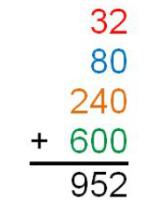
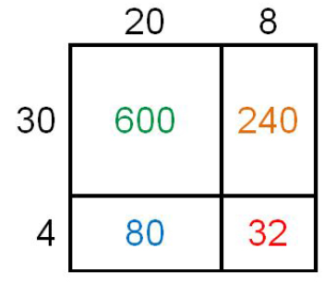
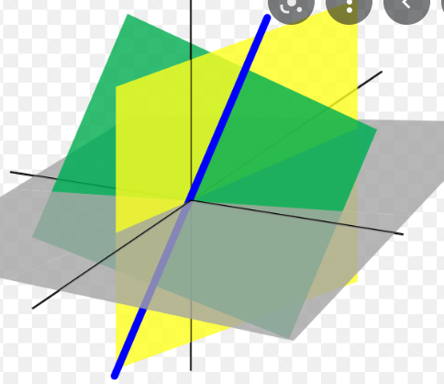
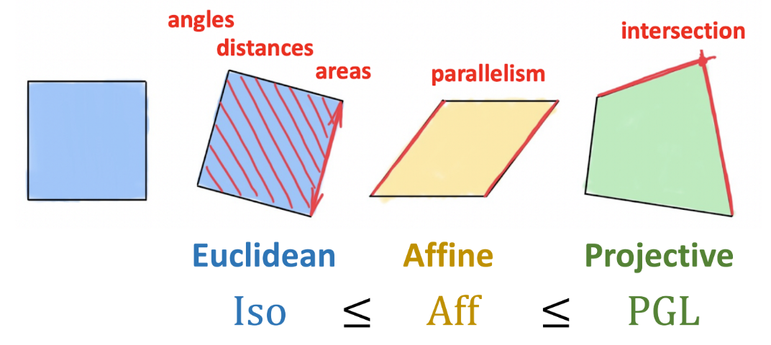
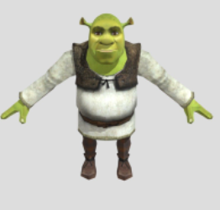
Managing cognitive load
2(a + b) ≡ 2a + 2b
2(a+b) = 3c

Slide 49
PISA tests six types of mathematical knowledge
Concepts
Procedures
Facts
Tools
Computational thinking
Mathematical reasoning

Slide 50
What school mathematics can be … really … according to MiS

Slide 51
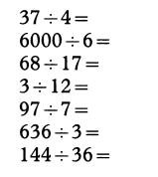
Negotiating Meanings for Division. Julia Anghileri, MiS 24(2)
Field for exploration

Slide 52
On Removing the Ceilings from Young Children's Number Work Marion Bird. MiS 21(5)
When carrying out set exercises, children are often limited to concentrating on only one idea at a time. Perhaps this is why they often fail to see connections between ideas?
Reasoning, conjecturing, generalizing, asking questions. “There is often little scope for these when children are working on more prescriptive tasks.”

Slide 53
Problem Solving Is More than Solving Problems. Janet Duffin and Harriet Marland. MiS 12(5)
Fit 18 milk bottles into a 6 by 4 crate so that the number of bottles in each row and column is always even.
“It includes discussion and dispute, and forces us to recognise that different approaches are both possible and desirable”
“… the desire to reformulate and extend a given problem becomes irresistible”

Slide 54
Algebra with Multilink Cubes. Steve Abbott MiS 21(2)
Investigate the square pyramid corresponding to the sum 12 + 22 + 32 + 42 +...
“Pupils were engaged on tasks which required them to
use algebraic ideas, to generalise, and which brought home the need for some kind of symbolic notation.”

Slide 55
Seeing Through the Window, C. Jones MiS 11(5)

Slide 57
Making Choices. Pat Perks & Stephanie Prestage MiS 21(5)

Slide 58
Free on the MiS webpage:
Shifting the Paradigm by Ben Sparks. MiS November 2014
… some inevitable questions – “What is changing? What is staying the same?”

Slide 59
Features of mathematical problems
Unfamiliarity
Unusual combination of interacting elements
Significant cognitive load
Recognise underlying structures
Devise suitable representation
Think about meanings and connections
Decide what is necessary
Remember necessary facts and methods
Identify subproblems
Extend findings
Compare methods
Enjoy efficiency
Devise new problems
…
Deal with awkward numbers
Textual comprehension
Go beyond …
Derive, devise or
transform known methods

Slide 60
What I find enjoyable about mathematics
Something to explore
Something unresolved
Getting caught up in it
Finding a manipulable representation
The adventure of following a possible solution route
Something I tried actually works
Moments of insight
Finding a solution to a problem – I did this!!!

Slide 61
What does a human mind do in a mathematical situation?

Slide 62
Teachers learn most about human mathematical minds by:
paying attention to people doing mathematics
doing mathematics themselves and with others
communicating with other teachers of mathematics

Slide 63
… mathematical memory is formed during mathematical activities (Szabo 2017)
(n.b. for people following up the references: Szabo’s thesis does a very good job of describing the work and findings of Krutetskii, whose book might be hard to find now).

Slide 64
Solving non-routine mathematics problems is learnt through experience of, and reflection on, solving non-routine mathematical problems

Slide 65
References
Carlson, M. & Bloom, I. (2005). The cyclic nature of problem solving: An emergent multidimensional problem-solving framework. Educational studies in Mathematics, 58(1), 45-75.
Cuoco, A., Goldenberg, E. P., & Mark, J. (1996). Habits of mind: An organizing principle for mathematics curricula. The Journal of Mathematical Behavior, 15(4), 375-402
Educational Endowment Foundationeducationendowmentfoundation.org.uk/education-evidence/evidence-reviews/mathematics-in-key-stages-2-and-3. Also evidence-reviews/cognitive-science-approaches-in-the-classroom
Fülöp, É. (2021). Developing Problem-Solving Abilities by Learning Problem-Solving Strategies Scandinavian Journal of Educational Research
Hewitt, D. https://www.atm.org.uk/CPD-for-Mathematics-Teachers
Kilpatrick, J., Swafford, J., & Findell, B. (2001). Adding it up: Helping children learn mathematics. Washington, DC: National Academy Press.
Krutetskii, V.A (1976 The psychology of mathematical abilities in schoolchildren Chicago: University of Chicago Press
Lee, H. S., & Anderson, J. R. (2013). Student learning: What has instruction got to do with it?. Annual review of psychology, 64, 445-469.
Marton, F., Dall'Alba, G. A., & Tse, L. K. (1996). Memorizing and understanding: The keys to the paradox? In D. A. Watkins & J. B. Biggs (Eds.), The Chinese Learner (pp. 69–83). Hong Kong/Melbourne: Comparative Education Research Centre, The University of Hong Kong/Australian Council for Educational Research.
Mathematics in Schools, archive
Niss, M., & Højgaard, T. (2019). Mathematical competencies revisited. Educational Studies in Mathematics, 102(1), 9-28.
PISA: https://data.oecd.org/pisa/mathematics-performance-pisa.htm
Rittle-Johnson, B., & Schneider, M. (2015). Developing conceptual and procedural knowledge of mathematics. Oxford handbook of numerical cognition, 1118-1134.
Star, J. R., & Stylianides, G. J. (2013). Procedural and conceptual knowledge: Exploring the gap between knowledge type and knowledge quality. Canadian journal of science, mathematics and technology education, 13(2), 169-181.
Steward, D. https://donsteward.blogspot.com/search/label/angles%20in%20polygons
Szabo, A. (2017). Mathematical abilities and mathematical memory during problem solving and some aspects of mathematics education for gifted pupils (Doctoral dissertation, Department of Mathematics and Science Education, Stockholm University). https://www.diva-portal.org/smash/record.jsf?pid=diva2%3A1143981&dswid=-6329
What Works Clearinghouse https://ies.ed.gov/ncee/wwc/Docs/PracticeGuide/MPS_PG_043012.pdf

Slide 66
pmtheta.com
@annemathswatson
annewatson1089@gmail.com

