Slide 1
Variation-Pedagogy: some lessons learned from Shanghai about the importance of teacher and student attention.
Promoting Mathematical Thinking
John Mason
Bremen
Nov 2016
The Open University
Maths Dept
University of Oxford
Dept of Education

Slide 2
Outline
Throat Clearing
Variation as a pedagogic strategy
In worked example and exercise construction
In concept comprehension and appreciation
Example: Tangency experiences
extensions
Attention
Example: Extreme values

Slide 3
Throat Clearing
Everything said here is a conjecture …
… to be tested in your experience
My approach is fundamentally phenomenological … I am interested in people’s lived experience.
So, what you get from this session will be mostly …
… what you notice (noticed) happening inside you!
Central role of attention:
… What is being attended to?
… How it is being attended to?

Slide 4
Variation
What is available to be learned …
... is what has been recently perceived as varying
Applies to concepts and to techniques / procedures
Marton & colleagues
Two Features
Dimensions (aspects) of possible variation
Range of permissible change
Watson & Mason
Same problem – different solutions
Same solution (method) different problems
Shanghai & beyond
Huang & Lee (2017) Teaching and Learning Mathematics through Variation

Slide 5
Variation Metaphor

Slide 6
Some Variation Issues
Attention may be attracted to what is varying or to what is invariant.
Variation and Invariance are mutually necessary
Invariance in the Midst of Change
is a pervasive and ubiquitous theme in mathematics
What needs pedagogically to be varied?
Critical features (Marton)
From experience; from inspection of own experience; from studying learners
Variation alone is rarely sufficient
Enter variation-pedagogy!

Slide 7
Role of Attention
What are students attending to in lessons?
How are they attending to it?
How do these align with teacher/lecturer attention?
Without alignment, teacher-student communication is at best hampered and at worst breaks down

Slide 8
Figural Concepts & Concept Images
Figural Concepts (Fischbein 1987, 1993)
HighSchool Physics
The average velocity over an interval is (usually) the average of the initial and final velocities
But only when the acceleration is constant, so speed is linear!
Tangent to a curve
“A tangent just touches at one point”
Can the tangent to a function at one point cut the curve somewhere else?
Can a tangent to a curve ‘cross over’ at the point of tangency?
Tall & Vinner (1981); Vinner (1981, 1983

Slide 9
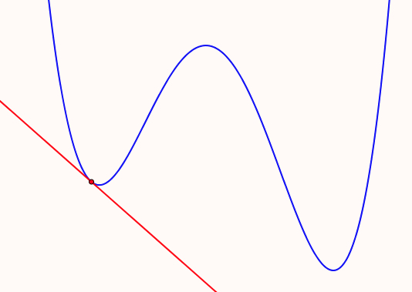
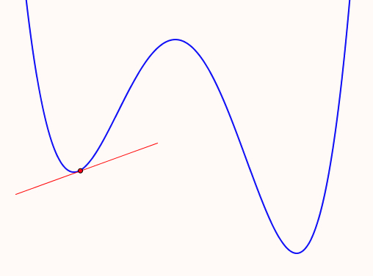
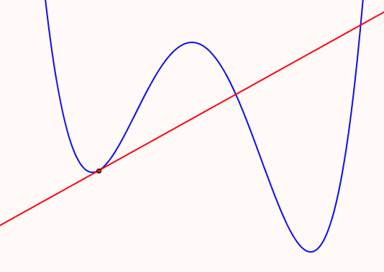
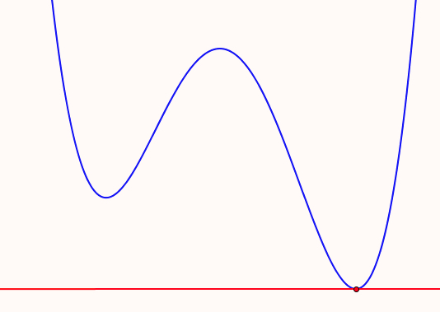
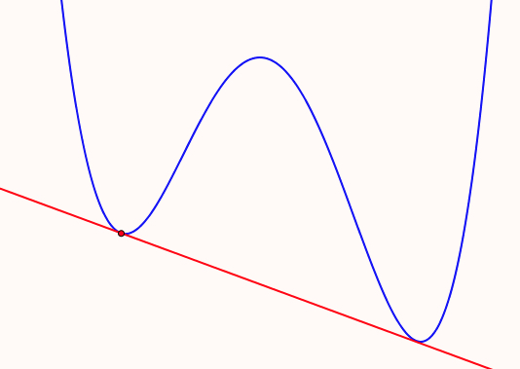
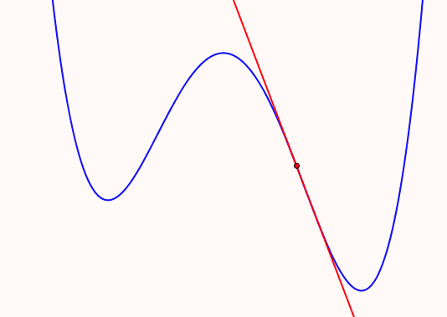
Tangency & Variation
What might be ‘taken as necessary’ using the following?
A tangent to a curve at a point is a line that touches the curve at that point
What misapprehensions might be induced?
Tall (1986); Biza (2011)
Notes:
Tall (1986) Constructing the Concept Image of a Tangent. PME Montreal
Biza (2011) Is The Tangent Line Tangible? Students’ Intuitive Ideas About Tangent Lines. BSRLM

Slide 10
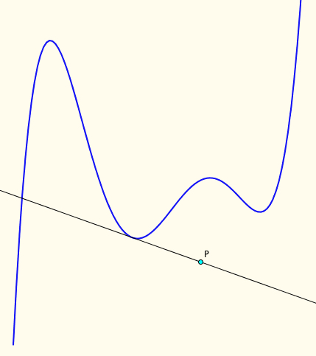
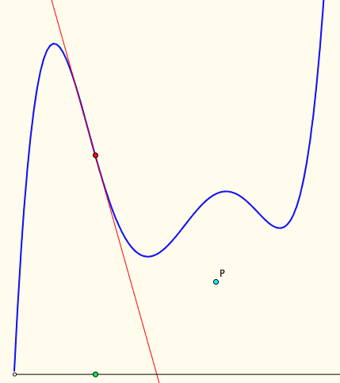
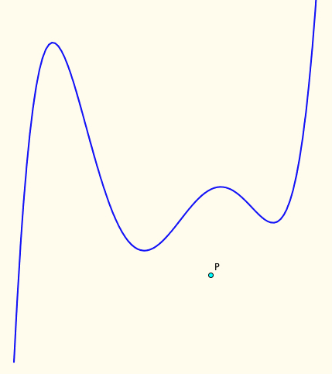
Tangent-Power (static)
If P goes a long way to the right, how many tangents are there through P?
The tangent power of a point P with respect to a function f is the number of tangents to f passing through P
How might you find the the tangent power of a point?
Describe the regions with specified tangent-power
How might you find regions with a given tangent-power?

Slide 11
Tangent Power Follow-Up
How many regions can be formed by the inflection tangents and the curve itself?
Characterise the families of lines that can be the inflection tangents of a polynomial, or of a differentiable function.

Slide 12
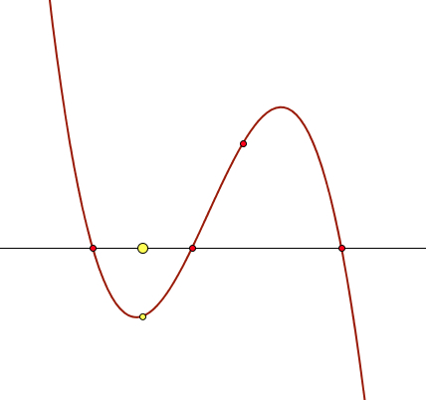
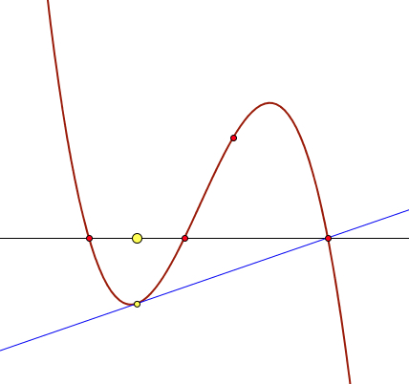
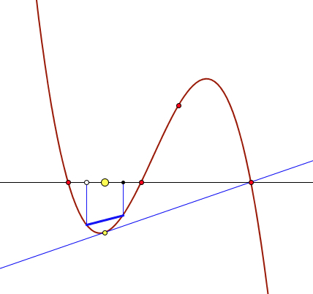
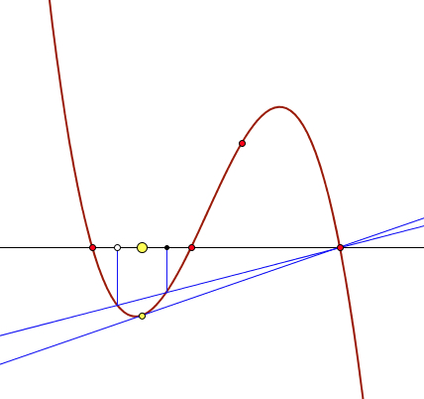
Cubic Phenomenon
Imagine a cubic with 3 real roots and positive inflection slope
Select the mid-point M of two of the roots
Draw the tangent at the corresponding point on the curve
Now draw a chord through two points on the curve whose mid-point is aligned with M
Extend it: where does it meet the cubic again?
What do the roots have to do with the phenomenon?

Slide 13
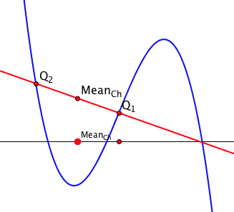
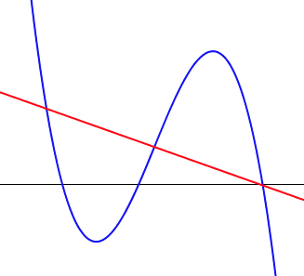
Cubic Phenomenon
Imagine the graph of a cubic polynomial with 3 real roots
Imagine a straight line through one of the roots
Imagine the mid-point of the other two points of intersection with the cubic
What is the locus of these mid-points as your line rotates about the root?
What does ‘being a root’ have to do with the phenomenon?

Slide 14
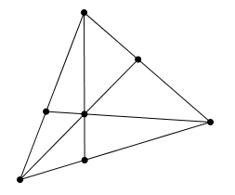
Recognising a Configuration
Imagine two points C₁ and C₂.
These are going to be the centres of scalings.
Scale any point P by a fixed scale factor from C₁.
Scale that point by a fixed scale factor from C₂
Now find a point C₁₂ that will act as a single scaling centre to achieve the same result.
How many of those configurations can you find in this diagram?

Slide 15
Is 51 + 51 = 50 + 52? How do you know?
What is Fran attending to?
Fran: Like fifty-one plus fifty-one are one hundred and two, but fifty-one, if you subtract fifty, you can add to fifty-one, one from the other, one more, and you get fifty-two.
Teacher-Researcher: Ah, that is interesting. You said that you can take one from here [pointing to the first fifty-one] and add it to this one [pointing to the second fifty-one]. Isn’t it? Is that what you said?
Fran: And you get there, one hundred… fifty plus fifty-two.
How is her attention shifting?
Babbling or Gargling?
What is being attended to?
Listening-to or listening-for?
Teaching Action: selecting/editing
What is Fran attending to?
Notes:
Mason, J. (2012). You Can Lead a Horse to Water…: Issues in Deepening Learning Through Deepening Teaching. In S. Hegedus & J. Roschelle (Eds.) Democratizing Access to Important Mathematics through Dynamic Representations: Contributions and Visions from the SimCalc Research Program. Berlin: Springer-Verlag.
Nicolina Malara; Brent Davis

Slide 16
Is 3n + 3 divisible by 3?
St: We can’t divide 3n+3 by 3.
R: Why can’t we do? You have 3 pockets of n, plus 3 ones. You want to divide them between three persons. What do you do?
St: It means you’re saying should I divide 3n by 3, and also its “plus three”?
R: [Silence]
St: Yes, it is! Because we could divide it, it means if we 3n+3 divide by 3 it gets 3n/3 multiple by 3/3.
R: plus
St: No, plus 3/3. 3/3 also gets 1. Then, 3n/3 also gets n. So, it’s n+1. .
What would I have to be attending to, and how, to say what St or R says?
Fatemeh Ahmadpour (private correspondence 2017)

Slide 17
Attention
What is being attended to (focused on)?
How is it being attended to?
Holding Wholes
Discerning Details
Recognising Relationships
Perceiving Properties as being instantiated
Reasoning on the basis of agreed properties
Focus on particular situation
Focus on generality
being instantiated
Focus on properties independent of context (axiom-like)

Slide 18
Examples of Mathematical Objects
Unfortunately, students sometimes over-generalise, mis-generalise or fail to appreciate what is being exemplified
What is involved in experiencing some thing as an example of something?
Notes:
Fischbein: Figural Concpets

Slide 19
Example Construction
What features need to be salient?
contrasting several examples
What can be changed (dimensions of possible variation) and over what range (range of permissible change)
What unintended assumptions might learners make?
Notes:
Essence of the concept

Slide 20
Reporting Data
Accounting For
Account of
“They couldn’t …”
“They can’t”
“They didn’t display evidence of …”
“They don’t display evidence of …”
“I didn’t detect evidence of …”
“I don’t detect evidence of …”

Slide 21
Precision Conjecture
The more precisely the data is specified,
the more we learn about
the researcher’s sensitivities to notice
The universe is a mirror in which we can contemplate only what we have learned to know about ourselves (Italo Calvino)

Slide 22
Accounts-of & Accounting-for
I cannot evaluate your analysis if I cannot distinguish it from the data itself
Accounts-of: brief-but-vivid accounts
Reduce-remove theorising, judgement, excuses, evaluations, justifications

Slide 23
Essence of Discipline of Noticing
Systematic Reflection
Past (accounts-of not accounting-for)
Preparing & Noticing
Actions and situations (educating awareness)
For Future & Present
Recognising Choices
Could-have & Could-be
(not should-have or shoul- be)
Validating
for Self & with Others

Slide 24
Systematic Reflection
Keeping
Accounts
Seeking
Threads
Recognising Choices
Distinguishing
Choices
Accumulating
Alternatives
Preparing & Noticing
Identifying & labelling
Imagining
Possibilities
Noticing
Possibilities
Validating with Others
Describing
Moments
Refining
Exercises

Slide 25
Specting
Intraspective
Extraspective
Introspective
Interspective

Slide 26
What are the significant products of research?
Transformations of the ‘being’ of the researchers
Increased sensitivity to notice what was previously not noticed
Refined vocabulary for discussing, discerning and analysing
Awareness which informs future choices of action
Self
Others

Slide 27
Interwoven Worlds
Own world of experience
Colleague's world of experience
Trying
Seeking
resonance
Reflecting
Recognising Possibilities
with others
Preparing
Expressing
World of observations & theories

Slide 28
Protases
I cannot change others; I can work at changing myself
To express is to over stress
One thing we do not seem to learn from experience, is that we do not often learn from experience alone

Slide 29
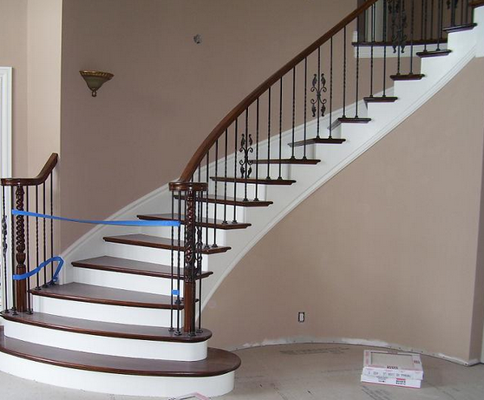
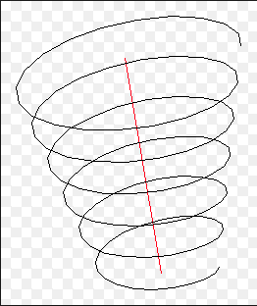
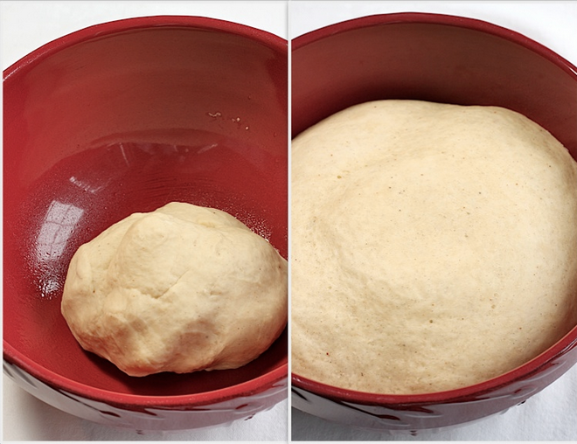
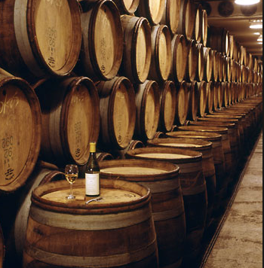
Conceptions of Learning
Staircase
Spiral
Maturation

Slide 30
Assumptions
The purpose of Research in Mathematics Education is to to work at
Improving the experience of learners as they encounter mathematics …
… by understanding how people develop & enrich their mathematical thinking from the experiences they undergo
… and by developing practices which promote the development of mathematical thinking through drawing upon the human psyche and the social conditions.

Slide 31
Questions
Do you assume that people’s choices reflect what is the case for them?
Do you assume that people’s choices are well considered?

Slide 32
Dual Systems Theory
(Kahneman; Frederick; Leron)
Human Beings have two modes of functioning:
S1: automatic reactions; habit; internalised functionings; awarenesses enabling actions; default parameters; educated intuitions;
S2: considered responses; intellect-cognition
Conscious control-direction of action is (mostly) an illusion (Norretranders)
Human beings as narrative animals (Bruner; …)
S1 offers up possibilities; S2 is “lazy”
Have you encountered learners who do or say the first thing that comes to them?
“They don’t think before they act!”

Slide 33
Educating & Re-Educating Intuitions (S2 -> S1)
Adding makes bigger
Adding something to a number does not always make it bigger
Multiplying makes bigger
Multiplying a number by a number does not always make it bigger
Squaring a positive number makes it bigger
only when it is bigger than one
A function can be differentiable at a point but have arbitrarily large slope arbitrarily close to that point
While a differentiable function of one variable on a closed interval attains its extreme values, a differentiable function of two variables on a closed set may not attain its extreme values

Slide 34
Stances
Deficiency
What learners cannot (do not) do at different ages and stages
What teachers do not know, do, or appreciate about different topics and pedagogical strategies
Proficiency
What learners & teachers & policy makers do already
Not doing for learners & teachers what they can already do for themselves
Efficiency & Effectiveness
Seeking efficient and effective ways of enhancing, extending, and enriching
Peoples’ sensitivities to notice what matters
Peoples’ powers,
Peoples’ appreciation of mathematical themes,
Peoples’ experience of mathematical thinking
Peoples’ internalisation of effective actions

Slide 35
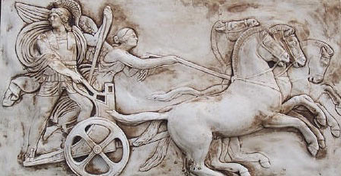
Human Psyche
Intellect (cognition)
Imagery
Attention/Will
Emotions (affect)
Body (enaction)
Habits Practices

Slide 36
Structure of a Topic
Language Patterns & prior Skills
Imagery/Sense-of/Awareness; Connections
Root Questions
predispositions
Different Contexts in which likely to arise; dispositions
Standard Confusions & Obstacles
Techniques & Incantations
Emotion
Awareness
Behaviour
Only Emotion is Harnessable
Only Awareness is Educable
Only Behaviour is Trainable
Only Attention can be Directed

Slide 37
Why Might This Matter?
Do simple causes have complex effects?
Constructing probes:
Beware of likelihood of S1 reactions as well as S2 responses
Integrating Social and Psychological explanations
Orientation (of learners; of teachers);
Seeking proficiency (what they do do)
Rather than seeking deficiency (what they do not do)
How can findings inform the future practices of
Learners
as well as Teachers
as well as Researchers
Activation: Cognitive, Affective, Enactive and Attentive
Activation is from outside; aim is to reduce dependency and develop autonomy and self-regulation

Slide 38
Results
From a strong or radical phenomenological stance, results are the ‘sense’ you made of what you noticed, together with possible task-exercises you can modify and use with others to alert them to noticing.
Commentary & Explanation are human narratives
Theories are frameworks of distinctions to help discern details, recognise relationships, and to perceive properties as being instantiated
Distinctions supported by rich descriptions are awarenesses that can enable actions to be enacted which …
Act as explanations
Enable predictions
Inform future actions
and so improve the experience of learners, teachers, researchers, policy makers, …

Slide 39
Possible Discussion Questions
What assumptions about human nature underpin your own data collection?
What assumptions about human nature underpin your analysis of your data?
Do you see learning as a staircase or a spiral or maturation or …
cause
influence
activty
learning
Do teachers’ actions student ?
Contact me at
john.mason @ open.ac.uk
www.PMTheta.com

Slide 40
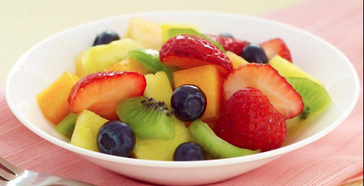
Knowledge & Wisdom
Knowledge is knowing a tomato is a fruit;
Wisdom is not putting it in a fruit salad! (Miles Kington)
Being (professional) is sustaining the complexity of both

