Slide 1


Working on Teaching: developing mathematical awareness in-action, in-discipline and in-counsel
§2
Trondheim
Aug 2021
in the time of Corona-delta

Slide 2
Catching Breath
Questions?
Observations?
Details to follow up?
Conjecturing
  (not uttering an answer before others have had time to think)

Slide 3
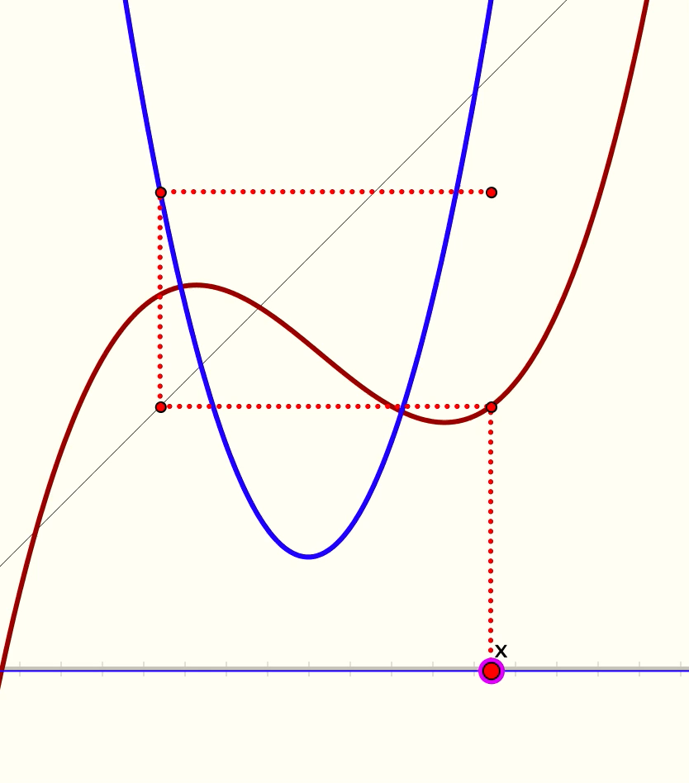
Animated
Here you see a quadratic
and a cubic.
Say What You See happening

Slide 4
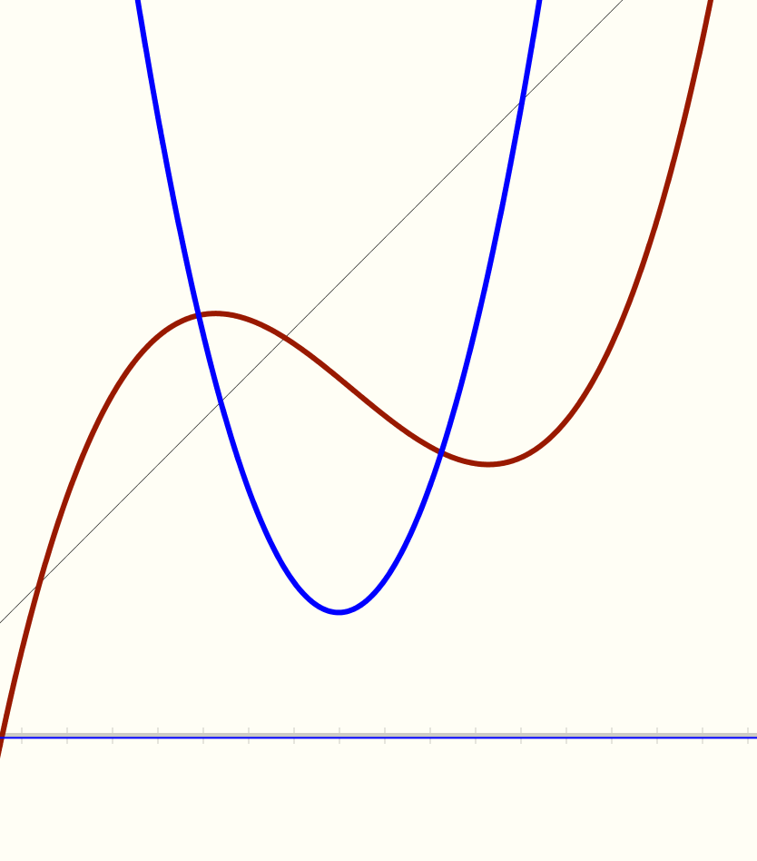
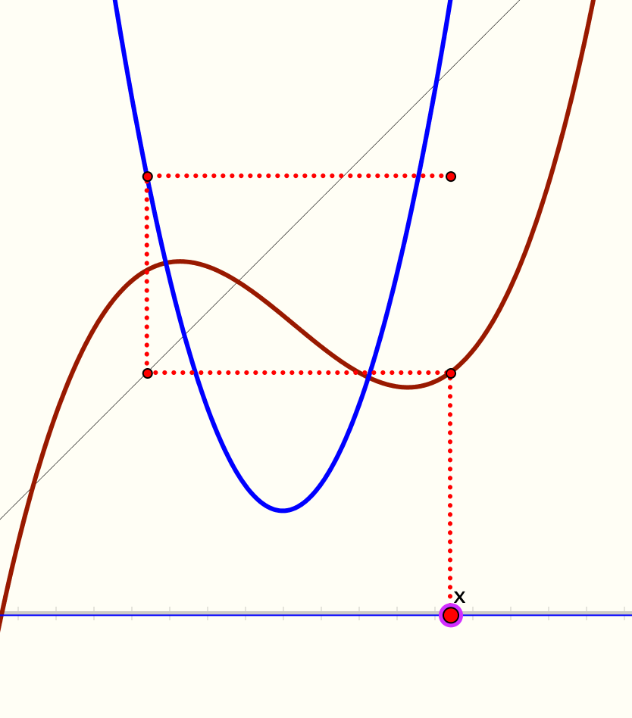
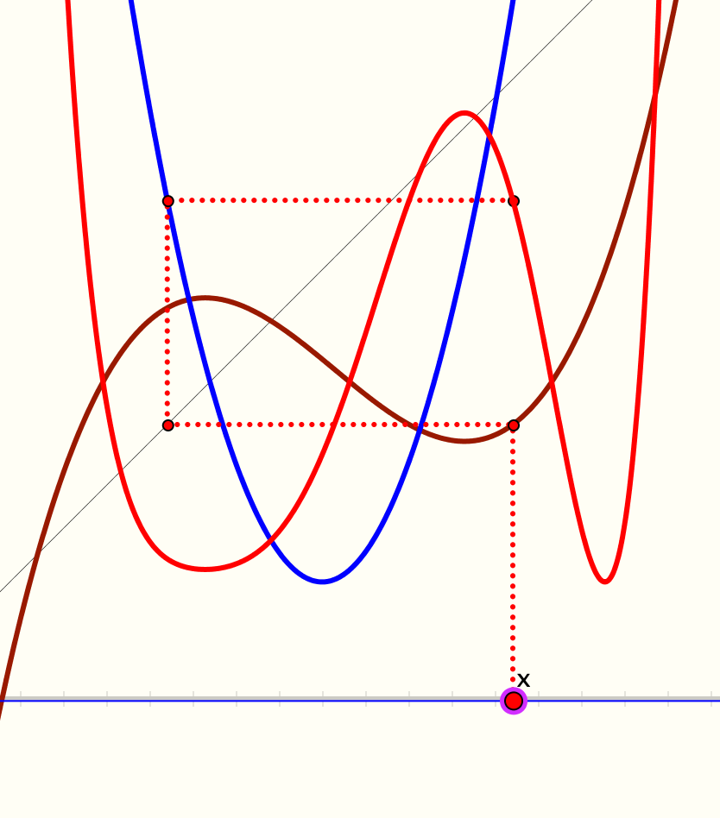
Static

Slide 5
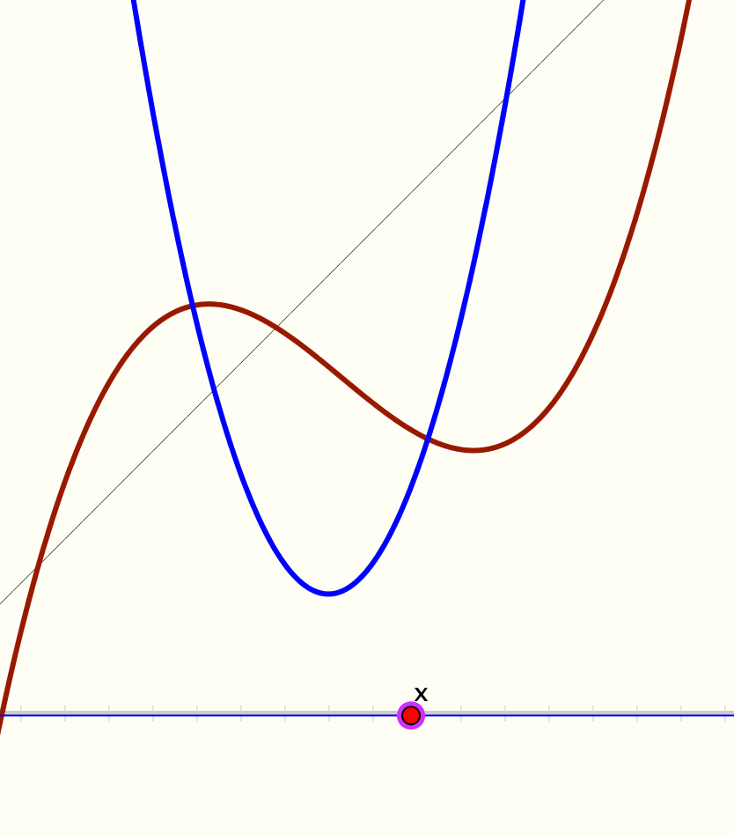
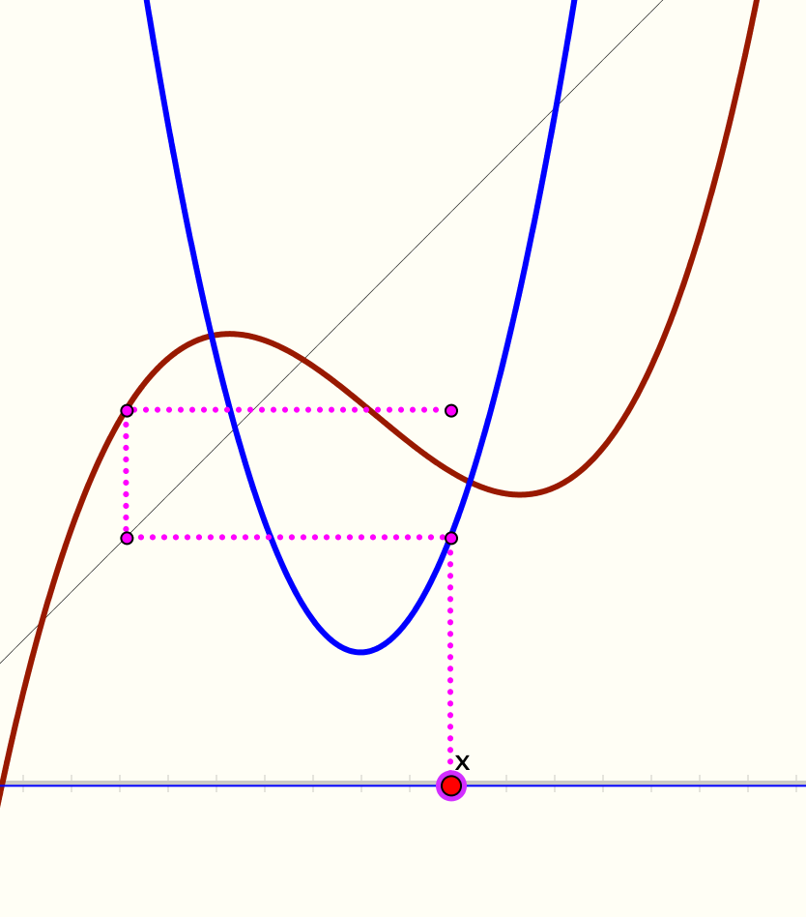
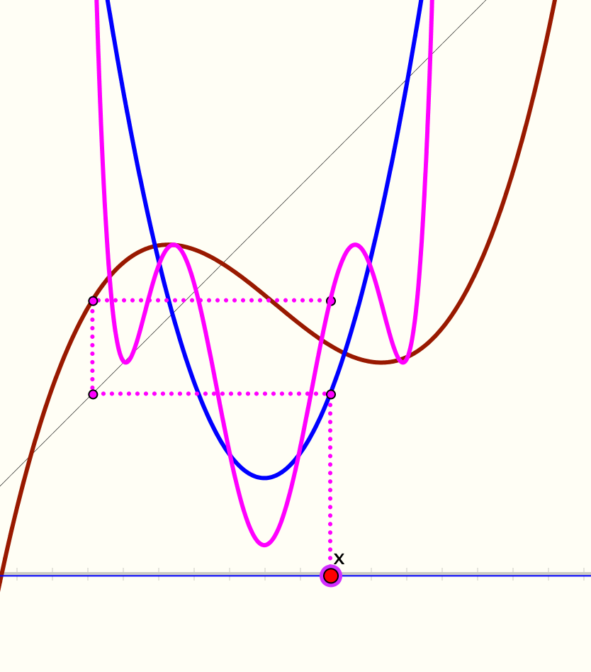

Slide 6
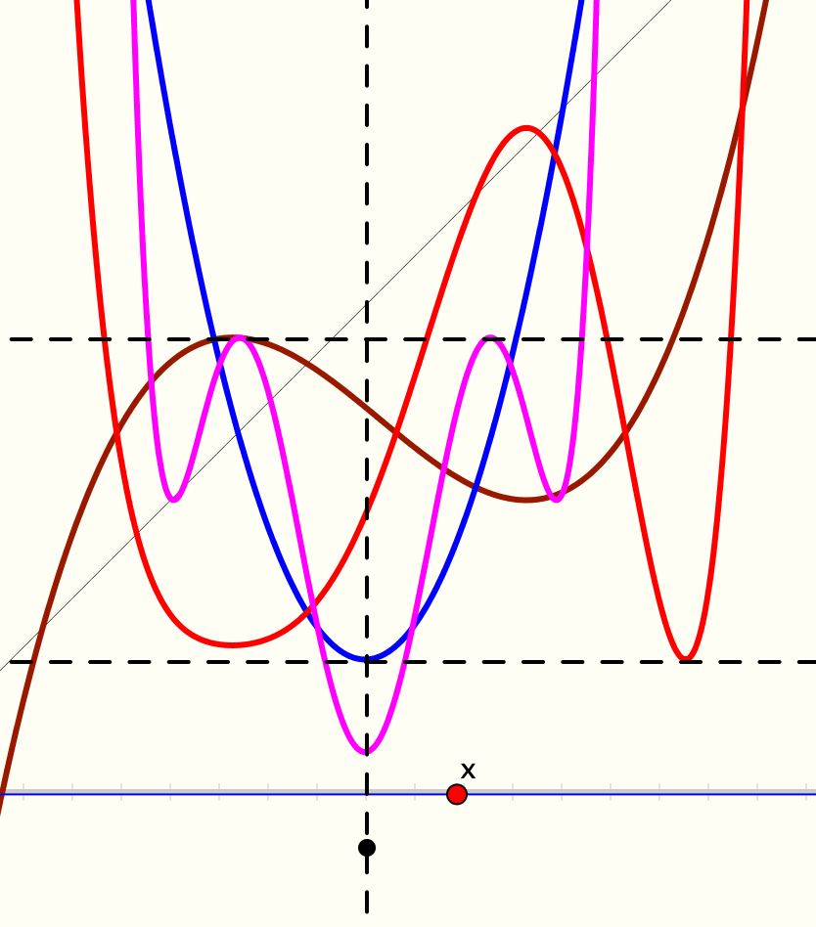
Possible Alignments

Slide 7
Working on Teaching …
… also means becoming aware of core awarenesses that constitute appreciating and comprehending (understanding) a topic, and associated actions
For example in the this task
  Core is idea of composite functions
  (leading to iteration for finding roots)
  Reading graphs; properties of polynomials
  Using coordinates; articulating relationships
Awareness-in-action:
using these
Awareness-in-Discipline:
awareness of those awarenesses
Awarenesses include
images, connections;
language & techniques or methods;
origins and uses of the topic
Awareness-in-Counsel:
enabling bringing Awareness-in-Discipline to the surface

Slide 8
Imagine a Number-Line (T1)
Imagine a copy on acetate, sitting on top
Imagine translating the acetate number-line by 7 to the right:
  Where does 3 end up?
  Where does -2 end up?
  Generalise
Notation:
T₇ translates by 7 to the right
T₇(x) =
x + 7
What is the notation for a translation to the left by 5?
T₋₅ translates by 5 to the right
Notation:
T_{t} translates by t
T_{t}(x) =
x + t
Notes:
No Diagrams! No Hands!
Is “to the right” needed for general a?

Slide 9
Imagine a Number-Line (T2)
Imagine a copy on acetate, sitting on top
Imagine translating the acetate number-line by 7 to the right;
Now translate the acetate number-line to the left by 4;
  Where does 3 end up?
  Where does -2 end up?
  Generalise
T₋₄ o T₇ translates by 7 and then by -4
Does order matter?
T_{s} T_{t} = T_{t} T_{s} = T_{s} _{+ t}
Notes:
No Diagrams!
No Hands!

Slide 10
Imagine a Number-Line (R1)
Imagine a copy on acetate, sitting on top
Imagine reflecting the acetate number-line in the point 0:
  Where does 3 end up?
  Where does -2 end up?
  Generalise
Notation:
R₀ reflects in 0
R₀ (x) = –x
Notes:
No Diagrams!
No Hands!

Slide 11
Imagine a Number-Line (R2)
Imagine a copy on acetate, sitting on top
Imagine reflecting the acetate number-line in the point 5:
  Where does 3 end up?
  Where does -2 end up?
  Generalise
Notation:
R₅ reflects in 5
R₅ (x) =
Notation:
R_{a} reflects in a
R_{a} (x) =
5 – (x – 5)
a – (x – a)
Expressing relationships in general
Tracking Arithmetic
Notes:
Two readings of 5 – (5 – x)

Slide 12

Differing Sums of Products
Write down four numbers in a 2 by 2 grid
4
7
28 + 15 = 43
5
3
Add together the products along the rows
20 + 21 = 41
Add together the products down the columns
43 – 41 = 2
Calculate the difference
That is the ‘doing’
What is an undoing?
Now find other positive numbers
for which the difference is the same as what you got
Notes:
Mathematical context
What probaby matters most is not eh context, but whether students ‘think’ they can solve the problem!

Slide 13
Differing Sums & Products
4
7
Tracking Arithmetic
5
3
(4x7 + 5x3)
–
(4x5 + 7x3)
4x(7–5) + (5–7)x3
= 4x(7–5) – (7–5)x3
= (4–3) x (7–5)
So how can you choose numbers so that 2 will still be the difference?
What about 6? Or any other number?
Importance of personal narrative:
bringing to articulation
Notes:
Revealing Structure by attending to relationships not calculations

Slide 14
Extended Differing Sums & Products
4
7
Take your initial grid
Add some number to both of the main diagonal entries
Subtract some number from both of the off diagonal entries
Why is the ‘result’ the same for all three grids?
5
3
9
7
5
8
9
3
1
8
Reading around the grids in both directions:
45 x 37 – 47 x 35
95 x 87 – 97 x 85
91 x 83 – 93 x 81
= 20
= 20
= 20
Notes:
Revealing Structure by attending to relationships not calculations

Slide 15
Analytic Frame
Awarenesses
What might be encountered during the task?
  Mathematical concepts; connections; propensity; themes; use of powers
What must be varied so as to enable something to be learned?
  What else could be varied so as to bring something to the surface?
What pedagogical actions might be needed?
What will participants manipulate, get-a-sense-of, and try to articulate? (MGA)
What will participants do, talk-about, and record? (DTR)

Slide 16
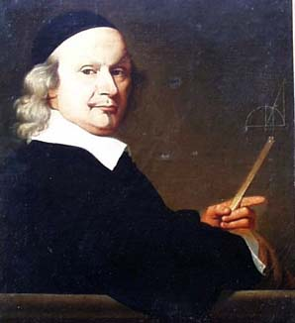
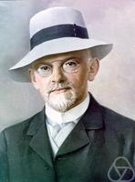
Reflexive Stance
What did you do?
  Use lots of examples?
    Whose examples were they?
  Recognising a Relationship in the particular situation?
  Perceiving a Property in its generality?
Working from examples
Many examples?
One generic example?
John Wallis 1616 - 1703
David Hilbert 1862-1943
Notes:
“My method of investigation”

Slide 17
Observations
Use of the same starting point, reducing the complexity and retaining what is becoming familiar so as to encounter the as-yet-unfamiliar
Drawing attention to what could be varied
Building experience in the hope that learners will begin to want to generalise for themselves
Alternative might be to get different learners to offer different ‘examples’ each time so as to develop flexibility.
No one approach is effective if used habitually: learners stop attending to it and become dependent on it!

Slide 18
Imagine a Number-Line (R3)
Imagine a copy on acetate, sitting on top
Imagine reflecting the acetate number-line in the point 5;
Now reflect that in the point where 2 was originally
  Where does 3 end up?
  Where does -2 end up?
  How are these results related?
  Generalise!
  How does a reflection interact with a translation?
R_{a}(x) = 2a – x
R_{b}(T_{a}(x)) =
R_{b}(x+a)
= 2b-(x+a)
= (2b-a) - x
= R_{2b–a}(x)
R_{b}(R_{a}(x)) =
R_{c}(R_{b}(R_{a}x)) =
Given a succession of reflections in various points, when is there a single point that can act as the reflection point?
R_{b}(2a – x)
R_{c}(T_{2(b-a)}(x))
= 2b – (2a – x)
= 2c – (x+2(b-a)
= 2(b–a) + x
= 2(c–b+a) – x
= T_{2(b–a)}(x)
= R_{2(c–b+a)}(x)

Slide 19
Imagine a Number-Line (R3a)
Imagine a copy on acetate, sitting on top
Imagine reflecting the acetate number-line in the point 5;
Now reflect that in the point where 2 now is.
  Where does 3 end up?
  Where does -2 end up?
  Generalise
Q₅ reflects in where 5 currently is
Q_{a}(x) = R_{a}(x) = 2a – x
Q_{b}(Q_{a}(x)) =
R_{R (b)}(R_{a}(x))
a
= R_{2a–b}(2a–x)
= 2(2a–b) – (2a – x)
Any resonances?
= 2(a – b) + x
= T_{2(a–b)}(x)
Notes:
Notice the use of absolute-reference-based actions in order to work with relative-reference-based actions

Slide 20
Analytic Frame
Awarenesses
What might be encountered during the task?
  Mathematical concepts; connections; propensity; themes; use of powers
What must be varied so as to enable something to be learned?
  What else could be varied so as to bring something to the surface?
What pedagogical actions might be needed?
What will participants manipulate, get-a-sense-of, and try to articulate? (MGA)
What will participants do, talk-about, and record? (DTR)

Slide 21
Imagine a Number-Line (S1)
-12
-11
-10
-9
-8
-7
-6
-5
-4
-3
-2
-1
0
1
2
3
4
5
6
7
8
9
10
11
12
Imagine a copy on elastic, sitting on top
Imagine stretching the elsatic number-line by a factor of 3/2 with 0 fixed:
  Where does 3 end up?
  Where does -2 end up?
  Generalise
Notation:
S_{3/2}(x : 0) scales from 0 by the factor 3/2
S_{3/2}(x : 0) =
3x/2
Suggestive:
S_{σ}(x : a) scales from a by the factor σ
S_{σ}(x : a) =
σ(x–a) + a
Notes:
Notice the same thinking as with the rotations: translate to a familiar pojnt, act, then translate back:
Conjugation & Bypasses

Slide 22
Imagine a Number-Line (S2)
Imagine a copy on elastic, sitting on top
Imagine stretching the elastic number-line
by a factor of 3/2 with 5 fixed
Now scale the elastic number-line by a
factor of 1/3 with the original point 2 fixed.
Notice the potential confusion from using 2 and 3 in two ways
S_{3/2}(x : 5) scales from 5 by the factor 3/2
S_{3/2}(x : 5) =
3(x–5)/2 + 5
S_{1/3}(S_{3/2}(x : 5) : 2) =
((3(x–5)/2+5–2)/3 + 2
= (x +1)/2
= (x –1)/2 +1
Put
Notes:
Notice the same thinking as with the rotations: translate to a familiar pojnt, act, then translate back:
Conjugation & Bypasses

Slide 23
Reflection
Meta Task
Outer Task
What did you do:
  Manipulating?
  Getting-a-sense-of?
  Articulating?
What did you encounter:
  Mathematically?
  Pedagogically?
Notice that arithmetic was encountered as simple actions
  Consequently, addition and subtraction commute!
  What about multiplication and division?
Inner Task
Personal narrative

Slide 24
Analytic Frame
Awarenesses
What might be encountered during the task?
  Mathematical concepts; connections; propensity; themes; use of powers
What must be varied so as to enable something to be learned?
  What else could be varied so as to bring something to the surface?
What pedagogical actions might be needed?
What will participants manipulate, get-a-sense-of, and try to articulate? (MGA)
What will participants do, talk-about, and record? (DTR)

Slide 25
Scaling in 2 Dimensions
Choose two points in your mental plane, not too far apart.
Call them C₁ and C_{2.}
Imagine a point P in the plane. Move it around to get a sense of its freedom
  Scale P towards C₁ by a factor of say 1/3 to point P₁
  Scale P₁ towards C₂ by a factor of say 2/3 to point P₂₁
Is there a single centre C which scales P towards it by a factor of 1/3 and ends up at P₂₁?
Where is it?
Does it depend on P?
Now perform the scalings of P in the opposite order.
Does the same centre work?

Slide 26
Invariance
Suppose point X acts as single centre for scaling by s towards C₁ and then by t towards C₂.
X must be invariant under the combined scaling
The first scaling sends X to C₁ + s(X – C₁).
The second sends that to C₂ + t(C₁ + s(X – C₁) – C₂) = X
So
which is independent of P.
Notice what happens when st = 1
  Any point will do because it is the identity!

Slide 27
Reflection
Meta Task
Outer Task
What did you do:
  Manipulating?
  Getting-a-sense-of?
  Articulating?
What did you encounter:
  Mathematically?
  Pedagogically?
Notice that arithmetic was encountered as simple actions
  Consequently, addition and subtraction commute!
  What about multiplication and division?
Inner Task
Personal narrative

Slide 28
Analytic Frame
Awarenesses
What might be encountered during the task?
  Mathematical concepts; connections; propensity; themes; use of powers
What must be varied so as to enable something to be learned?
  What else could be varied so as to bring something to the surface?
What pedagogical actions might be needed?
What will participants manipulate, get-a-sense-of, and try to articulate? (MGA)
What will participants do, talk-about, and record? (DTR)

Slide 29
Reflection
Meta Task
Outer Task
What did you do:
  Manipulating?
  Getting-a-sense-of?
  Articulating?
What did you encounter:
  Mathematically?
  Pedagogically?
Notice that arithmetic was encountered as simple actions
  Consequently, addition and subtraction commute!
  What about multiplication and division?
Inner Task
Personal narrative

Slide 30
Personal Narrative
What particular ideas struck you during this session?
What would you say to a colleague this session was about
Mathematical
Pedagogic
?
?
Make a note of ideas-constructs you want to pursue, think about, ask about

Slide 31
Themes & Powers
Doing & Undoing
Invariance in the midst of change
Freedom & Constraint
Restricting & Extending
Imagining & Expressing
Specialising & Generalising (Stressing & Ignoring)
Conjecturing & Convincing
(Re)-Presenting in different modes
Organising & Characterising

Slide 32
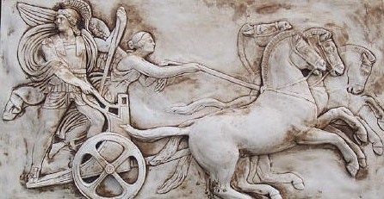
Making Use of the Whole Psyche
Assenting & Asserting
Awareness (cognition)
Imagery
Will
Emotions
(affect)
Body (enaction)
Habits
Practices

Slide 33
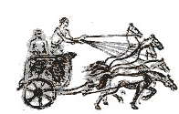
Three Only’s
Language Patterns
& prior Skills
Images/Sense-of/Core Ideas/Connections
Root Questions
predispositions
Different Contexts in which likely to arise;
dispositions
Standard Confusions
& Obstacles
Techniques & Incantations
Awareness
Emotion
Behaviour
Only Emotion is Harnessable
Only Awareness is Educable
Only Behaviour is Trainable

Slide 34
Reflection Strategies
What technical terms involved?
What concepts called upon?
What mathematical themes encountered?
What mathematical powers used (and developed)?
What links or associations with other mathematical topics or techniques?
What pedagogical actions might be needed?

Slide 35
What is Multiplication?
Most learners will have encountered at least a dozen distinct realizations of multiplication by the 8th grade. They include: skip counting, hopping along a number line, stretching and compressing a number line, grid making, area generation, dimension jumping, scaling, a linear function, and a process that might be illustrated by repeated folding, splitting, or layering.
Multiplication, for example, was likely originally conceived as repeated addition and/or some sort of a grouping process. However, this conception breaks down when one attempts to add 5⁄8 to itself 3⁄4 times, π to itself d times, or to assemble –2 groups of –3.
Concept Study
  Variety of authors with their own versions, many inspired by Japanese and Chinese PD practices
  Brent Davis version
    Appreciation and comprehension evolve, rather than ‘either-or’, ‘present-absent’, for learners, for teachers, and for mathematics educators
Davis 2012

Slide 36
Teacher Focus
Student
Teacher-Student interaction
Student-Mathematics interaction
Teacher
Mathematics
Teacher-Mathematics interaction
Nicholas Andrews
Language/technical terms
Examples, Images &
Representations
Enactive Obstacles
Origins
Applications & Uses
Affective Obstacles
Cognitive Obstacles:
common errors, …
Methods & Procedures

Slide 37
Inner & Outer Aspects
Outer
  What task actually initiates explicitly
Inner
  What mathematical concepts might be underpinned
  What mathematical themes might be encountered
  What mathematical powers might be invoked
Personal Narratives
  What might be anticipated?
  What might be missing?
Meta
  What personal propensities might brought to awareness

Slide 38
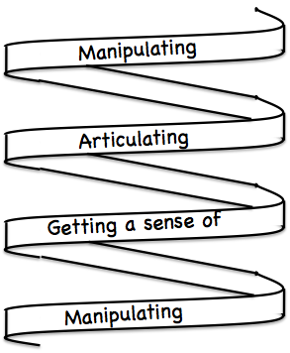
Frameworks
Enactive– Iconic– Symbolic
Doing – Talking – Recording
See – Experience – Master

Slide 39
Other Constructs
Scaffolding & Fading
  Directed–Prompted–Spontaneous
Didactic Transposition
    Expert awareness is converted into instruction in behaviour
  Didactic contract
    Teachers set tasks; students try to complete those tasks; required learning happens
  Didactic tension
    The more explicit the expected behaviour is made,
    the easier it is for learners to display the behaviour without actually generating it from themselves

Slide 40
Reminder of Preparatory Task
Make a new topic web for “Mathematical Actions” which your learners will encounter in your teaching.
Make a new separate topic web for “compounding or composing actions”: in what situations will actions follow actions?
Preparatory Task
used to bring ideas to the surface in preparation
Used again later
to monitor development

Slide 41
Task for November
Take a topic you are teaching before November (to school students, to trainee teachers, as an in-service session)
Consider carefully what constitutes that topic:
  What awarenesses-in action are central
  What awarenesses-discipline would you like to have come to the surface?
  What tasks might bring those actions and awarenesses to the surface
  What pedagogic moves might help participants become aware of the importance of those actions?

Slide 42
Follow-Up
John.Mason @ open.ac.uk
PMTheta.com

