Slide 1




Teaching More by Teaching Less:
Getting Learners to Make Use of Their Natural Powers
Promoting Mathematical Thinking
John Mason
ATM
London
Oct 2015
The Open University
Maths Dept
University of Oxford
Dept of Education

Slide 2
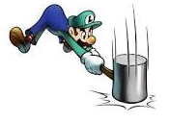
Throat Clearing
Everything said here is a conjecture …
  … to be tested in your experience
My approach is fundamentally phenomenological …
I am interested in lived experience.
Radical version: my task is to evoke awareness (noticing)
So, what you get from this session will be mostly …
  … what you notice happening inside you!
Avoid the teaching of
speculators,
whose judgements are
not confirmed
by experience.
(Leonardo Da Vinci)
Who takes initiative?
Who makes choices?
What is being attended to?

Slide 3
Outline
Some Problematic Situations
Some Situations Vacant
  Opportunities to pose questions
Specific Topic: Perimeter & Area
Opening up Situations
  Role of variation, extension, generalisation
Sustaining Activity
  (activity is what learners actually do; tasks are what stimulate activity)
Drawing Activity to a Close

Slide 4

Three for Me and Two for You
Language of multiplicative comparison
Notes:
What fraction of the whole will be a given colour? What fraction of one colour is another colour?
What percentage will be a given colour?
What is the ratio between two different colours?
What ratios can there be between different combinations of colours?
Make up your own!

Slide 5

Sharing
In how many different ways can you express the relationships?
Notes:
What fraction of the whole will be a given colour? What fraction of one colour is another colour?
What percentage will be a given colour?
What is the ratio between two different colours?
What ratios can there be between different combinations of colours?
Make up your own!

Slide 6


Same & Different
Notes:
What fraction of the whole will be a given colour? What fraction of one colour is another colour?
What percentage will be a given colour?
What is the ratio between two different colours?
What ratios can there be between different combinations of colours?
Make up your own!

Slide 7
Magic Square Reasoning
What other
configurations
like this
give one sum
equal to another?
6
7
2
2
1
5
9
Try to describe
them in words
2
8
3
4
Any colour-symmetric
arrangement?
)
Sum(
–
Sum ( )
= 0
Notes:
Think of all the patterns obtained like this one but with different choices of the red line and the blue line.
Sketch a few
Here is another reasoning
What about this pattern: is it true?
did you have difficulty recognising the components? This may be why learners find it hard to remember what they were taught recently!

Slide 8
More Magic Square Reasoning
Sum(
)
–
Sum( )
= 0

Slide 9
Frieze
It is known that this frieze pattern is generated by a repeating block of cells, and that a generating block appears at least twice.
What question(s) might you ask?
What colour is the 100th cell?
In what position is the 100th green cell?
Make up your own
  Make an easy one
  Make a challenging one
What makes it challenging?
Notes:
Chant the sequence of colours … you might find your chanting falling into a rhythm! (Watch What You Do)

Slide 10
Task Sheet
Marbles
Syndrome
Bags
Differences
Water Loss

Slide 11
Situations Vacant

Slide 12
Problem Solving
What is a ‘problem’?
  When is a problem?
  When someone experiences something as problematic, as curious, or in need of explanation
Where do suitable ‘problems’ come from?
  From people’s experiences
  So promoting ‘problem-posing’ is vital
    Just as expressing generality is a precursor to being asked to manipulate algebraic expressions
    So is posing your own questions a precursor to problem solving.
How do we learn what sorts of questions are mathematically interesting?
  From experience of being asked such questions
  From curiosity

Slide 13
Perimeters
Coordinated Perimeters
Based on an idea of Dan Meyer

Slide 14
Max Min

Slide 15
Opening Up Situations
Situations Vacant
  Malcolm Swan: eg Orange Grove
  Dan Meyer: multiple examples on web
    Pedagogic format
Particular to General to even more General
General to more General via Particular
Very General via Particular and General

Slide 16
Multi-Level Initiating of Tasks
In how many ways can a unit fraction be expressed as the difference of two unit fractions?
Notice that
Notice that
Notes:
Ways of initiating activity through presentation of a task

Slide 17

More or Less Variations
Number of factors
Frequency
Number of local maxima
LCM
Fewer
Smaller
More
Larger
Number of
prime factors
Period
Same
Number of
local minima
HCF
More
Larger
Same
300
84, 126
Fewer
Smaller

Slide 18
Attribute Grids: functions
Range
Domain
(0, 1)
[0, 1)
(0, 1]
[0, 1]
(0, 1)
[0, 1]
(0, 1]
[0, 1]

Slide 19
Outline
Some Problematic Situations
Some Situations Vacant
  Opportunities to pose questions
Specific Topic: Perimeter & Area
Opening up Situations
  Role of variation, extension, generalisation
Sustaining Activity
  (activity is what learners actually do; tasks are what stimulate activity)
Drawing Activity to a Close

Slide 20
Finding Suitable Situations
Your own experience
Learners’ own experience
Being alert to contradictions, ambiguity, confusions
Mathematical Topics
  Animations
  Posters
  Exercise sets

Slide 21
Posing & Resolving Problems
Co-emergence of
  Posing your own questions (being curious)
    Recognising structural relationships
  Learning what types of questions are mathematically fruitful
    Generalising particular relationships
    Seeking multiple ways to resolve uncertainties
Prompting Learners to use their OWN powers
Notes:
Thanks to Jenni Ingram for alerting me to this co-emergence

Slide 22
Teaching More by Teaching Less
Getting learners to make significant choices
  Especially mathematical choices
Prompting Learners to pose questions
  Co-emerging with learning what questions might be fruitful
Trying to do for learners only what they cannot yet do for themselves
  Scaffolding & Fading
Invoking and Evoking their powers
  Imagining & Expressing
  Specialising & Generalising
  Conjecturing & Convincing
  Organising & Characterising
Encountering Pervasive Mathematical Themes
  Doing & Undoing
  Invariance in the midst of change
  Freedom & Constraint
Notes:
Assigning one person to be in charge of choosing numbers for that lesson
Assigning one person to be in charge of choosing letters (for algebra)
Each person constructing their own example(s) to try things out on (specialising)
Co-emergence of problem posing and problem solving: Jenni Ingram

Slide 23
Pedagogical Strategies
Initiating
  Encountering Problematic Situation
  Learner Choices: Withdrawing from Action & Considering Next Action
  Say What You See & Watch What You Do
  Same & Different; What Can Be Varied (What if not?)
  Provoking & Promoting use of Learners’ Powers
Sustaining
  Learner Choices: Withdrawing from Action & Considering Next Action
  Using Powers; Exploiting Themes
  Enactive–Iconic–Symbolic & Doing–Imagining–Symbolising
  Manipulating–Getting-a-sense-of–Articulating
Completing
  Justifying Conjectures
  Formulate conjecture(s) and record evidence
  Extending & varying
Notes:
Marion Walter & Stephen Brown: The Art of Problem Solving (What if Not?)
Same & Different: Laurinda Brown & Alf Coles

Slide 24
Mathematical Thinking
How might you describe the mathematical thinking you have done so far today?
How could you incorporate that into students’ learning?
What have you been attending to:
  Results?
  Actions?
  Effectiveness of actions?
  Where effective actions came from or how they arose?
  What you could make use of in the future?

Slide 25
Reflection as Self-Explanation
What struck you during this session?
What for you were the main points (cognition)?
What were the dominant emotions evoked? (affect)?
What actions might you want to pursue further? (Awareness)
Notes:
Chi et al

Slide 26
To Follow Up
PMTheta.com and mcs.open.ac.uk/jhm3
john.mason@open.ac.uk
A Brief Guide to Modelling in Secondary School: estimating big numbers (TEAMAT 34 p223-228)
Designing & Using Mathematical Tasks (Tarquin)
Mathematics as a Constructive Enterprise (Erlbaum)
Thinking Mathematically (Pearson)
Key Ideas in Mathematics (OUP)
Researching Your own Practice Using The Discipline of Noticing (RoutledgeFalmer)
Questions and Prompts: (ATM)
Fundamental Constructs in Mathematics Education (RoutledgeFalmer)
Annual Institute for Mathematical Pedagogy
(end of July: see PMTheta.com)

Slide 27
Water Loss
Facts:
  40% of the nation’s water leaks out of the system.
  A company is about to build a new reservoir
“We need to make it 40% bigger than we estimated in order to cover for the waste.”
Additional facts
  1/3 of London water leaks away
  17% of leaks are on private property
Back
Notes:
Friday July 1st 2005 someone being interviewed on radio 4 asserted these two facts,
and then said …
Can this be correct? Generalise? How might you represent the situation to justify your position?
Get learners to collect other examples where there are percentage increases and percentage decreases such
as VAT ad discounts.

Slide 28
Syndrome
The results of a medical test show that 10% of the population exhibit a particular characteristic but 40% of the people who develop a particular syndrome also exhibit that characteristic. This means that people with that characteristic are 6 times as likely to develop the syndrome as people not exhibiting that characteristic.
Back

Slide 29
Differences
I have been given two numbers and I am to subtract the second from the first.
Just before I start, someone adds 2 to both of my numbers. What difference will that make?
What if they add 2 to the first number and subtract 1 from the second: what difference will that make?
What can be varied?
How does that change the thinking?
Back

Slide 30
Bag Constructions (1)
Place coloured objects into four bags such that for each pair of bags, there is just one colour for which the total number of that colour in the two bags is 3.
Back
Notes:
Minimising one aspect may not minimsie the other!

Slide 31
Bag Constructions (2a)
For b bags, how few objects can you use so that each pair of bags has the property that there are exactly two colours for which the difference in the numbers of that colour in the two bags is exactly 1.
Back
Notes:
Minimising one aspect may not minimsie the other!

Slide 32
Bag Constructions (2b)
Here there are three bags. If you compare any two of them, there is exactly one colour for which the difference in the numbers of that colour in the two bags is exactly 1.
For four bags, what is the least number of objects to meet the same constraint?
For four bags, what is the least number of colours to meet the same constraint?
17 objects
3 colours
Back
Notes:
Minimising one aspect may not minimsie the other!

Slide 33
Bag Constructions (3)
Here there are 3 bags and two objects.
There are [0,1,2;2] objects in the bags and 2 altogether
Given a sequence like [2,4,5,5;6] or [1,1,3,3;6] how can you tell if there is a corresponding set of bags?
In how many different ways can you put k objects in b bags?
Back
Notes:
Encountering unfamiliar notation: Charachterising
The last is a very difficult, possibly even unsolved problem!

Slide 34
Marbles
If John gives one of his marbles to Chris, they will then have the same number of marbles.
If John gives three of his marbles to Anne and Anne gives two of her marbles to Kate, they will all then have the same number of marbles.
If John gives two of his marbles to Quentin, then Quentin will have twice as many marbles as John then has.
What can be varied?
How does that change the thinking?
Back

Slide 35
Count
How many white squares are there?
How did you do it?
How were you attending?
In how many different ways can you count the white squares?
Count blacks and subtract
  Notice 6 rows of 3 blacks & 3 rows of 1 black
  Notice 6 columns of 3 black & 3 columns of 1 black
  Notice diagonal stripes of blacks
  Columns: 3 lots of (3 + 3 + 1) blacks
Similar for whites
Notice the effect on your attention between these two task types
Notice what you do with your attention to make sense of these ways
Resolución de Problemas de Final Abierto Chile 2013 p67
Notes:
Introduction to Frequency Tables and means
Seeking relationships

Slide 36
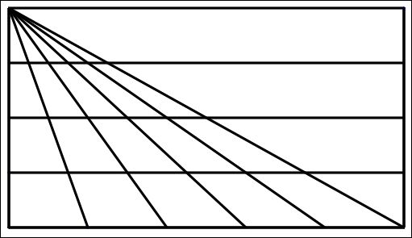
Triangle Count
In how many different ways might you count the triangles?
(5 + 4 + 3 + 2 + 1) x 4 + 1
What are you attending to?
Notes:
15 x 4 + 1

Slide 37
Square Count
How many squares can you see?
What question am I going to ask you?
In how many different ways can you count them?
What were you doing with your attention?
Notes:
16?

Slide 38
Doing & Undoing
What operation undoes ‘adding 3’?
What operation undoes ‘subtracting 4’?
What operation undoes ‘subtracting from 7’?
What are the analogues for multiplication?
  What undoes ‘multiplying by 3’?
  What undoes ‘dividing by 4’?
  What undoes ‘multiplying by 3/4’?
    Two different expressions!
    Dividing by 3/4
    or Multiplying by 4 and dividing by 3
What operation undoes dividing into 12?
Notes:
Dave Hewitt’s THOAN sequences

Slide 39
Composite Doing & Undoing
I am thinking of a number …
What’s my number?
I add 8 and the answer is 13.
What’s my number?
I add 8 and then multiply by 2;
the answer is 26.
I add 8; multiply by 2; subtract 5;
the answer is 21.
What’s my number?
I add 8; multiply by 2; subtract 5; divide by 3;
the answer is 7.
What’s my number?
HOW do you turn +8, x2, -5, ÷3 answer into a solution?
7
Generalise!

Slide 40

Think Of A Number (ThOAN)
Think of a number
Add 2
Multiply by 3
Subtract 4
Multiply by 2
Add 2
Divide by 6
Subtract the number you first thought of
Your answer is 1
7
7
+ 2
3x + 6
7
7
3x + 2
6x + 4
7
6x + 6
7
+ 1
7
1

Slide 41
Using Tracking Arithmetic
?
3+4x7
+6x4+
4x1+8
3+3x7
+3x4+1
7+3x4
+3x1+8
3+2x7
+4
7+2x4
+1
4+2x1
+8
3
7
4
1
8
3+7
7+4
4+1
1+8
3
7
4
1
8
What could be varied?
Notes:
Applies to Pascal’s triangle; Leibniz’s triangle, multiplication and other tables

Slide 42
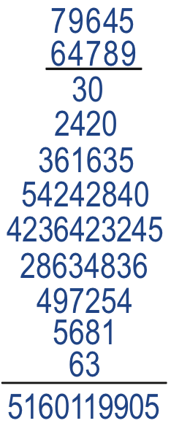
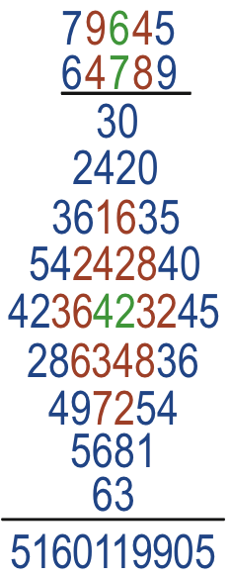
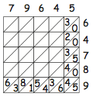
Diamond Multiplication
Notes:
What is going on here?

Slide 43
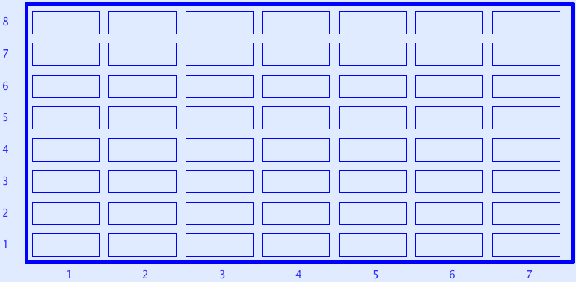
Sundaram Grids
7
12
4
7
If a number appears in this grid (extended to the right and up) then
doubling it and adding 1
gives a composite number.
All rows and columns are arithmetic progressions
How many entries do you need to fill out the grid?
Notes:
Drc=6, Dr=4 Dc=3 S=1 –> numbers that are the product of two numbers, one odd, the other congruent to 1 mod 3
Drc*rc+r(Dr-Drc)+c(Dc-Drc)+Drc-Dr-Dc+S
Disturbance; challenge + Trust that it is not excessive

