Slide 1


Mathematical Tasks:
What, When, Why and How?
Lampton School
Feb 2020

Slide 2
The OfStEd ‘Mores’
Knowing that
Knowing how
Knowing when
Knowing More
Remembering More
Doing More
Knowing to
Short-term
Long-term
Metaphoric resonance
Metonymic triggers
Images & Experience
I Do
We Do
You Do
Procedurally
Conceptually
Reconstructed
or Memorised?
Didactic Tension:
The more clearly you show learners what behavior you are seeking,
Not ‘what to do next’
but
knowing why you next do what you do
The more easily they can display that behaviour
without generating it from themselves

Slide 3
Powers & Themes
Are students being encouraged
to use their own powers?
Powers
Imagining & Expressing
Specialising & Generalising
Conjecturing & Convincing
Organising & Characterising
or
are their powers being usurped by textbook, worksheets and … ?
Themes
Doing & Undoing
Invariance in the midst of change
Freedom & Constraint
Restricting & Extending
Exchanging

Slide 4
Some Topics
Angle
Negative Numbers
Multiplicative structure of numbers
Fractions
Ratio
Inequalities
Algebra
Reasoning

Slide 5
Didactics
What is the role of exercises?
Who constructs examples?
What is learned?

Slide 6
Pedagogic Actions
Imagine …
Same & Different
Say What You See
Talking in Pairs
Pausing
Narrative construction

Slide 7
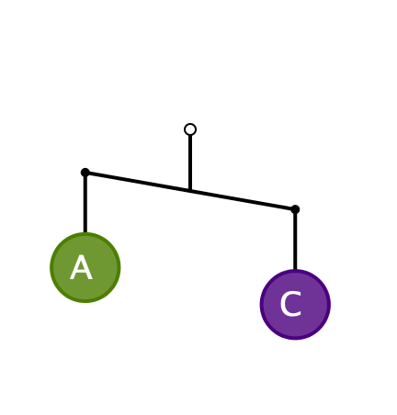
First Encounter
What can you say about the masses A and C?
  It is meant to be a
  2-dimensional picture,
  not 3-dimensional!

Slide 8
Pedagogic Issue
The diagram is WRONG, physically!
Is it appropriate to use misleading or wrong ideas at one stage, so that they have to be corrected later?
  “Multiplication makes bigger”
  “to multiply by 10 put a zero at the end”
  …

Slide 9

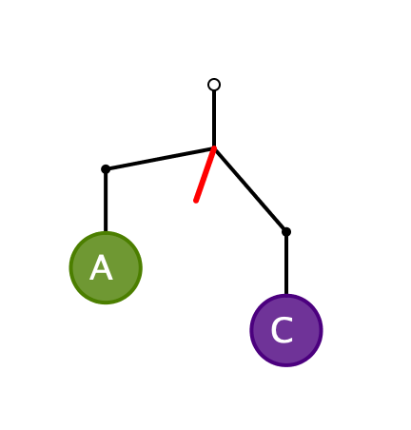
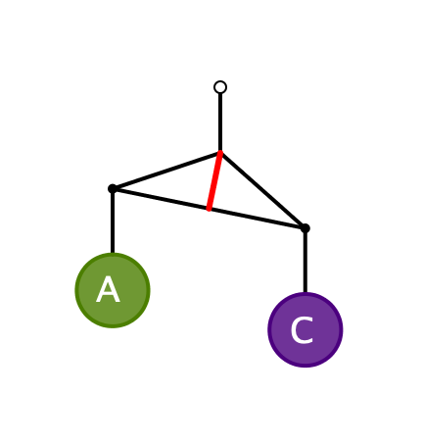
Physically Correct Diagrams
The angle of tilt takes into account both the masses A and C,
and the mass of the ‘bar’ or ‘coat hanger’

Slide 10
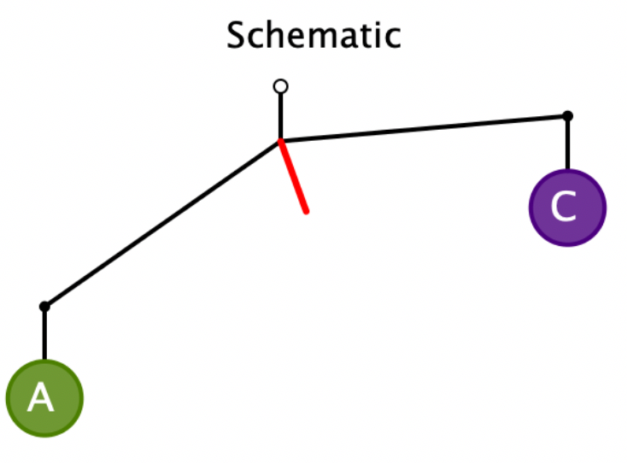
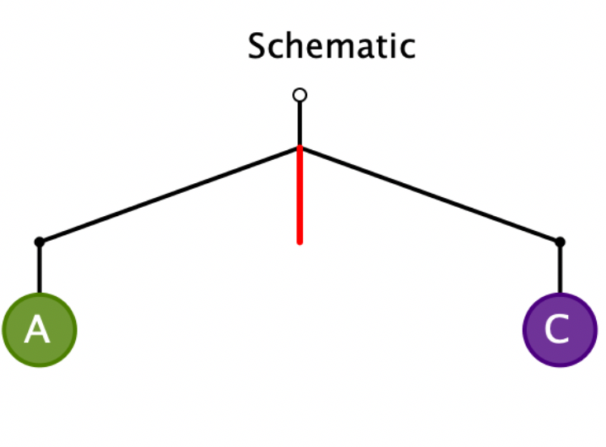
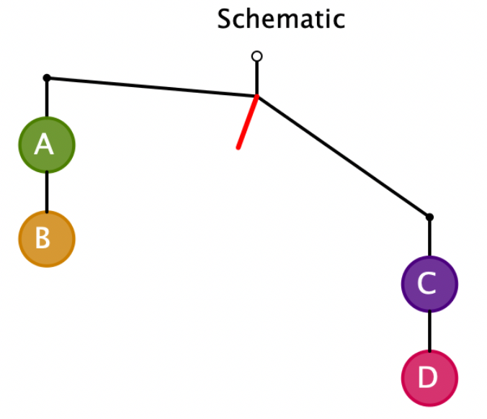
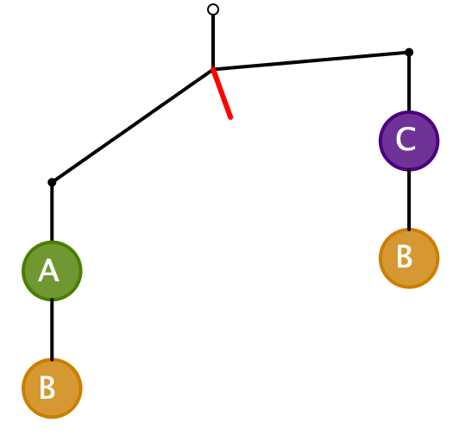
Systematic Development
Express a relationship between the masses
A > C
A = C
A + B > C + B
A > C
C + D > A + B

Slide 11
Systematic Development
A > C
A = C
A > C
Express to someone else
what principles you have recognised
Now draw a schematic bent-bar
which would be read as
A + F > D
And another!
C + D > A + B
And another!

Slide 12
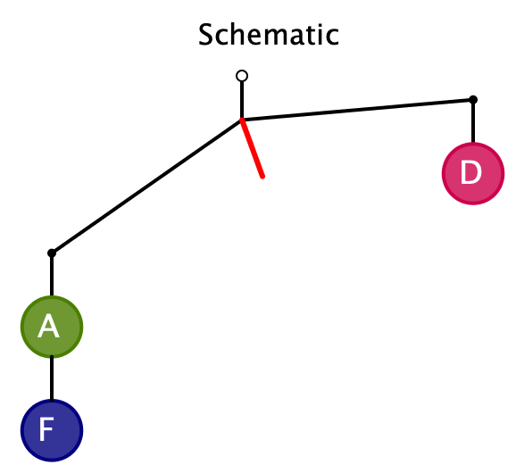
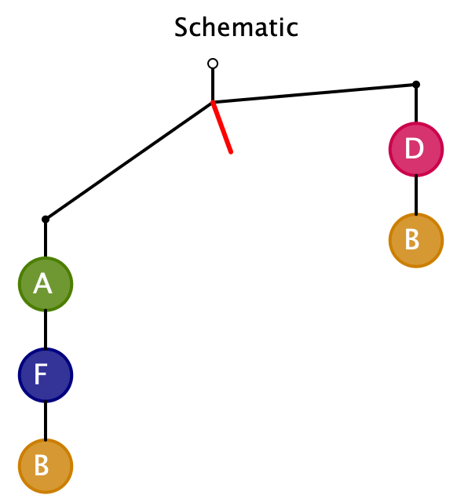
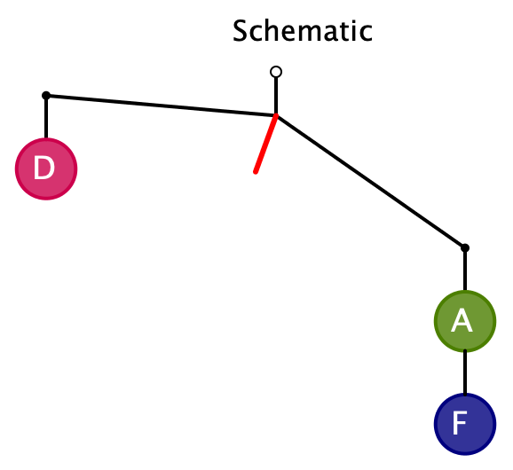
Resolution: A + F > D
…

Slide 13
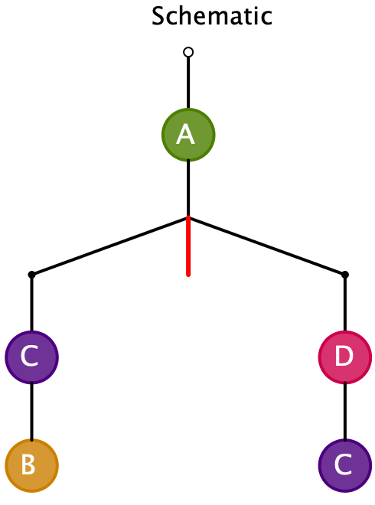
From Actual Masses to Diagram
Pre-release Diagram
Here the diagram shows BEFORE the configuration has been released!
Given the following masses, draw a suitable bent-bar diagram
A = 1
B = 3
C = 2
D = 4
Note the pedagogical
shift of direction
Assign masses so that it tilts the other way

Slide 14
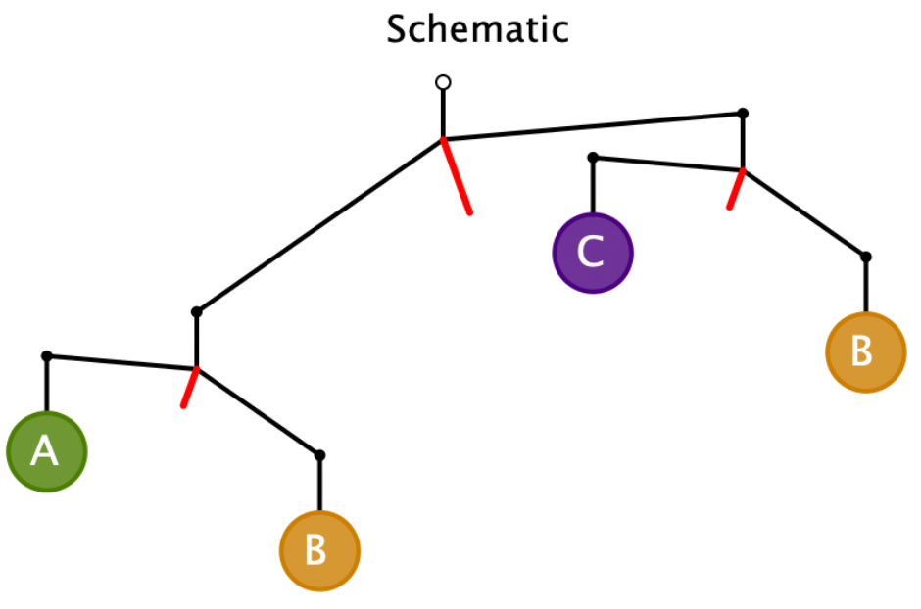
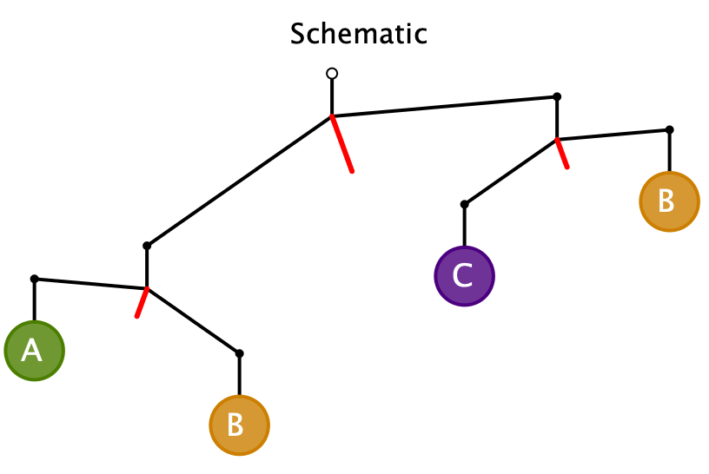
Further Development
B > A
C > B
B > C
B + A > B + C
A > C and C > B > A
A > C
Contradiction!
B > A > C
It is impossible!
Express to someone else
what further principles you have recognised

Slide 15
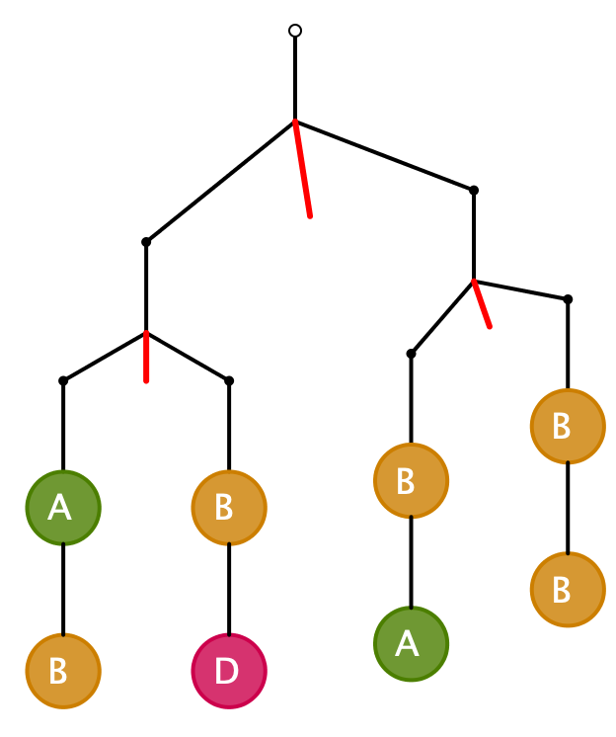
More Challenging
What can be said about the relative masses in each case?
What would be suitable masses to assign to each letter?
A + B = B + D
A = D
A + B > B + B
A > B
A + 2B + D > A + 3B
A = 2; D = 2; B = 1
D > B
D = A > B

Slide 16
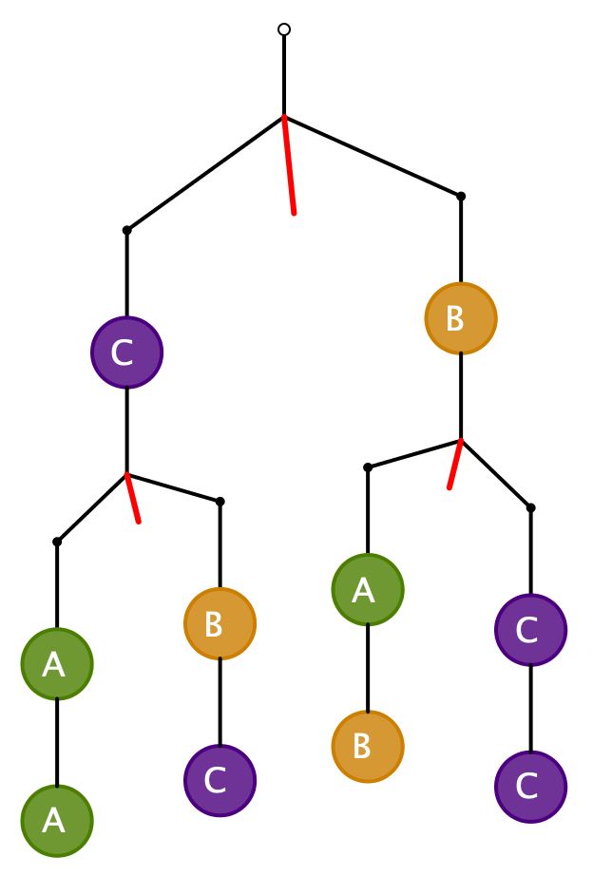
More Challenging
What can be said about the relative masses in each case?
What would be suitable masses to assign to each letter?
2A > B + C
2C > A + B
2A + B + 2C > A + 2B + 2C
A > B
2C > B + B = 2B
C > B
B = 1, C = 3, A = 4
So no conclusion
about A and C
B = 1, C = 4, A = 3
Need to check all relations, not just conclusions
B = 2, C = 4, A = 3

Slide 17
Challenge
How many tasks like this are needed in order to learn from the experience?
Do you feel a need to practice? To rehearse?
By constructing your own, you can explore boundaries and problematic situations

Slide 18
Counting “Lots of”
Imagine a collection of 5 parallel straight lines
Imagine another collection of 7 parallel straight lines, which all cross the first collection.
Imagine another collection of 3 parallel straight lines, which all cross both the other collections.
What is the most number of intersections there can be?
  How might there be fewer?

Slide 19
Counting Intersections

Slide 20
Reflection
What arose in you
  Mathematical thoughts?
  Pedagogical possibilities?
  Feelings/Desires?
  Personal dispositions activated?
What sort of activities might develop confidence and facility?

Slide 21
Counting Dots
3x7 + 12x4 + 5x4
3x11 + 4x4 + 5x8
3x7 + 7x4 + 5x8
12x15 – 9x7 - 7x4

Slide 22
Reflection
What arose in you
  Mathematical thoughts?
  Pedagogical possibilities?
  Feelings/Desires?
  Personal dispositions activated?
What sort of activities might develop confidence and facility?

Slide 23
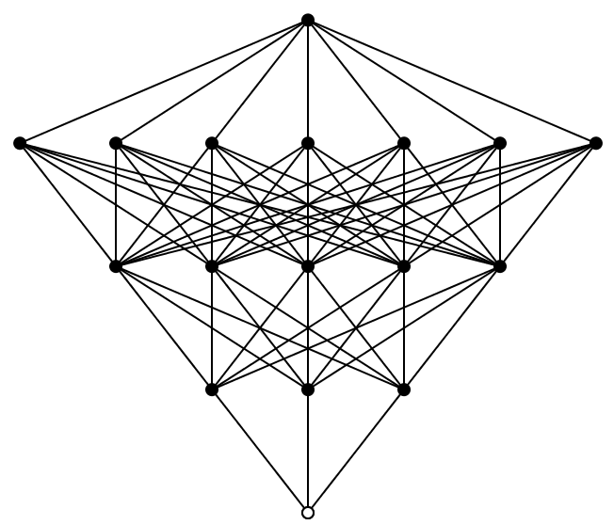
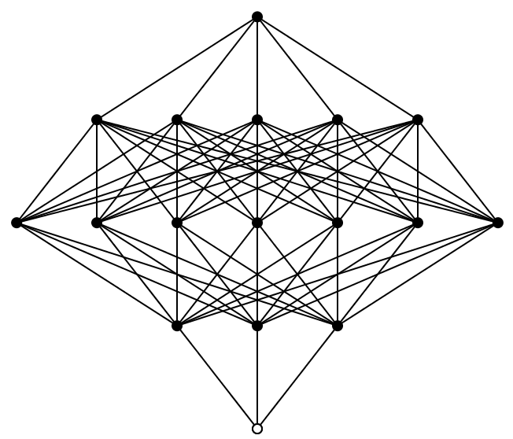
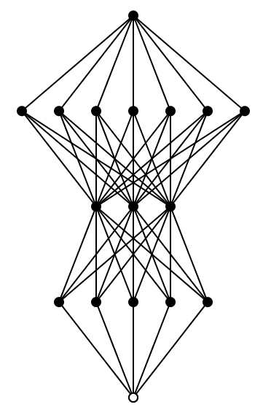
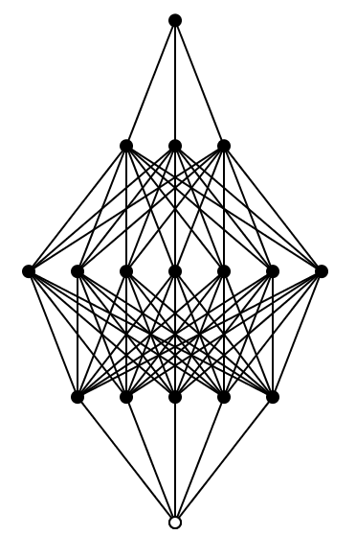
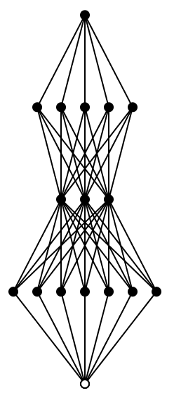
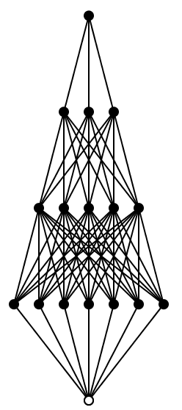
Counting Threads
How many threads
From bottom to top?
How many different
diagrams will have
the same answer?

Slide 24
Reflection
What arose in you
  Mathematical thoughts?
  Pedagogical possibilities?
  Feelings/Desires?
  Personal dispositions activated?
What sort of activities might develop confidence and facility?

Slide 25
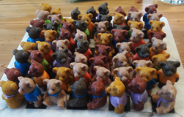
Teddies
Teddies come in 4 colours
They can be sitting
  with either a scarf or a tie in one of five colours, or nothing
Or standing
  with either skates or shoes in one of five colours, or barefoot
  with a t-shirt of one of 5 colours, or none
How many Teddies are possible in a full set?

Slide 26
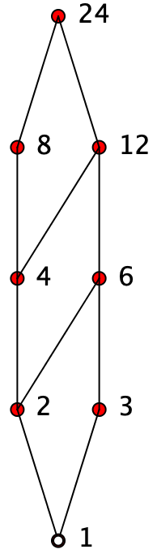
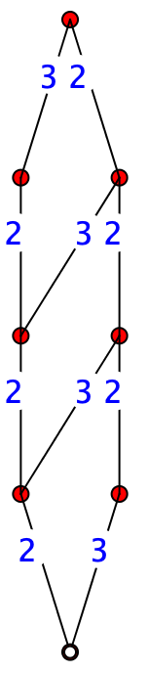
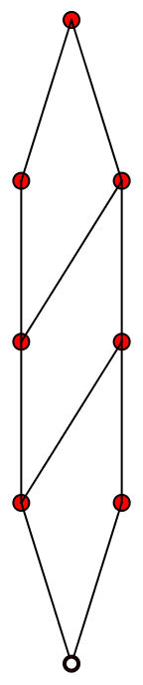
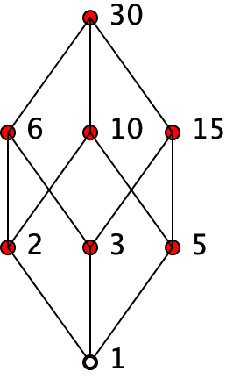
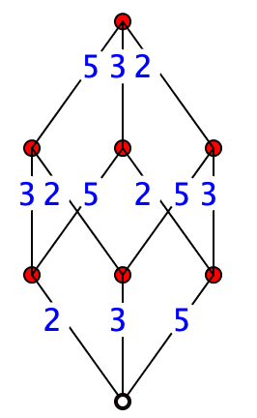
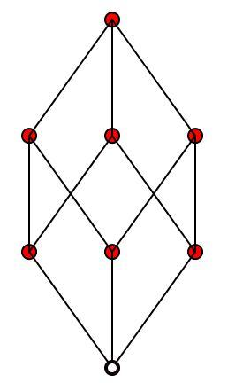
Divisor Lattices
How has this diagram been constructed?
Construct a similar diagram for 24.
What other numbers would have the same lattice structure as one of these??

Slide 27
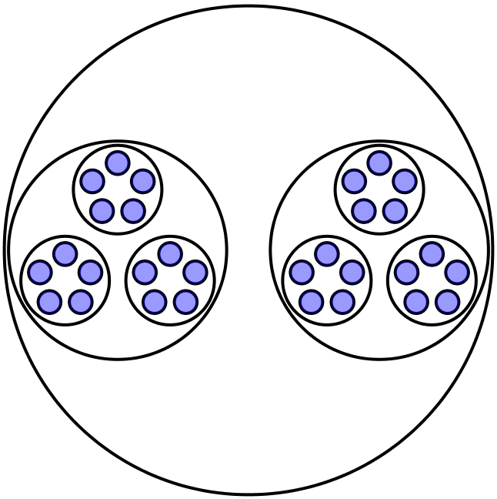
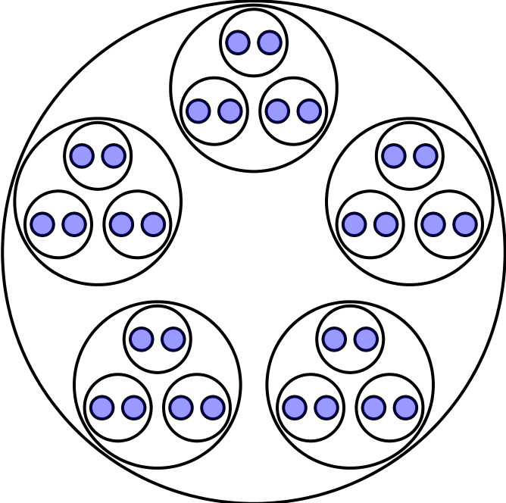
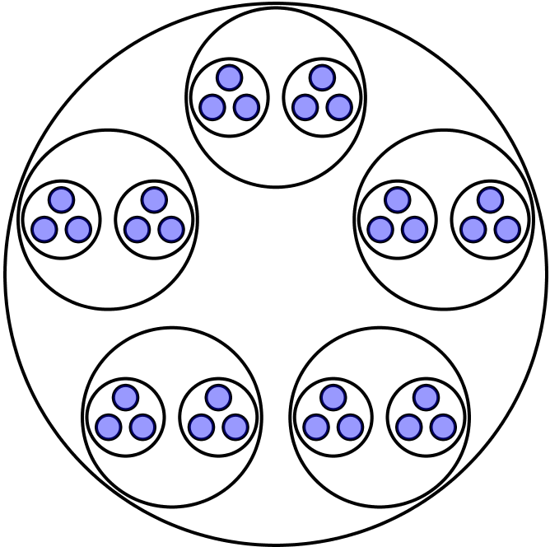
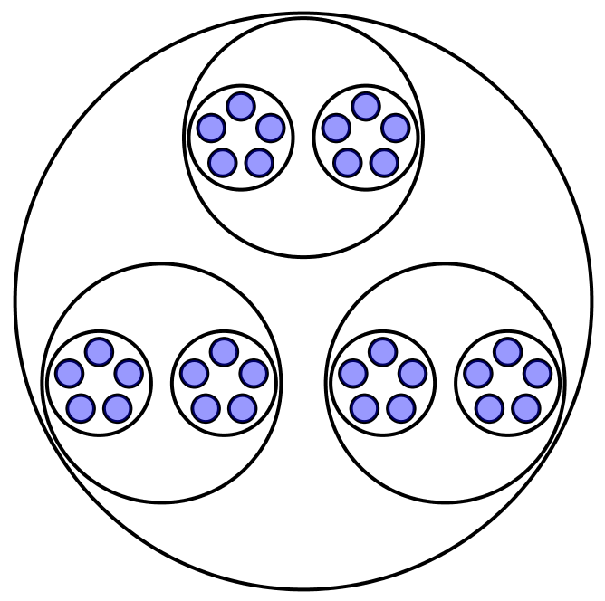
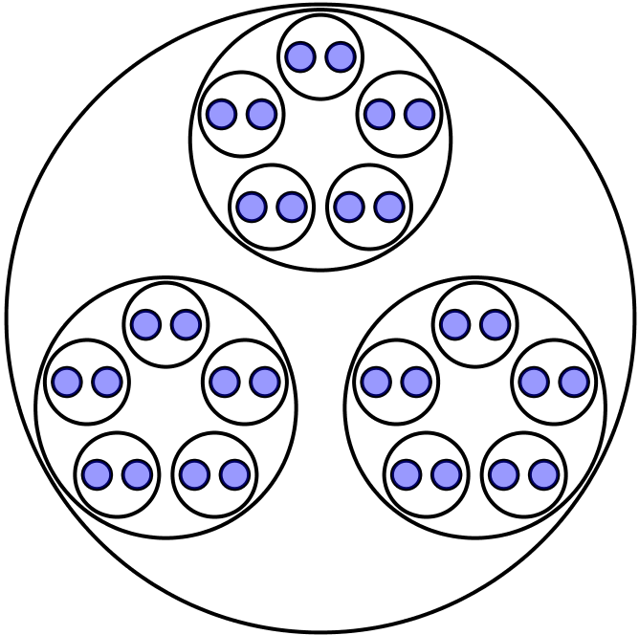
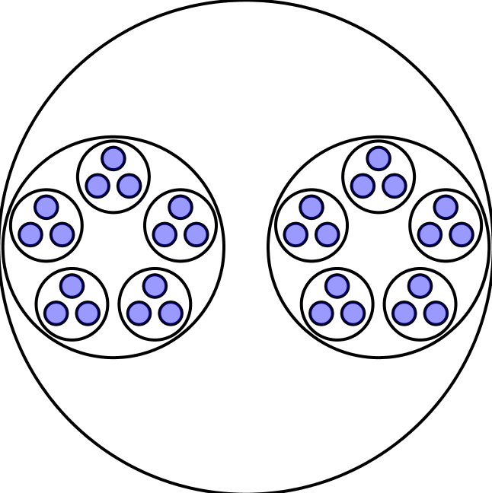
Reading Balloons
2 lots of 3 lots of 5
5 lots of 3 lots of 2
5 lots of 2 lots of 3
3 lots of 2 lots of 5
3 lots of 5 lots of 2
2 lots of 5 lots of 3

Slide 28
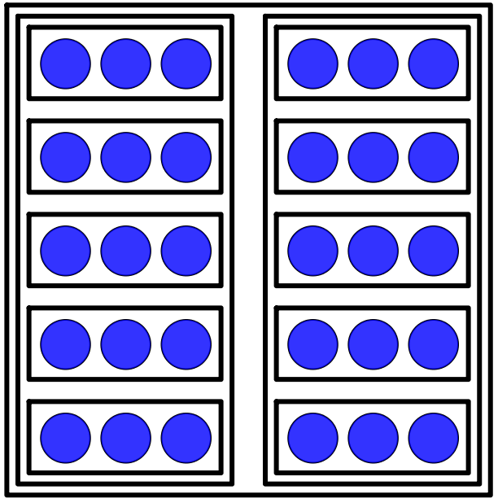
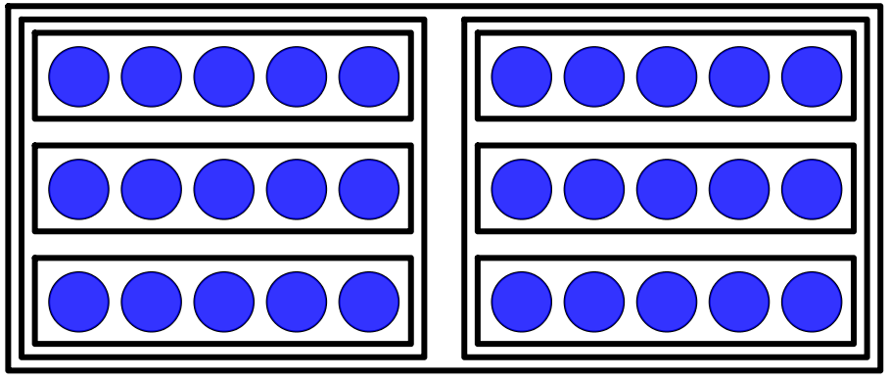
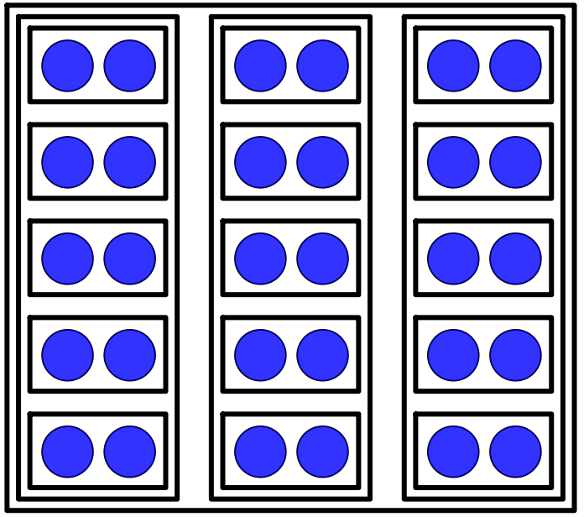
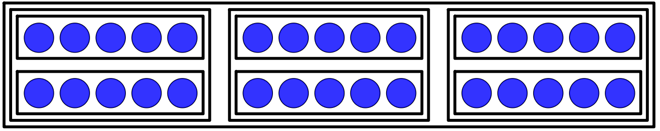
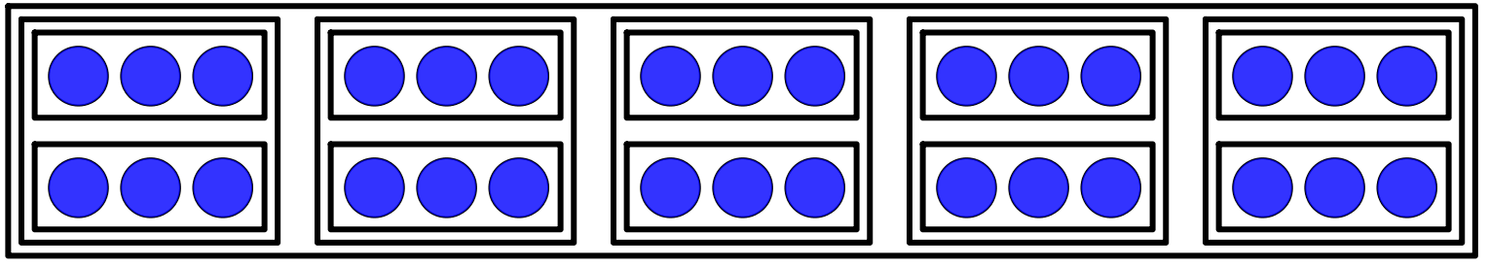
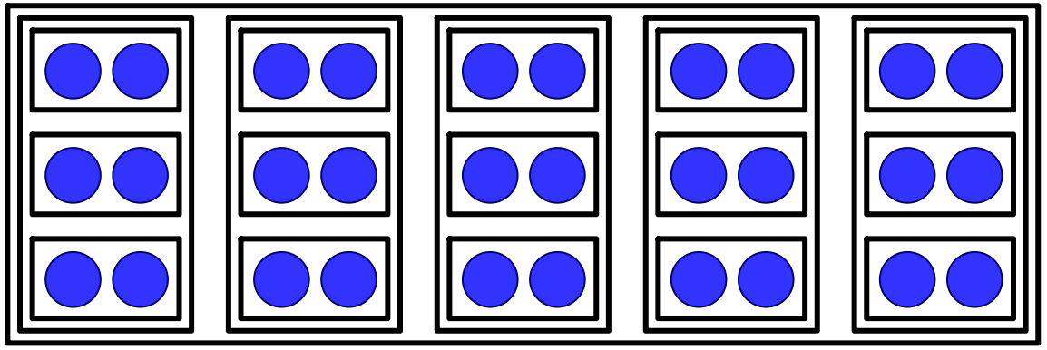
Reading Boxes
Packing
UnPacking
3 in each of 2 in each of 5
5 in each of 3 in each of 2
5 in each of 2 in each of 3
3 lots of 2 lots of 5
2 lots of 5 lots of 3
2 lots of 3 lots of 5

Slide 29
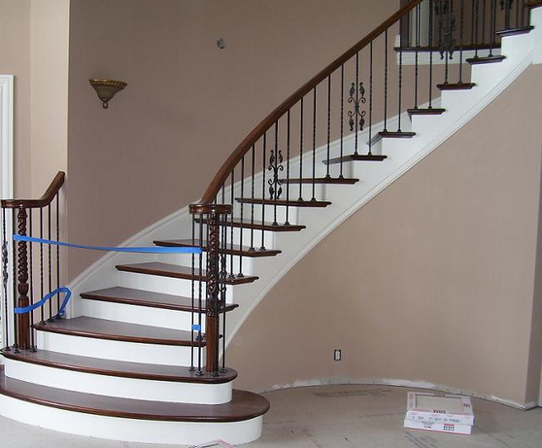
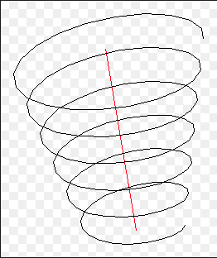
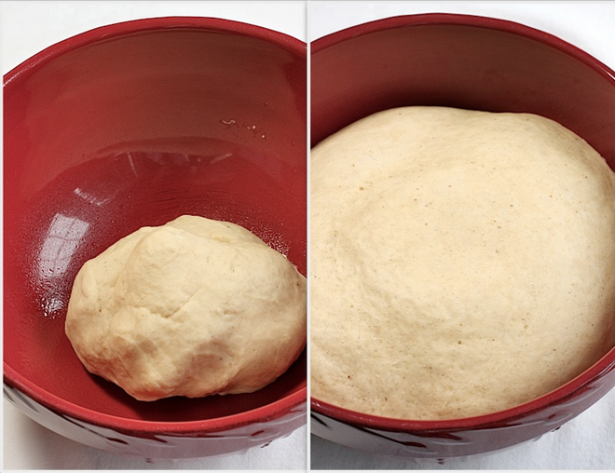
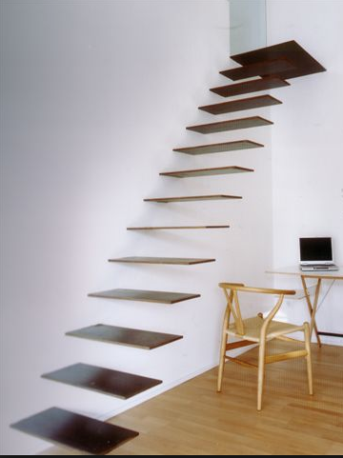
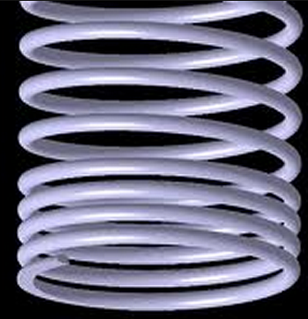
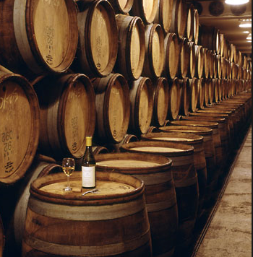
Conceptions of Learning
Staircase
Spiral
Maturation

Slide 30
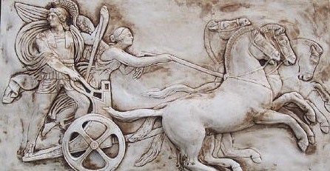
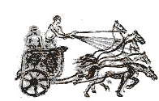
Structure of a Topic
Language Patterns
& prior Skills
Imagery/Sense-of/Awareness; Connections
Root Questions
predispositions
Different Contexts in which likely to arise;
dispositions
Standard Confusions
& Obstacles
Techniques & Incantations
Emotion
Awareness
Behaviour
Only Emotion is Harnessable
Only Awareness is Educable
Only Behaviour is Trainable
Notes:
SoaT is NOT a checklist;
it is a source of inspiration when ideas dry up;
it is a reminder of dimensions of significance to draw upon.

Slide 31
Follow-Up
John.Mason @ open.ac.uk
PMTheta.com

