Slide 1
School mathematics education in England
Anne Watson
University of Oxford

Slide 2
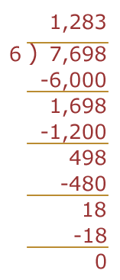

Slide 3
Who owns the curriculum?
Entitlement or prescription?
Depends on use – has become prescription, administered according to social/cultural differences; transparency of consultation
Statutory and non-statutory?
Depends on inspection and accountability – non-statutory becomes statutory through inspection;
Research; culture; political
Freedom for teachers to innovate – research-informed practice; cultural signposts; political assumptions
Experienced by students?
Textbook authors and testing companies – fragmented ideas; what can be tested; limited approaches
Notes:
US core standards; expectations; access for everyone; has become only what is testable, what you must do = all you do; same curriculum for everyone? (TIMSS 2003)

Slide 4
Assessment
Impact of national testing
Teaching to the test – not distinguishing essential procedural skills from conceptual developments
Early entry – who else stops maths at 15/16/18?
Teacher assessment
Same or different to test result?
What can be assessed? How and when?
Learning from the past
Assessment as integral part of teaching
Informative and responsive
Another form to fill

Slide 5
Inspection
Raising expectations and changing practices, e.g. ‘Understanding the score’
Assessing individual teachers on the basis of small evidence
Inspection within schools
Judgements based on generic criteria

Slide 6
Teaching and learning
Politicisation: help or hindrance? Smith Report, NCETM, ACME, funding streams, Task Force …
We pioneered coursework, teacher assessment, exploratory mathematics, ‘active’ learning, integrated curriculum
Different groups/same curriculum; different groups/different curriculum
Teachers need to understand mathematics deeply
Generic criteria for curriculum (QCDA); assessment (??); inspection (Ofsted); teacher knowledge (TDA); study at M-level (TDA); examination structure (Ofqual)

