Slide 1
A Rational Approach to Fractions and Rationals
Promoting Mathematical Thinking
John Mason
July 2015
The Open University
Maths Dept
University of Oxford
Dept of Education

Slide 2
Coordination
Global structure for proportional evaluation
Numerical structure for Splitting & Doubling
one of the most important roles that instruction can play is to refine and extend the naturally occurring process whereby new schemas are first constructed out of old ones, then gradually differentiated and integrated [Case & Moss 1999]
Order arbitrary (?) (Confrey 1994)
What is important is coherent progression based on children’s experience
Use of water, based on Halving from 100 (to link with %) and combining

Slide 3
What Does it Mean?
The instruction to divide 3 by 5
The action of dividing 3 by 5
The result of dividing 3 by 5
The action of ‘three fifth-ing’
The result of ‘three fifth-ing’ of 1 as a point on the number line
Three out of every five, as a proportion or ‘rate’ or ’density’
The value of the ratio of 3 to 5
The equivalence class of all fractions with value three fifth’s (a number)
…

Slide 4
‘Different’ Perspectives
What is the relation between the numbers of squares of the two colours?
Difference of 2, one is 2 more: additive thinking
Ratio of 3 to 5; one is five thirds the other etc.: multiplicative thinking
What is the same and what is different about them?
What is the same and what is … about them?
Notes:
Note absence of language for multiplicative relationship as a question!

Slide 5
Raise your hand when you can see …
Something that is 3/5 of something else
Something that is 2/5 of something else
Something that is 2/3 of something else
Something that is 5/3 of something else
What other fractional actions can you see?

Slide 6
Raise your hand when you can see …
Two things in the ratio of 2 : 3
Two things in the ratio of 3 : 4
Two things in the ratio of 1 : 2
In two different ways!
Two things in the ratio of 2 : 7
Two things in the ratio 3 : 1
What other ratios can you see?
How many different ones can you see (using colours!)

Slide 7
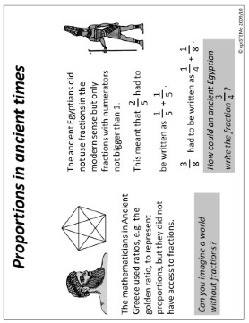
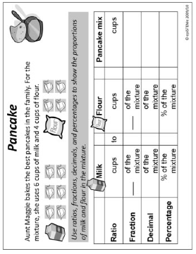
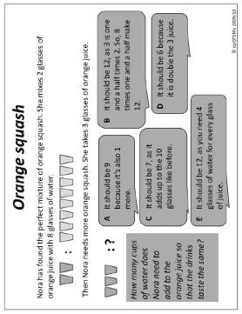
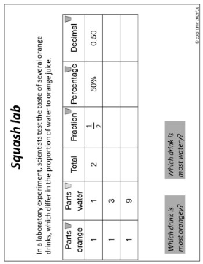
Ratios and Fractions Together

Slide 8
Ratios and Fractions Together
Notes:
Christine Howe, Stefanie Luthman, Kenneth Ruthven, Neil Mercer, Riikka Hofmann, Sonia Ilie & Paula Guardia (2015) Rational number and proportional reasoning in early secondary school: towards principled improvement in mathematics, Research in Mathematics Education, 17:1, 38-56, DOI: 10.1080/14794802.2015.1019914

Slide 9
SWYS (say what you see)
Notes:
Issue of the invisible cuboids … seeing or assuming what is not there

Slide 10
Describe to Someone How to See something that is…
1/3 of something else
1/5 of something else
1/7 of something else
1/15 of something else
1/21 of something else
1/35 of something else
8/35 of something else
Generalise!

Slide 11
Seeing Actions
Notes:
Seeing compound fraction actions

Slide 12
Stepping Stones
Raise your hand when you can see
something that is 1/4 – 1/5 of something else
R
…
What needs to change so as to ‘see’ that
…
R+1

Slide 13
Doing & Undoing
What action undoes ‘adding 3’?
What action undoes ‘subtracting 4’?
What action undoes ‘adding 3 then subtracting 4’? Two different expressions
What are the analogues for multiplication?
What undoes ‘multiplying by 3’?
What undoes ‘dividing by 4’?
What undoes ‘multiplying by 3 then dividing by 4
What undoes ‘multiplying by 3/4’? Two different expressions
Notes:
Dave Hewitt’s THOAN sequences

Slide 14
Mathematical Thinking
How describe the mathematical thinking you have done so far today?
How could you incorporate that into students’ learning?
What have you been attending to:
Results?
Actions?
Effectiveness of actions?
Where effective actions came from or how they arose?
What you could make use of in the future?

Slide 15
Elastic Scaling
Getting Started
Take an elastic (rubber band)
Mark finger holds either end
Mark middle
Mark one-third and two-third positions (between finger holds)
Make a copy on a piece of paper for reference

Slide 16
First Moves
Stretch elastic by moving both hands.
What stays the same and what changes?
Mid point fixed
Marks get wider
Relative order of marks stays the same
Relative positions of marks stays the same (1/3rd point is still 1/3rd point)

Slide 17
Related Moves
Stretch the elastic so that the 1/3rd mark (from your left hand) stays the same.
What stays the same and what changes?
1/3rd point stays fixed (mark expands)
Relative positions remains the same
Relative distances stays the same
1/2 mark is still at 1/2 of stretched elastic
1/3 mark is still at 1/3 of stretched elastic

Slide 18
Acting on (measuring out)
Use your elastic to find the midpoint, the one-third point and the two-thirds points of various lengths around you (all at least as long as the elastic!)
How did you do it?
Stretch and match?
Guess and stretch?

Slide 19
Comparisons
Imagine stretching your elastic by a scale factor of s with the left hand end fixed
Now imagine stretching an identical elastic by a scale factor of s with the 1/3rd point fixed
What is the same and what different about the two elastics?

Slide 20
One End Fixed
Throughout, keep the left end fixed
Stretch so that the mid point goes to where the right hand end was
What is the scale factor?
Where is 1/3rd point on elastic?
Where is 1/3rd point measured by standard reference system?
Stretch so that the 2/3rd point goes to where the right hand end was
What is the scale factor?
See it as ‘half as long again’
See it as dividing by 2/3
Where has the 1/3rd point gone?
Generalise!

Slide 21
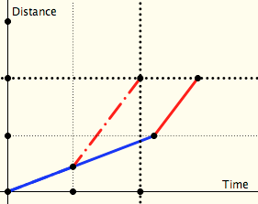
Two Journeys
Which journey over the same distance at two different speeds takes longer:
One in which both halves of the distance are done at the specified speeds?
One in which both halves of the time taken are done at the specified speeds?
distance
time

Slide 22
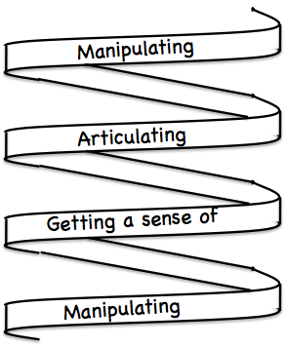
Frameworks
Doing – Talking – Recording (DTR)
(MGA)
See – Experience – Master (SEM)
Enactive – Iconic – Symbolic (EIS)
Specialise … in order to locate structural relationships …
then re-Generalise for yourself
Stuck?
What do I know?
What do I want?

Slide 23
Reflection as Self-Explanation
What struck you during this session?
What for you were the main points (cognition)?
What were the dominant emotions evoked? (affect)?
What actions might you want to pursue further? (Awareness)
Notes:
Chi et al

Slide 24
To Follow Up
www.PMTheta.com and mcs.open.ac.uk/jhm3
john.mason@open.ac.uk
Researching Your own practice Using The Discipline of Noticing (RoutledgeFalmer)
Questions and Prompts: (ATM)
Key ideas in Mathematics (OUP)
Designing & Using Mathematical Tasks (Tarquin)
Fundamental Constructs in Mathematics Education (RoutledgeFalmer)
Annual Institute for Mathematical Pedagogy (end of July) (see PMTheta.com)

