Slide 1
Preparing school students for a problem-solving approach to mathematics
Professor Anne Watson
University of Oxford
Kerala, 2013

Slide 2
Problems about ‘problem-solving’?
What is meant by 'problem-solving'?
What is learnt through 'problem-solving'?
What are the implications for pedagogy?

Slide 3
What is 'problem-solving'?
Routine and non-routine word problems
Application problems
Problematising mathematics

Slide 4
Routine word problems
If I have 13 sweets and eat 8 of them, how many do I have left over?
Build Your Own Burger allows people to decide exactly how large they want their burger. Burgers sell for $1.50 per ounce. The restaurant's cost to actually make the burger varies with its size. Build Your Own Burger states that if x is the size of the burger in ounces, for each ounce the cost is 1 x^{1/3} dollars per ounce.
2
Use definite integrals to express and find the profit on the sale of an 8-ounce burger.

Slide 5
What is 'problem-solving'?
Sweets: spot the relevant procedure
Burgers: work out how to use the given procedure

Slide 6
What is learnt?
Practice in using the procedure
How the procedure applies to real situations

Slide 7
Implications for pedagogy
Focusing on:
  developing procedures from manipulating quantities
  formalising what we do already
  understanding procedures as manipulating relations between quantities
  methods that arise within mathematics that can be applied outside
  ‘doing’ and ‘understanding’

Slide 8
Non-routine problems
Mel and Molly walk home together but Molly has an extra bit to walk after they get to Mel’s house; it takes Molly 13 minutes to walk home and Mel 8 minutes. For how many minutes is Molly walking on her own?
Build Your Own Burger allows people to decide exactly how large they want their burger. Burgers sell for $1.50 per ounce. The restaurant's cost to actually make the burger varies with its size. Build Your Own Burger states that if x is the size of the burger in ounces, for each ounce the cost is 1 x^{1/3} dollars per ounce.
2
Express and find the profit on the sale of an 8-ounce burger.

Slide 9
What is 'problem-solving'?
Understand the situation and the relations between quantities involved – not just ‘spot the procedure’ or use the given procedure
Walking home: understand the structure, maybe using diagrams
Burgers: identify variables and express their relationships

Slide 10
What is learnt ?
Experience at knowing what situations need what procedures
Modelling a situation mathematically
Experience at how to sort out the mathematical structure of a problem

Slide 11
Implications for pedagogy
Do students know what a particular procedure can do for them?
Focus on relationships between quantities and variables
The importance of diagrams

Slide 12
A sequence of more non-routine problems to highlight the need for previous experiences ...

Slide 13
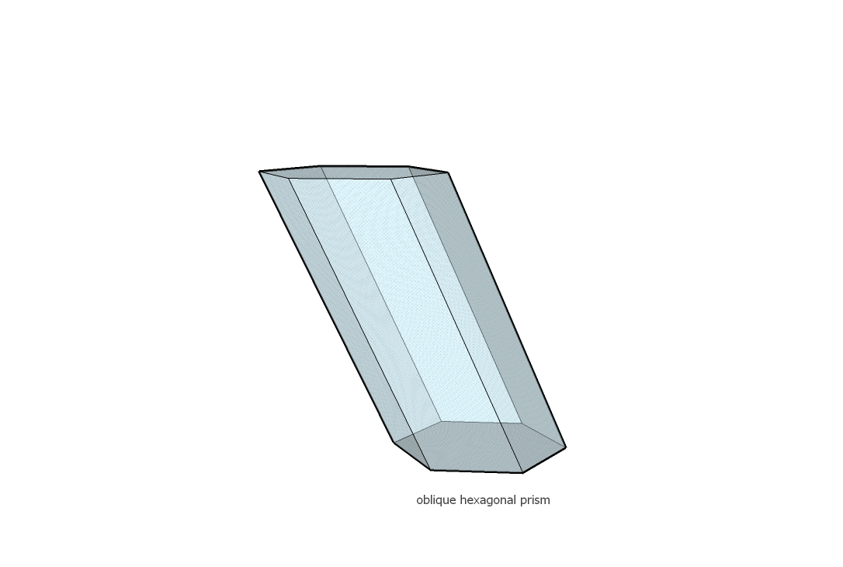
Oblique hexagonal prism problem
Find the capacity

Slide 14
What is 'problem-solving'?
Avoid thoughtless application of formulae
Analyse the features of the shape
Adapt formulae
Apply formulae where possible

Slide 15
What is learnt ?
Clarity about capacity and volume
Clarity about height of a prism
Adapting formulae for specific cases

Slide 16
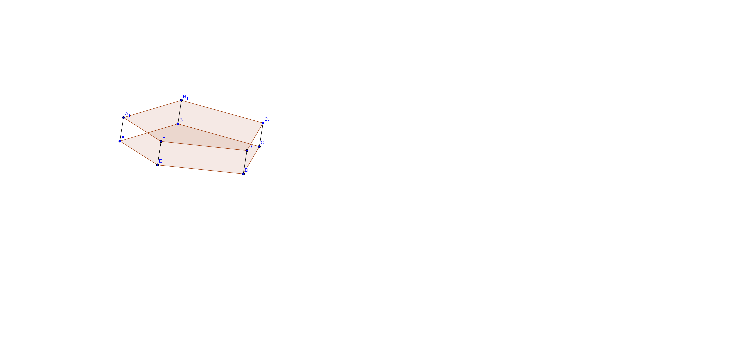
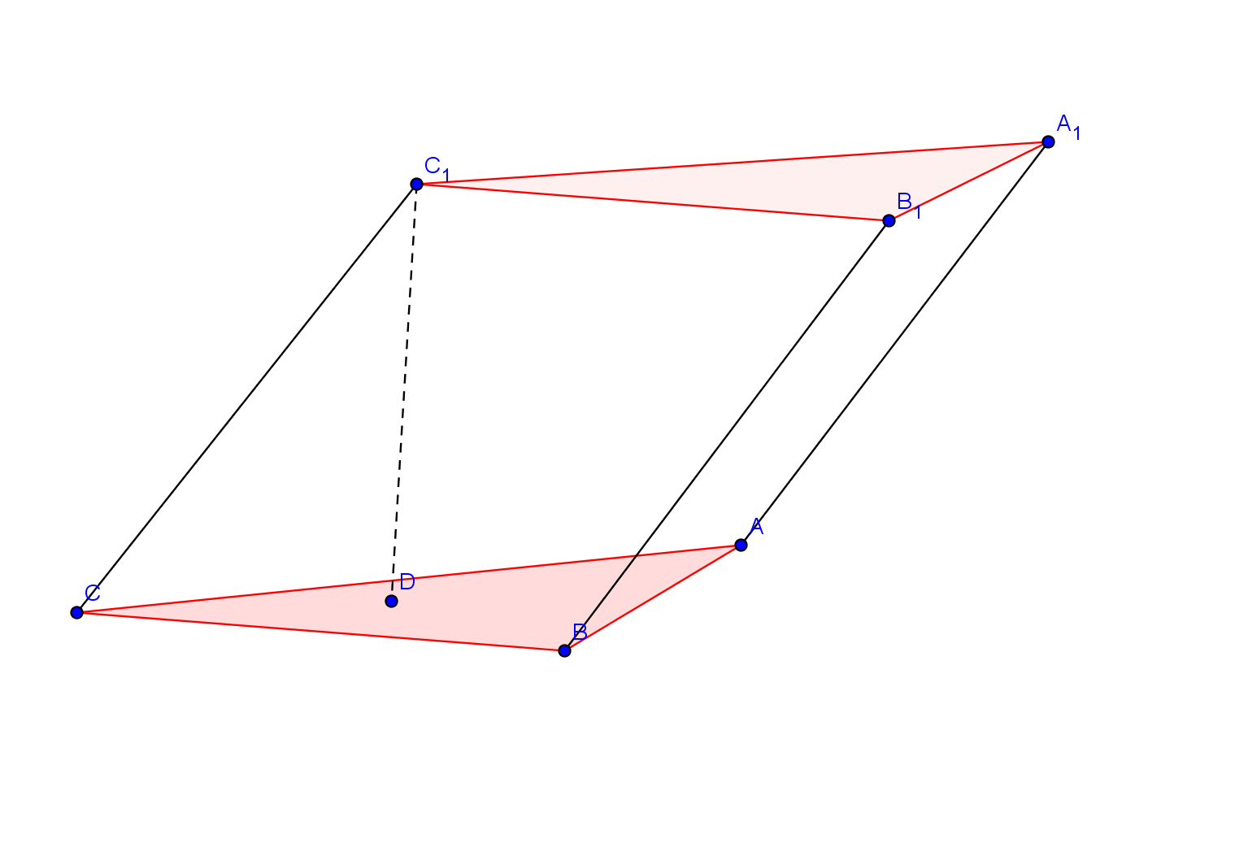
Implications for pedagogy
Experience with non-standard shapes
Understand the elements of the formula

Slide 17


Slide 18
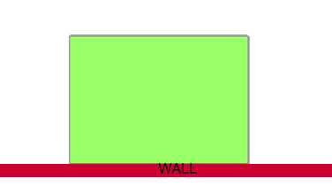
Fence problem
Imagine you have 40-metres of fencing. You can build your fence up against a wall, so you only need to use the fence for three sides of a rectangular enclosure:
What is the largest area you can fence off?

Slide 19
What is 'problem-solving'?
Conjecture and test with various diagrams and cases using various media:
  Practical
  Squared paper
  Spreadsheet
  Algebra
  Graphing
  Calculus

Slide 20
What is learnt ?
Knowledge of area and perimeter
Knowledge of relation between area and perimeter develops (counter-intuitive)
Optimisation: numerical and graphical solutions
Development of mathematical thinking: deriving conjectures from cases and exploration and formalising them

Slide 21
Implications for pedagogy
Students need freedom to explore cases and make conjectures
Teacher needs to decide whether, when and how to introduce more formal methods to test conjectures
Discuss common intuitive beliefs that perimeter and area increase or decrease together

Slide 22

Holiday problem
“Plan a holiday” given a range of brochures and prices for a particular family, timescale and budget

Slide 23
Implications for pedagogy
How large will the working groups will be?
How will participation be managed?
How should answers be presented?
How long should this take?
How to manage non-mathematical aspects?
What new mathematics will students meet?
How will they all meet it?

Slide 24
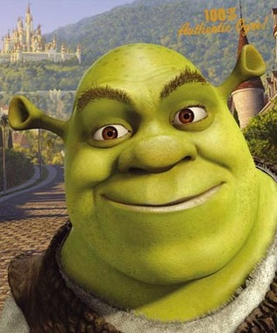
Shrek
Draw a picture of Shrek using mainly quadratic curves

Slide 25
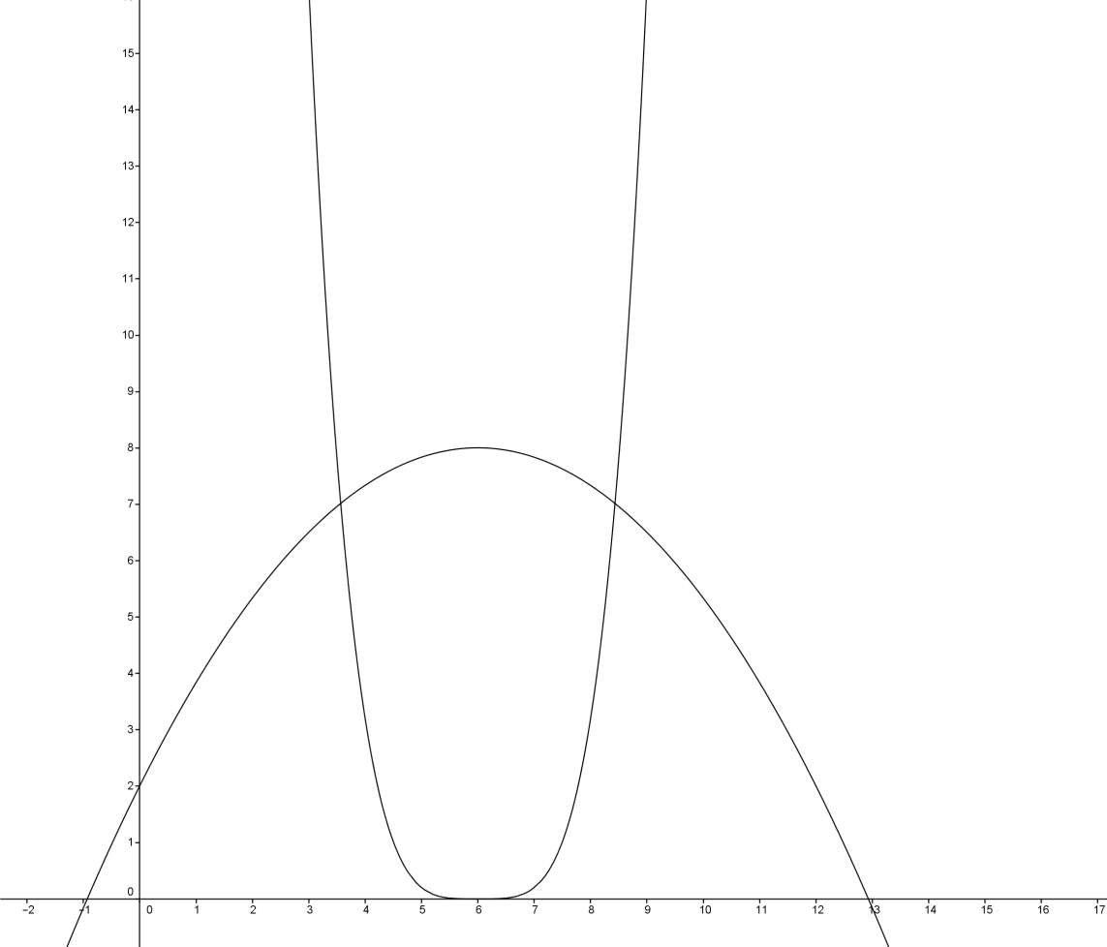
My first attempt: both curves need to be ‘the other way up’

Slide 26
What is learnt ?
Familiarity with various ways of transforming quadratics

Slide 27
Implications for pedagogy
Graph-plotting software availability
Time to explore and become more expert
Should the teacher suggest possible changes of parameters?
Should the teacher expect students to learn the effects of different transformations?

Slide 28

Applications and modelling
It is a dark night; there is a street lamp shining 5 metres high; a child one metre high is walking nearby. Think about the head of the child’s shadow.

Slide 29
What is 'problem-solving'?
Visualise the situation
Pose mathematical questions
Identify variables and how they relate
Conjecture and express relationships

Slide 30
What is learnt ?
various possible purposes:
  experience in spotting uses for similar triangles
  understanding that loci are generated pathways following a relationship
  more generally - experiencing modelling
  comparing practical, physical, geometric and algebraic solutions

Slide 31
Implications for pedagogy (summary)
focus on relationships between quantities and variables
representing and formalising: whether, how, when and who?
understanding procedures as a way to manipulate relations between quantities
the importance of diagrams, images, models, representations
non-standard situations
freedom and tools to explore cases and make conjectures
social organisation: groups, participation, presentation, time

Slide 32
Problematising new mathematics: examples
If two numbers add to make 13, and one of them is 8, how can we find the other?
What is the effect of changing parameters of functions?

Slide 33
From Schoenfeld (see paper)
Consider the set of equations
ax + y = a²
x + ay = 1
For what values of a does this system fail to have solutions, and for what values of a are there infinitely many solutions?

Slide 34
Implications for pedagogy
Mathematising a problem situation: recognising underlying structures
Problematising mathematics: posing mathematical questions
What is 'problem-solving'?

Slide 35
Recognising structures requires:
Knowledge of structures
Experience of recognising them in situations and in hidden forms
Implications for pedagogy

Slide 36
Recognising multiplication, division and fractions in hidden forms:

Slide 37


Slide 38
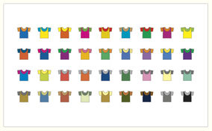

Slide 39
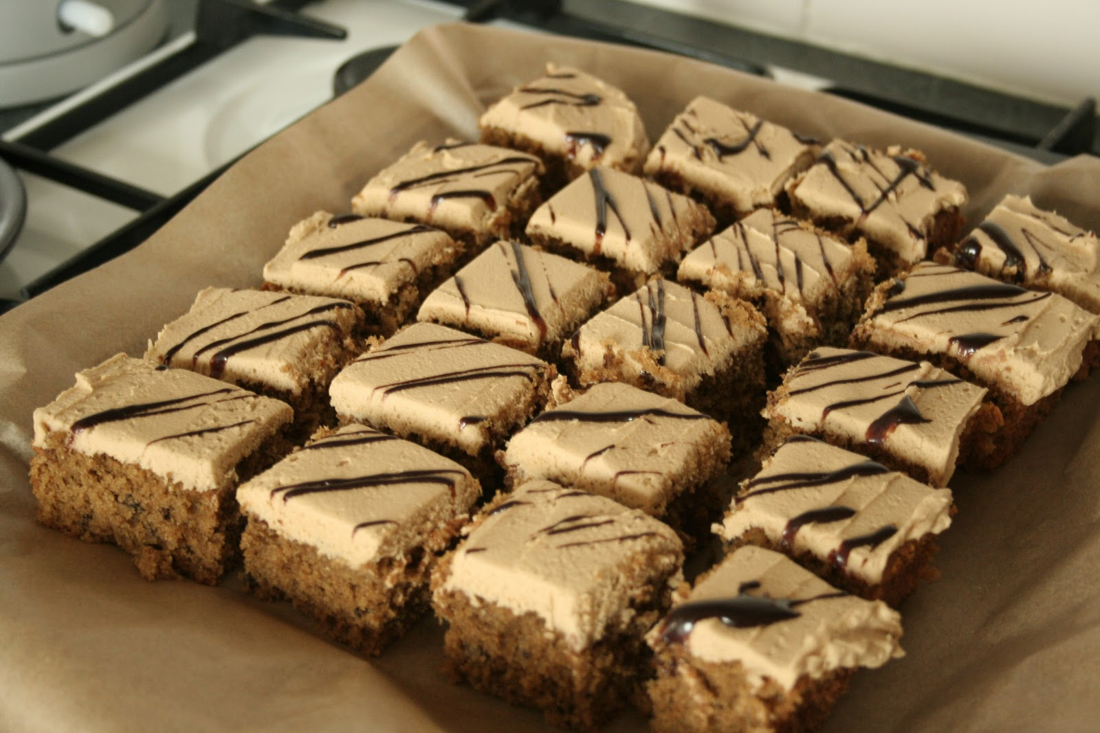
.
Type: | JPG

Slide 40
Same quadratic hidden forms:
6x² - 5x + 1 = y
(3a – 1) (2a - 1) = b
6e^{8z} – 5e^{4z} + 1 = y
7sin²x + 8cos2x – 5cosx = y

Slide 41
Posing questions requires:
Knowing what mathematics is
Being interested in:
  What is the same and what is different?
  What changes and what stays the same?
  Transforming, e.g. reversing question and answers
Experience in answering such questions
Implications for pedagogy

Slide 42
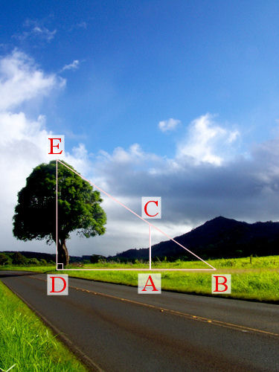
What is the same and what is different?
What changes and what stays the same?
Transforming:
reversing question
and answers

Slide 43
Mathematical problem solvers need:
Repertoire of structures and questions (knowledge and strategies)
Experience in using these
Combinations of knowledge and experience that generate:
  Awareness of what might be appropriate to use
  Teachers who are themselves mathematical problem-solvers

Slide 44
anne.watson@education.ox.ac.uk
PMƟ
Promoting Mathematical Thinking

