Slide 1
Researching from the Inside: confessions of a lifelong phenomenologist
John Mason
Dept of Education
Charles University
Prague
Nov 2018

Slide 2
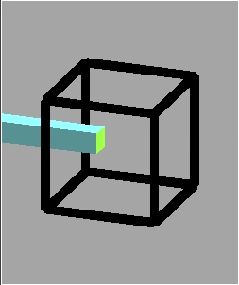

Slide 3
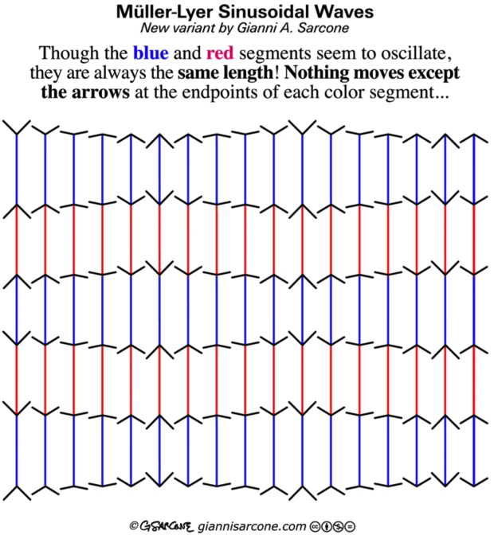

Slide 4
How To Begin
Tempting to start with some background contexts and history
This conflicts with my principle that learners need to have direct experience before being offered a discourse for talking about their powers, their psyche, and mathematical themes.
They need to engage in activity, initiate actions, and become aware of the effectiveness of those actions.
So I have elected to exemplify my way of working, by engaging you in two or three tasks, by means of which you may get a taste of what has been, for me, a career long process.

Slide 5
Lived Experience of Transpositions
Mathematical → Pedagogical
thinking about teaching & learning particular mathematical topics
Pedagogical → Mathematical:
explorations arising from pedagogical situations

Slide 6
Mathematical –> Pedagogical
There are three sets of counters, A, B, and C.
Half of the A’s are B’s; half of the B’s are C’s.
What is the most and the least in C relative to A?
Turns out to be counter-intuitive and a bit tricky
B
A
C

Slide 7
Set Ratios
In how many different ways can you place 17 objects so that there are equal numbers of objects in each of two sets?
S₁
S₂
What can be varied?

Slide 8
Pedagogy → Mathematics:
Set Ratio Variations
What can be varied?
Scaffolding & Fading
Number of objects
Ratios between sets
Kind of question
  What is the largest number of objects that CANNOT be placed in the two sets in any way so that the ratio is 5 : 2?
Number of sets
So that learners ask these for themselves
S₂
S₁
S₃

Slide 9

Mathematics → Pedagogy: “Lots of” Numbers
Began as a computer science task!
Notes:
Von Worley, S. (2012) datapointed.net/2012/10/animated-factorization-diagrams
Based on an idea of
Yorgey, B. (2012). mathlesstraveled.com/2012/10/05/factorization-diagrams/

Slide 10
”Lots of” Numbers controlled

Slide 11
Exploiting “Lots Of” Numbers Pedagogically
Different orderings of ”Lots of”
Skip Counting with “Lots of”
“Lots of” and Bases
“Lots of” Number Pairs
”Lots of” and Divisor Lattices

Slide 12
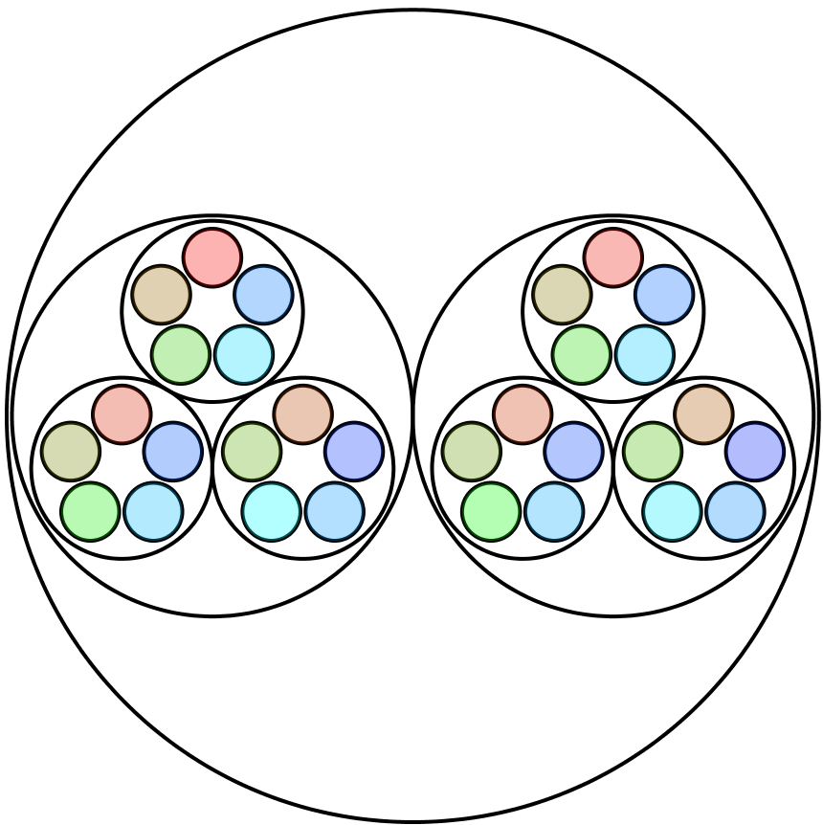
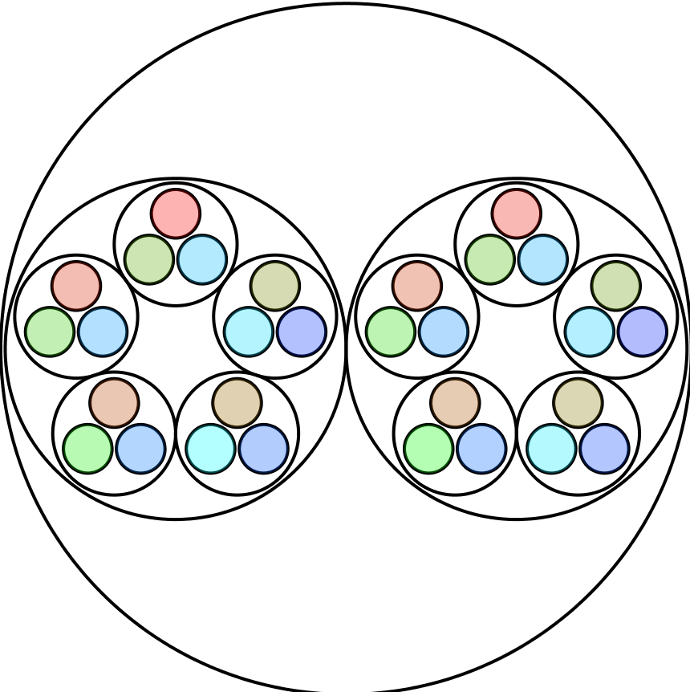
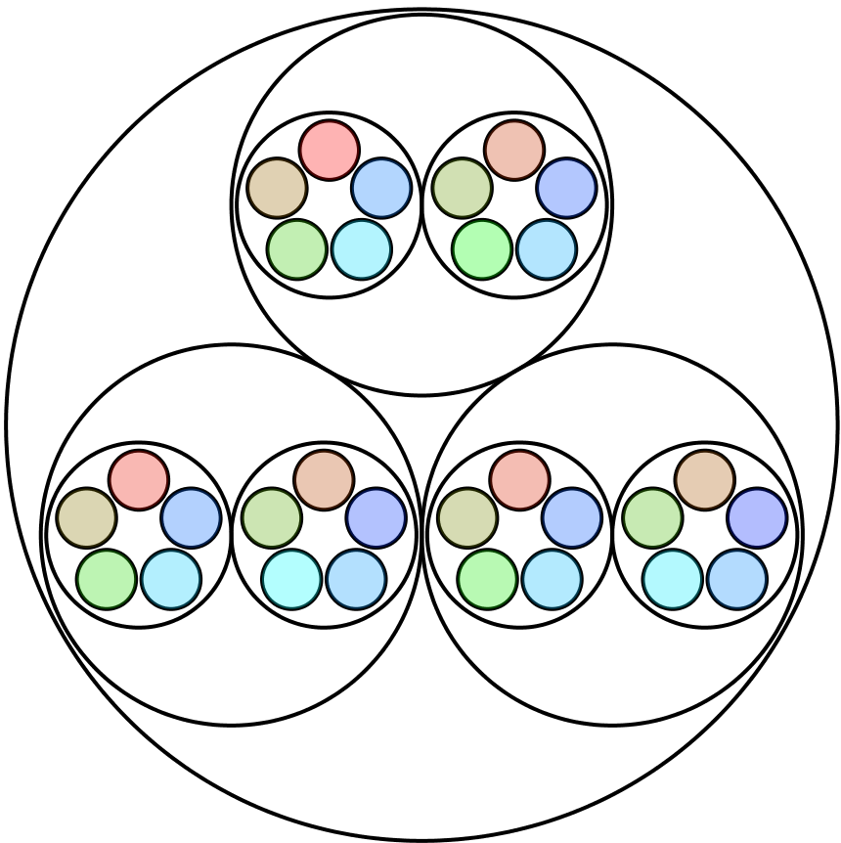
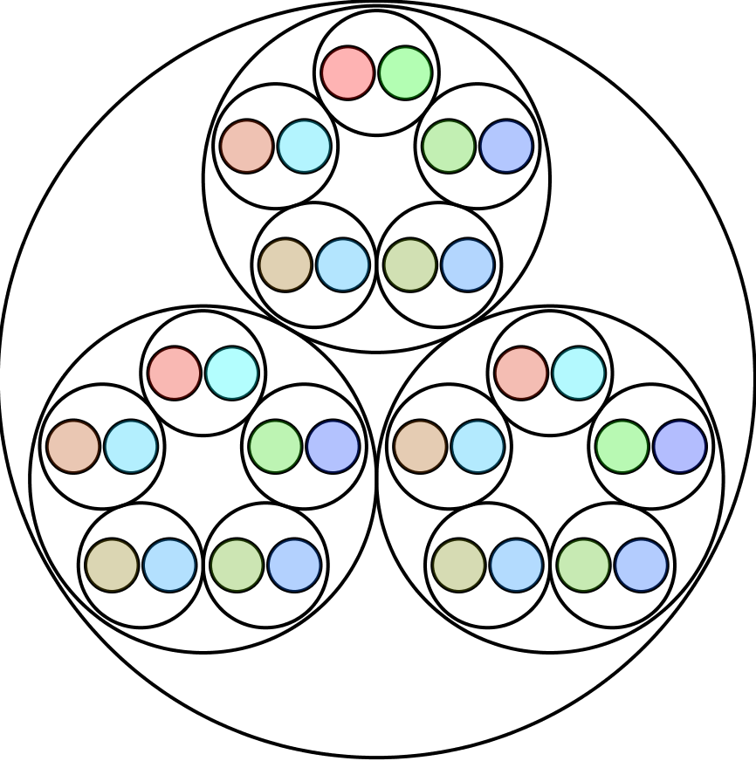
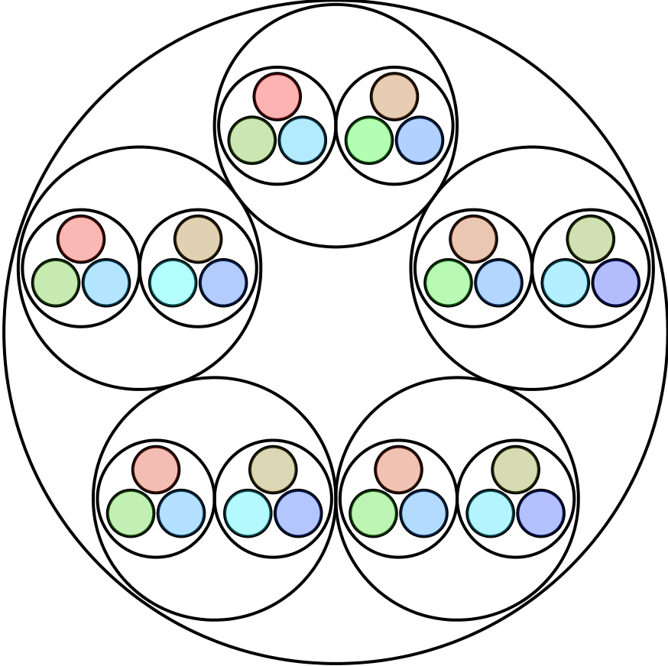
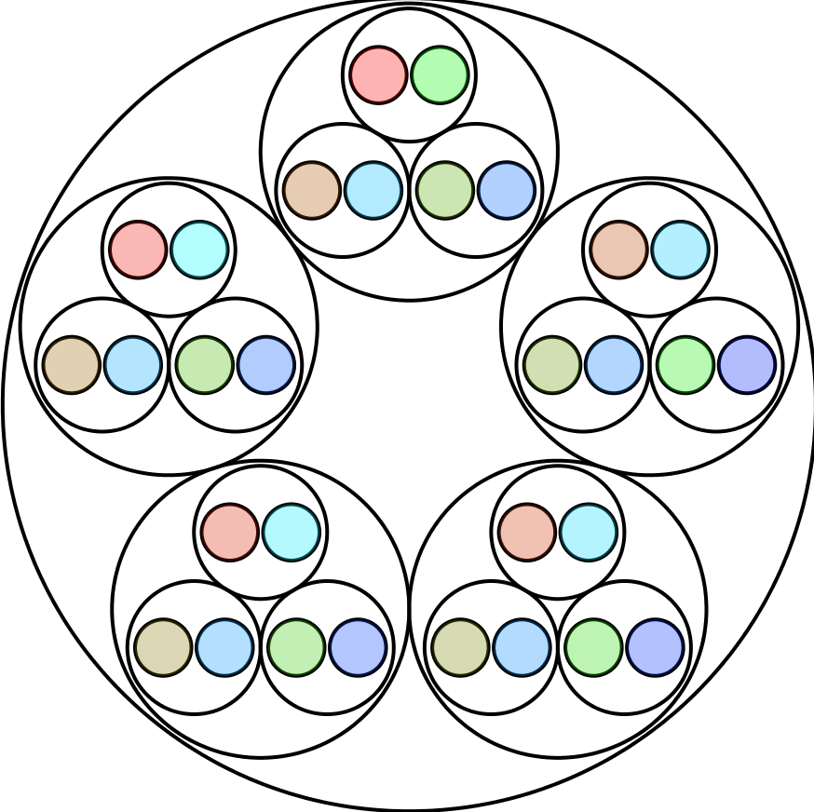
What is the Same & What Different?

Slide 13
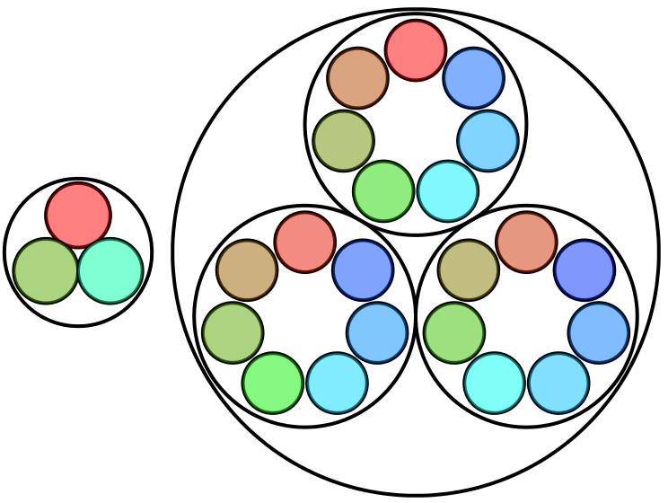
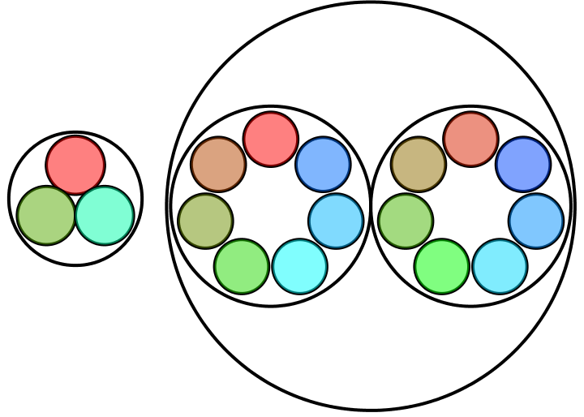
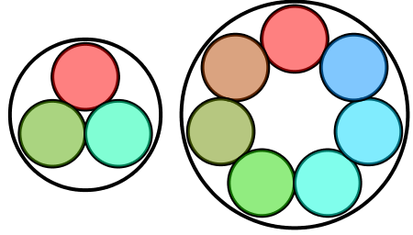

Skip Counting with “Lots of” Numbers
1
2
3
4

Slide 14





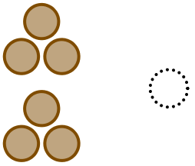
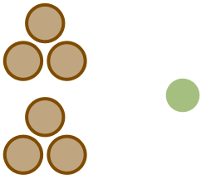
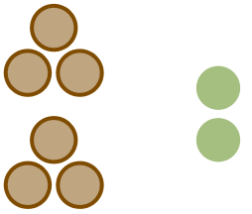

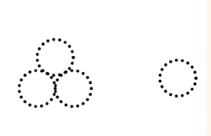
“Lots of” in Base 3

Slide 15
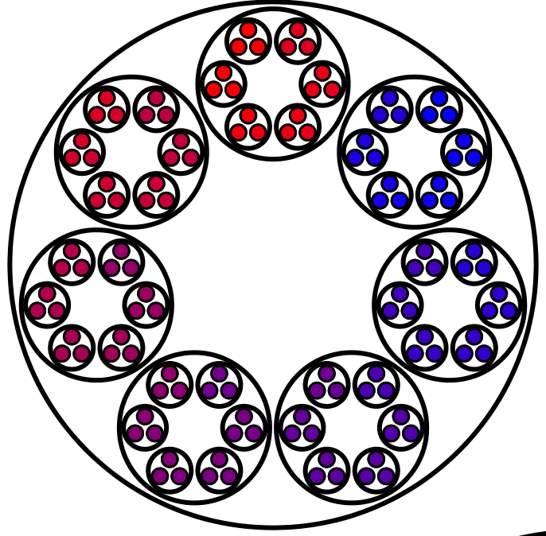
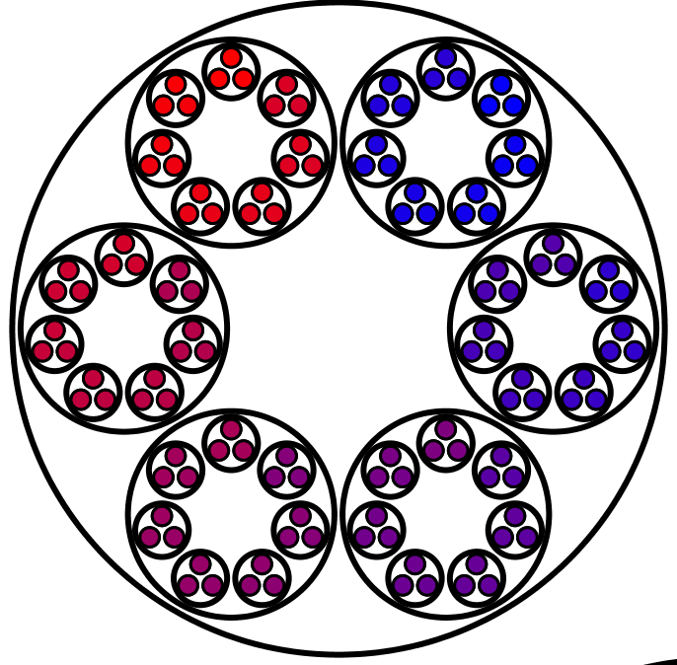
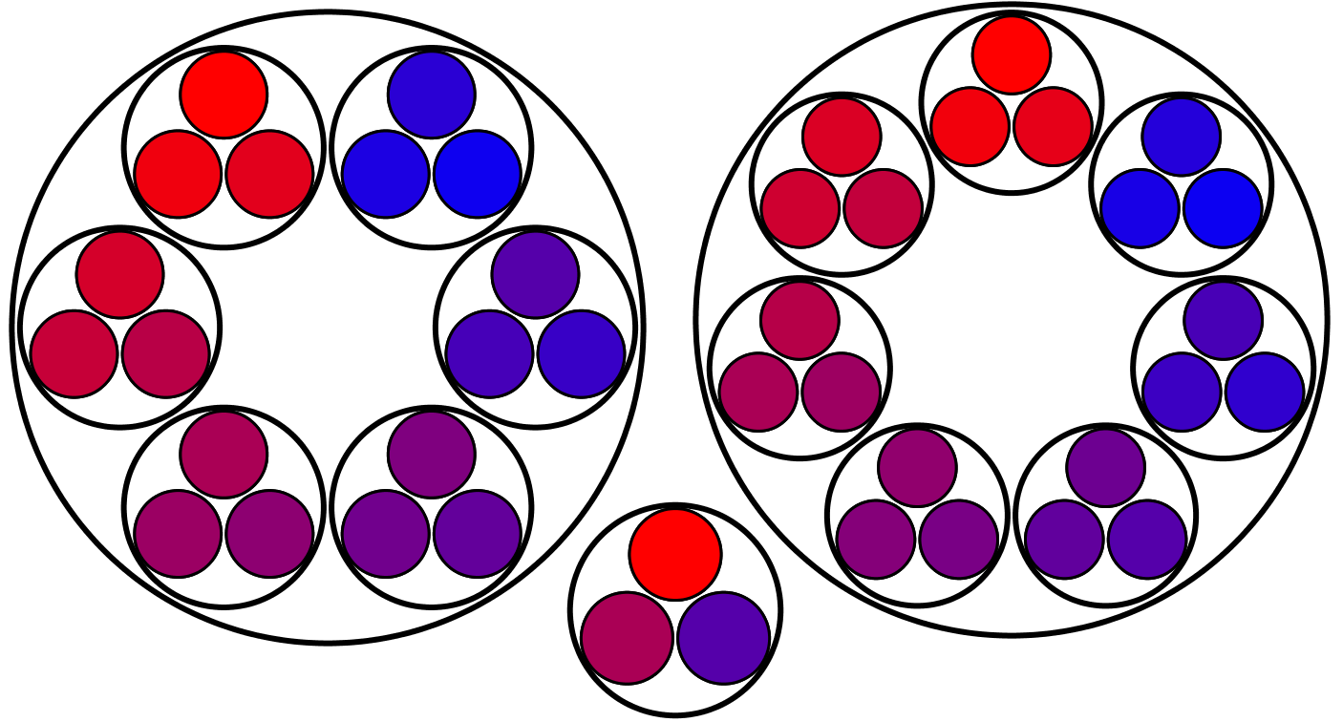
Pairs of “Lots of” Diagrams
Say What You See!
What is the same, and what different?
6 of 7 of 3
126
7 of 6 of 3
126
Given a number N,
for how many pairs of positive numbers is it the LCM?
Doing & Undoing
6 of 3
18
7 of 3
21

Slide 16
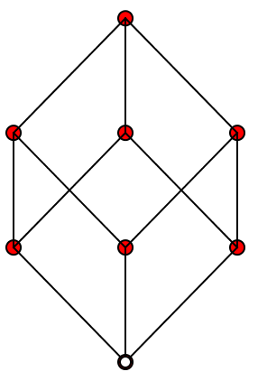
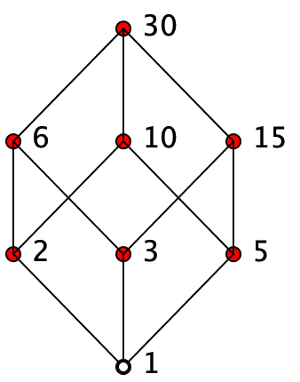
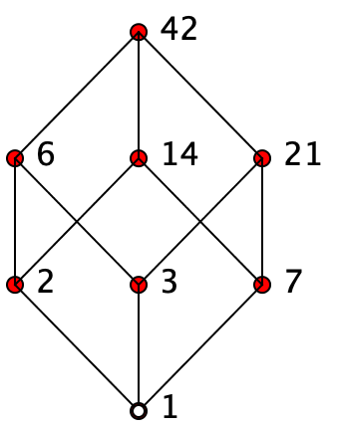
”Lots of” Factors and Divisors
Each red dot is a number;
Two numbers are joined when one is a prime number times the other.
The white dot is the number 1
What numbers could appear at the top?
pqr
pq
qr
pr
p
q
r
1

Slide 17
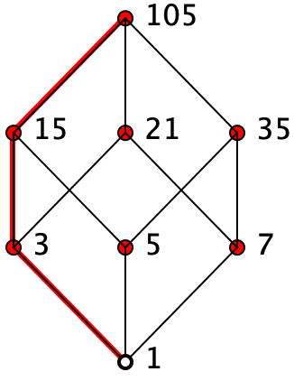
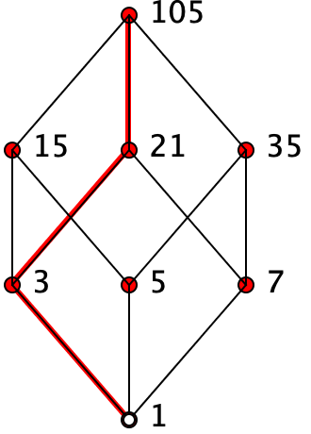
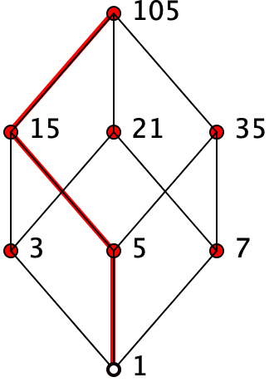
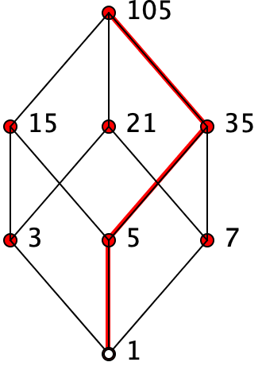
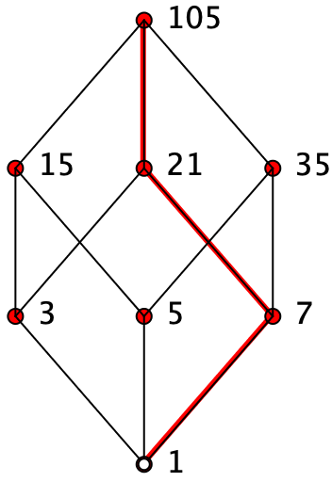
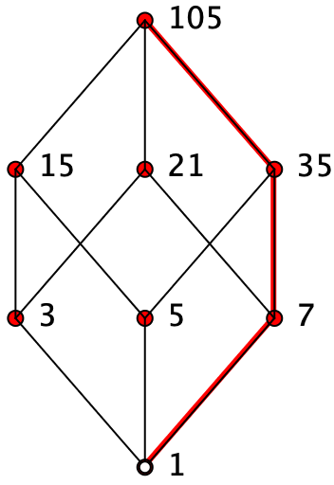
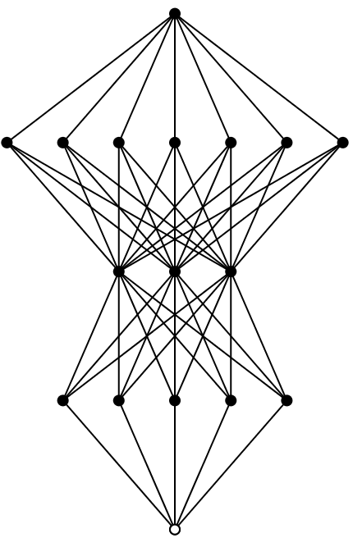
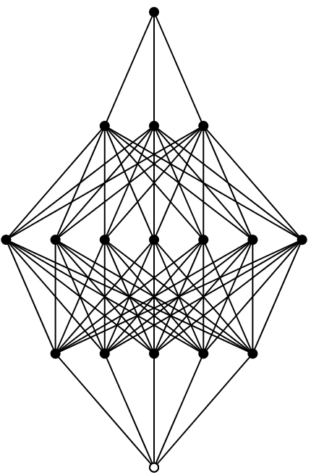
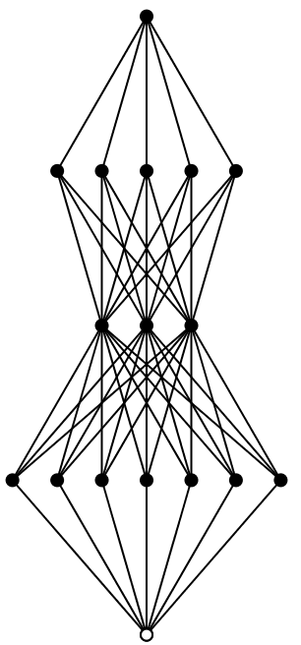
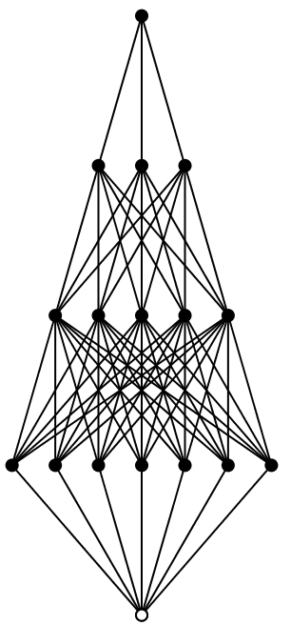
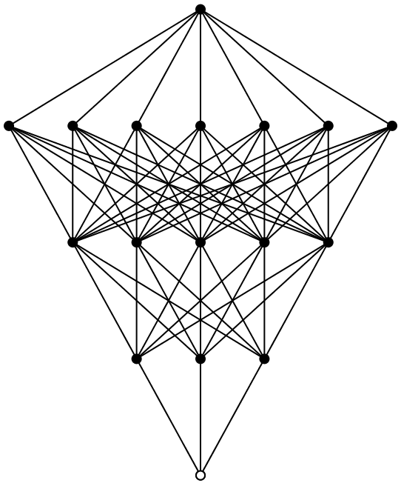
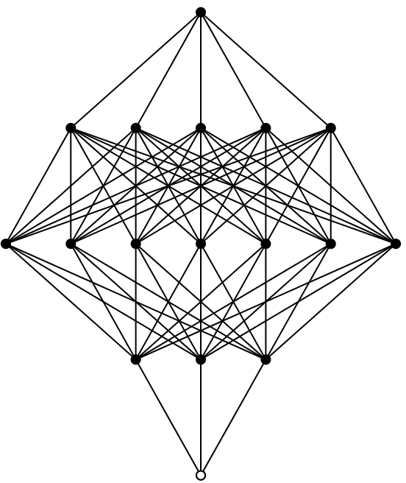
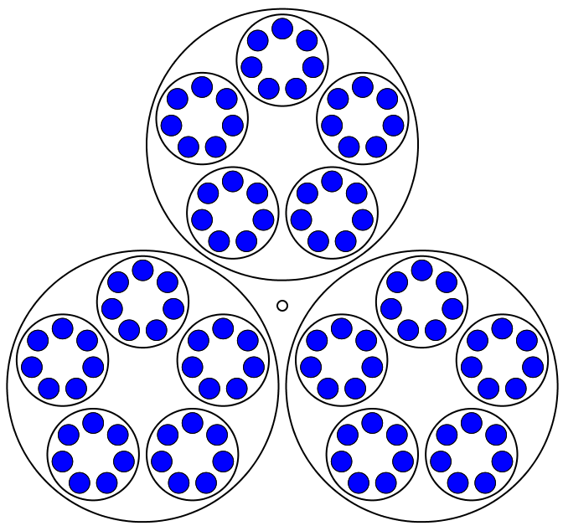
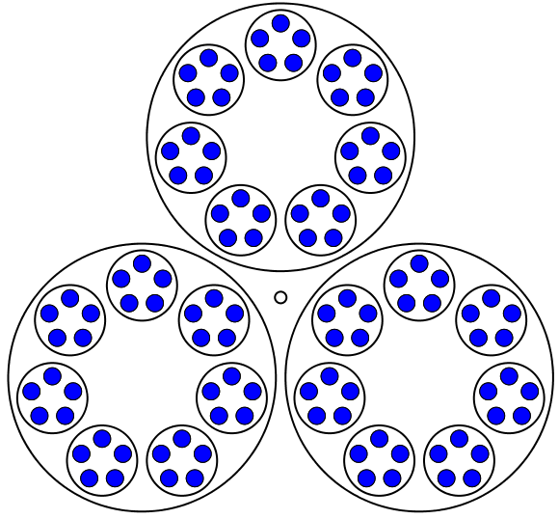
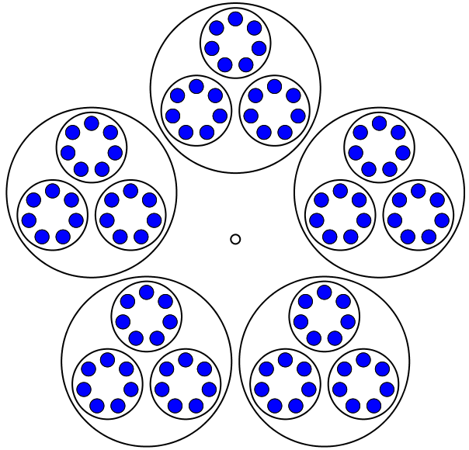
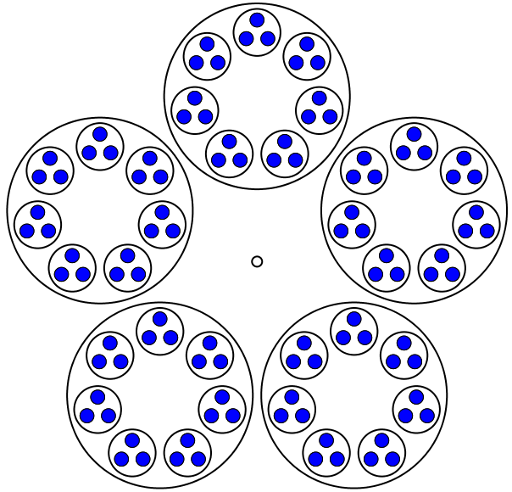
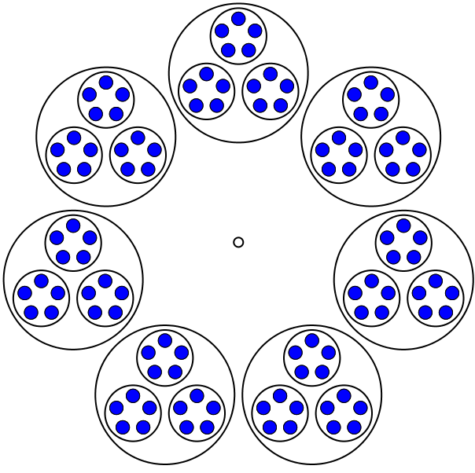
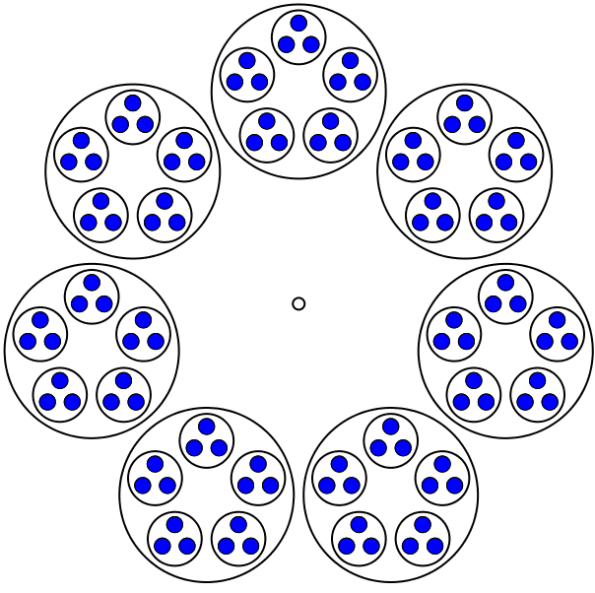
Lattices, Thread Counts, and “Lots of”
What role does 105 play here?

Slide 18
Some Sums
1 + 2 =
3
4 + 5 + 6 =
7 + 8
9 + 10 + 11 + 12
= 13 + 14 + 15
16
+
17 + 18 + 19 + 20
= 21 + 22 + 23 + 24
25
+
26 + 27 + 28 + 29 + 30
= 31 + 32 + 33 + 34 + 35
Generalise
Say What You See
Watch What You Do
Justify

Slide 19
1 + 2 =
1:
3
4 + 5 + 6 =
2:
7 + 8
= 13 + 14 + 15
3:
9 + 10 + 11 + 12
16
+
4:
17 + 18 + 19 + 20
= 21 + 22 + 23 + 24
Generalise
+
26 + 27 + 28 + 29 + 30
= 31 + 32 + 33 + 34 + 35
25
5:
²
+
( + 1)
+…+
²
²
+
( + 2)
( + )
:
²
²
²
²
=
( + + 1)
+
( + +2)
+…+
( + + )
Justify

Slide 20
Say What You See!
Say What You See

Slide 21
Theory
Originally meaning ‘a way of seeing’ … hence ‘perceiving
When articulated, theories describe and label what is attended to:
  Characteristic phenomena
  Details worth discerning
  Relationships worth recognising
  Properties worth perceiving as instantiated
  Permitting reasoning on the basis of properties
Notes:
Theories are collections of distinctions (frameworks) for describing etc.

Slide 22
Roles for Theories
Describing
what is noticed
Illustrating
technical terms/labels/constructs
Explaining
behaviour, actions
Informing
future actions (imminent & distant
Predicting
imminent & distant future
Evaluating
what was noticed
Focusing attention so as to
communicate, analyse, probe, , justify…

Slide 23
Say What You See
Notes:
Can you see boy reading?, boy copying or checking? Girl thinking?

Slide 24
SWYS again

Slide 25
Rationale for Researching Oneself
Whatever someone else says, lived experience is …
  … what is lived and experienced, however misinterpreted
Lived experience is not ‘the truth’, but the starting point for investigating what might be the case ///
  … and there might be multiple interpretations, multiple stories

Slide 26
Classic Influences
Observation is influenced by
  Anchoring: early perceptions
  Availability: familiar but specialised sampling
  Bandwagon: already familiar distinctions
  Belief Bias: plausibility of conclusion justifying reasoning
  Blind Spot Bias: trusting one’s own perceptions
  Clustering: small clusters in large data
  Courtesy Bias: fitting in with social norms
  Endowment: fits with own perceptions
Based in part on Kahnemann
Raconteur raconteur.net/infographics/cognitive-bias

Slide 27
Influence Antidotes
Statistics
  At best these give macro trends
Treating observations as conjectures …
  … to be tested in other people’s experience
  (Discipline of Noticing)
What matters is
  how claims are articulated
  how claims are tested

Slide 28
Questioning
The questions that interest me are of the form
  What is it like to …
  What is it helpful to have come-to-mind (come-to-action) when …
  How can I sensitise or attune myself to notice …
In addition, I find myself constantly working on mathematics myself, in order to keep alive to the ways of thinking that are of particular interest and relevance to teaching and learning.

Slide 29
Topics
Topics I work on include
  The effective use of mental imagery in thinking mathematically,
  the role and nature of attention in mathematics,
  the role of animation and interactive media in mathematics
  how generality is indicated in ancient and modern texts, including e-screens
  promoting mathematical thinking and supporting others who wish to promote it
  task design and classroom interaction

Slide 30
Human Psyche
Enaction–Affect–Cognition
  Behaviour–Emotion–Intellect
  Witness–Will–Attention
Not-Noticing – Noticing – Marking – Recording

Slide 31
Potential Weakness
Self-edit during reporting (Nisbett and Wilson, 1977)
Actions below level of consciousness

Slide 32
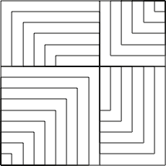
Present or Absent?

Slide 33
Is 51 + 51 = 50 + 52?
How do you know?
What is Fran attending to?
Fran: Like fifty-one plus fifty-one are one hundred and two, but fifty-one, if you subtract fifty, you can add to fifty-one, one from the other, one more, and you get fifty-two.
Teacher-Researcher: Ah, that is interesting. You said that you can take one from here [pointing to the first fifty-one] and add it to this one [pointing to the second fifty-one]. Isn’t it? Is that what you said?
Fran: And you get there, one hundred… fifty plus fifty-two.
How is her attention shifting?
Babbling or Gargling?
What is being attended to?
Listening-to or
listening-for?
Teaching Action:
selecting/editing
What is Fran attending to?
Notes:
Mason, J. (2012). You Can Lead a Horse to Water…: Issues in Deepening Learning Through Deepening Teaching. In S. Hegedus & J. Roschelle (Eds.) Democratizing Access to Important Mathematics through Dynamic Representations: Contributions and Visions from the SimCalc Research Program. Berlin: Springer-Verlag.
Nicolina Malara; Brent Davis

Slide 34
Conjecture
A sensible place to begin analysis of qualitative data is to ask yourself:
  What would I have to be attending to in order to say or do what I hear being said or see being done?
  What would I be overlooking?
  How would I be attending to it?
  What might I be overlooking when I look at this data?

Slide 35

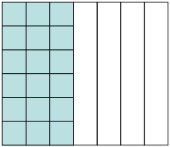
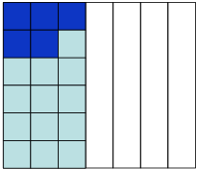
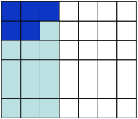
Semantic & Syntactic-Babble
(1073) Syria: Nikol divided her square into seven equal parts and took the three. Then she coloured with a dark blue marker the five sixths of the area she coloured first. She divided into six parts and took the five.
(1074) T: But which five did Nikol take?
(1075) Syria: She took the five.
(1076) Xenios: Please sir now I got it…
(1077) Jim: This is what I wanted to tell you sir.
(1078) Syria: Ah, she did wrong. She should have taken five pieces.
(1079) T: What do you mean by five pieces?
(1080) Syria: Five rows.
What is being attended to?
Notes:
Students are working on finding 5/6 of 3/7.
(1072) T: Let’s see what Nikol did. Nikol would you like to explain us what you did? But no, let’s hear Syria explain to us what Nikol did.

Slide 36
(1081) T: So class do you all see here [He points to Figure]? Nikol took five small squares. And what is her answer?
(1082) Syria: 5/42.
(1083) T: Correct, it is 5/42 because she took five small squares from a total of 42. Do you agree?
(1084) Class: No.
The case of Syria is a representative example of a pupil whose awareness of the meaning underlying multiplication is both “in action” and “in articulation”

Slide 37
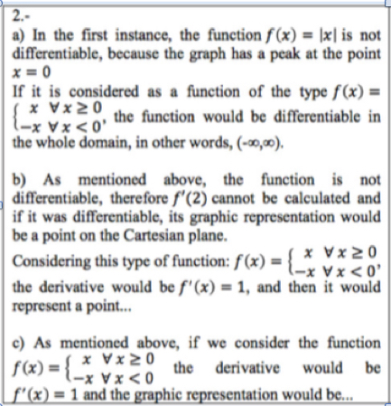
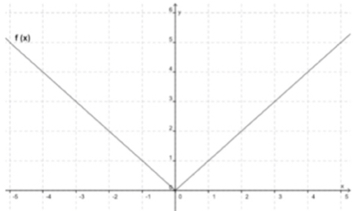
Luis Pino-Fan et al (2017) PNA (2).
Examine the function
f(x)=|x| and its graph
For what values of x is f(x) differentiable?
If possible, calculate f’(2) and draw a graph representation of your solution. If not possible explain why
If possible, calculate f’(0) and draw graph representation of your solution. If not possible explain why

Slide 38
Assumptions about Questioning
Do you assume that people’s choices reflect what is the case for them?
Do you assume that people’s choices are well considered?

Slide 39
Attention
What is being attended to (focused on)?
How is it being attended to?
  Holding Wholes
  Discerning Details
  Recognising Relationships
  Perceiving Properties as being instantiated
  Reasoning on the basis of agreed properties
Focus on particular
Focus on generality
being instantiated

Slide 40
Precision Conjecture
The more precisely the data is specified,
the more we learn about
the researcher’s sensitivities to notice
The universe is a mirror
in which we can contemplate
only
what we have learned
to know about ourselves
(Italo Calvino)

Slide 41
Accounts-of & Accounting-for
I cannot evaluate your analysis
if I cannot distinguish it
from the data itself
Accounts-of: brief-but-vivid accounts
Reduce-remove theorising, judgement,
excuses, evaluations, justifications

Slide 42
Reporting Data
Accounting For
Account of
“They couldn’t …”
“They can’t”
“They didn’t display
evidence of …”
“They don’t display
evidence of …”
“I didn’t detect
evidence of …”
“I don’t detect
evidence of …”

Slide 43
Essence of Discipline of Noticing
Systematic Reflection
  Past (accounts-of not accounting-for)
Preparing & Noticing
  Actions and situations (educating awareness)
  For Future & Present
Recognising Choices
  Could-have & Could-be
  (not should-have or shoul- be)
Validating
  for Self & with Others

Slide 44
Systematic Reflection
Keeping
Accounts
Seeking
Threads
Recognising Choices
Distinguishing
Choices
Accumulating
Alternatives
Preparing & Noticing
Identifying & labelling
Imagining
Possibilities
Noticing
Possibilities
Validating with Others
Describing
Moments
Refining
Exercises

Slide 45
Specting
Intraspective
Extraspective
Introspective
Interspective

Slide 46
What are the significant products of research?
Transformations of the ‘being’ of the researchers
Increased sensitivity to notice what was previously not noticed
Refined vocabulary for discussing, discerning and analysing
Awareness which informs future choices of action
  Self
  Others

Slide 47
Interwoven Worlds
Own
world of experience
Colleague's
world of experience
Trying
Seeking
resonance
Reflecting
Recognising
Possibilities
with others
Preparing
Expressing
World of observations
& theories

Slide 48
Protases
I cannot change others;
I can work at changing myself
To express is to over stress
One thing we do not seem to learn from experience,
is that we do not often learn from experience alone

Slide 49
Stances
Deficiency
  What learners cannot (do not) do at different ages and stages
  What teachers do not know, do, or appreciate about different topics and pedagogical strategies
Proficiency
  What learners & teachers & policy makers do already
  Not doing for learners & teachers what they can already do for themselves
Efficiency & Effectiveness
  Seeking efficient and effective ways of enhancing, extending, and enriching
    Peoples’ sensitivities to notice what matters
    Peoples’ powers,
    Peoples’ appreciation of mathematical themes,
    Peoples’ experience of mathematical thinking
    Peoples’ internalisation of effective actions

Slide 50
My Background
BSc (Toronto) Mathematics, Physics & Chemistry
MSc (Toronto) Mathematics
PhD (Madison Wisconsin) Combinatorial Geometry
Started teaching age 15
40 years at the Open University writing distance learning courses in mathematics, then in mathematics education

Slide 51
Context of Open University
We wrote materials which were sent to students
Students studied at home
Access to
  tutorials (reasonably local)
  Computing (first distributed computing network in the UK)
  Home kits such as graphs on acetate or fold-up polyhedral
  Regular TV programmes
  Regular radio programmes, became tape-cassette
  One week Summer School
Now on line Moodle

Slide 52
Context Advantages
Context Disadvantages
Time to prepare and modify materials
Team work; critical comments
No immediate demands from students
Not as much time as you would like
Comments often very critical rather than supportive
No on-campus students to ‘research’

Slide 53
My Context
Discovered Let Us Teaching Guessing (George Pólya film) in 1968: my teaching changed over night
  It released in me how my secondary teacher ‘dealt’ with me!
Spent 9 months with a mathematician-philosopher-mystic (J. G. Bennett)
He reinforced and expanded my sense that the way to teach is to engage learners in challenging activity, and then to stimulate reflection on what actions were successful and what actions not so successful

Slide 54
Zoltan Dienes (1960s)
Dynamic Principle: preliminary, structured and practice games must be provided as necessary experiences from which mathematical concepts can eventually be built, so long as each game is introduced at an appropriate time… Mental games can gradually be introduced to give. Taste of that most fascinating of all games, mathematical research.
Constructivity Principle: In the structuring of games, construction should always precede analysis …
Mathematical Variability Principle: Concepts involving variables should be learnt by experiences involving the largest possible number of variables.
Perceptual Variability Principle: To allow as much scope as possible for individual variations in concept-formation, as well as tom induce children to gather the mathematical essence of abstraction, the same conceptual construction should be presented in the form of as many perceptual equivalents as possible.

Slide 55
Follow Up
John.mason@open.ac.uk
PMTheta.com
Researching Your Own Practice using the Discipline of Noticing
Researching from the Inside

