Slide 1


Bringing Enquiry into
My Classroom
Part 2
PLATINUM
Webinar 2
May 2021
in the time of Corona

Slide 2
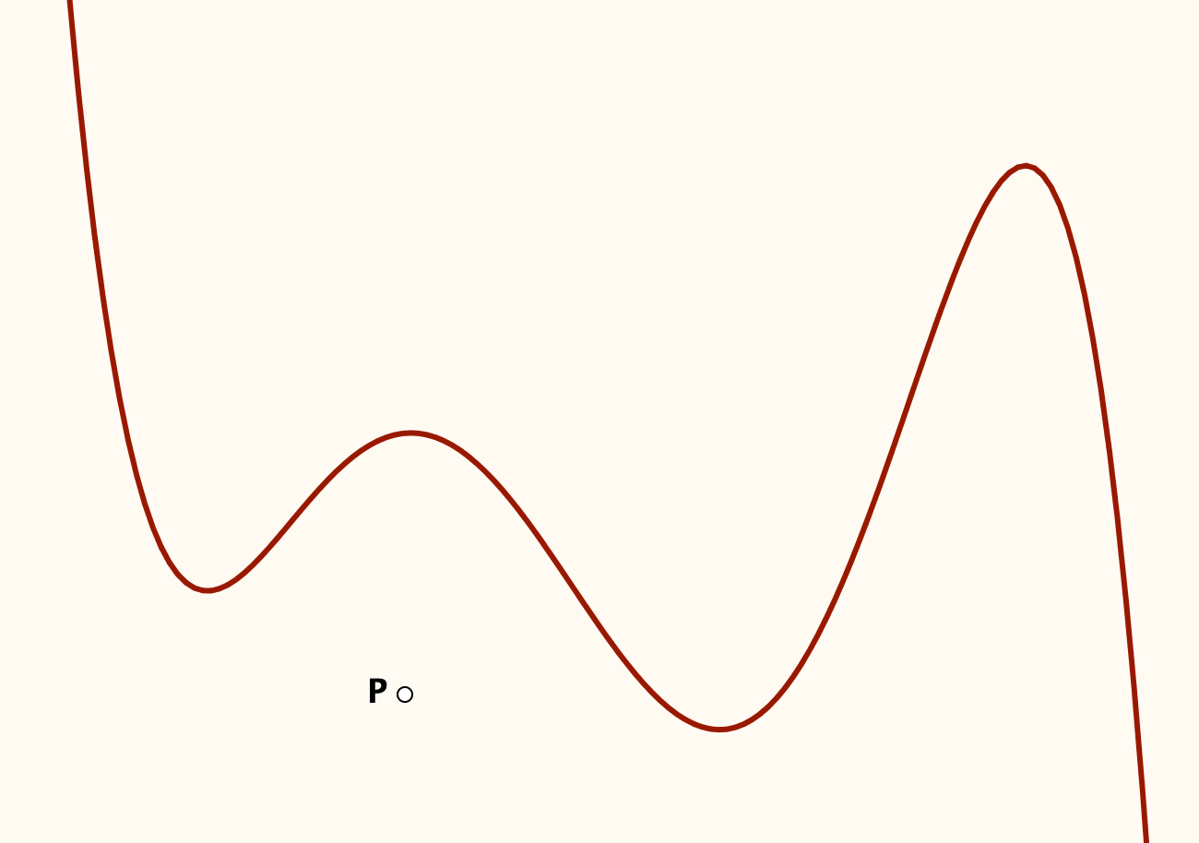
Tangent Power
The Tangent Power of a point P with respect to a function f is the number of tangents to f that pass through P.
What is the tangent power of P with respect to the quintic?

Slide 3
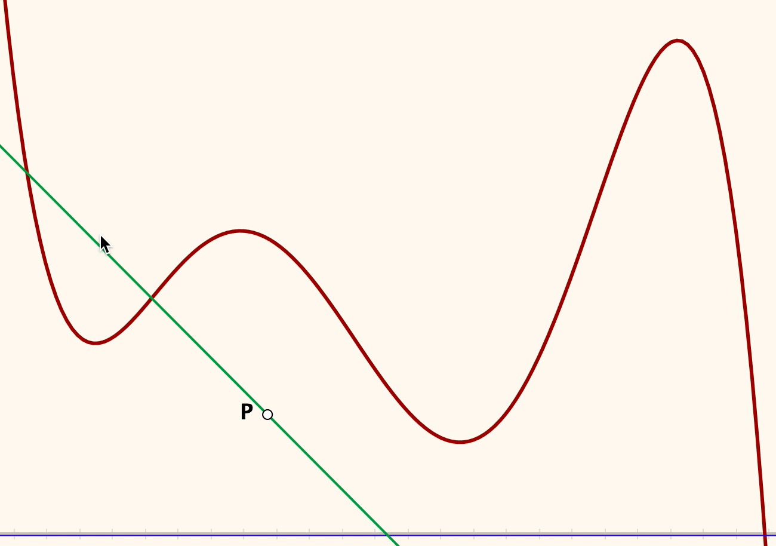
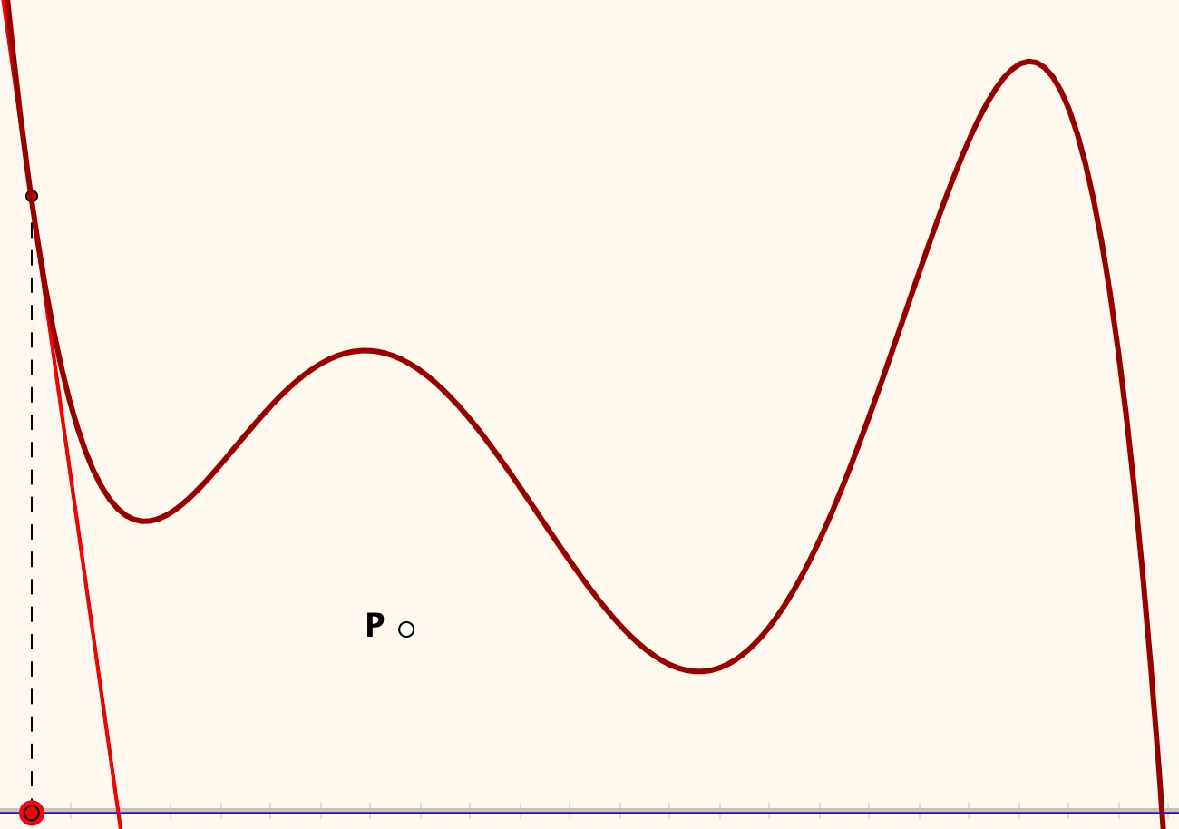
Choices
How did you imagine doing the counting?
Poll Questions
Question 1
A: I first thought of rotating a line about P (left animation)
B: I first thought of running a tangent along the curve (right animation)
Question 2
A: Yes, I actually counted the tangent power of P
B: No, I did not actually find the tangent power of P
Question 3
A: I used a physical object to help me
B: I imagined a line to make the count

Slide 4
Tangent Powers
What are the possible tangent powers of points with respect to this quintic?

Slide 5
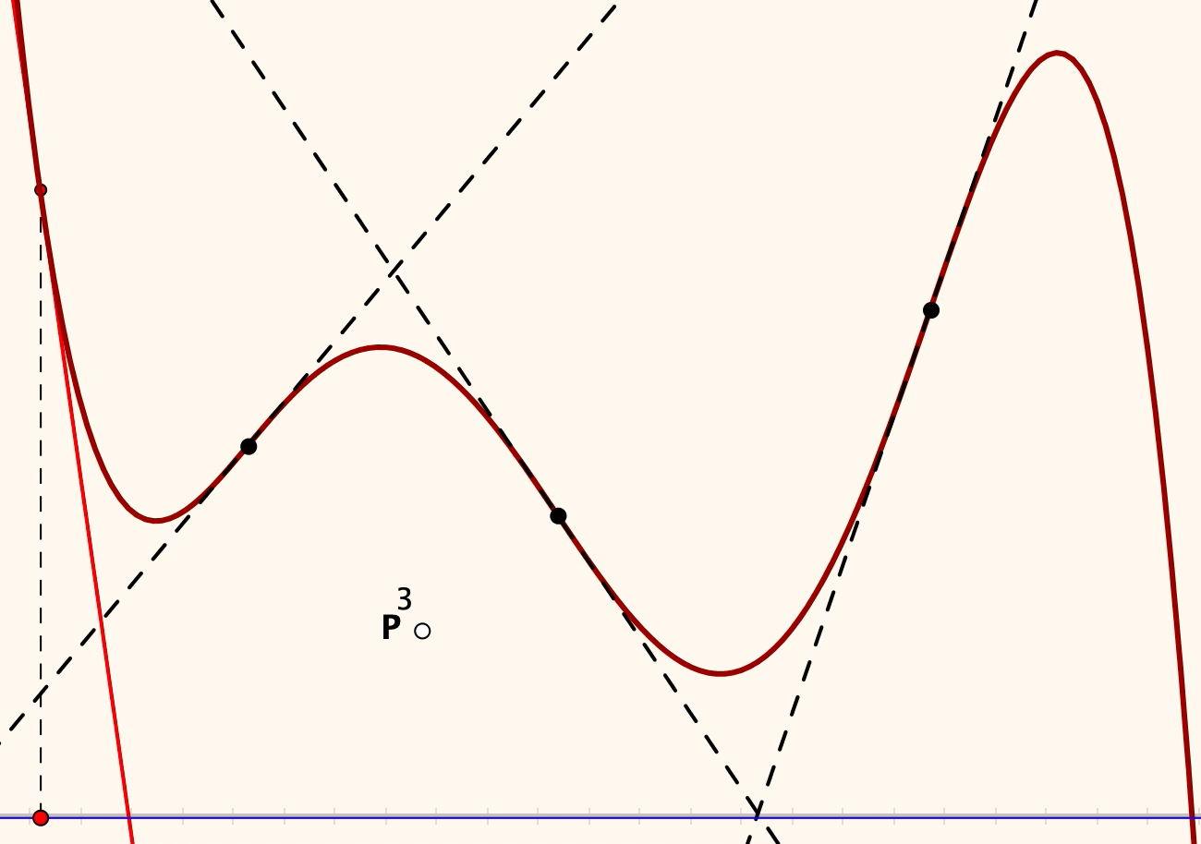
Regions
Doing it physically provides an enactive sense of inflection points
Combining it with Taylor Series raises more questions

Slide 6
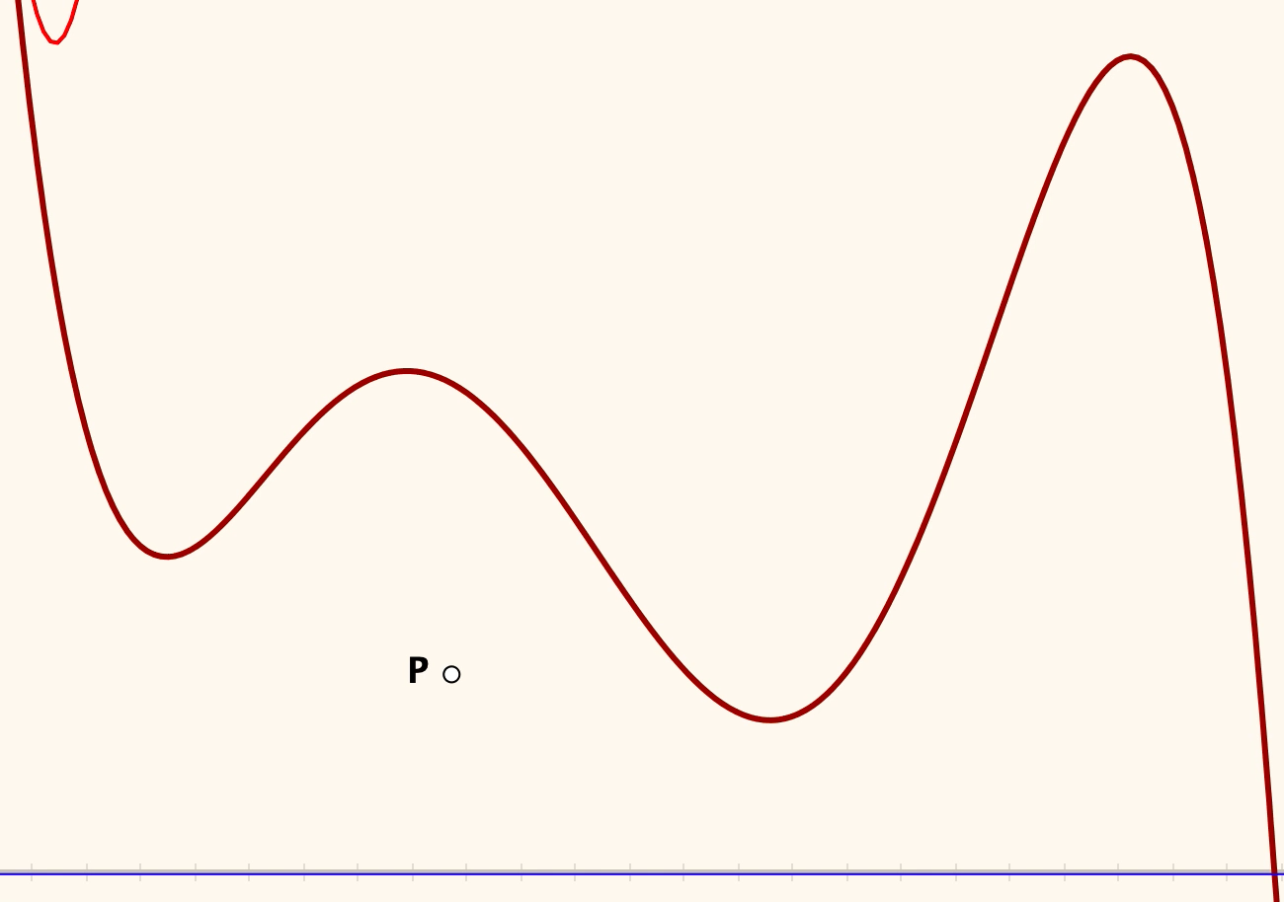
Taylor Powers
Thinking of a tangent
as a first degree Taylor approximation leads to a more general phenomenon

Slide 7
Reflection
What struck you mathematically?
What struck you pedagogically?
Tell yourself a ‘story’ about what was going on in the last animation. (personal narrative)

Slide 8
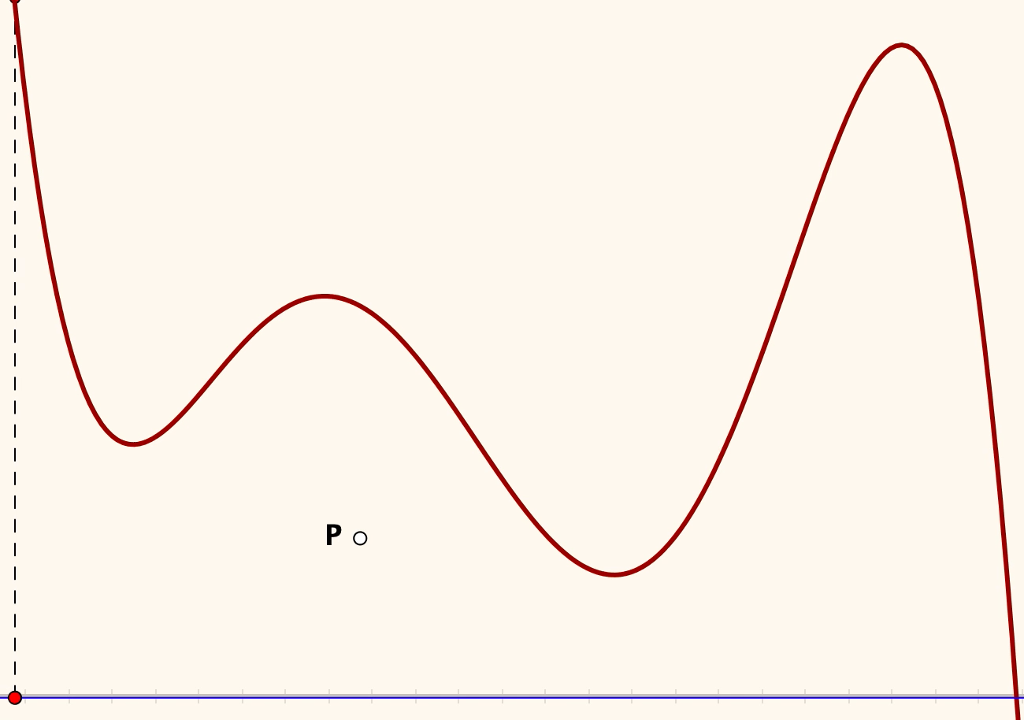
0 Taylor Power
What would the 0 Taylor power of P be?

Slide 9
Break for 5 minutes

