Slide 1
(Some) Psychology of Learning & Doing Mathematics
The Open University
Maths Dept
Promoting Mathematical Thinking
University of Oxford
Dept of Education
Oxford N1A §3 2019
Notes:
Think back to previous session:
were the relationships we worked on necessary and extant or were they created by us?

Slide 2
Notes:
Didactic Contract (Brousseau): wouldn’t ask unless they were constant! Aldo Didactic Tension
Didactic Transposition (fails here)

Slide 4
Psychology: study of the psyche
Cognition (intellect)
Enaction (behaviour)
Affect (emotion including disposition)
Attention
Will
Witness
Sociological Dimension
How these are influenced by the social
Notes:
Cutural influences on practices, beliefs, dispositions
Expectations (personal, peer, significant others)

Slide 5
What does it mean to ‘understand’ in mathematics?
To carry out procedures unaided
By templating
By re-constructing
To have appropriate procedures and concepts come to ‘mind’ or to ‘action’
To explain adequately to someone
Own narrative (self-explanation)
To a Novice
To a Peer/Colleague
To an Expert
To modify in order to meet new circumstances
To be familiar with a viable model (structural relationships treated as properties)
To understand is "to prove formally what is seen intuitively, and to see intuitively what is proved formally” (p. 72)
Polya, G (1957) How to solve it
Understand(?) or Comprehend & Appreciate?
Notes:
Recall the coke can balancing act … I appealed to ‘continuity’ to justify the need for the CofG to move from the middle to the lowest point to the middle again without a sudden jump. What was needed to ‘understand’ or appreciate ‘continuity’ in that context?

Slide 6
Concept Image
“ … all the cognitive structure in the individual's mind that is associated with a given concept” (Tall & Vinner 1981)
the total cognitive structure that is associated with the concept, which includes all the mental pictures and associated properties and processes. It is built up over the years through experiences of all kinds, changing as the individual meets new stimuli and matures.
Concept Image ≠ Concept Definition
Notes:
It is quite hard to say what you mean by ‘understanding’ something.
Number; angle; function; continuity; group; ring; …

Slide 7
Concept Images: examples
What is
A fraction
Angle between two lines
Differentiability
Tangent to a curve
|x|

Slide 8
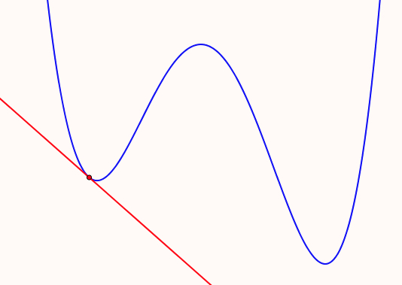
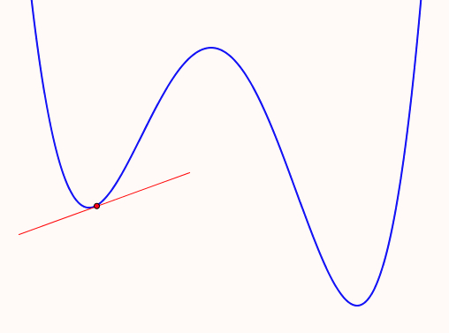
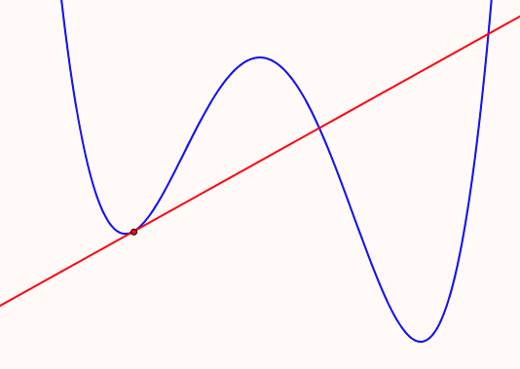
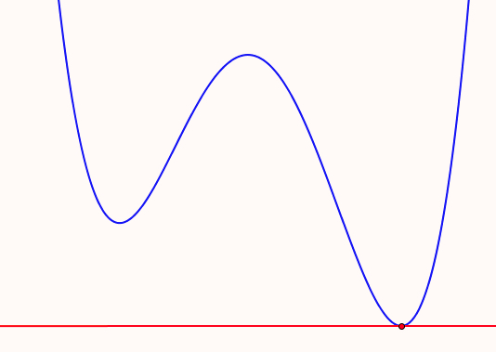
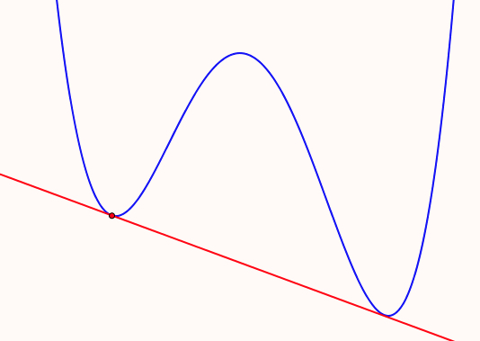
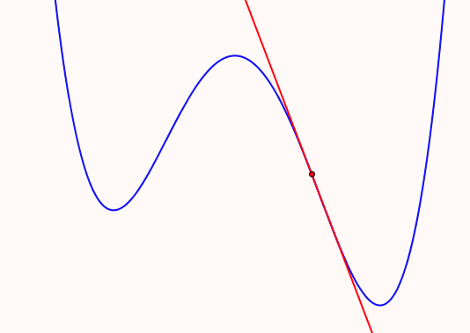
Tangents
Which of the following matches your immediate concept image of tangent to a curve?
What misapprehensions might be induced?

Slide 9
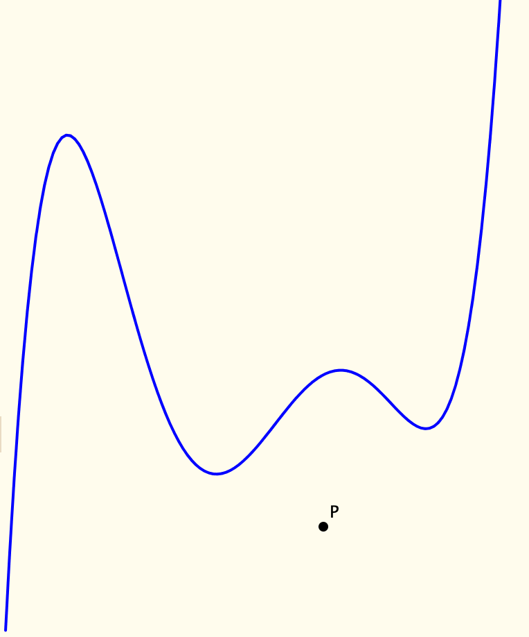
Tangent Power
The tangent power of a point P wrt a function f is the number of tangents to f through P

Slide 10
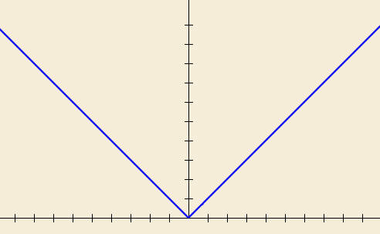
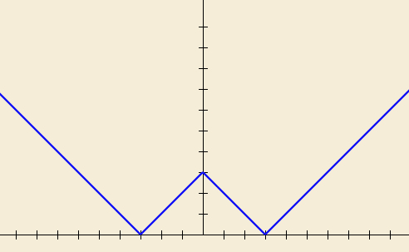
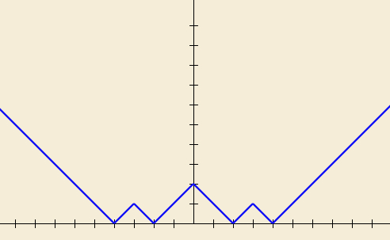
ZigZags
What does it mean to comprehend & appreciate x –> |x|?
Imagine the graph of f₁(x) = |x|
Imagine the graph of f₂(x) = |f₁(x) – 3|
Imagine the graph of f₃(x) = |f₂(x) – 1|
Constructing own examples
Enriching your example space
Notes:
What happens in the long run.
What about other sequences?

Slide 11
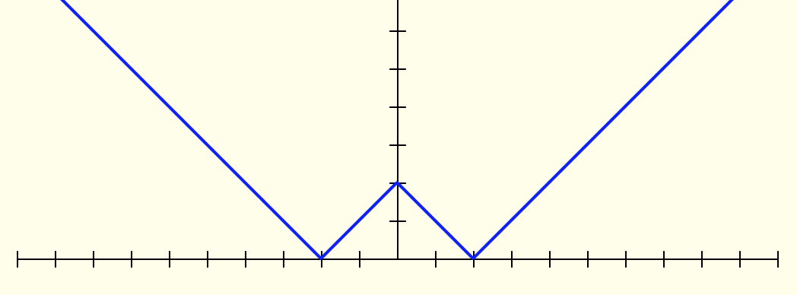
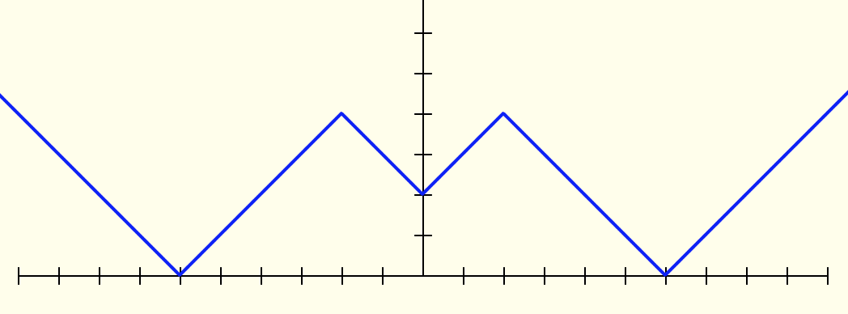
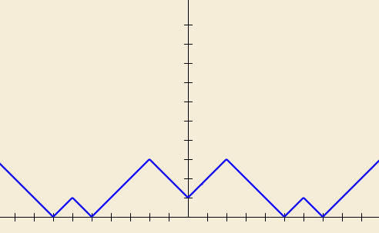
Undoing Zig Zags
What is the function?
||||x| – 2| – 4| – 1|
Notes:
Doing & Undoing:
An key mathematical theme, an important source of questions
||||x| – 2| – 4 –1|

Slide 12
More |x|
What does the graph of x|x| look like?
What other specifications can you construct for it?
What variations might be worth considering?

Slide 13
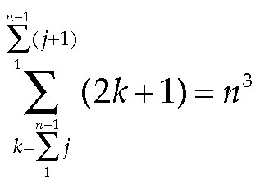
Some Sums
Gazing at the Whole?
Discerning Details?
Recognising Relationships?
Perceiving Properties?
Reasoning on the basis of Properties?

Slide 14
Onion Model of Growth of Understanding
Folding Back
Image
Property
making
Observing
Inventising
Primitive
Image
noticing
having
Structuring
Formal
ising
Susan Pirie & Tom Kieren
Notes:
Maths Education is mainly about making distinctions, then associating these with pedagogic or mathematical actions

Slide 15
Templating & Re-Constructing
Instrumental & Relational Understanding (Skemp 1971)
Following a Template & Reconstructing to Meet Circumstances
Procedural & Conceptual
Formal & Intuitive insight/comprehension
Trained Behaviour & Educated Awareness

Slide 16
Templating & Reconstruction: examples
Reverse Number Notation
What can be said about f if
Notes:
Challenging automatised procedures
Turning a ‘doing’ into an ‘undoing’

Slide 17
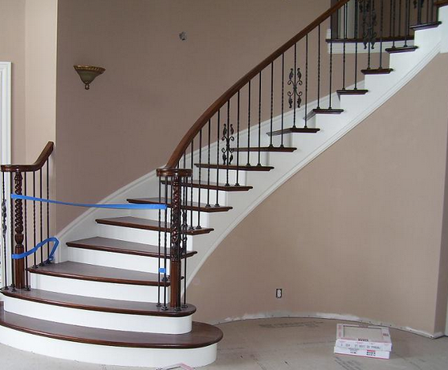
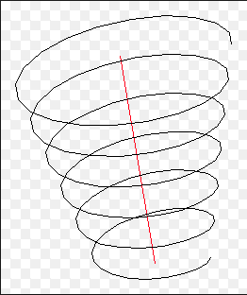
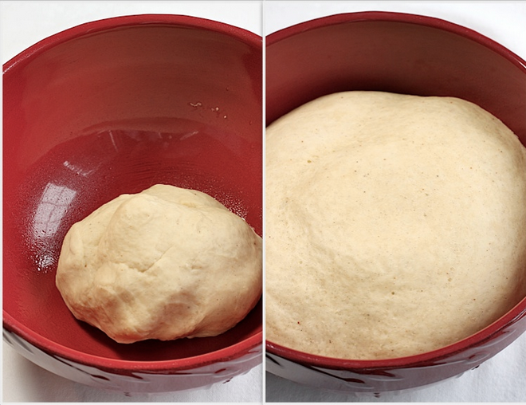
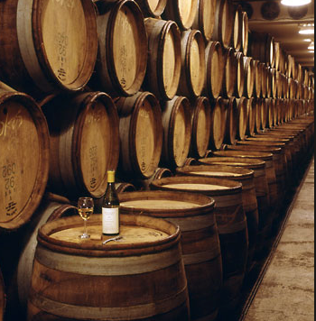
Conceptions of Learning
Staircase
Spiral
Maturation

Slide 18
Action & Activity
Goals
Teacher/Tutor
Resources
Tasks
Student
Maths
milieu
Initial State
Teaching takes place IN time; learning takes place OVER time
Every act of a teacher is an intervention in students’ attention
Notes:
Brousseau & Didactic Engineering & Didactic Contract
Andrews
Bennett & Mason

Slide 19
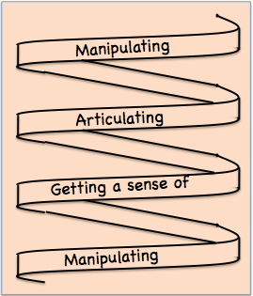
Development
Manipulating familiar confidence inspiring objects (specialising, particularising)
In order to get a sense of underlying structural relationships
Bringing this experience to articulation, which over time, becomes more succinct and useable (manipulable)
(modelling, axiomatising, justifying, proving …)
Notes:
Stinulated by Bruner but rephrased to try to capture experience and provide a practical framework for teaching

Slide 20
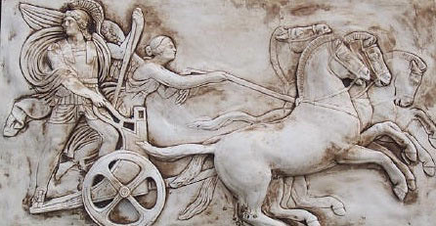
Partial Structure of the Psyche
Awareness (cognition)
Imagery
Will
Emotions (affect)
Body (enaction)
Habits Practices
Notes:
From the Upanishad; reflected in modern psychology

Slide 21
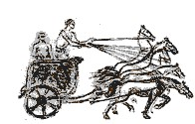
Structure of a Topic
Language Patterns & prior Skills
Imagery/Sense-of/Awareness; Connections
Root Questions
predispositions
Different Contexts in which likely to arise; dispositions
Standard Confusions & Obstacles
Techniques & Incantations
Emotion
Awareness
Behaviour
Only Emotion is Harnessable
Only Awareness is Educable
Only Behaviour is Trainable
Notes:
SoaT is NOT a checklist;
it is a source of inspiration when ideas dry up;
it is a reminder of dimensions of significance to draw upon.

Slide 22
Coming to Know in Mathematics
Observing
What strikes us (disturbance revealing expectation )
Probing and elucidating underlying structure (Modelling, Axiomatising, Proving)

Slide 23
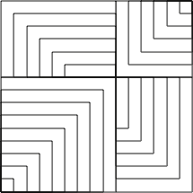
Present or Absent?

Slide 24
Attention in Mathematics
Holding Wholes (gazing)
Discerning Details
Recognising Relationships (in the situation)
Perceiving Properties
Reasoning on the basis of agreed properties

Slide 25
Worlds of Experience
Inner World of imagery
World of Symbols
Material World
Confidently manipulable
Imaginable
Articulable
Enactive
Iconic
Symbolic
(Bruner)
Notes:
Bruner

Slide 26
Experiential Psychology
Reframing the subject & the object
No such thing as an event
only the stories told (narratives)
Data is own experience
Seeking resonance with past; seeking to inform acts in future
Negotiating ‘taken as shared’ with others (cf Reasoning …)
Product is heightened sensitivity to notice and to act
Educating awareness(es)
Centred around ‘initiating acts’
Consciousness is a retrospective narrative
Participating in choice is ‘freedom’
“I” is a linguistic practice
Misleads us into unhelpful assumptions
Multiple selves; energy transformers

Slide 27
Summary
Concept Image & Concept Definition
Templating & Reconstructing
Action & Activity
Awareness (ability to act) – Emotion – Behaviour
Only awareness is educable
Only behaviour is trainable
Only emotion is harnessable
Structure of a Topic
Onion model of coming to understand
Manipulating – Getting-a-sense-of – Articulating
Enactive – Iconic – Symbolic modes or worlds
Attention:
Gazing (holding wholes) – Discerning Details
Recognising Relationships – Perceiving Properties
Reasoning on the basis of agreed properties

