Slide 1


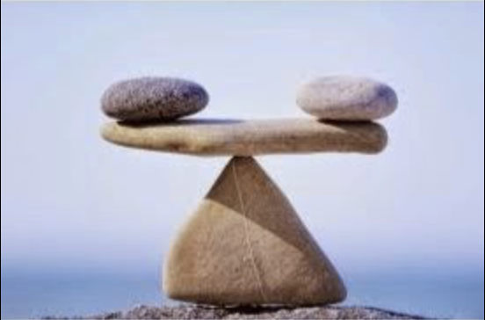
Balance in Mathematics
John Mason
Maths Mastery
Feb 2020

Slide 2
Throat Clearing
Everything said here today is a conjecture
  It must be tested in your experience
What matters most is what you notice happening for you as you engage with the tasks
  How might you alter the task to use with your learners?
  What pedagogic actions might you initiate?

Slide 3
Prelude
Has anyone here used a pair of scissors, or a wheel barrow, or a hammer?
Has anyone here ever picked up a tray with several things on it, and held it up in one hand?
Has anyone here used the image of a ‘balance’ when simplifying or solving equations?

Slide 4
Plan
My plan is to indicate how the notion of balance is fundamental to mathematical thinking, at all levels.
Start with some simple reasoning
  See how it can become more complex as learners become more sophisticated
Magic Square Reasoning
  Leading to algebraic reasoning about equations
Building on and developing intuitions about
the Centre of Mass
  Leads to the principle of moments
Single Fulcrum balance beams
Double Fulcra balance beams
Complex Fulcra

Slide 5
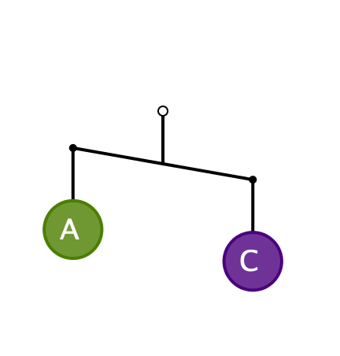
First Encounter
What can you say about the masses A and C?
  It is meant to be a
  2-dimensional picture,
  not 3-dimensional!

Slide 6
Pedagogic Issue
The diagram is WRONG, physically!
Is it appropriate to use misleading or wrong ideas at one stage, so that they have to be corrected later?
  “Multiplication makes bigger”
  “to multiply by 10 put a zero at the end”
  …

Slide 7

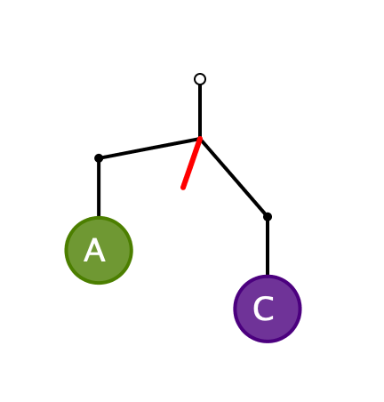
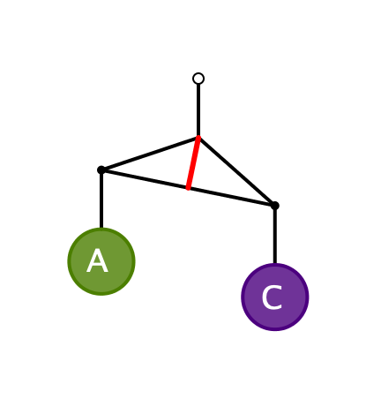
Physically Correct Diagrams
The angle of tilt takes into account both the masses A and C,
and the mass of the ‘bar’ or ‘coat hanger’

Slide 8
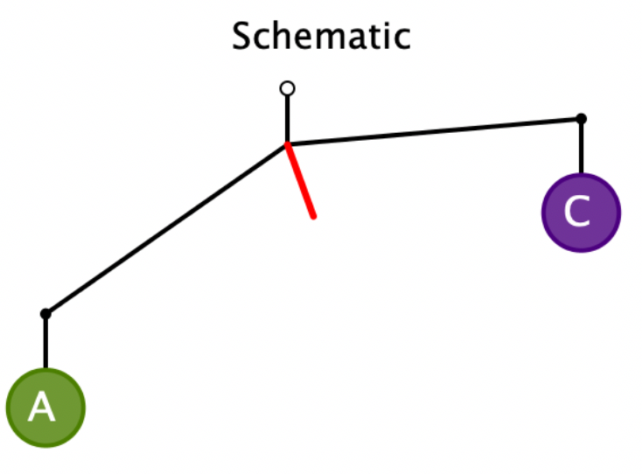
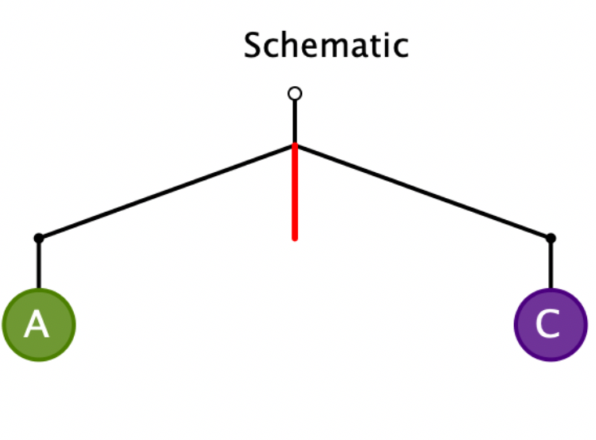
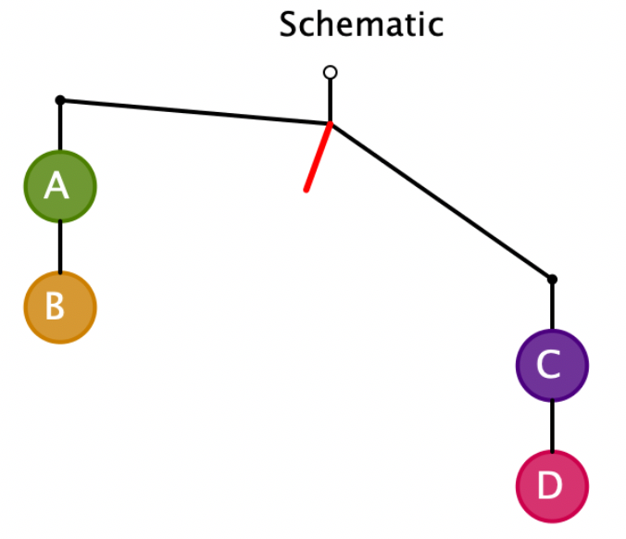
Systematic Development
Express a relationship between the masses
A > C
A = C
C + D > A + B

Slide 9
Systematic Development
A > C
A = C
C + D > A + B
Express to someone else
what principles you have recognised
Now draw a schematic bent-bar
which would be read as
A + F > D
And another!
And another!

Slide 10
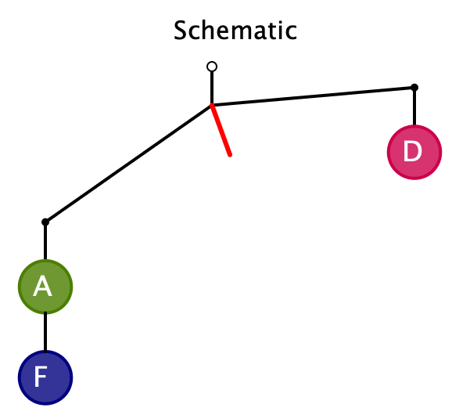
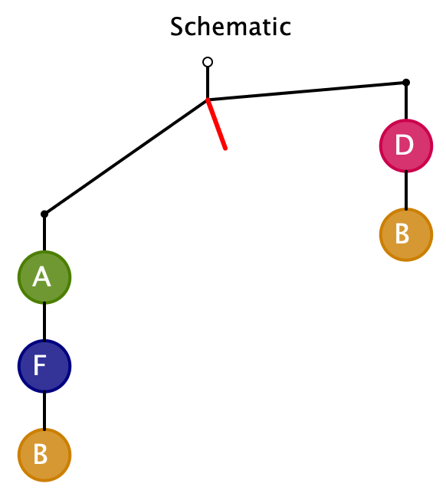
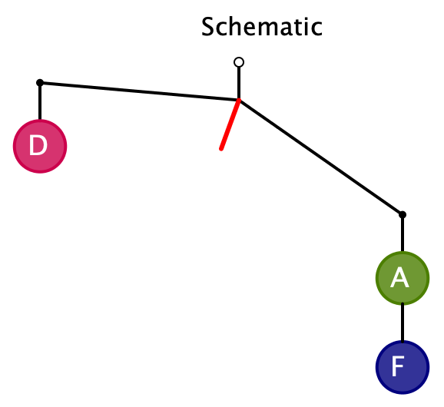
Resolution: A + F > D
…
Learners can create possibilities
and become aware of principles

Slide 11
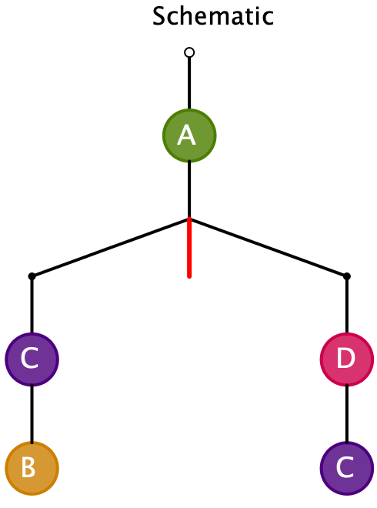
From Actual Masses to Diagram
Pre-release Diagram
Here the diagram shows BEFORE the configuration has been released!
Given the following masses, draw a suitable bent-bar diagram
A = 1
B = 3
C = 2
D = 4
Note the pedagogical
shift of direction
Assign masses so that it tilts the other way

Slide 12
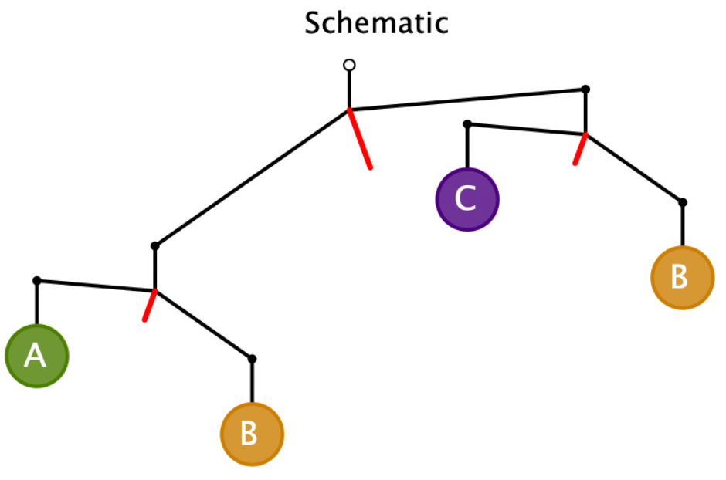
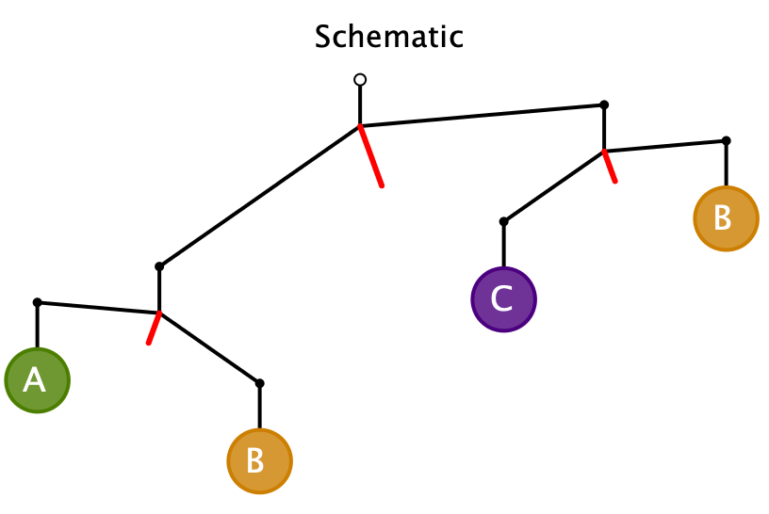
Further Development
B > A
C > B
B > C
B + A > B + C
A > C and C > B > A
A > C
Contradiction!
B > A > C
It is impossible!
Express to someone else
what further principles you have recognised

Slide 13
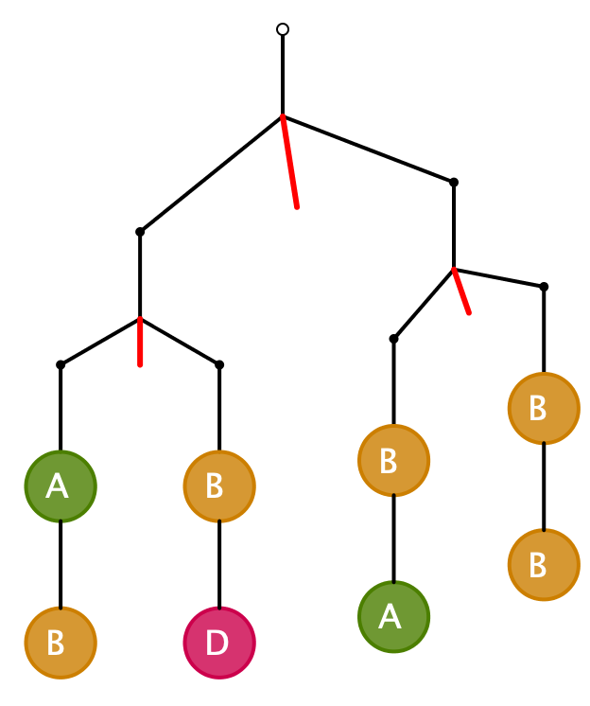
More Challenging
What can be said about the relative masses in each case?
What would be suitable masses to assign to each letter?
A + B = B + D
A = D
A + B > B + B
A > B
A + 2B + D > A + 3B
A = 2; D = 2; B = 1
D > B
D = A > B

Slide 14
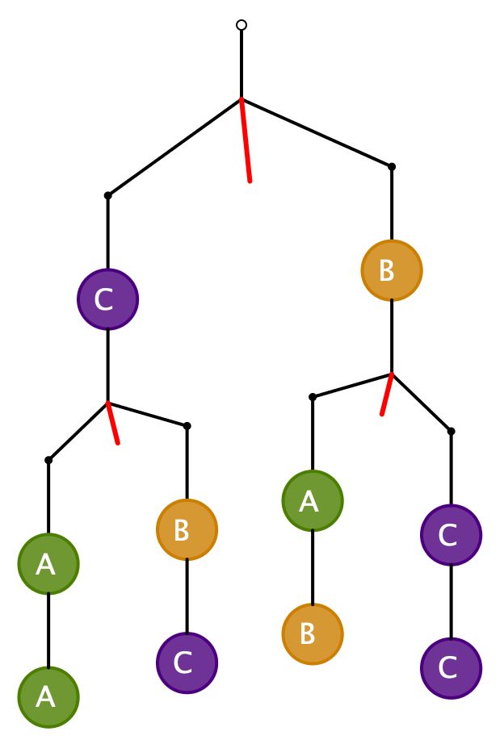
More Challenging
What can be said about the relative masses in each case?
What would be suitable masses to assign to each letter?
2A > B + C
2C > A + B
2A + B + 2C > A + 2B + 2C
A > B
2C > B + B = 2B
C > B
B = 1, C = 3, A = 4
So no conclusion
about A and C
B = 1, C = 4, A = 3
Need to check all relations, not just conclusions
B = 2, C = 4, A = 3

Slide 15
Challenge
How many tasks like this are needed in order to learn from the experience?
Do you feel a need to practice? To rehearse?
By constructing your own, you can explore boundaries and problematic situations

Slide 16
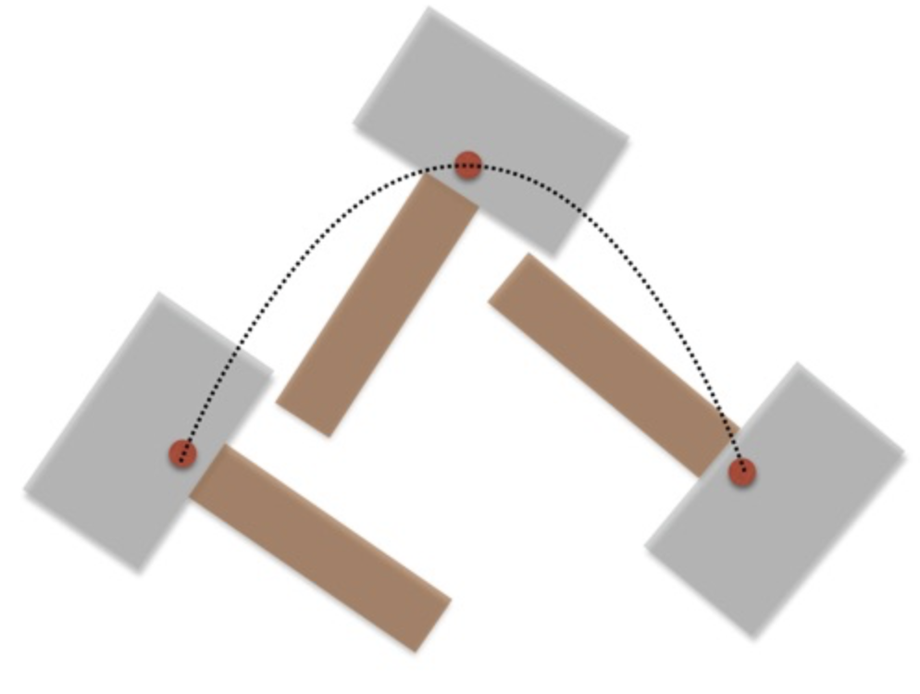
Newton’s Centre of Mass
Centre of mass
  Plumb lines
Principle of moments
To balance, the Centre of Mass must be at the fulcrum
Left-mass x distance to Fulcrum = Right-mass x distance to Fulcrum

Slide 17
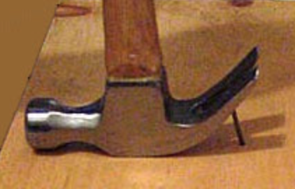
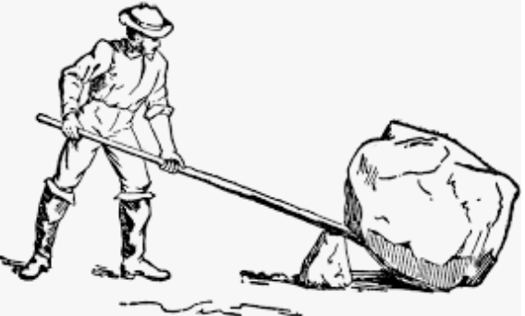
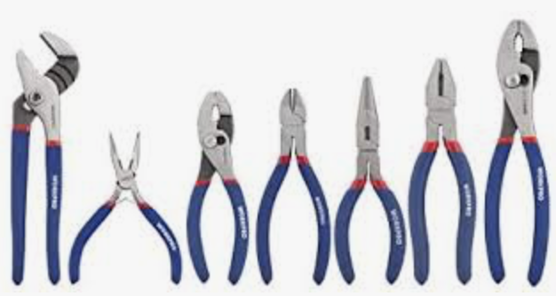

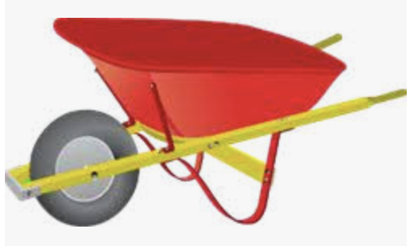
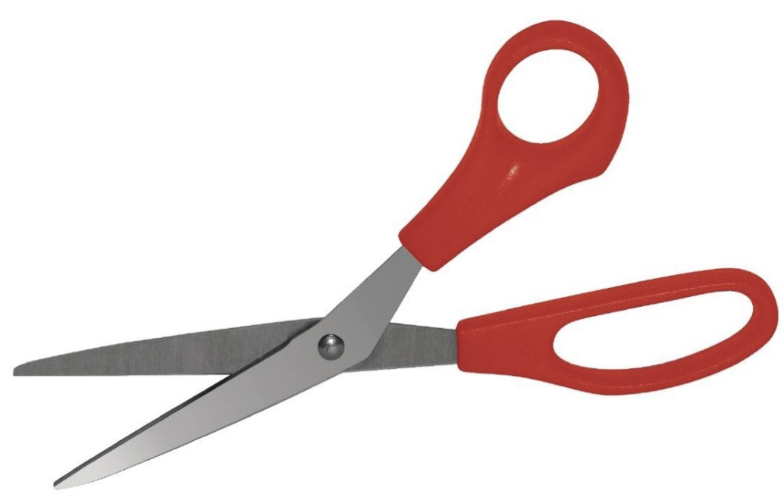
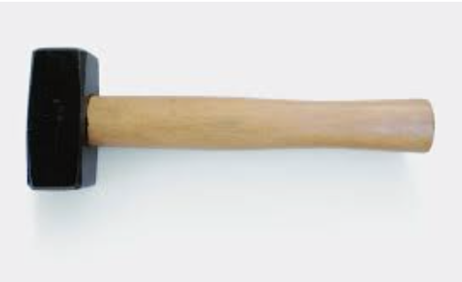
From Balances to Levers
Exploiting moments

Slide 18
Where we could go
I have a circular tray
It sits on a cylindrical post at its centre
How can I be sure that when I put things on the tray, it will not fall off the post?

Slide 19
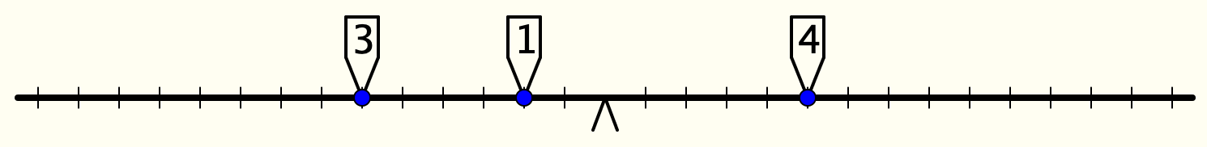
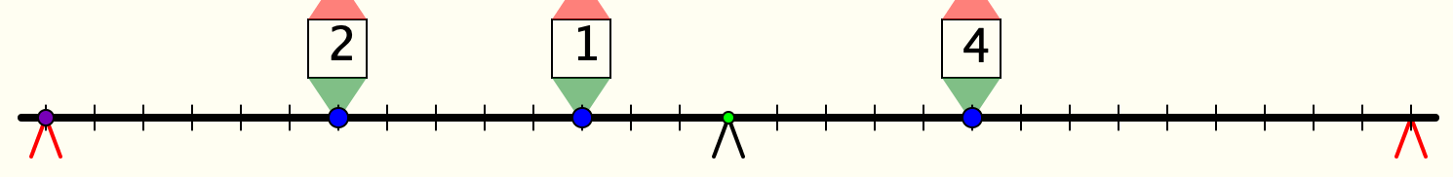
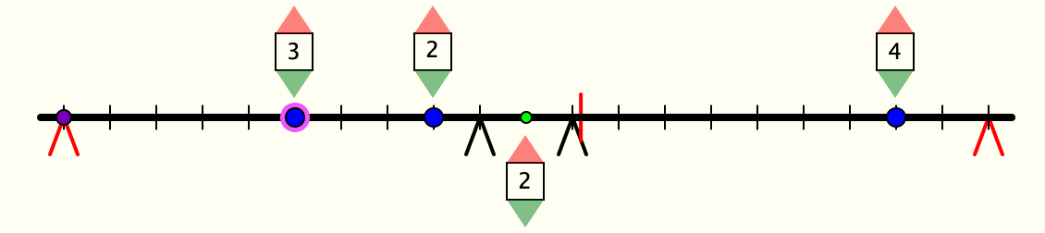
Fulcra
Why is this beam balanced?
Will this beam balance?
Will this beam balance?

Slide 20
Magic Square Reasoning
What other
configurations
like this
give one sum
equal to another?
6
7
2
2
1
5
9
Try to describe
them in words
2
8
3
4
Any colour-symmetric
arrangement?
Sum(
)
–
Sum( )
= 0
Notes:
Think of all the patterns obtained like this one but with different choices of the red line and the blue line.
Sketch a few
Here is another reasoning
What about this pattern: is it true?
did you have difficulty recognising the components? This may be why learners find it hard to remember what they were taught recently!

Slide 21
More Magic Square Reasoning
Sum(
)
–
Sum( )
= 0

Slide 22
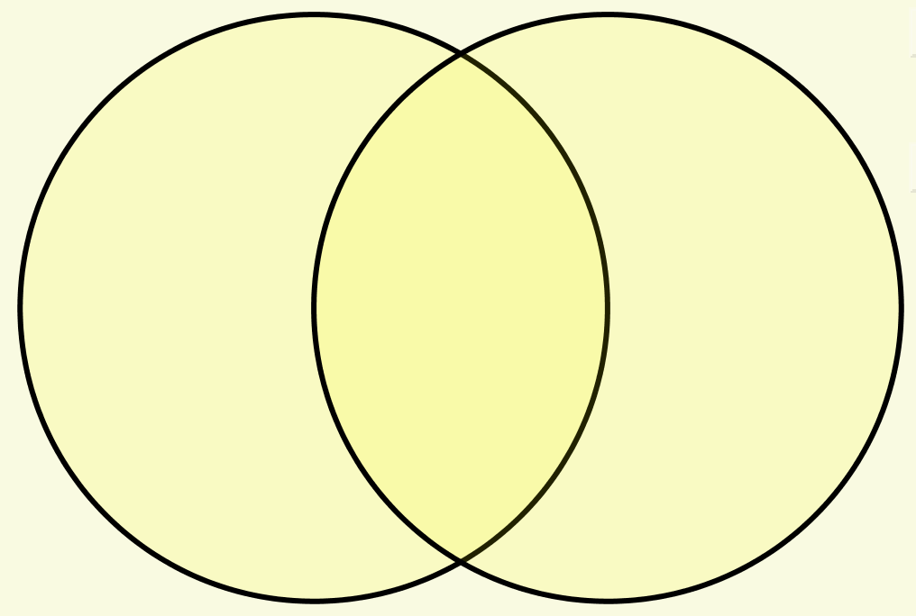
Set Ratios
You have 17 counters to place in the diagram so that the two sets A and B have the same number of counters.
Most people end up finding an action which preserves the equality but rearranges the counters
This is ‘preserving a balance’, or ‘keeping something invariant’
A
B
The same idea applies when you try to place the counters so that
the ratio of the number in A to the number in B
is some specified ratio like 3 : 2

Slide 23
Follow-Up
John.Mason@open.ac.uk
PMTheta.com

