Slide 1
Workshop: Implications for mental and written calculations KS1/2
Anne Watson
Balcarras
2013

Slide 2


Slide 3


Slide 4
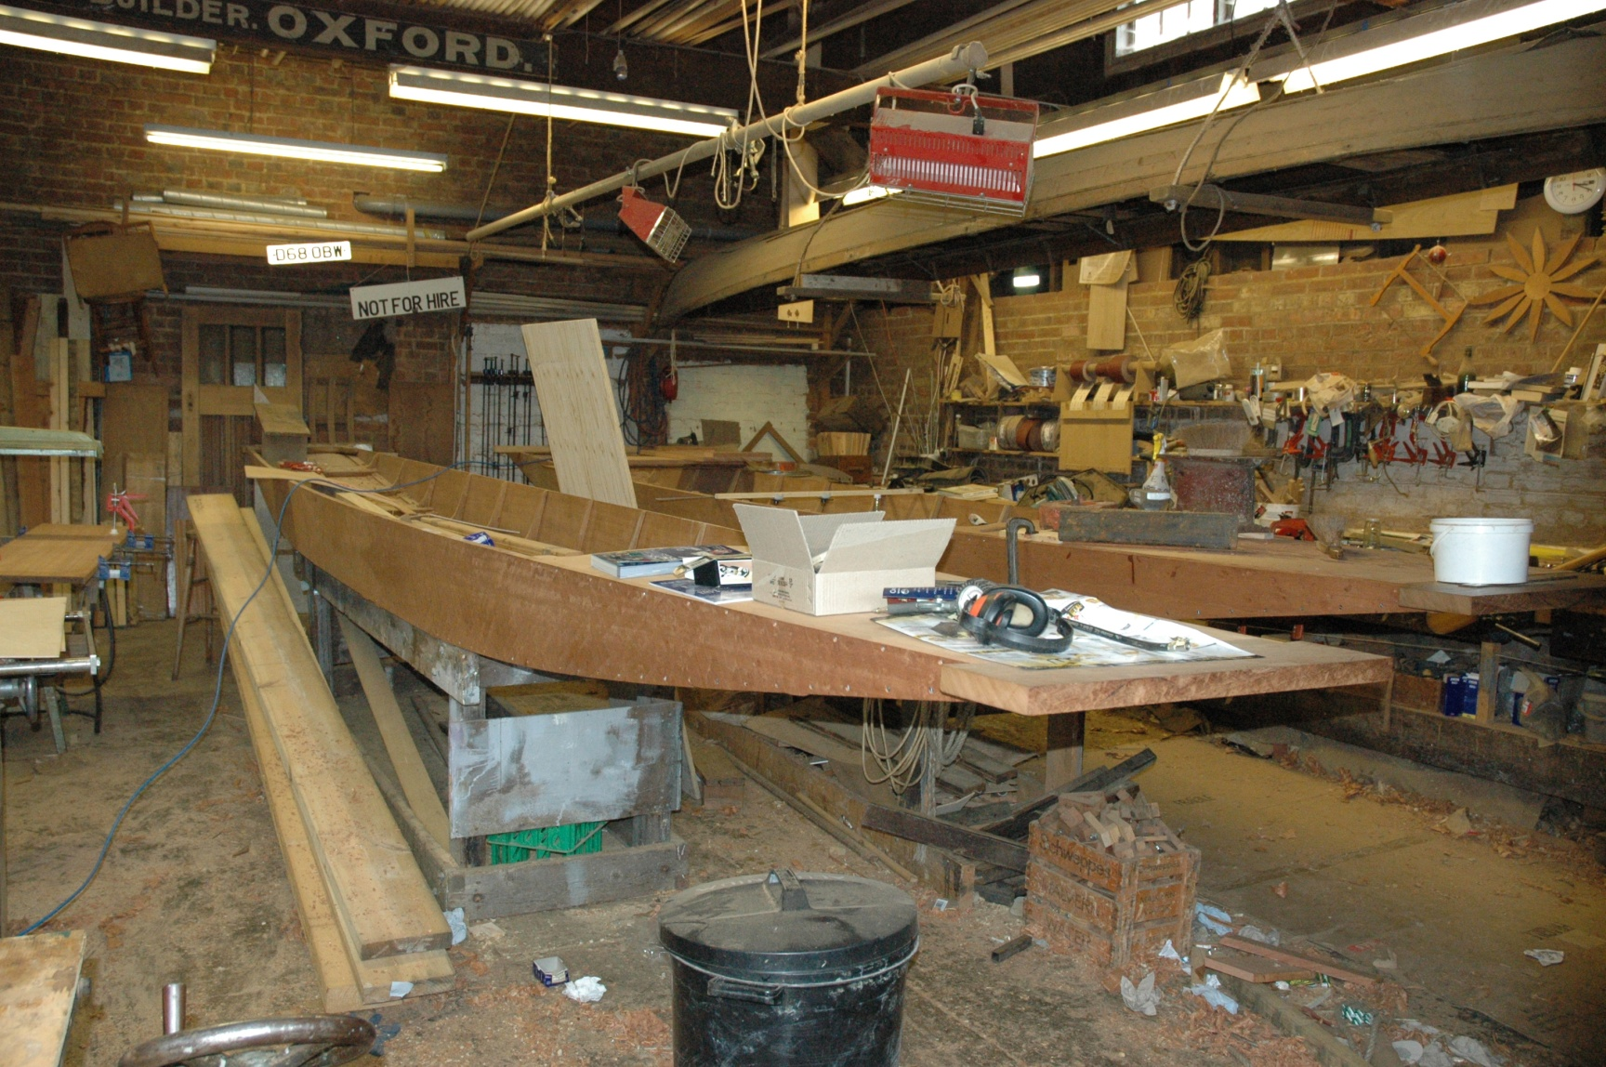

Slide 5
Workshop: Implications for mental and written calculations KS1/2
To gain familiarity with the draft NC through exploring calculation:
  implications for materials
  implications for notation
  implications for learning ‘by heart’
  implications for learning concepts
  implications for becoming fluent

Slide 6
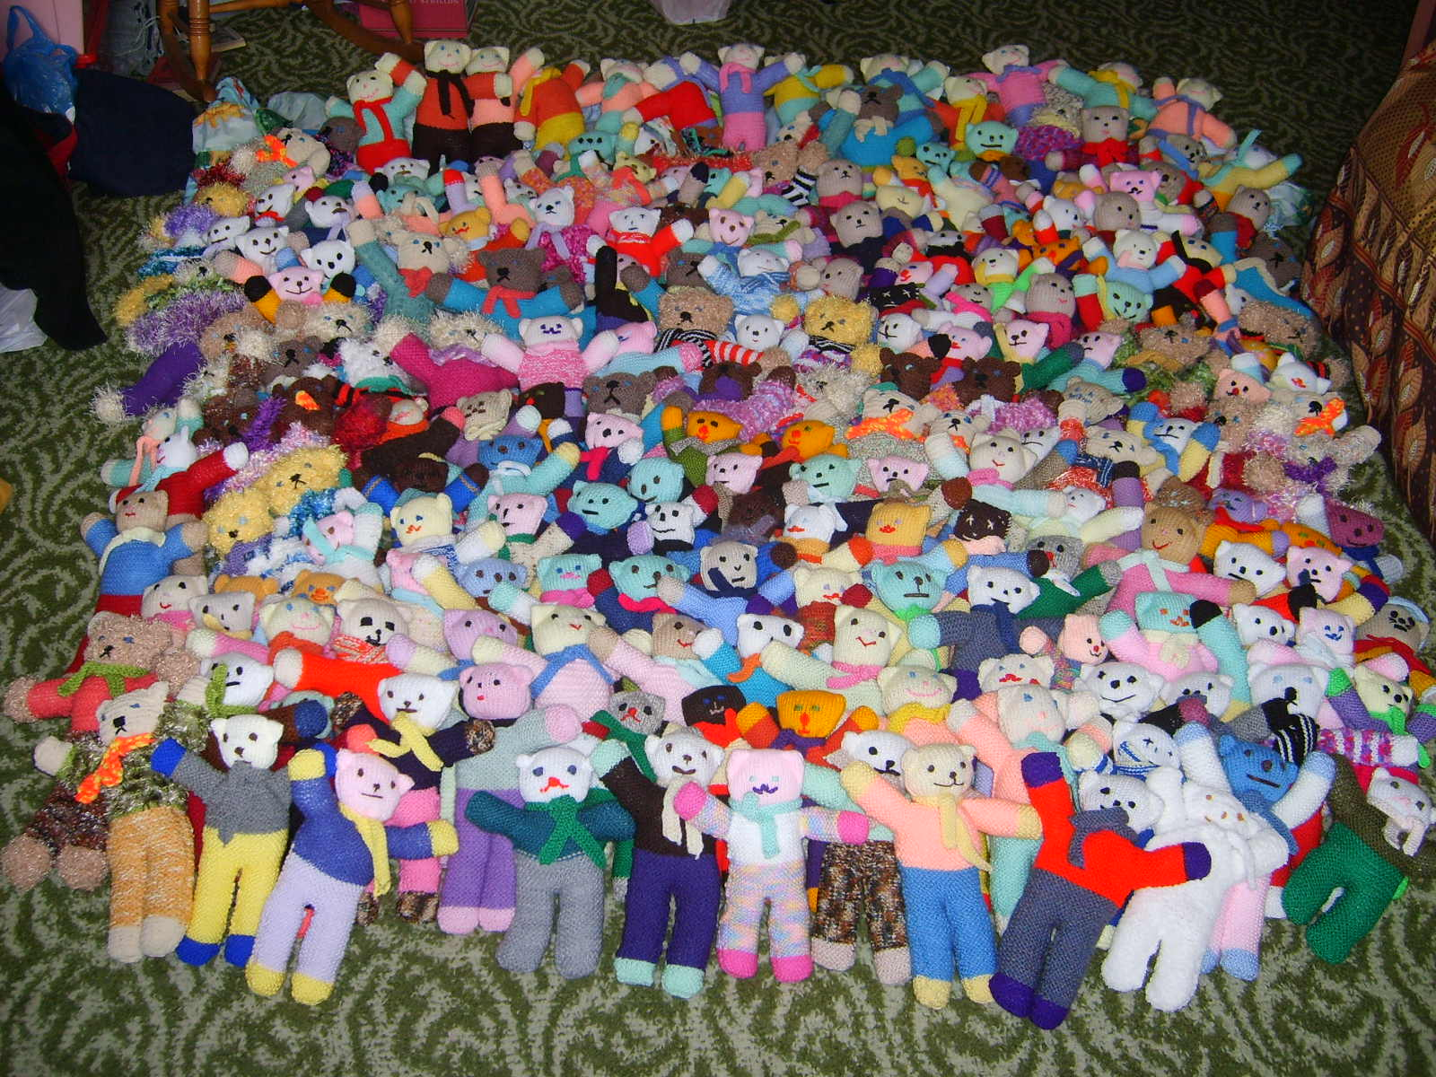

Slide 7



Slide 8

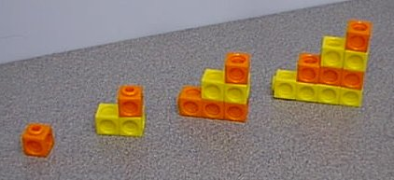

Slide 9
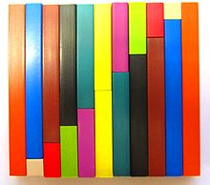

Slide 10
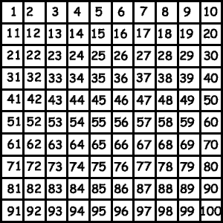

Slide 11


Slide 13


Slide 14


Slide 15
  M materials (different images/actions)
  P pupils’ notation (recording)
  S standard notation (to column methods)
  H learning ‘by heart’ (resources)
  C conceptual learning (meaning)
  F fluency (techniques and facts)

Slide 16
Intro to new NC draft
n.b. this is NOT the final product or in the final layout
Progression
  (i) free choice
  (ii) division

Slide 18
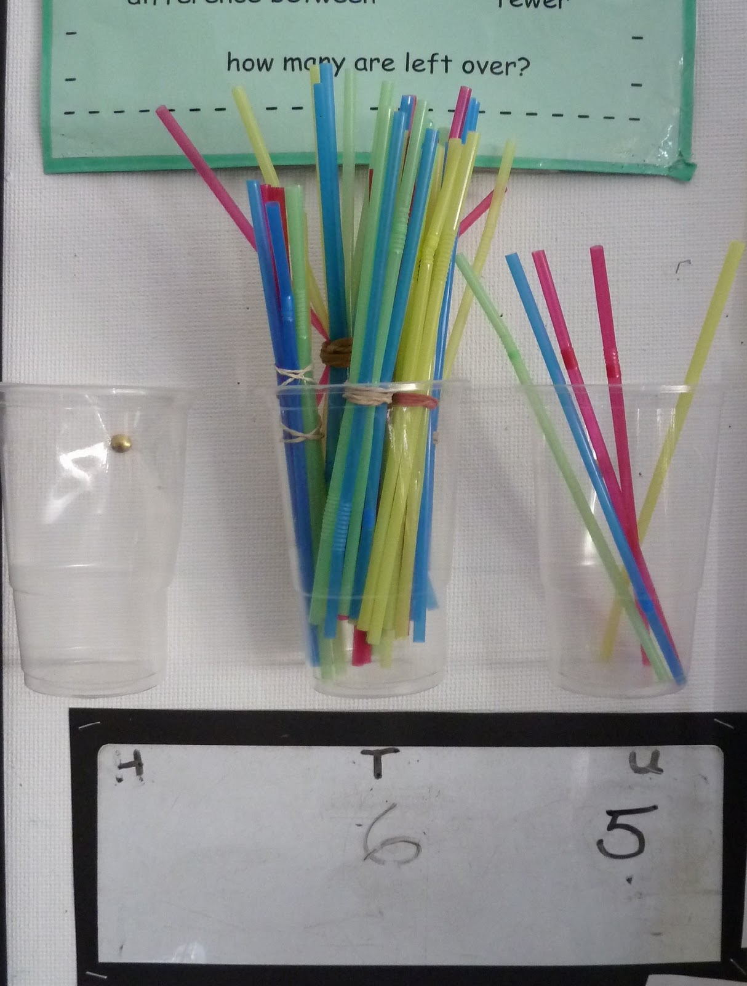

Slide 19
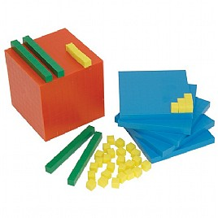

Slide 20
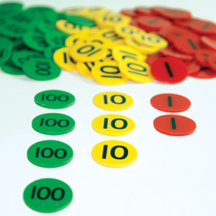

Slide 21
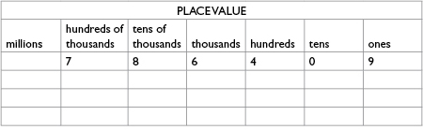

Slide 22
  M materials (different images/actions)
  P pupils’ notation (recording)
  S standard notation (to column methods)
  H learning ‘by heart’ (resources)
  C conceptual learning (meaning)
  F fluency (techniques and facts)

Slide 23
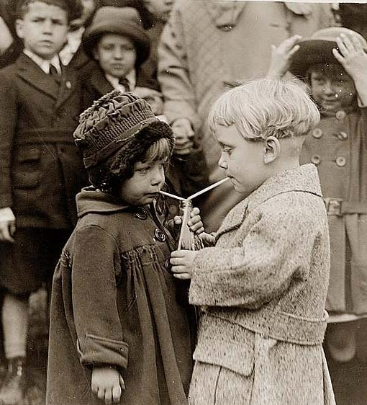

Slide 24


Slide 25
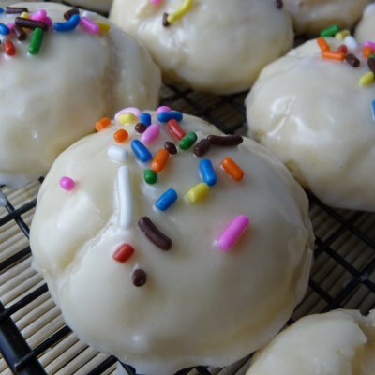

Slide 26


Slide 27
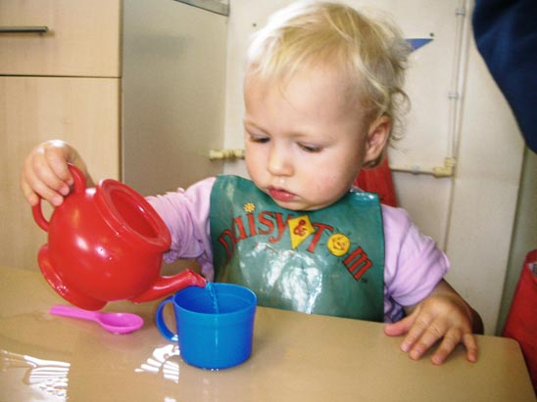

Slide 28



Slide 29
Division as inverse of area model for multiplication
Long Division - Part 1 on Vimeo

Slide 30

Division/multiplication as scaling

Slide 31
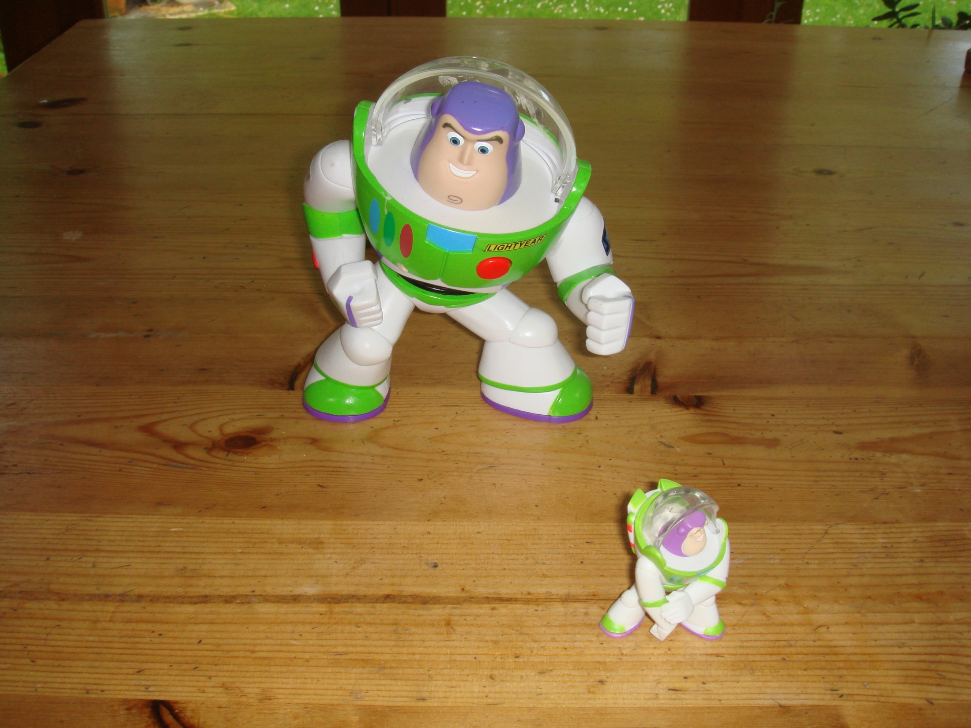

Slide 32
Learning arithmetic
Meaning - quantities, materials, realistic situations (image/action)
Meaning - within mathematics, using the number system (diagram/icon)
Mental method – number facts, derived facts, memory, image
Notation – symbols, layout
Written method – number facts, layout, shortcuts, inner talk

Slide 33
Do
Talk
Record
(Open University)
Enactive
Iconic
Symbolic
(Bruner)

