Slide 1
Developing Learners Undoubted Powers to Think Mathematically
Promoting Mathematical Thinking
John Mason
Mathematics Mastery
London Feb 2016
The Open University
Maths Dept
University of Oxford
Dept of Education

Slide 2
Conjectures
Everything said here today is a conjecture … to be tested in your experience
Arithmetic is the study of
Actions on numbers
Properties of those actions …
and hence properties of numbers
Calculations are a by-product
The best way to sensitise yourself to learners
is to experience parallel phenomena yourself
So, what you get from this session is what you notice happening inside you!

Slide 3
Inner & Outer Aspects
Outer
What task actually initiates explicitly
Inner
What mathematical concepts underpinned
What mathematical themes encountered
What mathematical powers invoked
What personal propensities brought to awareness

Slide 4
What’s The Difference?
Notice that we started
with Pictorial-Symbolic
but you had access to concrete-imagistic if you chose to specialise
–
=
First, add one to each
How would the difference change?
How would the difference change?
First, add one to the larger and subtract one from the smaller
What could be varied?
Notes:
• 153 – 87 = ? Orally; visibly;
•That is arithmetic; Now let’s do some mathematics!
Two volunteers: think of a three digit number and a two digit number.
• We’re going to subtract the smaller from the larger but before we do, lets add one to both.
What’s the difference now?

Slide 5
Affordances
What does that task offer?
Opportunity to
Think generally rather than with specific numbers but with recourse to specific numbers if need be
`encounter ‘equal addition/subtraction’
Experience arithmetic as actions on numbers
Opportunity to vary and extend

Slide 6
Composite Doing & Undoing
I am thinking of a number …
What’s my number?
I add 8 and the answer is 13.
What’s my number?
I add 8 and then multiply by 2; the answer is 26.
I add 8; multiply by 2; subtract 5; the answer is 21.
What’s my number?
I add 8; multiply by 2; subtract 5; divide by 3; the answer is 7.
What’s my number?
HOW do you turn +8, x2, -5, ÷3 answer into a solution?
7
Generalise!

Slide 7
Affordances
What does that task offer?
Opportunity to
Think generally rather than with specific numbers but with recourse to specific numbers if need be
Experience arithmetic as actions on numbers
Opportunity to vary and extend when constructing your own
Encounter ‘Doing & UnDoing’ & ‘Freedom & Constraint’
Briefly encounter the essence of ‘equation solving’

Slide 8
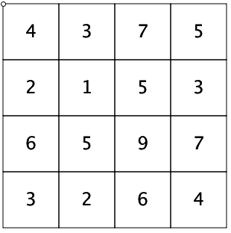
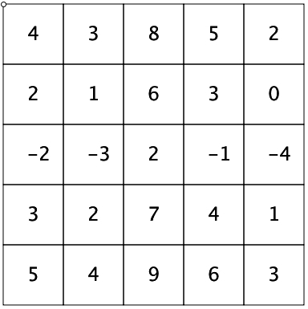
Covered-Up Sums
Cover up 4 cells, exactly one from each row and column
Add their values together
How many different answers can you get?
How do you know?
Say What You See
What relationships can you find?

Slide 9
Exchange
Please put some of your YELLOW counters in a line.
You are going to exchange each YELLOW for two GREENS
Imagine how you will arrange them so that the exchange is immediately recognisable.
Now DO IT!
What arithmetic operation have you illustrated or enacted?
Multiplication (but not repeated addition!)

Slide 10
Another Exchange
Please put some of your GREEN counters in a line
You are going to exchange two GREENS for a single RED and keep doing that until you can no longer do it.
Imagine how you will lay it out so that someone else can see the exchange you have made.
Now DO IT!
What arithmetic operation have you illustrated or enacted?
Division possibly with remainder

Slide 11
And Another Exchange
Please put some of your RED counters in a line.
You are going to exchange each RED for two GREENS and a YELLOW.
Imagine how you will lay them out so that someone else can see the exchange you have made.
Now DO IT!
What arithmetic operation have you illustrated or enacted?
Multiplication with a hint of ratio

Slide 12
Outline
Counting as a context
Recitation of ‘poem’
Enumeration: counting something
1, 2, 3, 4,
2, 3, 4, 5

Slide 13
Counting
What if the objects were still, but your attention was darting about?
Notes:
What if the objects were still, but your attention was flitting about, not knowing what to settle on?

Slide 14
Count
How many white squares are there?
How did you do it?
How were you attending?
In how many different ways can you count the white squares?
Count blacks and subtract
Notice 6 rows of 3 blacks & 3 rows of 1 black
Notice 6 columns of 3 black & 3 columns of 1 black
Notice diagonal stripes of blacks
Columns or rows: 3 lots of (3 + 3 + 1) blacks
Similarly for whites
Notice the effect on your attention between these two task types
Notice what you do with your attention to make sense of these ways
Resolución de Problemas de Final Abierto Chile 2013 p67
Notes:
Introduction to Frequency Tables and means
Seeking relationships
Parking first impulse?

Slide 15
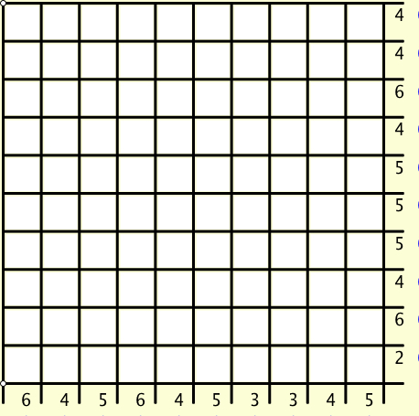
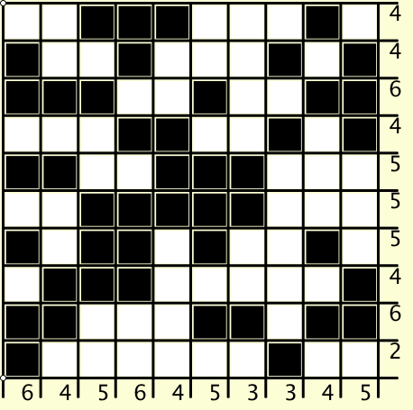
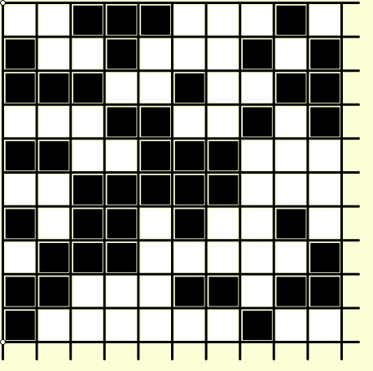
Grid Counts
For each row and column, how many cells are black?
Too Hard!
What did you (have to) do with your attention?
Too Hard!
That is a ‘doing’
What would be an ‘undoing’?
Notes:
What might be interesting is how you need to control your attention.

Slide 16
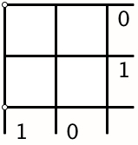
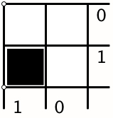
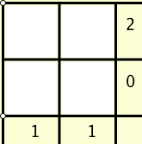
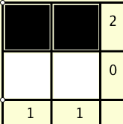
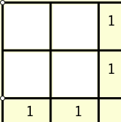
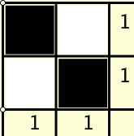
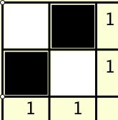
Specialising Undoing Grid Counts
What’s the same
and
what is different?
Invariance in the midst of change
Notes:
Withdrawing from action and reflecting
Immersion in mathematical thinking, not ‘memorising’ classroom rubric!

Slide 17
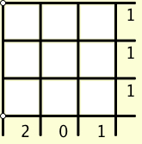
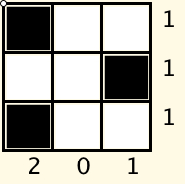
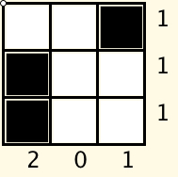
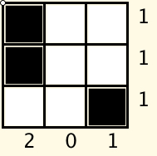
Specialising Undoing Grid Counts
What’s the same
and
what is different?
Invariance in the midst of change

Slide 18
Reflection
Withdrawing from action
Becoming aware of an action, or a relationship
NOT ‘telling them so they remember’ BUT rather immersing them in a culture of mathematical practices

Slide 19
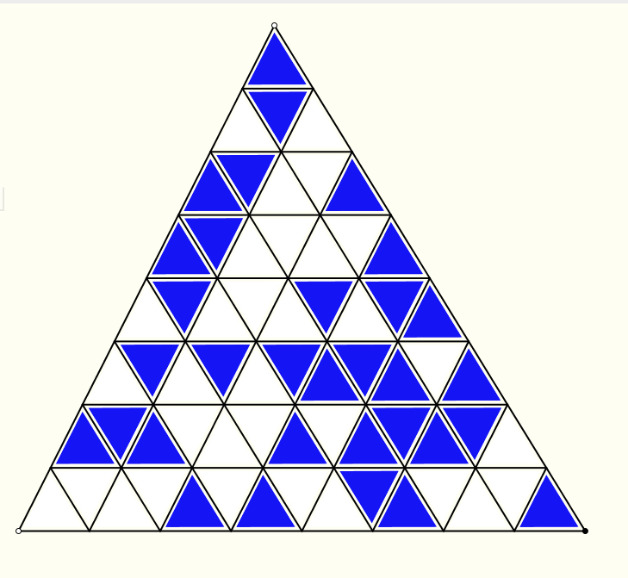
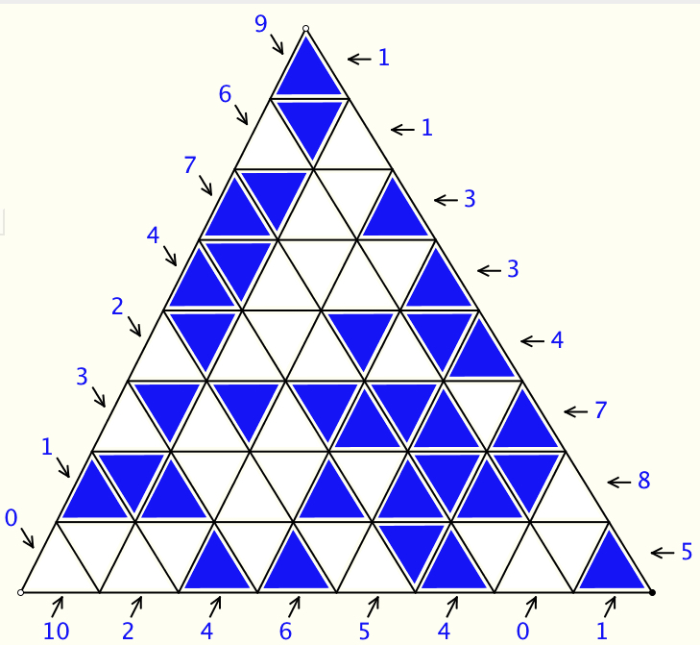
How Many Cells are Blue on Each Line?
What do you have to do with your attention?

Slide 20
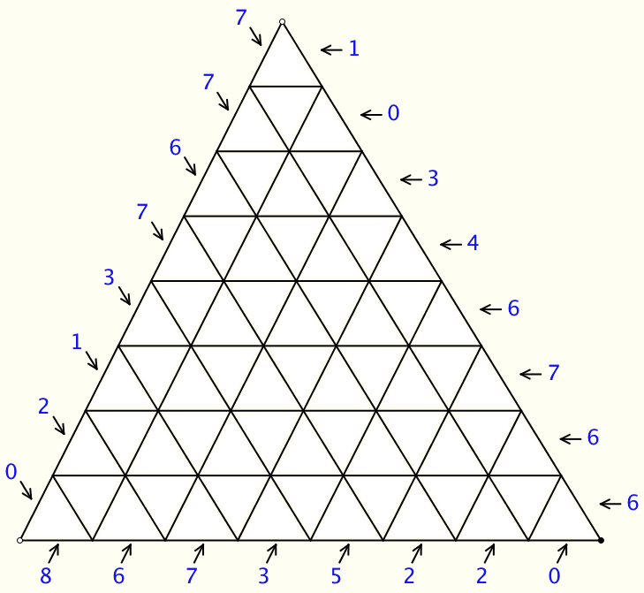
Which Cells are Coloured?
Doing & Undoing

Slide 21
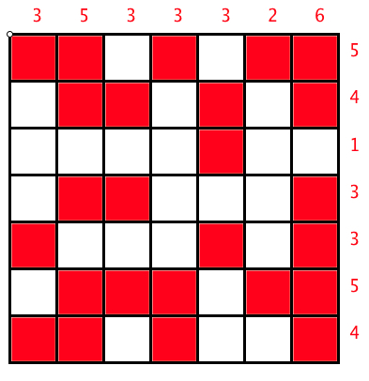
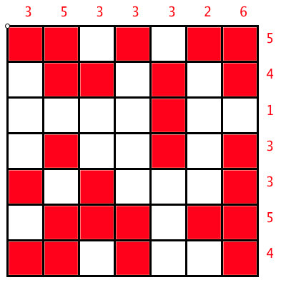
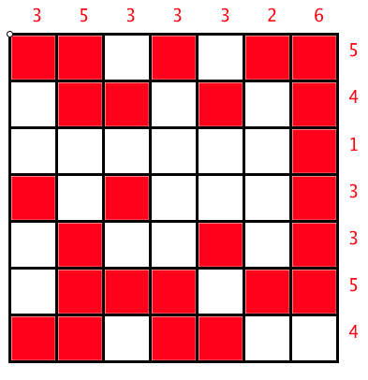
Same & Different
What’s the same and what different between these?
How did you use your attention?

Slide 22
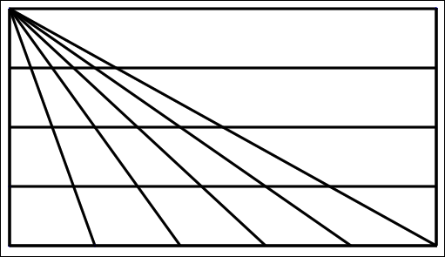
Triangle Count
In how many different ways might you count the triangles?
(5 + 4 + 3 + 2 + 1) x 4 + 1
What are you attending to?
Notes:
15 x 4 + 1

Slide 23
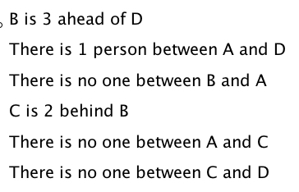
Queuing
B
A
C
D

Slide 24
Mathematical Thinking
How might you describe the mathematical thinking you have done so far today?
How could you incorporate that into students’ learning?
What have you been attending to:
Results?
Actions?
Effectiveness of actions?
Where effective actions came from or how they arose?
What you could make use of in the future?

Slide 25
Reflection as Self-Explanation
What struck you during this session?
What for you were the main points (cognition)?
What were the dominant emotions evoked? (affect)?
What actions might you want to pursue further? (Awareness)
Notes:
Chi et al

Slide 26
Doing & Undoing
What operation undoes ‘adding 3’?
What operation undoes ‘subtracting 4’?
What operation undoes ‘subtracting from 7’?
What are the analogues for multiplication?
What undoes ‘multiplying by 3’?
What undoes ‘dividing by 4’?
What undoes ‘multiplying by 3/4’?
Two different expressions!
Dividing by 3/4 or Multiplying by 4 and dividing by 3
What operation undoes dividing into 12?
Notes:
Dave Hewitt’s THOAN sequences

Slide 27
Marbles
If John gives one of his marbles to Chris, they will then have the same number of marbles.
If John gives three of his marbles to Anne and Anne gives two of her marbles to Kate, they will all then have the same number of marbles.
If John gives two of his marbles to Quentin, then Quentin will have twice as many marbles as John then has.
What can be varied?
How does that change the thinking?

Slide 28
Think Of A Number (ThOAN)
Think of a number
Add 2
Multiply by 3
Subtract 4
Multiply by 2
Add 2
Divide by 6
Subtract the number you first thought of
Your answer is 1
7
7
+ 2
3x + 6
7
7
3x + 2
6x + 4
7
6x + 6
7
+ 1
7
1

Slide 29
Raise your hand up when you can see …
Something that is 3/5 of something else
Something that is 2/5 of something else
Something that is 2/3 of something else
Something that is 5/3 of something else
What other fractional actions can you see?

Slide 30
SWYS

Slide 31
Describe to Someone How to See something that is …
1/3 of something else
1/5 of something else
1/7 of something else
1/15 of something else
1/21 of something else
1/35 of something else

Slide 32
Powers & Themes
Are students being encouraged to use their own powers?
Powers
or are their powers being usurped by textbook, worksheets and … ?
Imagining & Expressing
Specialising & Generalising
Conjecturing & Convincing
(Re)-Presenting in different modes
Organising & Characterising
Themes
Doing & Undoing
Invariance in the midst of change
Freedom & Constraint
Restricting & Extending
Exchanging

Slide 33
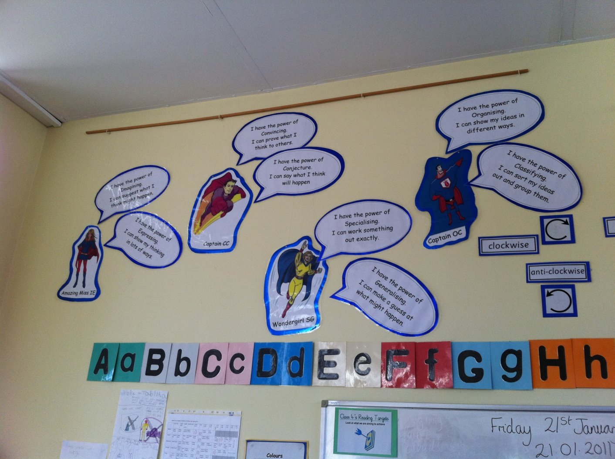
Mathematical Powers
Those with Mathematical Powers are Super Heroes!
Notes:
Ways in which teachers have cast the notion of mathematical powers

Slide 34
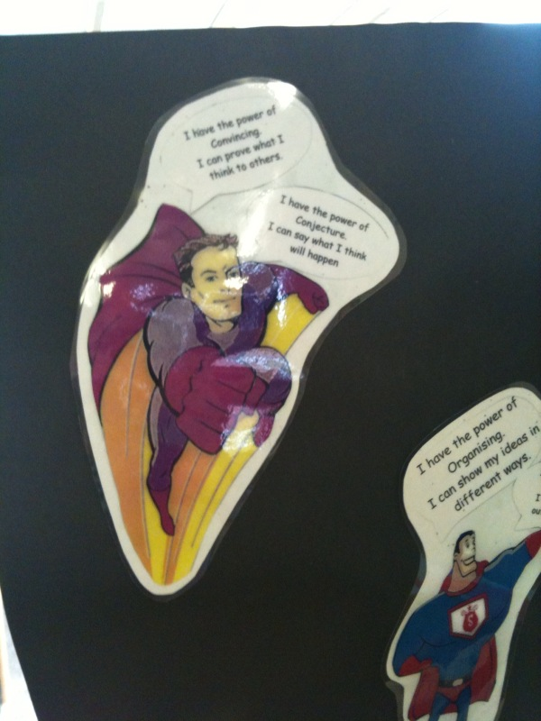
Captain CC
I have the power of conjecture I can say what I think will happen
I have the power of convincing I can prove what I think to others

Slide 35
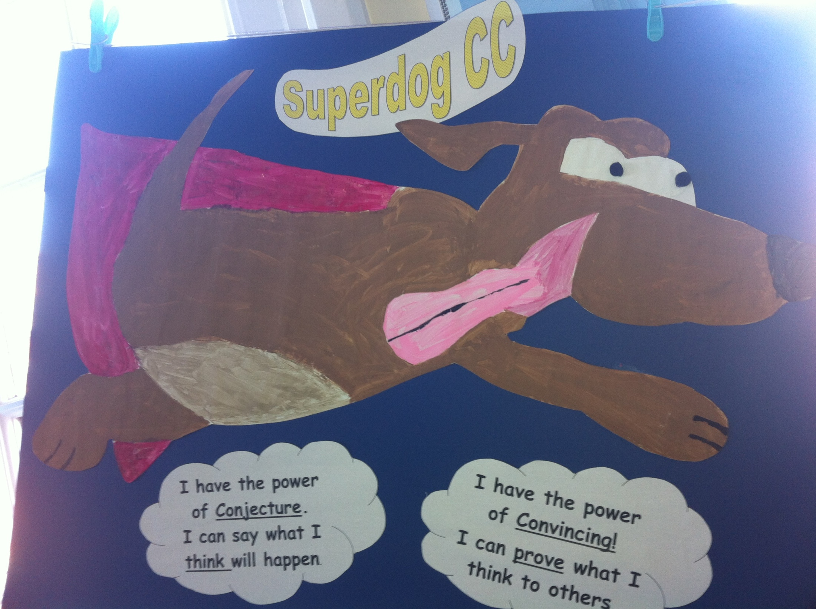

Slide 36
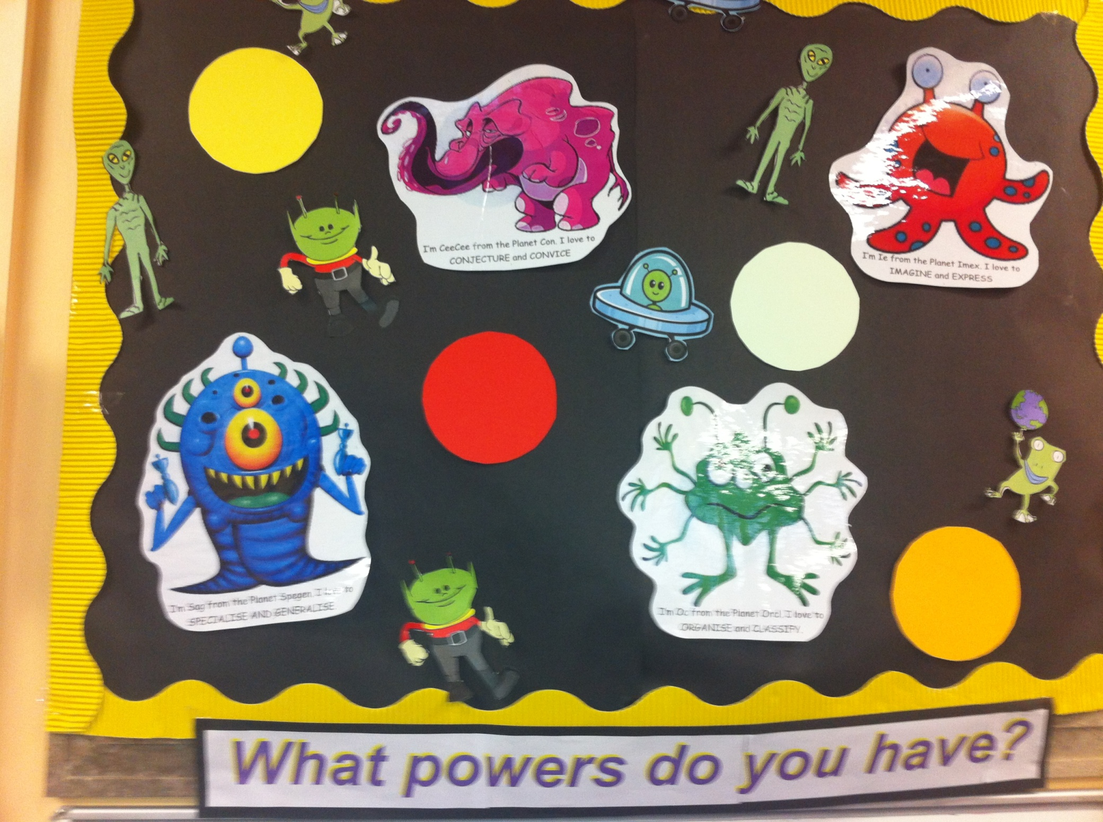

Slide 37
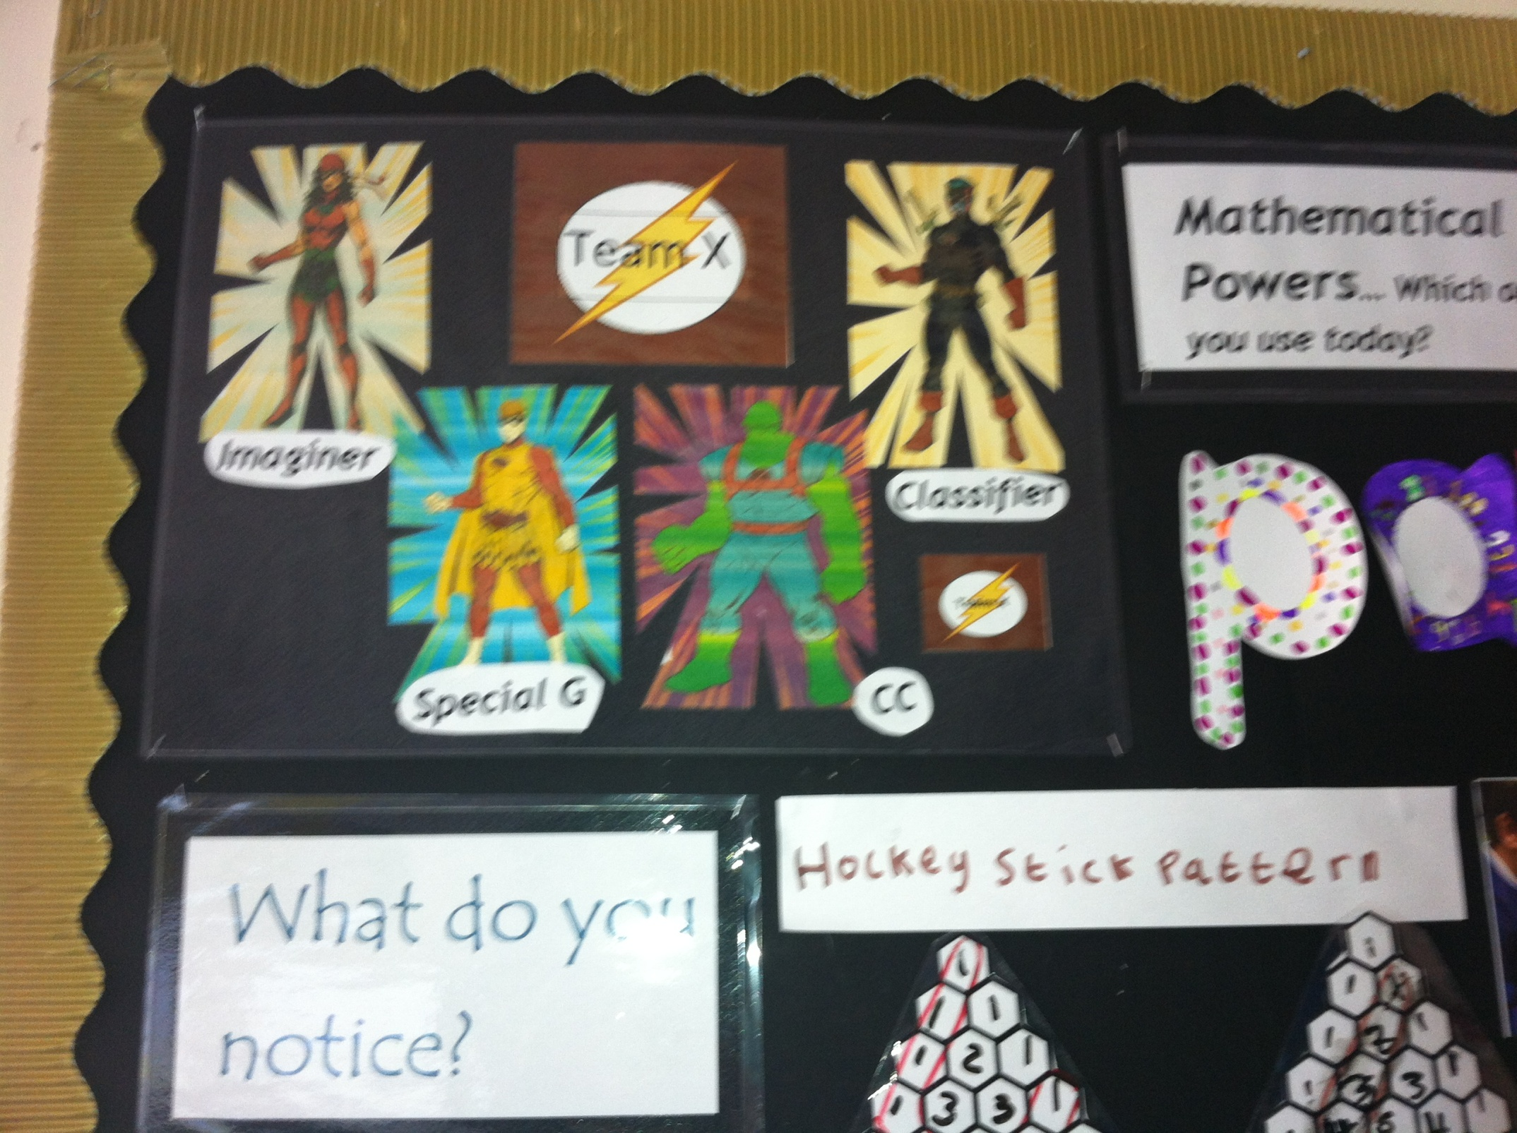

Slide 38
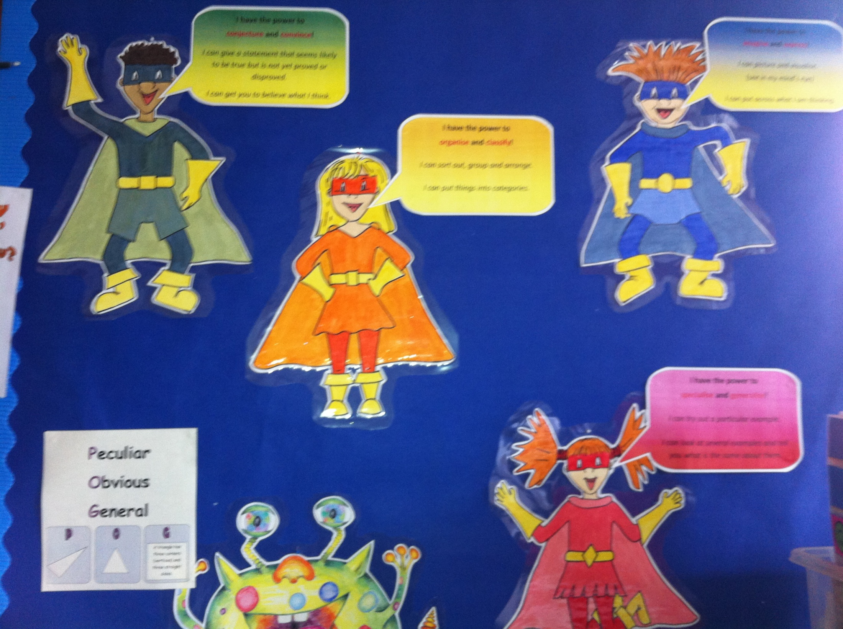

Slide 39
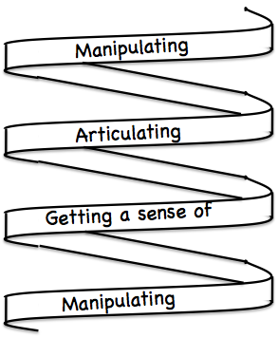
Frameworks
Enactive – Iconic – Symbolic
Doing – Talking – Recording
See – Experience – Master
Concrete – Pictorial– Symbolic

Slide 40
Reflection as Self-Explanation
What struck you during this session?
What for you were the main points (cognition)?
What were the dominant emotions evoked? (affect)?
What actions might you want to pursue further? (Awareness)
Notes:
Chi et al

Slide 41
Reflection
It is not the task that is rich
but the way the task is used
Teachers can guide and direct learner attention
What are teachers attending to?
powers
Themes
heuristics
The nature of their own attention

Slide 42
To Follow Up
www.pmtheta.com
john.mason@open.ac.uk
Thinking Mathematically (new edition 2010)
Developing Thinking in Algebra (Sage)
Designing & Using Mathematical Tasks (Tarquin)
Questions and Prompts: primary (ATM)

