Slide 1


Making Maths Count
University of Oxford
Dept of Education
Promoting Mathematical Thinking
Anne Watson
Bristol Heads’ Conference
Chepstow March 2015

Slide 2

My background knowledge
Nuffield synthesis of research on children’s mathematical learning (http://www.nuffield
foundation.org/key-understandings-mathematics-learning)
Advisory Committee on Mathematics
Education (http://www.acme-uk.org/home)
Primary Mathematics National Curriculum subject expert panel
International comparisons: TIMSS etc.
University of Oxford research and graduate teaching
Japan, China, Singapore etc.

Slide 3
Implications of NC for improvement
Mathematical coherence
(from learners’ perspective:
lesson sequences and textbooks)
Depth of teacher knowledge (not only ‘how to do’)
Subject specific initial training and CPD (not generic)
Critical collaboration (not only ‘sharing best practice’)
Key ideas missing from previous curriculum
  Number sense and structure (not only calculation)
  Multiplicative reasoning (not only repeated addition)

Slide 4
Four crucial areas (research-based)
Place value
Number from quantity (counting and measuring)
Operations structures: additive and multiplicative
Multiplicative reasoning

Slide 5

Challenges in expectations
Fractions
Column calculations
Mastery approach
Keeping your job

Slide 6
Challenges in implementation
Time for teachers to work together to develop a commitment to a coherent approach
Vertical and horizontal coherence throughout school: images, representations, materials, language, notations
Textbook choice: https://www.ncetm.org.uk/files/21383193/NCETM+Textbook+Guidance.pdf
Balancing number sense and structure with calculation
Parallel routes of development for number

Slide 7
Challenge 1: Balancing number sense and structure with calculation
2376 x 15
1652 ÷ 28

Slide 8
Additive reasoning
a + b = c c = a + b
b + a = c c = b + a
    c – a = b b = c - a
    c – b = a a = c - b

Slide 9
Multiplicative reasoning
a = bc bc = a
a = cb cb = a
b = a a = b
c c
c = a a = c
b b

Slide 10

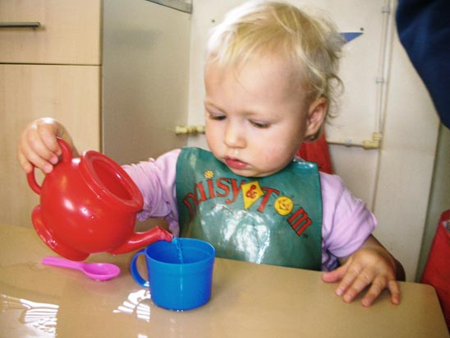


Challenge 2: Parallel routes of development for number

Slide 11
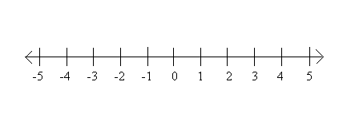
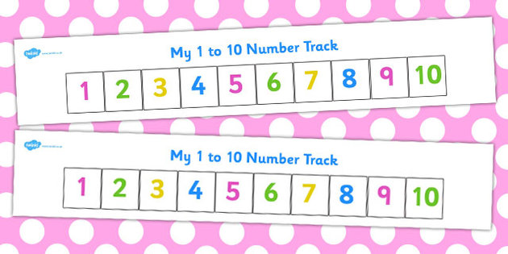
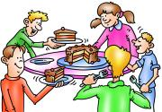
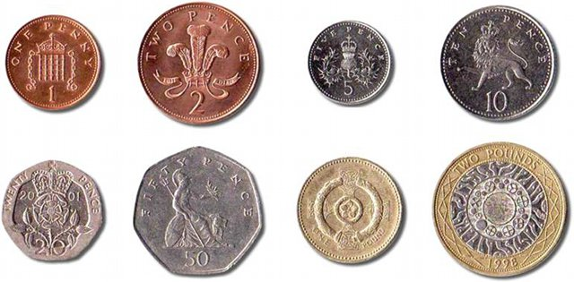
Challenge 3: Whole school coherence of images, representations, language, notations

Slide 12
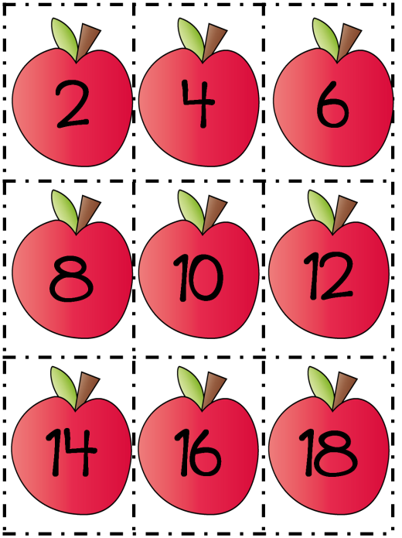
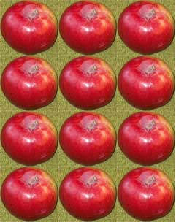

Slide 13
Challenge 4: Time for teachers to work together to develop a commitment to a coherent approach
Example: multiplicative reasoning
Why?
measure; quantity; enumeration;
scaling up and down; decimals; fractions; ratio; proportional reasoning; graphing; applications
NOT just counting → repeated addition

Slide 14
Ways of working: ITT, NQT, CPD
Group discussion of lines of development
Building concept map, or comparing existing concept maps
Looking for contradictions in textbooks
What do we do, and how does it match up?
One-off events

Slide 15
Building lines of development
counting in hundreds
shrinking/growing
enumerating incomplete arrays
multiplying n to get a sequence value
per cent
changing units
steps counting the number of steps
comparing liquids
multiplication facts written several ways
counting in twos, threes etc
grouping non-countable stuff
rate of change
dividing whole numbers that do not go exactly
half of a half of ....
unit fractions of length, cake, number ...
non-unit fractions <1 of ...
multiplying and dividing lengths

Slide 16
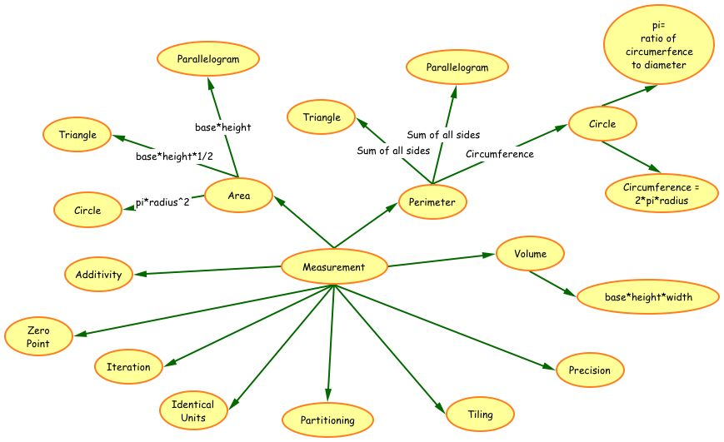
School concept map ?

Slide 17
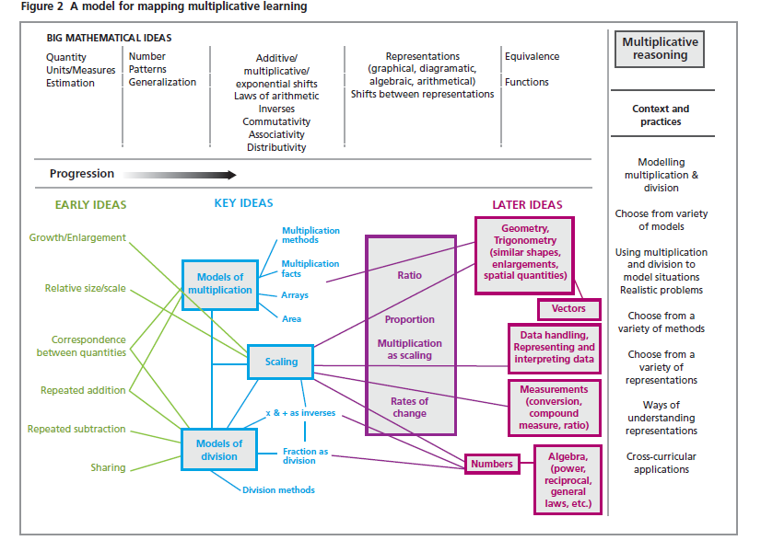
School concept map ?

Slide 18
Comparing textbooks for coherence

Slide 19
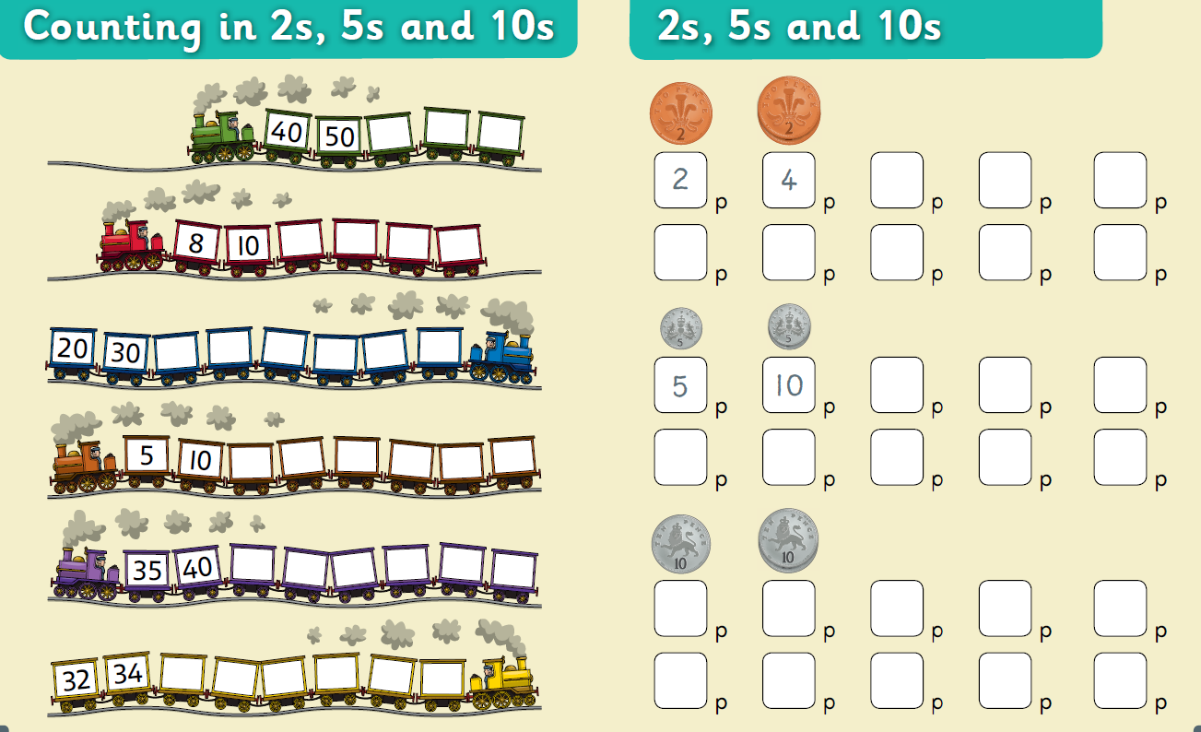

Slide 20
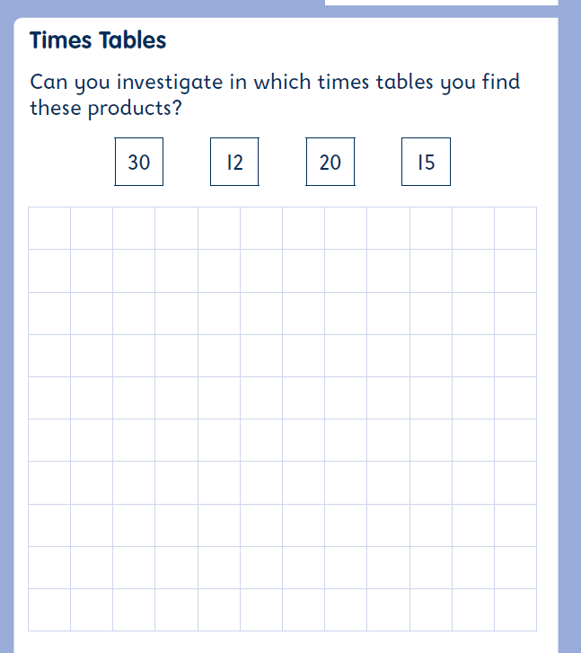
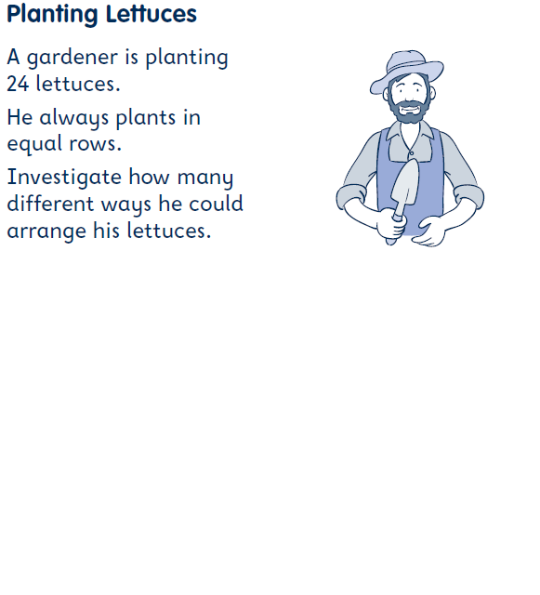

Slide 21
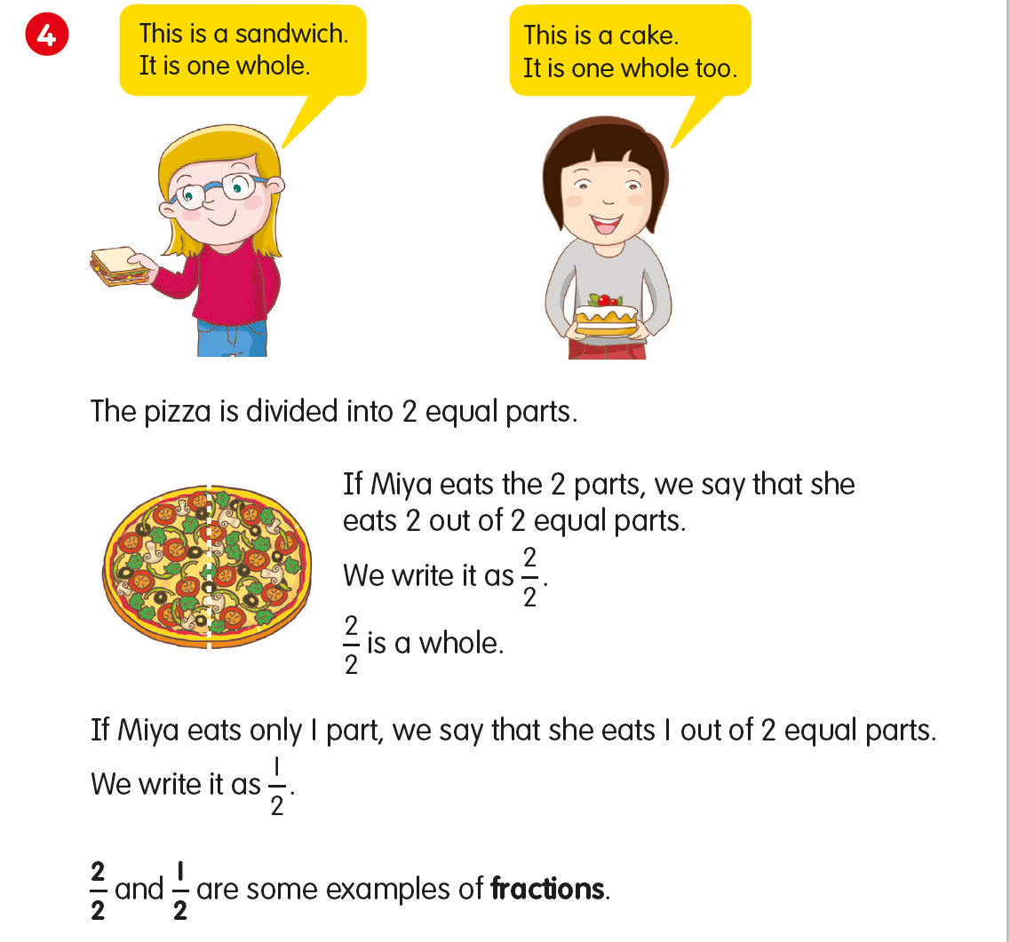

Slide 22
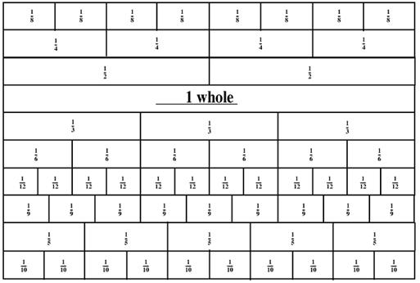
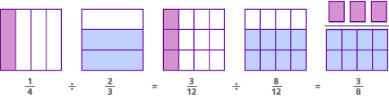
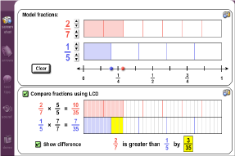
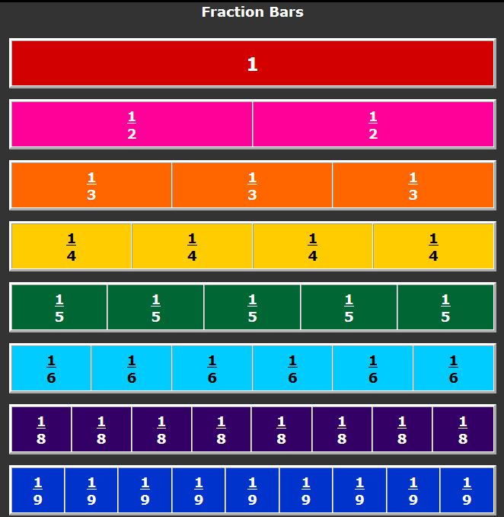
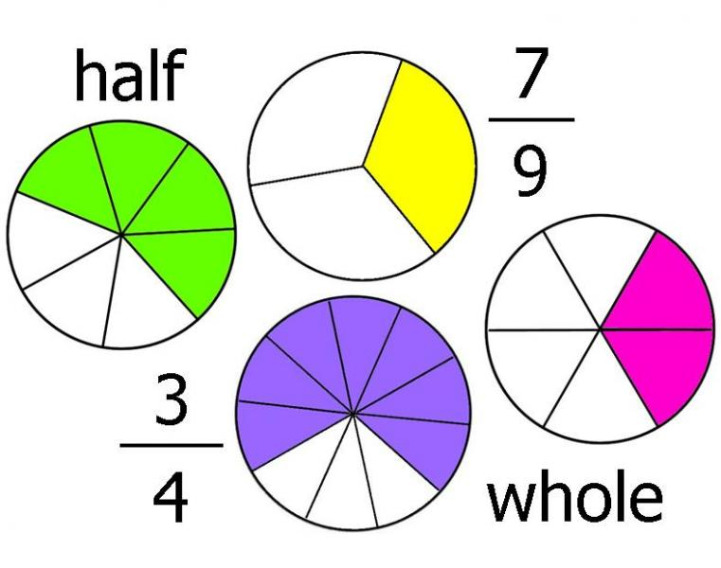
What do we do, and how does it match up?

Slide 23

One-off events (CPD?)
Take away new ideas, tools and insights.
The objective of the conference is to motivate teachers in primary and lower secondary schools to develop pupils’ mathematical ability and confidence, and make mathematics more engaging and interesting.
Be inspired to take a problem solving approach in your classrooms and develop your pupils’ comprehension.
Do your children look forward to your fun, lively and pacy mental maths sessions? If not, this course will give you an abundance of creative lesson ideas that will make your pupils buzz and make progress without even realising! Pace – what is the difference between speed and pace in a mental maths lesson?
Movement – getting the children out of the chairs and learning
Classroom organisation – moving the chairs and tables to create a learning space
How lively learning leads to mastered concepts
Understand the role of the Maths Hubs
Hear from a new lead primary school
Increase your knowledge of how mathematics is inspected
Explore reasoning and problem-solving in NC
See how a mastery approach develops increased depth and fluency
Gain knowledge of the key learning points from the Shanghai teaching exchange

Slide 24
Sorting
enumerating incomplete arrays
counting in hundreds
shrinking/growing
changing units
multiplying n to get a sequence value
steps counting the number of steps
per cent
multiplication facts written several ways
comparing liquids
grouping non-countable stuff
rate of change
counting in twos, threes etc
half of a half of ....
dividing whole numbers that do not go exactly
non-unit fractions <1 of ...
unit fractions of length, cake, number ...
multiplying and dividing lengths

Slide 25
University of Oxford
Dept of Education
Promoting Mathematical Thinking
Anne Watson: anne.watson@education.ox.ac.uk

