Slide 1
Learner differences in mathematics
Professor Anne Watson
CANOTTA Distinguished Visiting Fellow in Faculty of Education, HKU
University of Oxford
Hong Kong 2011

Slide 2
Reasons for learning difficulties
Disrupted schooling
Lack of support from home/community
Social and emotional difficulties
Lack of specialised teaching
Limited teaching methods
Low expectations self/parents/teacher
Learned helplessness
Reading and writing difficulties
Language difficulties
Physical and physiological problems
Cognitive problems
Superficial ways of studying
Procedural basis for past success

Slide 3
Blame the learner
Blame the mathematics
Blame the exam system
Blame the learning style
Focus on deficiencies
...
Focus on proficiencies

Slide 4
Doing what comes naturally …
What nearly all learners do naturally
Task-types
Describe
See and continue patterns
Visualise
Seek patterns
Seek similarities and differences
Play with variation
Express in ‘own words’
Give examples to illustrate ideas
Build things, tinker and adjust
Informal deduction: if X therefore Y
Draw on prior experience and repertoire
Make connections
Say what you see
Continue/predict a pattern
Imagine
Look for particular patterns
Same and different?
When A varies, what changes and what stays the same?
Talk about ....
Give me an example of ....
Can you make a ....
When and why will Y happen?
What does it look like/remind you of?
Give things to connect

Slide 5
Say what you see
http://www.youtube.com/watch?v=inwEGhwxkGg

Slide 6
Continue/predict a pattern
2, 4, 6, 8 …
2, 5, 8, 11 …
2, 6, 10,14 …
.
.
2, …

Slide 7
2, 4, 6, 8 …
3, 5, 7, 9 …
4, 6, 8,10 …
.
.
n, …

Slide 8
2, 4, 6, 8 …
5, 8, 11, 14 …
-9, -4, 1, 6 …
generalise

Slide 9
Imagine

Slide 10
Look for particular patterns
x
X-a
a

Slide 11
Same and different?

Slide 12
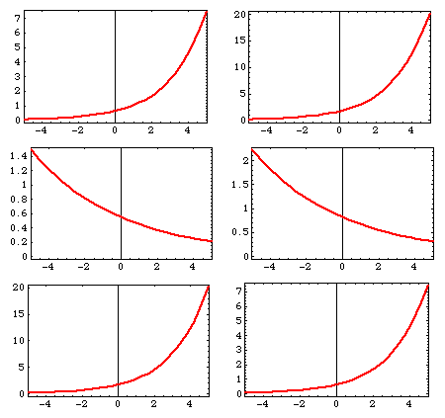

Slide 13
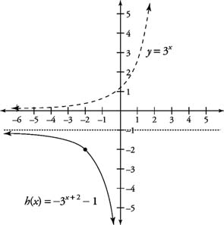

Slide 14
When A varies, what changes and what stays the same?

Slide 15
Talk about ....
In a right angled triangle, what happens to the ratio of the lengths of the side opposite the angle and the hypotenuse if the triangle is enlarged?

Slide 16
Give me an example of ....
A rational number which gets bigger when you raise it to the power of a positive integer
... and another
... and another
generalise

Slide 17
Can you make a ....
... rational number which gets bigger when you raise it to the power of -0.5?
What do all such numbers have in common?
Convince somebody

Slide 18
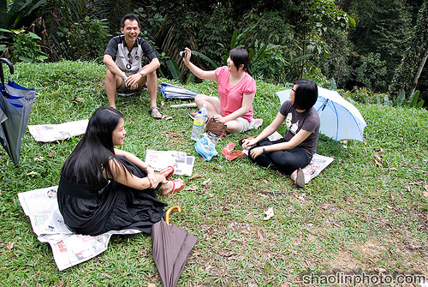
When and why will Y happen?

Slide 19
When and why will Y happen?
Three people are sitting around a circular table; where can you put the coffee pot so they are all the same distance from it?
Four people are sitting around on the grass for a picnic; when and why can you find a place to put the water bottle so they are all the same distance from it?

Slide 20
What does it look like/remind you of?
e^{2x} – 5e^{x} + 6 = 0
(e^{x}) ² – 5e^{x} + 6 = 0
² – 5 + 6 = 0

Slide 21
Give things to connect

Slide 22
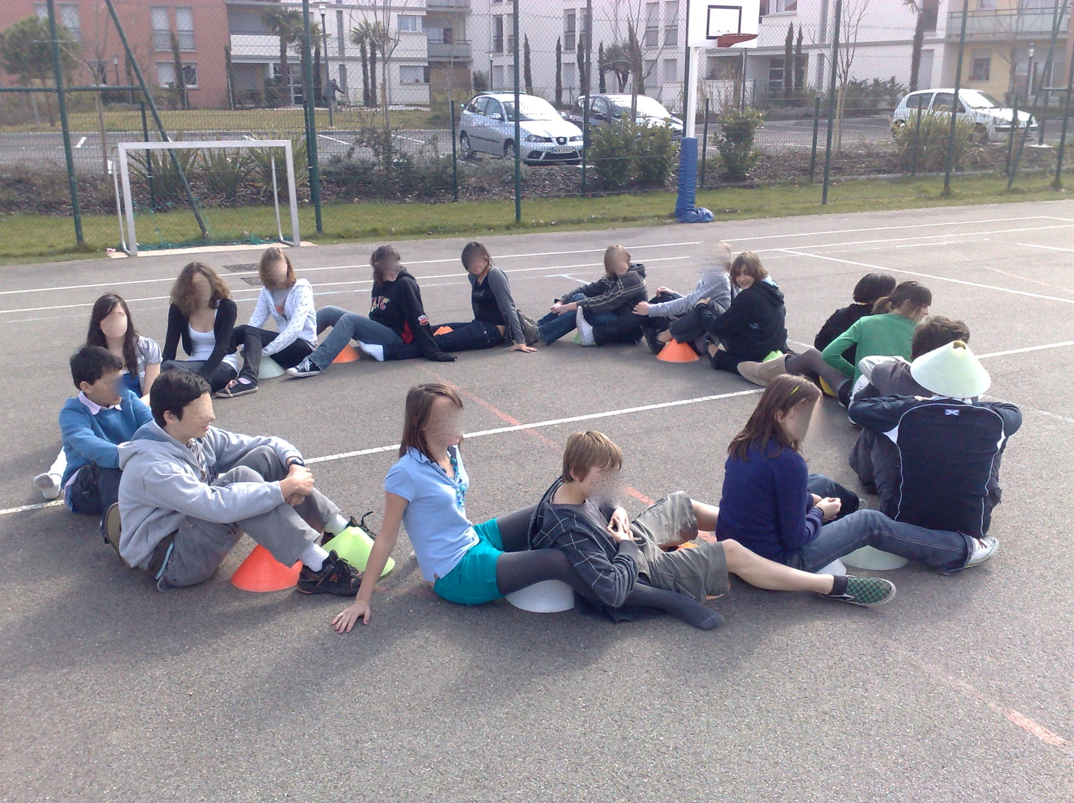

Slide 23
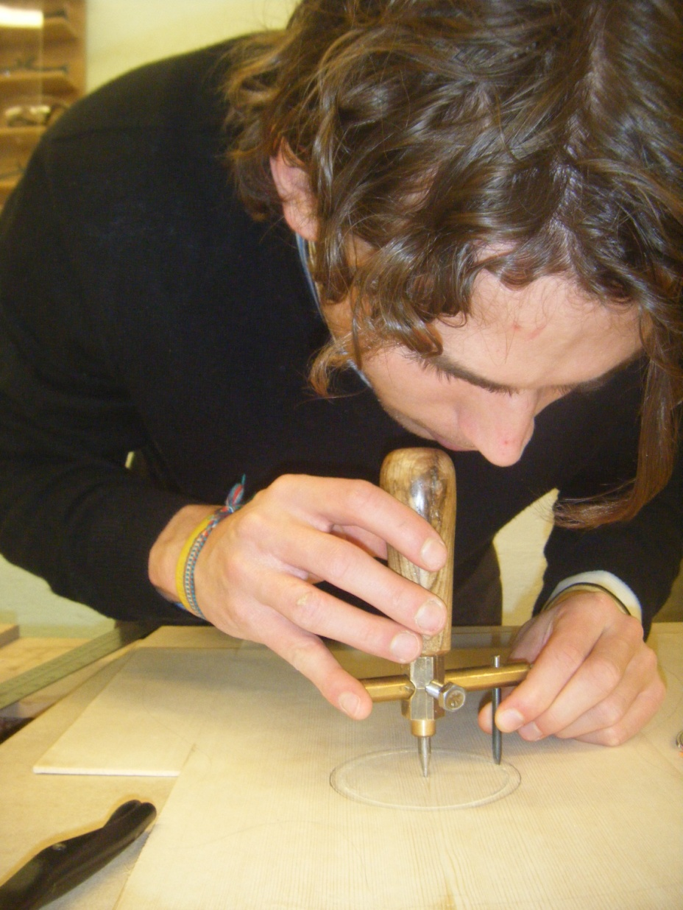
Notes:
So I looked at videos of some of these five lessons with Helen Doerr, and we noticed a subtle difference:
One teacher ‘same distance’ – relation to centre point is isomorphic
Another teacher – ‘all the points for which ...’ points and lines mean the same thing –joined up and two-way relations. You can see this in the two enactments of the circle. In one the points are important, in another they have tried to show continuity.
The surface features, even the pedagogic design, were very similar, but in the end what made the difference was the teacher’s own conceptualisation of locus –
This sense of ‘what is available to be learnt’ has exercised me for quite a few years now - at secondary level the teacher’s own conceptualisations are very important.

Slide 24
Successful all-attainment group teaching
Being true to the complexity, abstraction and formalisation of maths
Reaching out to learners to pull them in
Showing them the scenery

Slide 25
CMTP project (www.cmtp.co.uk)
Remember something familiar
Students see and describe something new
Teacher points class attention towards new idea
Tasks draw personal attention towards new idea
Outcomes of the task are analysed and generalised
Ideas are synthesised – language and notations
Rigorous statements
Later - tasks to become familiar with new idea
Later - tasks to generate fluency

Slide 26
Deep progress in mathematics
Learning more mathematics
Getting better at learning mathematics
Feeling better about learning mathematics

Slide 27
Thankyou
anne.watson@education.ox.ac.uk
www.cmtp.co.uk
http://www.atm.org.uk/reviews/books/deepprogressinmathematics.html

