Slide 1
Pedagogical Mathematics for Student Exploration of Threshold Concepts
Promoting Mathematical Thinking
John Mason
KHDM
Hannover Dec 2015
The Open University
Maths Dept
University of Oxford
Dept of Education

Slide 2
Outline
Some Background Constructs
Example from Linear Algebra
Some Pedagogical Constructs

Slide 3
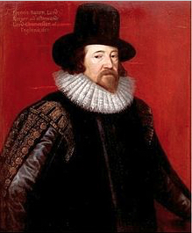
Insight from Francis Bacon
So knowledge, while it is in aphorisms and observations, it is in growth; but once it is comprehended in exact methods, it may perchance be further polished and illustrated, and accommodated for use and practice; but it increaseth no more in bulk and substance (Francis Bacon 1609)

Slide 4
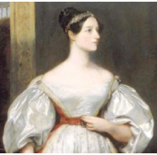
Inspiration from Ada Lovelace
Mathematical science ... is the language of unseen relations between things. But to use and apply that language, we must be able fully to appreciate, to feel, to seize, the unseen, the unconscious.
Imagination is the Discovering Faculty, pre-eminently … it is that which feels & discovers what is, the REAL which we see not, which exists not for our senses.

Slide 5
Some Background Constructs
Pedagogical Mathematics
Mathematical problems arising from pedagogical situations (Mason 2007)
Threshold Concepts
concepts that need to be deeply comprehended, appreciated and integrated into learners’ functioning so as to make progress, and which, once appreciated, are ever-present to inform related concepts and the carrying out of procedures (Meyer & Land 2003).
Ubiquitous Mathematical Themes
Doing & Undoing (Bypasses)
Invariance in the midst of change
Freedom & Constraint
Organising & Characterising
Notes:
Mason, J. (2007). Mathematical Pedagogy. PIMS Celebration Lecture, Simon Fraser University, Vancouver.
Meyer, J. and Land, R. (2003).Threshold concepts and troublesome knowledge (1): linkages to ways of thinking and practising, in Rust, C. (Ed.), Improving Student Learning – ten years on. Oxford: OCSLD.

Slide 6
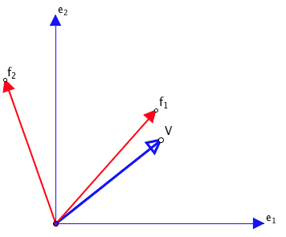
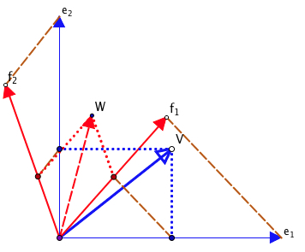
Linear Algebra
Given a basis for an image space, how do you find the new coordinates of the image vector W of a vector V (geometrically)?

Slide 7
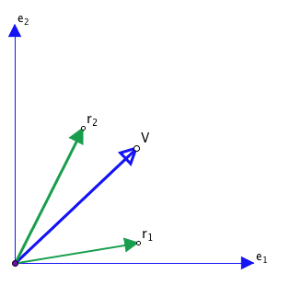
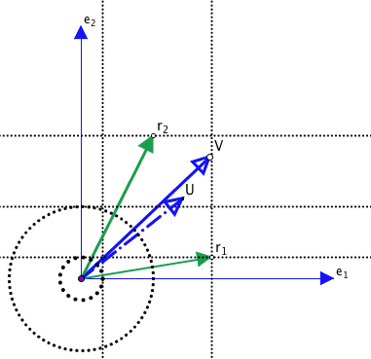
Row Spaces
Given a basis for a row-space, how do you find the image U of a vector V?

Slide 8
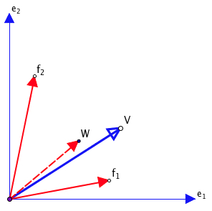
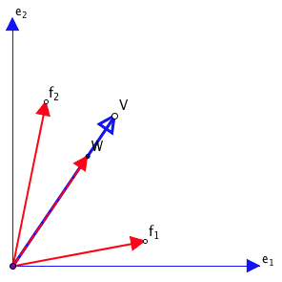
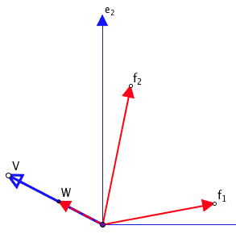
Eigen Directions
Traditional to ask when V and its image W are aligned

Slide 9
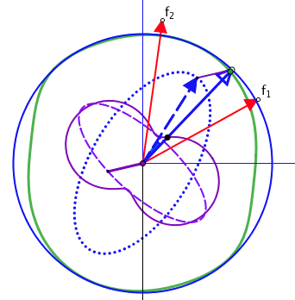
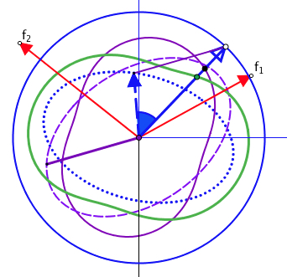
Getting an Angle
When is the angle between vector V and image W the greatest, and when the least?
Green is cosine of angle between V and W
Purple is length of VW associated with V
Dashed Purple is the VW vector
Notes:
Which one has the eigen directions?

Slide 10
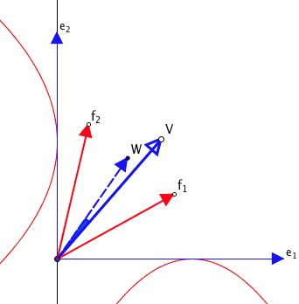
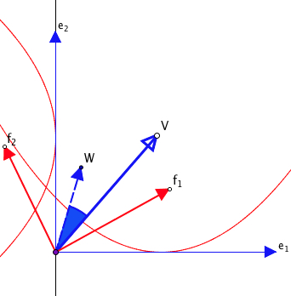
Changing the Column Space Basis
Sometimes there are eigen directions, sometimes not
Fixing f1 what is the boundary at which f2 yields eigen directions or fails to have eigen directions?

Slide 11
Some Pedagogical Constructs
Integration through Subordination
Concept Images, Example Spaces & Question Spaces
Assenting & Asserting; Conjecturing Atmosphere
Task Roles:
To introduce a topic
To develop and enrich learner example spaces mid topic
To review a topic
To obtain evidence of appreciation and comprehension (understanding) of topic
See-Experience-Master; Manipulating–Getting-a-sense-of–Articulating; Enactive–Iconic–Symbolic
Notes:
Person who learns most from an applet is probably the applet constructor.

Slide 12
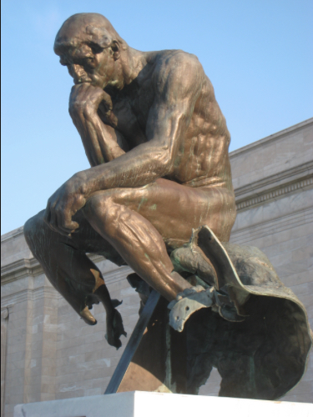
Thank you for stimulating me to develop this particular domain

Slide 13
Follow-Up
Full length draft paper
Mathematics Teaching Practice: a guidebook for university and college lecturers. Chichester: Horwood Publishing, (2002)
Designing and Using Mathematical Tasks. St. Albans: Tarquin. (2004 2nd edition 2006)
Fundamental Constructs in Mathematics Education. London: RoutledgeFalmer.

