Slide 1
Developing the Inner Explorer in Spatial Reasoning
The Open University
Maths Dept
Promoting Mathematical Thinking
University of Oxford
Dept of Education
John Mason
Tønsberg Norway Sept 2016

Slide 2
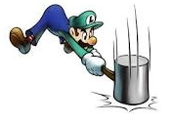
Throat Clearing
Everything said here is a conjecture …
… to be tested in your experience
My approach is fundamentally phenomenological … I am interested in lived experience.
Radical version: my task is to evoke awareness (noticing)
So, what you get from this session will be mostly …
… what you notice happening inside you!
Avoid the teaching of speculators, whose judgements are not confirmed by experience. (Leonardo Da Vinci)
Who takes initiative?
Who makes choices?
What is being attended to?

Slide 3
Possibilities
Tower Distributions
Ordering Perspectives
Projections
Scaling from different centres
Exploiting Area Relationships (Fraction adding)
Law of Cosines and Vecten

Slide 4
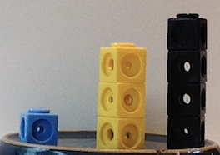
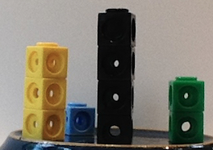
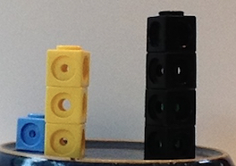
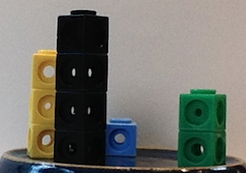
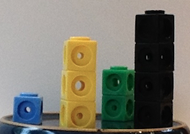
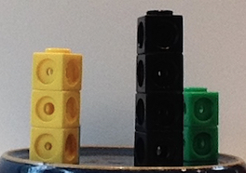
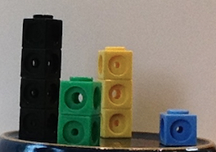
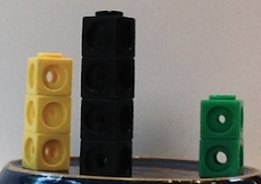
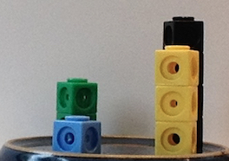
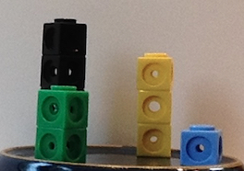
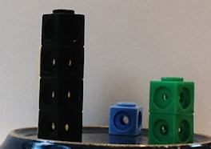
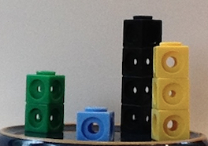
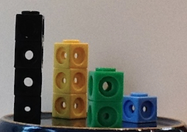
Spatial Ordering
Spot the duplicate!
Put the pictures in order, justifying your choices
Notes:
What orders are possible to arrange to see?

Slide 5
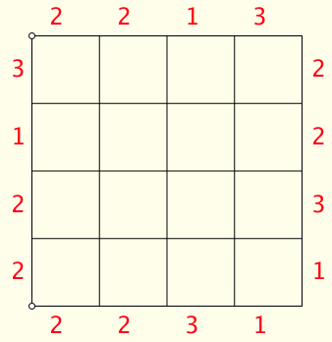
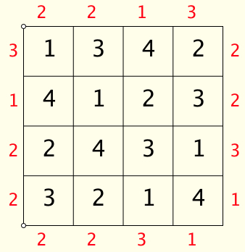
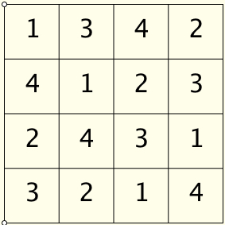
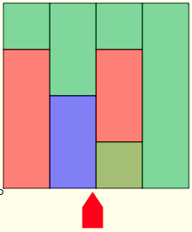
Tower Grids
Each cell in this 4 by 4 grid has a tower whose height is shown.
Here is the view from the South (bottom)
The red numbers count the number of towers that can be seen from that direction.
Given the red numbers (tower visibility counts) can you (always) reconstruct the tower heights?
Are there any constraints on possible Tower Visibility Counts?

Slide 6
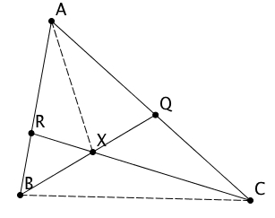
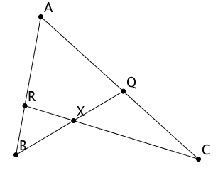
Geometric Fraction Multiplication
How many pairs of triangles can you see with a ‘common vertex’ and bases on the same line?
Notes:
Scale B towards A to reach R, then scale R towards C to reach X
It nust be the same as scaling B towards Q to reach X

Slide 7
Lemma
implies

Slide 8
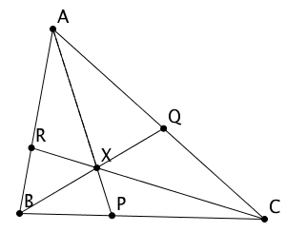
Consequences of Embedded Figures
How many triangles can you see?
How many pairs of triangles can you see with ‘a common vertex and bases on a common line’?

Slide 9
Consequences of Embedded Figures

Slide 10
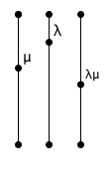
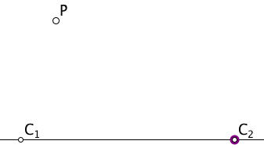
Compound Scalings
Everything in the plane is going to be scaled by a factor of μ from a point P.
Then everything is going to be scaled by a factor of λ from a point Q.
Is it possible to achieve the same over-all effect by scaling by some factor σ from some point R?

Slide 11
Compound Rotations
Everything in the plane is going to be rotated through an angle of θ anti-clockwise around a centre P.
Then everything is going to be through an angle of φ anti-clockwise around a centre Q.
Is it possible to achieve the same over-all effect by rotating through some angle around some centre R?
Does the order matter?

Slide 12
Rotating and Scaling
Everything in the plane is going to be rotated anti-clockwise through an angle of θabout a centre P and then scaled by a factor of μ from a point Q.
Is it possible to achieve the same overall effect by rotating about some point and scaling from that same point?
Does the order matter?

Slide 13
Compound Dilatations
Everything in the plane is going to be rotated through an angle of θ anti-clockwise around a centre P and scaled by a factor μ from P.
Then everything is going to be rotated through an angle of φanti-clockwise around a centre Q and scaled by a factor of λ from Q.
Is it possible to achieve the same over-all effect by rotating through some angle around some centre R and scaling by some factor σ?

Slide 14
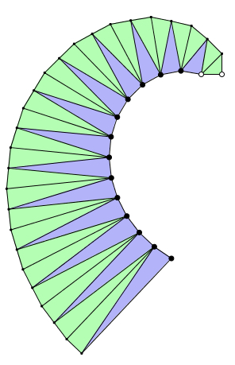
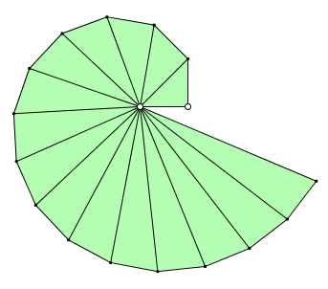
Pythgorean Spiral of Theodorus (465-398 BCE)
Say What You See
What could be varied?
Notes:
Say What you See

Slide 15
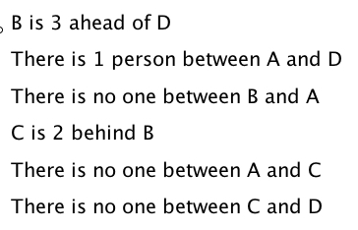
Queuing
B
A
C
D

Slide 16
Projections

Slide 17
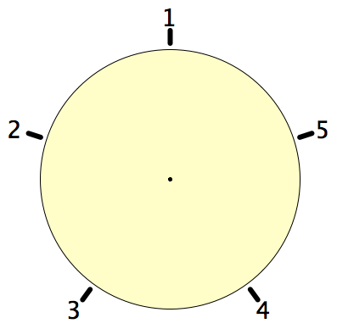
Secret Places
One of these five places has been chosen secretly.
You can get information by clicking on the numbers.
If the place where you click is the secret place, or next to the secret place, it will go red (hot), otherwise it will go blue (cold).
How few clicks can you make and be certain of finding the secret place?
Can you always find it in 2 clicks?
Notes:
Imagine a round table …

Slide 18
Magic Square Reasoning
What other configurations like this give one sum equal to another?
6
7
2
2
1
5
9
Try to describe them in words
2
8
3
4
Any colour-symmetric arrangement?
)
Sum(
–
Sum ( )
= 0
Notes:
Think of all the patterns obtained like this one but with different choices of the red line and the blue line.
Sketch a few
Here is another reasoning
What about this pattern: is it true?
did you have difficulty recognising the components? This may be why learners find it hard to remember what they were taught recently!

Slide 19
More Magic Square Reasoning
Sum(
)
–
Sum( )
= 0

Slide 20
Reflection
Withdrawing from action
Becoming aware of an action, or a relationship
NOT ‘telling them so they remember’ BUT rather immersing them in a culture of mathematical practices

Slide 21
Mathematical Thinking
How might you describe the mathematical thinking you have done so far today?
How could you incorporate that into students’ learning?
What have you been attending to:
Results?
Actions?
Effectiveness of actions?
Where effective actions came from or how they arose?
What you could make use of in the future?

Slide 22
Reflection as Self-Explanation
What struck you during this session?
What for you were the main points (cognition)?
What were the dominant emotions evoked? (affect)?
What actions might you want to pursue further? (Awareness)
Notes:
Chi et al

Slide 23
Powers & Themes
Powers
Imagining & Expressing
Conjecturing & Convincing
Specialising & Generalising
Organising & Characterising
Themes
Doing & Undoing
Invariance in the midst of change
Freedom & Constraint
Restricting & Extending

Slide 24
To Follow Up
PMTheta.com
john.mason@open.ac.uk
Designing & Using Mathematical Tasks (Tarquin)
Mathematics as a Constructive Enterprise (Erlbaum)
Thinking Mathematically (Pearson)
Key Ideas in Mathematics (OUP)
Researching Your Own Practice Using The Discipline of Noticing (RoutledgeFalmer)
Questions and Prompts: (ATM)
Annual Institute for Mathematical Pedagogy (end of July: see PMTheta.com)

