Slide 1
§3 Reasoning
IMM 2021

Slide 2
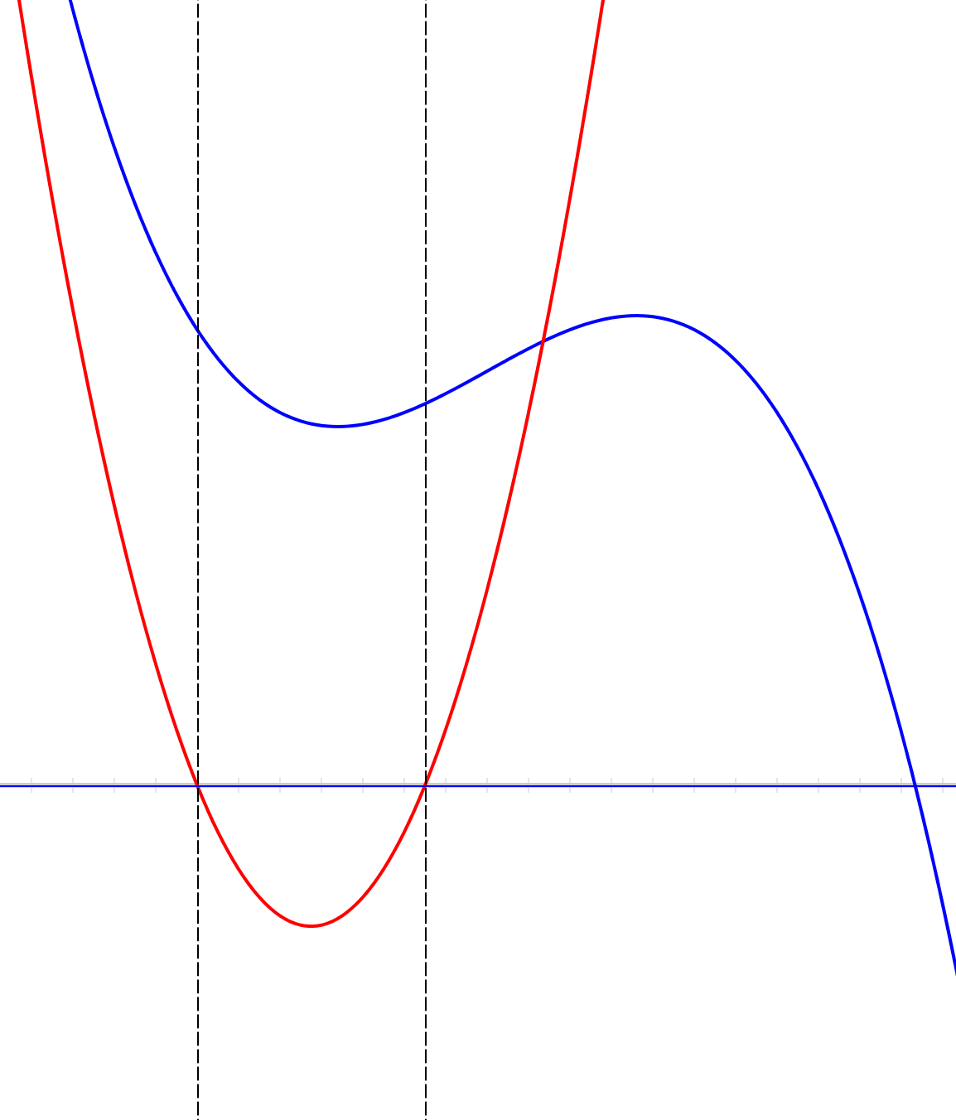

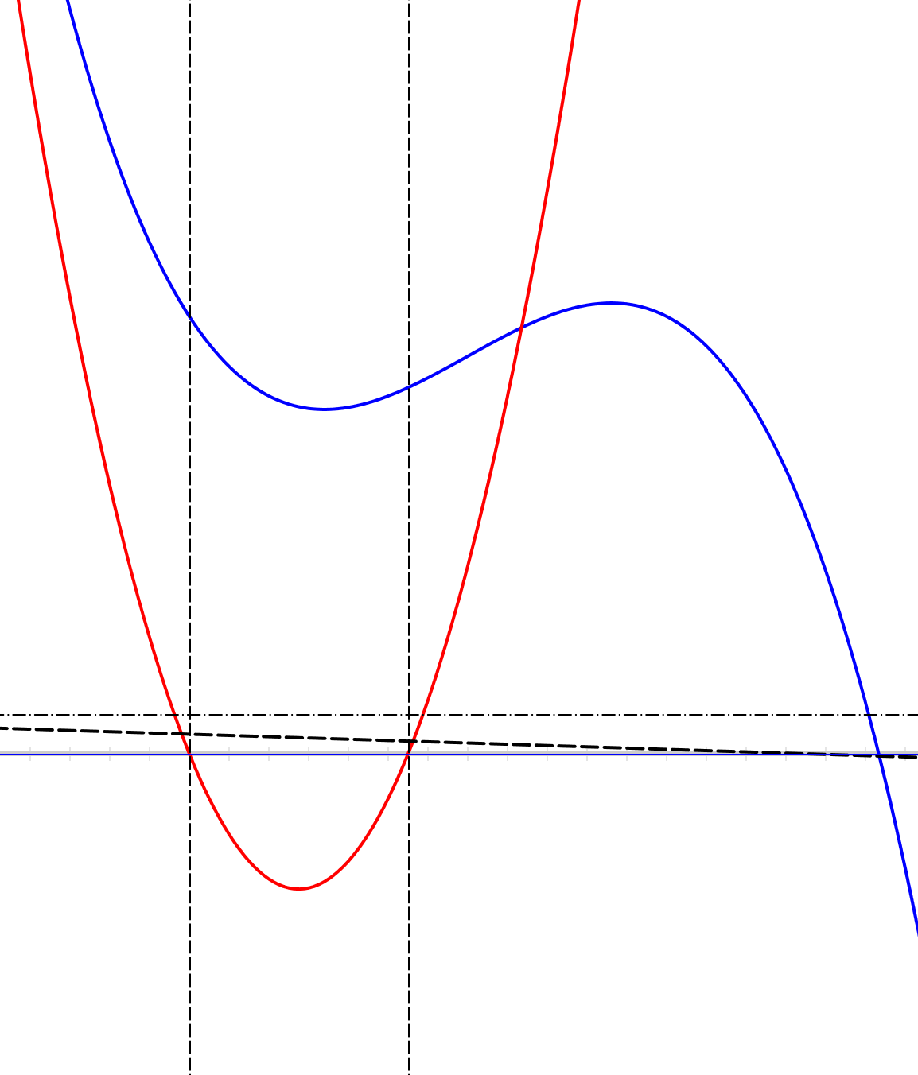
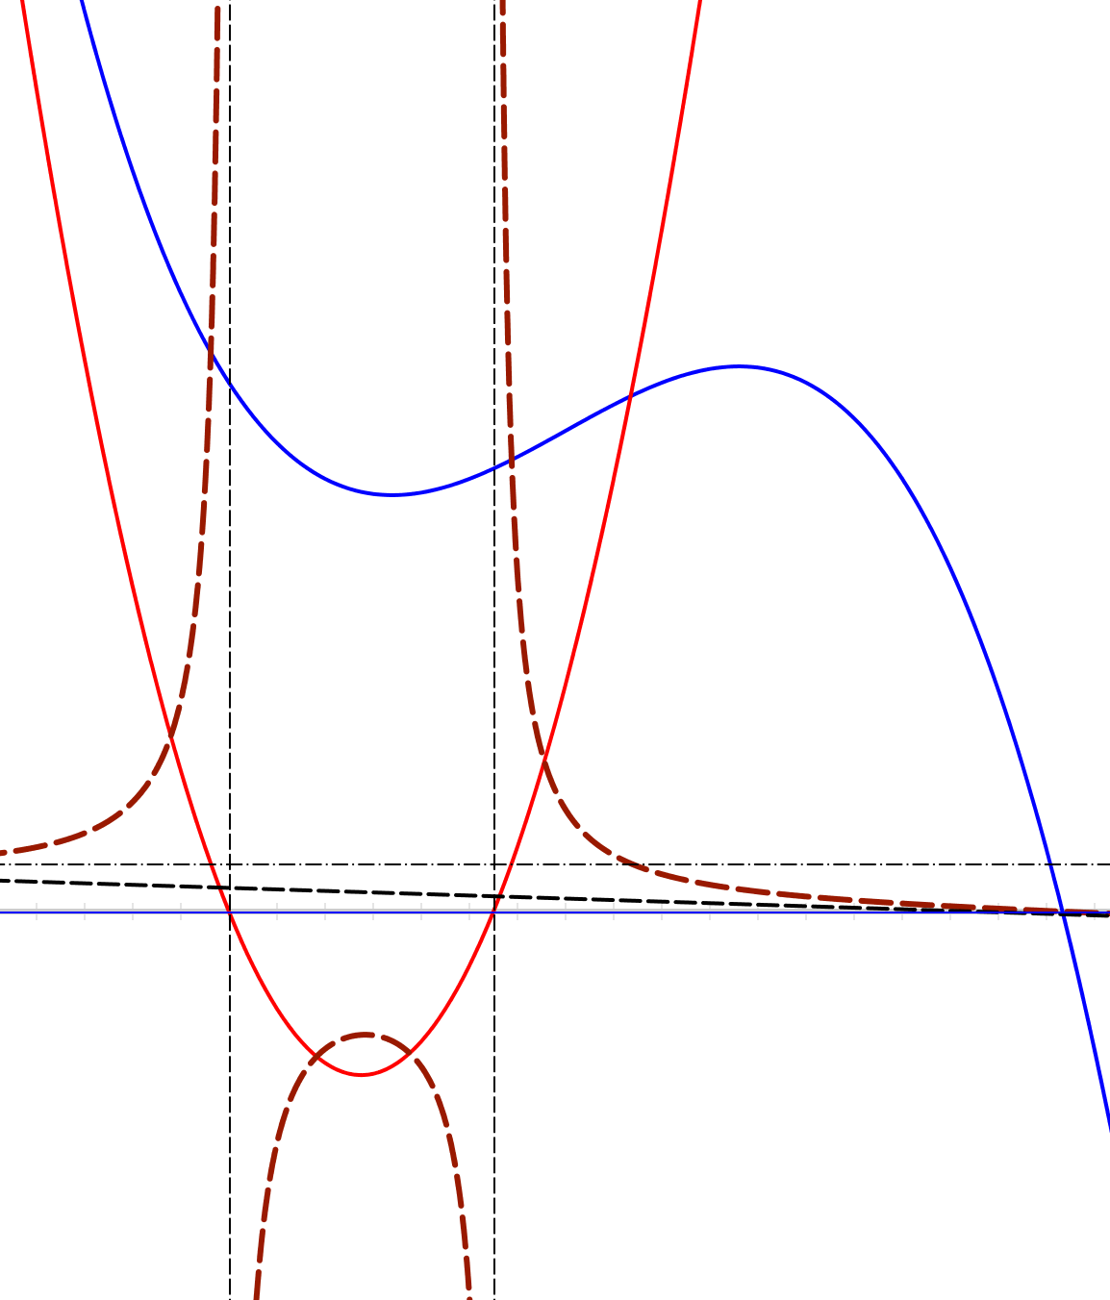
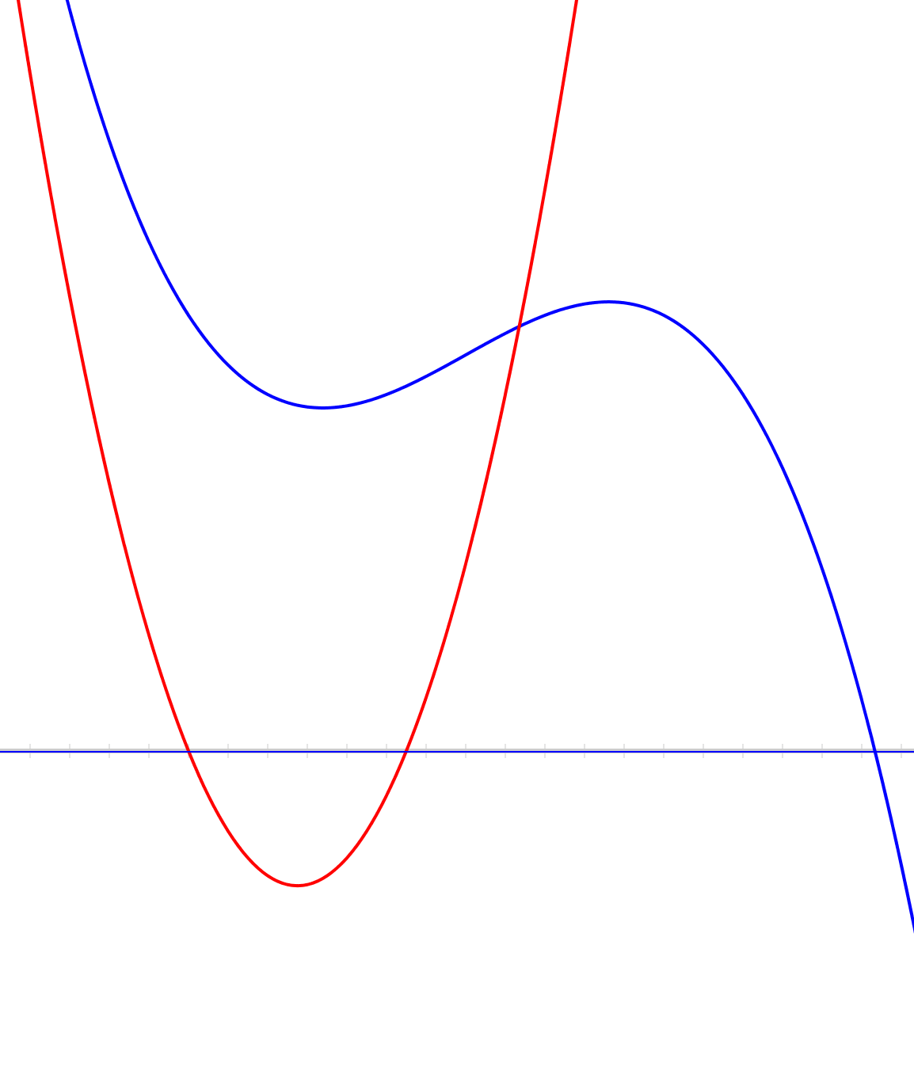
Task 1: Being Rational about Polynomials
You see here the graphs of two polynomials.
One is the numerator and one the denominator of a ‘rational polynomial’
What can you deduce about the graph of the rational polynomial?

Slide 3
Personal Narrative
Tell yourself a story about what was going on in that task

Slide 4
Did You Notice:
Use of natural powers?
  Imagining & Expressing
  Specialising & Generalising
  Conjecturing & Convincing
  Organising & Characterising
  Others?
Encountering Mathematical Themes?
  Doing & Undoing
  Invariance in the midst of change
  Freedom & Constraint
  Making the implicit explicit
  Others?
Shifts of Attention?
  Gazing (Holding Wholes)
  Discerning Details
  Recognising Relationships
  Perceiving Properties as being instantiated
  Reasoning on the basis of agreed properties

Slide 5
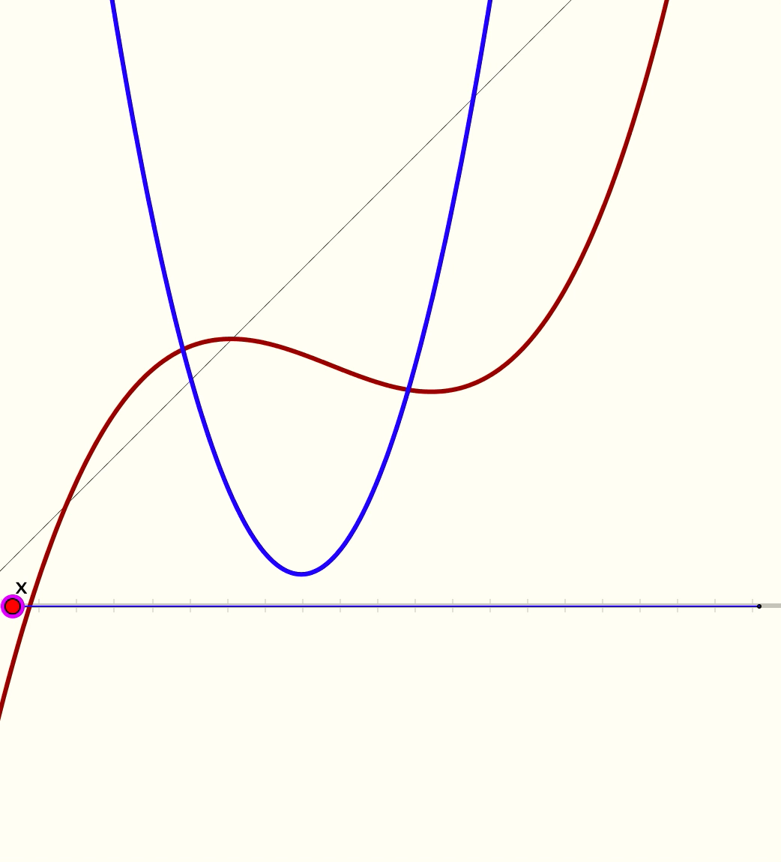
Combining Two Functions
Here are the graphs of a quadratic and a cubic, and the line
y = x
Describe the construction shown in the animation

Slide 6
Personal Narrative
Tell yourself a story about what was going on in that task

Slide 7
Did You Notice:
Use of natural powers?
  Imagining & Expressing
  Specialising & Generalising
  Conjecturing & Convincing
  Organising & Characterising
  Others?
Encountering Mathematical Themes?
  Doing & Undoing
  Invariance in the midst of change
  Freedom & Constraint
  Making the implicit explicit
  Others?
Shifts of Attention?
  Gazing (Holding Wholes)
  Discerning Details
  Recognising Relationships
  Perceiving Properties as being instantiated
  Reasoning on the basis of agreed properties

Slide 8
gcd & LCM
gcd = greatest common divisor of two positive integers denoted (a, b)
LCM = lowest Common Multiple of two positive integers denoted [a, b]

Slide 9
Rational Division
The rational number is said to be divisible by the
rational number if
is an integer
What is the LCM of and ?
What is the gcd of and ?

Slide 10
Personal Narrative
Tell yourself a story about what was going on in that task

Slide 11
Did You Notice:
Use of natural powers?
  Imagining & Expressing
  Specialising & Generalising
  Conjecturing & Convincing
  Organising & Characterising
  Others?
Encountering Mathematical Themes?
  Doing & Undoing
  Invariance in the midst of change
  Freedom & Constraint
  Making the implicit explicit
  Others?
Shifts of Attention?
  Gazing (Holding Wholes)
  Discerning Details
  Recognising Relationships
  Perceiving Properties as being instantiated
  Reasoning on the basis of agreed properties

Slide 12
Reflection on Sessions
What struck you particularly?
What natural powers might be worth developing?
What Mathematical Themes might be worth looking out for?
What might you do when you find that you are stuck?

Slide 13
On Getting Unstuck
Becoming explicitly aware of being stuck
Calling upon mathematical actions and personal powers
  Specialise (work through an example, paying attention to what happens, and using that as the basis for generalising)
  Treating all insights as conjectures that need justifying
  Gazing (Holding Wholes)
  Discerning Details
  Recognising Relationships (in the particular situation)
  Perceiving Properties as being instantiated
  Reasoning on the basis of agreed prioperties

Slide 14
Follow Up
John.mason @ open.ac.uk
PMTheta.com
Thinking Mathematically (2010) Routledge

