Slide 1


What Makes an Example
Exemplary?
(probing accessible example spaces)
New Mathematics Lecturers
Cambridge
Sept 14-15 2022

Slide 2
Throat Clearing
My focus is on lived experience of learners
It requires a Conjecturing Atmosphere
  Everything said is a conjecture …
  uttered with the intention of modifying it as seems necessary
  You must not believe anything I say … you must test it in your experience
Sage advice is to get to know your students
  I shall concentrate on getting to know them mathematically
  What they are absorbing, how they are progressing
What might be available from this session
  some task structures or types that you can modify and adapt
  some maths education constructs which underpin these
Although the slides are in a semi-coherent order, I am likely to jump about according to what strikes me
I am unlikely to say anything that you don’t already know, but you may not have thought of it in the context of your teaching

Slide 3
Experience
Please sketch an example of a function continuous on R and differentiable everywhere except at one point.
  And another (differently non-differentiable)
  And another (again differently non-differentiable)
Articulate your ‘sense’ of the space of continuous functions failing to be differentiable at a single point.

Slide 4

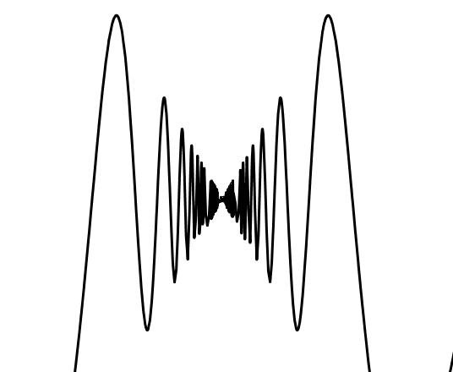

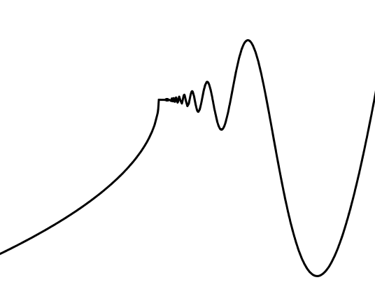
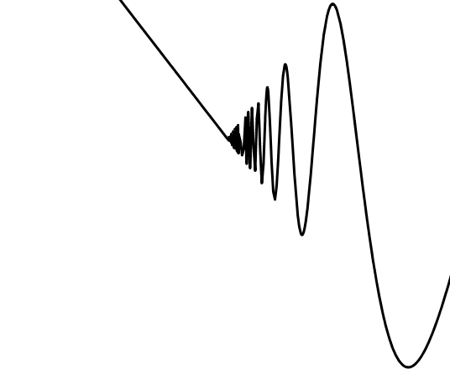
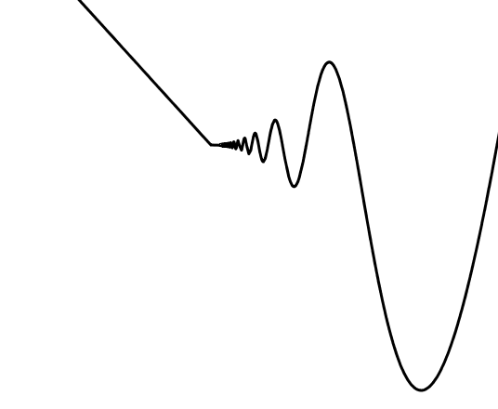

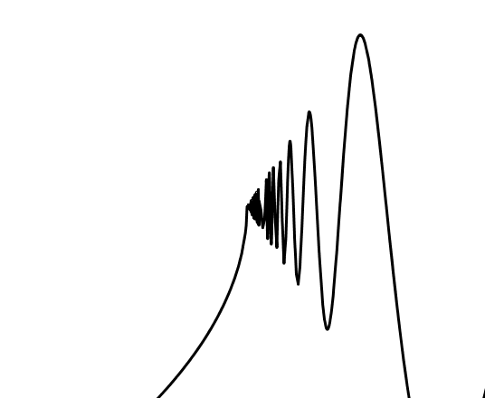
Experience
In what essentially different ways can a continuous function fail to be differentiable at a single point?
Student’s accessible example space:
What is the same and what different about each pair of graphs?
Objects
For each triple, what is the same about two but different from the third?
Construction techniques

Slide 5
Reflection on Experience
In what essentially different ways can a continuous function fail to be differentiable at a single point?
What did you do to make sense of these objects?
initial Gazing
Discerning Details
Telling yourself a story
Personal Narrative
Recognising Relationships
Perceiving Properties
Reasoning on the basis of Properties

Slide 6

Using Symbols
Conjecture:
you might have had a taste of what it might be like for your students to encounter stuff you put on a board or screen
What to attend to, and how?
So what might a student ‘do’ with this example?
Some conjectures:
It all takes time!!
For a moment you were simply aware of a complex of symbols, particularly summations
Holding Wholes (gazing)
At some point you picked out a detail
(a summation probably)
and re-expressed it verbally, or even algebraically
Discerning Details
Recognising Relationships
Repeating this, you eventually recognised relationships between some details
At some point you made use of properties that you know hold in general
Perceiving Properties
Which enabled you to reason algebraically
Reasoning on the basis of agreed properties

Slide 7

Using Symbols
So what might a student ‘do’ with this example?
n = 3: 3 + 4 + 5 + 6 = 3x6
n = 4: 6 + 7 + 8 + 9 + 10 = 4x10

Slide 8
Phenomena
Students often ignore conditions when applying theorems
Students often ask for more examples ...
Students often have a very limited notion of mathematical concepts ...
  But do they know what to do with the examples they have?
  What do students need to do with the examples they are given?
  What is it about some examples that makes them useful for students?

Slide 9
What do students say?
“I seek out worked examples and model answers”
“I practice and copy in order to memorise”
“I skip examples when short of time”
“I compare my own attempts with model answers”
NO mention of mathematical objects other than worked examples!
Notes:
These are Oxford ugs starting their 2nd year in mathematics

Slide 10
Worked Examples & Case Studies
Do you use worked examples (case studies) in your teaching?
Ancient history:
  ”Do thou likewise”; “Thus is it done”; …
Current Govt Policy
  I do; We do; You do
  Templating: changing numbers to match
Extensive Research
  What matters is not so much what you do next,
  as how you know what to do next
  Self-Explanations or Personal Narratives are vital
What is important about worked examples?
  knowing the criteria by which each step is chosen
  knowing things that can go wrong, conditions that need to be checked
  having an overall sense of direction
  having recourse to conceptual underpinning if something goes wrong
You may have noticed (2000 years of trials)
that practice does not by itself make perfect:
most learners do not learn robustly and meaningfully simply by rehearsing techniques on similar ‘examples’.

Slide 11

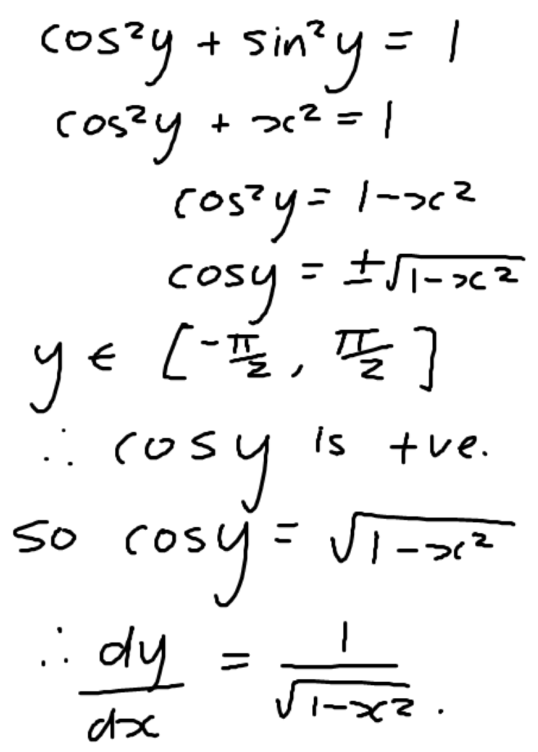
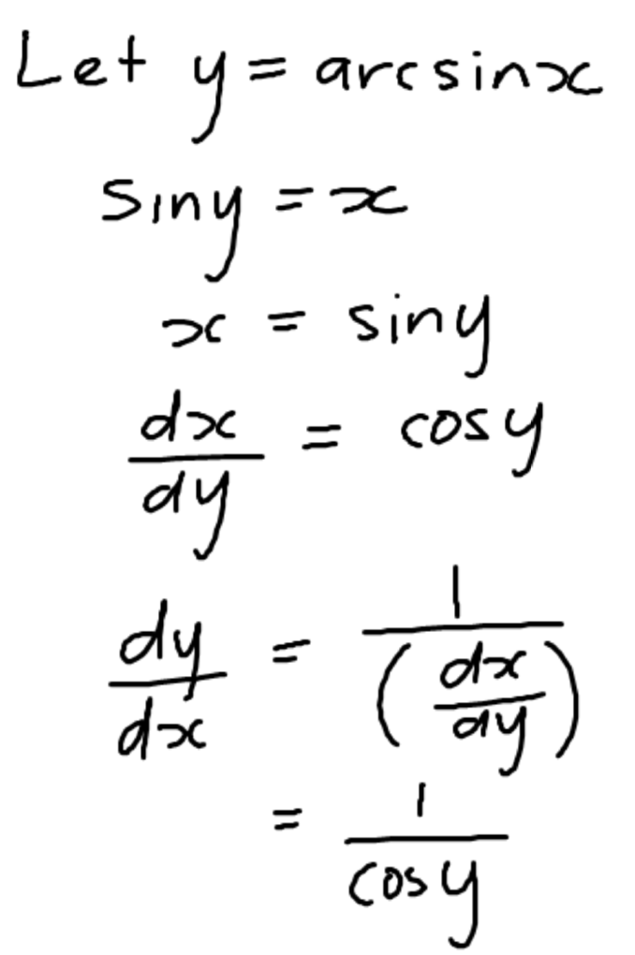
Differentiating Inverse Functions
Foci of attention?
Main idea(s)?
Main steps?
How know what to do next?
Notes:
https://www.adelaide.edu.au/mathslearning/resources/maths1a/maths1a-examples-calc-diff.pdf

Slide 12

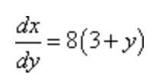
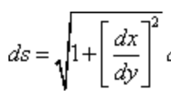


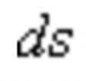


Helpful working
Step 1
Since we are not told which ds to use we will have to decide which one to use. In this case the function is set up to use the ds in terms of y.
If we were to solve the function for y (which we’d need to do in order to use the ds that is in terms of x) we would put a square root into the function and those can be difficult to deal with in arc length problems.
Note that we did not square out the term under the root. Doing that would greatly complicate the integration process so we’ll need to leave it as it is.
Step 2
In this case we don’t need to [do] anything special to get the limits for the integral. Our choice of ds contains a dy which means we need y limits for the integral and nicely enough that is what we were given in the problem statement. So, the integral giving the arc length is,
Finally all we need to do is evaluate the integral. In this case all we need to do is use a trig substitution. We’ll not be putting a lot of explanation into the integration work so if you need a little refresher on trig substitutions you should go back to that section and work a few practice problems.
…
Note use of ‘heads-up’ advice
Note use of ‘we’
Note use of ‘all we need to do’
Notes:
http://tutorial.math.lamar.edu/Problems/CalcII/ArcLength.aspx

Slide 13
Change of Perspective
What are they attending to?
What are they aware of?
What actions become available?
What do they actually know?
Accessible Example Space
Educated Awareness
Exposed through the construction of examples
Actions available

Slide 14
Examples of Mathematical Objects
Do you provide examples of
  mathematical objects?
  ways of making sense of a definition?
  the use of mathematical proof methods?
  The application of mathematical procedures?
What do you do with examples in your own work?
What would you like students to do with examples?
What do you do publicly with the examples you give?
Unfortunately, students sometimes over-generalise, mis-generalise
or fail to appreciate what is being exemplified
  To find 10% you divide by 10
  so to find 20% you … .
  The centre of the circle (x-1)² + (y+1)² = 2² is [1, –1] and radius = 2
  so the centre of the circle (x-2)² + (y+3)² = 5² is [3, -2] and radius = 2 (?)
Concept Definition
Concept Image
Are learners attending to the same details that you are?
Are learners attending in the same way that you are?

Slide 15
Definitions
Please write down a definition of what it means for a straight line to be tangent to a curve at a point
  different textbooks have different definitions, with slightly different consequences
Providing examples is a classic pedagogic approach
  but are students attending to the details and relationships which you are attending to?
Concept Definition
Concept Image
Developed through examples

Slide 16
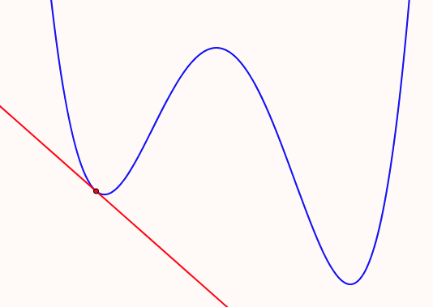
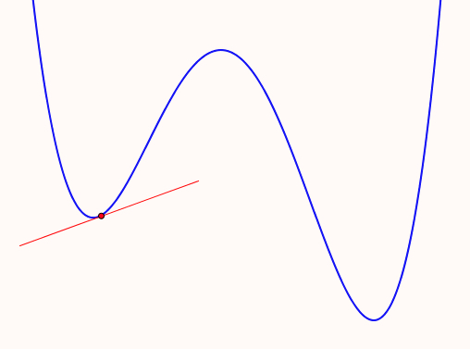
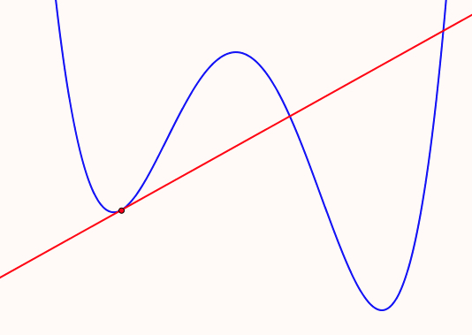
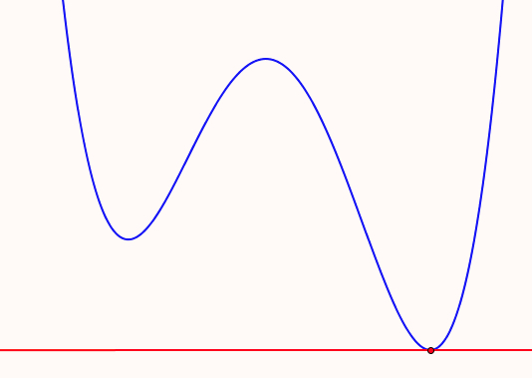
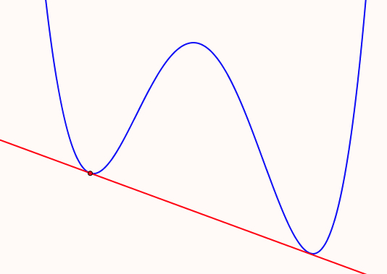
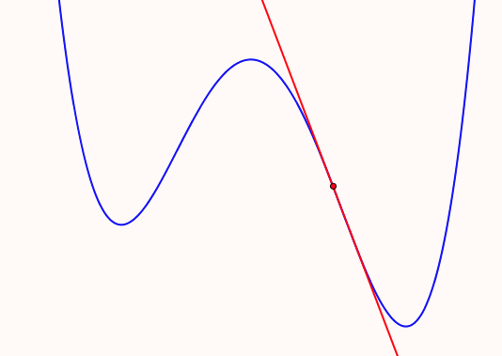
Tangents
Sketch some examples of tangents to a quartic for students learning about tangents
Example Space
of types of tangency
What misapprehensions might be induced by any one of these?

Slide 17
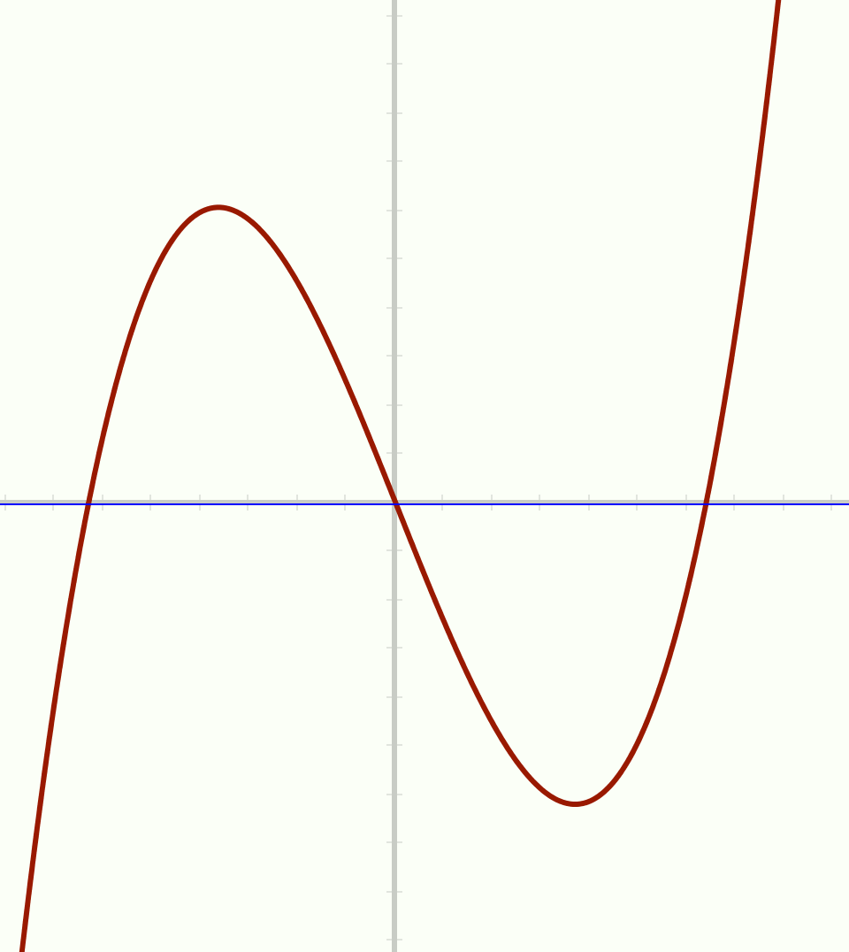
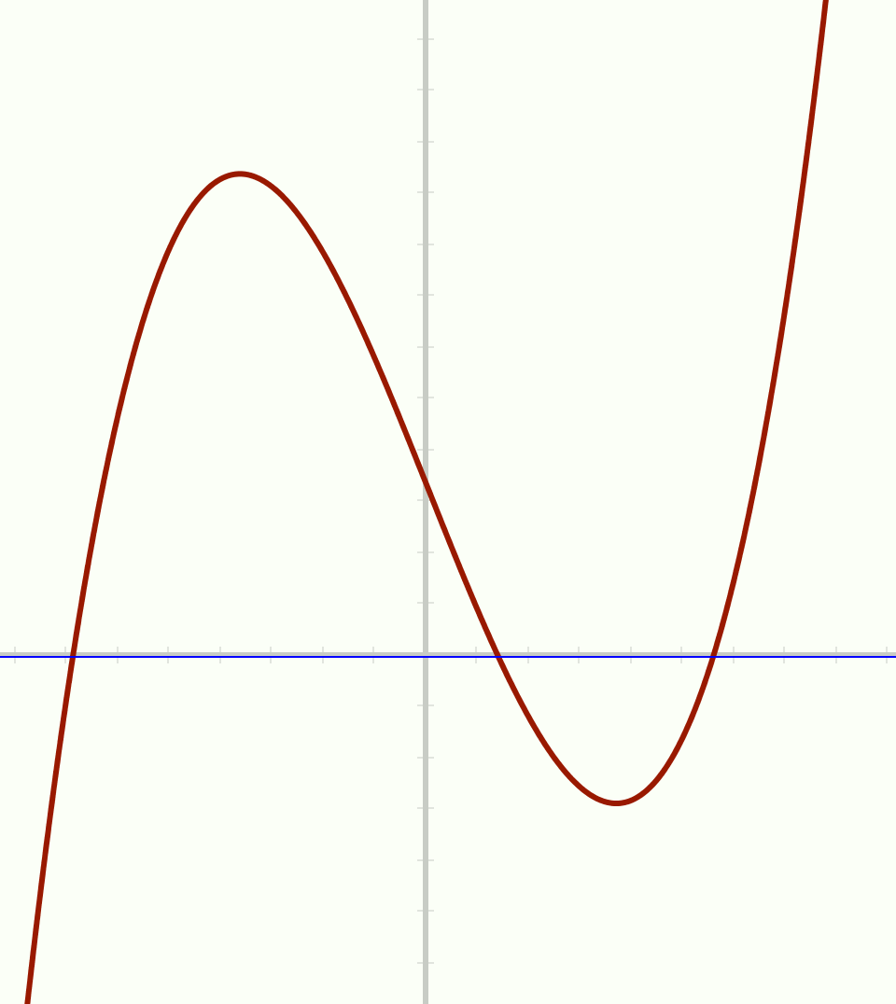
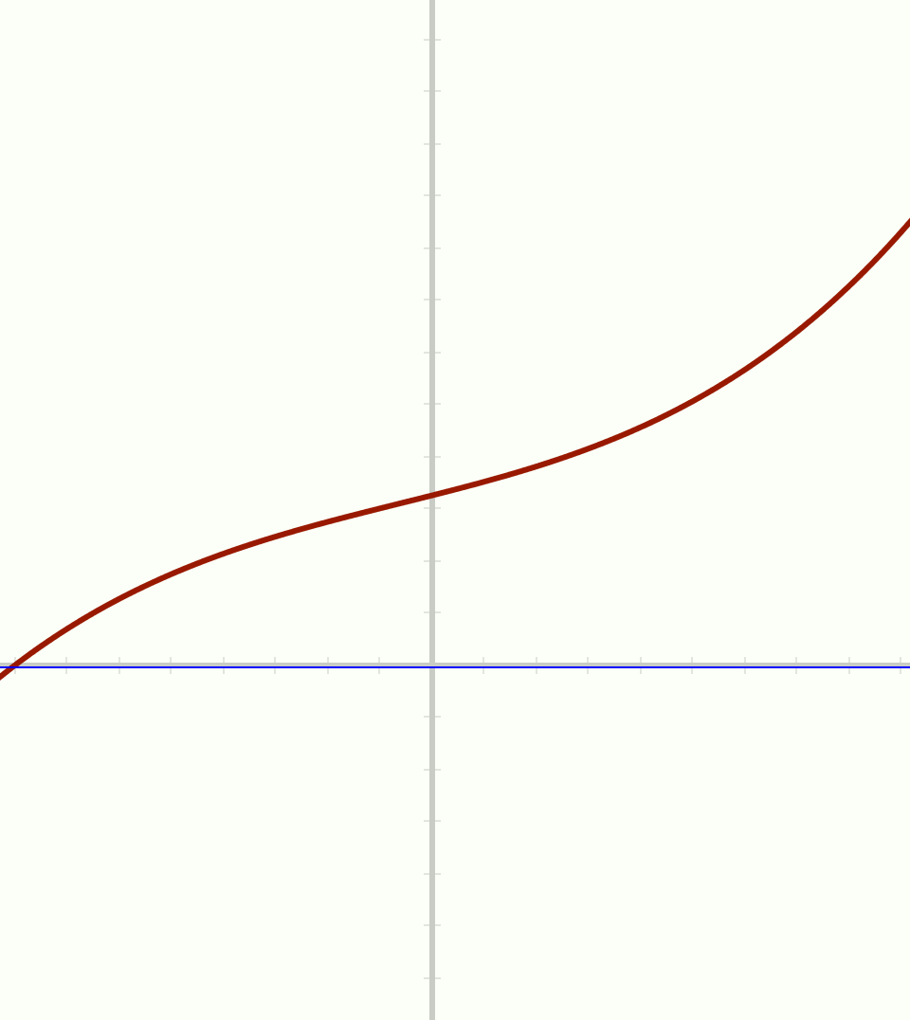
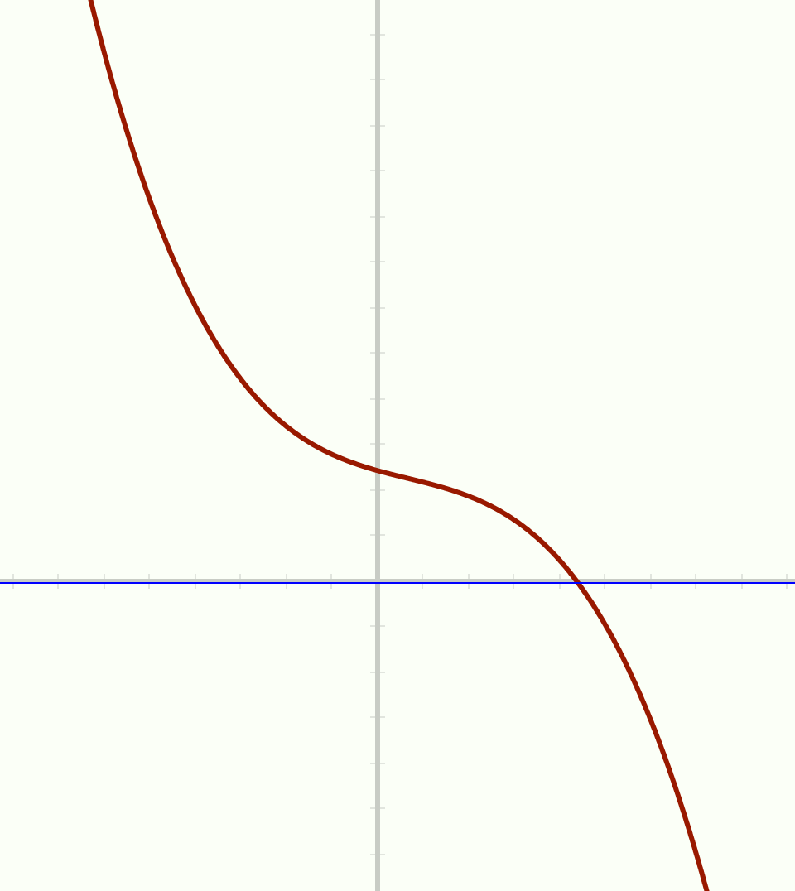
Imposing Constraints
Sketch a cubic
which does not go through the origin
and which is monotonic
and for which the inflection slope is negative
Is there a quadratic whose root-slopes are perpendicular?
Is there a cubic whose root-slopes are consecutively perpendicular?
Is there a quartic whose root-slopes are consecutively perpendicular …?
  is it possible for other angles to be alternating root-slopes?
Notes:
Aim is to impose a constraint which is contrary to implicit assumptions made by learners in order to enrich and expand their example space: quadratic & cubic are possible; quartic is not.
In fact, for any polynomial with distinct real roots, the sum of the cotangents of the root slopes is always zero! More generally, if a line of slope m cuts a polynomial of degree d in d distinct points, the sum of the cotangents of the angles between the tangents at the cutting points and the straight line is md.

Slide 18
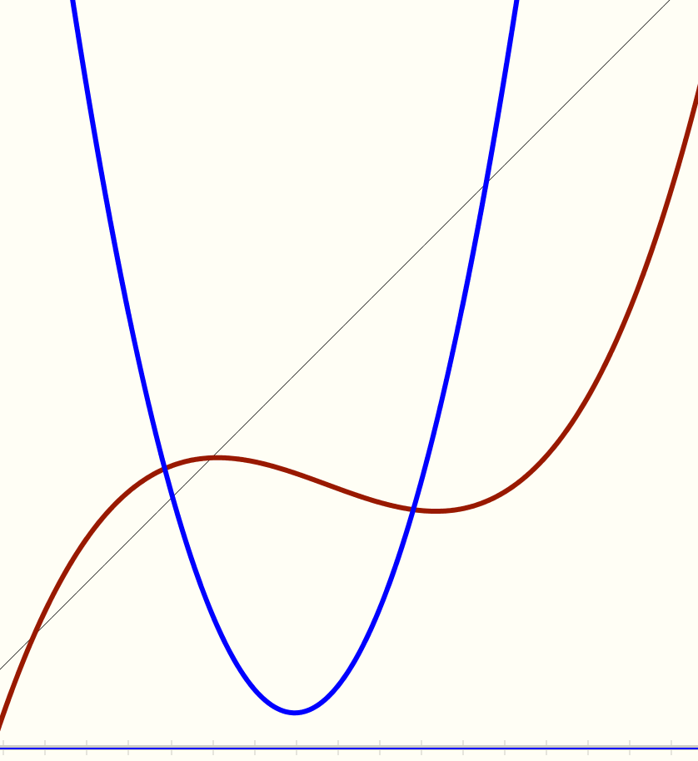
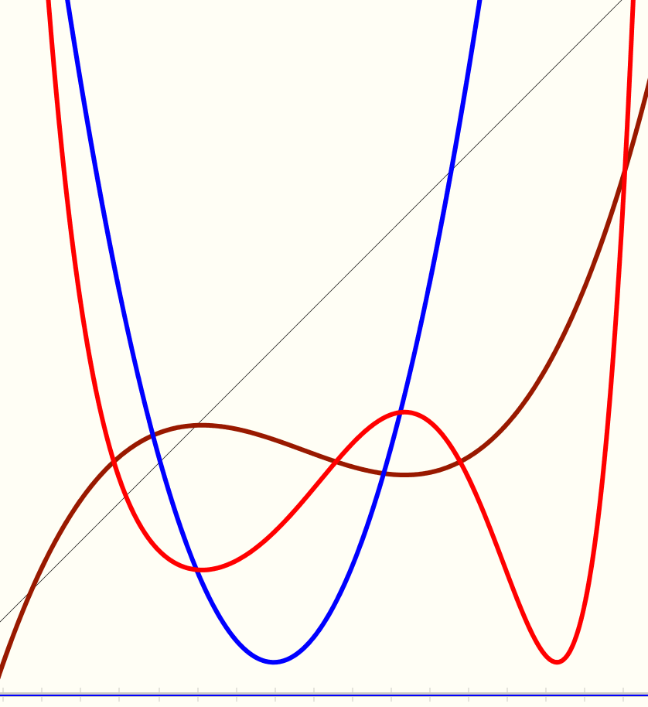
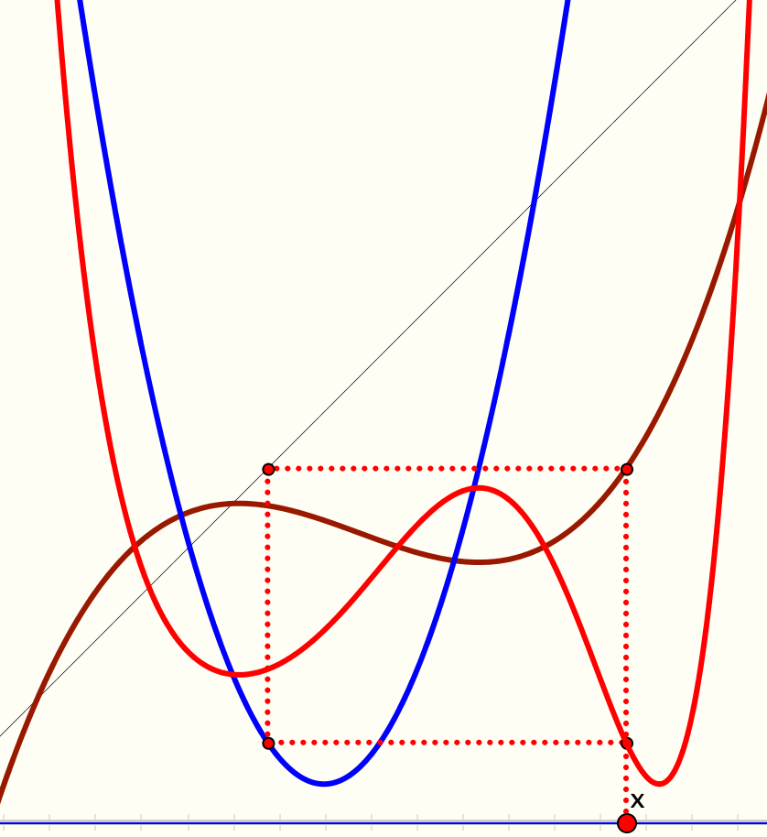
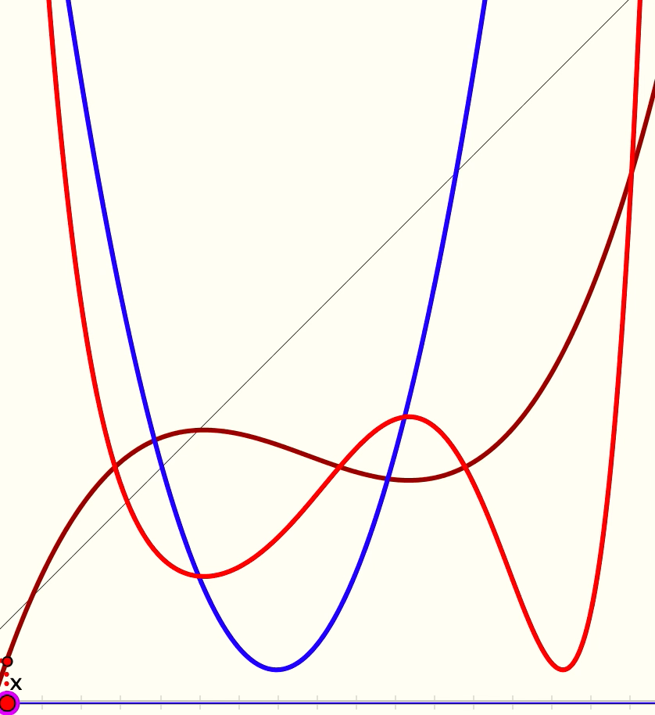
Different Presentations
y = x
Imagine the composites
of these two functions
Which one is this?
How does this help??

Slide 19
Cobwebs Reviewed
What was being exemplified in this task version?
  Exploiting properties
  Relative affordances of
  static picture,
  with construction lines,
  animation,
  interactive software
What can be exemplified in a developmental task version?
  Cubic specified by 4 points, Quadratic by 3;
  Any cubic; Any quadratic;
  Cobweb constructions and reading graphs using coordinates
  Way to think about or work with composite functions
  Properties of composite functions

Slide 20
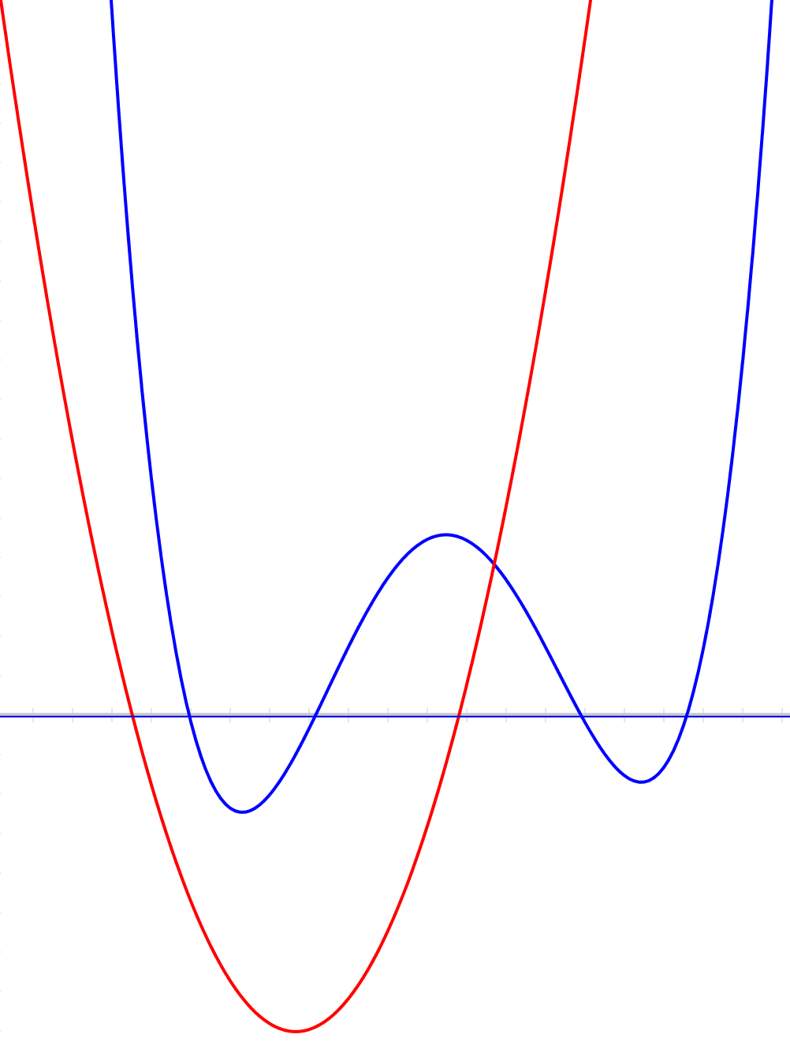
Rational Polynomials
Blue is the numerator of degree 4
Red is the denominator of degree 2
Imagine the graph of the quotient
What happens when the zeros of the denominator are moved?

Slide 21
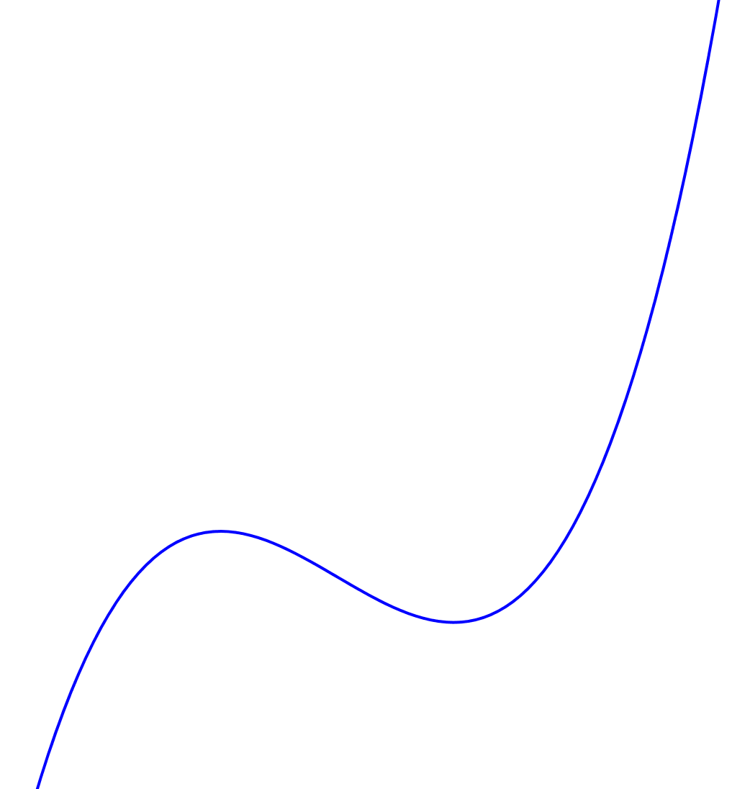
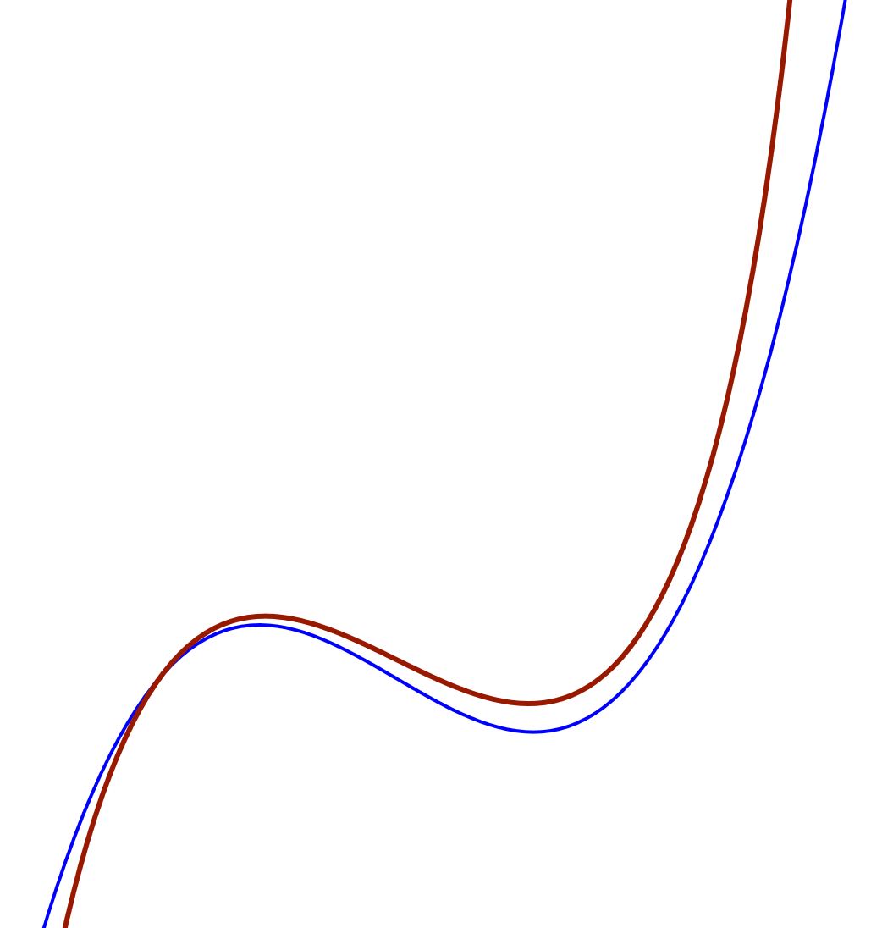
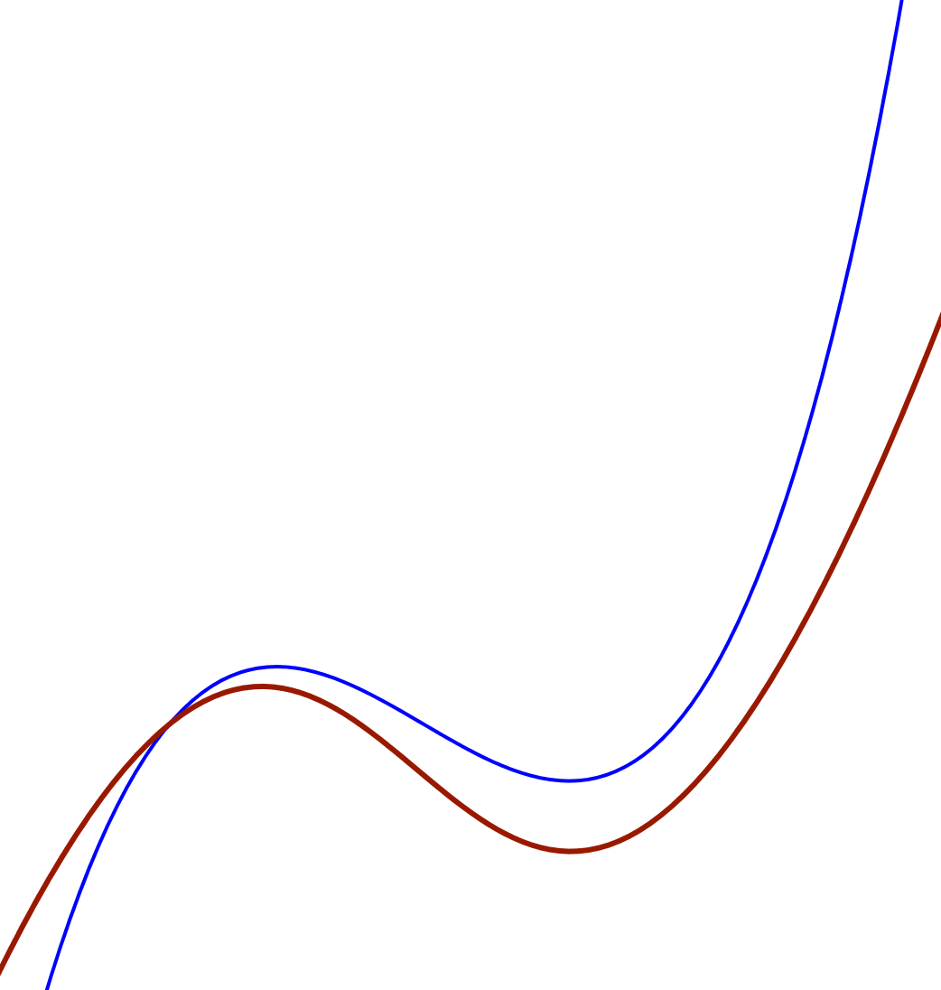
When is a Curve the Graph of a Function?
Through what angles could the graph of a cubic be rotated and still be the graph of a function?

Slide 22
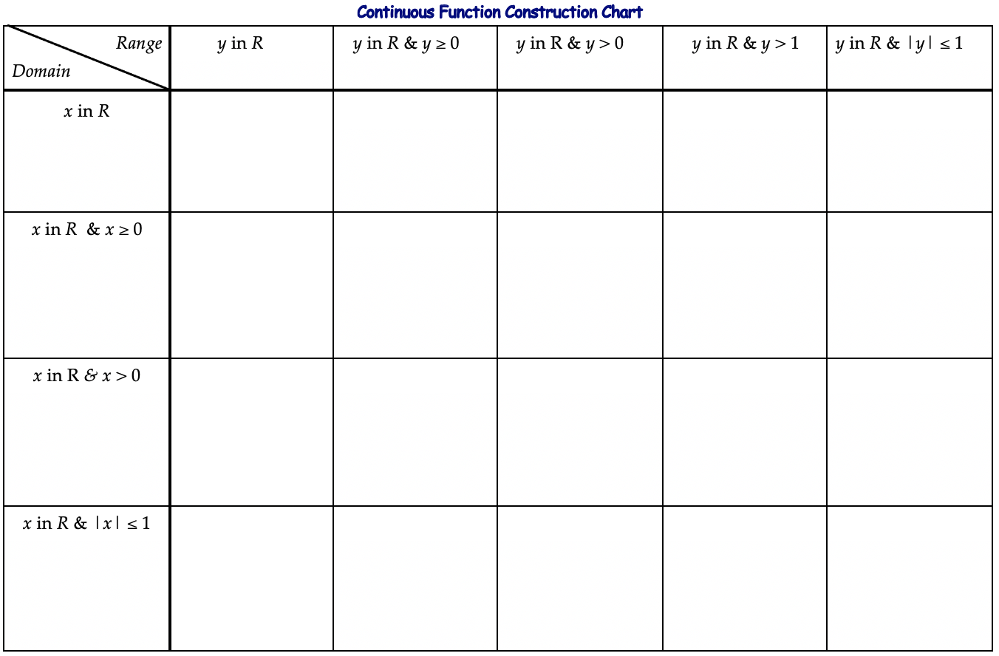
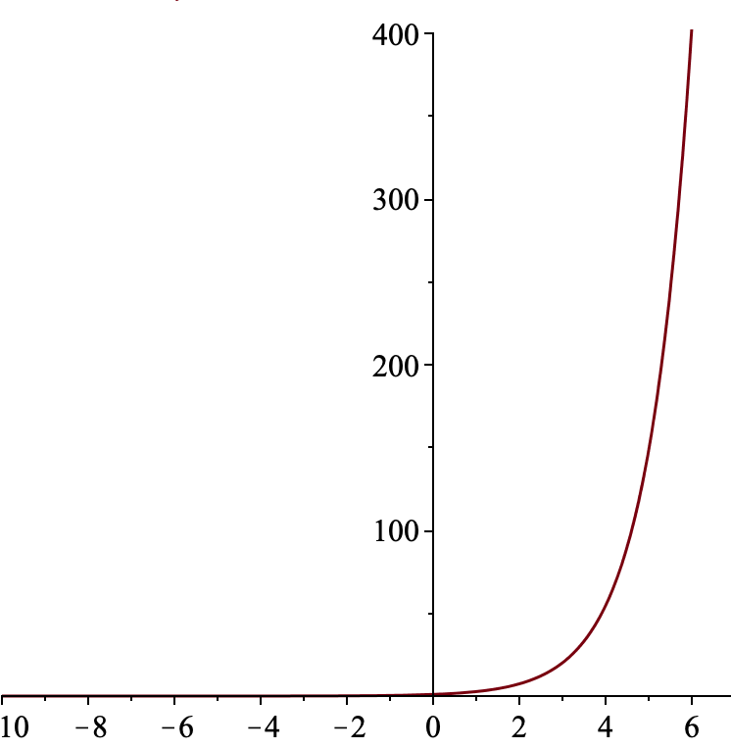
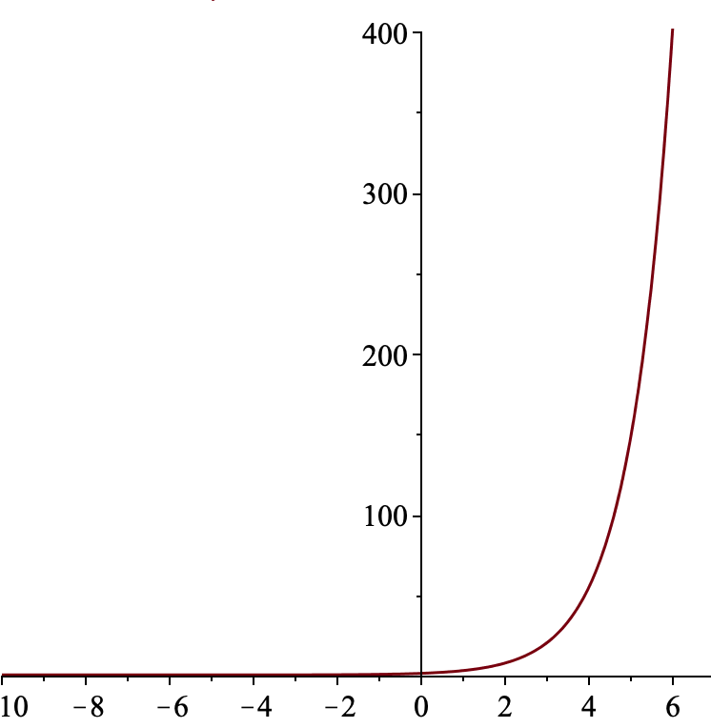
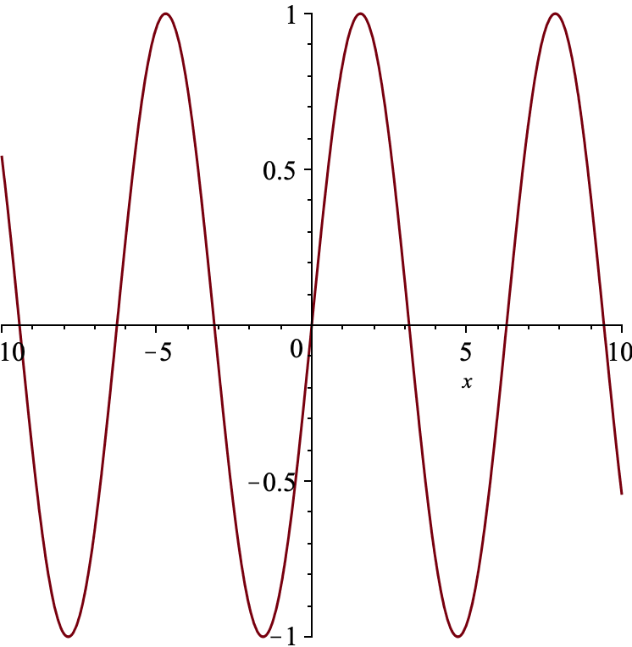
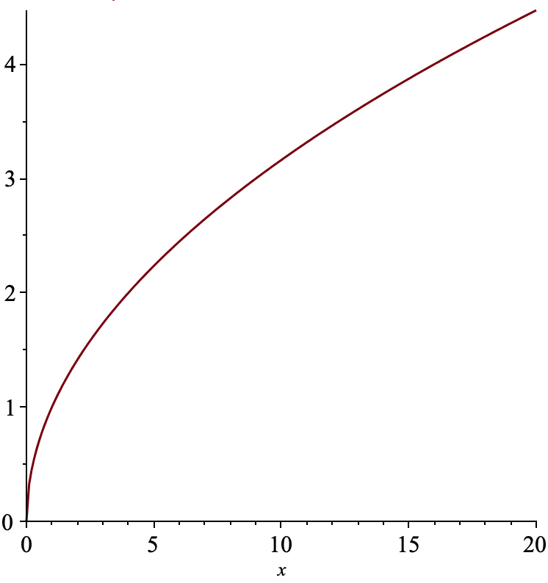
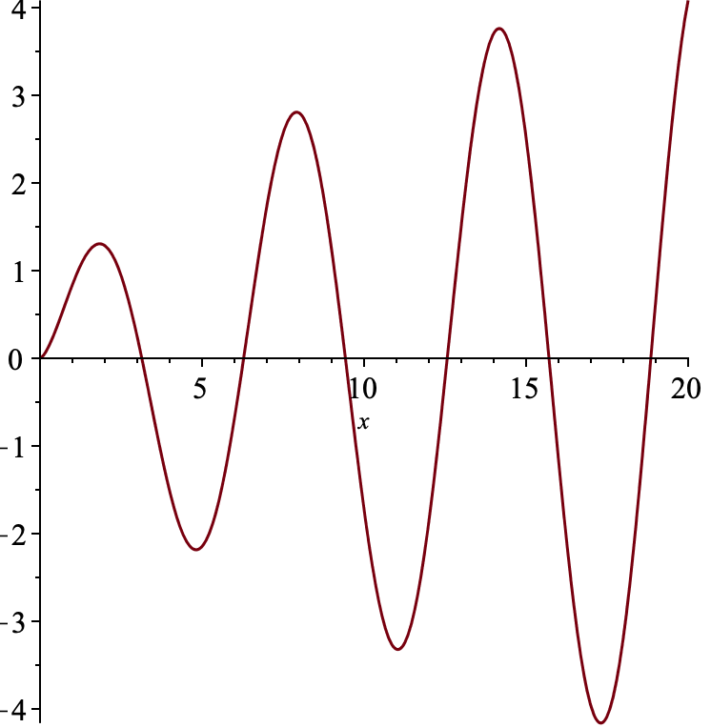
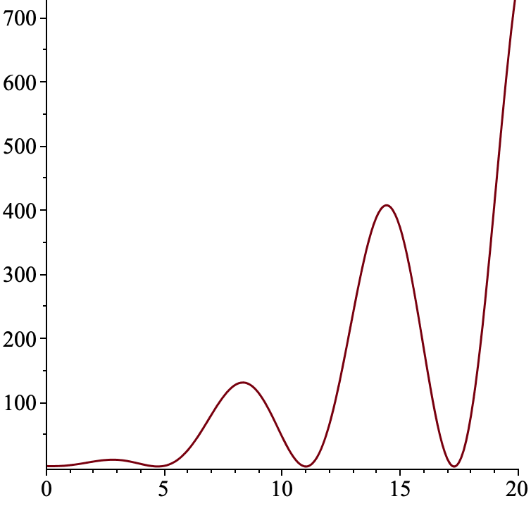
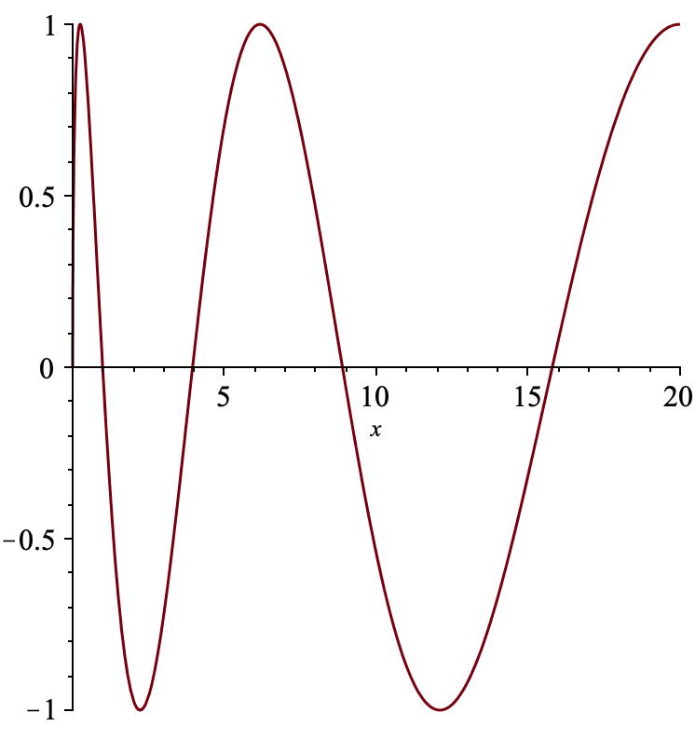
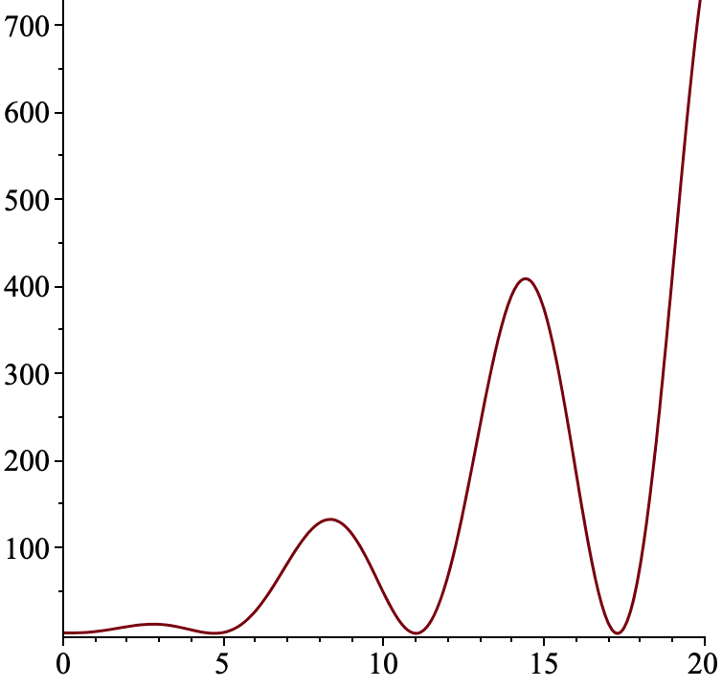
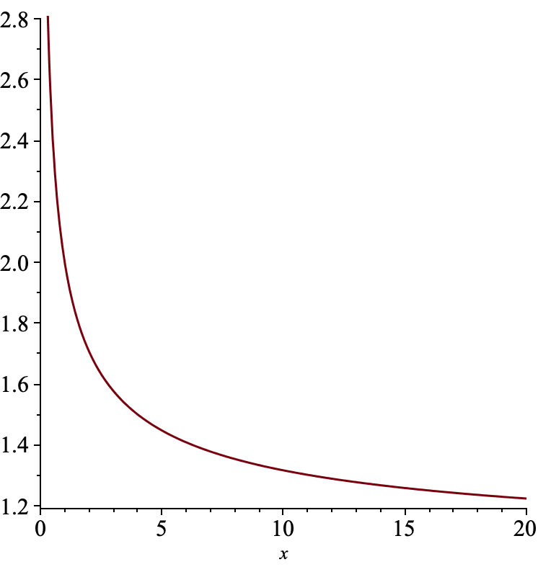
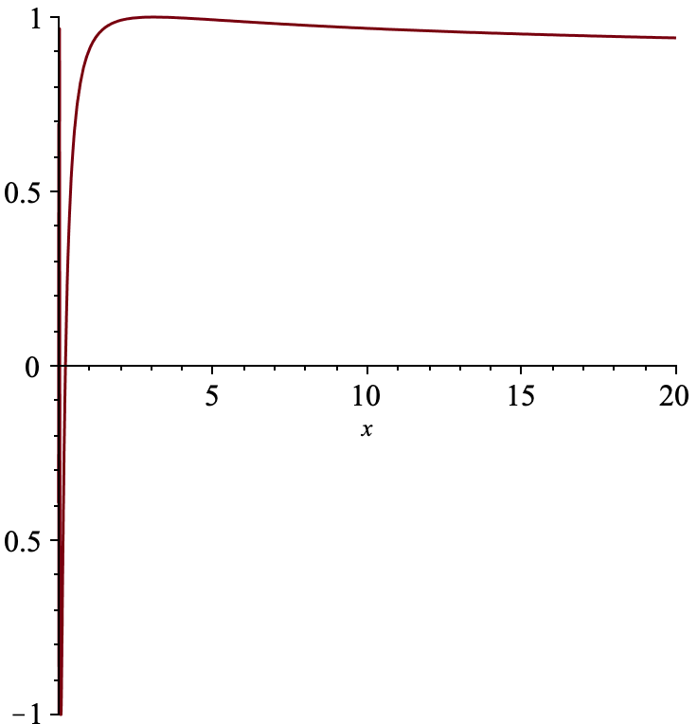
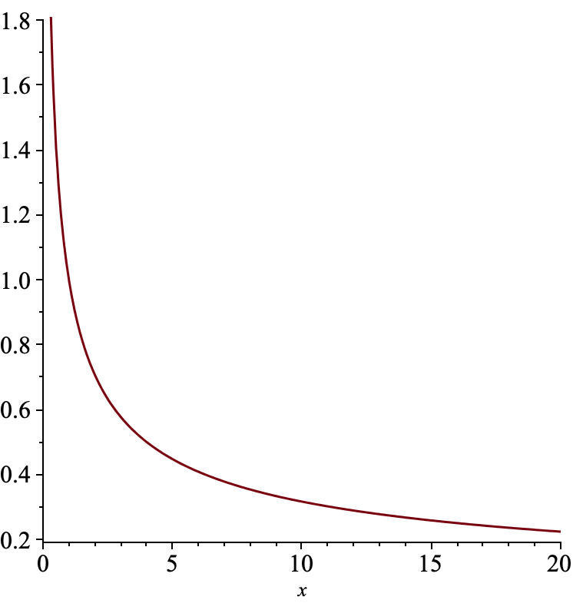
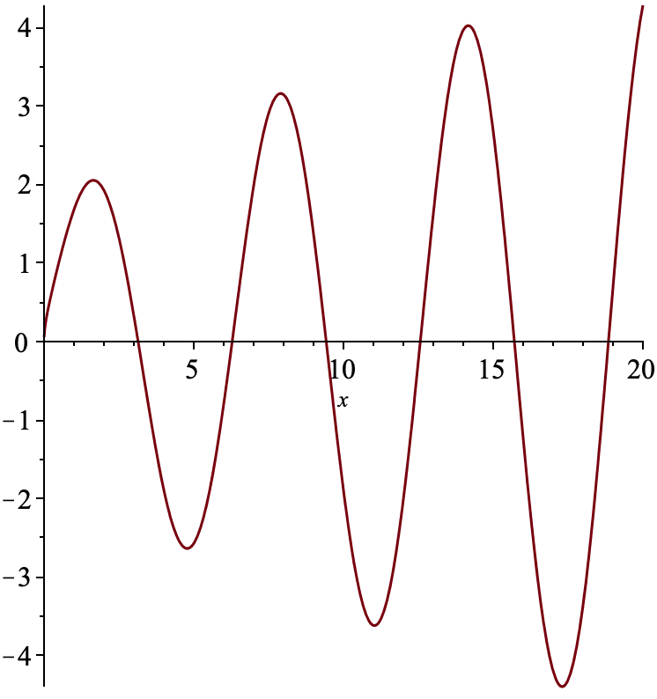
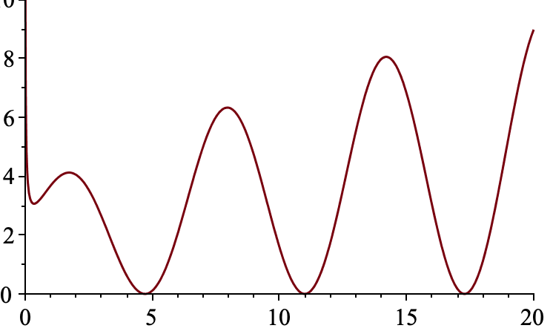
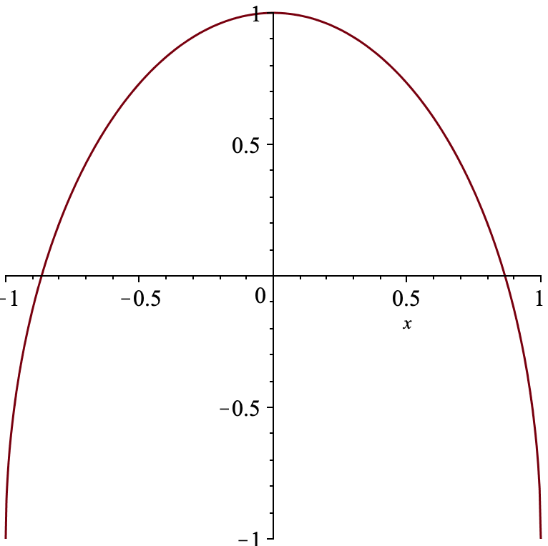
Constructing Examples
In each cell, write down a formula for a continuous function whose maximal domain and full range are indicated by the row and column headings
Impossible?
Impossible?
Impossible?
Impossible?

Slide 23
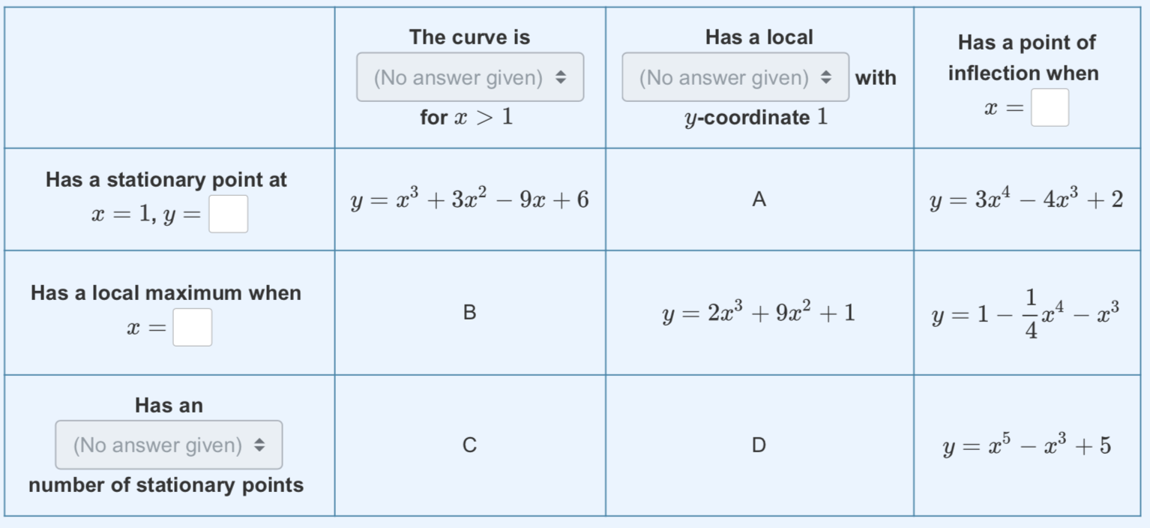
Complex Constructions
George Kinnear Edinburgh

Slide 24
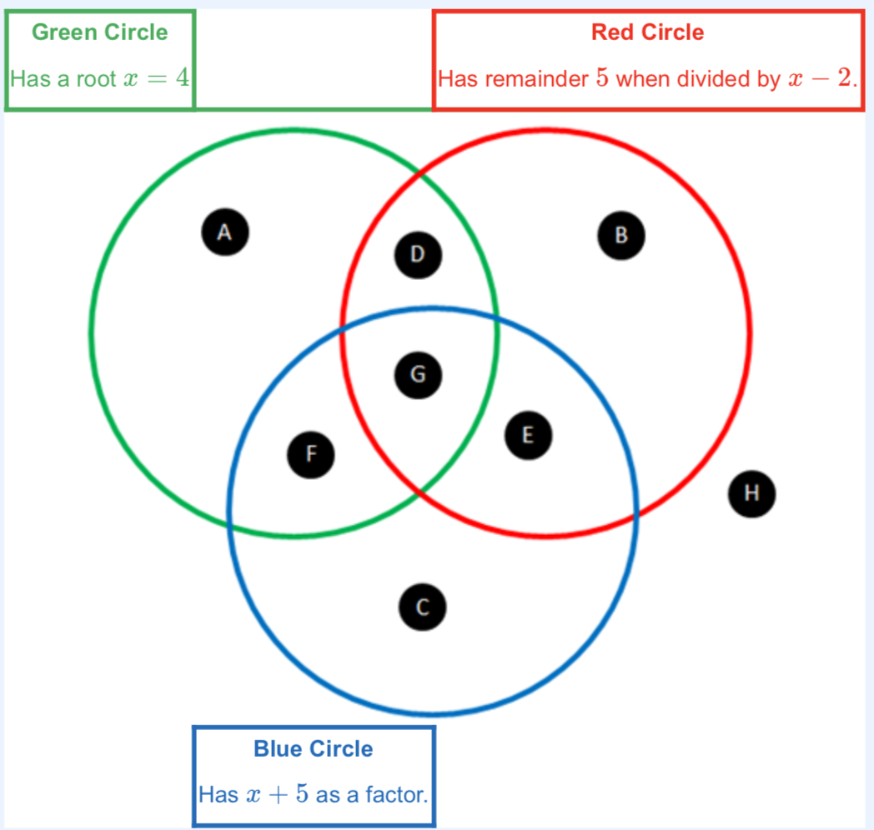
Properties of Parabolae
Construct a parabola for each
region of the Venn diagram.
NB: being outside a region means
NOT having that region’s property
What is being brought to participant’s attention?
George Kinnear Edinburgh

Slide 25
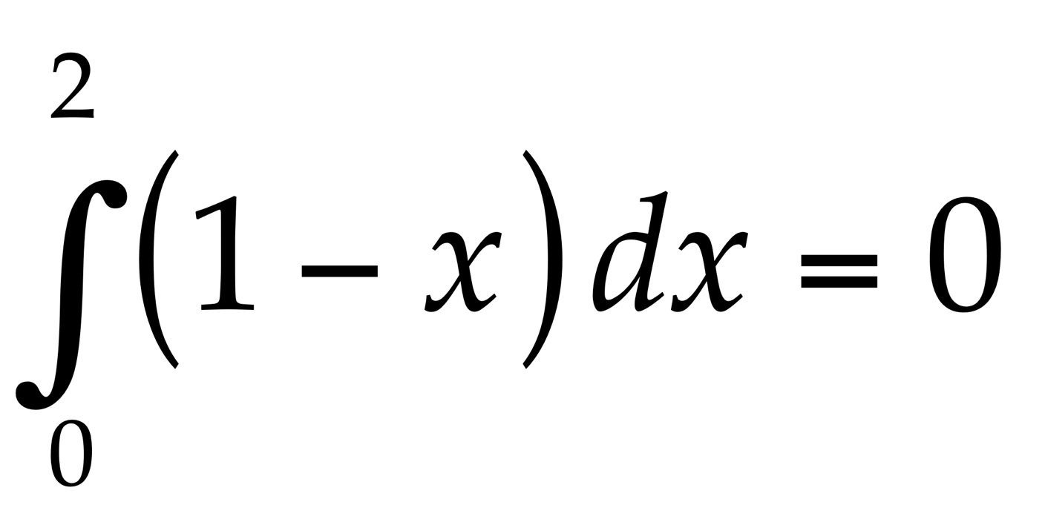
Write down another integral like this one which is also zero
  and another
  and another
  and another which is different in some way
What is the same and what is different about your examples and the original?
What features can you change and still it has integral zero?
Write down the most general integral you can, like this, which has answer zero.
Notes:
Example of reversing or undoing something which is familiar as a doing
Some learners tried preserving the difference between the limits(!) despite associating integral with area
Some immediately multiplied by a constant, but others did not
Some altered the linear function; some went to sin(x)
some revealed uncertainty between integral and area and negative area.
Have you ever found that students don’t recognise when a theorem can be applied (or else apply it when it is not applicable)?

Slide 26
Variation
What can be changed and still it is an example?

Slide 27
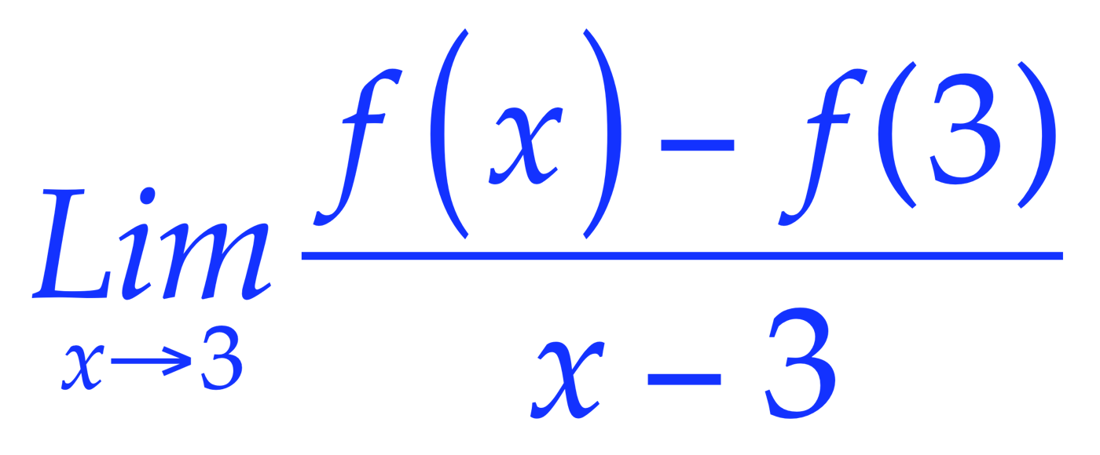
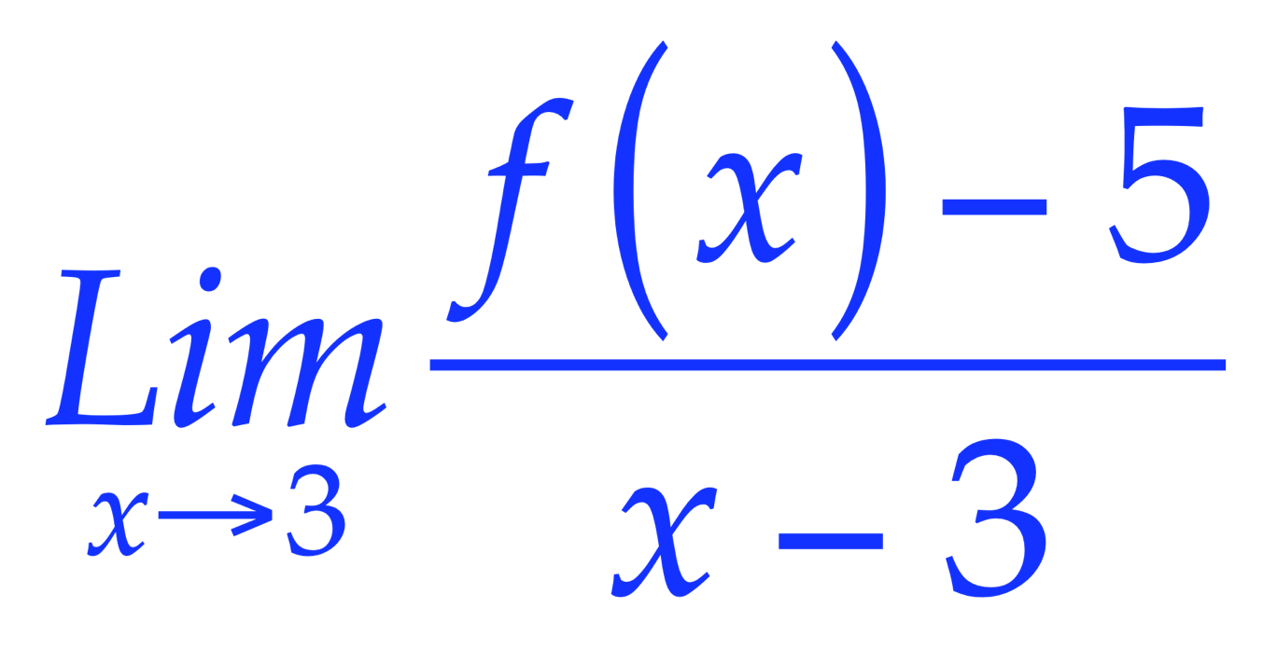
Undoing a Familiar Doing
Familiar doing:
Given f(x), find
unfamiliar undoing:
What can you say about f if
= 2
Notes:
f(x) = 2x+1 + h(x)(x-3)^2 for any h(x) with a limit at 3.
f’(3) = 2

Slide 28
Bury The Bone
Construct an integral which requires two integrations by parts in order to complete it
Construct a limit which requires three uses of L’Hôpital’s rule to calculate it.
Construct an object whose symmetry group is the direct product of four groups
Notes:
Alternatives:
construct an object which makes it difficult to see that it is ...
an integration by parts; a use of L’Hopital; that its symmetry group is a direct product; ...

Slide 29
Trials with Beginning Undergraduates
Evidently unfamiliar with constructing examples
as familiarity grows, so too does competence

Slide 30
Did You Notice:
Use of natural powers?
  Imagining & Expressing
  Specialising & Generalising
  Conjecturing & Convincing
  Organising & Characterising
  Others?
Encountering Mathematical Themes?
  Doing & Undoing
  Invariance in the midst of change
  Freedom & Constraint
  Making the implicit explicit
  Others?
Shifts of Attention?
  Gazing (Holding Wholes)
  Discerning Details
  Recognising Relationships
  Perceiving Properties as being instantiated
  Reasoning on the basis of agreed properties

Slide 31
Conjecture
When learners construct their own examples of mathematical objects they:
  Extend and enrich their accessible example spaces
  Become more engaged with and confident about their studies
  Make use of their mathematical powers
  Experience mathematics as a constructive and creative enterprise

Slide 32
The Exemplification Paradox
In order to appreciate a generality, it helps to have examples;
In order to appreciate something as an example, it is necessary to know the generality being exemplified;
so,
I need to know what is exemplary about something in order to see it as an example of something!
What can change and
what must stay the same,
to preserve examplehood?
Dimensions of possible variation
Ranges of permissible change
Notes:
Need to break into this ‘shell’
Using the previous ‘examples’, we can explore some pedagogic tactics

Slide 33
What Makes a Set of Examples Exemplary?
What is the same and what different about them?
What is invariant amongst them all?
  But only if you are attending to this aspect:
  recognising relationships
  and perceiving these as instances of properties
Learners clear on what you are attending to, and how you are attending to it
What is varied and what is invariant points to the important aspects or attributes of the concept
Learners have construction tools available to tinker with, modify, generalise from the specific to a general class
Minimal potential confusion about
  parameters,
  Variations
How their attention is directed

Slide 34
In Summary
You can find out a lot about your students’ thinking by
  Inviting them to construct examples of objects meeting specified constraints
  Chris Sangwin will show how to do this on line
  Using many of Lara Alcock’s beautiful in-session task structures
  Inviting them to create topic webs based on core (threshold) ideas … expect these to become increasingly sophisticated over time (useful as a study technique!)
  Getting them to imagine, before writing or typing
Worked Examples and Case Studies
  specifically providing commentary as to how to know what to do next
Self-Explanations & Personal Narratives
  developing learner facility by sometimes doing it yourself at first
  getting them to compare with a neighbour
  exploiting variation
Enriching accessible example-spaces

Slide 35
My Hope is That …
… you found something attractive or striking that you can imagine developing in your own context
I have been offering you EXAMPLES of task structures!

Slide 36
For MANY more tactics:
Mathematics Teaching Practice: a guide for university and college lecturers, Horwood Publishing, Chichester, 2002.
Mathematics as a Constructive Activity: learners constructing examples. Erlbaum 2005.
Using Counter-Examples in Calculus College Press 2009.
John.Mason @ open.ac.uk
PMTheta.com
for these slides
for Applets … for contributions to appreciating functions, derivatives, linear transformations …

Slide 37
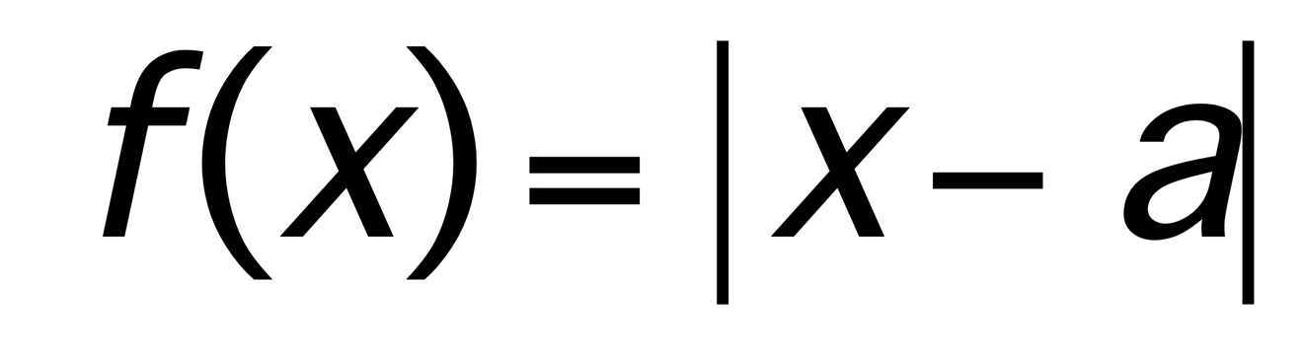
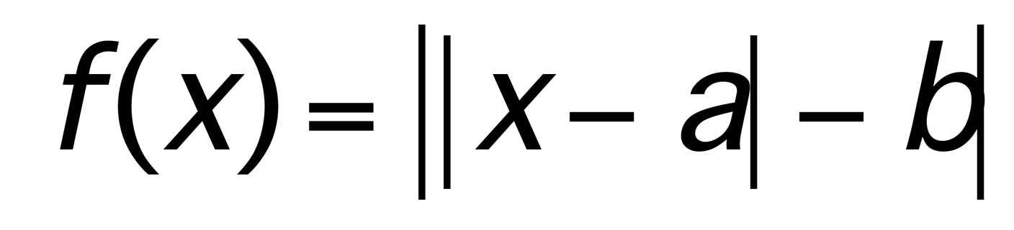


|x|
Of what is |x| an example?
What is the same and what different about
graphs of functions of the form
...
or
Characterise these graphs in some way

Slide 38


Lagrange (?)
Define to be the set of positive divisors of N.
For any positive integer N,
Choose a positive integer. Write down all of its positive divisors. For each of them, write down the number of divisors it has. Take the sum of the cubes of these numbers, and the square of their sum. Compare your answers.
The divisors of 12 are 1, 2, 3, 4, 6, 12
  these have, respectively, 1, 2, 2, 4, 4, 6 divisors
  1³ + 2³ + 2³ + 4³ + 4³ + 6³ = 361
  (1 + 2 + 2 + 4 + 4 + 6)² = 19² = 361

Slide 39
Building-Up
Please write down a number that lies between 2 and 3
and which does not use the digit 5
and which does use the digit 7
and which is as close to 5/2 as possible

Slide 40
Building-Up
Please sketch a function from R to R such that
  For all k in R there exists an M in R such that
  for all x > k, f(x) > M

Slide 41
Quantifiers
There exists a positive integer N such that
for all integers M > N,
there exists an integer K such that
2^{K} < M < K!
For N= 4: 2⁴ = 16 < 18 < 4! = 24
and if 2^{n} < n! then 2^{n+1} =2x2^{n} <2xn! < (n+1)!
But for N = 3: 2³ = 8 but 3! = 6
so N = 3
To prove: For all x there exists y …
  Let x₀ be an (arbitrary) x. Now find a y.
  ‘if P then Q’ with propositions is one thing;
  with predicates it is an order of magnitude more difficult
Finding examples that satisfy one property but which do not satisfy another can be extra tricky, especially when the second implies the first (but not vice versa).

Slide 42




On a Queries Website
You intuition is wrong
But what is leading you astray?
One example can be misunderstood as ‘the only example’
Class of examples
What relationships between parameters achieve a counter-example?

Slide 43







Gluing

Slide 44



Slide 45
Accessible Example Space
Images
  Shapes using
    asymptotes (vertical, horizontal
    local and global maxima and minima
Objects:
  Polynomials, Exponentials, Quotients
Constructions
  Gluing at a point; matching values, derivatives, …
Concept Images vs Concept Definitions
Construction Tasks
  For homework, an impossible construction to give meaning to the next theorem

Slide 46
Considerations
Concept Image vs Concept Definition
Over generalisation (in language; in maths)
Generalisation arises from stressing and consequently ignoring (Gattegno)
If proof is seen as a mathematician’s game but not really necessary, then examples might lead to untested false generalisations
Davidov: humans start from the general and the specialise

