Slide 1
Equitable classrooms that recognise similarity and difference
Anne Watson
BBO June 2023

Slide 2
Task 1

Slide 3
Does everyone see the same thing?
In the same way?
Do they describe it the same way?
Are they accessing the same classroom norms when they describe it?
Are they accessing the same mathematical norms when they describe it?
Are they all managing to guess what the teacher hopes they will say?
How are the differences managed?

Slide 4
Does everyone see the same thing?
In the same way?
Do they describe it the same way?
Are they accessing the same classroom norms when they describe it?
Are they accessing the same mathematical norms when they describe it?
Are they all managing to guess what the teacher hopes they will say?
How are the differences managed?

Slide 5
Does everyone see the same thing?
In the same way?
Do they describe it the same way?
Are they accessing the same classroom norms when they describe it?
Are they accessing the same mathematical norms when they describe it?
Are they all managing to guess what the teacher hopes they will say?
How are the differences managed?

Slide 12
These diagrams can be used to make conjectures about:
Angles on a straight line
Vertically opposite angles
Angles and parallel lines
Angles of a triangle
Interior angles of a parallelogram
Exterior angles of triangles
Interior angle sum of a hexagon
… other

Slide 13
What gets in the way of learning?
Possible objects of learning in this task
To draw parallel lines
Identify angles
Identify relations between angles
Precise indication of angles
Name angle types
Remember names of angle types
Do arithmetic with sums to 180
Use of tools
Faffing with the drawing
Geogebra app in pupils’ control
Draw diagrams for (preparation) homework
Equipment discipline
Physical ability pairing (dyspraxia etc.)
Indicating equal angles
Measurement
Colour
Cutting out and overlaying
Individual angles or families of angles
Letters
Naming them
Remembering the names
Understand difference between ‘It looks like’ and ‘It is … because…’
Articulate reasons for angle values and relations
Make conjectures about angle sums of polygons

Slide 14
Longer term objects of learning
Differentiation by access
Differentiation by expected outcome
Differentiation by what is noticed
Differentiation by articulation
Expectations of what to do in maths lessons
Dependence on memory
Dependence on arithmetic
Tool use
Language of facts
Language of generalisations
Language about meanings
Language for reasoning
Does everyone see the same thing?
In the same way?
Do they describe it the same way?
Are they accessing the same classroom norms when they describe it?
Are they accessing the same mathematical norms when they describe it?
Are they all managing to guess what the teacher hopes they will say?
How are the differences managed?

Slide 15
Task 2

Slide 16
These numbers are part of a linear (arithmetical) sequence. What numbers could go into the gaps? How do you know?
13 |  |  |  | 97

Slide 17
Possible objects of learning for this task
To apply and practise two-digit arithmetic
To adapt previously learnt rules
To conjecture or devise a method of interpolation
To express a method of interpolation
To generalise a method of interpolation
Differentiation by arithmetic
Differentiation by method
Differentiation by focus of attention
Differentiation by past experience
Differentiation by articulation
Expectations of what to do in maths lessons
Dependence on memory
Dependence on arithmetic
Tool use
Language of facts
Language about meaning
Language of explanation and generalisation

Slide 18
What are the common obstacles to mathematics learning?
Home/community life
School life
Effects of poverty and displacement
Hunger
Poor health
Depression
Focus on survival
Low self-esteem
Fear
Insecurity
Restricted language forms
Home attitudes
Social and emotional problems
Disrupted schooling
Specific cognitive difficulties
Frequent changes of teacher
Limited teaching methods
Different expectations
Teacher attitudes
Ideas of fixed ability
Reading and writing difficulties
Lack of specialised subject teaching
Repeated past failure
Restricted language forms

Slide 19
Restricted language forms in mathematics
Induction into the mathematics ‘register’
Technical terms and meanings (e.g. proof; generalisation …)
The language of instructions: ‘solve, simplify, calculate, find …’
The way we talk about truth
Stem sentences – generalisations, connections, not instructions
Use of imperative language – giving or remembering instructions

Slide 20
Equitable v. imperative classrooms

Slide 21
Equitable classrooms | Imperative classrooms
Valuing everyone equally, with attention to differences | Confuse equity with equal and rule-based expectations
Learners are socially and emotionally safe | Learners are socially safe when they follow the instructions
Everyone’s thinking and work is valued | All thinking and work that match the plan is valued
Concept inclusion (everyone thinks about the same content) | Concept inclusion (everyone does the same)
Cognitive inclusion (everyone’s thinking is part of the lesson) | Cognitive inclusion (everyone follows the same cognitive pathway)

Slide 22
Equitable classrooms | Imperative classrooms
Interactive inclusion (everyone gets to develop language of explanation, discussion and reasoning) | Interactive inclusion (everyone gets to answer questions and give reasons)
Everyone is challenged and supported to meet those challenges | Everyone is challenged and supported to meet those challenges
The language of reasoning and explanation is developed | The language of reasoning and explanation is given
Obstacles to accessing the object of learning are anticipated and removed or overcome | Obstacles to accessing the object of learning are anticipated and expected
Tool use is familiar, fluent, supported | Tool use is a set of instructions

Slide 23
Task 3: Show, using materials/sketch/diagram:
How 6 pieces of toast can be shared equally between 2 people.
How 6 pieces of toast can be shared equally between 3 people.
How 6 pieces of toast can be shared equally between 4 people
How 6 pieces of toast can be shared equally between 5 people

Slide 24
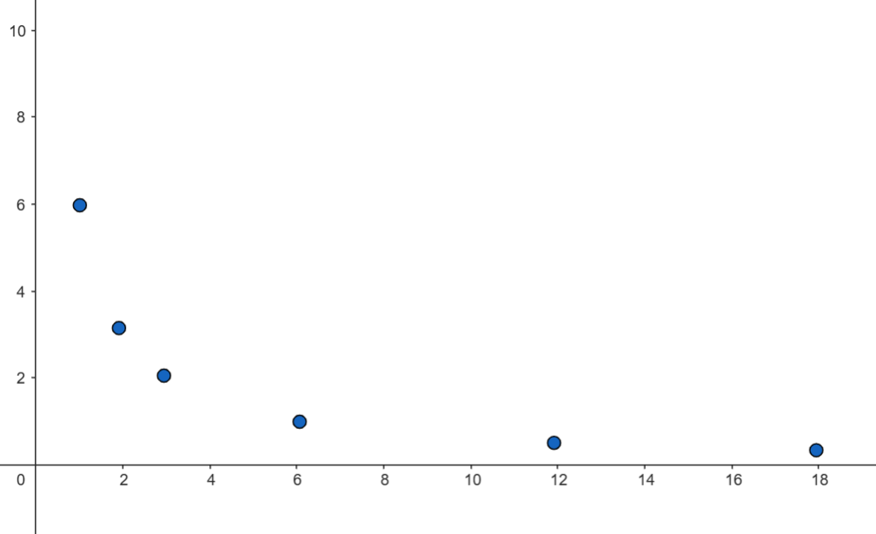
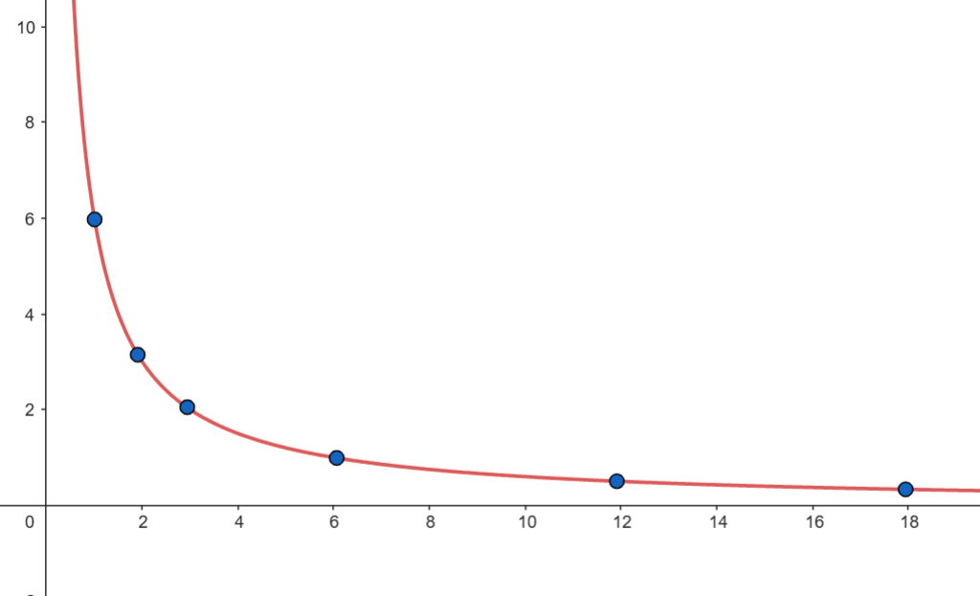
Does everyone see the same thing?
In the same way?
Do they describe it the same way?
Are they accessing the same classroom norms when they describe it?
Are they accessing the same mathematical norms when they describe it?
Are they all managing to guess what the teacher hopes they will say?
How are the differences managed?

Slide 26
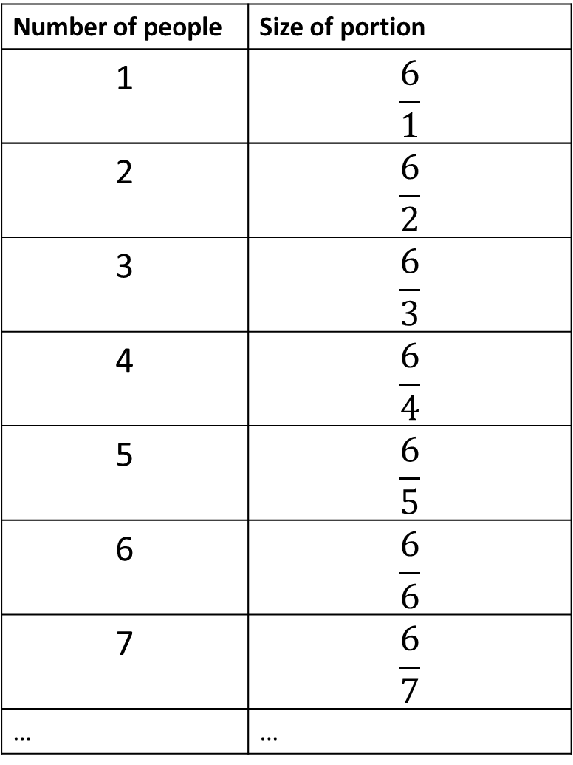
Number of people | Size of portion
1 | $$\frac{6}{1}$$
2 | $$\frac{6}{2}$$
3 | $$\frac{6}{3}$$
4 | $$\frac{6}{4}$$
5 | $$\frac{6}{5}$$
6 | $$\frac{6}{6}$$
7 | $$\frac{6}{7}$$
… | …

Slide 27
How could this task contribute to a learners’ repertoire and storehouse of knowledge in ways that are:
fixed and fragile?
robust, fluid and flexible?

Slide 28
How are we all the same as learners?
Need time to gaze
to think
to listen
to talk
to be heard
See and seek patterns and connections
Make distinctions (same and different)
Generalise (this always happens)
Observe effects of changing something (when this changes, what happens?)
Generalise the effect of actions (when I do this ….)
Understand dependencies (this depends on that)
Needing to make sense (make connections and meanings)
Easier to recognise than recall (I’ve seen this before)
See or seek similarity among experiences (this is like ….)
Seek clues in recent experience (I must be supposed to ….)
Too much at once is confusing
Making connections aids memory

Slide 29
How are we different as learners?
Repertoire and storehouses of knowledge
fixed and fragile
robust, fluid and flexible
Habits of mind: what we pay attention to in mathematics
How we perceive the social context and its constraints
How the way we think matches or clashes with what is expected
Expectations of what to do in maths lessons
Dependence on memory
Dependence on arithmetic
Experience of tool use
Experience of language of facts and memory
Experience of language for expressing meaning
Experience of language for explanation, reasoning and generalisation

Slide 30
Things to think about …
Stem sentences:
getting from home ‘restricted codes’ to mathematics ‘restricted codes’ while also developing the language of thinking, explanation and elaboration
‘Low threshold – high ceiling’: where is equity?
Cognitive load …

Slide 31
Equitable language
Use of contributions from everyone
Use of dialogue with everyone
Equal access to using meaning-related language(e.g. stem sentences that are about meanings, not instructions)
Explicit reference to connections and relationships between different forms of language

Slide 32
Low threshold; high ceiling????
“It can go anywhere”
Different methods of solution
Working in my usual way
Supported to work in a different way
Different outcomes v. same core outcome
Need clarity about objects of learning; what is the high ceiling and how can everyone get there?

Slide 33
Cognitive load? Or …
Cognitive control
Cognitive activation
Cognitive acceleration
- restricted codes
- elaborated codes
Cognitive care
Cognitive repair

Slide 34
pmtheta.com annewatson1089@gmail.com

