Slide 1
Embedding enrichment
Anne Watson
NRich
July 2013

Slide 2
It’s not just methods ...
Understanding: instrumental and relational (Skemp)
Understanding: procedural and conceptual (Hiebert)
Understanding: how to use procedures; when to use procedures; meaning of concepts (Watson)
Proficiency: concepts, fluency, strategy, reasoning, productive disposition (Kilpatrick)
Curriculum aims: problem-solving through: skills, concepts, processes, metacognition, attitudes (Singapore)
Curriculum aims: fluency (recall, selection & use of methods), reasoning, problem-solving (new NC)

Slide 3
Jenni Piggott:
Problem solving
Mathematical thinking
Enrichment

Slide 4
Problem solving – three kinds
Procedural: Having been subtracting numbers for three lessons, children are then asked: ‘If I have 13 sweets and eat 8 of them, how many do I have left over?’
Application: A question has arisen in a discussion about journeys to and from school: ‘Mel and Molly walk home together but Molly has an extra bit to walk after they get to Mel’s house; it takes Mel 13 minutes to walk home and Molly 8 minutes. For how many minutes is Mel walking on her own?’
Conceptual: If two numbers add to make 13, and one of them is 8, how can we find the other?

Slide 5
Conceptual enrichment
Enrichment through extra activities, non-curriculum
Enrichment through embedding rich images as resources
Enrichment through richly-connected entry to ideas
Enrichment through embedded changes in questioning

Slide 6
Enrichment through rich images as resources
Enrichment through richly-connected entry to ideas
Enrichment through changes in questioning

Slide 7
http://nrich.maths.org/9941

Slide 8
Enrichment through rich images as resources
Enrichment through richly-connected entry to ideas
Enrichment through changes in questioning

Slide 9
Division
What if yellow is 5 and blue is 9?
What if blue is 27?
What if yellow is 10?
What if blue is 1?
What if yellow is 1?

Slide 10
What if yellow is 10?
What if blue is 27?

Slide 11
Measuring
Ratio
Factors
Highest/any common factor
Remainders
Division as a fraction
Remainders as fractions

Slide 12
What if yellow is 5 and blue is 9?
What if blue is 1?
What if blue is 27?
What if yellow is 10?
What if yellow is 1?

Slide 13
Measuring
Ratio
Any common multiple
Lowest common multiple
Scaling

Slide 14
Enrichment through rich images as resources
Enrichment through richly-connected entry to ideas
Enrichment through changes in questioning

Slide 15
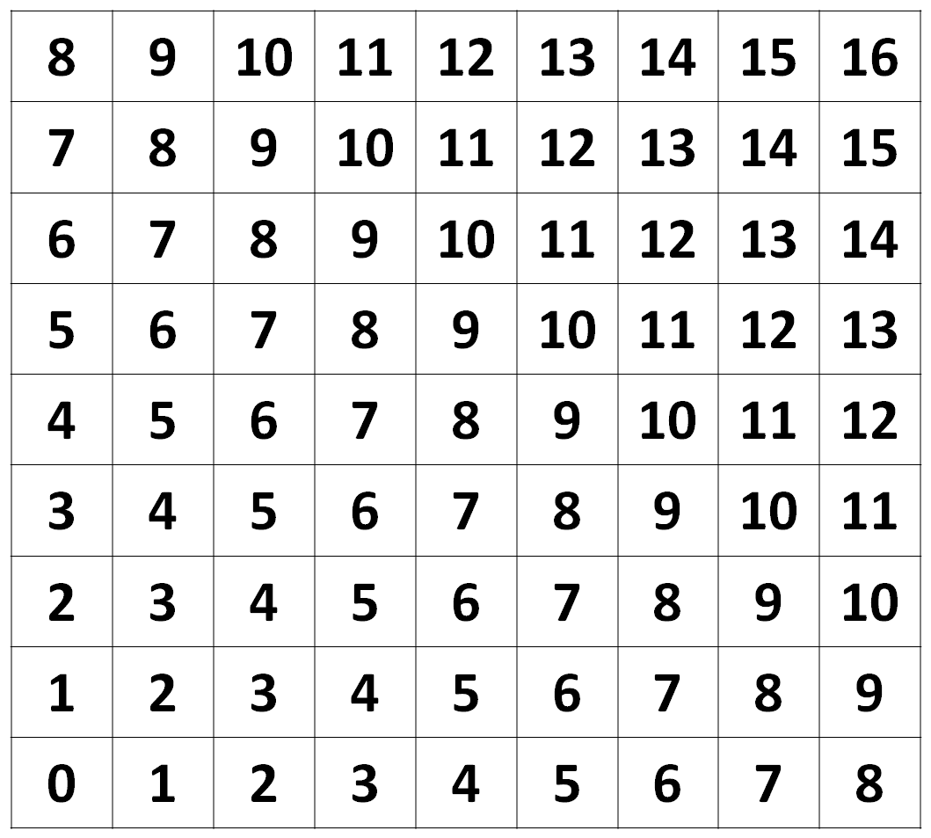

Slide 16
7
6
5
4
3
2
1
0
1
2
3
4
5
6

Slide 17
7
6
5
4
3
2
1
0
1
2
3
4
5
6

Slide 18
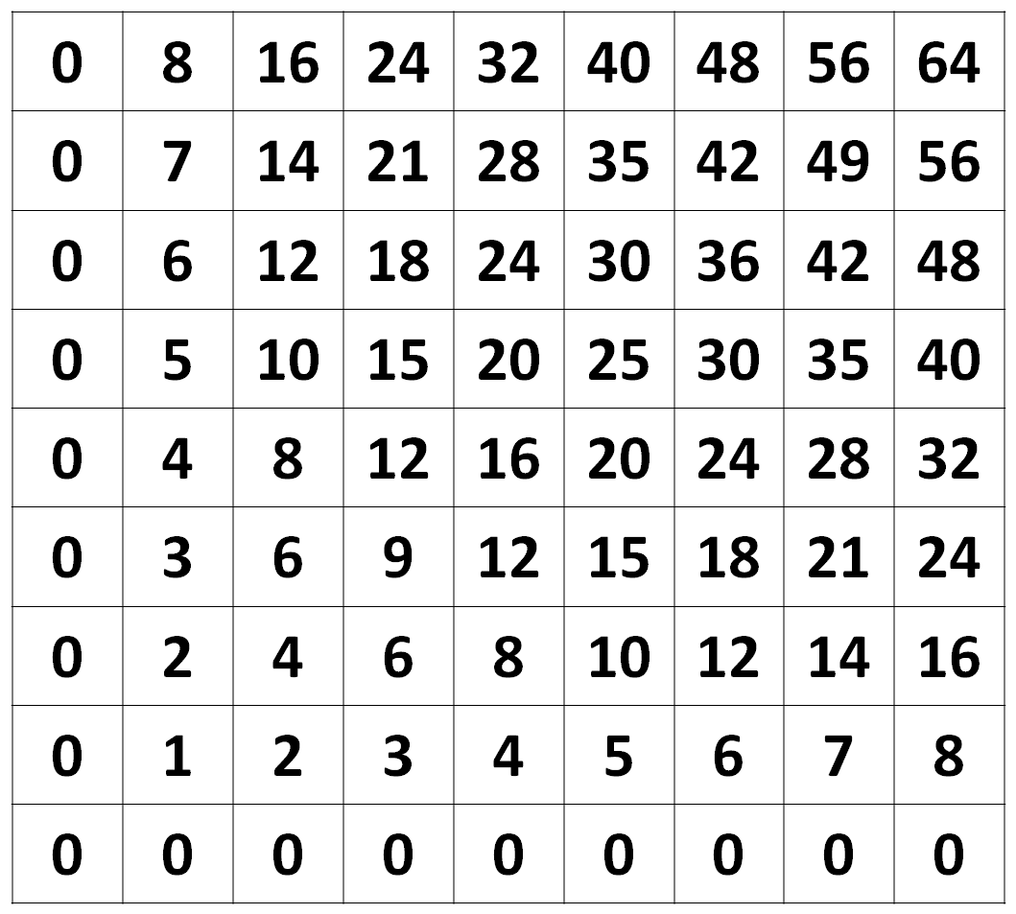

Slide 20
7
6
5
4
3
2
1
0
1
2
3
4
5
6

Slide 21
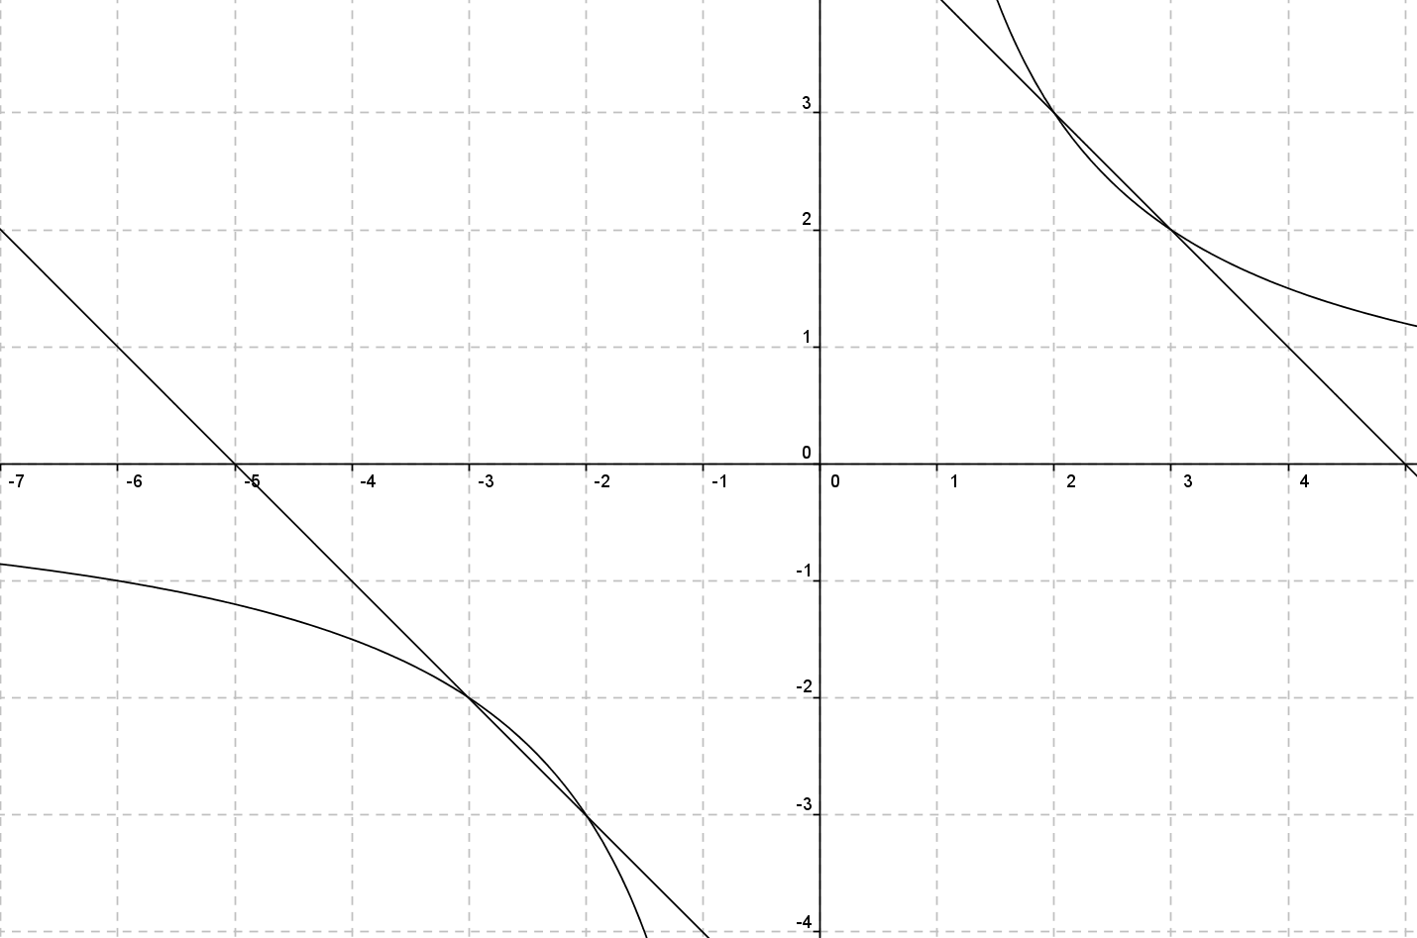

Slide 22
Enrichment through rich images as resources
Enrichment through richly-connected entry to ideas
Enrichment through changes in questioning

Slide 23
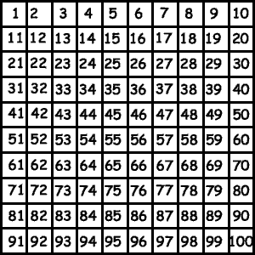
Generalise for 100 number grid

Slide 24
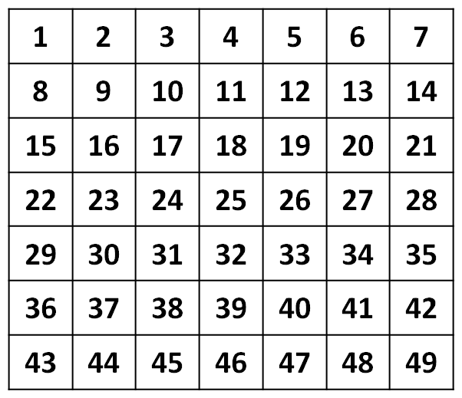
Generalise for an unfriendly number

Slide 25
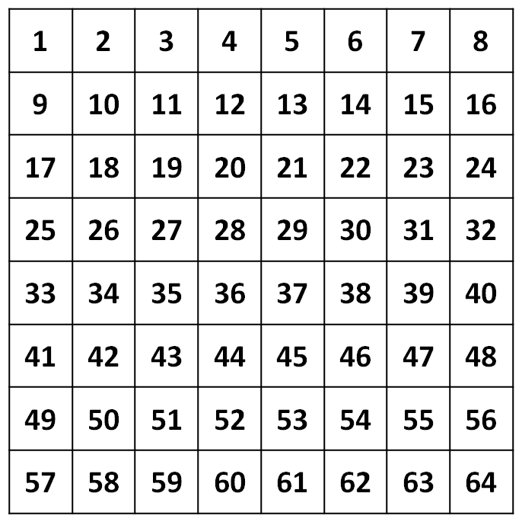
Generalise for any number: variables and parameters

Slide 26
What new kinds of question can be asked and why?

Slide 27
New question-types
On an 9-by-9 grid my tetramino covers 8 and 18. Guess my tetramino.
What tetramino, on what grid, would cover the numbers 25 and 32?
What tetramino, on what grid, could cover cells (m-1) and (m+7)?

Slide 28
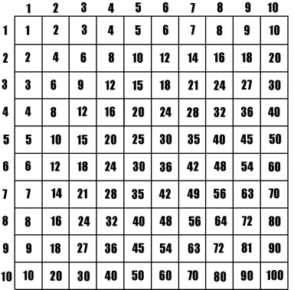
Generalise for a times table grid

Slide 29
What new kinds of question can be asked and why?

Slide 30
New question-types
What is the smallest ‘omino’ that will cover cells (n + 1, m – 11) and (n -3, m + 1)?

Slide 31
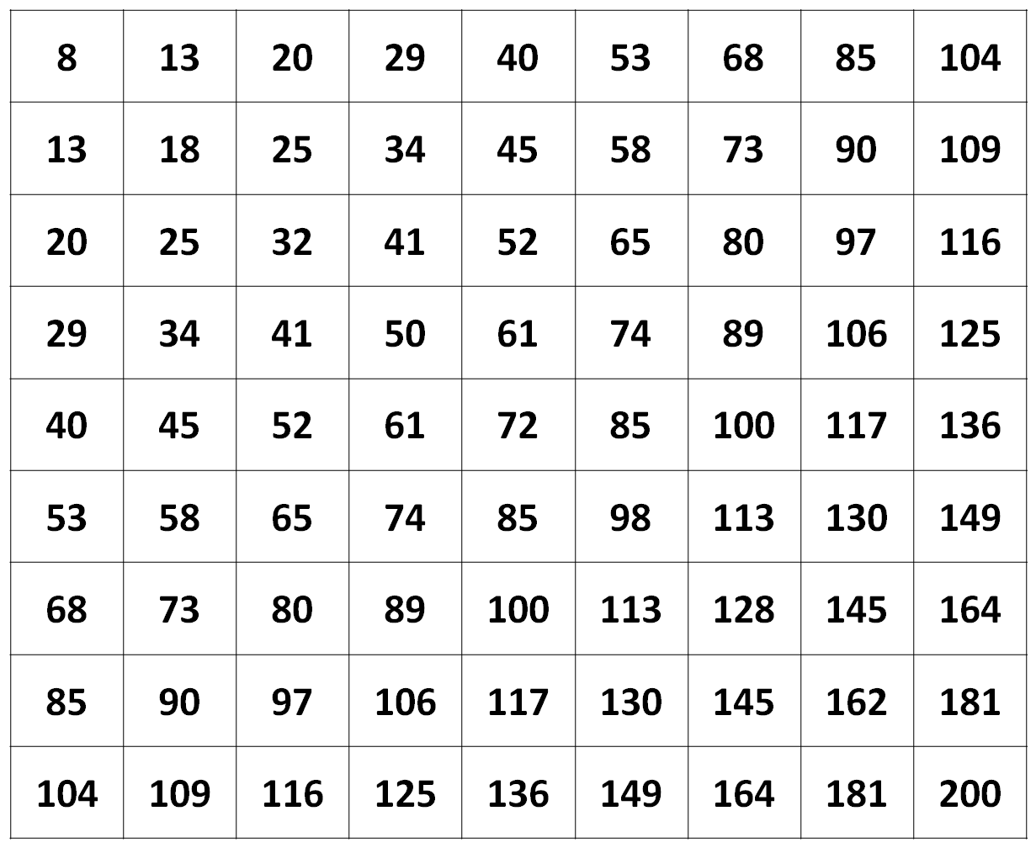

Slide 32
Enrichment through extra activities, non-curriculum
Enrichment through rich images as resources
Enrichment through richly-connected entry to ideas
Enrichment through changes in questioning

Slide 33
Finally: expectations of rich activity
Write down as many things as you can about the number 143
Write down as many things as you can about the number 1.43

Slide 34
anne.watson@education.ox.ac.uk

