Slide 1



What Makes Examples Exemplary for Students of Mathematics?
The Open University
Maths Dept
Promoting Mathematical Thinking
University of Oxford
Dept of Education
John Mason
Dundee
Feb 2018

Slide 2
Outline
Phenomena: Familiar Student Behaviour
Headlines for what is possible today
Mathematical & Pedagogical Theme
  Invariance in the midst of change
Pedagogical Constructs as Strategies

Slide 3
Conjectures
Everything said here today is to be treated as a conjecture …
... to be tested in your experience
I normally take a phenomenological stance ...
... I start from and try to connect to, experience
BUT
  Your time is precious and mine today is short ...

Slide 4
Some Phenomena
Students often ignore conditions when applying theorems
Students often ask for more examples ...
  But do they know what to do with the examples they have?
Students often over generalise, or fail to generalise at all
Students often have a very limited notion of mathematical concepts ...
  What is it about some examples that makes them useful for students?
  What do students need to do with the examples they are given?
Do students know how to study mathematics (for an exam)?
  Do you indicate useful study strategies?

Slide 5
Really Simple Examples (sic!)
To find 10% you divide by 10
so, to find 20% you divide by …
To differentiate x^{n} you write nx^{n-1}
so, to differentiate x^{x} you write ...
(x-1)² + (y+1)² = 2² is a circle which
has centre at (1, -1) and radius 2
if f(3) = 5 then f(6) = 10
  other appearances:
  sin(2x) = 2sin(x);
  ln(3x) = 3ln(x)
  sin(A + B) = sin(A) + sin(B)
  (a + b)² = a² + b² etc.
It’s all about attention
What are students attending to
How they are
attending to it
Notes:
In each case, students have used an example as the basis for generalisation!
Sometimes linearity is only used when the ‘scale factor’ is large
(accounting for: minimise effort; find something to do; carry out first action that becomes available)

Slide 6
Headlines
Worked Examples
  What would you like or what do you expect students to do with worked examples?
  How do you indicate this to students?
  It is not simply knowing ‘what to do next’ (templating)
  but ‘how do you know what to do next’
Mathematical Examples (definitions of concepts)
  What would you like or what do you expect students to attend to in an example?
  And how would you like them to attend to it?
  How do you indicate this to students?
Some Pedagogical Constructs
  Concept Images vs Concept Definitions
  Variation as a Pedagogic Principle
  Didactic Contract, Didactic Tension & Didactic Transposition
  (accessible) Example Space; Question Space

Slide 7
Requests
Depending on the student and topic there is sometimes a "Why would I care about this?" attitude.
Perhaps it would be good to know how to motivate material such that also the weak students get interested.
How to get/observe feedback from a large cohort while lecturing.
Also I wonder whether there are known possibilities for a meaningful interaction, with lecturer or other students, in a large group scenario? The latter is in order to keep people more engaged.
Notes:
1) Homework: trying to do the impossible so that the proof is of interest
For students from allied disciplines … it is not just what to do, but how you know whether it is acceptable, and what to do next that makes maths useable.
Cards with quick answers noted (w or wo identity). Example construction (easy, hard, peculiar, general; “hardest idea” or “what lecture was about for me” or “what I need to work on before next lecture”

Slide 8
Own Experience
Apprenticeship
  learning through being present and assisting
  Rather more involved than watching lectures!
What did you do with examples when studying?
What do you do with examples when reading a paper?
What would you like students to do with examples that you give them or that they find in texts?

Slide 9
Exemplifying (case studies)
Use of Technique
  Worked Examples (Case srudies)
  Proof
Developing a Concept
  Concept Image vs Concept Definition
Task types … Question Space
Used since ancient times
Using past papers

Slide 10
What do students say?
“I seek out worked examples and model answers”
“I practice and copy in order to memorise”
“I skip examples when short of time”
“I compare my own attempts with model answers”
NO mention of mathematical objects other than worked examples!
Notes:
These are Oxford ugs starting their 2nd year in mathematics

Slide 11
On Worked Examples
Did you ever use worked examples as a student?
  How?
What do you expect and what would you like students
to do with worked examples?
  What do you want them to attend to?
  What do you want them to re-access (re-member) in future?
Templating: changing numbers to match
What is important about worked examples?
  knowing the criteria by which each step is chosen
  knowing things that can go wrong, conditions that need to be checked
  having an overall sense of direction
  having recourse to conceptual underpinning if something goes wrong
  Being able to re-construct when necessary
Notes:
Extensive research by Renkl et al shows that what matters is not only what to do next, but how you know to do that

Slide 12

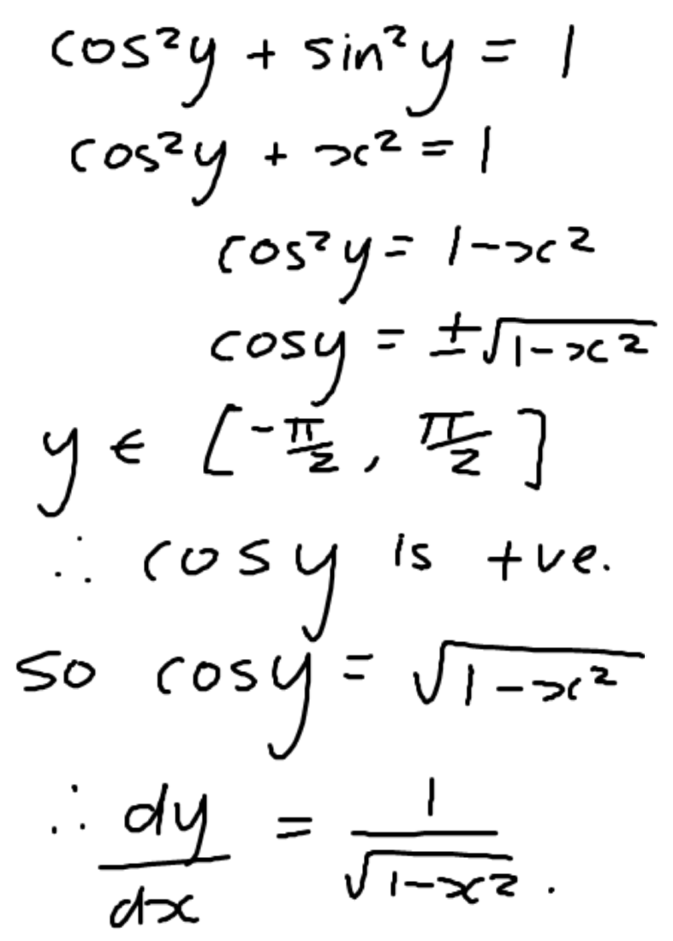
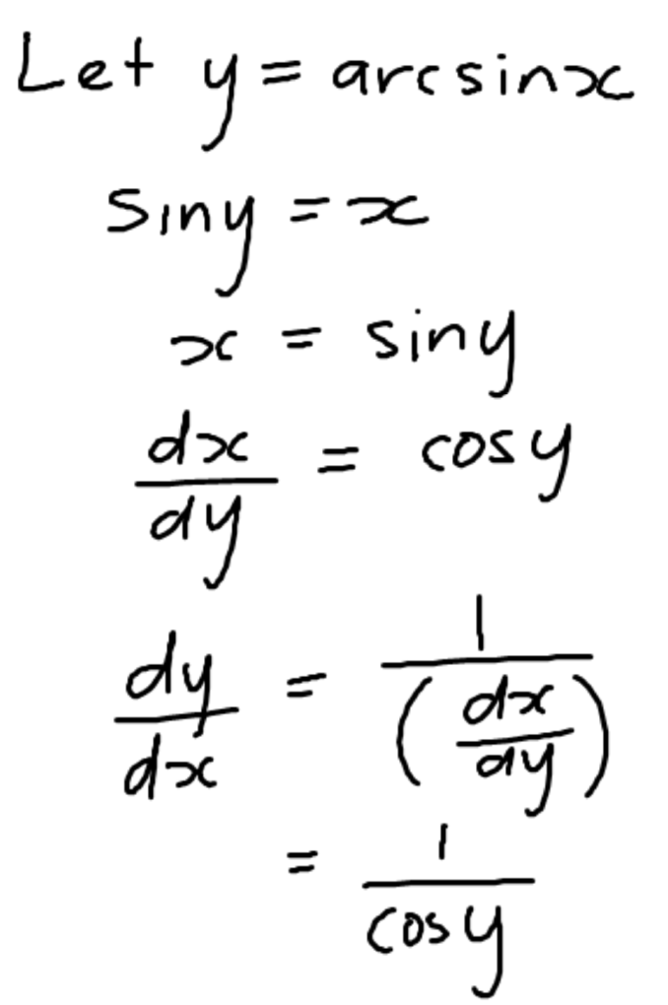
Differentiating Inverse Functions
Foci of attention?
Main idea(s)?
Main steps?
How know what to do next?
Notes:
https://www.adelaide.edu.au/mathslearning/resources/maths1a/maths1a-examples-calc-diff.pdf

Slide 13
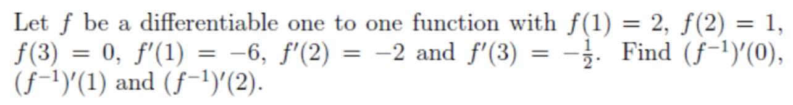
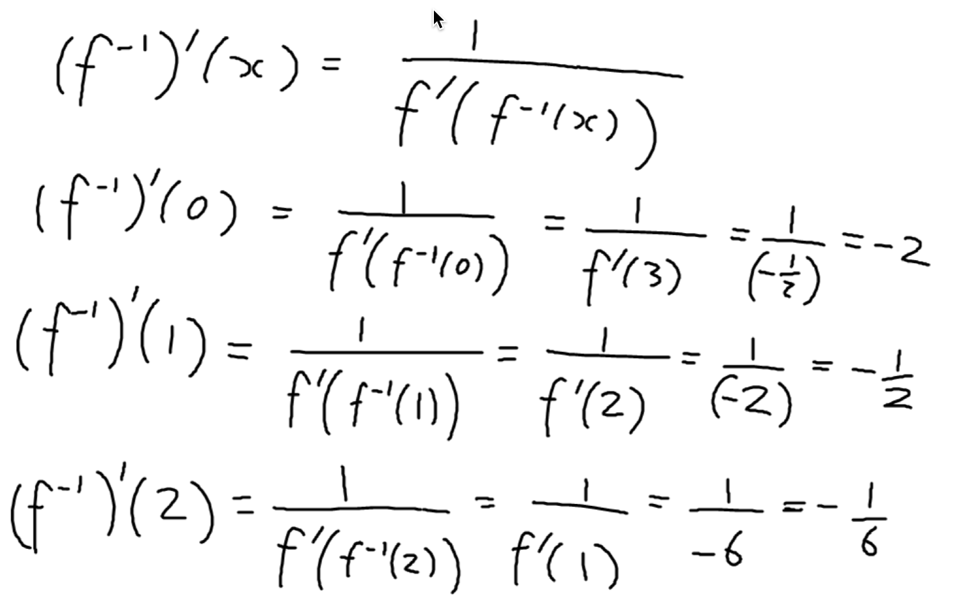
Derivatives and Inverse Fns
Notes:
https://www.adelaide.edu.au/mathslearning/resources/maths1a/maths1a-examples-calc-diff.pdf

Slide 14
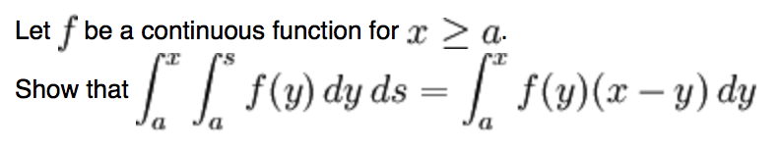
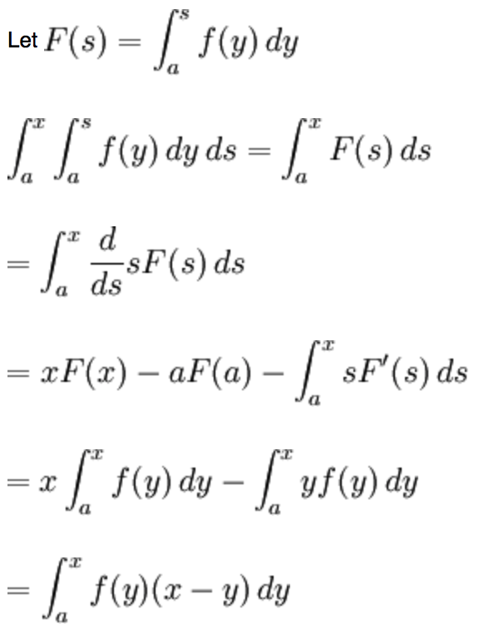
Worked Example 3
Any slips/errors?
Notes:
http://exampleproblems.com/wiki/index.php/Calc1.9

Slide 15

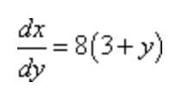
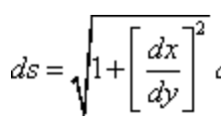



Helpful working
Step 1
Since we are not told which ds to use we will have to decide which one to use. In this case the function is set up to use the ds in terms of y.
If we were to solve the function for y (which we’d need to do in order to use the ds that is in terms of x) we would put a square root into the function and those can be difficult to deal with in arc length problems.
Note that we did not square out the term under the root. Doing that would greatly complicate the integration process so we’ll need to leave it as it is.
Step 2
In this case we don’t need to [do] anything special to get the limits for the integral. Our choice of ds contains a dy which means we need y limits for the integral and nicely enough that is what we were given in the problem statement. So, the integral giving the arc length is,
Finally all we need to do is evaluate the integral. In this case all we need to do is use a trig substitution. We’ll not be putting a lot of explanation into the integration work so if you need a little refresher on trig substitutions you should go back to that section and work a few practice problems.
…
Note use of ‘heads-up’ advice
Note use of ‘we’
Note use of ‘all we need to do’
Notes:
http://tutorial.math.lamar.edu/Problems/CalcII/ArcLength.aspx

Slide 16
Using a Worked Example
What needs to be attended to particularly?
(What is being exemplified?)
How do you know what to do next?
  What images or awarenesses invoked?
What can be changed in the ‘problem’ and still the technique can be used?
What choices might arise?
What wrinkles might occur?

Slide 17
Examples of Mathematical Objects
Unfortunately, students sometimes over-generalise, mis-generalise or fail to appreciate what is being exemplified
What is involved in experiencing some thing as an example of something?
Notes:
Fischbein: Figural Concpets

Slide 18
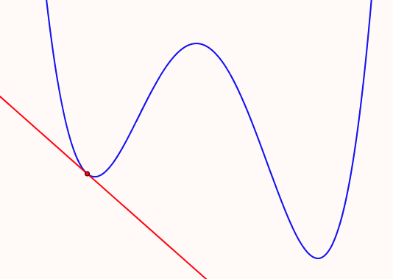
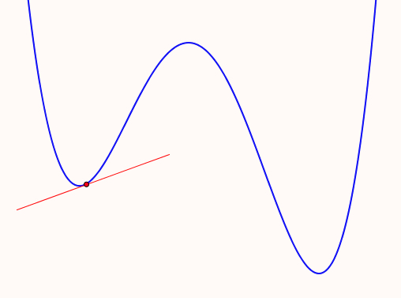
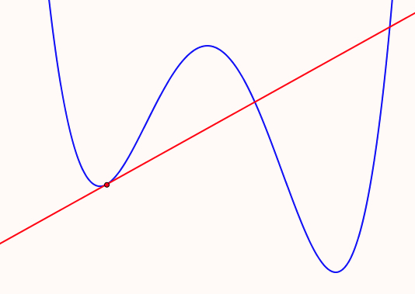
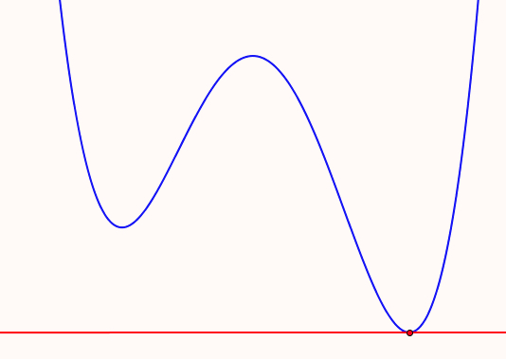
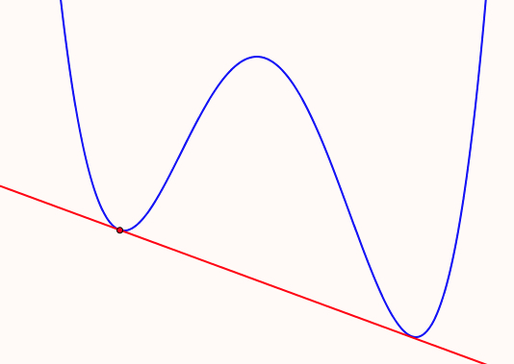
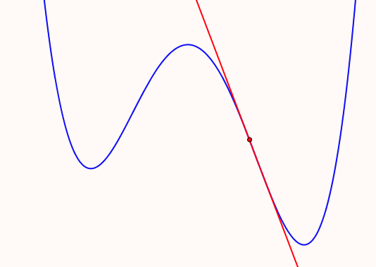
Tangents
Sketch some examples of tangents to a quartic for students learning about tangents
What misapprehensions might be induced by one or a few?

Slide 19
Example Construction
What features need to be salient?
  contrasting several examples
  What can be changed
  (dimensions of possible variation)
  and over what range
  (range of permissible change)
  What unintended assumptions might learners make?
Notes:
Essence of the concept

Slide 20
Example, Non-Example, Counter-Example, Boundary Example
.9
  is an example of
  is a non-example of
  is a counter example to
a number whose square is less than itself
numbers whose square is greater than or equal to themselves
the conjecture that the square of a number is always greater than itself
The harmonic series
  is an example of …
  is a non-example of …
  is a counter example to …
  is a boundary non-example for
  is a boundary example for
series u_{n} = 1/n^{1+𝝴} which converge
series for which u_{n} converges to 0 but sum diverges

Slide 21
Write down another integral like this one which is also zero
  and another
  and another
  and another which is different in some way
What is the same and what is different about your examples and the original?
What features can you change and still it has integral zero?
Write down the most general integral you can, like this, which has answer zero.
In what way is yours ‘like’ this one, and in what ways is it different?
Notes:
Perhaps require stick to polynomials, with degree as small as possible
Example of reversing or undoing something which is familiar as a doing
Some learners tried preserving the difference between the limits(!) despite associating integral with area
Some immediately multiplied by a constant, but others did not
Some altered the linear function; some went to sin(x)
some revealed uncertainty between integral and area and negative area.
Have you ever found that students don’t recognise when a theorem can be applied (or else apply it when it is not applicable)?

Slide 22
Variation
What can be changed and still it is an example?

Slide 23
Mathematical Objects
Who produces examples?
  Lecturer?
  Students?
What do they do with them?

Slide 24
Conjecture
When learners construct their own examples of mathematical objects they:
  Extend and enrich their accessible example spaces
  Become more engaged with and confident about their studies
  Make use of their own mathematical powers
  Experience. mathematics as a constructive and reative enterprise

Slide 25
Proposal
The first time you give an example of a mathematical object (not a worked example)
  ask students to write down on a slip of paper what they expect to do with the example
Near the end of the course, when you give (or get them to construct) an example
  ask students to write down on a slip of paper what they expect to do with the example
get them to put their initials or some other identifying mark on the papers, so that you can identify development
Notes:
Is there any development over time?

Slide 26
Preparing the Ground
Construct a function F : [a, b] --> R
  which is continuous and differentiable on (a, b)
  for which f(a) = f(b)
  but nowhere on (a, b) is f’(x) = 0
Having attempted this, students are likely to appreciate the proof that it is impossible
Notes:
Setting an impossible task in order to prompt possibility and significance of a theorem

Slide 27
Choosing Examples to Exemplify
Suppose you were about to introduce the notion of relative extrema for functions from R to R.
  what examples might you choose, and why?
  would you use non-examples? why or why not?
How might you present them?

Slide 28
The Exemplification Paradox
In order to appreciate a generality, it helps to have examples;
In order to appreciate something as an example, it is necessary to know the generality being exemplified;
so,
I need to know what is exemplary about something in order to see it as an example of something!
What can change and
what must stay the same, to preserve examplehood?
Dimensions of possible variation
Ranges of permissible change
Notes:
Need to break into this ‘shell’
Using the previous ‘examples’, we can explore some pedagogic tactics

Slide 29
Undoing a Familiar Doing
familiar doing:
Given f(x), find
unfamiliar undoing:
What can you say about f if
What if f is known to be continuous?
Notes:
Limit f(x) as x-3 is 5;
Egs: f(x) = 2x–1 + h(x)(x-3)^2 for any h(x) with a limit at 3.
If f is continuous, f(3)=5 and f’(3) = 2

Slide 30
Bury The Bone
Construct an integral which requires two integrations by parts in order to complete it
Construct a limit which requires three uses of L’Hôpital’s rule to calculate it.
Construct an object whose symmetry group is the direct product of four groups
Notes:
Alternatives:
construct an object which makes it difficult to see that it is ...
an integration by parts; a use of L’Hopital; that its symmetry group is a direct product; ...

Slide 31
Probing Awareness
Asking learners what aspects of an example can be changed, and in what way.
  learners may have only some possibilities come to mind
  especially if they are unfamiliar with such a probe
Asking learners to construct examples
  another & another; adding constraints
Asking learners what concepts/theorems an object exemplifies

Slide 32
What Makes an Example ‘Exemplary’?
Awareness of
‘invariance in the midst of change’
What can change and still the technique can be used or the theorem applied?
Particular seen as a representative of a space of examples.
It may depend on the pedagogical choices: the way attention is directed

Slide 33
Mathematical Powers & Themes
Powers
Themes
Distinguishing & Connecting
Imagining & Expressing
Stressing & Ignoring
Specialising & Generalising
Conjecturing & Convincing
Extending & Restricting
Classifying & Characterising
Doing & Undoing
Invariance in the midst of change
Freedom & Constraint

Slide 34
Attention
Holding Wholes (gazing)
Discerning Details
Recognising Relationships in a situation
Perceiving Properties that can be instantiated
Reasoning on the basis of agreed properties
Notes:
Reflections (post-paration)

Slide 35
Useful Constructs
Accessible Example Space
(objects + constructions)
Dimensions of Possible Variation
  Aspects that can change
Range of Permissible Change
  The range over which they can change
Conjecture:
  If lecturer’s perceived DofPV ≠ student’s perceived DofPV
  then there is likely to be confusion
  If the perceived RofPCh’s are different, the students’ experience is at best impoverished
Notes:
Link to Chris Sangwin’s Question Space

Slide 36
To Investigate Further
Ask your students what they do with examples (and worked examples, if any)
Compare responses between first and later years
When displaying an example, pay attention to how you indicate the DofPV & the RofPCh.
Consider what you could do to support them in making use of examples in their studying

Slide 37
For MANY more tactics:
Mathematics Teaching Practice: a guide for university and college lecturers, Horwood Publishing, Chichester, 2002.
Mathematics as a Constructive Activity: learners constructing examples. Erlbaum 2005.
Using Counter-Examples in Calculus College Press 2009.
John.Mason @ open.ac.uk
www.PMTheta.com/jhm-Presentations.html
[for these slides & Applets … for contributions to appreciating functions, derivatives, linear transformations]

