Slide 1
The Calleja Spiral
Imagine a cartesian grid based on integers
Imagine the following points
[0, 1]
[2, 0]
[0, -3]
[-4, 0]
[0, 5]
[6, 0]
[0, -7]
[-8, 0]
[0, ...]
[..., 0]
[0, ...]
[..., 0]
…
Now join them in sequence by straight lines
Say What You See to a neighbour
Notes:
James Calleja at ATM Stratford-upon-Avon, 2017.

Slide 2
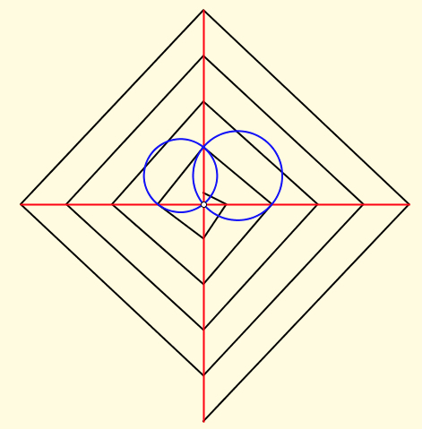
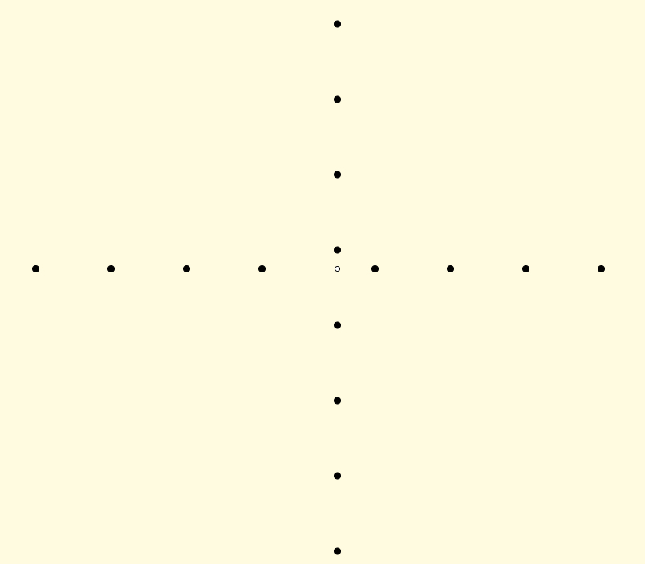
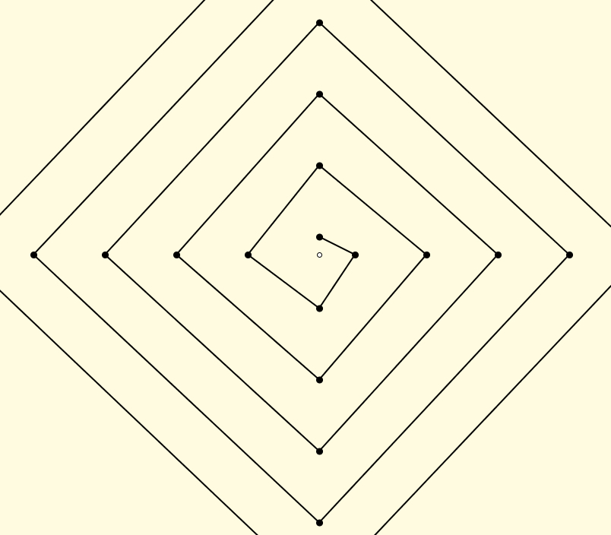
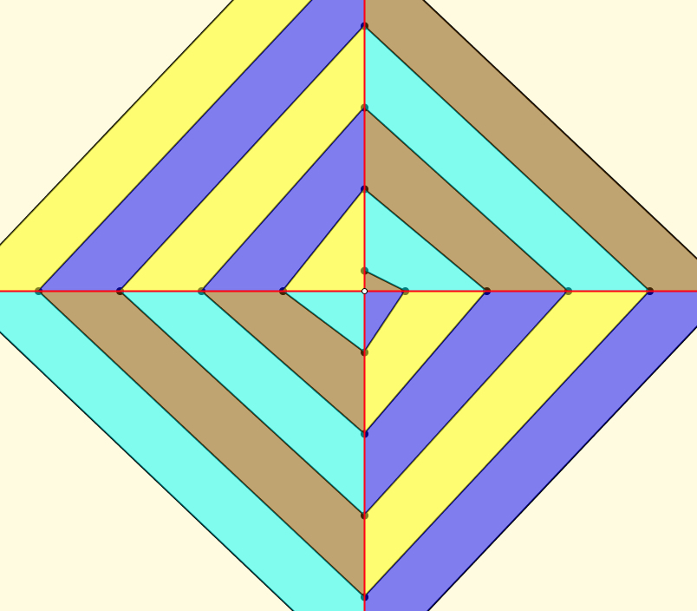
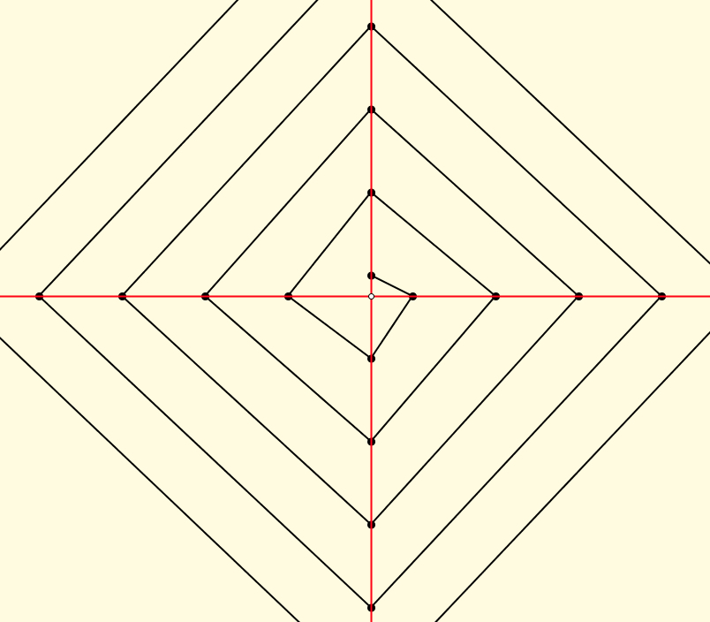
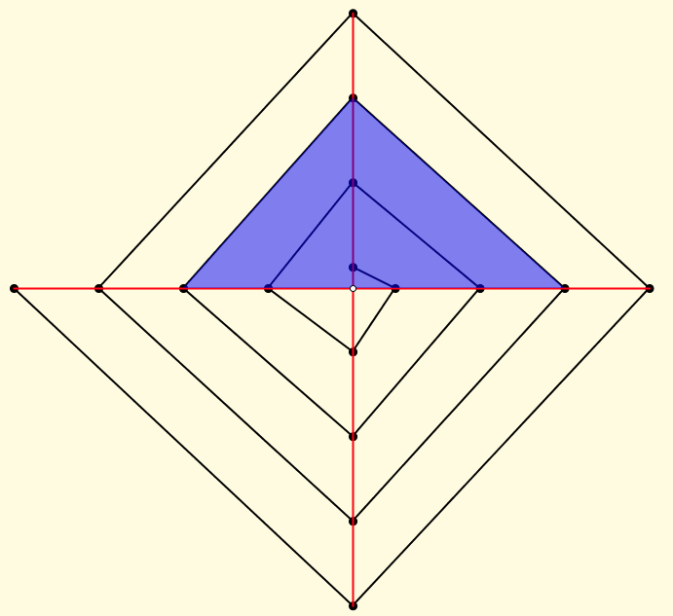
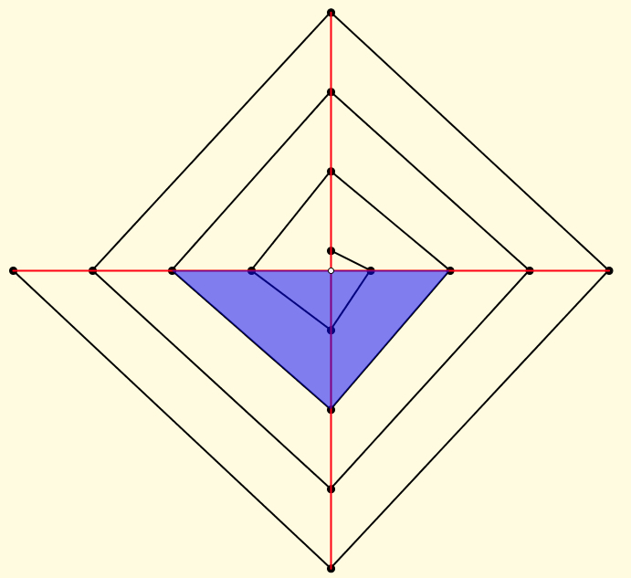
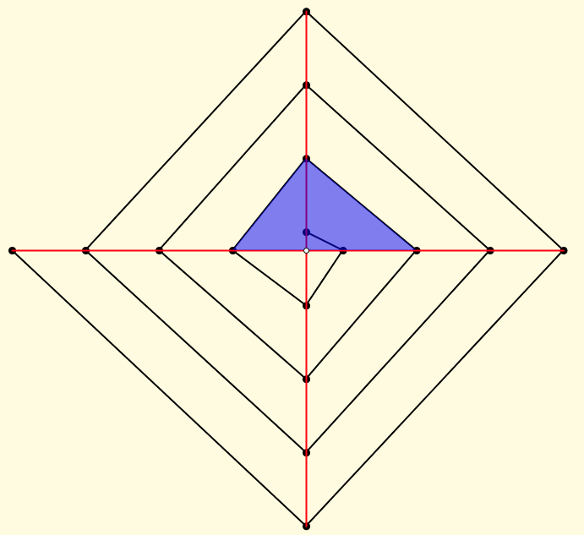
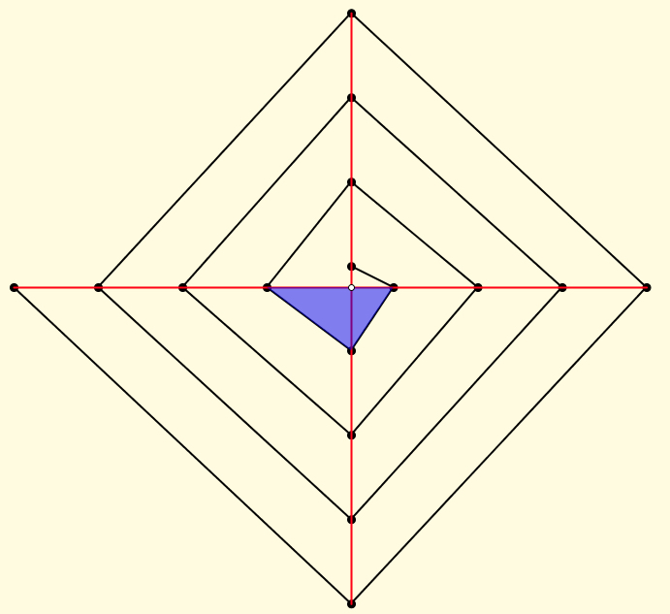
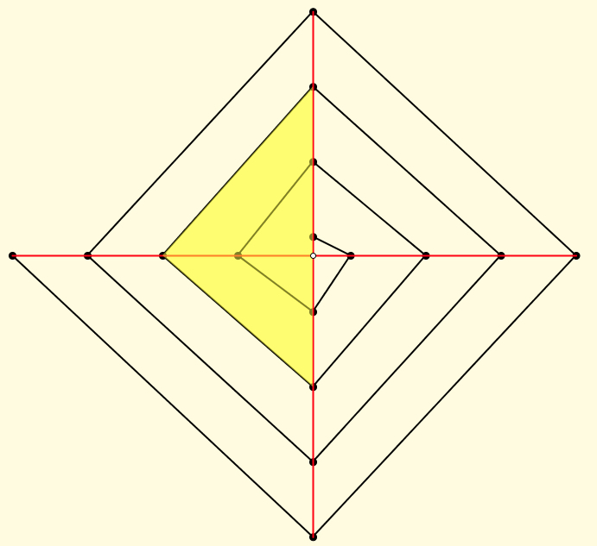
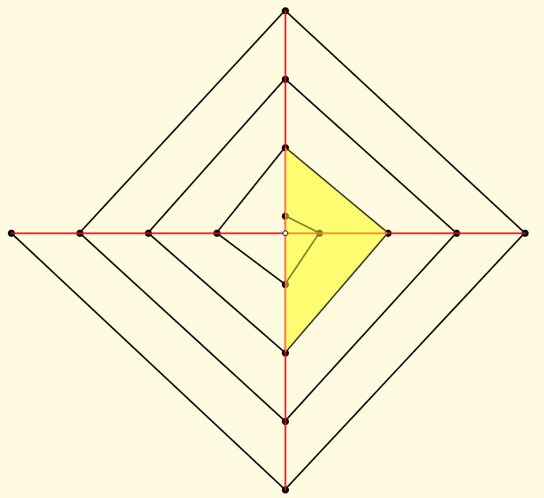
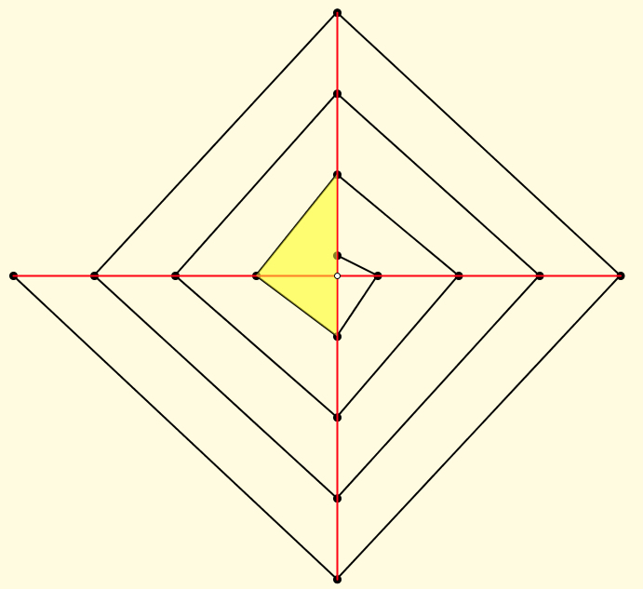
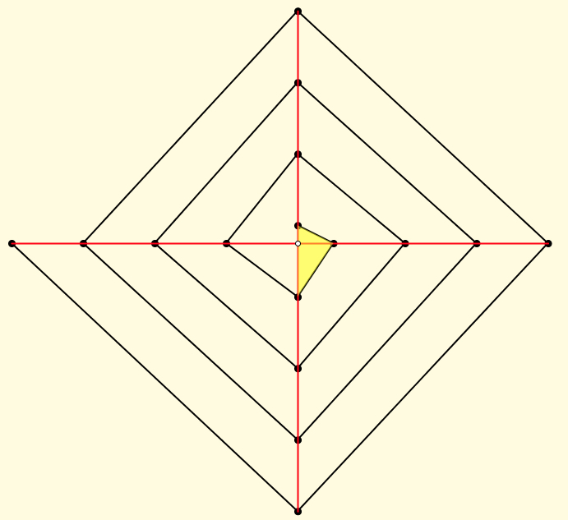
What more can you ‘see’?
Almost parallel lines?
Right-angled triangles?
Almost trapezia?
Lengths?
Slopes?
Areas?
Sequences of
lengths, areas, slopes, … ?
Sums of Sequences (series)?
Circles?
Almost right-angled triangles?

Slide 3
Relevant Curriculum Topics
Area of triangles
Triangular numbers (formula)
Using triangles to form other figures
Slopes and Equations of lines
Conditions for lines being parallel
Lengths (Pythagoras; vertex coordinates)
Area of Quadrilaterals
Expressing n^{th} term of a sequence
Expressing n^{th} sum of a sequence
Limits of sequences
Constructing a line through a point and the virtual intersection of two lines

