Slide 1


Pedagogic Actions to promote
Meaning-Making
John Mason
MatRIC Workshop
Bergen
Oct 2019

Slide 2
Pedagogical actions
Every act of a teacher is an intervention in student attention
Pedagogic actions initiate student activity and teacher-student-mathematics interaction
What pedagogical actions contribute to:
  Developing a disposition to make-meaning?
  Developing access to mathematical actions which support meaning-making?
Everything said here today is a conjecture
  It must be tested in your experience
  There are no ‘theorems’ in maths education

Slide 3
What Pedagogic Actions did you observe yesterday?
Imagine … before showing
Pausing & promoting personal narrative
Static Image & Animation to introduce phenomenon
Activate what everyone can do (Galilean Sequence)
Another & Another (block the expected examples)

Slide 4
“Its Ok for Mathematicians, but …”
Service-subject students want to invest minimum of energy in meeting criteria
Our job is to provoke them into using their own powers
  so much more engaging than having your powers usurped
  supports increasing independence
Underpinning every concept and every procedure lie
  Concept images (associations, images, connections, …)
  Inner incantations and personal narratives

Slide 5
Properties Chart
Range
All
y > 0
All
y ≥ 0
All y:
|y| ≤ 1
All y:
|y| < 1
Whole of R
Domain
Whole of R
All x ≥ 0
All x > 0
All x: |x| ≤ 1
All x: |x| < 1

Slide 6
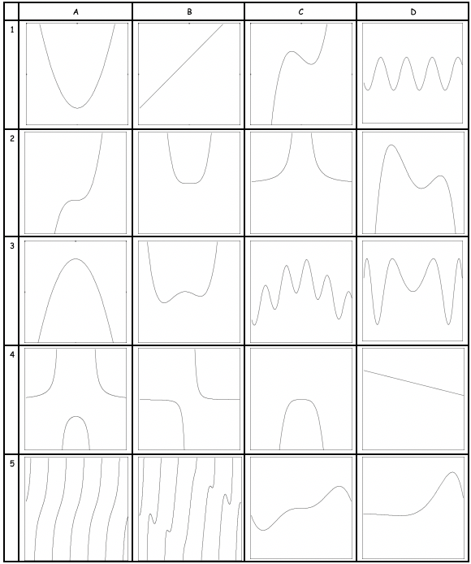
Sorting Task
How they are sorted suggests dominant foci of attention
Malcolm Swan constructed a range of clever sorting tasks often making use of movement between images and symbols

Slide 7
Tangent Power
Definition
  The tangent power of a point P with respect to a differentiable function f is the number of tangents to f through P.

Slide 8
Another & Another
Construct another integral like this
  Say to someone else what is the same and what different about your integral and this one
And another
Construct one that is different in some way
Tends to reveal what learners are attending to
Releases creativity
Activates & Enriches Example Space

Slide 9
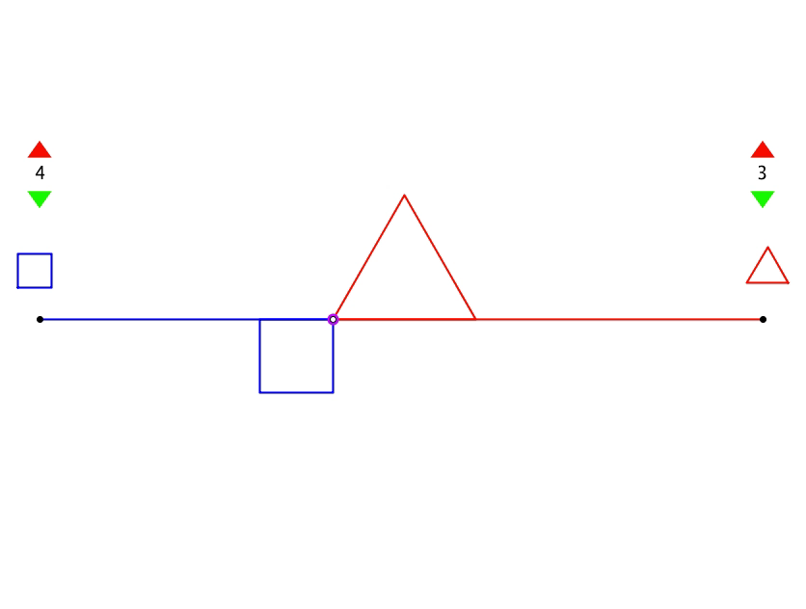
Coordinated Perimeters
Based on an idea of Dan Meyer

Slide 10
Ride & Tie
Two people have to share a single horse to make a long journey. One rides while the other walks. The rider stops, ties the horse and walks on. The other arrives at the horse and rides on. The alternate horse and walking. They aim to arrive at the same time. (Also the horse needs a certain rest time when tied).

Slide 11
Ride & Tie Reflection
Displaying something with an error
  Something attractive about locating errors
Correcting the error
  Using this experience to probe more deeply in the situation
Ride & Tie is about interpreting graphs
  So was the Submerged Can problem

Slide 12
Cobwebs
Notes:
Same & Different

Slide 13
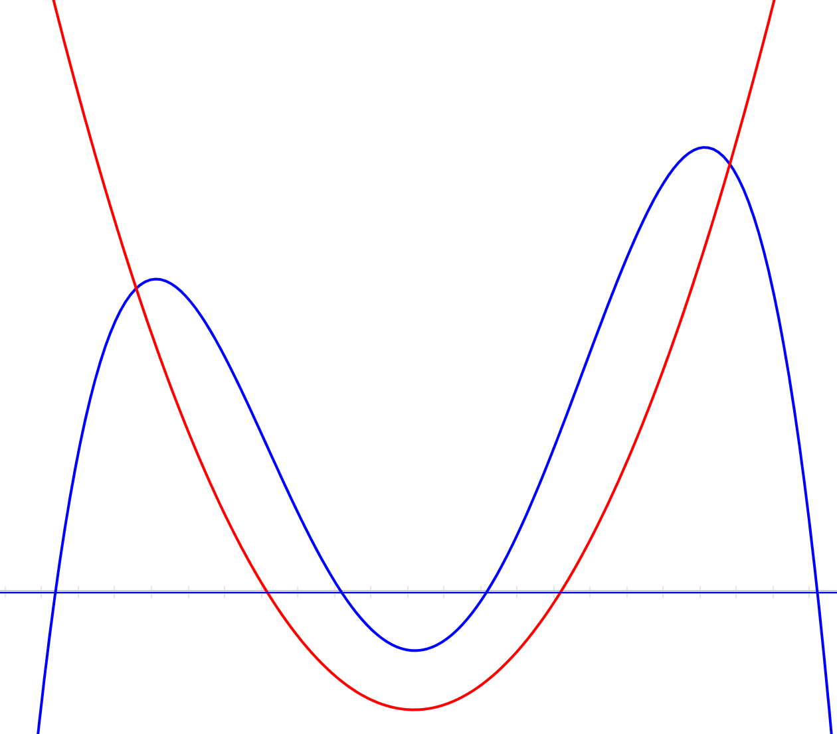
Rational Polynomials
The red curve is the denominator and is a quadratic
The blue curve is the numerator and is a quartic
What can you say about the graph of the quotient?

Slide 14
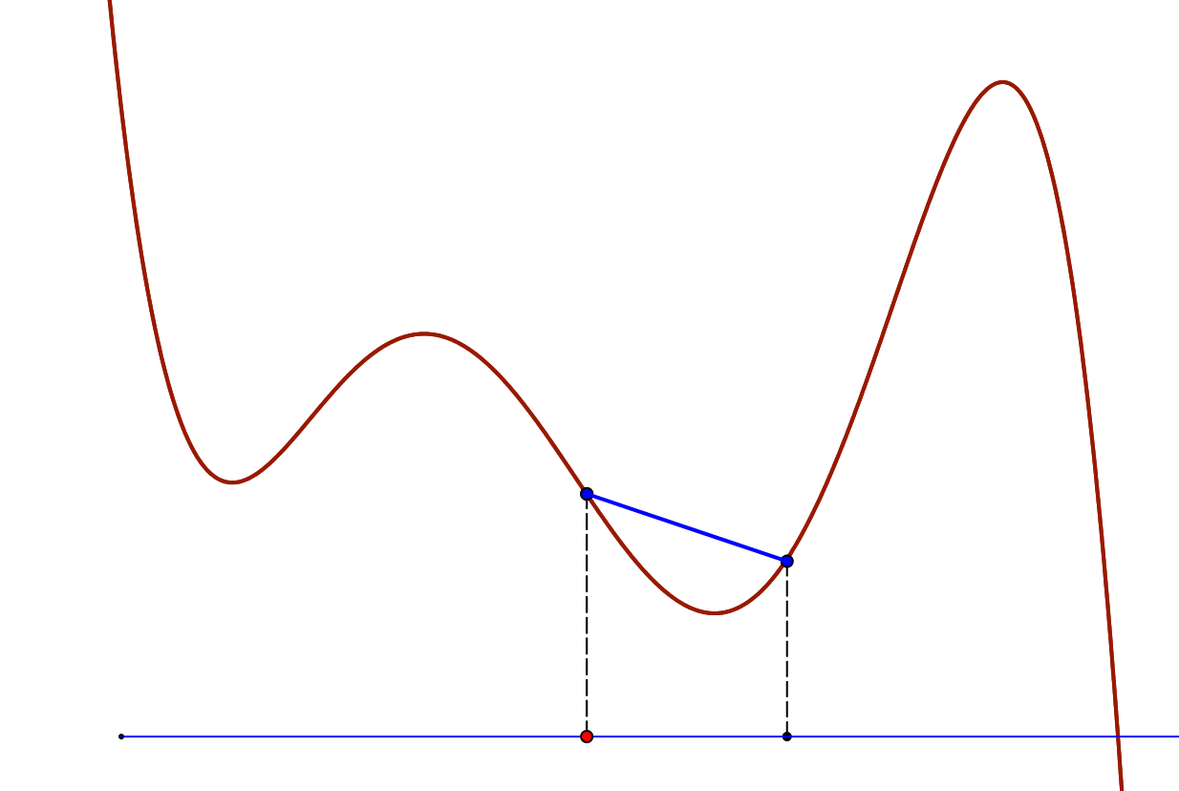
Going to 0

Slide 15
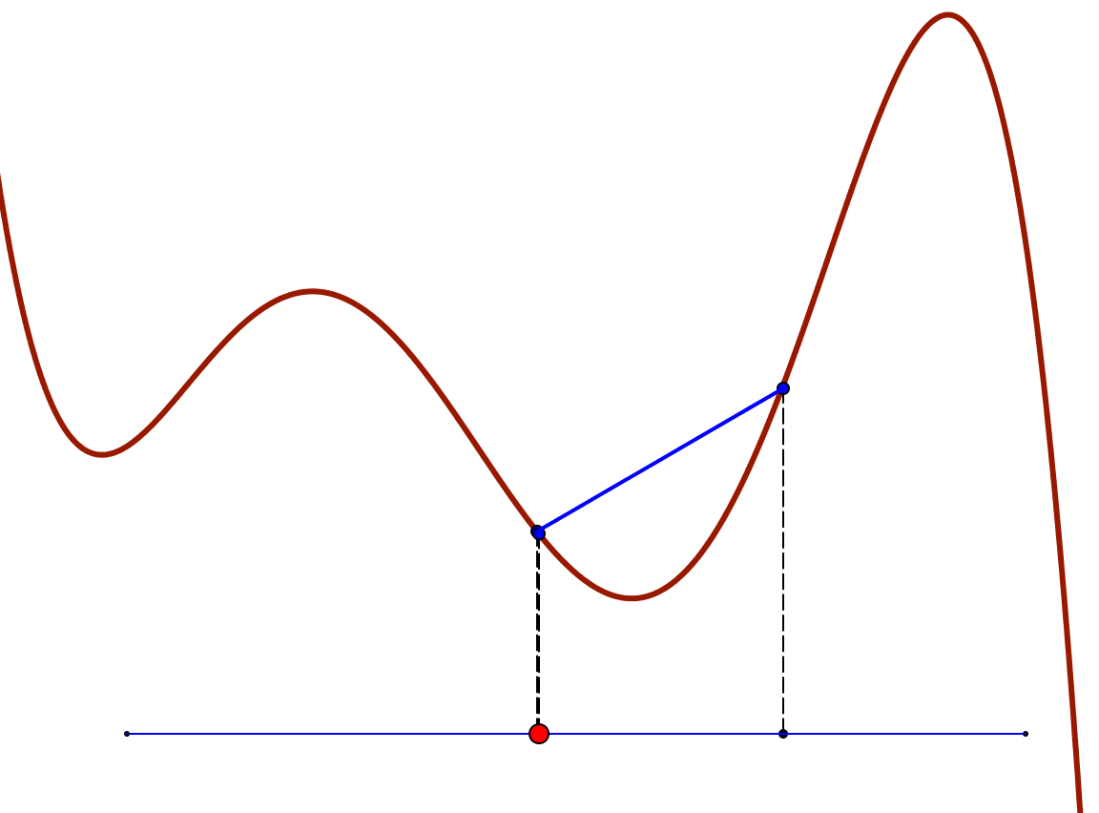
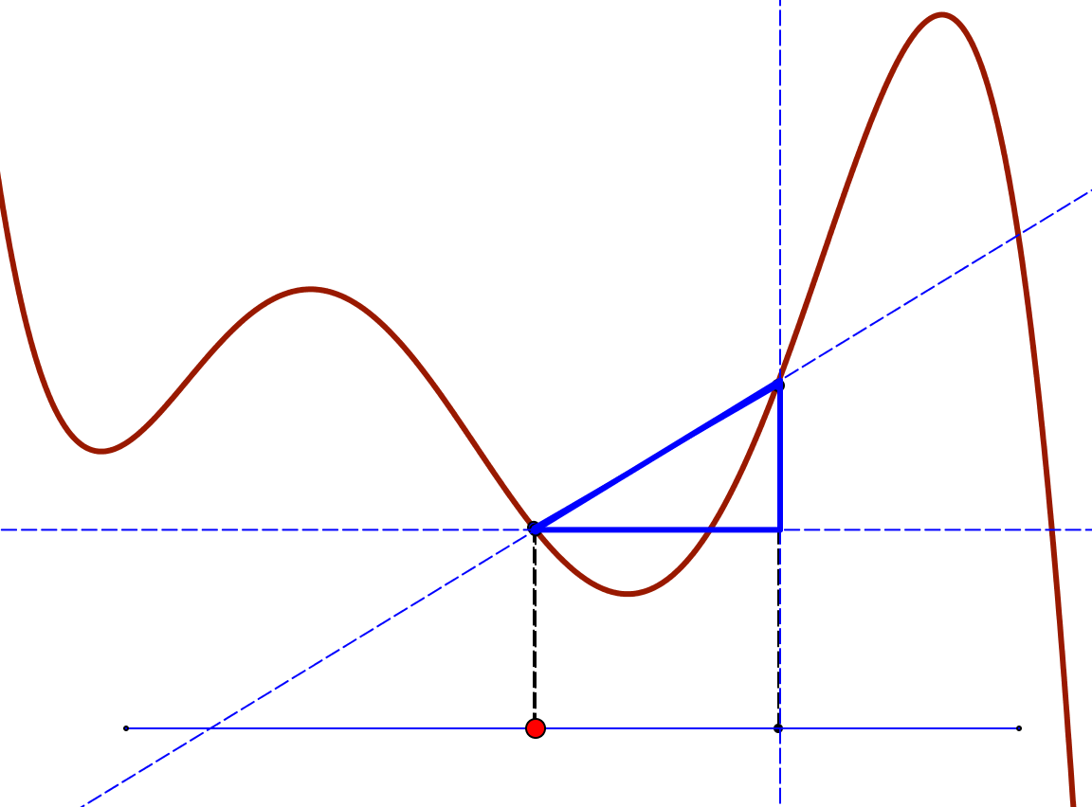
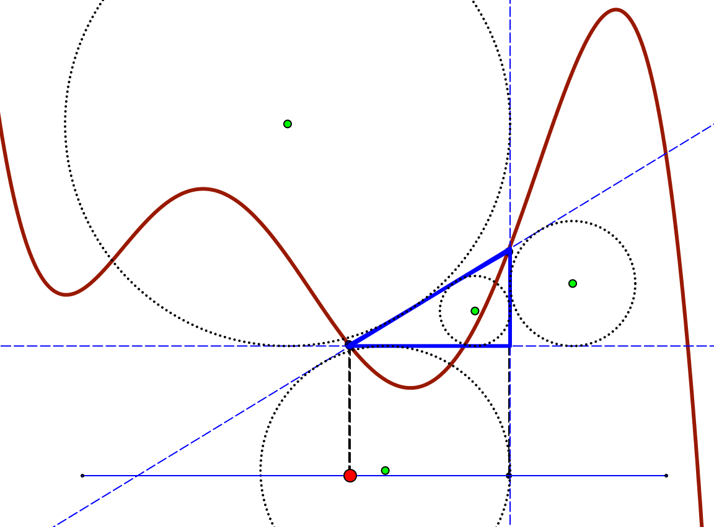
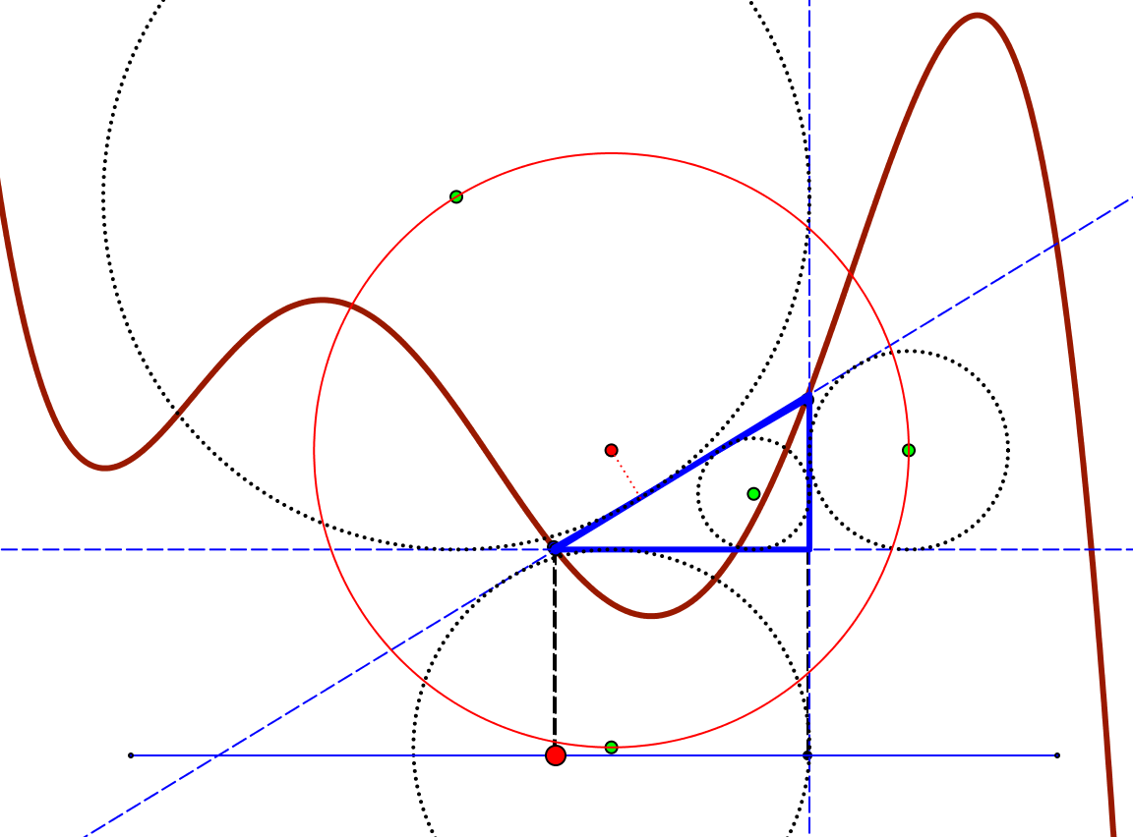

Chordal Constructions

Slide 16
Crossed Ladders
In an alleyway there is a ladder from the base of one wall to the opposite wall, and another the other way, reaching to heights 3m and 4m respectively on the opposite walls. Find the height of the crossing point.
3
4
h

Slide 17



Crossed Ladders Solution
Dimensions of possible variation
3
4
h
a
b
h
a₁
b₁
h₁
a₂
b₂
h₂
Harmonic or
Parallel Sum

Slide 18
Ancient & Modern Problems
Couriers
  A courier sets out from one town to go to another at a certain pace; a few hours later the message is countermanded so a second courier is sent out at a faster pace … will the second overtake the first in time?
Meeting Point
  Some people leave town A headed for town B and at the same time some people leave town B headed for town A. They all meet at noon, eating lunch together for an hour. They continue their journeys. One group reaches their destination at 7:15 pm, while the other group gets to their destination at 5pm. When did they all start?
  [Arnold’s favourite problem]

Slide 19
Meeting Point Solution
Some people leave town A headed for town B and at the same time some people leave town B headed for town A. They all meet at noon, eating lunch together for an hour. They continue their journeys. One group reaches their destination at 7:15 pm, while the other group gets to their destination at 5pm. When did they all start?
Draw a graph!
B
Distance
from
A
Dimensions of possible variation?
A
time

Slide 20
Trains
Henry Dudeney (1917/1970)
  Two trains start at the same time, one from London to Liverpool, the other from Liverpool to London. If they arrive at their destinations 1 hour and 4 hours after passing each other, how much faster is one train running than the other?

Slide 21
Cistern Filling
A cistern is filled by two spouts, which can fill the cistern in a and b hours respectively working alone. How long does it take with both working together?
Draw a graph!
a
a
full
h
empty
b
b
time
time
Dimensions of possible variation?

Slide 22
Crossed Planes
Imagine three towers not on a straight line.
Imagine a plane through the base of two towers and the top of the third; and the other two similar towers.
  These planes meet in a point.
Imagine a plane through the tops of two towers and the base of the third; and the other two similar towers
  These planes meet in a point
The first is the mid-point between the ground and the second.
The first is one-third of the way to the plane through the tops of the towers
Notes:
And it generalises to higher dimensions

Slide 23
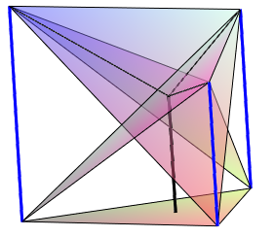
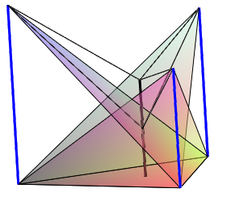
Tower Diagrams

Slide 24
Narrative Connections
Construct a sentence which makes mathematical/pedagogical sense
and which uses the words
graph and coordinates
pausing, personal narrative, and meaning

Slide 25
Of-What Exemplification
Draw a topic web for |x|
Where does it appear?
What does it exemplify?
|x|
What does its graph look like?
What functions can be constructed using it?

Slide 26
Underpinning Values
Acknowledging & respecting the worth of everyone
(especially their natural powers)
Caring for Learners; Caring for Mathematics
Trying to do for Learners
ONLY
what they cannot yet do for themselves
Stimulating, Prompting
learners to take Initiative

Slide 27
Principles
Being mathematical with and in front of learners
Calling upon
natural powers
Being in presence of psychological processes (Vygotsky)
Drawing attention to mathematical themes
Displaying sense-making for students to use for themselves
Allowing time
and conditions to
make sense
Being explicit about sense-making actions
Notes:
Stephen von Worley at http://www.datapointed.net/2012/10/animated-factorization-diagrams/
Idea from Yorgey

Slide 28
Principles as Frameworks
Manipulating
Making structure manifest
Virtual form of enactive elements accessed through mental imagery
Getting-a sense-of
Articulating
images --> symbols
symbols –> images
Say What You See & Watch What You Do
Doing-Talking-Recording
Developing a vocabulary for talking about specific pedagogic actions and follow-upo actions
Notes:
Stephen von Worley at http://www.datapointed.net/2012/10/animated-factorization-diagrams/
Idea from Yorgey

Slide 29
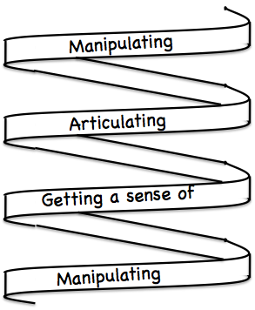
Frameworks
Enactive– Iconic– Symbolic
Doing – Talking – Recording
See – Experience – Master

Slide 30
Pedagogic Actions
Say What You See (SWYS) & Watch What You Do (WWYD)
Same & Different
Pausing
Talking in Pairs
Mini-White-Boards/Clickers
Imagining before Showing
Connecting technical terms
Sorting tasks
Construction tasks
Varying (specialising, extending, generalising)
Seeking an error
It is not just the action that is initiated
but
the principles & intentions
which lead to this initiation
The ethos and intentions
are manifested in
how learner responses are dealt with

Slide 31
How is Meaning Made?
By Linking
  Rich concept images
  Richly connected example spaces
Relevant personal incantations
Through developing personal narratives

Slide 32
What Encourages Meaning Making?
Time
Being in the presence of others making meaning
Desire on the part of students
Relationship between
  teacher and mathematics
  teacher and students
influences
Relationship between
students and mathematics

Slide 33
Mathematical Themes
Doing & Undoing
Invariance in the midst of change
Freedom & Constraint
Restricting & Extending

Slide 34
Natural Powers
Imagining & Expressing
Specialising & Generalising (Stressing & Ignoring)
Conjecturing & Convincing
(Re)-Presenting in different modes
Organising & Characterising

Slide 35
Inner & Outer Aspects
Outer
  What task actually initiates explicitly
Inner
  What mathematical concepts underpinned
  What mathematical themes encountered
  What mathematical powers invoked
  What personal propensities brought to awareness

Slide 36
Challenge
Appropriate Challenge:
  Not too great
  Not too little
  Scope depends on student trust of teacher
  Scope depends on teacher support of mathematical thinking not simply getting answers

Slide 37
Follow-Up
Designing & Using Mathematical Tasks (Tarquin/QED)
Thinking Mathematically (Pearson)
Mathematics Teaching Practice: a guide for university and college lecturers (Horwood Publishing)
Fundamental Constructs in Mathematics Education (RoutledgeFalmer)
Questions & Prompts for Mathematical Thinking (ATM)
Thinkers (ATM)
Mathematics as a Constructive Activity (Erlbaum)
Learning & Doing Mathematics (Tarquin)
Researching Your Own Practice Using The Discipline Of Noticing (RoutledgeFalmer)
John.mason @ open.ac.uk
PMTheta.com

