Slide 1




Reaching for Mastery:
Achievement for All
Promoting Mathematical Thinking
John Mason
Meeting the Challenge of Change
in Mathematics Education
Kent & Medway Maths Hub
Maidstone, Kent
July 2016
The Open University
Maths Dept
University of Oxford
Dept of Education

Slide 2
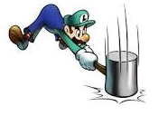
Throat Clearing
Everything said here is a conjecture …
  … to be tested in your experience
My approach is fundamentally phenomenological …
I am interested in lived experience.
Radical version: my task is to evoke awareness (noticing)
So, what you get from this session will be mostly …
  … what you notice happening inside you!
Avoid the teaching of
speculators,
whose judgements are
not confirmed
by experience.
(Leonardo Da Vinci)
Who takes initiative?
Who makes choices?
What is being attended to?

Slide 3
Mastery Shanghai Style
Everyone achieves (some) understanding
Making use of Carefully Structured Variation
  It isn’t the variation itself but how it is handled
Variation-Pedagogy
Attention
  What teacher is attending to, and how
  What students are attending to, and how

Slide 4
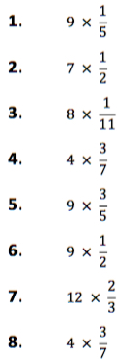
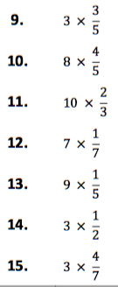
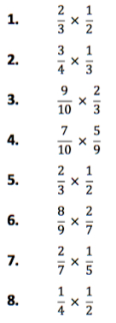
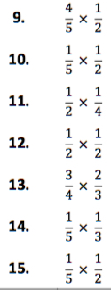
Multiplying Fractions Tasks 1 & 2
mathsBox

Slide 5
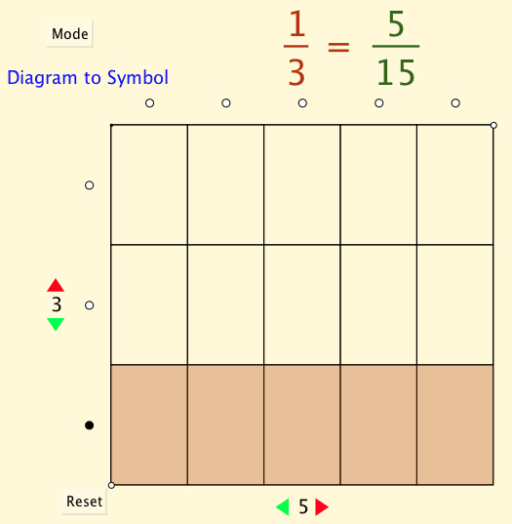
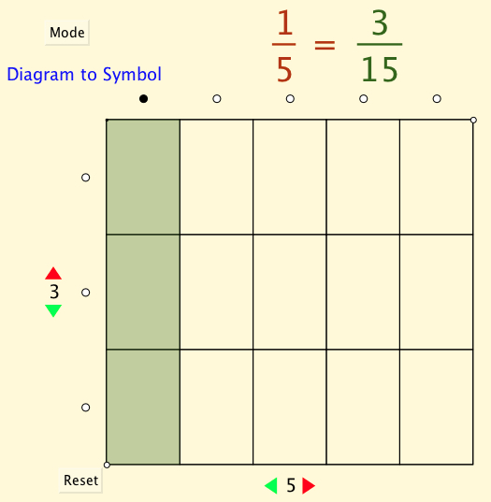
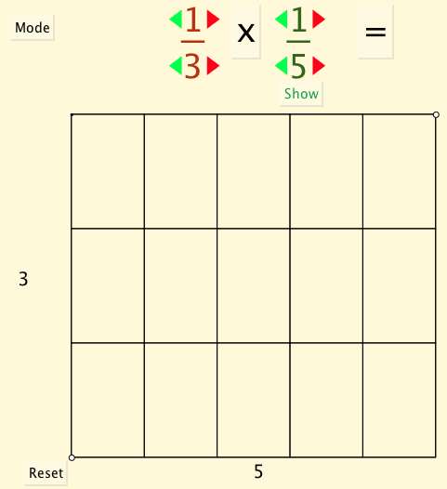
Foundations of Fractions

Slide 6
Multiplying Fractions:
Structured Exercises
What is coming next?
Anticipation
not
‘catching up’
…
How often will these have a
‘cancellation’?
…
…
What else could be varied??
Notes:
Enabling learners t obe immersed in and to dwell in relationships

Slide 7
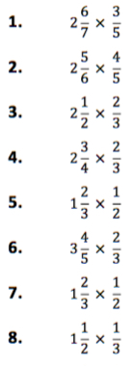
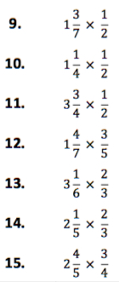
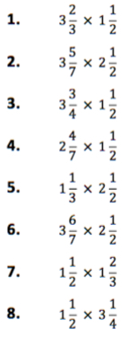
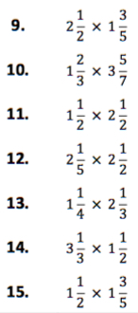
Multiplying Fractions Tasks 3 & 4
mathsBox

Slide 8
Mixed Fraction Multiplication
Pedagogic Choice!
Choice of method &
Image to fall back on
Notes:
Slowly unfolding the meaning
Recognising a relationship to area calculations (varying the representation
Re-presenting the mixed fractions
Simplifying

Slide 9
Attention
Are you and your learners attending to the same thing when you (they) are talking?
Are you and your learners attending in the same way when you (they) are talking?
If not, communication is likely to be impoverished
Ways of Attending
Holding Wholes
Discerning Details
Recognising Relationships in the particular
Perceiving Properties as being instantiated
Reasoning on the basis of agreed properties

Slide 10
Multiplying Fractions: Revision
Make up an easy fraction multiplication
  What makes it easy?
Make up a hard fraction multiplication
  What makes it hard?
Make up a difficult fraction multiplication
  What makes it difficult?
Make up three of your own fraction multiplication tasks in which none of your fractions reduce, but the product does reduce, in different ways.
Make up a fraction multiplication for which the answer is

Slide 11
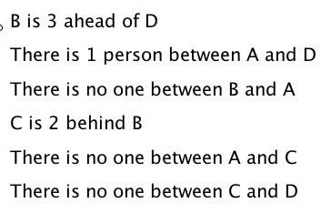
Queuing
B
A
C
D

Slide 12
Magic Square Reasoning
What other
configurations
like this
give one sum
equal to another?
6
7
2
2
1
5
9
Try to describe
them in words
2
8
3
4
Any colour-symmetric
arrangement?
)
Sum(
–
Sum ( )
= 0
Notes:
Think of all the patterns obtained like this one but with different choices of the red line and the blue line.
Sketch a few
Here is another reasoning
What about this pattern: is it true?
did you have difficulty recognising the components? This may be why learners find it hard to remember what they were taught recently!

Slide 13
More Magic Square Reasoning
Sum(
)
–
Sum( )
= 0

Slide 14
Problem Posing: Contexts for 3 – 1 = 2
(1) I was given three apples, and then ate one of them. How many were left?
(2) A barge-pole three metres long stands upright on the bottom of the canal, with one metre protruding above the surface. How deep is the water in the canal?
(3) Tanya said: “I have three more brothers than sisters”. How many more boys than girls are there in Tanya’s family?
(4) How many cuts do you have to make to saw a log into three pieces?
(5) A train was due to arrive one hour ago. We are told that it is three hours late. When can we expect it to arrive?
(6) A brick and a spade weigh the same as three bricks. What is the weight of the spade?

Slide 15
More Problem Posing:
…
(20) It takes 1 minute for a train 1km long to completely pass a telegraph pole by the track side. At the same speed the train passes right through a tunnel in 3 minutes. What is the length of the tunnel?
Opportunity to work on 3 x 2 = 6.
Opportunity to work on other numbers.
From I. Arnold, quoted in Borovik in press

Slide 16
Marbles 1
If Alison gives one of her marbles to John, they will have the same number of marbles.
  What can you say about the relation between the number of marbles they each started with?
  Generalise!
Let A be the number of marbles Alison started with
Let J be the number of marbles John started with
A – 1 = J + 1
A = J + 2

Slide 17
Marbles 2
If Alison gives one of her marbles to John, they will both have the same number of marbles;
if John now gives two of his marbles to Quentin, they will have the same number as each other.
  What can you say about the relation between Alison’s and Quentin’s marbles to start with?
  At the beginning, how many marbles might Alison have given to Quentin so that they had the same number?
Let A, J, Q be the number of marbles Alison, John & Quentin started with
A – 1 = J + 1
A – 2 = J
(J+1) – 2 = Q + 2
(J+1) – 4 = Q
(A–2 + 1) – 4 = Q

Slide 18
Marbles 3
If Alison gives John one of her marbles, she will then have one more than twice as many marbles as John then has.
If John started with 12 marbles, how many did Alison start with?
Pudian: substitution
Temptation to rush on here
Succinct relationship
Opportunity to develop
If John has one more than 12 at the start, how many more than 28 would Alison have?
some
Notes:
Notion of expressing generalty; expressing a relationship
Substituting (Pudian)
If J actually had 13 (one more) how many more would A have?

Slide 19
Marbles 3 again
If Alison gives John one of her marbles, she will then have one more than twice as many marbles as John then has.
Alison
John
–1
+1
One fewer
One more
Important thing is to imagine the action,
and
to make record or
to express that
in some way
John
John
Alison
= 1+ 1 +
+ 1
+ 1

Slide 20
Marbles 4
If Alison gives John one of her marbles, she will then have one more than twice as many marbles as John then has.
However, if instead, John gives Alison one of his marbles, he will have one more than a third as many marbles as Alison then has.
How many marbles have they each currently?
What could be varied?
Notes:
J = 11 & A = 26

Slide 21
Varying Context
If one person gets off the bus at the next stop, then before people get on, there will be one more than twice as many people on the bus as there are people at the bus stop.
If Alison gives John one of her marbles, she will then have one more than twice as many marbles as John then has.
However, if instead, John gives Alison one of his marbles, he will have one more than a third as many marbles as Alison then has.
When the first person waiting at the next stop gets on, then there will be one more than a third of the people on the bus still waiting to get on.
Conjecture: relevance has more to do with confidence in your competence than it does with immediate use outside of school

Slide 22
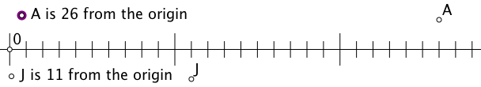
Varying Context
Alison and John are standing on a numberline. If Alison moves 1 step towards John, and John moves 1 step towards Alison, then Alison will be one step further away from the origin than twice as far as John is.
If Alison gives John one of her marbles, she will then have one more than twice as many marbles as John then has.
If instead, John moves 1 step away from Alison and Alison moves 1 step away from John, John will be 1 step further from the origin than one-third of Alison’s distance from the origin
However, if instead, John gives Alison one of his marbles, he will have one more than a third as many marbles as Alison then has.
Marbles and numberline movements may not be exactly the same!
Notes:
J = 11, A = 26
J = -9; A = -22

Slide 23
Reflection
Withdrawing from action
Becoming aware of an action, or a relationship
NOT ‘telling them so they remember’
BUT rather
immersing them in a culture of mathematical practices
Evoking their natural powers
Being aware of necessary movements of attention
  In yourself
  For students
Learners experiencing the origins of ‘problems’ by constructing them for themselves
  Easy; Peculiar; Hard; General

Slide 24
Mathematical Thinking
How might you describe the mathematical thinking you have done so far today?
How could you incorporate that into students’ learning?
What have you been attending to:
  Results?
  Actions?
  Effectiveness of actions?
  Where effective actions came from or how they arose?
  What you could make use of in the future?

Slide 25
Reflection as Self-Explanation and Personal Narrative
What struck you during this session?
What for you were the main points (cognition)?
What were the dominant emotions evoked? (affect)?
What actions might you want to pursue further? (Awareness)
Notes:
Chi et al

Slide 26
Mastery as Achievement for All
Principle: Variation
  Something is available to be learned only when it is varied in relation to something else
  So learners discern what must be discerned
  Recognise relationships that are critical
  Perceive properties as being instantiated
  (through generalisation)
Variation itself is no guarantee
Variation Pedagogy informed by being aware of attention
  Holding wholes
  Discerning Details
  Recognising Relationships
  Perceiving Properties
  Reasoning on the basis of known properties
A little time taken strategically
will save a great deal of time later

Slide 27
To Follow Up
PMTheta.com
john.mason@open.ac.uk
Variation: Anne Watson in latest MT
Designing & Using Mathematical Tasks (Tarquin)
Mathematics as a Constructive Enterprise (Erlbaum)
Thinking Mathematically (Pearson)
Key Ideas in Mathematics (OUP)
Researching Your Own Practice Using The Discipline of Noticing (RoutledgeFalmer)
Questions and Prompts: (ATM)
Annual Institute for Mathematical Pedagogy
(first week of August: see PMTheta.com)

